Slide 1

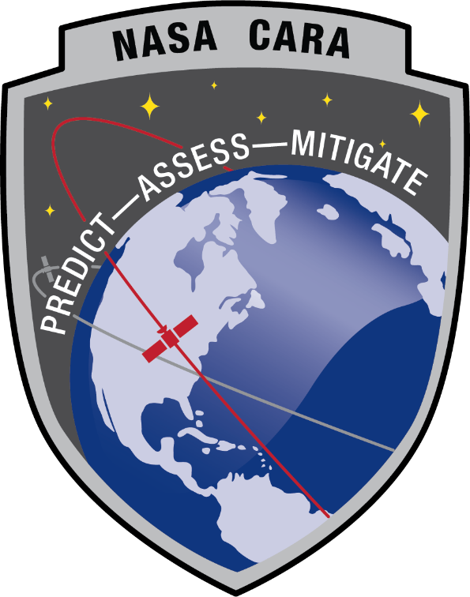
Conjunction Assessment Risk Analysis
Collision Avoidance “Short Course”
Part III: CA in Changing Space Flight Environment
Lauri Newman
NASA Conjunction Assessment Program Officer

Slide 2
Changing Space Environment
Space environment has been changing, and will continue to evolve rapidly over the coming years due to the following drivers:
  Active payload proliferation/large constellations
  SmallSat proliferation
  New space actors
New technologies and methodologies are evolving, adding complexity to the CA enterprise
CA practices will need to evolve to meet growing needs
  Data sharing
  AI/ML
  New CA methodologies
  Cis-Lunar CA
  Best practices

Slide 3
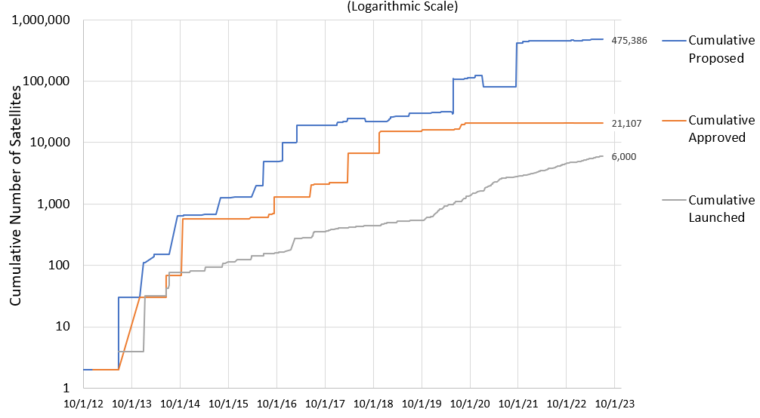
Active Payload Growth:
“Large Constellation” Effect
New active payload growth due to large constellations substantial
  20,000 new satellites approved, of which only ~4500 launched
  Filings for new constellations exceed 100,000 satellites
Active payload conjunctions more demanding than with debris
  Coordination/negotiation with other O/O required—more demanding
  Potential consequence higher: collision would destroy two active satellites and create substantially larger debris field
Imputed additional operational workload considerable
Proposed/Approved/Deployed Constellation Satellites vs Time

Slide 4
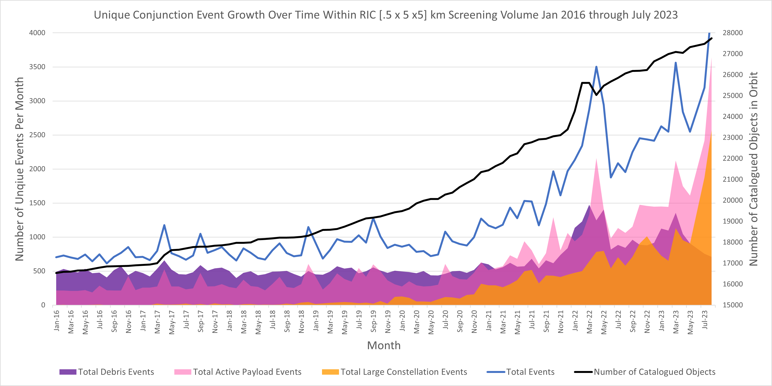
Conjunction Assessment Trends:
Situation is Getting Worse!
Russian ASAT test
15 NOV 2021
1st Starlink launch
23 MAY 2019
Current CA workload is large and continues to grow
  Across the LEO fleet, NASA CARA sees about 2000 unique conjunctions each month
    Tripled since 2018 primarily due to Starlink and OneWeb conjunctions
    Russian ASAT test in 2021 added 30% more events
Large constellations will continue to drive the close approach event risk.
Notes:
The number of satellites over time continues to grow.
Number of conjunctions with operational spacecraft now outnumbers conjunctions with debris
Several ultra-large constellations (up to 30k space vehicles) have been announced (for Low Earth Orbit), though not yet deployed.

Slide 5
New Space Actors
The space environment today is very different from a decade ago and continues to evolve very rapidly
  Historically, space operations were domain of large governmental entities
  Commercial space operations now the predominant paradigm—a different business model and set of concerns from those of government actors
  Smallsats are cost effective and accessible for everyone, even down to elementary schools
Challenge in educating new space actors on best practices and availability of data and tools
  DOC is US agency to develop policies for best practices and data sharing
  Possible example rule: space “regionalization”
    Altitude < 350km a “Wild West” region for smallsats with little flight dynamics experience or orbital control
    Allows inexperienced actors to access space without threatening high-value assets

Slide 6
SmallSat Proliferation:
Small Doesn’t Mean “Safe”
In a collision, small satellites can destroy large satellites and create large debris clouds
Small satellites must be tracked in order to prevent collisions
  Small satellites harder to track, and some below regular tracking threshold
  Many small satellite operators do not compute their own ephemeris and rely on TLEs, making SSN tracking essential to their position determination
Maneuverable small satellites must have their maneuvers screened
  Neighbors unaware of intended trajectory cannot mitigate close approaches
In short, it is a fallacy that small, cheap satellites do not require CA
  In fact, in some respects more dangerous than traditional satellites
Smallsat operators should share their ephemerides including planned maneuvers (if applicable) with DOD and be prepared to perform avoidance maneuvers if capable.

Slide 7
Trending Concern:
Importance of Data Sharing
Many reasons O/Os can have future positions that tracking networks will not model properly
  Planned future impulsive maneuvers
  Low thrust / electric propulsion, especially over long periods, which is very difficult to solve for with traditional methods
  Satellites too small to be tracked reliably
Missions thus need to share predicted ephemerides to all for CA
  Predicted ephemerides are not proprietary—they are needed for safety of flight, and the satellite’s future position will be openly discoverable anyway
  Without shared data, other operators have no way to tell where these assets are
  Sharing should be through a trusted/protected mechanism, like Space-Track.org or SDA
  Screening authority will need to access these ephemerides to include them in CA screenings

Slide 8
Satellite Autonomous Maneuvering
Becoming more common for satellites to employ autonomous maneuvering (especially large constellations)
  SpaceX’s Starlink current example: ~5000 active satellites operated this way
  Other, smallsat autonomous constellations planned
Maneuvers automatically commanded/executed
  Often ground systems do not even know of maneuvers until after execution
CA can also be executed autonomously
  CDMs for upcoming conjunctions uploaded to spacecraft
  On-board CA software can determine risk based on spacecraft’s latest position information, plan maneuvers to avoid close approaches, and execute them
  If CDMs generated with sufficiently large screening volume, then autonomous CA likely to be effective against debris

Slide 9
Autonomous Flight Dynamics:
Active-vs-Active CA Issue
Autonomous systems program maneuvers and perform CA based on CDMs uploaded as frequently as contacts allow
Co-located autonomously-controlled constellations need other solution
  Two satellites in conjunction from different constellations may be planning mitigation actions, but neither knows what the other is planning to do
  Satellites could therefore maneuver into each other
  Not merely a fanciful situation: in famous Iridium-COSMOS collision, Iridium has stated that their satellite maneuvered into the COSMOS trajectory due to lack of available CA data
    This situation led the advancement of the CA process to what we know and use today
For autonomous CA with other active satellites, latencies in information exchange cause CA problems
  Non-autonomous active satellites need to refrain from maneuvers 12-24 hours before close approaches with autonomous satellites that use CDMs
  Allows sufficient time for submitted ephemeris that includes their maneuver to be screened for CA and these screening results uploaded to autonomous system

Slide 10
Active-vs-Active CA Issue Potential Solution:
Federated Conjunction Responsibility Management
Consortium among NASA Ames, NASA CARA, SpaceX, and Emergent Technologies have developed and are demonstrating a prototype autonomous CA approach
  Participants in Starlink/Starling formal experiment for autonomous CA
  To run JAN-SEP 2024
AMOS paper on this subject Thursday morning, CA session
No additional details right now, in order not to spoil suspense!

Slide 11
New Methodologies (1/2)
Potential new CA paradigms to handle workload
  CA remediation against “grouped” events using an aggregate Pc
  Station-keeping burn strategy to minimize conjunction risk, without actually remediating individual events unless an extremely high Pc
  Consideration of consequence in addition to risk to determine which events to remediate—already moving towards implementation at NASA
CARA tools are available free to the public as Software Development Kits (SDKs) on the CARA repository (https://github.com/nasa/CARA_Analysis_Tools)
  Contain benchmark test cases in addition to Matlab source code

Slide 12
New Methodologies (2/2)
Automation/artificial intelligence
  Investigate methods to automate more of the process while retain key safety elements
  Determine usefulness of machine learning, neural nets, etc. in decision-making
  Enterprise difficult because CA lacks “truth” data—very few collisions actually take place
  NASA initial CA AI / machine learning studies show little improvement
Challenges: no truth data make training the system hard
  Dog-vs-cat ML/AI trained against millions of curated dog/cat photographs
  In CA, only a few verified collisions, and these often lack modern data
  Similar to predicting 1000-year floods: have no modern empirical data

Slide 13
Cis-lunar CA
Catalog of non-cooperatively tracked objects used in CA only available near Earth
Activity at Moon, Mars, and Libration points increasing risk of collision without screening
DOD developing cis-lunar catalog and screening capability
  Requirements not yet defined
  Implementation is years away
NASA Multimission Automated Deepspace Conjunction Assessment Process (MADCAP) provides ephem-on-ephem screening for missions that utilize DSN
  Most operators do not currently provide covariance, preventing Pc computation
  Relies on sharing of data; sharing of non-NASA data encouraged

Slide 14
CA Best Practices
CA industry is evolving rapidly
Guidelines/standards are needed to enable healthy growth
  Safety of Flight best practices should be adapted universally
Sources of existing best practices:
  AIAA, Iridium, OneWeb, SpaceX released “Satellite Orbital Safety Best Practices” Reference Guide September 2022
  Best practices for using 18 SDS/19 SDS support are available on Space-Track.org website
  Secure World Foundation publishes “Handbook for New Actors in Space”
  Best practices for satellite operations at Spacesafety.org
  CONFERS publishes best practices for Proximity ops
  NASA published CA best practices Handbook (update Feb 2023); contains analysis describing the technical/scientific foundations of best practices

Slide 15
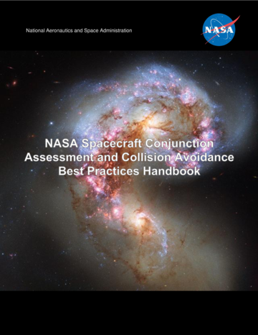



NASA Spacecraft Conjunction Assessment and
Collision Avoidance Best Practices Handbook
Covers the current USG CA process end-to-end, including high-level details of DOD screening process.
Provides list of best practices with rationale and appendices on methodologies
Comments or suggestions are welcome
    Send to ca-handbook-feedback@nasa.onmicrosoft.com
Downloadable from: https://nodis3.gsfc.nasa.gov/OCE_docs/OCE_51.pdf
NASA CA Handbook
CARA Tools
NASA CA website

Slide 16
Summary
Exciting growth offers opportunities that will change society, but needs to be done safely to ensure that we have continued use of the space environment for future generations

Slide 17


