Slide 1



LunaNet Position, Navigation, and Timing Services and Signal, Enabling the Future of Lunar Exploration
ION GNSS+ 2023
Denver, Thursday 14th Sept
Session F3: Lunar Positioning, Navigation, and Timing 1
Pietro Giordano, ESA
Richard Swinden, ESA
Cheryl Gramling, NASA
Juan Crenshaw, NASA
Javier Ventura-Traveset, ESA
ESA UNCLASSIFIED - For Official Use

Slide 2
LunaNet PNT Services
“LunaNet is envisioned as a network of cooperating networks (network of networks, akin to the terrestrial Internet) upon which providers can deliver communications, navigation, and other services for users on and around the Moon. LunaNet is based on a framework of mutually agreed-upon standards, protocols, and interface specifications that enable interoperability. LunaNet is intended to allow many lunar mission users to engage the services of diverse commercial and government service providers in an open and evolvable architecture.”
LunaNet PNT services:
Peer-to-Peer navigation services (direct links between the user and the provider)
Lunar Augmented Navigation Service (LANS)

Slide 3
Lunar Augmented Navigation Service
LANS characteristics:
The concept is similar to GNSS (maximum reuse of GNSS techniques and technologies).
This service is provided from multiple providers nodes to multiple users at the same time.
LANS Interoperability¹: each service provider that claims to be LunaNet compliant (becoming a LunaNet Service Provider, LNSP) for the LANS service, must:
Be compliant to a common signal and message structure (Augmented Forward Signal, AFS).
Adopt a common lunar reference system (including reference frame) and lunar time system.
Be compliant to Signal In Space Error requirements.
Scope of this presentation
¹ ICG SSV booklet: “(interoperability is defined as) the ability of global and regional navigation satellite systems, and augmentations and the services they provide, to be used together to provide better capabilities at the user level than would be achieved by relying solely on the open signals of one system”

Slide 4
LunaNet Signal-in-Space Requirement Specifications – Augmented Forward Signal (LSIS)
The “LunaNet Interoperability Specification (LNIS)” document refers to the “LunaNet Signal-in-Space Recommended Standard – Augmented Forward Signal” (LSIS) document for the detailed specification of the AFS.
LSIS implements two categories of specifications:
Precise specifications are provided to avoid ambiguity, with no flexibility at the LNSP level.
General specifications are provided in order to guarantee interoperability and providing flexibility for the LNSP to define a specific implementation.
Each LNSP shall:
Comply to LSIS
Define a LNSP-specific SISICD
Define user algorithm and models and develop example SW and test vectors
LSIS
LNSP1 SISICD
LNSP2 SISICD
LNSP3 SISICD

Slide 5
Lunar Augmented Navigation Service
“LunaNet Interoperability Specifications (LNIS)” and “LunaNet Signal-in-Space Recommended Standard – Augmented Forward Signal” (LSIS) are published as draft documents to allow the community to review and provide feedback.
After consolidation, the final version of the documents will be issued.

Slide 6
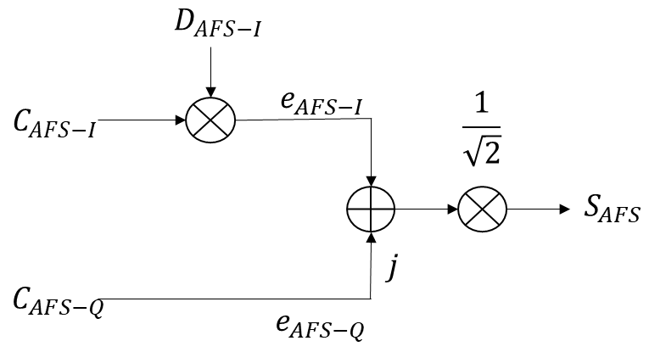
AFS Signal Specifications
The navigation signal carrier frequency shall be 2492.028 MHz.
The transmitted navigation signal shall be Right-Hand Circularly Polarized (RHCP).
The receiver reference bandwidth centered on the carrier frequency to be considered for the correlation losses shall be 15.944MHz (TBC).
Data channel BPSK(1)
Pilot Channel BPSK(5)
Linear Multiplexing
Component | Ranging code chip-rate [Mchip/s] | Symbol-rate [symbols/s]
I | 1.023 | 500
Q | 5.115 | No data (pilot component)

Slide 7
AFS Spreading Code Characteristics
Data channel has 1023 chips and duration of 1ms (TBC). No secondary code is foreseen for the data channel.
Pilot channel primary code has 5115 (TBC) chips and duration of 1ms (TBC).
Pilot channel uses a secondary code of 20 (TBC) symbols, each of 1ms (20ms TBC) secondary code period.
AFS Component | Primary code period [ms] | Secondary code period [ms] | Code length [chips]
 |  |  | Primary | Secondary
I | 1 (TBC) | N/A | 1023 | N/A
Q | 1 (TBC) | 20 (TBC) | 5115 | 20 (TBC)

Slide 8
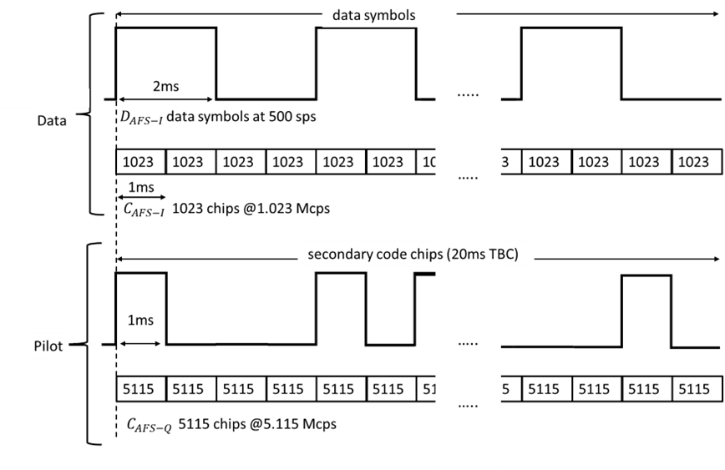
AFS Spreading Code Synchronicity

Slide 9
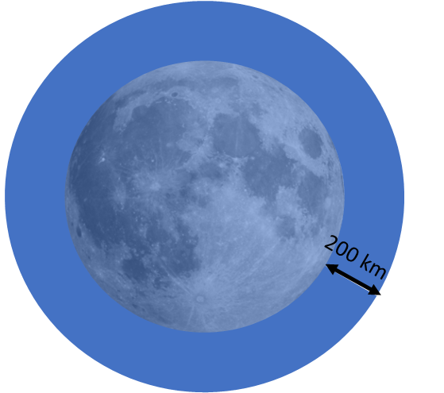
AFS Received Signal Power
Interoperability means also avoiding interference from and to other LNSP.
LunaNet defines the target LANS service volume as the full Moon, however, it anticipates an evolutionary approach to build toward the full service volume, with an expected start over the South Pole of the Moon.
As part of the LNSP-specific SISICD, each LNSP shall define the expected LNSP-specific service volume.
Minimum and maximum received power on the lunar surface are specified within LSIS, within and outside the LNSP-specific service volume.
 | Within the LNSP-specific service volume |  | Outside the LNSP-specific service volume
AFS Component | Received minimum power [dBW] | Received maximum power [dBW] | Received maximum power [dBW]
I | -166 (TBC) | -153 (TBC) | -143 (TBC)
Q | -166 (TBC) | -153 (TBC) | -143 (TBC)

Slide 10
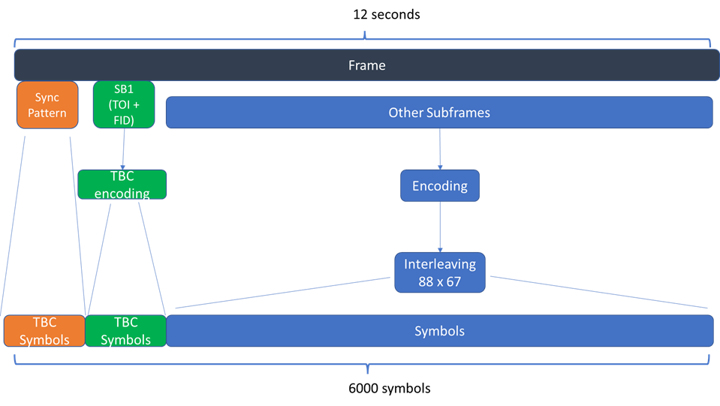
Message Format Specification
High-level objectives:
Disseminate the mandatory messages for positioning (e.g.: clock and ephemeris data, time, etc.)
Allow dissemination of the optional messages defined in LunaNet (meaning that it is left to the LNSP whether the information is disseminated)
Allow dissemination of LNSP specific information/data/messages that are not defined in LunaNet
Be flexible to adapt to future needs and evolutions
Re-use of GNSS and CCSDS
The data dissemination is structured in frames of 12 seconds and 6000 symbols
Each frame is composed of:
The uncoded synchronization pattern,
One subframe (called SubFrame1, SB1) that contains at least the Time-Of-Interval (TOI) and the FrameID (FID),
And subsequent subframes that depend on the specific FID value.

Slide 11
Message Format Specification
Synchronization Pattern: allows the receiver to achieve synchronization to the frame boundary. In the current draft, the number of symbols and the symbols for the synchronization pattern are TBD.
Time of Interval (TOI): is used to represent time (more on this in the following slides).
Frame Identifier (FID): is used to define different types of frames and allows for implementation of different schemes, including:
Different type of encoding of the “Other Subframes” other than SB1, and
Different type and number of subframes.
Parameter | Definition | Bits | Scale factor | Unit | Values
TOI | Time of interval | 9 | N/A | dimensionless | 0…399
FID | Frame ID | TBC | N/A | dimensionless | 0…TBC

Slide 12
Message Format - Interleaving
The combination of synch pattern and SB1 contains 104 (TBC) symbols; the remaining 5896 (TBC) symbols representing the remaining subframes are interleaved, after encoding, using a block interleaver.
Parameters | Values
Block interleaver size (symbols) | 5896 (TBC)
Block interleaver dimensions (n columns x k rows) | 88 x 67 (TBC)

Slide 13
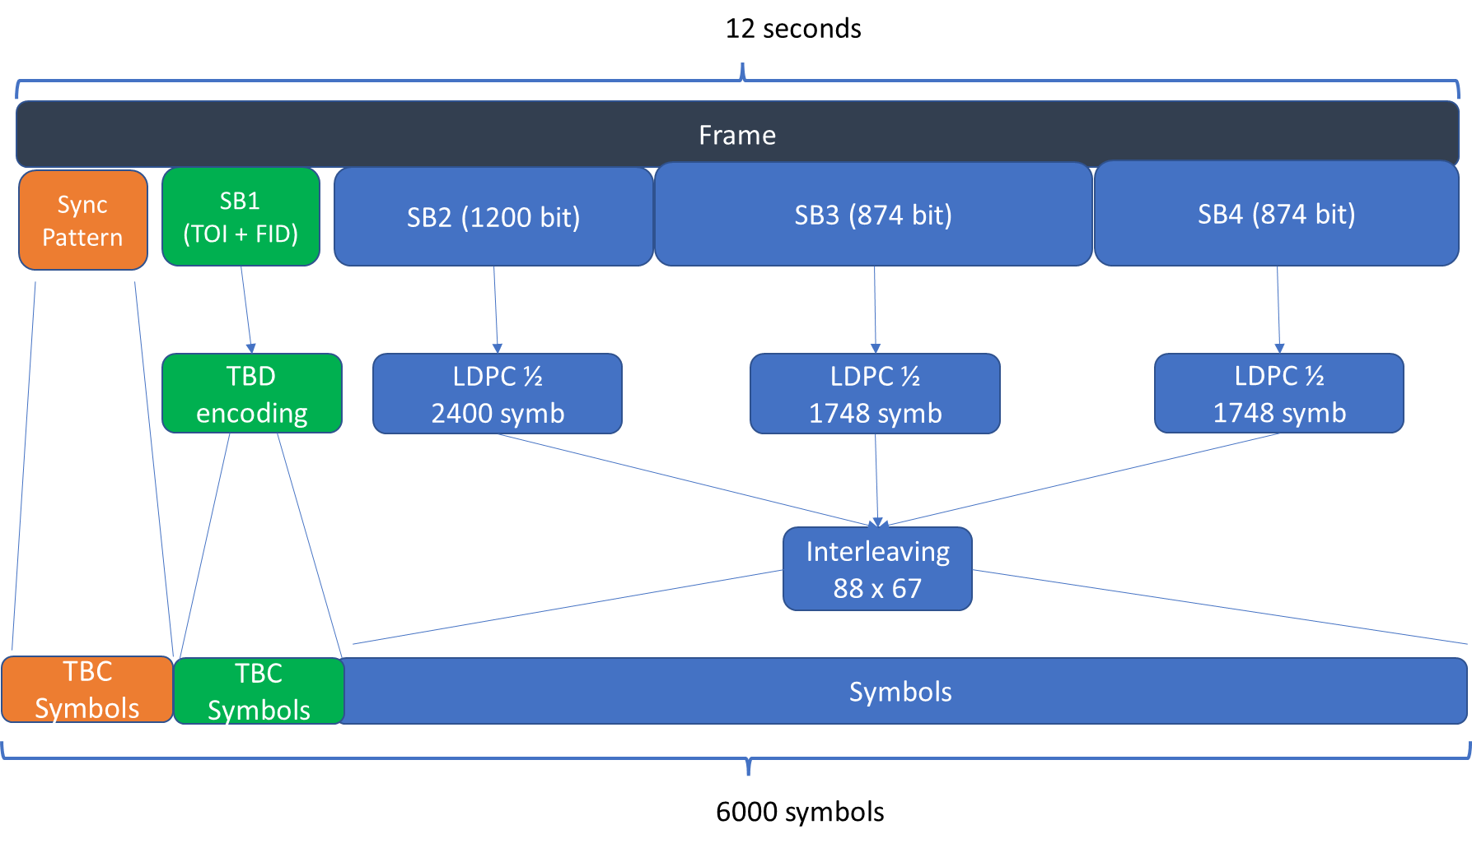
Message Format - FrameID = 0
The current version of LSIS defines only FID = 0, the other options are left for future use.
In case of FID=0, three other subframes (in addition to SB1) are defined.
FID | Definition
0 | Frame structure including SB2, SB3 and SB4
1 to TBD | Reserved for future use

Slide 14
Message Format - FrameID = 0
Subframe 2 is always broadcasted in every frame and the structure is invariable.
Subframe 3 is a variable data frame that might contain different information. The specific information broadcasted is identified by the subframe identifier.
Subframe 4 is a variable frame that will contain variable data potentially supporting services other than the navigation service, The specific information broadcasted is identified by the subframe identifier.
Number of bits and encoding rate for SB2, SB3 and SB4 are TBC

Slide 15

Message Format - FrameID = 0 – SB2
The SB2 shall be broadcast in every frame.
The SB2 structure shall be identical in every frame.
SB2 shall contain at least the following data:
Clock and ephemeris data (CED)
Week Number (WN)
Interval Time of Week (ITOW)
Health status
Cyclic Redundancy Check
Additional data specified by the LNSP may be broadcast in SB2 in addition to the mandatory data.
Data | CRC
1176 (TBD) | 24

Slide 16
Message Format - FrameID = 0 – SB3
The SB3 data content shall be identified by the SB3 type field.
SB3 shall contain at least the following data:
Almanac data (note that the almanac data for the full constellation is expected to be disseminated using multiple SB3).
LunaSAR (Search and Rescue) return link message.
Alerts messages.
The following data should be disseminated using SB3:
MAntennaProperties
GNSS Augmentation
Maneuver
SAttitude State/ Ephemeris
Conjunction
Detection Alert
Custom messages defined by the LNSP.
SB3 type | Data | CRC
4 or 6 (TBC) | 844 or 846 (TBC) | 24

Slide 17
Message Format - FrameID = 0 – SB4
The SB4 data content shall be identified by the SB4 type field.
SB4 shall contain at least the following data:
LunaNet Network Access Information
The following data should be disseminated using SB4:
MAntennaProperties
Maneuver
SAttitude State/ Ephemeris
GNSS Augmentation
Scheduling information for communication service
Updates of lunar maps or lunar DEM
Ancillary info
Conjunction
Science data
Acknowledge- of non-SAR MSG
UIS Response
FF Commands
Custom messages defined by the LNSP
SB4 type | Data | CRC
4 or 6 (TBC) | 844 or 846 (TBC) | 24

Slide 18
Message Format and Definition - LNSP Implementation Flexibility
The LSIS allows each LNSP to implement their specific concept for the dissemination of navigation data/information. For example, aspects such as the cadence of dissemination of certain data content, the update rate of the data are left to be defined by the LNSP.
LNSP can also define custom messages for dissemination; custom messages are only allowed in SB3 and SB4.
SB2 allows broadcast of LNSP specific data, if some bits are left unused after the allocation of the mandatory data.
For many of the messages defined in LNIS, the current version of LSIS does not provide a clear definition. Definitions are expected in future versions of the document.

Slide 19
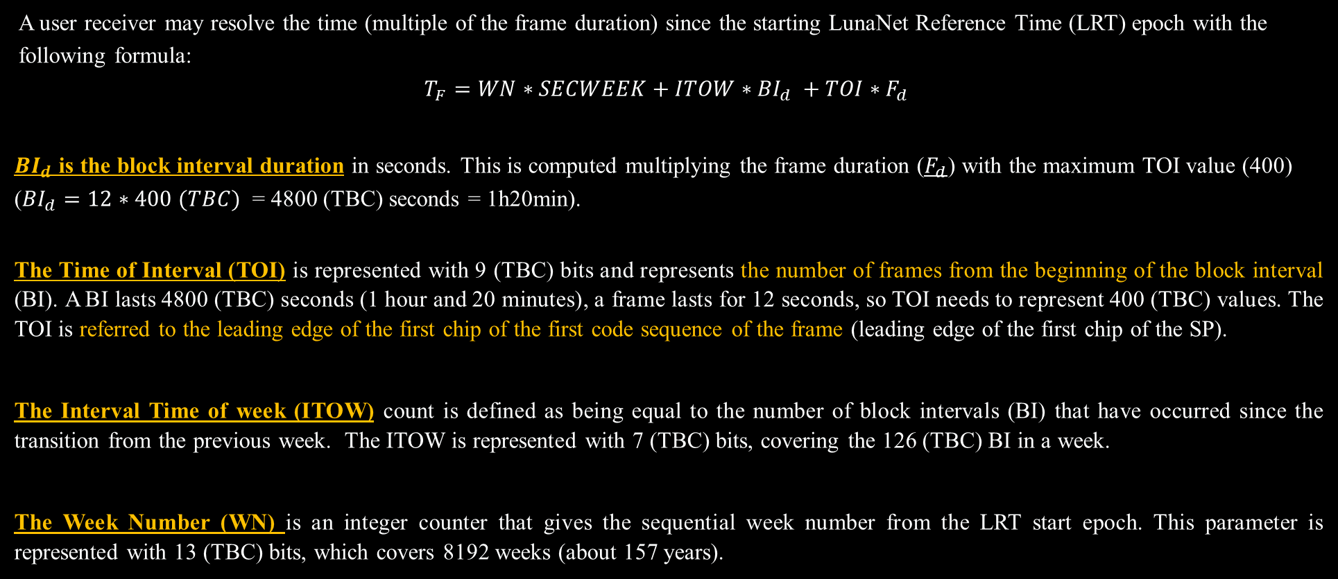
Time of Transmission Definition
A user receiver may resolve the time (multiple of the frame duration) since the starting LunaNet Reference Time (LRT) epoch with the following formula:
$$T_{F}=WN∗SECWEEK+ITOW∗{BI}_{d} +TOI∗F_{d}$$
${BI}_{d}$ is the block interval duration in seconds. This is computed multiplying the frame duration ($F_{d}$) with the maximum TOI value (400) (${BI}_{d}=12∗400 (TBC)$ = 4800 (TBC) seconds = 1h20min).
The Time of Interval (TOI) is represented with 9 (TBC) bits and represents the number of frames from the beginning of the block interval (BI). A BI lasts 4800 (TBC) seconds (1 hour and 20 minutes), a frame lasts for 12 seconds, so TOI needs to represent 400 (TBC) values. The TOI is referred to the leading edge of the first chip of the first code sequence of the frame (leading edge of the first chip of the SP).
The Interval Time of week (ITOW) count is defined as being equal to the number of block intervals (BI) that have occurred since the transition from the previous week. The ITOW is represented with 7 (TBC) bits, covering the 126 (TBC) BI in a week.
The Week Number (WN) is an integer counter that gives the sequential week number from the LRT start epoch. This parameter is represented with 13 (TBC) bits, which covers 8192 weeks (about 157 years).

Slide 20
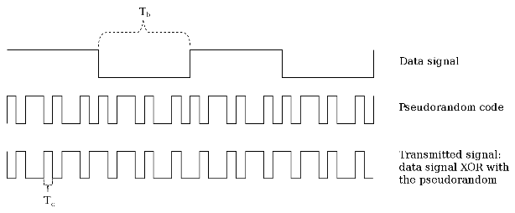
Time of Transmission Definition
BI
ITOW
0
1
2
3
125
1 week = 604800 seconds
Frame
TOI
0
1
2
3
399
1 BI = 4800 seconds (1h20min)
Synch Pattern
Subframe1 (FID+TOI)
Other Subframes (ITOW, WN)
….. 6000 symbols of the frame …
1 Frame = 12 seconds
1 Pilot channel primary code = 1 ms
TOI is referred to the edge of the first chip of the first primary code sequence of the frame

Slide 21

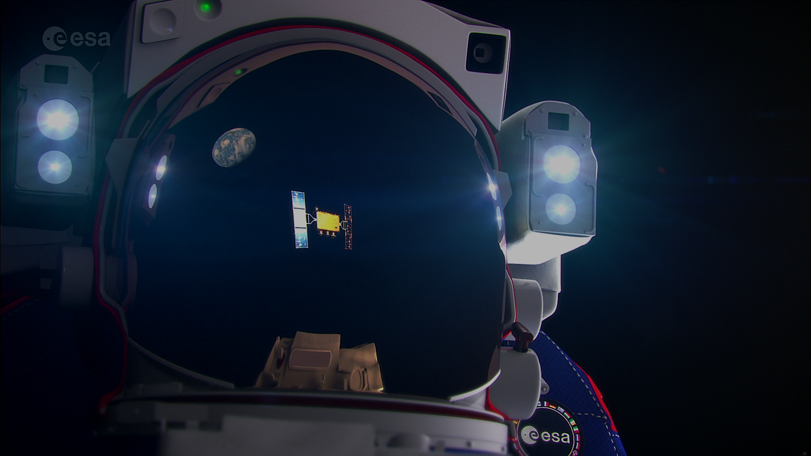

Contacts:
Pietro.Giordano@esa.int cheryl.j.gramling@nasa.gov
Thank you !!

