Slide 1

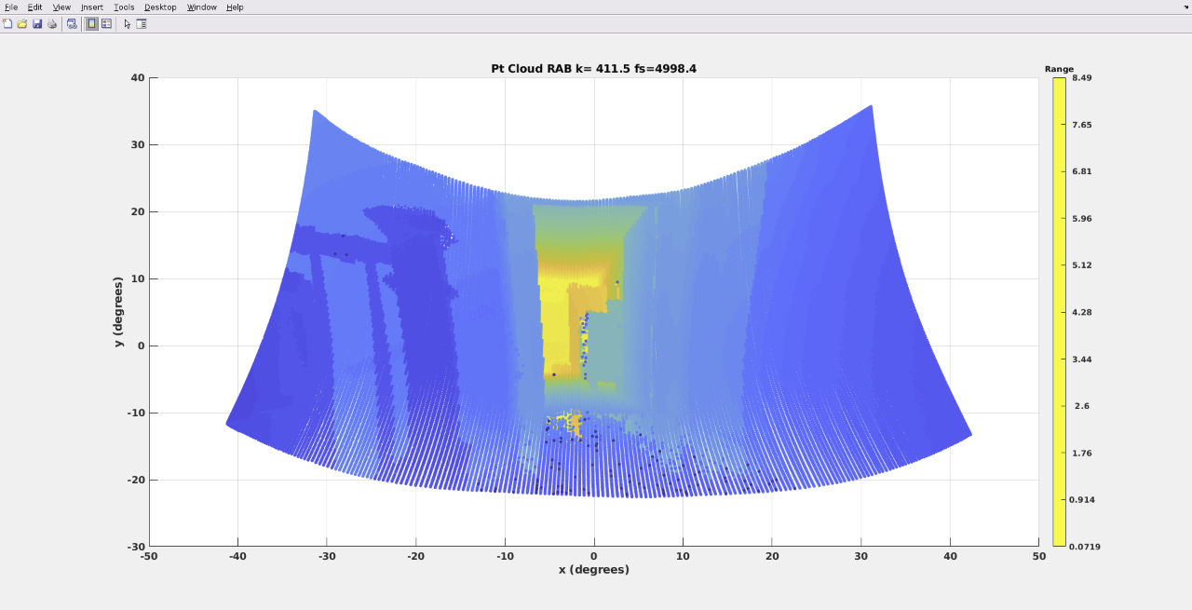
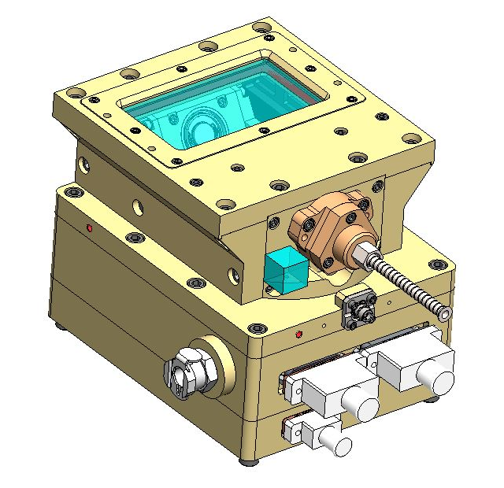
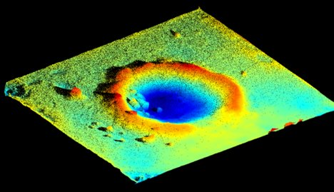
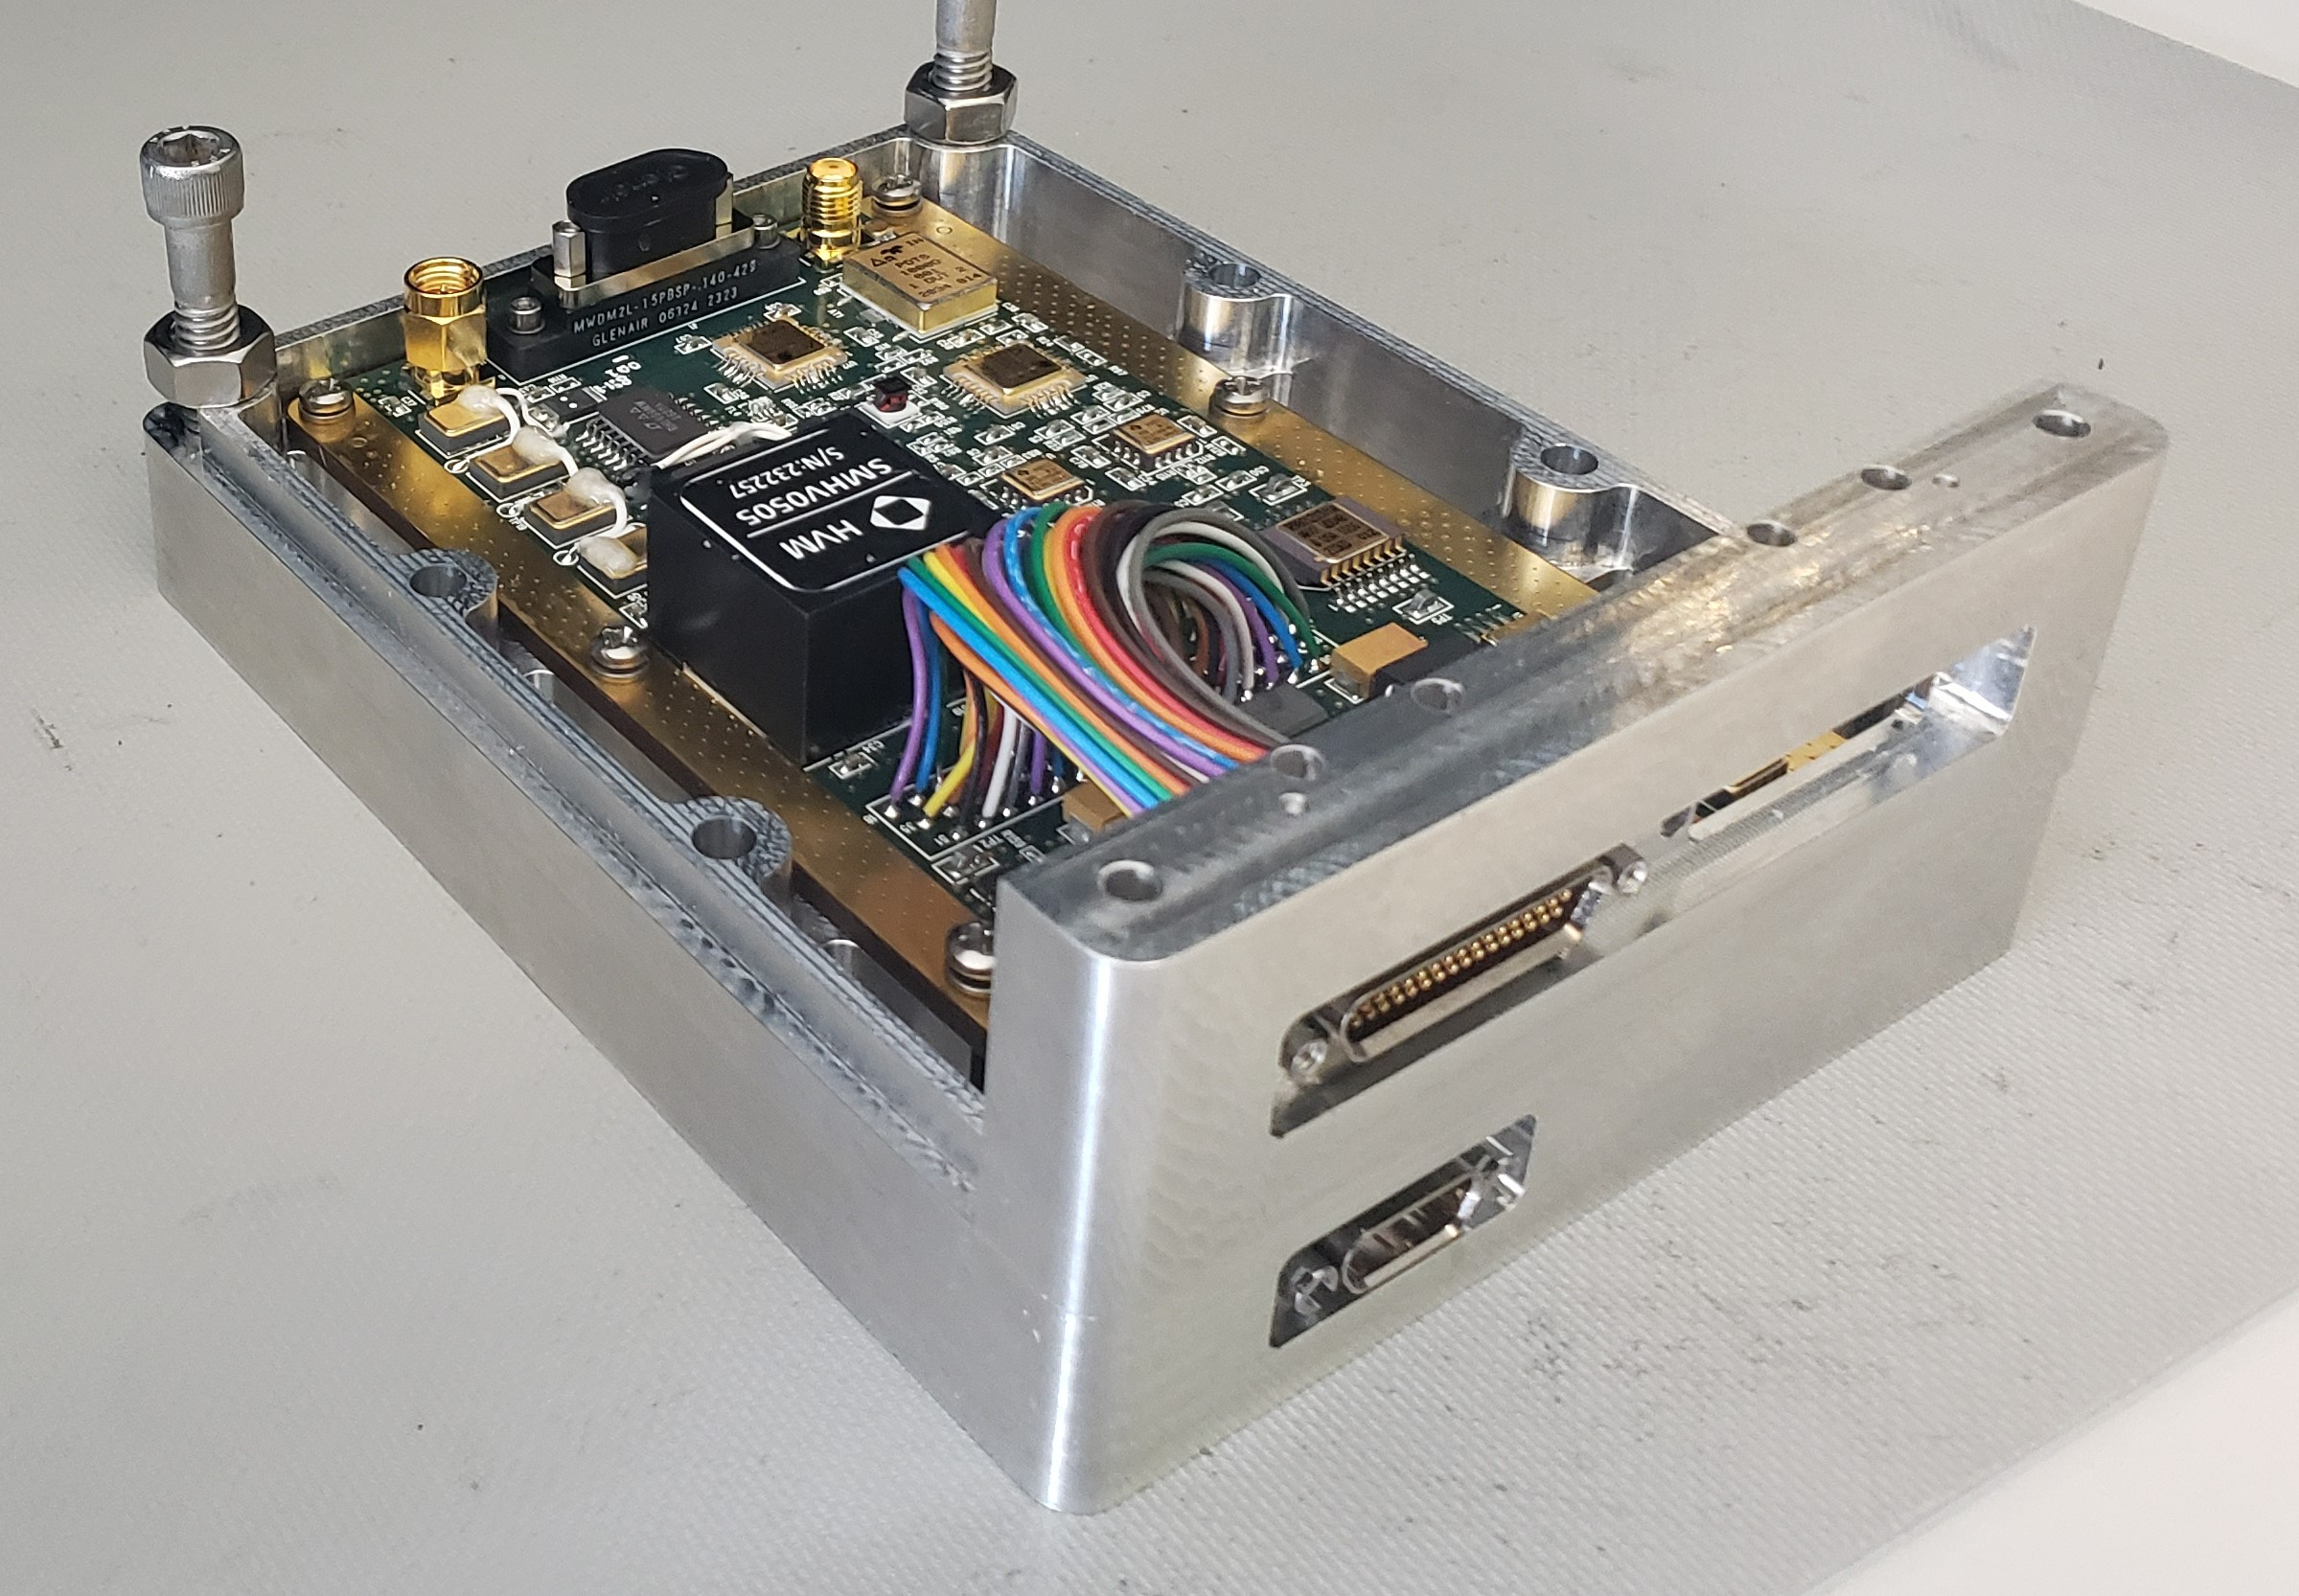
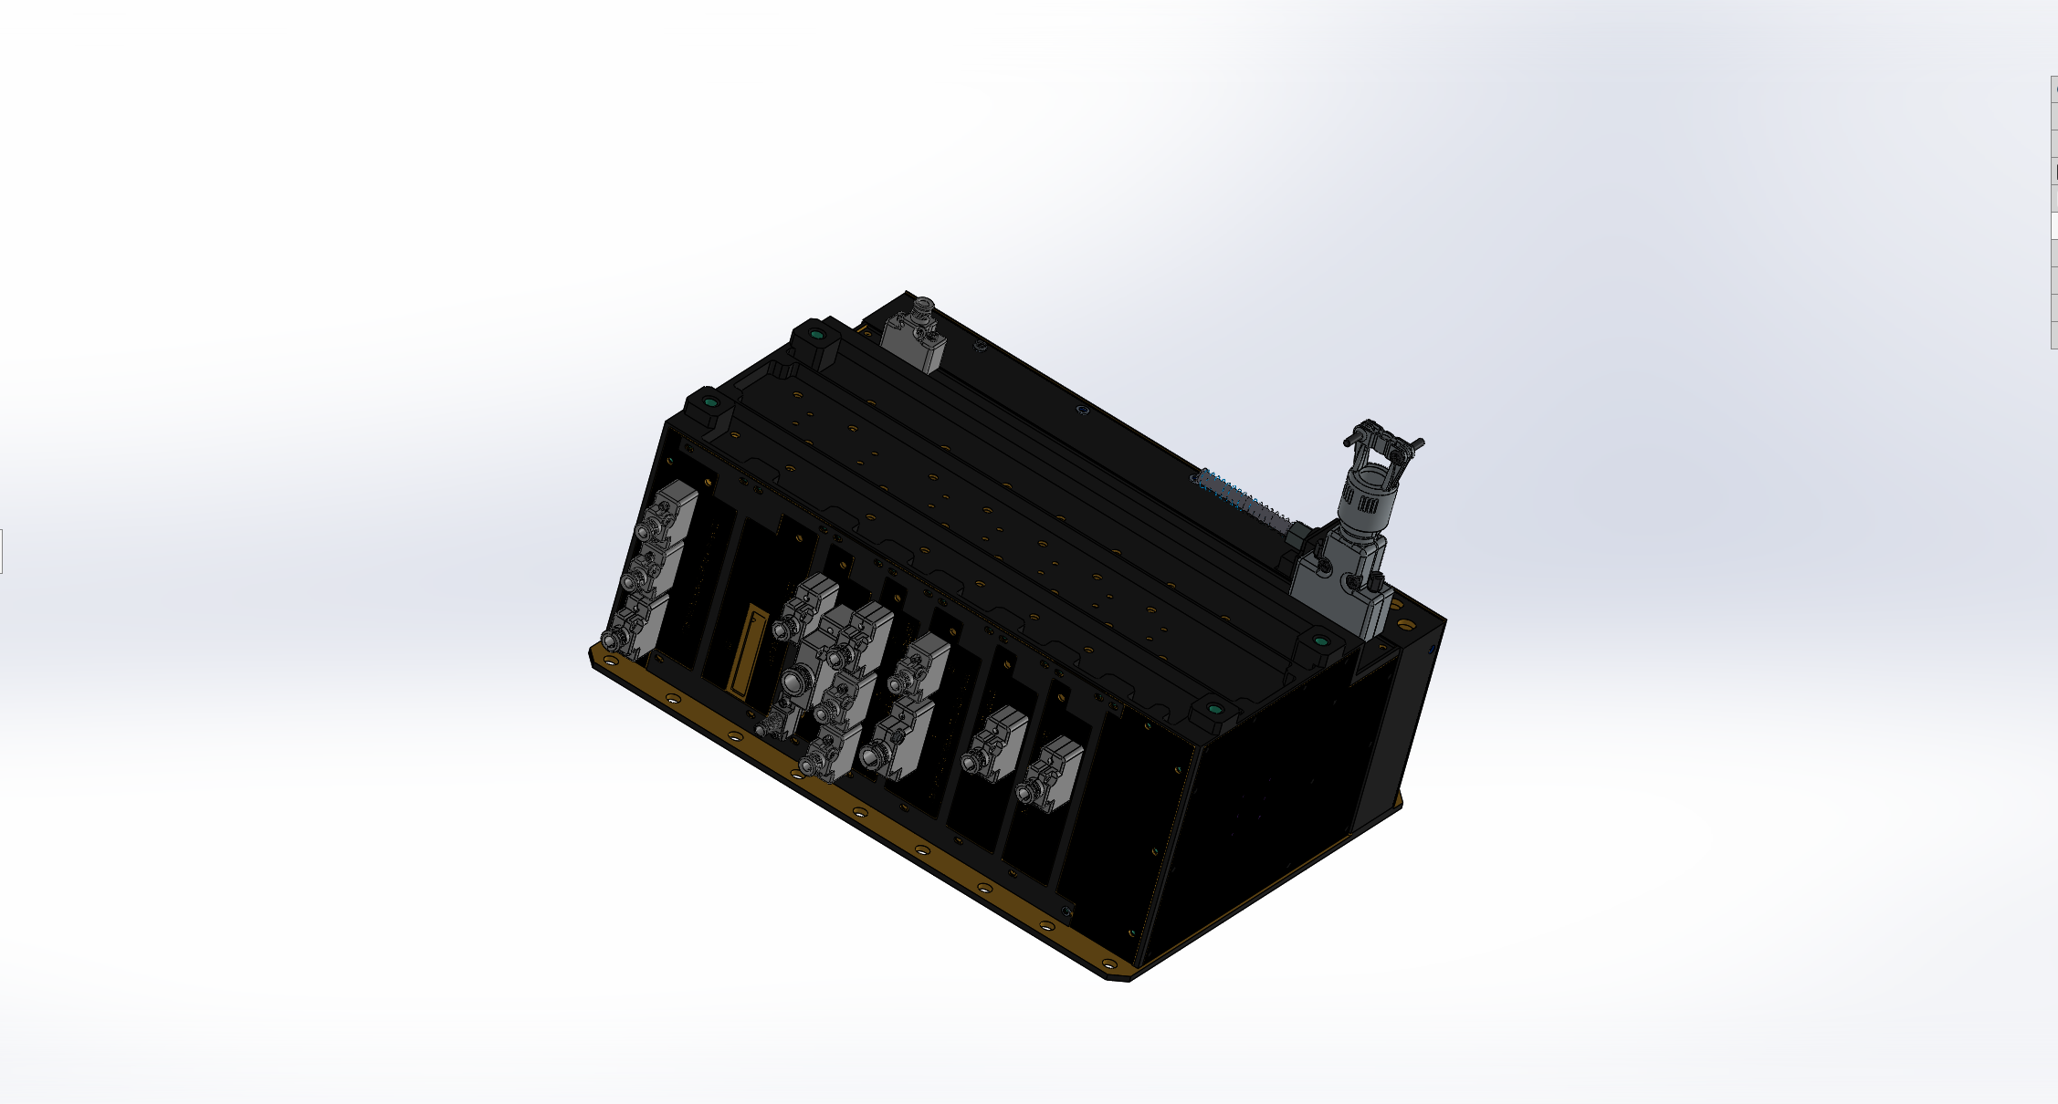
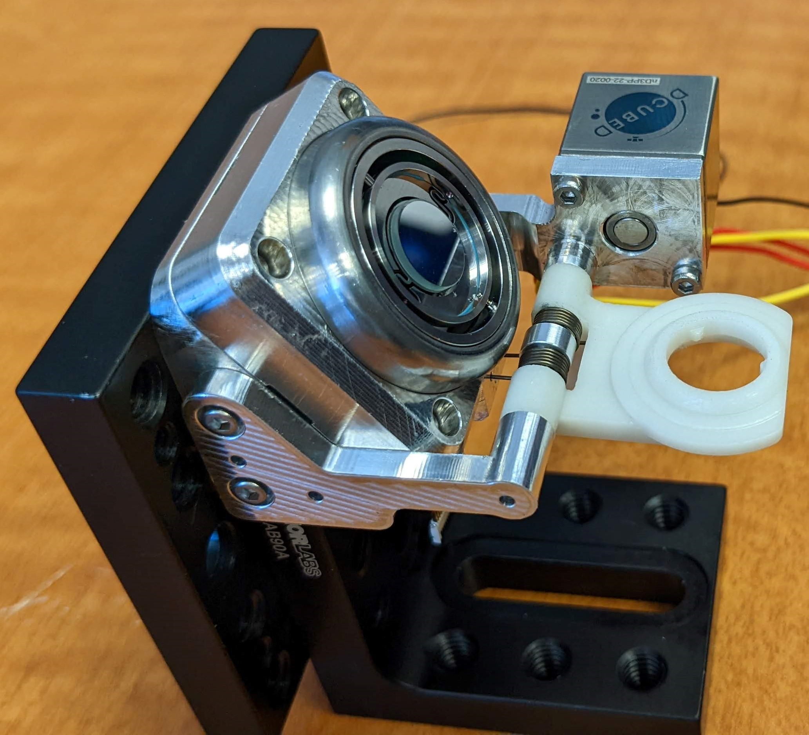
Space Technology Mission Directorate
Game Changing Development Program
Nathanial Gill | Stephen Stelmash | FY23 HTRL High TRL Lidar Annual Review Presentation | 09/18/2023
Name/Email POC: Nathanial Gill nathaniel.a.gill@nasa.gov

Slide 2

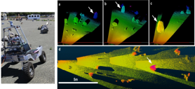
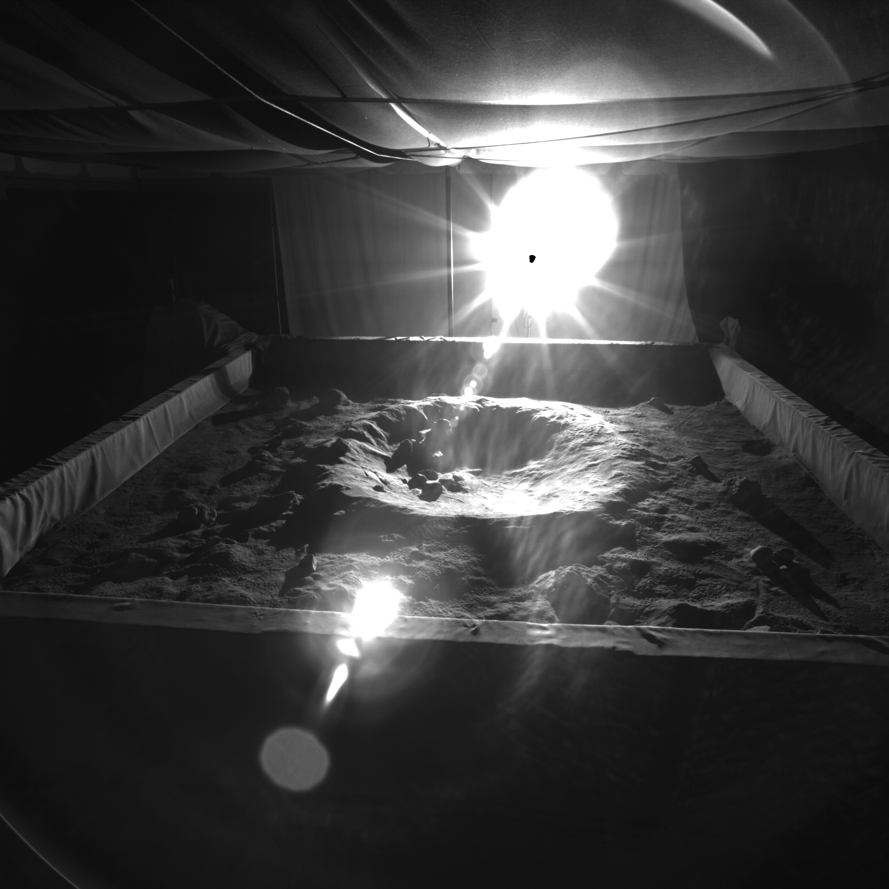
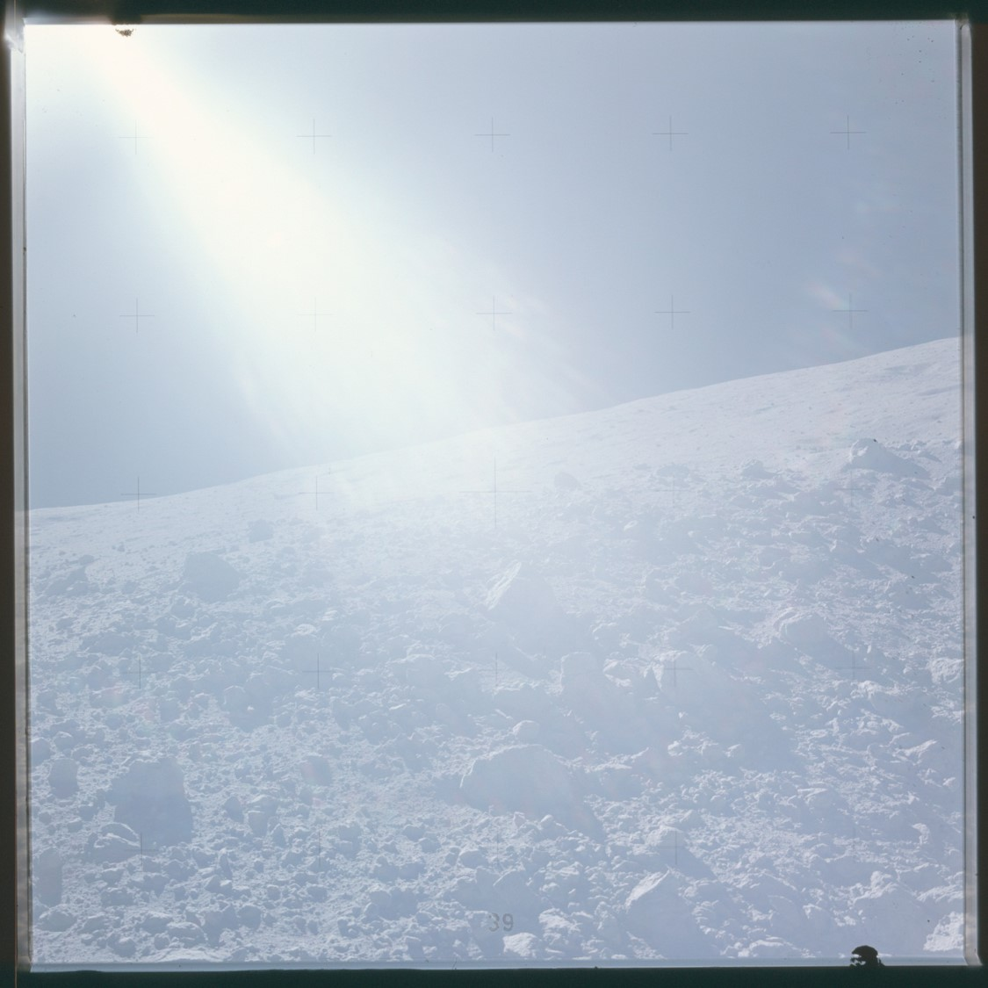
Project Overview
This project will produce a 3D lidar system (engineering unit) to greatly expand rover navigation capability, including hazard detection range, field of view and light condition sensitivity. Provide required science data products and terrain mapping capabilities.
Quantitative Impact
  Camera based vision doesn’t work in the dark or driving into low sun (like in and around lunar poles) but lidar works well in these scenarios. [Enabling Capability, not possible otherwise]
  Extends hazard detection range from 2m up to 100m in all lighting conditions, enabling exploration of extreme locations of great interest to science (ie permanently shadowed craters, lava tubes, etc)
  Potentially increase the speed of rovers offering continuous motion, due to increased hazard detection rate and range, greatly expanding scientific return and operational capabilities.
  Flexible system capable of sub-mm resolution for science quality scans and sedimentology.
  Lidar point cloud image provides more 3D information with smaller comm rates, reduces on board processing and number of optical sensors and support position estimation.
“Design and build a LIDAR engineering test unit (ETU, AKA - SQRLi) and demonstrate a 30 m or greater range, larger than 40x80 degree field of view at maximal range, and operation capability under poor lighting conditions. “
Rover Lidar Demonstration Data
Simulated Crater lens flare example
Example poor image condition
Notes:
Provide an overview of the Project/Task
The slide content is intended to remain static unless significant changes are made to the Project
Pictures are encouraged, please provide new pictures as frequently as possible

Slide 3
Project Overview
Technology Development Needs Addressed by Project
STMD | Develop technologies for science instrumentation supporting new discoveries. [Low TRL STMD/Mid-High TRL SMD. SMD funds mission specific instrumentation (TRL 1-9)] | TX08.X
LTV | Sensing and perception technologies for autonomous systems collect and process information internal and external to the system from sensors and instruments. | TX10.1.1
Project Goals
Goal #1 | Design and build an engineering test unit of a high TRL (5-6) rover LIDAR system and demonstrate its operating capabilities at 30 m or greater with an increased field of view under ideal, low sun angle, and poor light conditions.
Project Objectives
Objective #1 | Complete System Requirements, Trade Studies, and Risk Reduction Testing
Objective #2 | Design, build and test the Front-End Box (FEB).
Objective #3 | Design build and test the components, cards, and subassemblies of Main Electronics Box (MEB)
Objective #4 | Integrate HTRL FEB with MEB emulator to performance test the Engineering Test Unit (ETU)
Notes:
Provide an overview of the Project
Pictures are encouraged, please provide new pictures as frequently as possible

Slide 4
Project Overview
Project Objectives
Objective #5 | Conduct Pre-environmental baseline performance analysis of the HTRL FEB.
Objective #6 | Conduct environmental testing of the HTRL FEB.
Objective #7 | Conduct Post-environmental testing performance analysis of the HTRL FEB.
Notes:
Provide an overview of the Project
Pictures are encouraged, please provide new pictures as frequently as possible

Slide 5
Team Members / Project Org Slide
Josh Mehling
JSC (ER541) PT/SCLT
Eugene Schwanbeck
GCD Program Element Manger
David Moore
GCD Program Manager
Nat Gill
GSFC (0596) PI Engineering lead
Eliad Peretz
GSFC (0596)
Program Manger
Stephen Stelmash
GSFC (0596) Project Development Lead
Caitlin Bacha
GSFC (0400) Instrument
Program Manger
Chensheng Wu
GSFC (0551)
Optics Lead
Bryan Martin
GSFC (0543) Opto-Mechanical Lead
Josh Berrier
GSFC (0551)
AI&T Lead
Erik Laurila
GSFC (0551)
Electrical Lead
Notes:
If you have submitted a Project Plan, you could utilize the Organizational Chart found in section 8.3 – Management Structure making sure to add in your assigned PEM and associated PT/SCLT

Slide 6
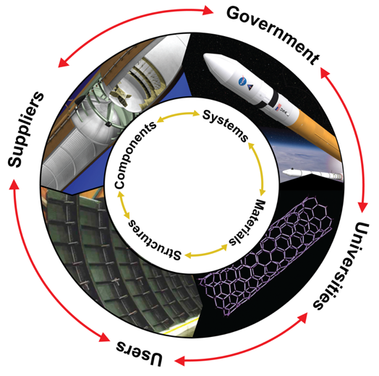
Collaborative Partnerships for Advancement of Aerospace Materials
Mission Infusion & Partnerships
NASA Centers
GSFC
AMES
JSC
JPL
ESI
Public/Private Partnerships
Optotune (Mirror)
DCubed (Launch lock)
OGA Leveraging
SBIR/STTR
Industry/Academia
UIowa - OPL
Collaborative multidisciplinary partnerships to leverage fiscal resources, ideas, knowledge & expertise.
Notes:
Detailed Example Only for context

Slide 7
SQRLi
Lifecycle Milestone/Maturity Schedule
Project Milestone
GCD (Key) Milestone
Controlled Milestone
TRL Progression
TRA
Subsystem TVAC
EDU & ETU
Integration
6
Detailed System Design
ETU
Development
ETU
Characterization
EPR II
TAPR
5
Detailed System Analysis
POC Testing
& Characterization
Detailed System Design
EPR I
Risk Reduction II
(Integrated)
4
Project Schedule & Budget
System requirements & Trades
Risk Reduction I
(Component)
3
_ _ _ _ _ _ _ _ _ _ _ _ I _ _ _ _ _ _ _ _ _ _ _ _ I _ _ _ _ _ _ _ _ _ _ _ _ I _ _ _ _ _
FY21
FY22
FY23

Slide 8
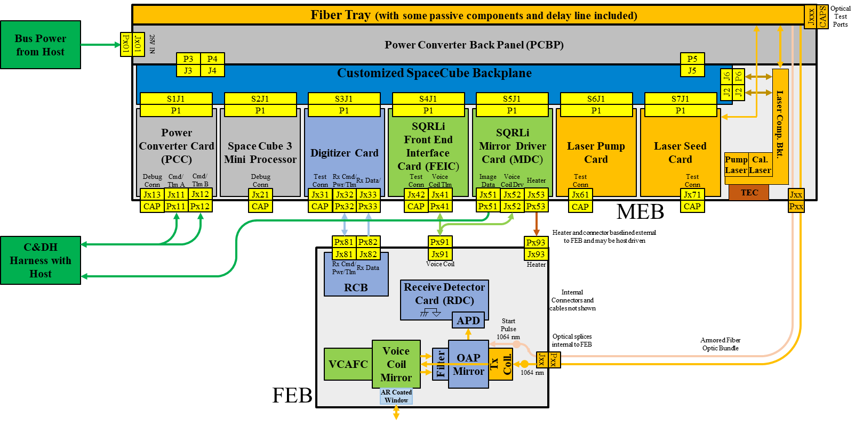
System Overview
In essence we need to:
Build and test the Front-End Box (FEB).
Build and test the Main Electronics Box MEB Emulator
  FEIC & MDC EDU
  Laser EDU
Integrate SQRLi FEB and MEB Emulator.
Conduct Pre-environmental baseline calibration and performance analysis of the SQRLi system.
Conduct environmental testing (Open air, Shock and vibe, ThermalVac of the SQRLi FEB.
Conduct Post-environmental performance analysis of the SQRLi system.
Access TRL Technical Readiness Level.
Notes:
Provide an overview of the Project/Task
The slide content is intended to remain static unless significant changes are made to the Project
Pictures are encouraged, please provide new pictures as frequently as possible

Slide 9
Accomplishments
Technical Accomplishments as of August 31, 2023
FEB Front End Box Design
FEB Mechanical design Complete
  29 Mechanical part drawings
    27 Released, 2 in review
    23 items procured and delivered
  7 Assembly drawings in process
FEB Size and Mass
  Dimensions:
    L=135mm
    W=86.2mm
    H=110m
  Mass: 1.48Kg TBR

Slide 10
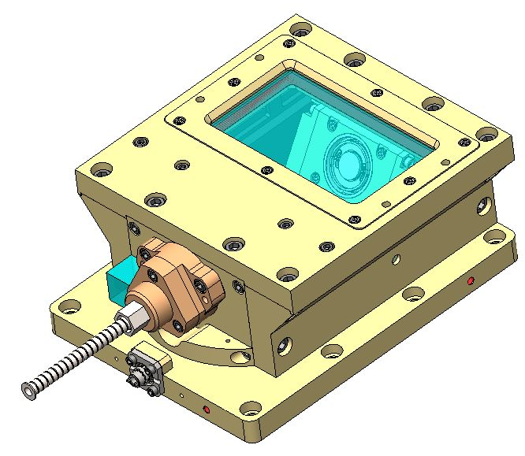
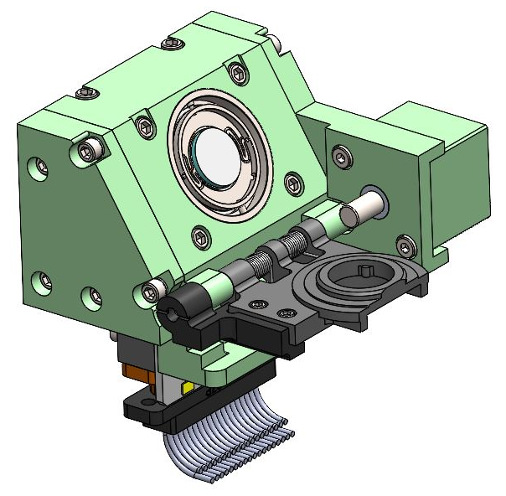
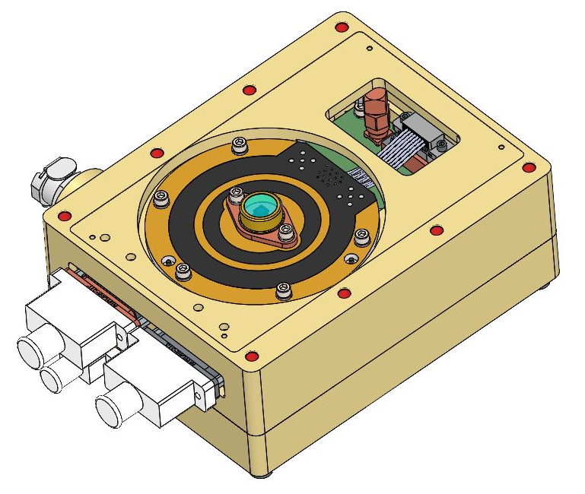
Accomplishments
The FEB design divides the optics and electronics into different sections.
Easier to control tolerances.
Easier to manage wiring between boards.
Optical Assembly
Voice Coil Mirror Assembly
RX Electronics Assembly

Slide 11
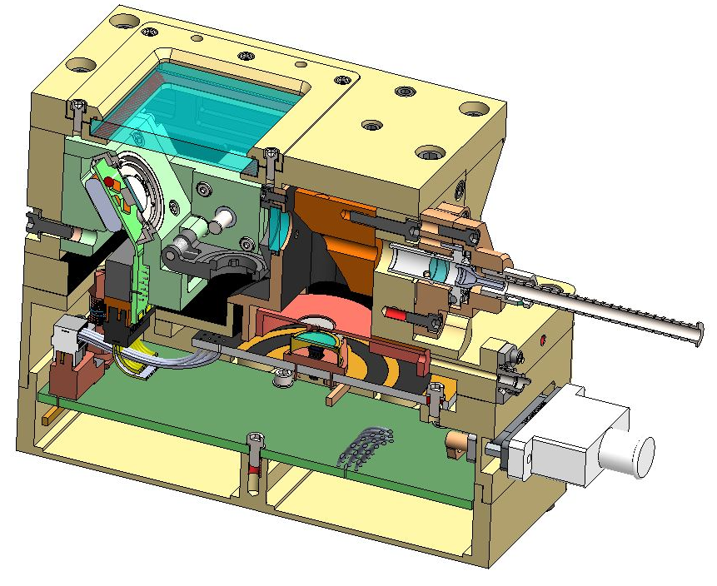
Accomplishments
There are 8 key components in optics: collimator assembly, BPF, VCM, window, OAP mirror, pinhole, PI, and the APD detector.
Fused Silica Window
BPF
OAP
VCM
Collimator Assembly
D-Cube
Launch Lock
Pinhole
PI input
APD

Slide 12
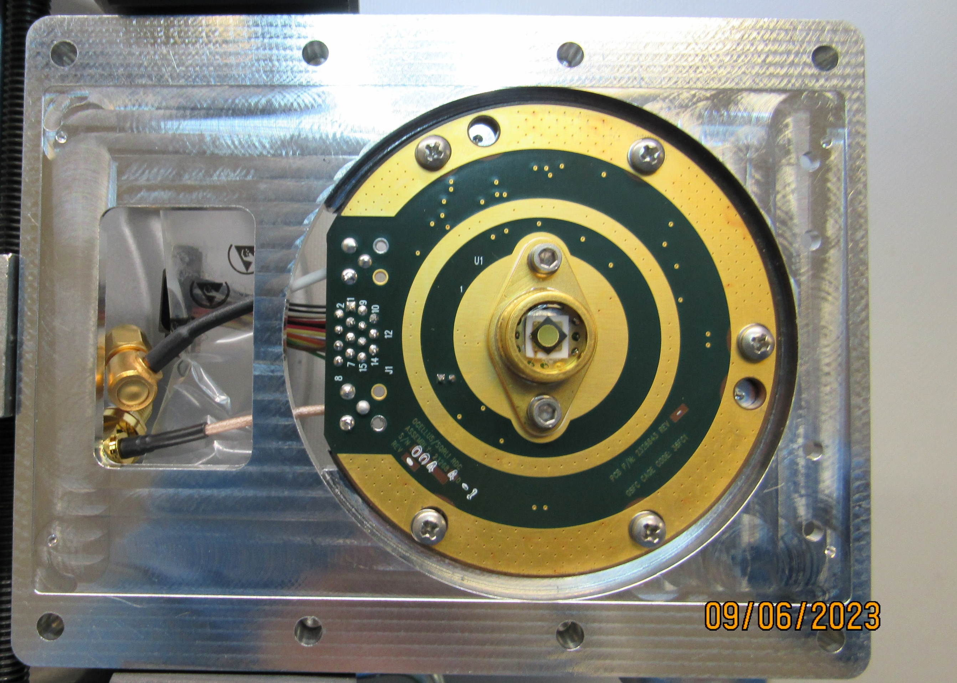
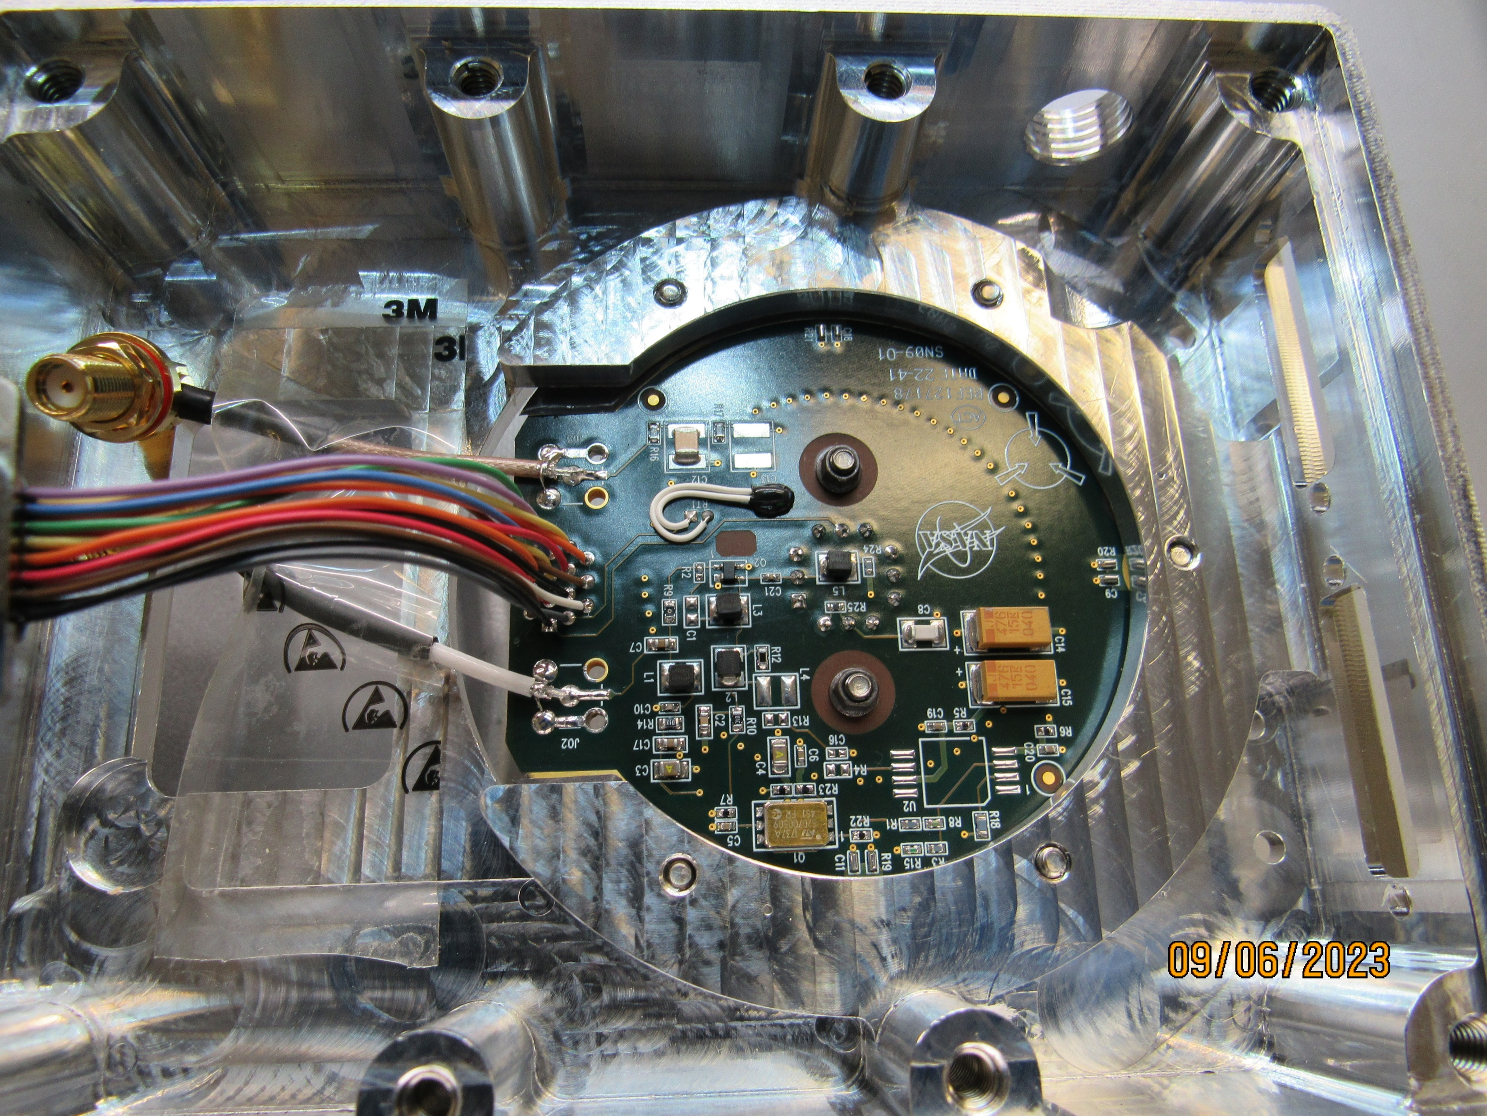
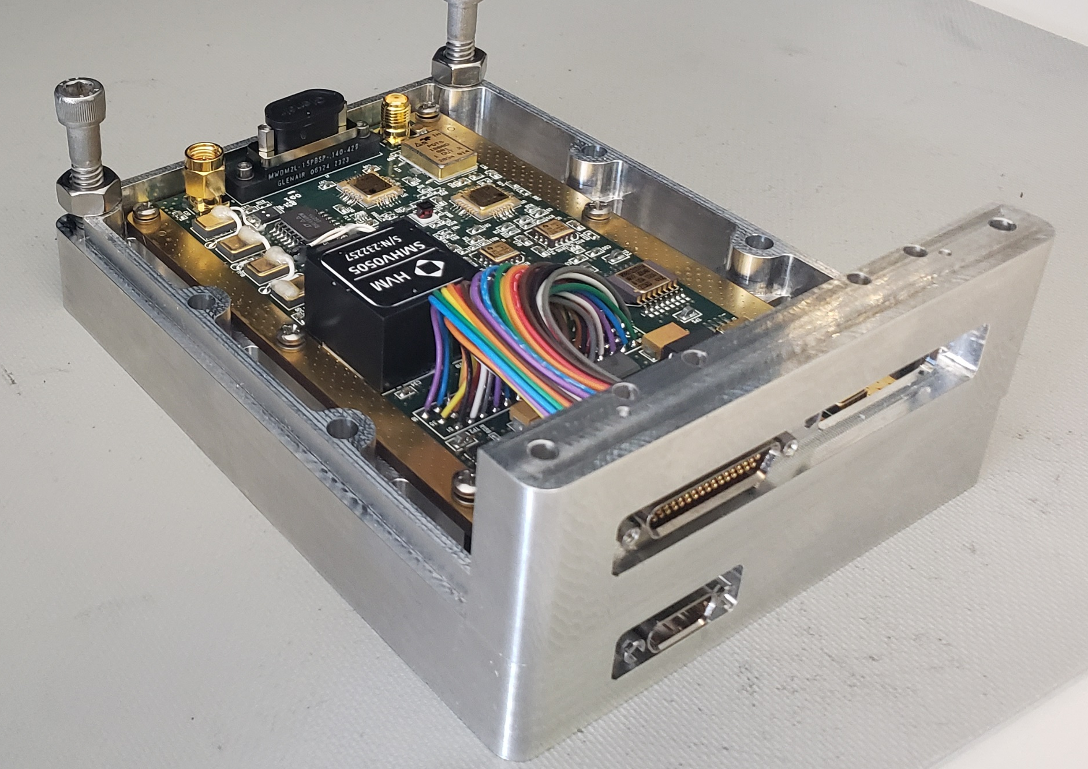
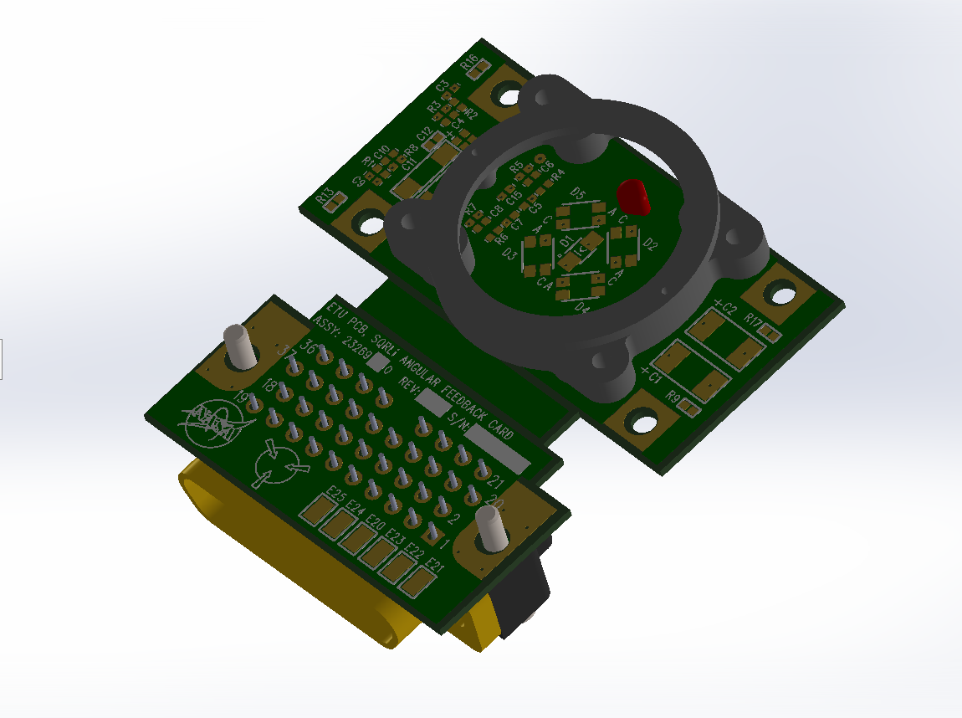
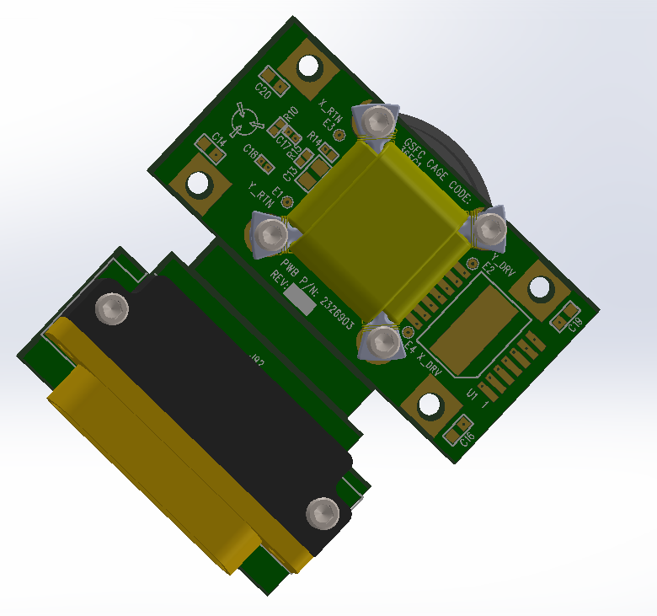
Accomplishments
Technical Accomplishments as of August 31, 2023
Electrical Design FEB
RDC Receiver Detector
Top
Bottom
FEB Electrical design complete
Schematics, fabrication and assembly drawing released
  3 PWA Printed wire assemblies
    RDC Receiver detector
      Assembly complete in test
    RCB Receiver conditioning
      Assembly complete in test
    AFBC Angular feedback
      Being fabricated
RCB Receiver Conditioning
AFBC Angular Feedback
Top
Bottom

Slide 13
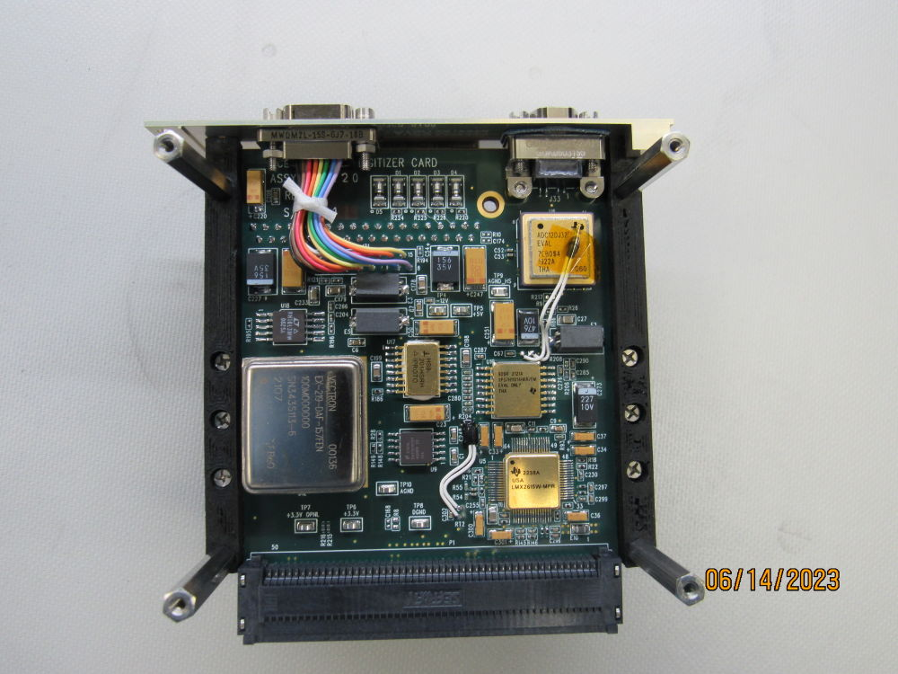
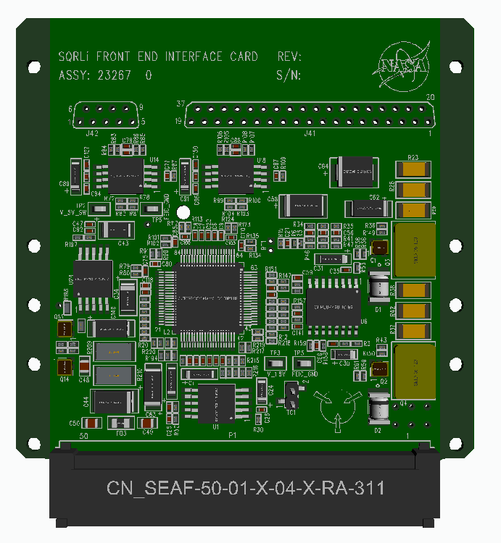
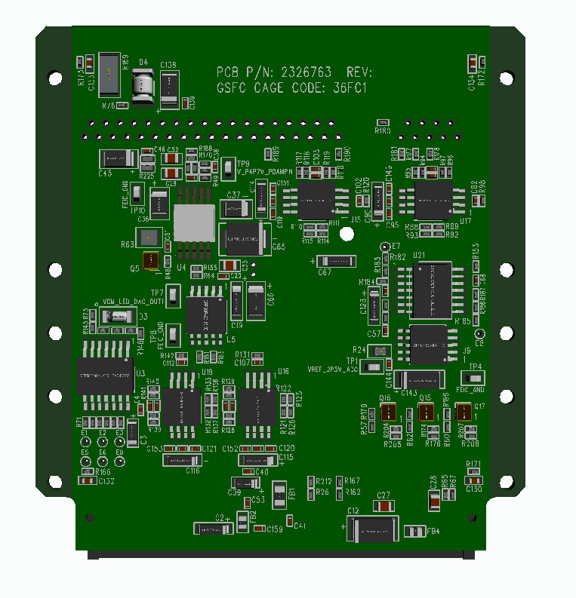
Accomplishments
Technical Accomplishments as of August 31, 2023
Electrical Design MEB Emulator
DIG Digitizer
MEB Emulator Electrical design complete
Schematics, fabrication and assembly drawing released
  3 PWA Printed wire assemblies
    DIG Digitizer
      Assembly complete in test
    MDC Mirror driver
      In assembly
    FEIC Front end interface
      In assembly
FEIC Front End Interface
MDC Mirror Drive
Top
Bottom
Top
Bottom

Slide 14
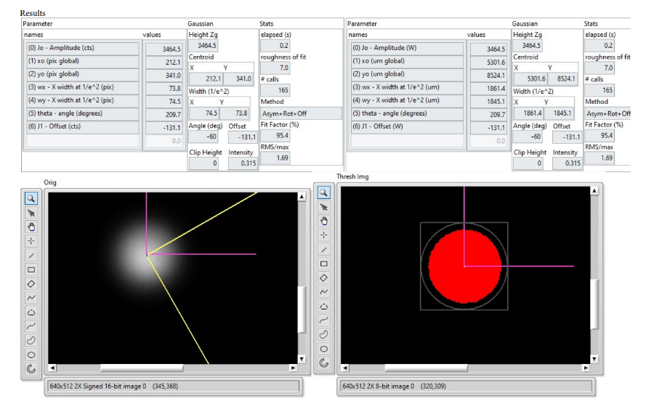
Accomplishments
Technical Accomplishments as of August 31, 2023
Optical Design Collimator
ETU collimator manufactured and inspected.
A selection program shows that #1 and #3 perform slightly better for SQRLi.
Exampled beam profile for collimator #1.
Relative transmission Efficiency
TER Table
Collimator | TER
315341-6 | 95.7%
315341-5 | 98.9%
315341-4 | 97.8%
315341-3 | 100.0%
315341-2 | 97.2%
315341-1 | 99.9%

Slide 15
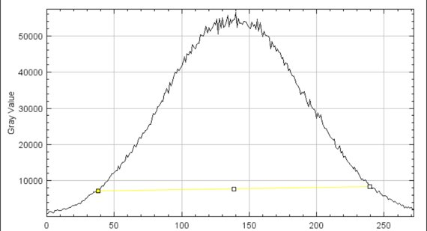
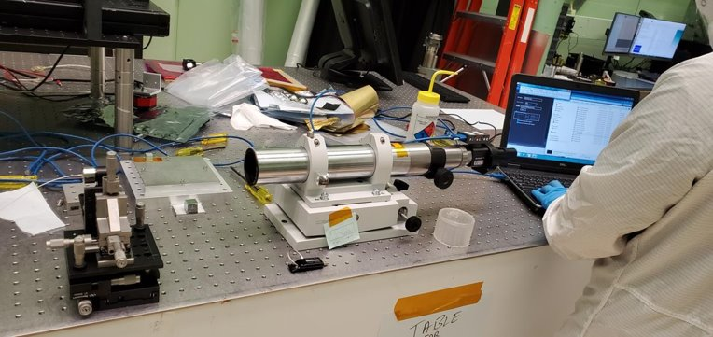
Accomplishments
Technical Accomplishments as of August 31, 2023
Optical Design Collimator
The ETU collimators are further compared with autocollimator measurements to ensure pass of requirement on beam divergence angle (<1.1 mrad). The result agrees with the manufacturer’s data.
All ETU collimators meet requirements.

Slide 16
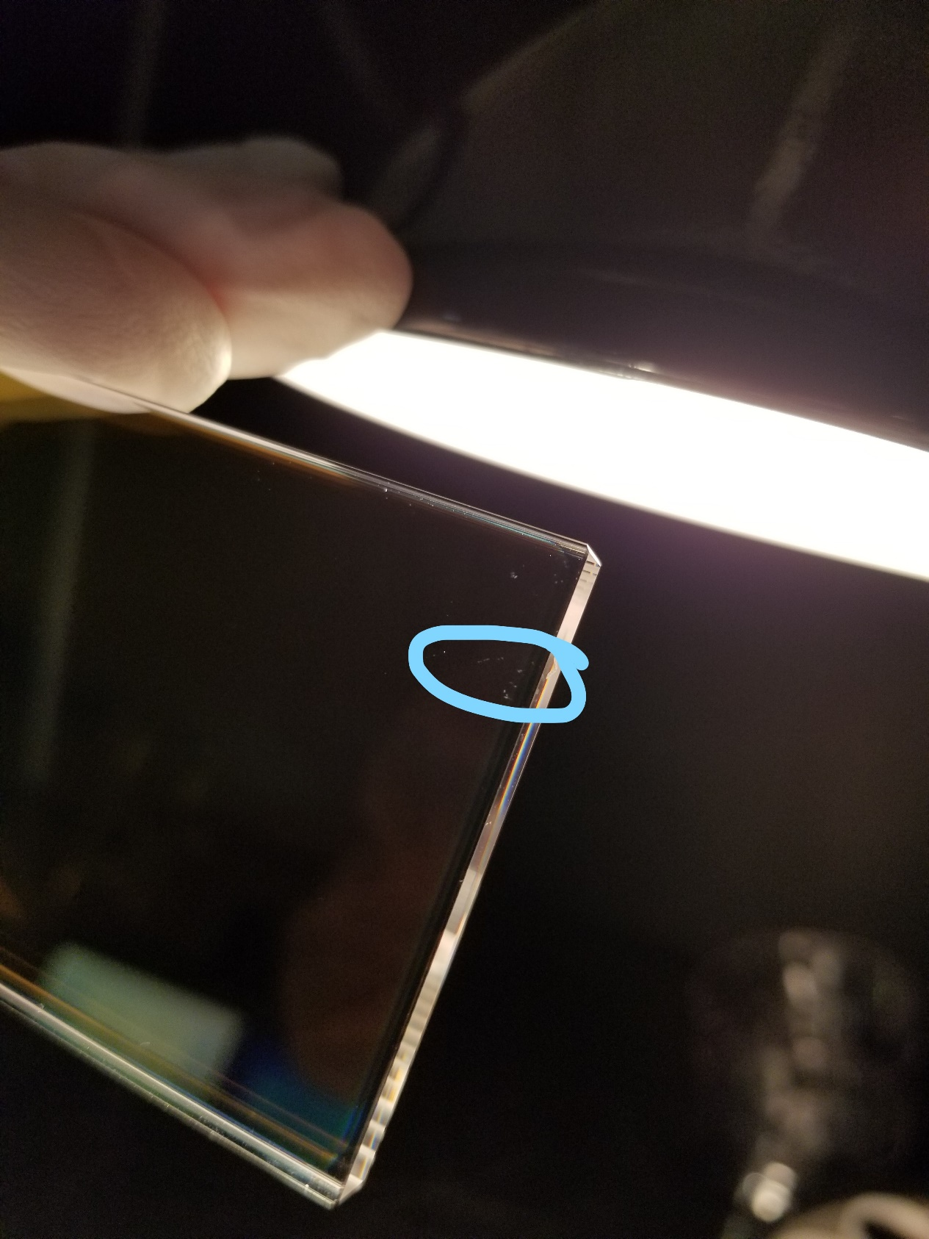
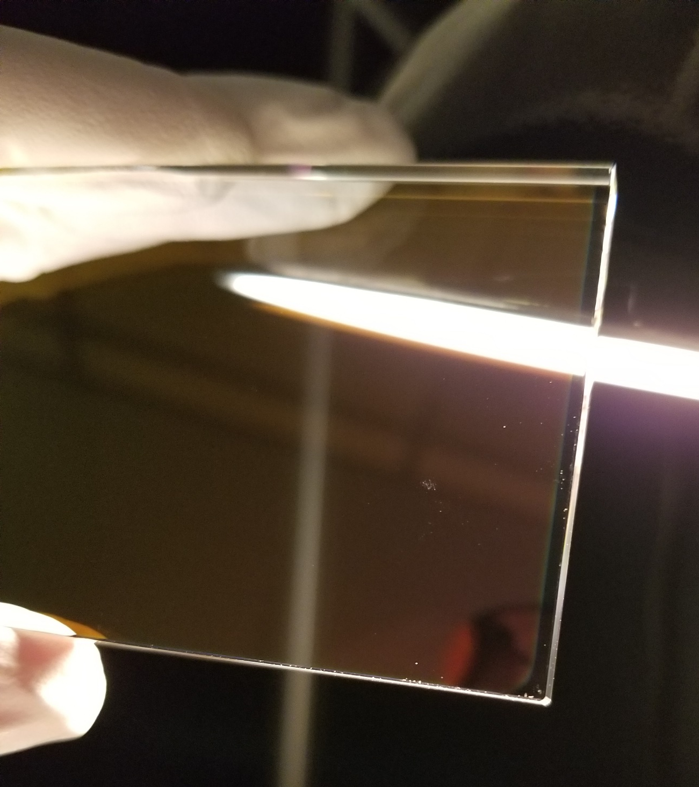
Accomplishments
Technical Accomplishments as of August 31, 2023
FEB Fused Silica Window
FEB window manufactured and visually inspected by Optimax. Post coating surface quality is reasonably good.
Some defect found but outside the laser operation region (accepted exception)
Visual inspection under 40 W light

Slide 17
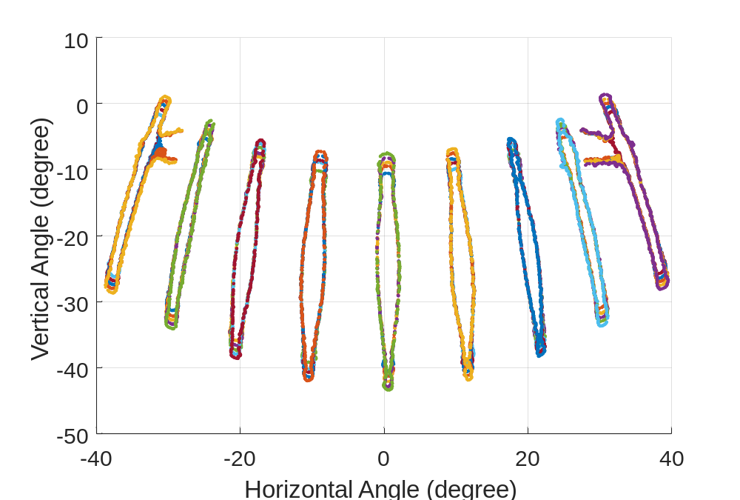
Accomplishments
Technical Accomplishments as of August 31, 2023
FEB VCM Voice coil mirror
BRDF characterized for the SQRLi gold coated VCM mirror and reflector at the back of the magnet.
Dry-run calibration conducted with ~9 lines for active scanning, each changing amplitude 5 times.
Data processing algorithm configured from raw data to calibrated output with V&V.
 | Fit data X | Fit data Y | Test data X | Test data Y
STD Error (degree) | 0.025794 | 0.146953 | 0.025838 | 0.175526
STD Error (mrad) | 0.450192 | 2.564814 | 0.450954 | 3.063512
Max Error (degree) | 0.115726 | 0.790281 | 0.126126 | 0.655949
Max Error (mrad) | 2.019805 | 13.793 | 2.20131 | 11.44846
Improvement to meet requirements:
1. Increase calibration dataset with more lines (~20) and more amplitude (~10).
2. Avoid errors in experiments (to reduce instances of outliers, which will bias the outcome).

Slide 18
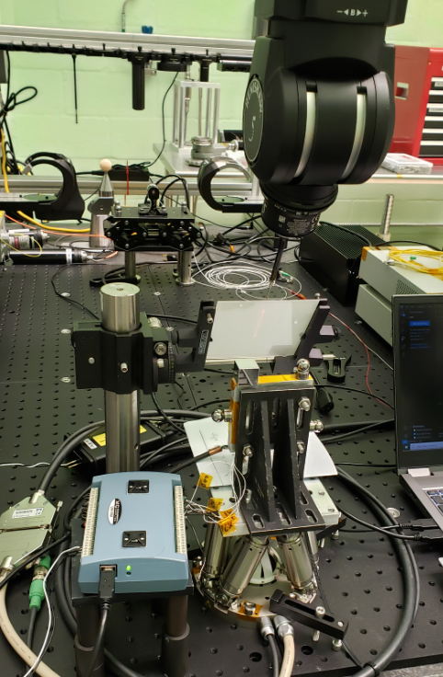
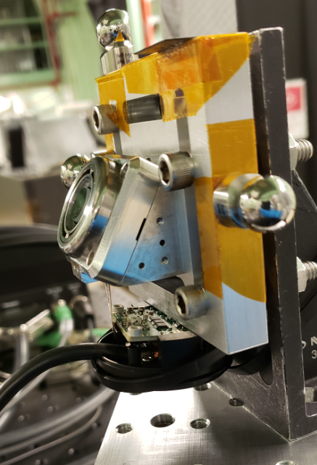
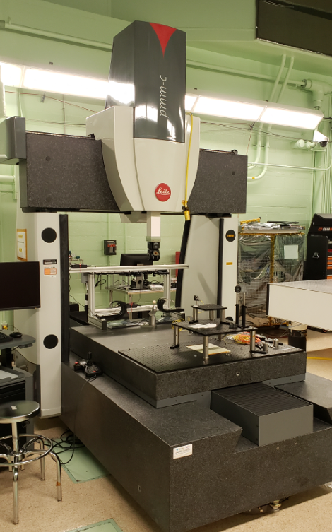

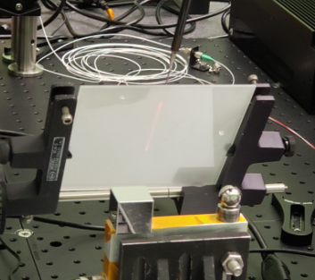
Accomplishments
Technical Accomplishments as of August 31, 2023
Characterization and Calibration
REVO-2
VCM
Collimator
Notes:
Measurement setup all located on CMM breadboard
REVO-2 touch probe measures location and pointing of laser beam coming out of collimator, VCM, and diffuser
Common coordinate system is then created to transfer all parts into same frame
CMM
laser
Diffuser
VCM on GSE mount
Touch probe
Laser beam
Reflected off VCM
Resonant axis active on VCM

Slide 19
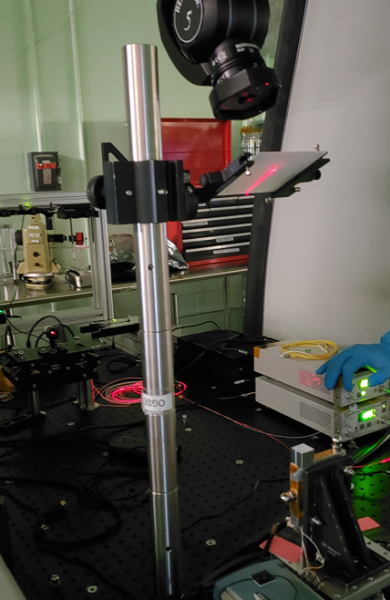
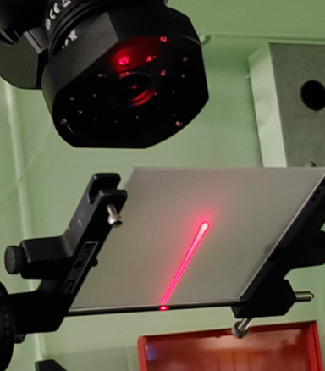
Accomplishments
Technical Accomplishments as of August 31, 2023
Characterization and Calibration
Notes:
VCM slow axis (VCM left or right) is commanded to user-chosen set point, the resonant axis is then turned on at user-chosen amplitude
REVO-2 vision probe measures the top and bottom sides of the laser line on the diffuser, per the constructed path defined in the prior slide
Vision probe
Diffuser
Collimator
laser
Laser beam
Reflected off VCM
Resonant axis active on VCM
VCM

Slide 20
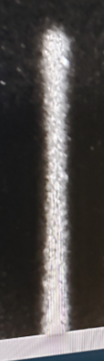
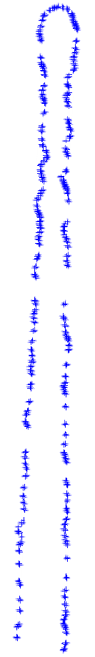
Accomplishments
Technical Accomplishments as of August 31, 2023
Characterization and Calibration
RMS
Notes:
REVO-2 vision probe software outputs point clouds of data fitted to perimeter of laser line ends as seen to far right in this slide
A circle, with a reported RMS uncertainty, is then fitted to the points at end of line to generate a circle center which represents the end of the line in cartesian space, XYZ
At same time metrology data is collected with REVO-2 vision probe, photodiode readouts from the VCM are also recorded

Slide 21
Accomplishments
Technical Accomplishments as of August 31, 2023
Requirement Validation
Flat-field tests to Verify Imaging mode performance
with dynamic and slew-and-stare pointing
The Flat-field (FF) is a complete test of the Imaging Mode. Verifies the Receiver and Transmitter FOV; Verifies the accuracy and precision of ToF and range measurements with dynamic pointing and slew-and-stare pointing; and verifies imaging mode performance over the operational temperature range in TVAC for SQRLi.
Requirements Satisfied: Lidar-108, 109, 110, 13, 116, 120, 122, 123, 124, 125, 127, 128, 129, 130, 131, 137, 138, 139, 140, 141, 142, 143, 147
Critical GSE: Flat-field targets & mounts: short range (dark), checkerboard; GSE imaging Lidar with 1mm (or sub-mm) accuracy
Critical alignments or setup: Flight lidar and GSE lidar must mount repeatably to mm (or sub-mm). Alignment of HW mounted or transmitted through: flat field target, e.g. collimators, power meter, energy meter, fast detector/oscilloscope, spectrometer
Design requirements:
This checkerboard will allow the SQRLi system to check it’s imaging mode, and time of flight
SQRLi Checkerboard will use a 4’ x 8’ Sheet of aluminum faced honeycomb
This will be slightly larger than the FOV from SQRLi FEB @ 1m
With a 40 x 80 degree FOV @ 1m
  1m*tan(40) = 0.839m = 33 inches
  FEB FOV is therefore: 33” x 66”
Repeating pattern of 2” squares
Paint reflectance: 12% Rmax (lighter color), 6% Rmin (darker color)

Slide 22
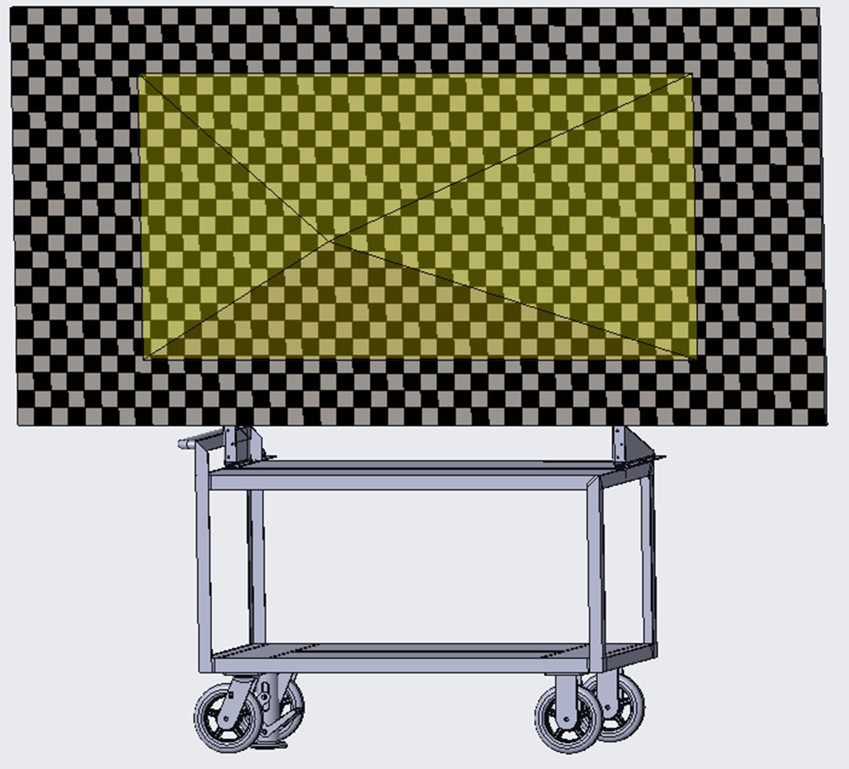
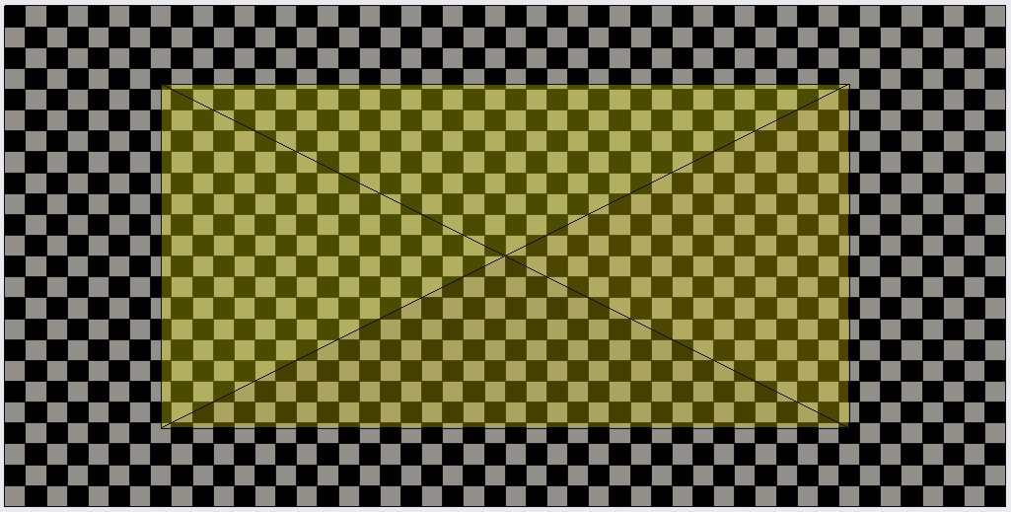
Accomplishments
Technical Accomplishments as of August 31, 2023
Requirement Validation
Checkerboard concept
4’ x 8’ panel with 2” checkers
black on grey paint
Mounted on a cart for easy transportation
With a locking mechanism to keep it from moving (locking floor jack, wheels, or hardpoints)
Depicted FOV

Slide 23
Project Assessment Summary
Project Name | Performance |  |  |  | Comments
 | C | S | T | P
Mid Year |  |  |  |  | Technical – Redesign and qual of laser scanning mirror a major challenge Cost – Schedule – Total schedule delay ~4-5 months Programmatic – Project plan being formulated
Annual |  |  |  |  | Technical – Staff reduction beginning September 1 to reduce burn rate Cost – Budget shortfall realized 3 ½ yrs on 3 yr budget necessitating reduction in scope to maximize deliverables. Schedule – Long lead time for parts have impacted I&T schedule Programmatic – Re-scope of the ETU to FEB qual only

Slide 24
Plans Forward and
Transition / Infusion Plan
Near Term
  LTV – interacted with project members and technical interest is there but LTV procurement approach presents challenges.
    If its possible to include SQRLi information in LTV RFP that could encourage vendor adoption
    Eyesafe version EHP PPBE slide next (not selected)
  Viper team collaborations – field testing with Ames
    Desire is to capture SQRLi data in lunar lab and mars yard then demonstrate hazard detection performance vs stereo cameras.
      if funding allows
  Artemis astronaut navigation
    Knack field testing for SLAM demo on flight hardware (if funding allows)
  PI engaged with Partnerships office to contact LTV and CLPS vendors to discuss SQRLi
  Any other CLPS opportunities?
  Other Prox ops missions for tech demo? ISS?
Longer Term Ideas
  Lunar
    Pressurized crewed rover
    Viper Follow-ons
  Mars
    Sample return fetch rover
    Next NASA rover?
  SQRLi research has resulted in next gen very small rover lidar concept that could double for astronaut wearable lidar for nav and safety
Notes:
Infusion: An investment reaches a conclusion where a technology is handed off for use by a mission or other need. Infusions can be made to other NASA Mission Directorates, other Government Agencies, Commercial Entities, or International Partner.
Transition: An investment reaches a conclusion where a technology is handed off for further development. Transitions can be made to other STMD programs, other NASA Mission Directorates, academic institution, other Government Agencies, Commercial Entities, or International Partner.

Slide 25
Summary
Accomplishments for the Year as of August 31, 2023
Successfully re-scoped effort to maximize delivered technology.
FEB analysis and design effort is completed, and mechanical and electrical subassembly fabrication is on going with I&T to begin in the near term.
Design documentation is under CM control and will be wrapping up.
GSE and EGSE is completed and awaiting the sub-assemblies to be completed.
Test facilities have been defined and are presently in the master schedule.
Validation and verification tests and matrices have been developed.
Test planning and procedures are in the works.
Project leads have developed communications with key stakeholders and outside entities to advertise HTRL capabilities and future uses.
  Ongoing discussions with LTV and Spacesuit development teams.

