Slide 1
Data Product Status (2023 Edition)
Robbie Manion
SAGE III/ISS Science Computing Facility

Slide 2
The “SCF”
The Team
  Robbie Manion, Mike Heitz, Marsha Larosee, Carter Hulsey, Darrell Dolliver
What We Do
  Maintain, develop, and operate the algorithms which process SAGE III/ISS data into vertical profiles of aerosol and gas species
Where
  Four dedicated servers at LaRC
When
  Daily product generation with “expedited” processing (GEOS FP-IT Met)
  Monthly product releases with ~3 week latency (MERRA-2 Met)
Notes:
- Currently provided to NASA as part of the RSES contract

Slide 3
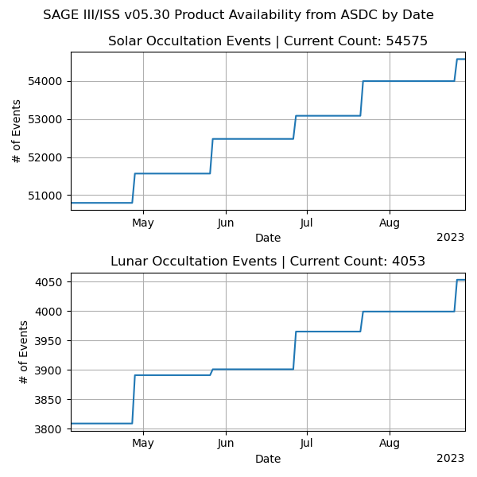
Version 05.30
Products
  Level 1 and Level 2 products for solar occultation; Level 2 for lunar
  Event-by-event: unformatted, HDF5
  Whole month: netCDF4
  Distributed by Atmospheric Science Data Center
New in v05.30: Full calendar months
  Previous version postponed processing the final day of the month to the next month’s processing
Notes:
- V05.30 became publicly available 4-April 2023

Slide 4
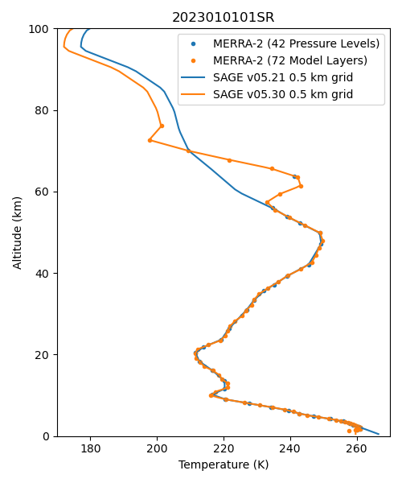
Also New In v05.30
Disturbance Monitoring Package (DMP) used for pointing correction
  Improved solar position registration → improved transmission calculation, altitude registration
60+ events recovered from overzealous automated QA
  Mostly Hunga Tonga observations
Some data quality flags restored
Meteorological input changed (higher extent, better resolution)
Notes:
inst3_3d_asm_Np (42 pressure levels) -> inst3_3d_asm_Nv (72 model layers)
Symbols are MERRA input, lines are our interpolation to 0.5km grid , GRAM95 lapse rates are used above the MERRA domain
Met change produced no significant product differences one way or the other through the reliable part of the L2 profiles

Slide 5
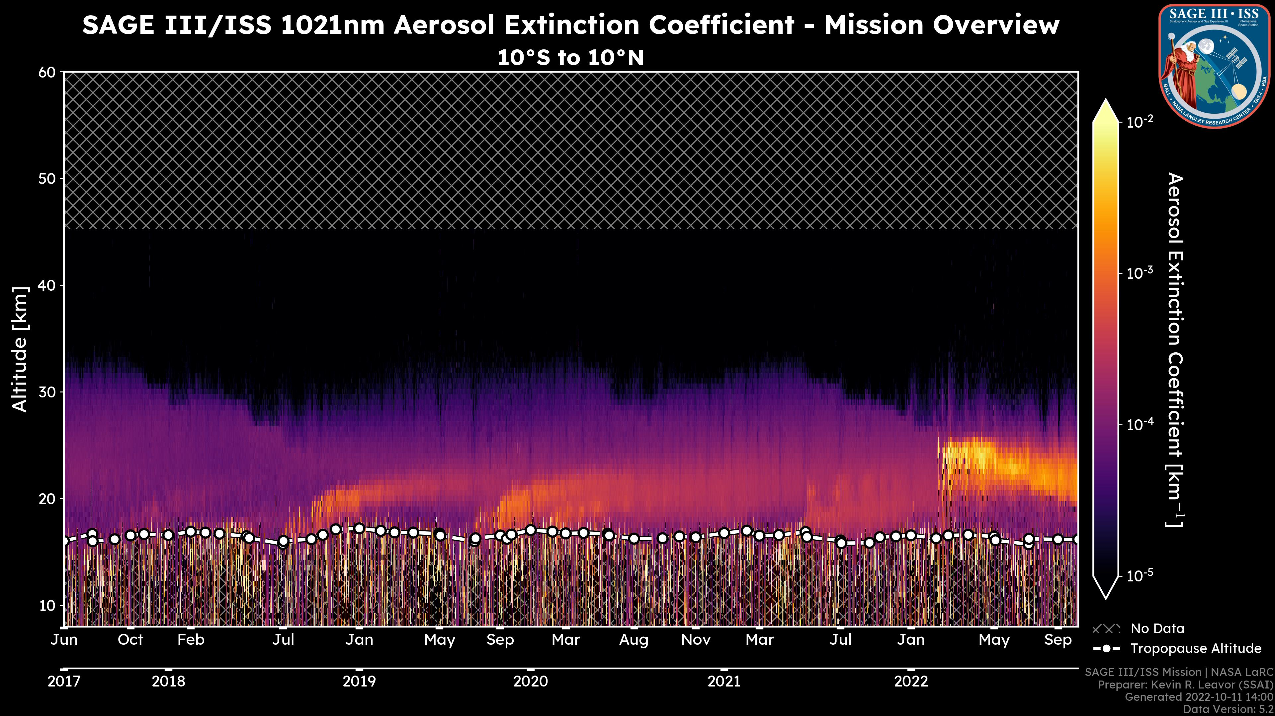
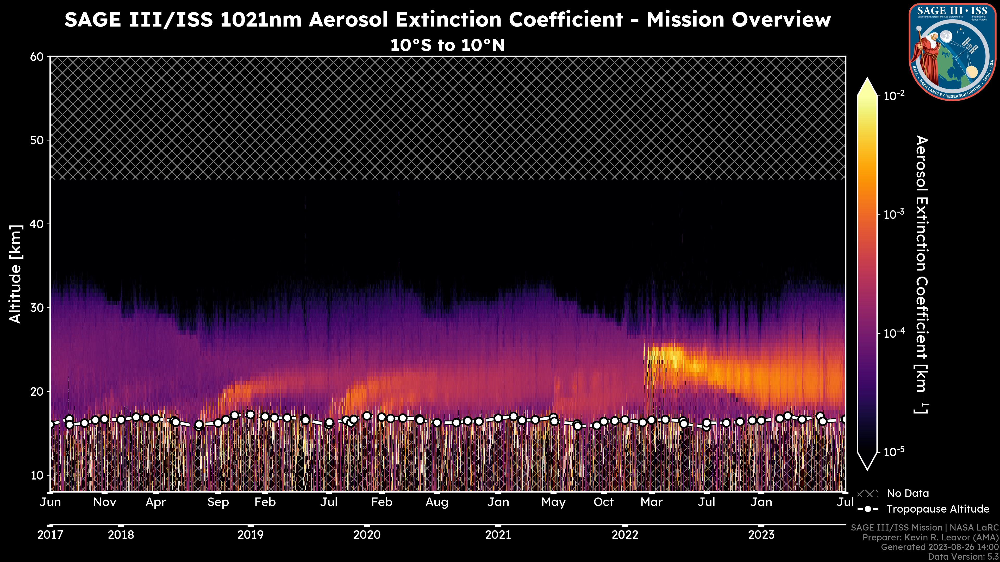
Northern Hemisphere
Wildfires
Australia Wildfires
Hunga Tonga
Ambae
Raikoke
La Soufrière
Notes:
These plots and others are now available to you at sage.nasa.gov
Kevin Leavor has a talk about this tomorrow afternoon

Slide 6
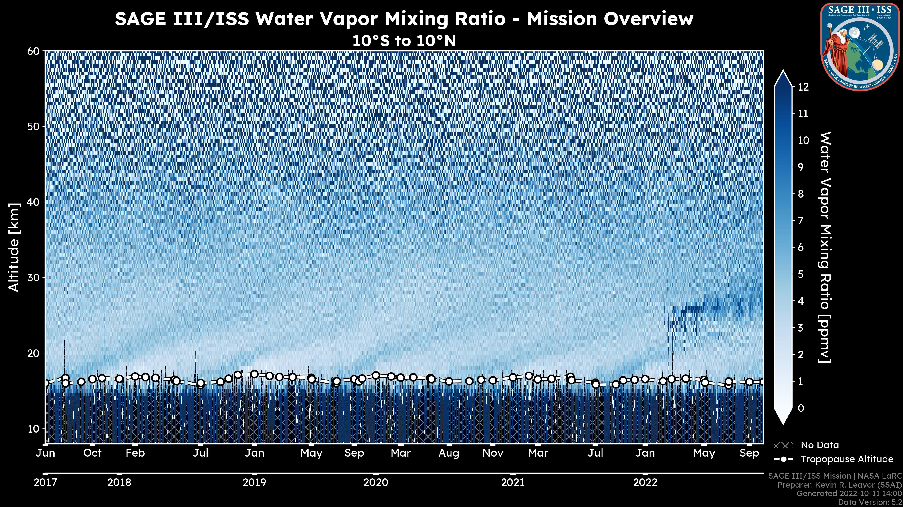
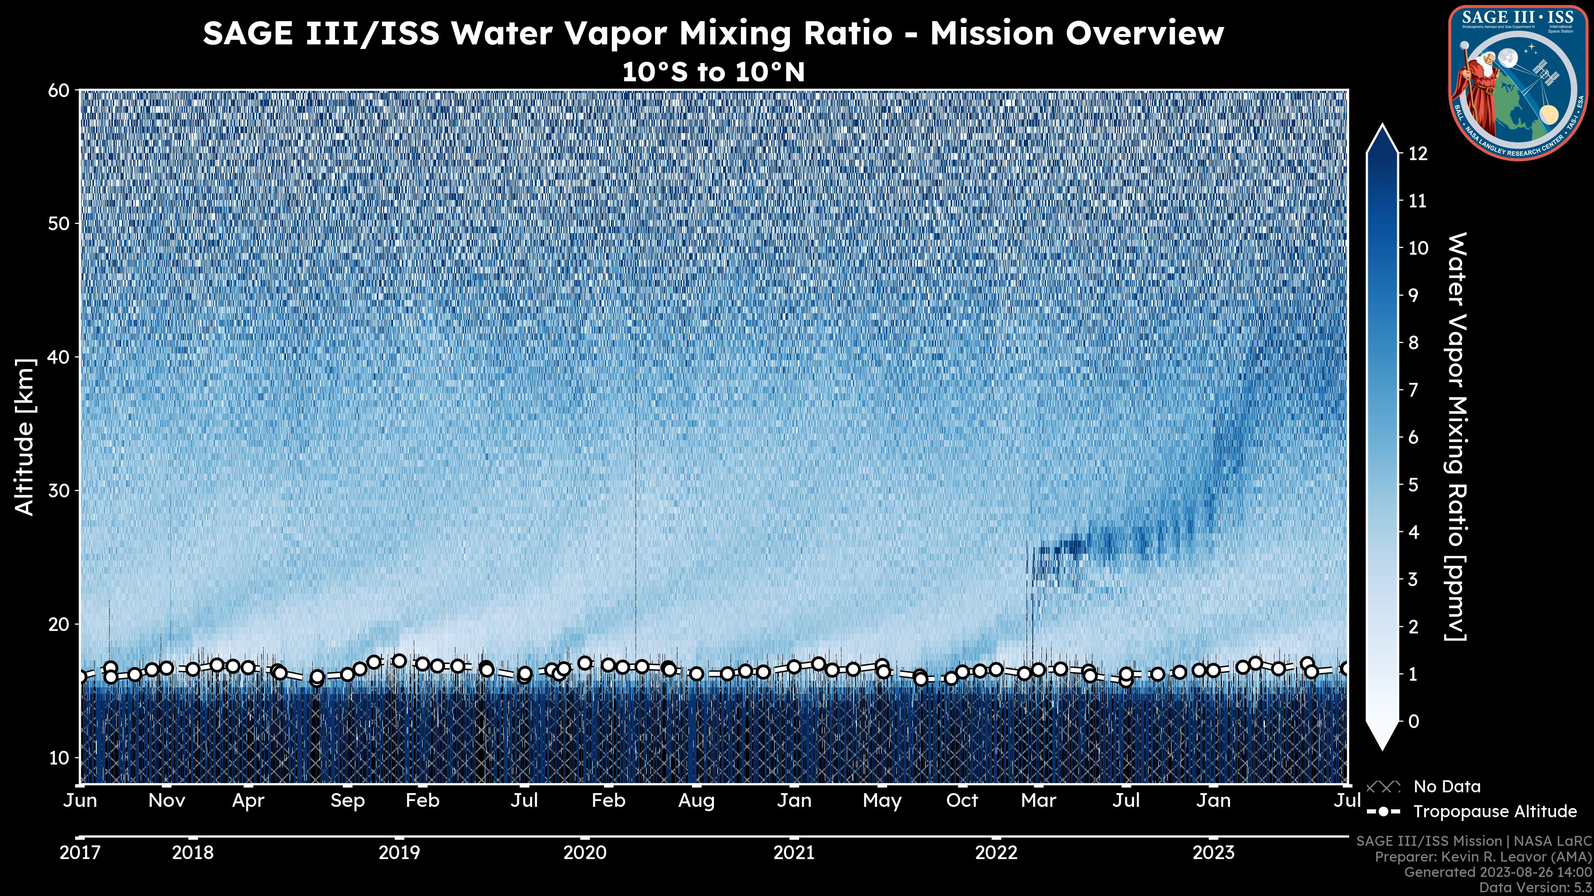
Notes:
These plots and others are now available to you at sage.nasa.gov
Kevin Leavor has a talk about this tomorrow afternoon

Slide 7
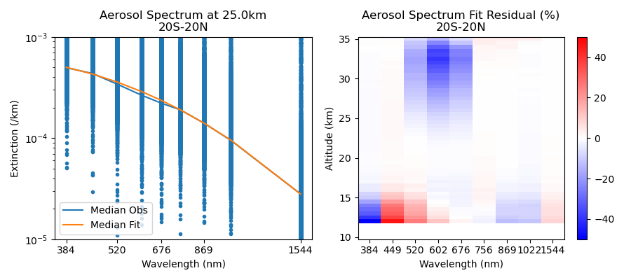
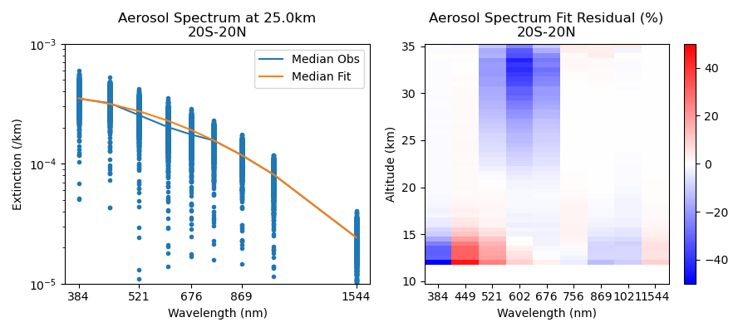
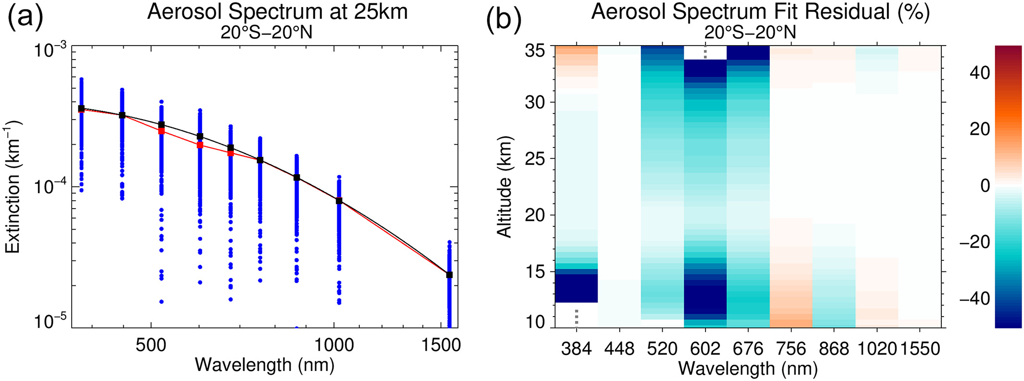
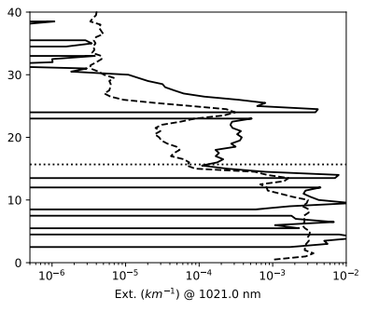
Previously Known Problems
“Aerosol seagull”
Physical disturbances flagged but not otherwise accounted for
Data quality flags largely unpopulated
Misregistration of data in the presence of optically thick layers (top-edge obscuration)
Overzealous automated QA following Hunga Tonga eruption
1021 nm Aerosol Extinction
2022020734SS
Notes:
- In any of our products, you could point to opportunity for improvement, but a few problems have broader impact.

Slide 8
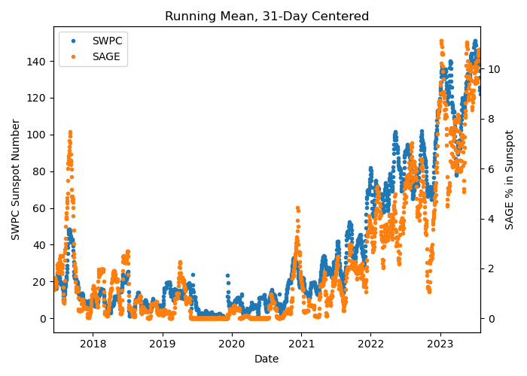
Newly-Identified Problems
An increasing number of events impacted by sunspots
  Algorithm detects sunspots and drops affected datapoints
  Sometimes leaves us with empty altitude bins in the level 1 (slant-path transmission) profile
  Results in species profiles that are incomplete, triggering our automated QA
Currently experimenting with mitigations in the algorithm
Notes:
We are a sun-scanning instrument– we construct a limb darkening curve

Slide 9
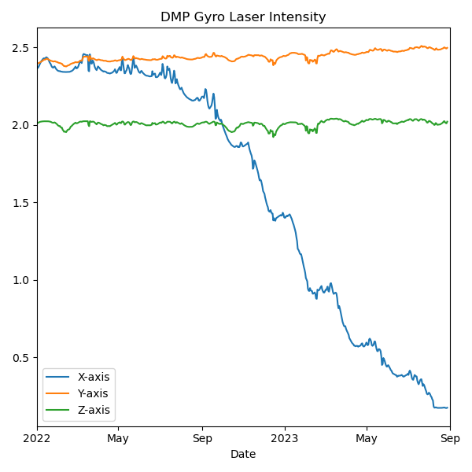
Newly-Identified Problems
One of three gyro axes on the Disturbance Monitoring Package has failed
More on this from Charles Hill in the next talk
Luckily not the most consequential axis for our pointing correction
Data from this axis is no longer reliable and must be removed from the pointing correction
Notes:
Ring laser gyroscope

Slide 10
Announcing v05.30 Patch 1
Motivated by need to accommodate the DMP X-axis failure
Ensures continuity of the pointing correction introduced in v05.30
Patch 1 software is in use starting with the events of 1-August 2023
  DMP X-axis screened out of pointing correction starting with the events of 3-August 2023 (date parameter added to algorithm)
Does not affect reproducibility of products for events before 1-August, hence the “patch” rather than a version increment
Release notes are being updated to describe Patch 1
Also: Python readers are updated to accommodate the deprecation of some NumPy data type aliases
  Completely backward-compatible
Notes:
Internally we may refer to this as v05.30.1
If the readers work for you, no need to change; if you run into deprecation errors, use our update– shouldn’t alter your results

Slide 11
Ongoing Work
Algorithm (re-)development
  Level 1: improvements to on-target position & altitude registration, refraction, stray light correction
  Level 2: improvement to water vapor and aerosol products
Housekeeping for existing products
  File formats, extensions (.h5, .dat, .nc4), documentation
  Improved versioning, behind-the-scenes info (input specifics, compiler info, etc.)
Additional products
  Level 3 aerosol/cloud categorization product – see Mahesh Kovilakam’s paper
  Retrieved meteorological profiles – see Michael Pitts’s talk tomorrow

Slide 12



Thanks!
Robbie Manion, Science Computing Facility Lead
robert.manion@nasa.gov
We speak…
Rob Damadeo, Lead Algorithm Scientist
robert.damadeo@nasa.gov
David Flittner, Project Scientist
david.e.flittner@nasa.gov

