Slide 1
NASA, Space,
& Spaceship Heatshield Engineering
Andrew Santos
Content borrowed from Don Ellerby

Slide 2
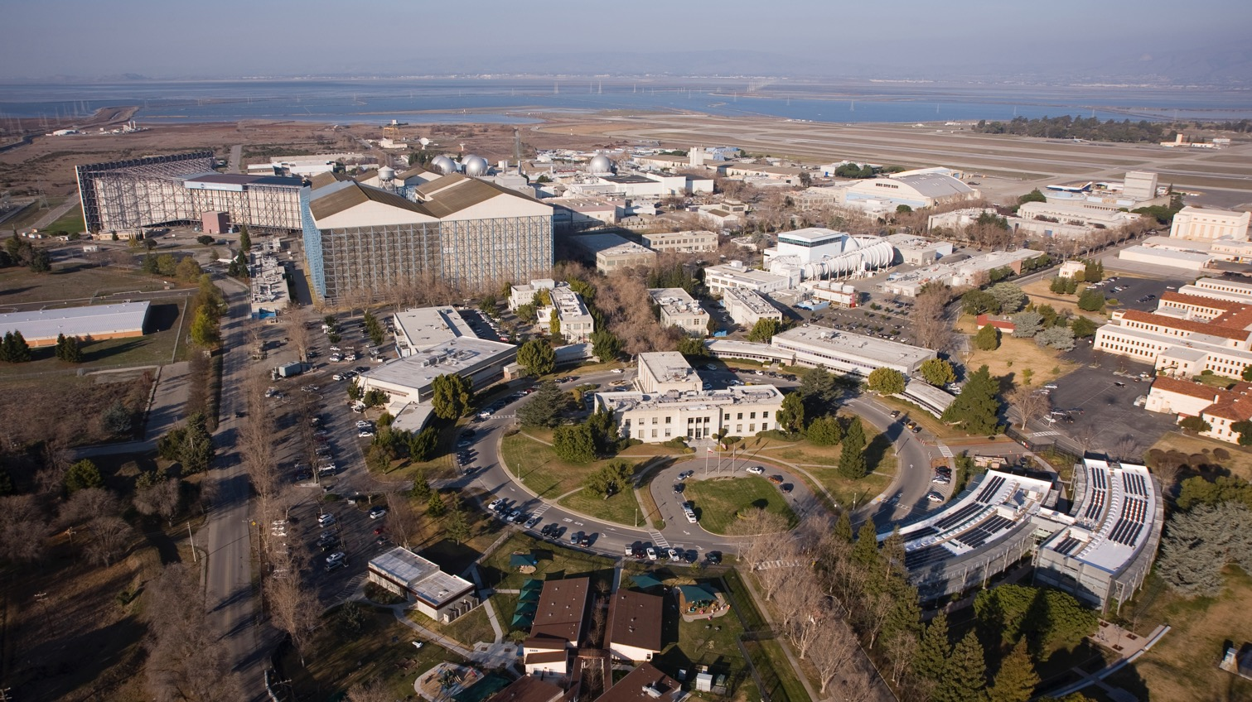

NASA Ames Research Center (SF Bay Area)

Slide 3


NASA Centers
Glenn Research Center
Goddard Space Flight Center
Ames Research Center
Headquarters
Jet Propulsion Laboratory
Kennedy Space Center
Langley Research Center
Armstrong Flight Research Center
Johnson Space Center
Stennis Space Center
Marshall Space Flight Center

Slide 4
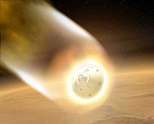
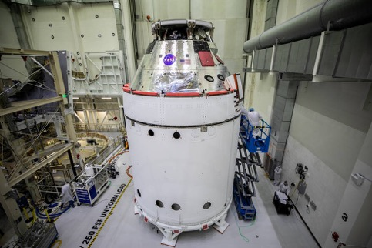
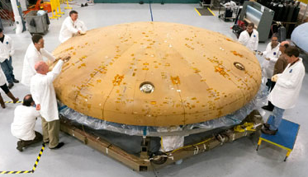
What’s my job?
I’m a Materials Scientist / Engineer
  Materials scientists study stuff/matter/materials
  Materials engineers design materials with specific properties for an application
I work on Thermal Protection Systems
  Which protect a spacecraft from the extreme heat generated when it enters the atmosphere of a planet or moon
A big part of my job is using computers to simulate heat shield materials

Slide 5


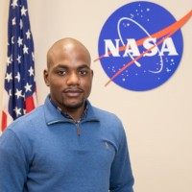

There are many jobs at NASA and ways to get there
Andrew and Darrell (college roommates)
Andrew
  College for chemical engineering
  Graduate school, surfactant (soap) computer simulations
  Postdoc at a national lab, powder and polymer simulations
Darrell
  College for electrical engineering
  Teaching math and science in the Peace Corps in Liberia
  Experimental Facilities Development
Ames
Johnson

Slide 6
Anyone know the name of the program to take humans back to the moon?
Anyone know the name of the NASA spacecraft that is going to replace the Space Shuttle?

Slide 7

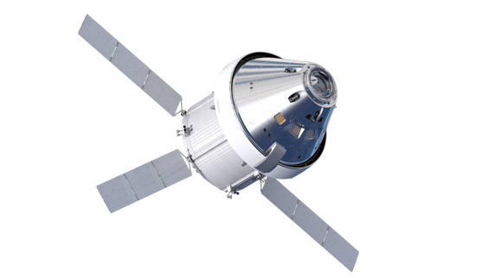
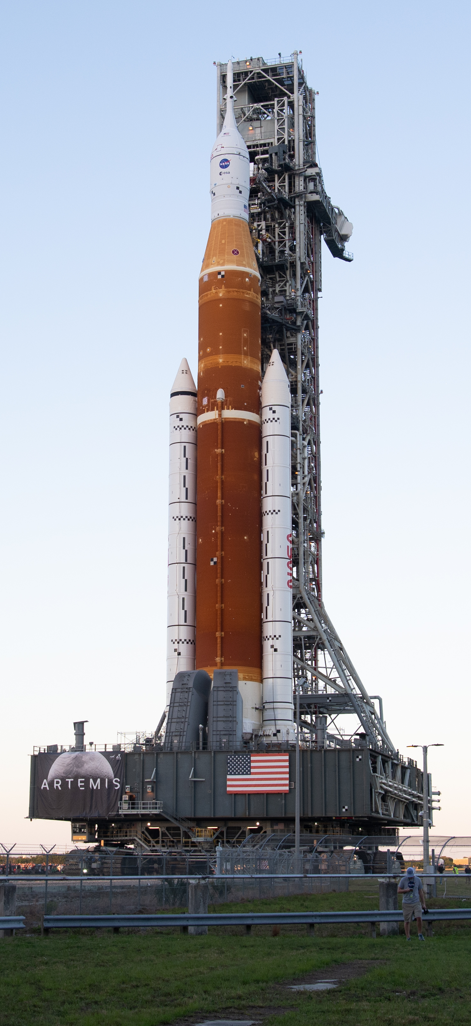
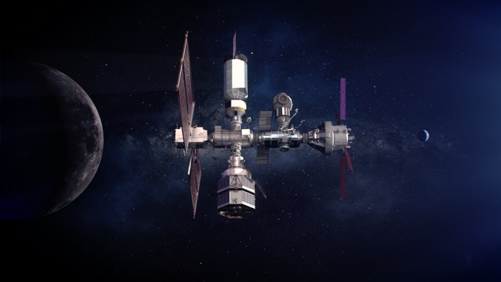
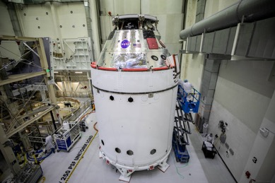
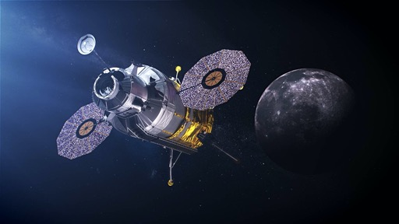
NASA Artemis Program Components
Space Launch System
Orion
Gateway
Lunar Lander
Notes:
SLS: will be most powerful rocket ever, to launch late 2021.
Orion: 4-6 astronauts.
Gateway: outpost orbiting moon to support long term human lunar activity + deep space exploration staging point.

Slide 8
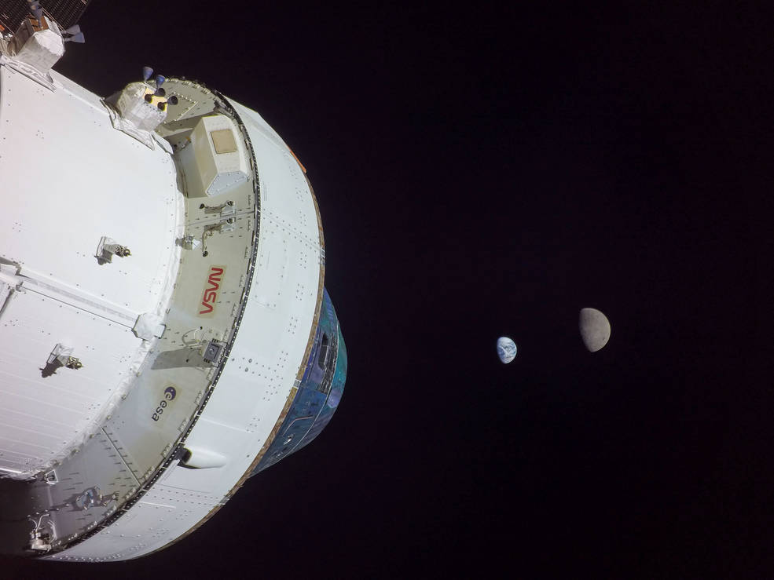
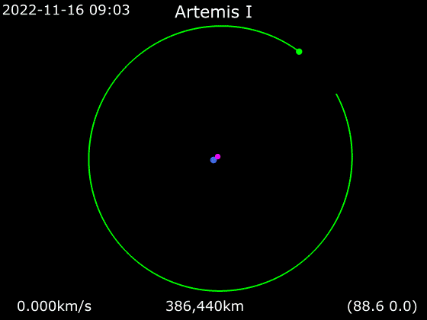
Artemis 1

Slide 9
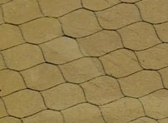
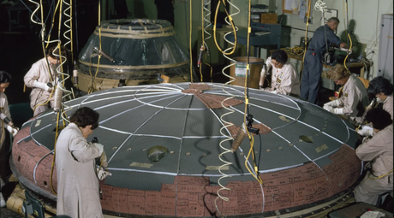

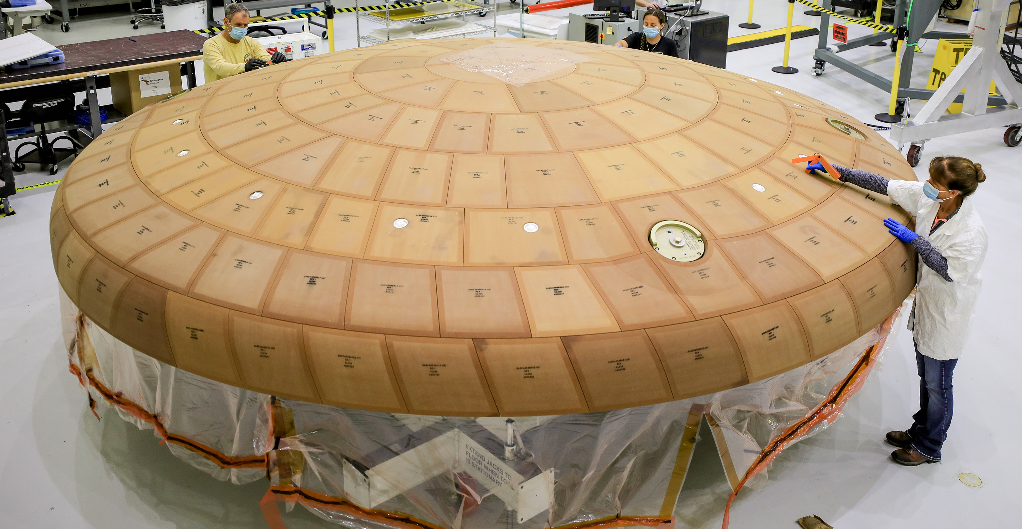
Orion heat shield component simulation
Does it matter how you build the heat shield?
We can simulate different packing procedures.
Apollo
Artemis

Slide 10
What just celebrated 20 years of having people continuously on board?

Slide 11
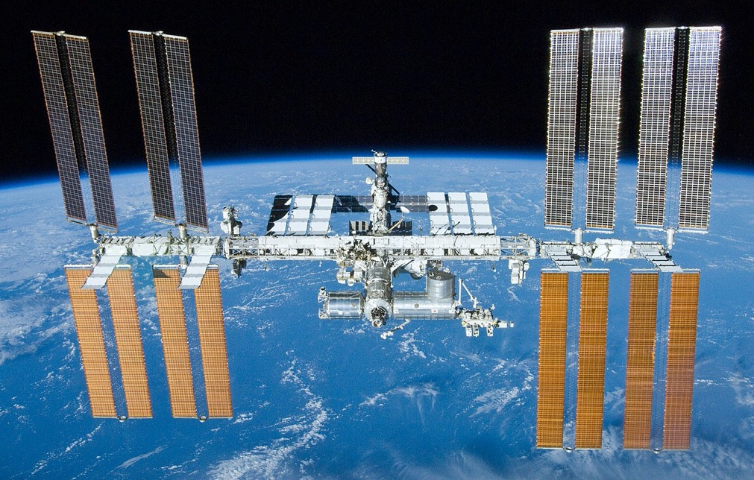
International Space Station

Slide 12
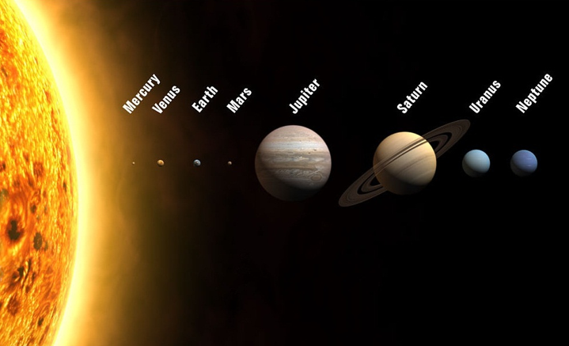
How far are we talking?
Some of NASA’s Visits to the Solar System
Mercury: MESSENGER
Venus: Pioneer Venus
Mars: Mars 2020, Mars Science Lab, Pathfinder/Sojourner
Jupiter: Galileo Probe, Voyager
Saturn: Cassini, Voyager
Uranus/Neptune: Voyager
Pluto: New Horizons
1,784M miles
2,800M miles
, 35M miles
, 92M miles
, 483M miles
888M miles
, 67M, miles
, 142M miles
Note: planet sizes are to scale, distances are not
Notes:
planet sizes are to scale, distances are not

Slide 13
How long will it take to get from Earth to Mars?
(~50 million miles)
  At the speed of an Airplane?
  At the Speed of Space Shuttle?
  At the Speed of Light?
  Think about this…
  If you send a text message to some one on Mars, it will take 5 min to get there and if they replied it will take 5 more min to get back to earth.

Slide 14
How long will it take to get from Earth to Mars?
(~50 million miles)
  At the speed of an Airplane? (600 miles/hour)
    100,000 hrs (4,166 days) (11 years)
  At the Speed of Space Shuttle?
  At the Speed of Light?
  Think about this…
  If you send a text message to some one on Mars, it will take 5 min to get there and if they replied it will take 5 more min to get back to earth.

Slide 15
How long will it take to get from Earth to Mars?
(~50 million miles)
  At the speed of an Airplane? (600 miles/hour)
    100,000 hrs (4,166 days) (11 years)
  At the Speed of Space Shuttle? (17,500 miles/hour)
    2860 hrs. (119 days) (4 months)
  At the Speed of Light?
  Think about this…
  If you send a text message to some one on Mars, it will take 5 min to get there and if they replied it will take 5 more min to get back to earth.

Slide 16
How long will it take to get from Earth to Mars?
(~50 million miles)
  At the speed of an Airplane? (600 miles/hour)
    100,000 hrs (4,166 days) (11 years)
  At the Speed of Space Shuttle? (17,500 miles/hour)
    2860 hrs. (119 days) (4 months)
  At the Speed of Light? (670 million miles/hour)
    5 minutes
  Think about this…
  If you send a text message to someone on Mars, it will take 5 min to get there and if they replied it will take 5 more min to get back to earth.

Slide 17

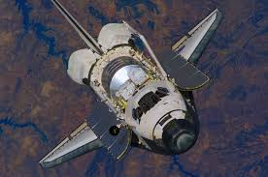
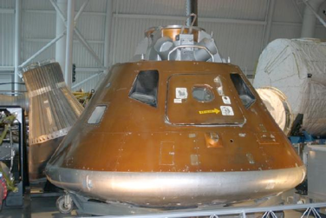
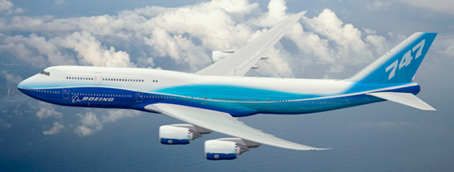
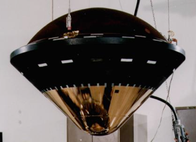
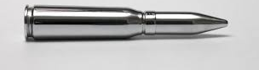
How fast are we talking?
Space
shuttle
100 mph
Apollo
17,500 mph
24,600 mph
600 mph
105,000 mph
1,800 mph
Galileo
Probe at Jupiter

Slide 18
Does anyone know what Perseverance is?
As it relates to NASA

Slide 19
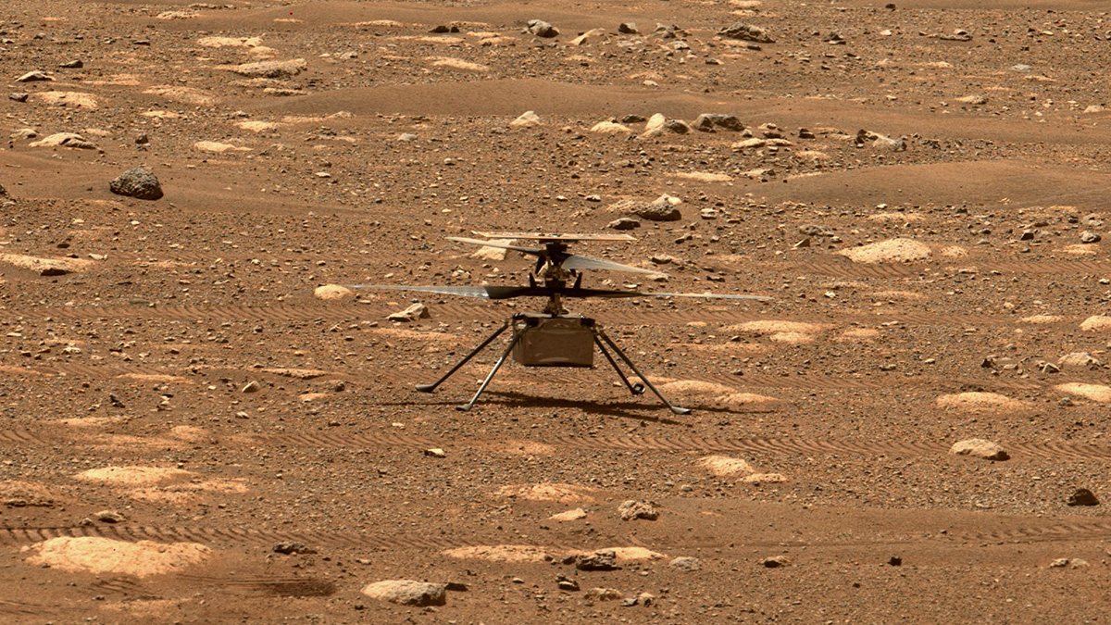
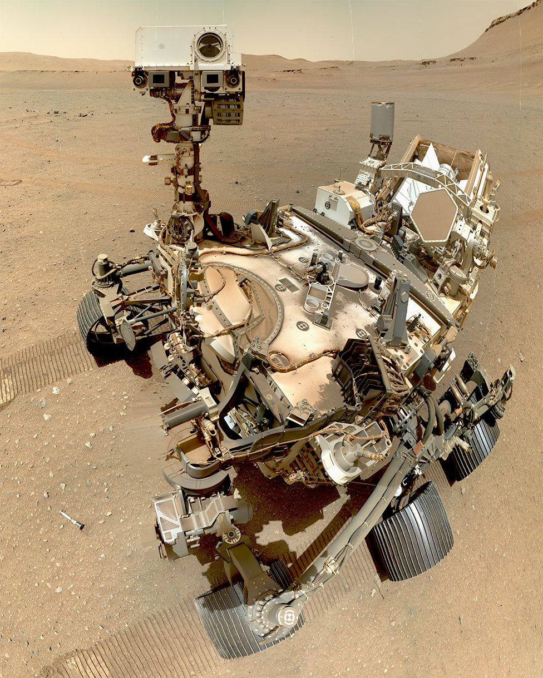
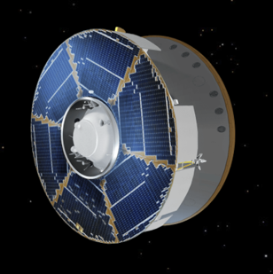
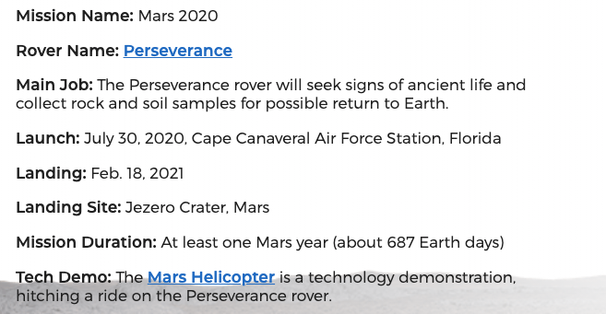
Perseverance Rover
Transportation
Travels at ~60,000mph
Ingenuity

Slide 20
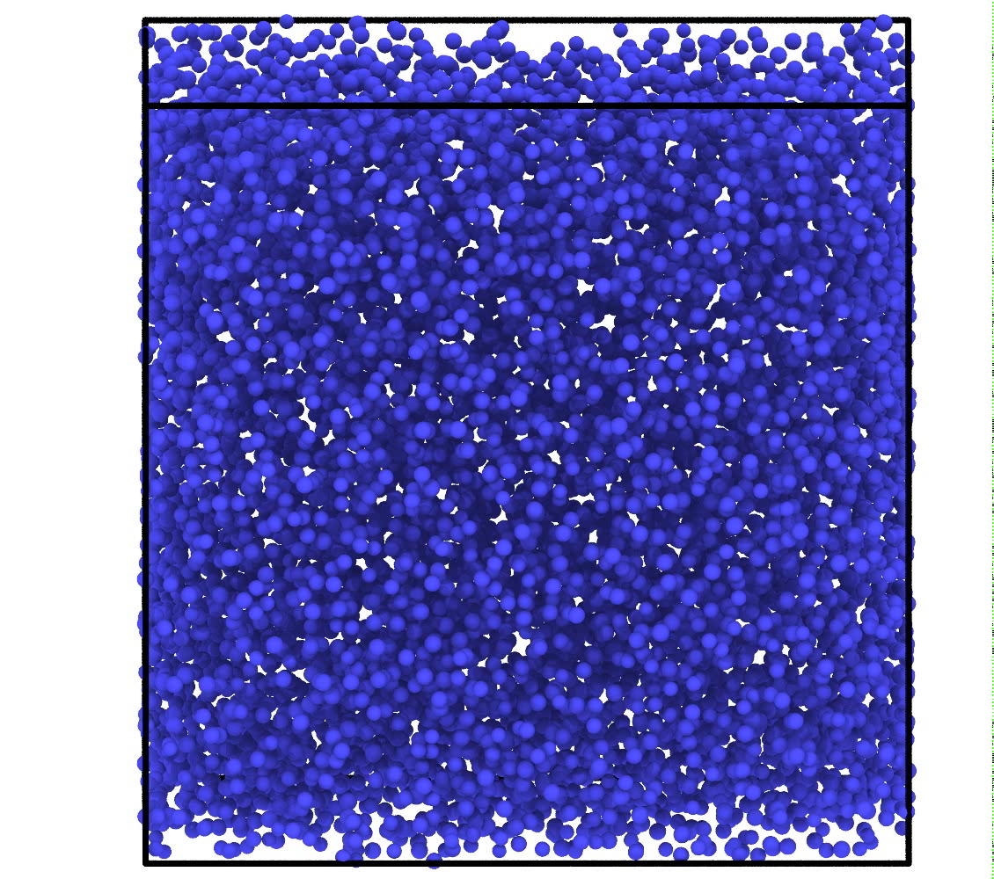
Regolith simulations
When does sand act like a liquid or a solid?
Frictional spheres can act like Martian dust (regolith).
Ingenuity

Slide 21
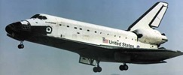
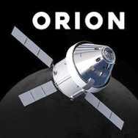
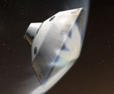
Heatshields protect the interior from overheating.
How hot do Spaceship Heatshields get?
Spaceship | Planet entered | Approximate Speed | Approximate Temperature
Shuttle | Earth | 17,000 mph | 3000 ℉ / 1650 ℃
Orion | Earth | 24,000 mph | 4300 ℉ / 2400 ℃
Perseverance | Mars | 13,000 mph | 2900 ℉ / 1600 ℃

Slide 22
How do we test heatshield materials before flying them?

Slide 23
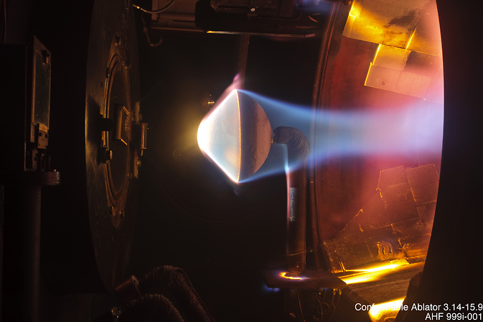
Test them in a special facility called and Arc Jet
Heat shield
12 inches
Hypersonic plasma flows from this nozzle

Slide 24
An Umbrella-type heat shield
18 inches

Slide 25
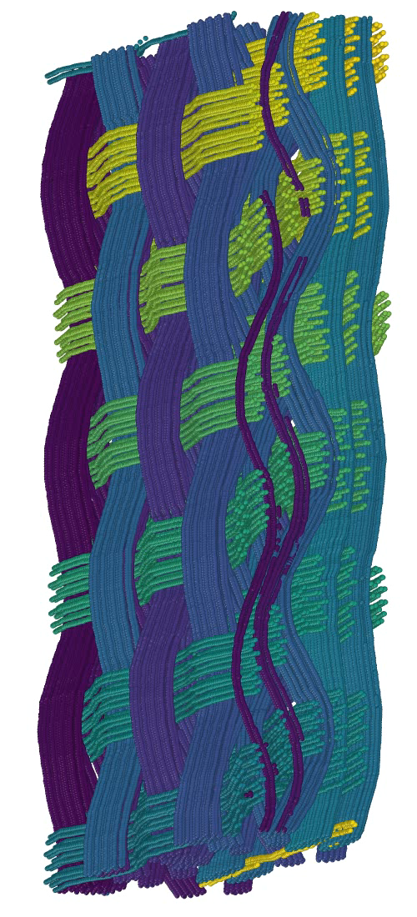
Woven heat shields
How much pressure can the fibers resist before breaking?
We can string spheres together to make fibers, and put those fibers into weaves.

Slide 26
How much power are we talking about?
Power per area = heat flux
Where the heat comes from | Heat Flux Watts/cm²
Sunny day on Earth | 0.1
Incandescent light bulb | 0.8
Toaster | 8
Perseverance Mars Entry | 80
Orion returning to Earth from the Moon | 800
Galileo Space Probe Entering Jupiter (2003) | 50,000

Slide 27
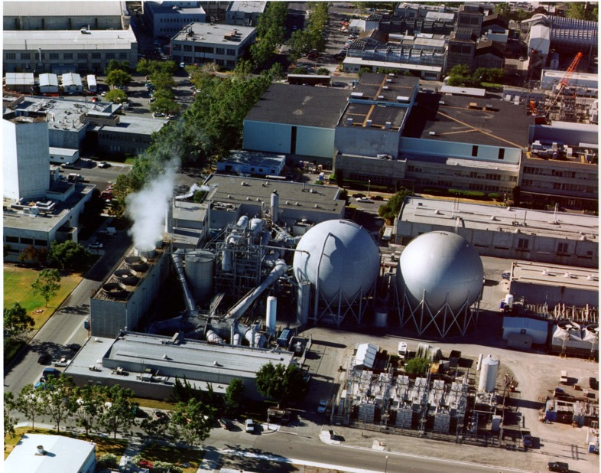
If a hairdryer uses 1,500 Watts of power, how much power does an arc jet use?
Hint: several buildings are required to run all of the equipment
Answer:
Up to 60 Million Watts!!!
That’s enough to power about 50,000 homes

Slide 28
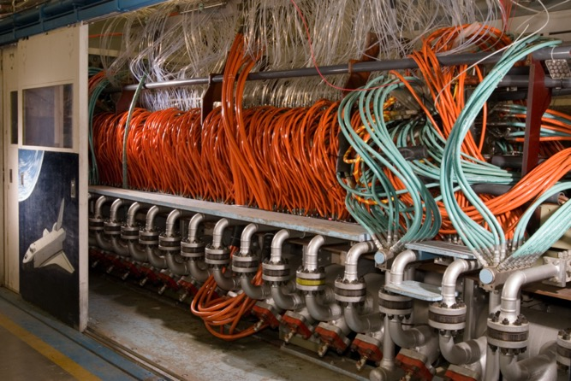
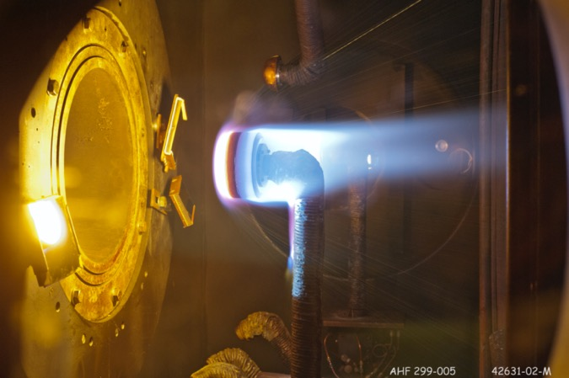
Arc Jet Fun Facts
It requires about 50 people to run and maintain 3 arc jet facilities at NASA Ames
Arc jet testing costs about $50,000 per day where about 4 to 8 tests can be run

Slide 29
What kinds of properties should a heat shield material have?
Should it be heat resistant?
Should it be strong?
Should it be heavy / dense?
Should it conduct heat well, or insulate?
Does the color matter?

Slide 30
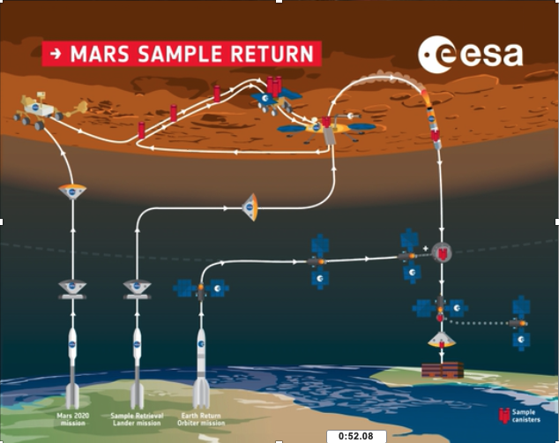
Mars Sample Return Mission
Mission to bring back samples that Perseverance rover will collect on Mars
A new composite material invented will be the heatshield on the spacecraft that brings the samples back to Earth

Slide 31

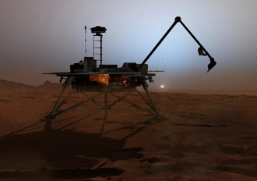


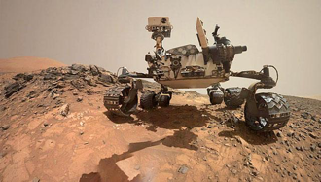
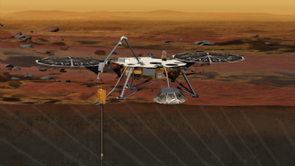


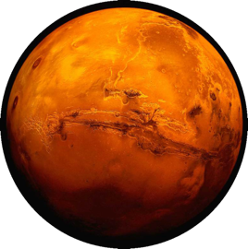
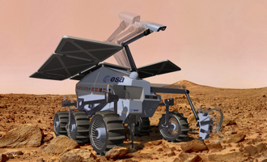
60 Years of Mars Exploration
1960
Soviet Union
United States
Russia
Japan
ESA
India
2007 Phoenix Scout
2011 Curiosity Rover
2018 Insight Lander
2020
2020 EXOMARS Rover (ESA)
Illustration by:
Bryan Christie Design
Updated: 2015

Slide 32
Has anyone heard of Bennu?

Slide 33
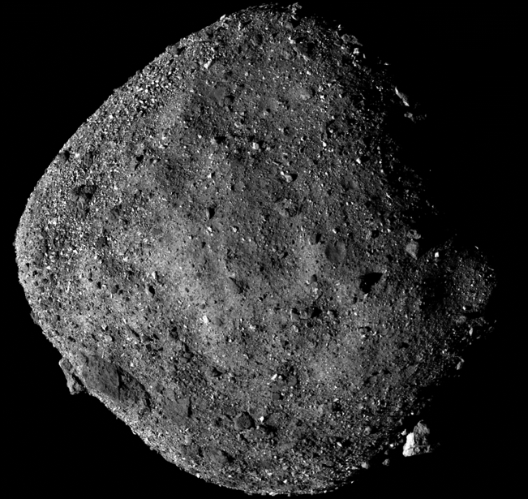
Bennu is a Near Earth Asteroid
~210 million miles from Earth
~2.2 Astronomical Unit
What is an Astronomical Unit?
Text message would take ~19 minutes to get there from Earth
What mission is currently at Bennu?
What is it doing there?

Slide 34
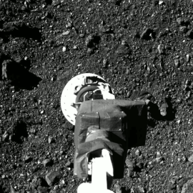
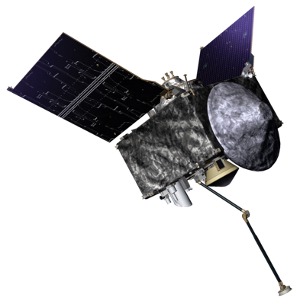
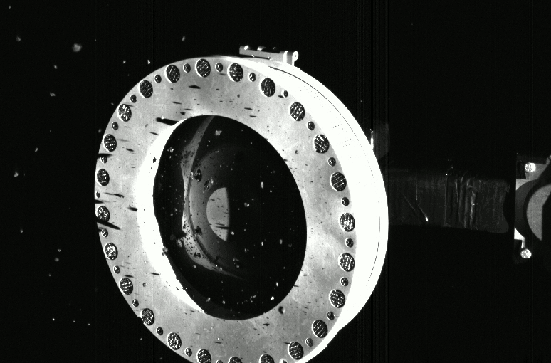
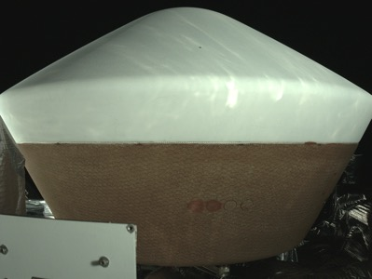
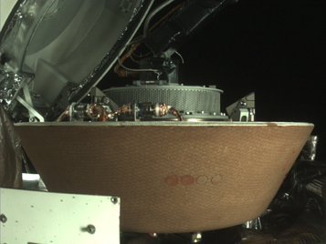

OSIRIS-REX Mission
Sample collected on Oct 20, 2020
Mission to bring a sample from Bennu back to Earth
Launched 2016
Arrived Bennu 2018
Leave Bennu 2021
Arrive Earth 2023
Sample Return Capsule

Slide 35
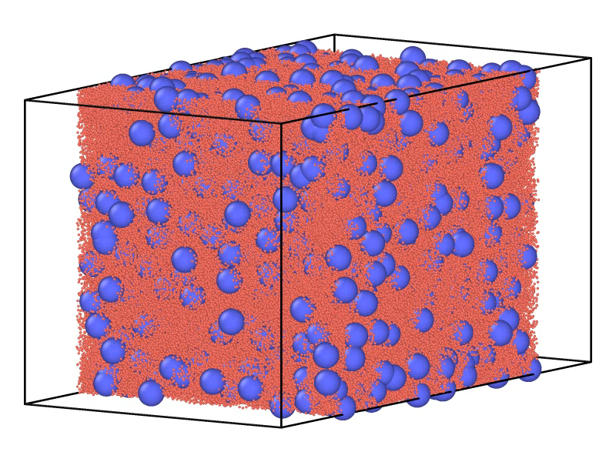
OSIRIS-REX Boulder simulations
Sample collected on Oct 20, 2020
The boulders on Bennu were looser than expected.
We can simulate the formation of a loose asteroid where the boulders gravitate to each other

Slide 36
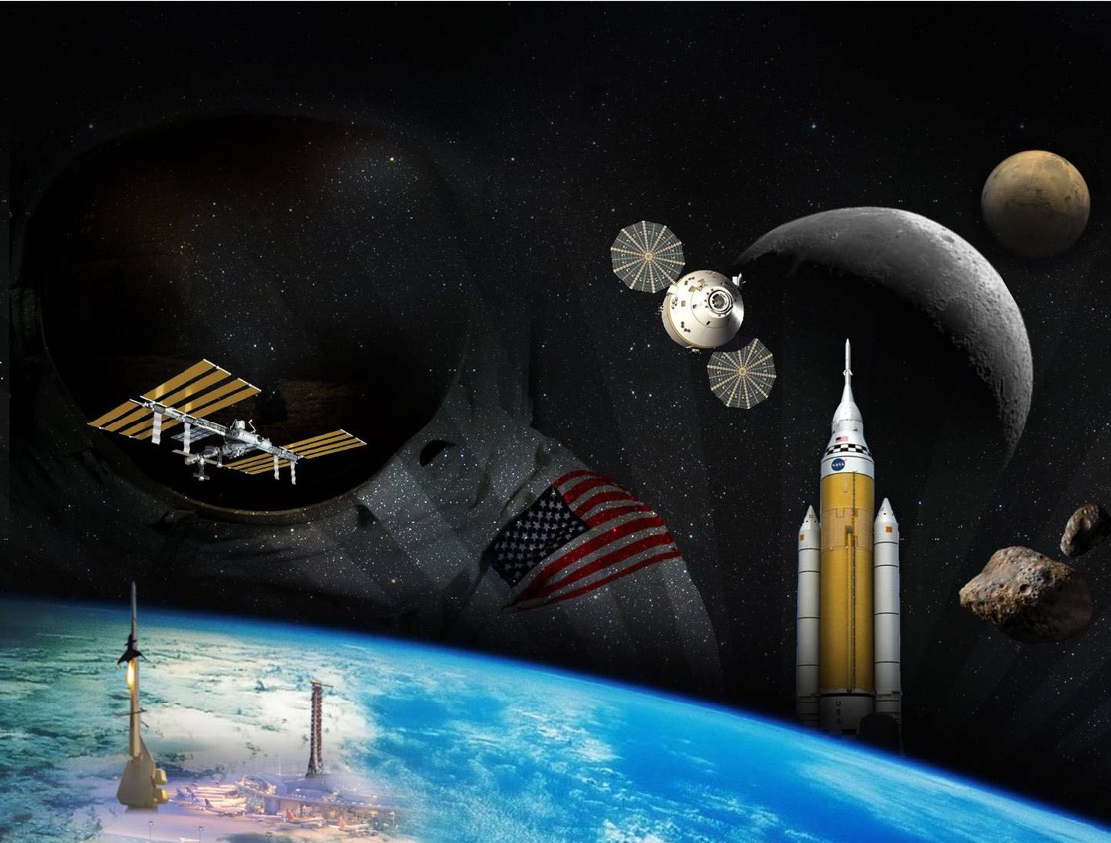
Thanks for Attending

