Slide 1
Space Technology Mission Directorate
Game Changing Development Program
Presenter: Robert Maddock | Moderator: Chi Nguyen | FY23 SCALPSS 1.1 Annual Review Presentation | 09.21.23
Name/Email POC: Robert Maddock / robert.w.maddock@nasa.gov

Slide 2

Project Highlights
Stereo CAmera for Lunar Plume-Surface Studies (SCALPSS) 1.1
Motivation:
  The behavior of dust and blast ejecta is Category “D” of the Lunar Strategic Knowledge Gap Theme III, “Understand how to live and work on the lunar surface.”
  The size and shape of the crater or craters formed at the point of landing will affect the risk to the landing vehicle, the science to be achieved there, and potentially the surface operations that can be conducted.
Technology Product Capability: Stereo imaging of plume surface interactions through CLPS lunar landing with high altitude stereo imaging prior to interactions onset. Data to be used to validate computational models needed for lander design nearby asset safety.
Technical Capabilities: Stereo photogrammetry in lunar environment
Partners: NASA LaRC (project mgmt., hardware development, AI&T, payload delivery), NASA MSFC (camera / lens selection and performance, PSI CFD modeling), NASA JSC (camera calibration, MLI), Firefly Aerospace (CLPS lander provider)
Launch: NET August 2024
Notes:
Provide an overview of the Project
Pictures are encouraged, please provide new pictures as frequently as possible

Slide 3
Project Overview
Technology Development Needs Addressed by Project
CLPS | Validated Prediction of Plume Surface Interaction (PSI) for Vehicles Landing on the Moon | STMD 321
CLPS/HLS | Flight Instrumentation to Acquire Plume Surface Interaction Performance Data | ESDMD 3633; STMD 333
Project Goals
Goal #1 | Develop and deliver flight payload for study of Plume-Surface Interactions near the lunar equator.
Goal #2 | Provide flight data for validation / anchoring of PSI modeling development.
Project Objectives
Objective #1 | Demonstrate the capture of landing site morphology, prior to, during, and following plume surface interactions (PSI)
Objective #2 | Demonstrate ability to detect onset of PSI
Objective #3 | Demonstrate ability to detect altitude at which ground obscuration occurs
Objective #4 | Demonstrate possible methods for determining ejecta sheet structure

Slide 4
Team Members / Project Org Slide
SCALPSS 1.1 Project Management
Project Support
Systems Engineering
Assembly, Integration & Test
Science and Operations
Safety and Mission Assurance
Flight Hardware
Electronics
Thermal
Structures
Mechanical
Science and Data Analysis
(MSFC)
Configuration and Photogrammetry
Camera System (MSFC)
MLI
(JSC)
Contamination Control
Software
PI: Michelle Munk / Wesley Chambers (MSFC)
PM: Rob Maddock
PPC: Dave Lehotay
Schedule: Cyndy McPherson
CM: Heidi Connolley
Technical Lead: Chi Nguyen
K C Johnson
Richard Rawls
Larry Cowen (QA)
Miko Przemyslaw
Mike Manginelli
Ray Lueg
Bill Witherow
Mike Manginelli
Alex Scammell
Adam Ben Shabat
Nick Vitullo
Cory Wilson (flight)
Matt Rodgers (ground)
Paul Danehy
Olivia Tyrrell
Tim Fahringer
Amy Kleypas
Notes:
If you have submitted a Project Plan, you could utilize the Organizational Chart found in section 8.3 – Management Structure

Slide 5

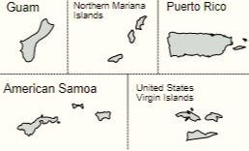

Collaborations & Partnerships
NASA
Commercial Lunar Payload Services (HQ/SMD)
Space Technology Mission Directorate (HQ)
Jet Propulsion Laboratory
Johnson Space Center
Langley Research Center
Marshall Space Flight Center
Industry/Academia
Alysium-Tech GmbH (Nuremburg, Germany)
Parraid, LLC
Protocase (Nova Scotia, Canada)
Protolabs
Teledyne FLIR
Public/Private Partnerships
Firefly Aerospace
Notes:
Infusion: An investment reaches a conclusion where a technology is handed off for use by a mission or other need. Infusions can be made to other NASA Mission Directorates, other Government Agencies, Commercial Entities, or International Partner.
Transition: An investment reaches a conclusion where a technology is handed off for further development. Transitions can be made to other STMD programs, other NASA Mission Directorates, academic institution, other Government Agencies, Commercial Entities, or International Partner.

Slide 6
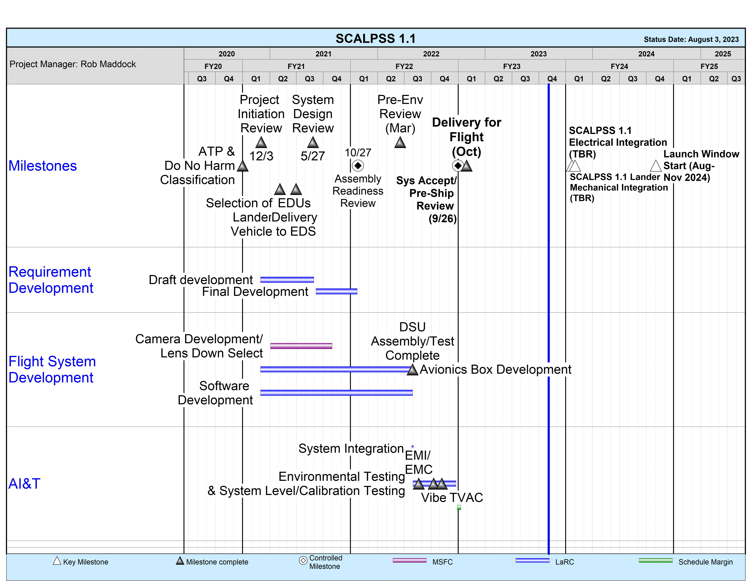
SCALPSS 1.1
Project Schedule
Additional flight of previously developed payload.
  currently at TRL8
  expected to be at TRL9 by the end of 2023
Current target lander integration dates (TBR):
  mechanical: 3-7 Nov 2023
  electrical: 13-14 Nov 2023
  payload calibration: 14 Nov 2023
  complete (leg) fiducial installation: 9 Jan 2024
Notes:
Chart purpose: show TRL/SRL/MRL advancement over the project lifecycle schedule. Show TRL advancements as whole integer increases. Show how Key and Controlled milestones align with TRL advancement.
TRL/SRL/MRL may not advance at each milestone. Often several milestones are required to produce a step increase in TRL/SRL/MRL.
There can be one, or more, of these charts per project as needed.
For projects with fewer technical elements, the TRL/SRL/MRL data can be combined on one chart.
For more complex projects, the TRL/SRL/MRL progression can separated into multiple charts by project technical area.
Show TRL, SRL, and MRL data for each technical element on the same chart.
Delete TRL/SRL/MRL axis-labels that do not apply – e.g., remove SRL/MRL for projects/technical areas where SRL and MRL do not apply.

Slide 7
Accomplishments
Environmental testing of flight hardware completed.
Pre-Ship / System Acceptance Review completed.
Completed collecting image data to be used for flight camera data calibration during flight operations.
Flight hardware shipped on schedule.
Flight hardware received by Firefly Aerospace and receipt and inspection procedure completed.
Final FSW build development completed.
  identified issue with COTS camera resulting in periodic/random camera drop-outs; tested solution to avoid issue with no impacts to primary science (data frame rate reduction during descent imaging)
Identified issue with lander simulator regarding data transfer rate between payload and lander.
  supported troubleshooting with Firefly which isolated issue to lander firmware
  subsequent updates have resolved issue
Supported troubleshooting of lander power on-rush issue identified during Firefly payload integration testing.
  issue identified as due to unclear / poorly worded lander requirement
  lander has implemented work-around to avoid issue with no impact or changes required to the payload
Supported successful CLPS/Firefly Payload Integration Readiness Review
Final modifications of the flight MLI blankets have been completed and blankets delivered to Firefly.

Slide 8
Project Assessment Summary
Project Name | Performance |  |  |  | Comments
 | C | S | T | P
Mid Year |  |  |  |  | Technical – Preparing for PIT+ testing (with lander simulator) Cost – Sufficient funding to support all planned activities though February 2023. Schedule – Awaiting final lander integration schedule. Programmatic – Continuing to track and watch for conflicts between remaining 1.0 integration and launch / mission operations and 1.1 lander integration and testing schedules.
Annual |  |  |  |  | Technical – Resolved data transfer and power issues identified on lander with no changes needed to payload hardware or software. Identified work-around to camera drop-out issue identified during FSW testing. Final test of FSW build expected by early October. Cost – Full FY23 BA received; funding swap for FY24 has been coordinated with GCD. Updated request for FY24 funds due to later launch date provided to GCD. Schedule – Continuing to track changes to lander integration (and launch) schedules. Programmatic – Continuing to track and watch for conflicts between 1.0 launch and mission operations and 1.1 lander integration and testing schedules.

Slide 9
Plans Forward and
Transition / Infusion Plan
  As NASA and commercial companies prepare to land larger payloads (growing to human scale) on the Moon (and eventually Mars) they will employ increased landing engine thrust resulting in plume interactions with the surface becoming more extensive on missions that will at the same time require higher reliability than their predecessors. It is critically important to understand the effects of PSI on the landing site, on the landing vehicle itself, and on any nearby assets (including historical sites).
  Several years of Small Business Innovative Research (SBIR) and other small, low-TRL investments have taken advantage of recent computational advances, resulting in a starting tool set that can be applied to future missions.
  SCALPSS 1.1 is an additional of the SCALPSS payload on a second CLPS lander (Firefly Aerospace Blue Ghost) with modifications to collect additional and improved PSI data.
  Both SCALPSS payloads rely heavily on the flight proven design of the Mars 2020 EDLCam system and COTS hardware.
  SCALPSS 1.0 and 1.1 data will feed directly into validation and anchoring of PSI computational and engineering models needed for the design of future landers.
  Lessons learned will be leveraged in the development of SCALPSS 2.0 as well as future CLPS PSI Mini-Suite sensors developed for flight on both CLPS and HLS scale lunar landers.
  The project is currently working with Blue Origin on possibly including spare SCALPSS 1.1 hardware on their HLS-scale cargo lander (Mk1) test flight(s) in 2024-2025.
    could open door to possible technology development partnership(s) and transfer with industry
Notes:
Infusion: An investment reaches a conclusion where a technology is handed off for use by a mission or other need. Infusions can be made to other NASA Mission Directorates, other Government Agencies, Commercial Entities, or International Partner.
Transition: An investment reaches a conclusion where a technology is handed off for further development. Transitions can be made to other STMD programs, other NASA Mission Directorates, academic institution, other Government Agencies, Commercial Entities, or International Partner.

Slide 10
Education/Public Outreach
EPO Involvement
EPO Calendar Outlook (High Priorities):
Presented paper titled "Investigating Photogrammetric Accuracy of a Lunar-Lander-Induced Crater Measurement System" at the 2023 AIAA SciTech conference which contains an explanation of the experimental setup, new data processing algorithm and results that were used to quantify the SCALPSS system's measurement accuracy on a lunar crater model as well as presents some preliminary data and findings about impacts of lighting to the system's performance.
SCALPSS hardware displayed in GCD booth at 2023 AIAA SciTech Conference.
SCALPSS hardware displayed at Tech Day on the Hill 2023 hosted by STMD.
6 Month Look-Ahead
SCALPSS 1.1 launch and mission operations | NET Nov 2023
Notes:
Summary of the EPO activities (papers, conferences, outreach events) participated in over the last 6 months and the forward outlook for 6 months

Slide 11
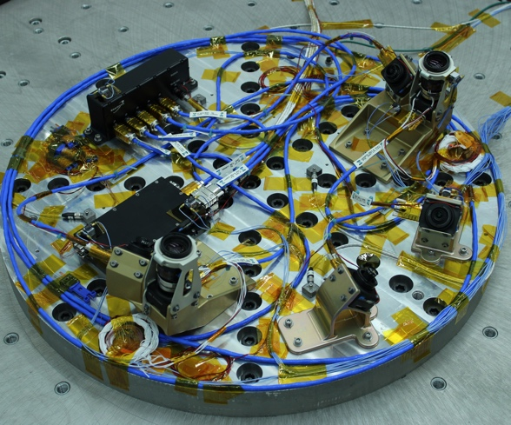
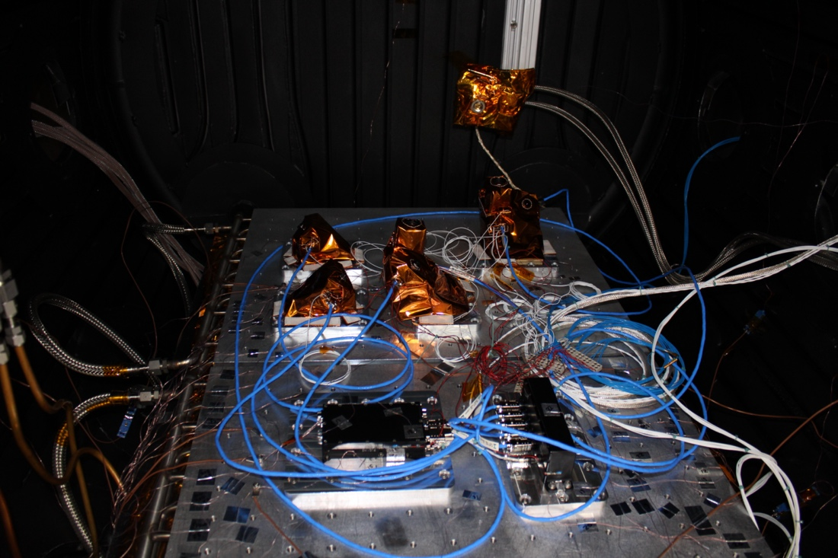
Summary
Key accomplishments for the year:
  Delivered SCALPSS 1.1 flight hardware to Firefly Aerospace on schedule.
  Completed final FSW build development.
  Supported troubleshooting issues identified with lander data transfer and power systems (with no impacts to payload hardware or software).
  Supported successful CLPS/Firefly Payload Integration Readiness Review.
(a)
(b)
SCALPSS 1.1 (CLPS 19D) hardware in (a) vibration testing and (b) thermal vacuum (TVAC) testing (June-August 2022)
Summary of the TechMat Capability End State for the Scope of the Project:
  SCALPSS 1.1 is an additional flight of the SCALPSS payload (also flying on the Intuitive Machines NOVA-C lander in late 2023) with modifications to collect additional and improved PSI data.
  Lander integration of the SCALPSS 1.1 payload is currently planned for November 2023 with launch NET August 2024.
  Together, SCALPSS and SCALPSS 1.1 will provide critical flight data for the validation of PSI modeling by:
    demonstrating the capture of landing site morphology, prior to, during, and following PSI
    demonstrating ability to detect onset of PSI
    demonstrating ability to detect altitude at which ground obscuration occurs
    demonstrating possible methods for determining ejecta sheet structure
  The project is currently working with Blue Origin on possibly including spare SCALPSS 1.1 hardware on their HLS-scale cargo lander (Mk1) test flight(s) in 2024-2025.

