Slide 1

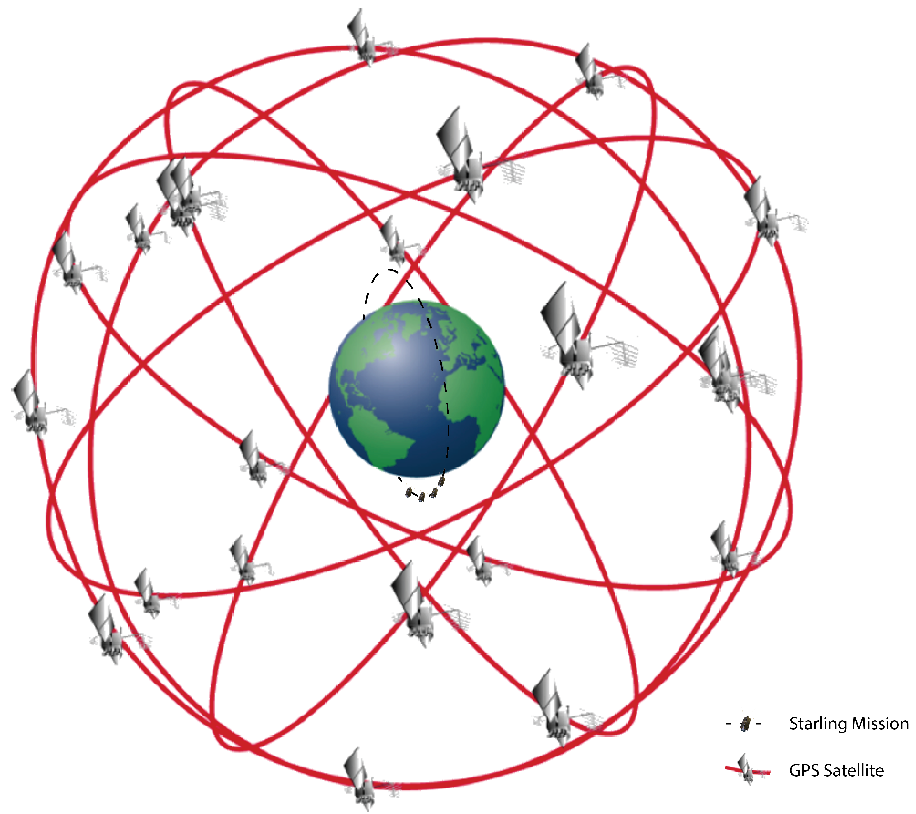
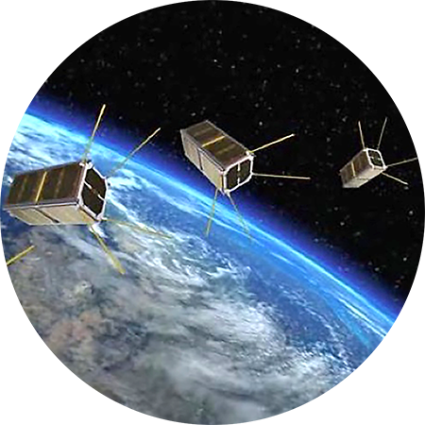
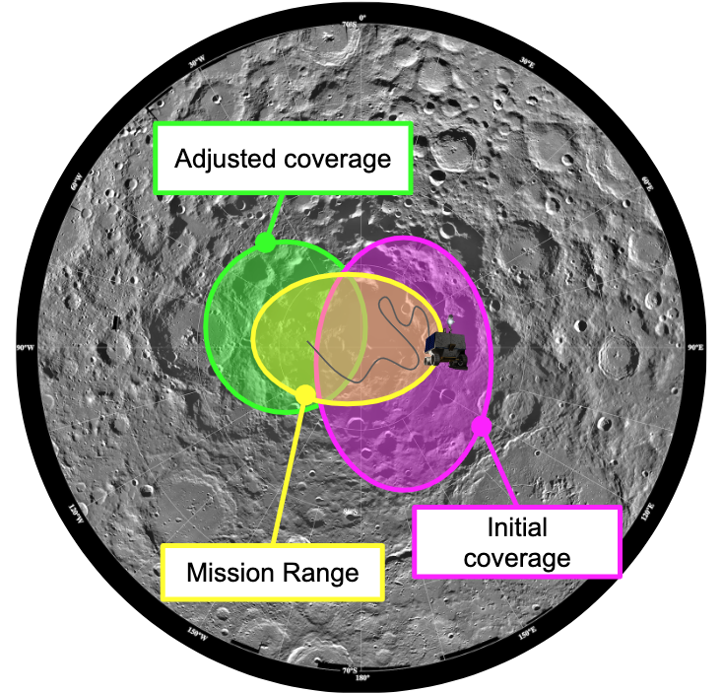
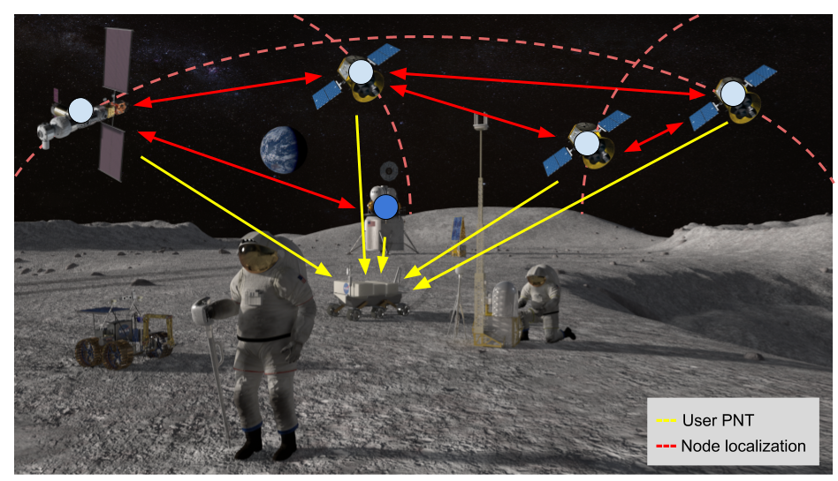
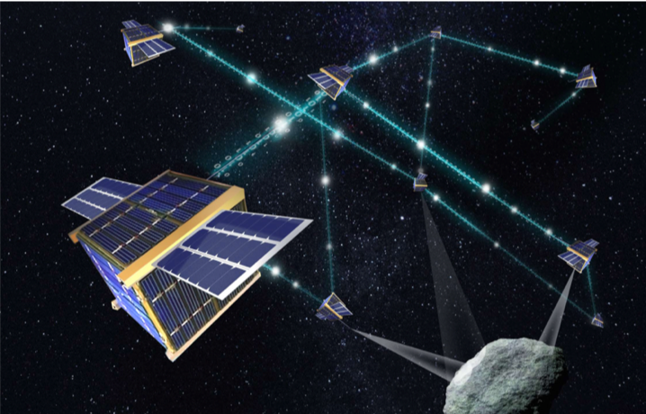
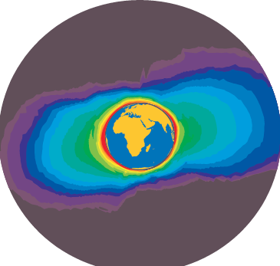
Space Technology Mission Directorate
Game Changing Development Program
Caleb Adams | Brian Kempa | FY23 Distributed Spacecraft Autonomy (DSA) Annual Review Presentation | 09.20.2023
Caleb.A.Adams@nasa.gov

Slide 2

Project Overview
Technology Development Needs Addressed by Project
GCD | Completion of project goals and objectives on time and in budget | Autonomous Systems, 679, 681, 723
SSTP | Demonstration of distributed autonomous technologies with small spacecraft | Autonomous Systems, 679, 681, 723
Project Goals
Goal #1 | Advance command and control methodologies for controlling a distributed space system as a single entity.
Goal #2 | Develop, mature, and demonstrate autonomous coordination between multiple spacecraft in the distributed space system.
Goal #3 | Develop, mature, and demonstrate approaches for adaptive reconfiguration and distributed decision-making across a distributed space system.
Project Objectives
Objective #1 | The DSA Project shall develop software to control a distributed space system.
Objective #2 | The DSA Project shall perform a technology demonstration of distributed space system software in flight.
Objective #3 | The DSA Project shall demonstrate the scalability of the distributed space system software in a simulation environment.
Notes:
Provide an overview of the Project
Pictures are encouraged, please provide new pictures as frequently as possible

Slide 3
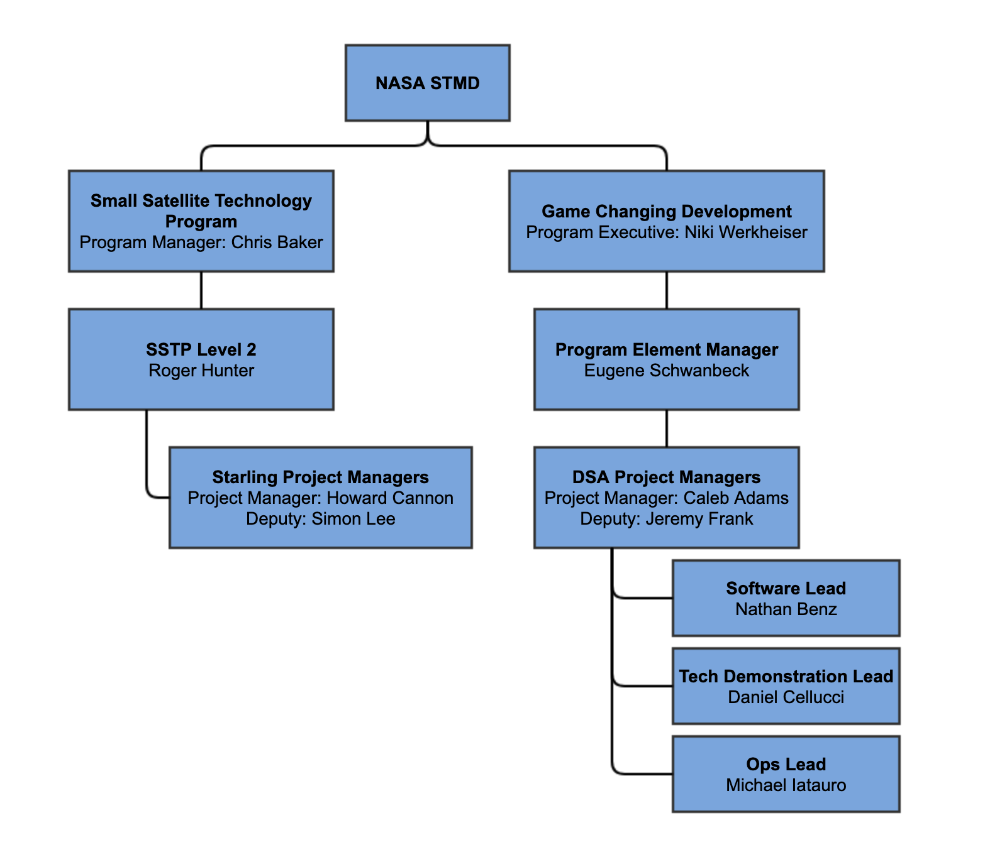
Project Org & Team Overview
Notes:
If you have submitted a Project Plan, you could utilize the Organizational Chart found in section 8.3 – Management Structure making sure to add in your assigned PEM and associated PT/SCLT

Slide 4

Collaborations & Partnerships
Contributing partners and/or stakeholders
  DSA has partnered with Unibap to demonstrate the DSA Communication application as a middleware between payload containers as part of a flight demonstration.
  CSUN and DSA have provided matching funds through the MUREP program for internships in underserved communities.
  Collaboration with University of Pittsburgh through the NSF SHREC Consortium on containerization and machine learning techniques.
  NRSAA with University of Georgia for smallsat work and collaboration
Through the SpaceROS ACO we are also working with Blue Origin, and GSFC
NASA Centers
ARC
Small Business
Unibap
University
California State University, Northridge
University of Pittsburgh
University of Georgia
Notes:
Encourage reaching out to OSTEM
https://msiexchange.nasa.gov/
Alternative Infusion plans

Slide 5
Distributed Spacecraft Autonomy
Milestone & Maturity Schedule
Project Milestone
GCD (Key) Milestone
Controlled Milestone
TRL/SRL/MRL Progression
7
FY19 | FY20 | FY21 | FY22 | FY23 | FY24 | FY25
Release 5
6
Release 1
Release 2
Release 4
5
Ground interaction through one swarm asset
Release 3
4
Network Communication
Commanding of the swarm as one entity
Release 6
Release 7
3
Coordination between multiple assets in the swarm
Bathtub Period
Closed-loop control by the swarm
Final Report & Review
2
Adaptive reconfiguration by distributed planning
TRL
PDR
CDA
Final
Launch
1
Project
Start
Notes:
Chart purpose: show TRL/SRL/MRL advancement over the project lifecycle schedule. Show TRL advancements as whole integer increases. Show how Key and Controlled milestones align with TRL advancement.
TRL/SRL/MRL may not advance at each milestone. Often several milestones are required to produce a step increase in TRL/SRL/MRL.
There can be one, or more, of these charts per project as needed.
For projects with fewer technical elements, the TRL/SRL/MRL data can be combined on one chart.
For more complex projects, the TRL/SRL/MRL progression can separated into multiple charts by project technical area.
Show TRL, SRL, and MRL data for each technical element on the same chart.
Delete TRL/SRL/MRL axis-labels that do not apply – e.g., remove SRL/MRL for projects/technical areas where SRL and MRL do not apply.

Slide 6
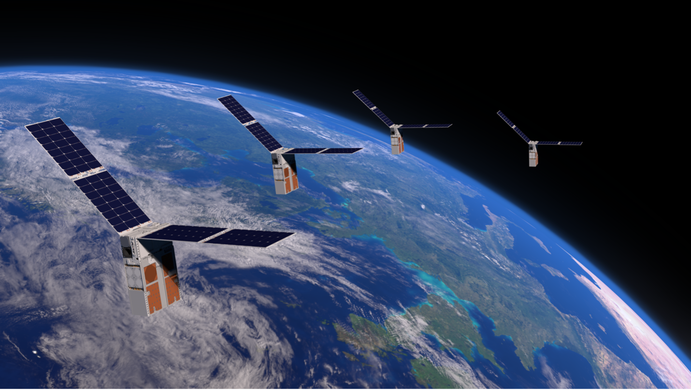
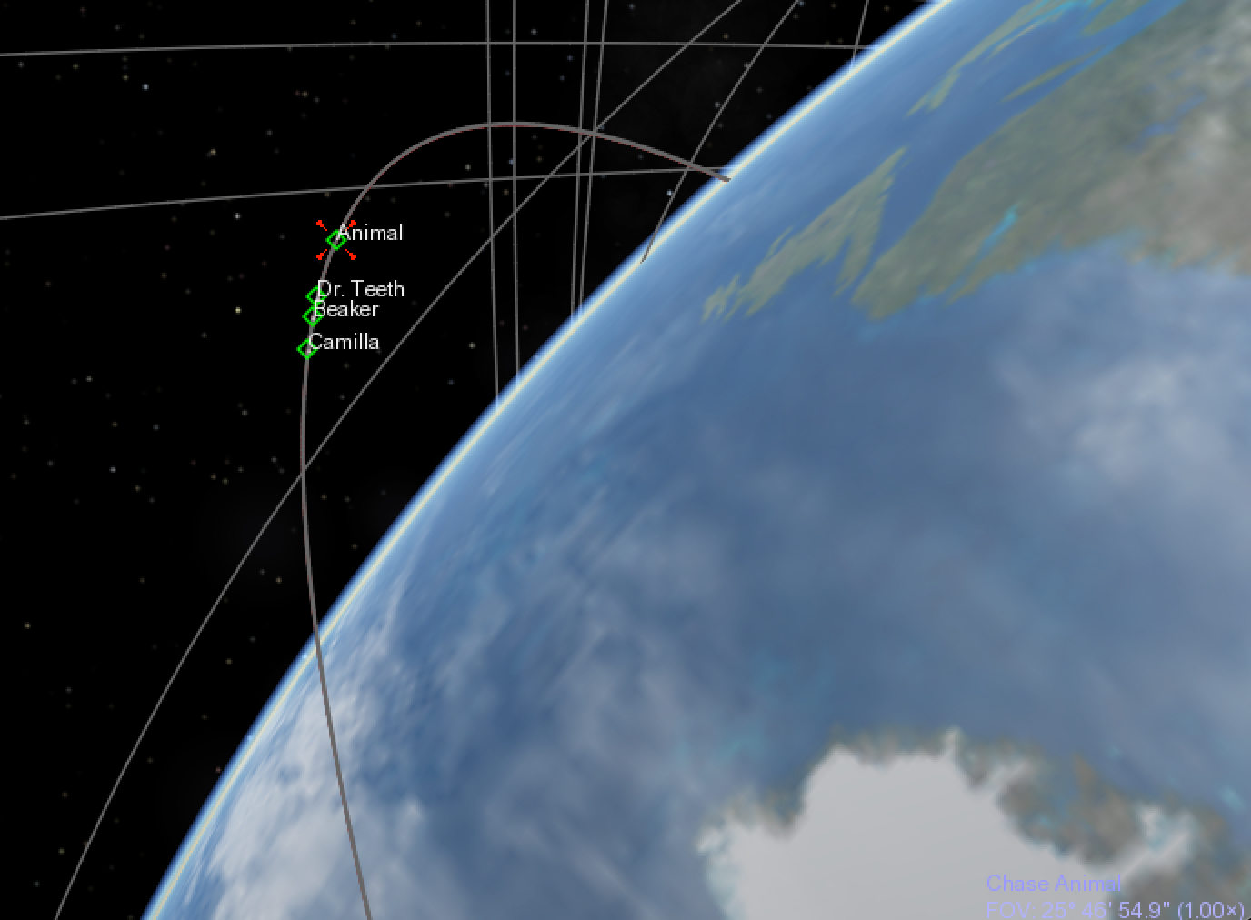
Accomplishments
Launched on July 17th on Rocket Lab Electron
Starling commissioning ongoing
All 4 spacecraft finished bus commissioning!
Crosslink commissioning ongoing (required for DSA)
Actively changing: Updates post-slide submission

Slide 7


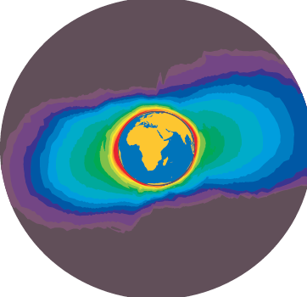

Accomplishments: DSA Sarling
Flight Software Status as of Mid FY23
Initial Verification Completed
Verification Started
Starling cFS Instance A
cFS Messages
Non-cFS Messages
Prototype
DSA Apps
Development Started
Spacecraft COMM
COMM App
AUTO App
Starling Apps
Starling Apps
DSA GDS
DDS Data Incoming
Data from other
Satellites
Network
DDS Data Outgoing
Novatel Receiver
GPS App
TEC App
Ionospheric results from CHAMP Mission. DSA will be reacting to the same phenomena
Heise, Stefan, et al. "Sounding of the topside ionosphere/plasmasphere based on GPS measurements from CHAMP: Initial results." Geophysical Research Letters 29.14 (2002): 44-1.

Slide 8
Accomplishments: DSA Starling
Flight Software Status as of Mid FY23
Verified on Orbit
Initial Verification Completed
Starling cFS Instance A
cFS Messages
Verification Started
Non-cFS Messages
DSA Apps
Prototype
Spacecraft COMM
COMM App
AUTO App
Starling Apps
Starling Apps
Development Started
DSA GDS
DDS Data Incoming
Data from other
Satellites
Network
DDS Data Outgoing
Novatel Receiver
GPS App
TEC App
Ionospheric results from CHAMP Mission. DSA will be reacting to the same phenomena
Heise, Stefan, et al. "Sounding of the topside ionosphere/plasmasphere based on GPS measurements from CHAMP: Initial results." Geophysical Research Letters 29.14 (2002): 44-1.
Starling Verification Started

Slide 9
Accomplishments: DSA Starling
Flight Software Status as of Mid FY23
Verified on Orbit
Initial Verification Completed
Starling cFS Instance A
cFS Messages
Verification Started
Non-cFS Messages
DSA Apps
Prototype
Spacecraft COMM
COMM App
AUTO App
Starling Apps
Starling Apps
Development Started
DSA GDS
DDS Data Incoming
Data from other
Satellites
Network
DDS Data Outgoing
Novatel Receiver
GPS App
TEC App
Ionospheric results from CHAMP Mission. DSA will be reacting to the same phenomena
Heise, Stefan, et al. "Sounding of the topside ionosphere/plasmasphere based on GPS measurements from CHAMP: Initial results." Geophysical Research Letters 29.14 (2002): 44-1.
First Apps DSA will Verify

Slide 10
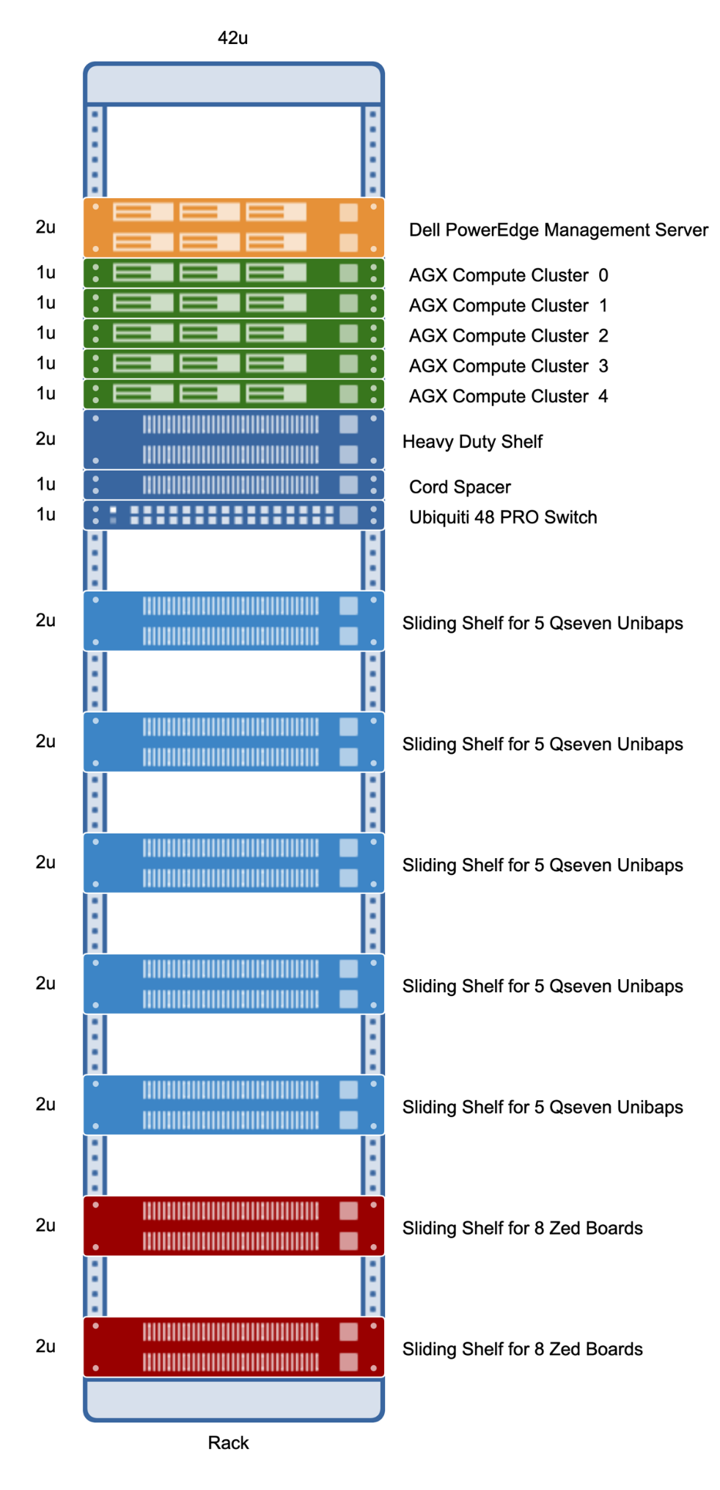
LPNT Scalability Accomplishments end of FY22
Initial Verification Completed
# nodes provisions
Verification Started
DDS Data Outgoing
Sim Network
Prototype
Development Started
Orbital and RF Sim Output
RANGE App
DEKF App
COMM App
NET App
MPLAN App
Experimental
Network
DDS Data Outgoing

Slide 11
LPNT Scalability Accomplishments end of FY23
Initial Verification Completed
# nodes provisions
Verification Started
DDS Data Outgoing
Sim Network
Prototype
Development Started
Orbital and RF Sim Output
RANGE App
DEKF App
COMM App
NET App
MPLAN App
Experimental
Network
DDS Data Outgoing

Slide 12
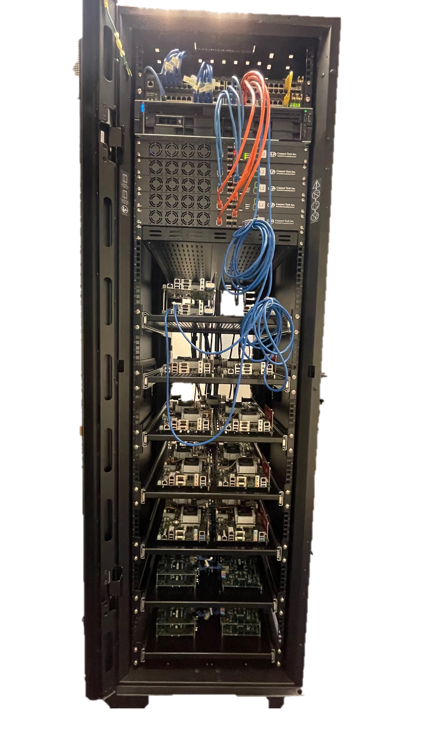
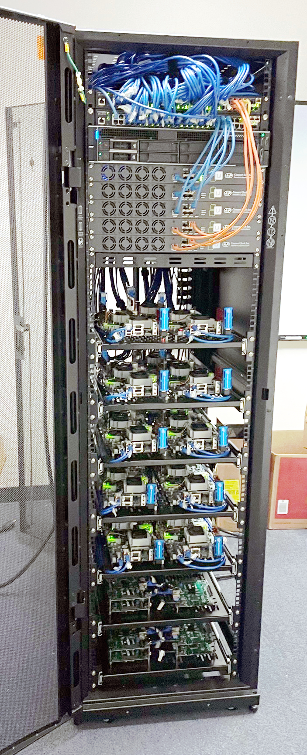
LPNT Scalability Accomplishments Send of FY23
It has wheels!
Integration complete

Slide 13
Project Assessment Summary
Project Name | Performance |  |  |  | Comments
 | C | S | T | P
Mid Year | G | Y | G | G | Technical – DSA ready for Ops; DSA tested scalability to 25 nodes Cost – DSA fully funded in FY23 and FY24 Schedule – Starling changed launch vehicle and new unknown launch dates were given in a wide estimated range (June - August). No control over this schedule Programmatic – Project focused on prep for flight ops ; scalability paused
Annual | G | G | G | G | Technical – DSA entering Ops; DSA tested scalability to 25 nodes Cost – DSA fully funded in FY23 and FY24 Schedule – Starling launched July 17th ; DSA to start commissioning September 10th Programmatic – Project starting flight ops and wrapping up scalability study

Slide 14
Plans Forward and
Transition / Infusion Plan
Infusion/Transition plan
  Recently funded Ames CIF will use DSA Test Rack
  DSA in discussion with SSTP regarding a DSA 2.0 Mission Concept
    Extend Autonomy into Scientific mission for TEC mapping (UCAR/NOAA/SSTP)
    Utilize existing DSA Comm App development
    Utilize autonomy matured on Starling 1.0
  Additional funding from SSTP
    Opportunistic Software Experiments Satellite (OSE-SAT)
    OSE-SAT funded in FY23 & FY24 (low cost)
    Utilizes DSA Comm App
    Utliizes DSA Scalability and Containerization
Notes:
Infusion: An investment reaches a conclusion where a technology is handed off for use by a mission or other need. Infusions can be made to other NASA Mission Directorates, other Government Agencies, Commercial Entities, or International Partner.
Transition: An investment reaches a conclusion where a technology is handed off for further development. Transitions can be made to other STMD programs, other NASA Mission Directorates, academic institution, other Government Agencies, Commercial Entities, or International Partner.

Slide 15
Plans Forward and
Transition / Infusion Plan
Mission Infusion
  DSA seeking opportunities with Earth Science Technology Office (ESTO) and the Surface Topography and Vegetation (STV) incubation study
  DSA seeks Unibap / ESA satellite platform test funded via SSTP
Partnerships & Commercial Transition
  DSA partnered with Unibap Corp to quickly deploy autonomy demonstration in orbit
  DSA in discussions with Laurence Livermore National Labs (LLNL) regarding Starling 2.0 concept (Sensors, Algorithms)
  DSA may work with SSTP and the Aerospace Corp on Starling 2.0 concept (Platform)
Notes:
Infusion: An investment reaches a conclusion where a technology is handed off for use by a mission or other need. Infusions can be made to other NASA Mission Directorates, other Government Agencies, Commercial Entities, or International Partner.
Transition: An investment reaches a conclusion where a technology is handed off for further development. Transitions can be made to other STMD programs, other NASA Mission Directorates, academic institution, other Government Agencies, Commercial Entities, or International Partner.

Slide 16
Education/Public Outreach
EPO Involvement
EPO Calendar Outlook (High Priorities):
6 Month Look-Ahead
Conference or Event | Date
Definitive Scalability Run | 10/25/2023
Starling Launch | 7/17/2023
Top 3 Newsworthy Events:
  Demonstration of Hardware Scalability Testbed, SpaceROS and DSA Container App to GCD management
  Starling launched on July 17th into LEO
  Infusion into future SSTP mission in FY24
Delivery of DSA-Starling FSW to Starling
Ames Mars Science Workshop (February 2023)
Flight Software Workshop at JPL (March 2023)
IEEE Aerospace Conference (March 2023)
Invited Talk at JPL on Autonomy (March 2023)
Cubesat Developers Workshop (April 2023)
IAAA/USU conference on Small Satellites (August 2023)
Notes:
Summary of the EPO activities (papers, conferences, outreach events) participated in over the last 6 months and the forward outlook for 6 months

Slide 17
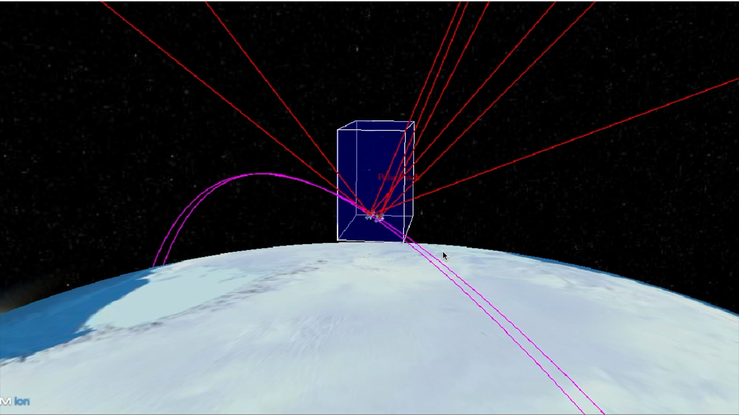
Summary
DSA is on orbit, prepared for commissioning, and ready to start operations!
DSA is pursuing future infusions
DSA is fully funded in FY24 to complete project goals
Objective #1: The DSA Project shall develop software to control a distributed space system. End state TRL 7
Objective #2: The DSA Project shall perform a technology demonstration of distributed space system software in flight. End state TRL 7.
Objective #3: The DSA Project shall demonstrate the scalability of the distributed space system software in a simulation environment. End state TRL 6

