Slide 1
Flex-Capsules for the Roman Space Telescope High Gain Antenna Gimbal 20th European Space Mechanisms and Tribology Symposium (ESMATS) 20th – 22nd September 2023 POLIN Museum Warsaw, Poland
Kenneth A. Blumenstock ⁽¹⁾, Jason A. Niemeyer ⁽¹⁾, Joseph P. Schepis ⁽¹⁾, Aleksandr Souk ⁽¹⁾, Peter A. Taraschi ⁽¹⁾, Robert Judy ⁽²⁾, Kenneth Y. Lee ⁽³⁾, Daniel B. Richardson ⁽³⁾, Cesar A. Ventura ⁽³⁾, Jonathan I. Penn ⁽³⁾
⁽¹⁾ NASA/GSFC, Greenbelt, MD USA, ⁽²⁾ SAIC, Lanham, MD USA,
⁽³⁾ Aerodyne, Lanham, MD USA, ⁽⁴⁾ KBR, Fulton, MD USA

Slide 2
Overview
Key Requirements.
Heritage Cable Wraps.
Flex-Capsule Alternative.
Flex-Capsule vs Cable Wrap Trade Study.
Design Considerations.
Flex-Tape Clocking.
Prototype Operation Video.
Angular Rotation Capability.
Flex-Tape Stack.
Rigid to Flex Delta Strain.
Life Analysis.
Engineering Model.
Testing Highlights.
Lessons Learned.
Conclusion.
Questions?
2

Slide 3
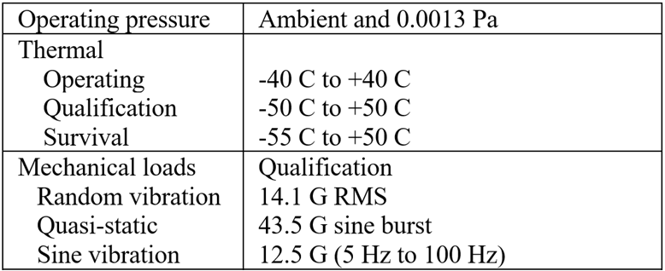
Key Requirements
Operational
Environmental
3

Slide 4
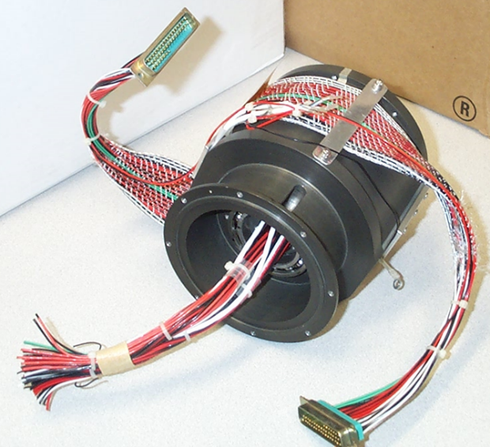
Heritage Cable Wraps
Round Wire Bundle Cable Wrap
Custom wire bundle.
Multiple slices.
Limited angle (180 to 200 degrees max).
Flatwise Cable Wrap
Single Conductors woven together
to form a ribbon.
No shielding.
More massive than Round Wire Bundle.

Slide 5
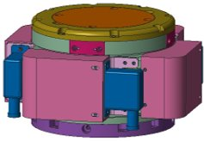
Flex-Capsule Alternative
A Flex-Capsule is like the Flatwise Cable Wrap, but instead of weaving together a ribbon of single conductors, flexible printed circuit board (PCB) is used in its place.
They are also referred to a “twist capsules.”
Since conductors are thin and wide, conductor stresses are lower than standard wire allowing for smaller bending radii.
Flex-Capsule

Slide 6
Flex-Capsule vs. Cable Wrap Trade-Study
Cable Wrap Pros
Heritage; easy justification for a Class A mission.
Cable Wrap Cons
History of development problems arising.
Lack of manufacturing consistency; labor and skill intensive.
Size and mass larger than Flex-Capsule.
Low to moderate level of confidence in predicting life cycles by analysis.
Flex-Capsule Pros
Consistency of manufacture.
Simple mechanical and electrical interface.
Less labor and skill intensive manufacture and assembly.
High level of confidence in predicting life cycles by analysis if strain is limited.
Size and mass smaller than Cable Wrap.
Incorporation of shielding.
Flex-Capsule Cons
Risk of new development; can we justify?
Debris generation from sliding of Flex-Tape (flexible printed circuit board).
Unknown shielding performance.
Unknown unknowns.
Trade study outcome led us to pursue a Flex-Capsule development.

Slide 7
Design Considerations
Separate Flex-Tapes for power and signal and primary and redundant; four Flex-Tapes total for elevation Flex-Capsule; two for azimuth.
Keep shields separate for thermal signals and encoder signals.
Incorporate rigid boards at the ends of Flex-Tapes for physical attachment and Flex-Tape to harness interface.
Vendor can provide connectors integrated with the flex; we preferred to use conventional stranded wire from the rigid board to the connecters and not risk adding a process to the vendor.
It was preferred to have a Flex-Tape length of 610 mm (24 in), which is the most standard. This length worked for our application, but with little angular margin.
Arrange multiple Flex-Tapes so that they do not buckle; we clocked four Flex-Tapes 90 degrees apart.
Multiple Flex-Tapes Attached Together Will Buckle Bending a Radius

Slide 8
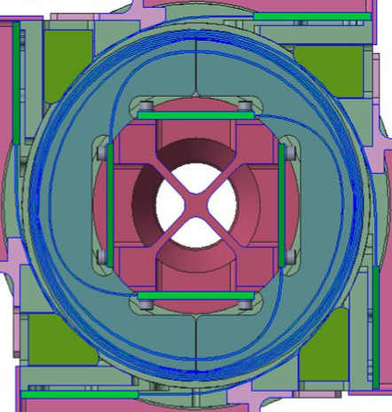
Flex-Tape Clocking
Four Flex-Tapes Clocked 90 Degrees Apart

Slide 9
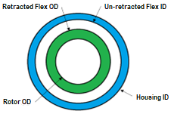
Angular Rotation Capability
Printed circuit board (PCB) panels are standard 610 mm (24 in), and 914 mm (36 in). We considered and used 610 mm (24 in).
Active Flex-Tape length does not include inactive portions of Flex-Tape which includes rigid portion and flex to housing inner diameter (ID), transition from blue to green below, and from rotor rigid portion to rotor outer diameter (OD) tangent.
Determine number of turns of the blue section when un-retracted, meaning the maximum amount of Flex-Tape resides in the blue section.
Determine the number of turns of green section when retracted, meaning the maximum number of turns are in the green sections.
Determine angular rotation capability by:
Φ = (N_{retracted} - N_{un-retracted} ) x 360 degrees

Slide 10
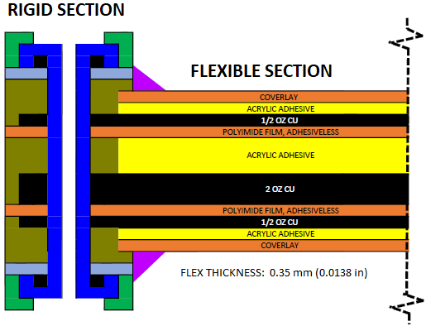
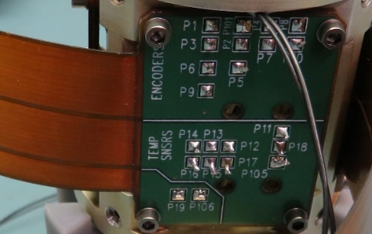
Flex-Tape Stack
Power layer is the thick brown inner layer and shielding layers are the thin brown outer layers.
There is asymmetry with an odd number of copper layers (image is not to scale).
Flex-Tape Stack
Flex-Tape Fastened to Rotor

Slide 11
Rigid to Flex Delta Strain
The flex portion near the rigid end bends a tight radius to become tangent with the rotor diameter.
We did not consider this in the life analysis since delta strain is small.
If the Flex-Tape was wound tightly when fully retracting, this flex portion could become the worst-case strain and stress location.
Implementing a flex hold-down strip near the rigid portion could reduce delta strain near the rigid section, but we did not implement it.
Flex-Tape Fastened to Rotor

Slide 12
Life Analysis
Flex-Tape strain, stress and fatigue analysis was performed to evaluate survival of 10,000 cycles of 196-degree operation.
Made use of the Institute for Printed Circuits (IPC) documents for analysis recommendations.
Discovered an error in the IPC equation for determining the Flex-Tape stack neutral axis in that two variable definitions were reversed (specified in paper).
Delta strain is determined based upon the largest and smallest diameters that are cycled; ID of the housing and OD of the rotor.
Utilized empirical stress/strain plots supplied by DuPont to determine stresses.
Fatigue life cycles to failure (N_{f} ) determined from IPC-TR-484 equation below.
The right side of the equation is based upon empirical data from the IPC study.
This equation belonging to IPC International, Inc. is used with permission, Copyright 2023

Slide 13
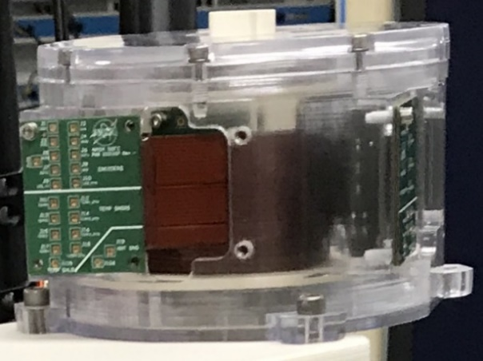
Engineering Model
Fabricated a printed plastic version of the Flex-Capsule.
Utilized to measure friction, to perform life cycling under ambient conditions, and to develop the assembly process.
Flex-Tape sliding did generate some debris, so we then performed a trial with an oil film applied to the Flex-Tapes; chose to retain that method for life test and flight units.
Printed Plastic Engineering Model

Slide 14
Engineering Model Operation Video

Slide 15
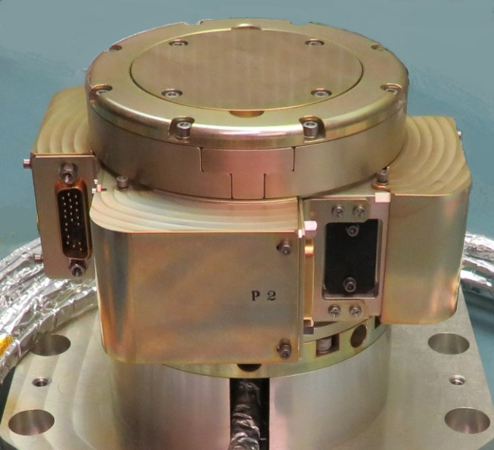
Testing Highlights
Passed life testing without issue.
Common mode conducted emissions electromagnetic interference (EMI) testing exceeded the spec, though not caused by the Flex-Capsule.
External gimbal harnessing with damaged Neptape shielding caused the outage.
Life Test Unit on Vibe Plate

Slide 16
Lessons Learned 1
Multiple individual relatively thin Flex-Tapes with three copper layers keeps stresses down and results in a high confidence life analysis. Recommend avoiding an excessive number of copper layers.
Properly orienting multiple Flex-Tapes prevents buckling and results in consistent behavior of the Flex-Tape set. Recommend avoiding multiple stacked Flex-Tapes with the same start location.
Shielding effectiveness was an unknown, but we have met conducted emissions EMI for our application. Recommend to utilize pre-flight Flex-Tapes for testing to confirm EMI acceptability.
Lubrication of Flex-Tapes with a light oil film reduces debris generation and was not difficult to implement. Both un-lubed and lubed met life for our application, but we chose using a light oil film due to the debris concern.
Rigid Boards at the ends of the Flex-Tapes included perforations for lacing cord to secure the harnessing. Recommend including a strain relief feature such as this.

Slide 17
Lessons Learned 2
Harnessing exiting the rotor from the four Flex-Tapes come together forming a circular cross-section that must fit through the actuator bore. Recommend developing tooling to hold the harness in its final shape during harness fabrication.
The rotor of the Flex-Capsule and the rotor of the actuator are keyed together such that centers of angular rotation of each device must be aligned. Recommend multiple checks to ensure proper alignment to capture requirement changes. Different coordinate systems of devices can lead to error.
Preliminary testing indicated excessive Flex-Tape edge wear caused by gravity sag onto the lower tape guide. Recommend life testing with the rotation axis horizontal for similarity to microgravity environment.
One of the two highly experienced Flex-Tape vendors we selected had repeated quality issues. Recommend careful selection of flexible PCB vendors along with dual sourcing.

Slide 18
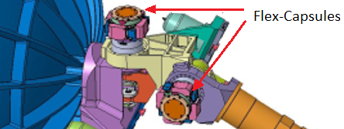
Conclusion
The benefits of a Flex-Capsule over a Cable Wrap development were realized, including:
Straightforward relatively easy development with few issues arising.
Much smaller and somewhat lighter than heritage.
Less labor-intensive manufacture and assembly.
Shielding layers were implemented and effective.
Roman Space Telescope High Gain Antenna

Slide 19
QUESTIONS?

