Slide 1
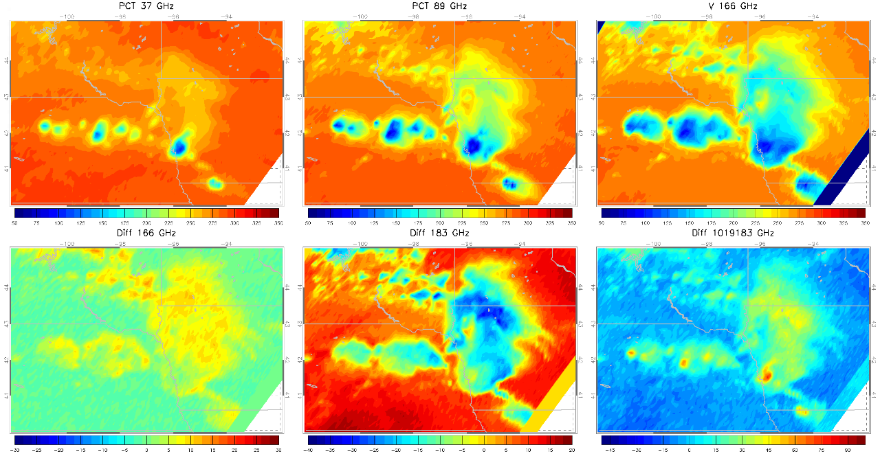
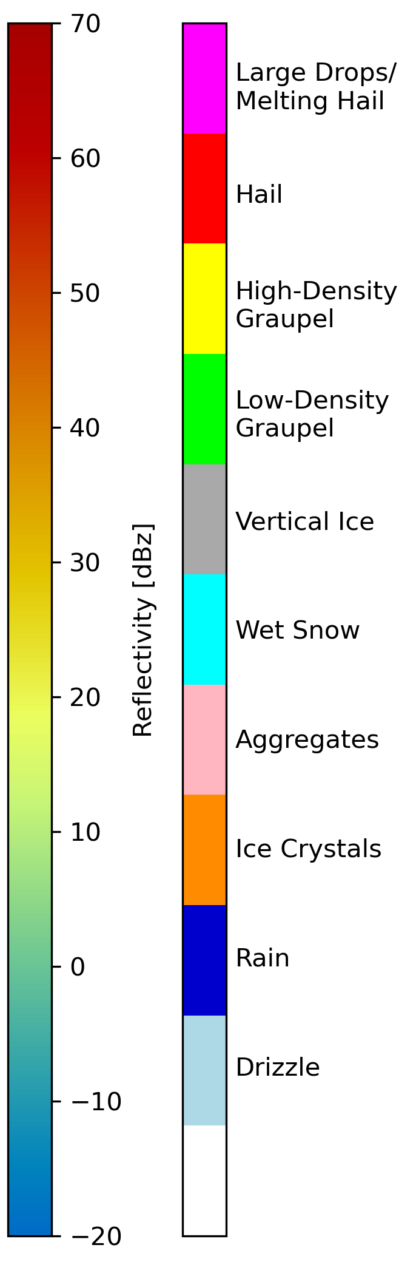
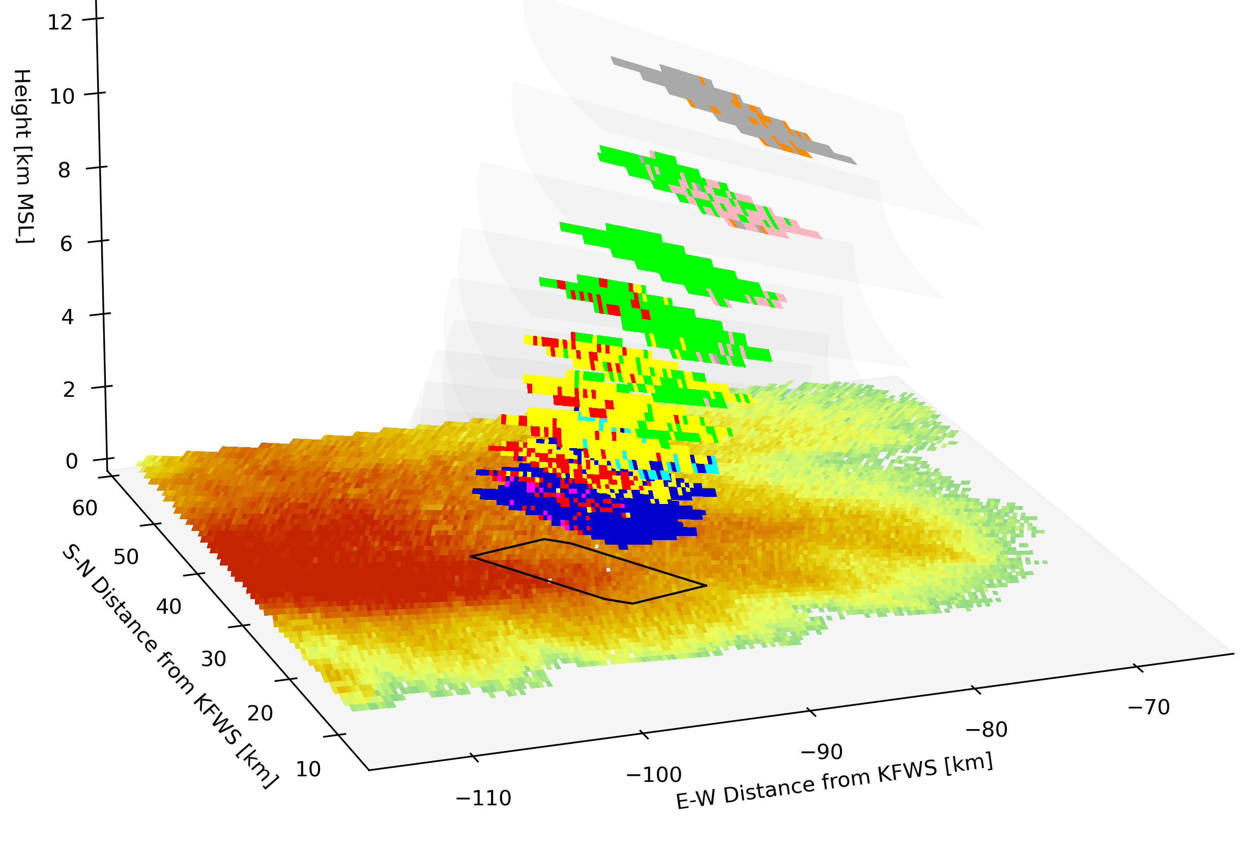
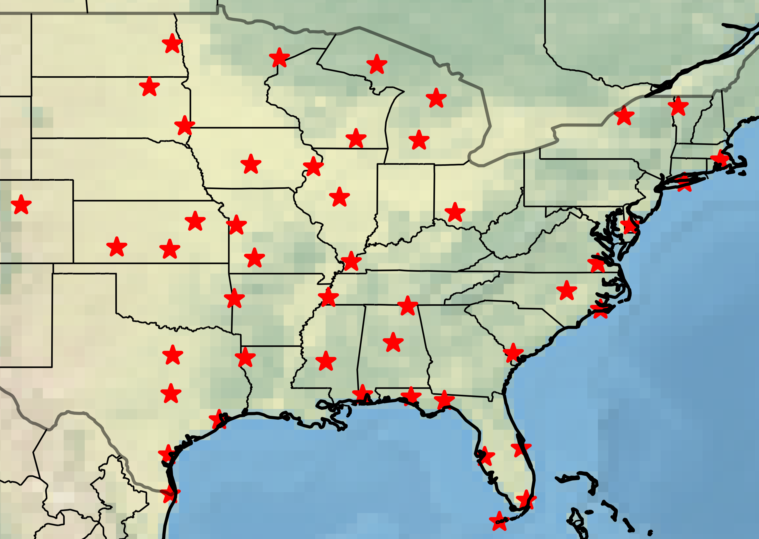
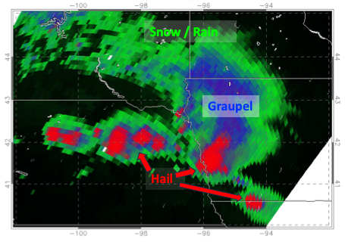
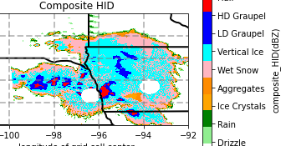
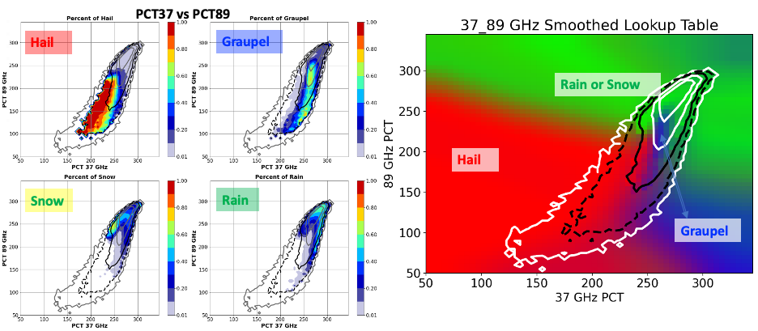
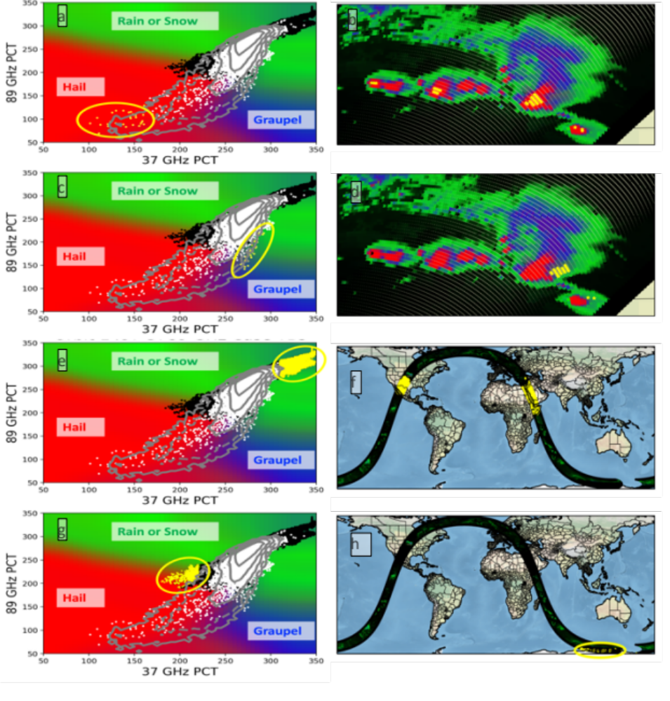
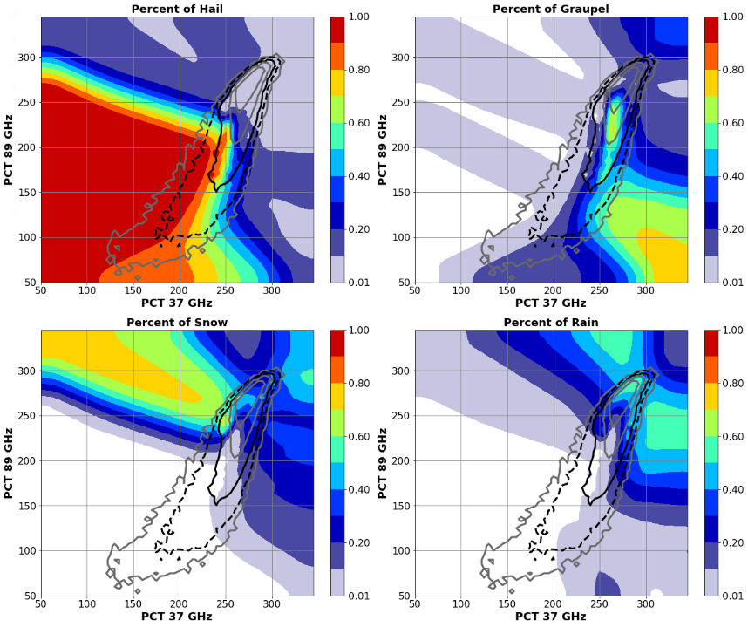
Retrieving Hydrometeor Information from GMI Brightness Temperatures
Daniel J. Cecil, NASA MSFC, Daniel.J.Cecil@nasa.gov
Michael B. Solomon, University of Alabama-Huntsville, mbs0025@uah.edu
Kenneth D. Leppert II, University of Louisiana-Monroe, leppert@ulm.edu
Objectives:
Use observational datasets to build empirical relationships between brightness temperatures (TB) and hydrometeor types (hail, graupel, snow, rain)
  GMI TB
  GPM Validation Network Hydrometeor Identifications (HID) (from dual-pol radar, matched to GMI field of view)
Use physical understanding to interpret empirical relationships
Construct lookup-tables of the likelihood of a hydrometeor type being present, based on multi-channel TB
Map the hydrometeor types in individual cases
Accumulate climatological maps of hydrometeor types
Example Mesoscale Convective System case from Nebraska-Iowa
GPM Orbit 1497, 03 June 2014, not part of our training or testing sample.
GMI channels used in our lookup tables are shown.
Example radar gates matched to one GMI pixel
Graphic below courtesy Sarah Stough, UAH
Building the TB-HID Lookup Tables
GPM Validation Network (VN) matches polarimetric radar data to GMI and DPR footprints, accounting for viewing angles. Each GMI footprint has many individual radar gates matched to it, at multiple elevations.
A subset of VN radars were used here from around the USA. We tested subsets by region and season. TB-HID relationships were not sensitive to those distinctions.
Our training and verification is entirely over land (USA)
VN data includes hydrometeor types from CSU algorithm (Dolan et al. 2013).
We use hierarchical categorization from Leppert and Cecil (2015):
If any matched radar gate has HID = Hail or Big Drops, assign the GMI TB to Hail category. If not, then…
If any matched radar gate has HID = Graupel, assign the GMI TB to Graupel category. If not, then…
If any matched radar gate has HID = Aggregates, Dry Snow, Vertically Oriented Ice, or Ice Crystals, assign the GMI TB to Snow category. If not, then…
If any matched radar gate has HID = Rain or Drizzle, assign the GMI TB to Rain category.
Left: HID retrieved from GMI using lookup tables
The lookup tables have trouble distinguishing {snow aloft} vs {rain without snow aloft} since we trained over land, so we plot both as green. The probabilities of both categories are produced separately.
Right: Composite HID retrieved from ground-based dual-polarization radar (KOAX, Omaha)
For the composite, our HID hierarchy is used to compile HID’s through the vertical
Building Lookup Tables
GMI channel combinations are paired, and for a given combination of brightness temperatures, the percentage of precipitating profiles identified as hail, graupel, snow, or rain is computed from a 3-year (2015-2017) training database.
Hail
Good correspondence between the HID types retrieved from GMI (left) and dual-pol radar (right).
In cases like this, our GMI lookup tables probably paint too broad an area as hail around the convective cores.
Our training approach treats a profile as hail if any part of the GMI footprint aligns with any ground-based radar gate identified as hail.
The percentages of profiles with each HID type are smoothed for TB bins with a small sample size (10-100 samples, between the dashed and solid black contours in the 2D-PDFs) and then extrapolated to TB bins with fewer than 10 samples in the training data (outside the dashed contour).
This ensures an HID probability is assigned for any brightness temperature combination in the parameter space.
Testing the extrapolated parts of parameter space:
At right, an orbit with a mesoscale convective system (MCS) is displayed to show how GMI observations that fall outside the training data are examined.
Top row (a-b): yellow pixels have very low PCT37 and PCT89, so they are interpreted as having hail. Their locations are inside the strong thunderstorm cores of the MCS.
2nd row (c-d): yellow pixels have relatively high PCT37 (~270 K) compared to their PCT89 (~150-200 K). The lookup tables give a mixed probability of graupel or rain. Their locations are suggestive of downshear anvil.
3rd row (e-f): yellow pixels have very high PCT37 and PCT89. Their locations are from warm, precip-free land surfaces. We rely on GPROF to screen these out.
4th row (g-h): yellow pixels have low PCT37, but higher PCT89. Their locations are from surface ice cover. We rely on GPROF 2-m temperature to screen these out.
For plotting purposes, we load the probability of hail to red, probability of graupel to blue, and probability of snow or rain to green in an R-G-B color table (above).
In plots of individual cases, these HID probabilities are further scaled by the GPROF Probability of Precipitation.
Black / dark shades = Low chance of precipitation
Red = Hail present
Purple = Hail or graupel present
Blue = Graupel present (but not hail)
Blue-Green = Mixed chances of graupel, snow, or rain
Green = Snow or rain present (but not graupel or hail)
Lookup tables of the probability of each HID type are made for 6 different channel combinations.
Only PCT37 vs PCT89 is shown here as an example.
We average the predicted probability of HID type from all 6 lookup tables, for application to GMI observations.

Slide 2
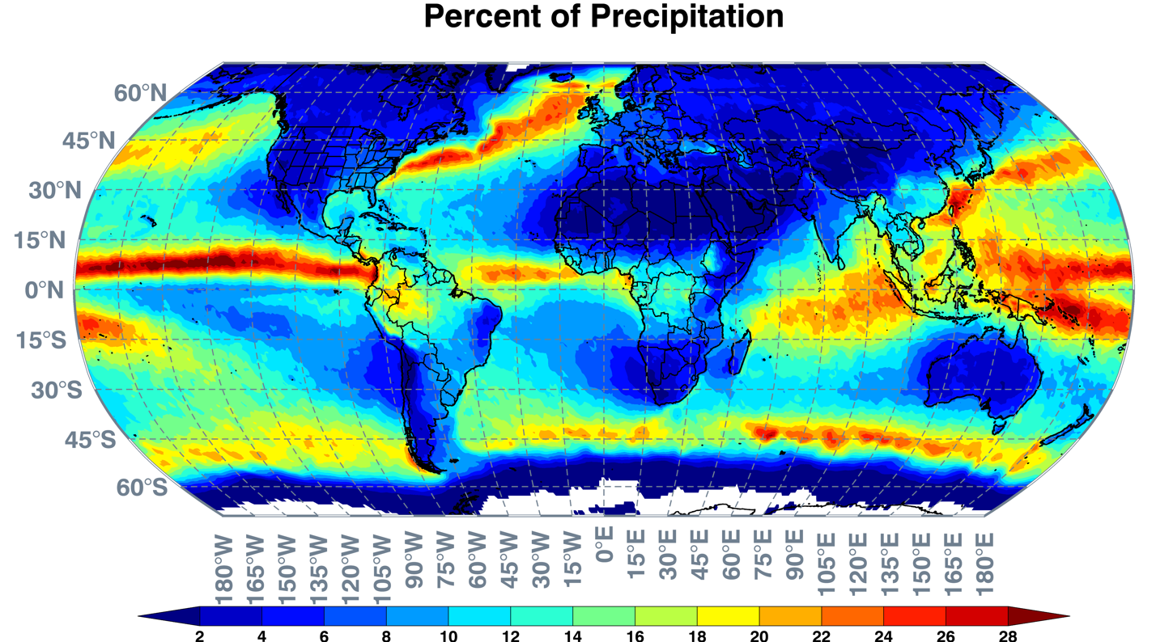
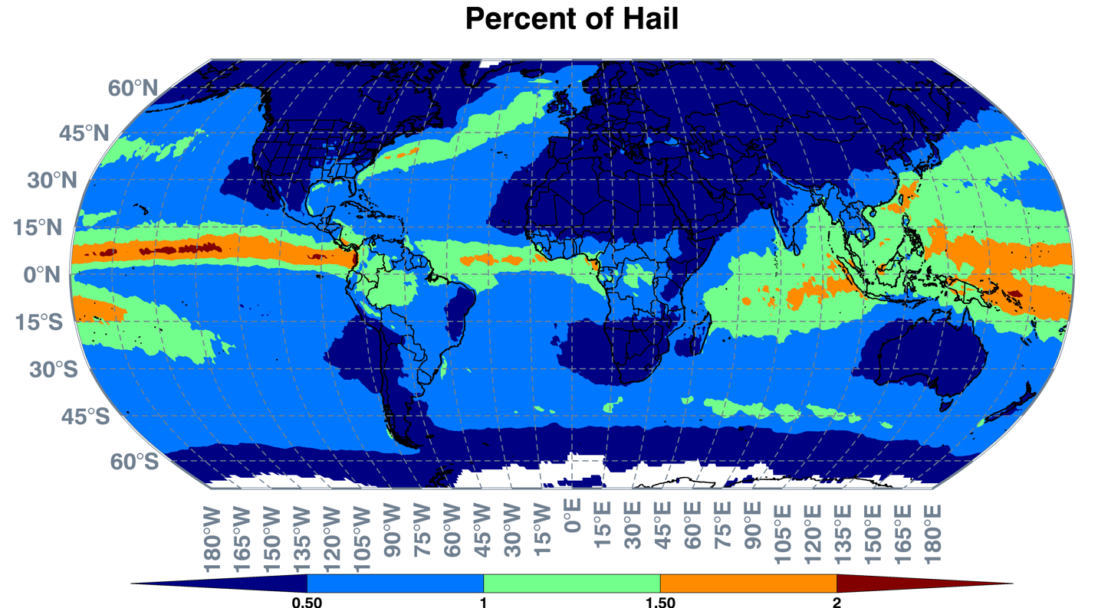
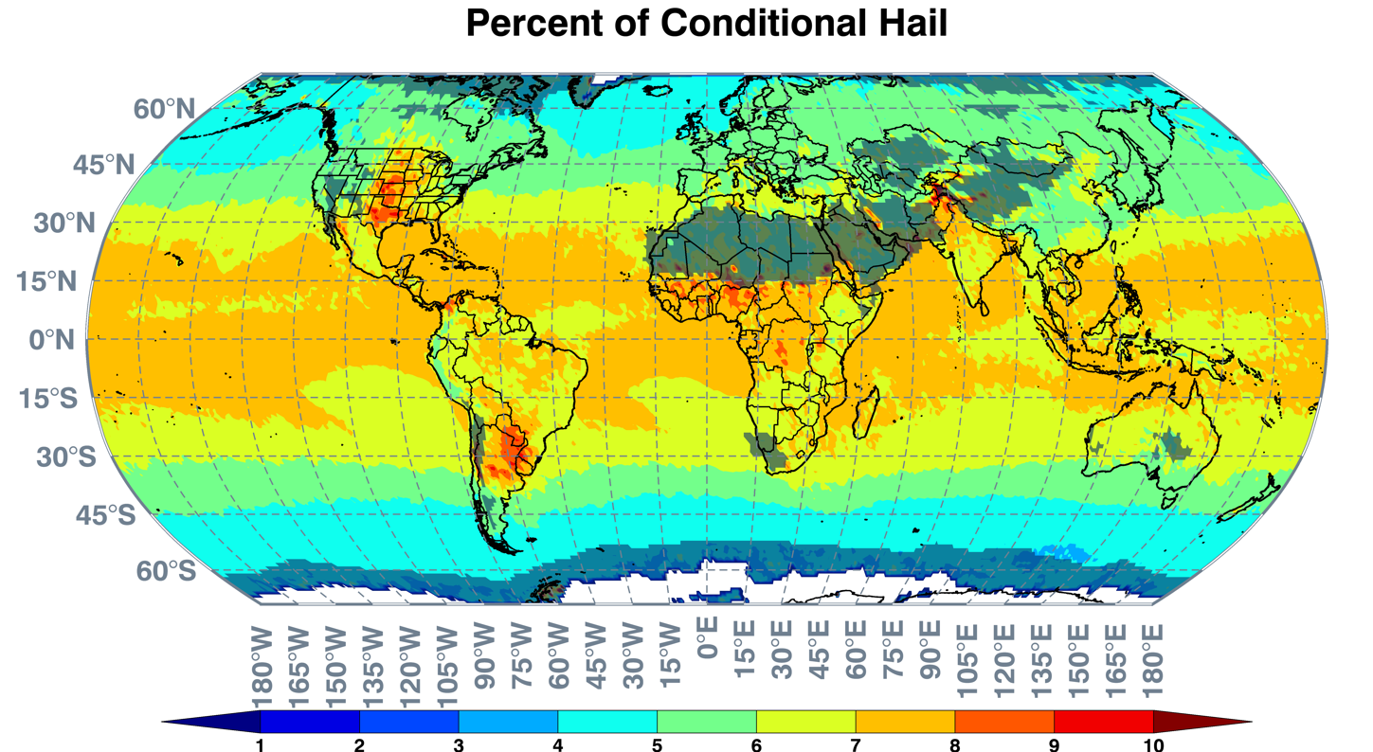
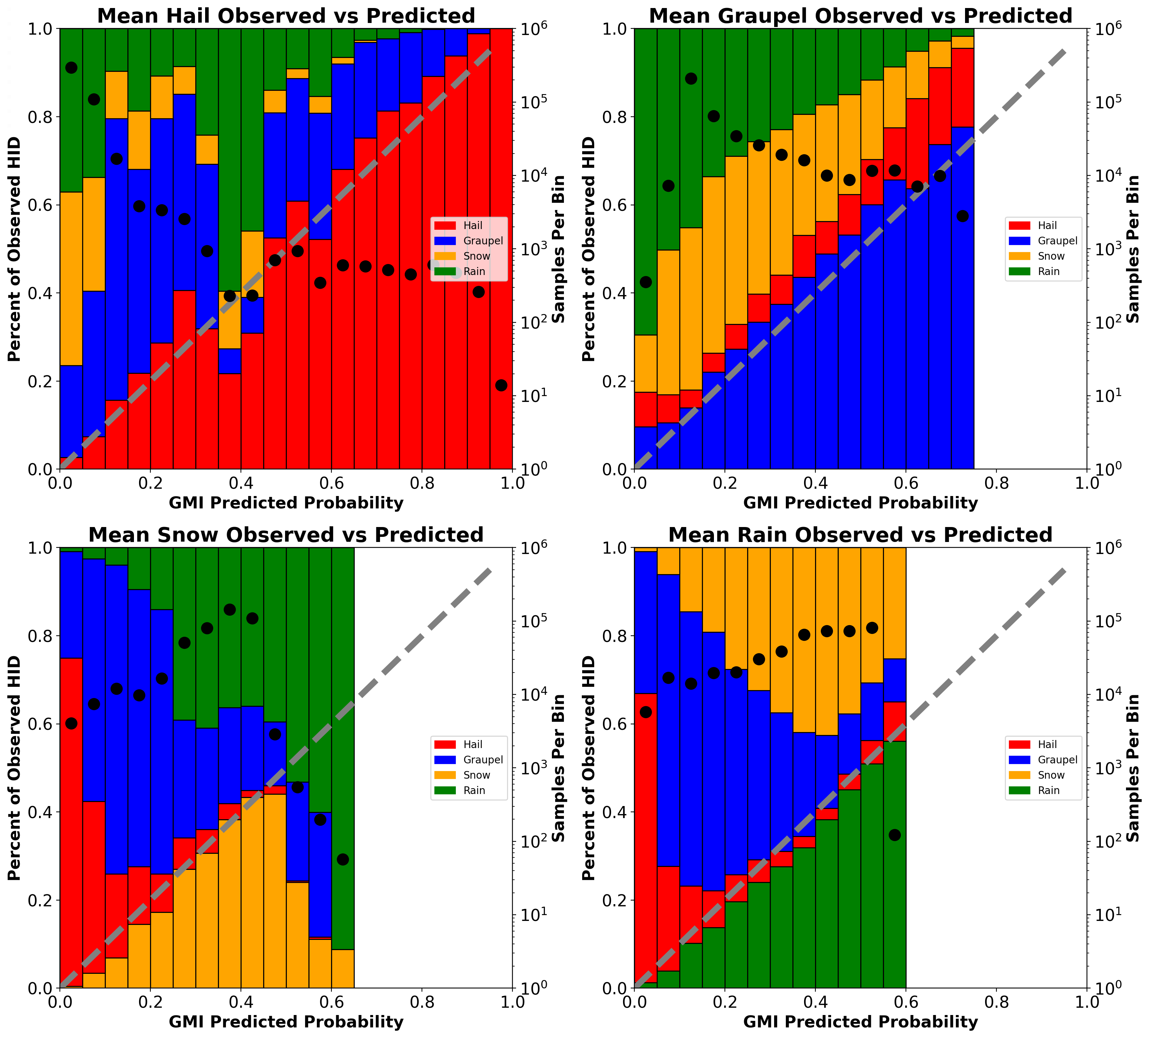
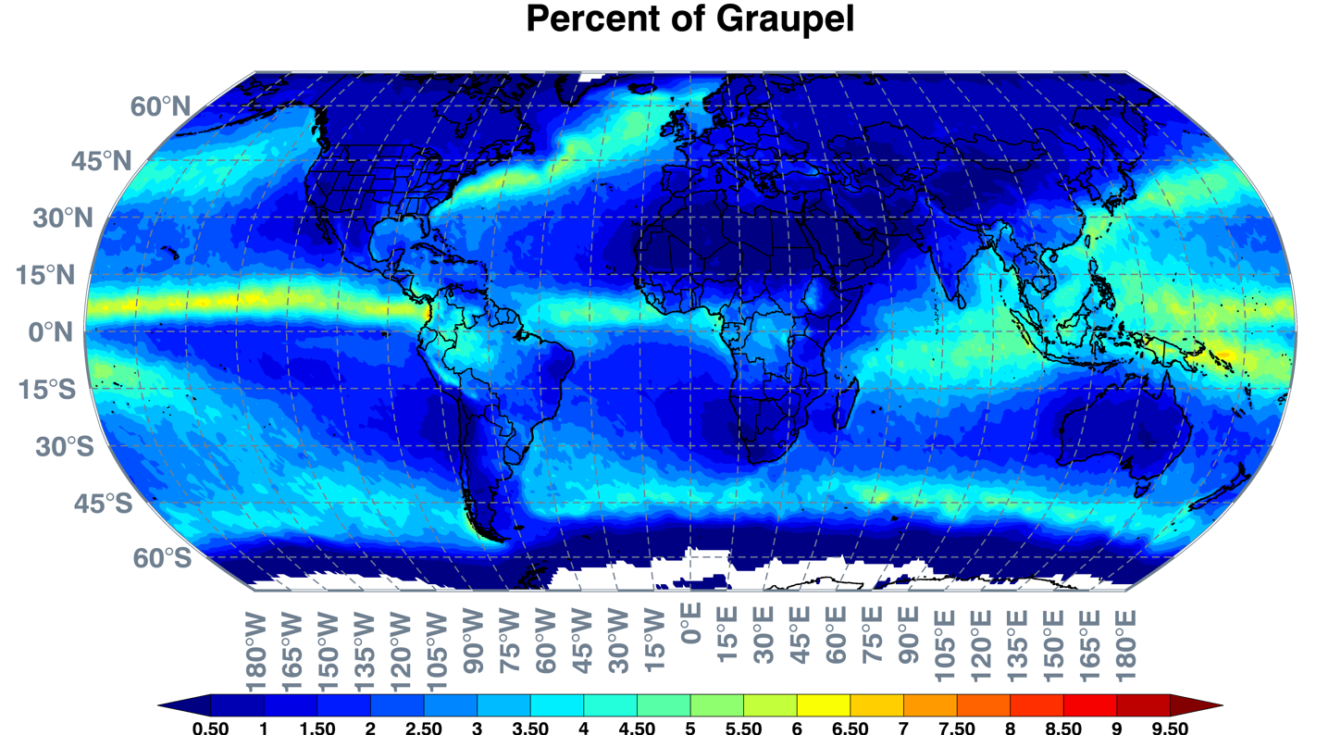
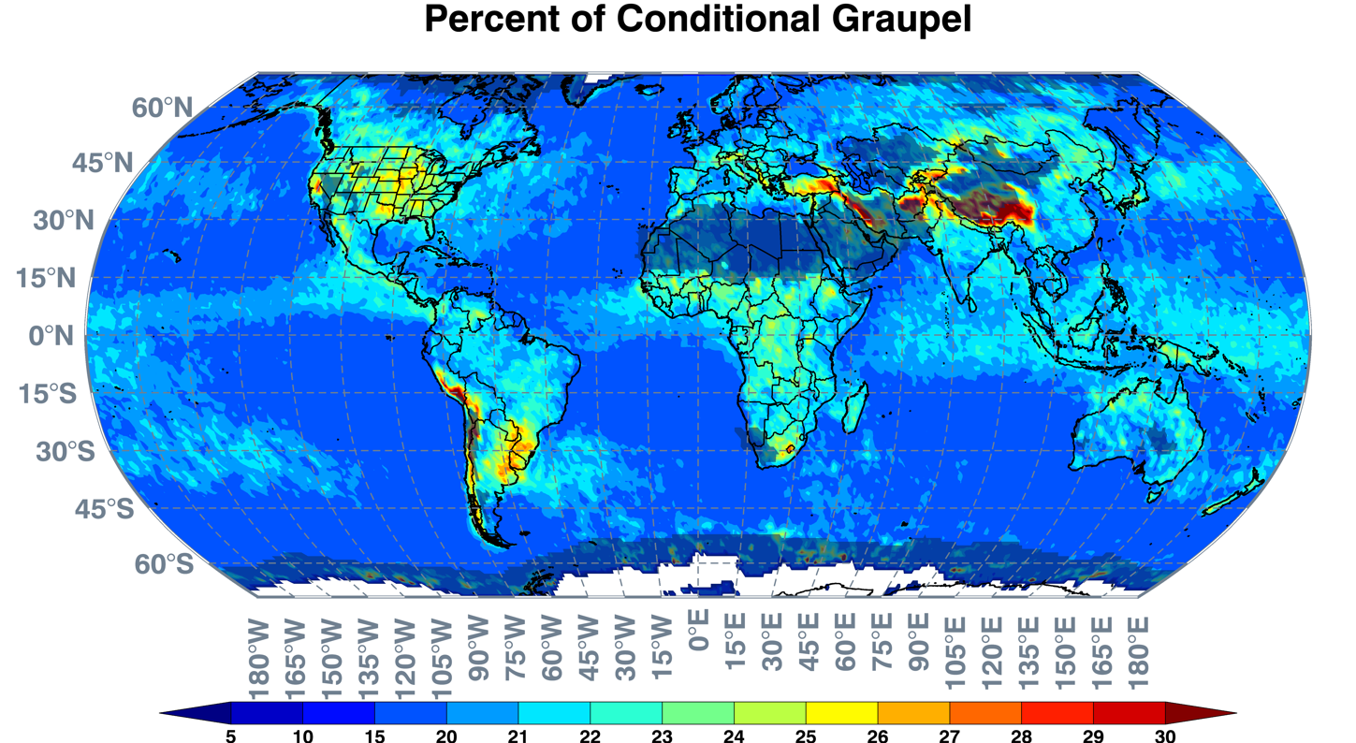
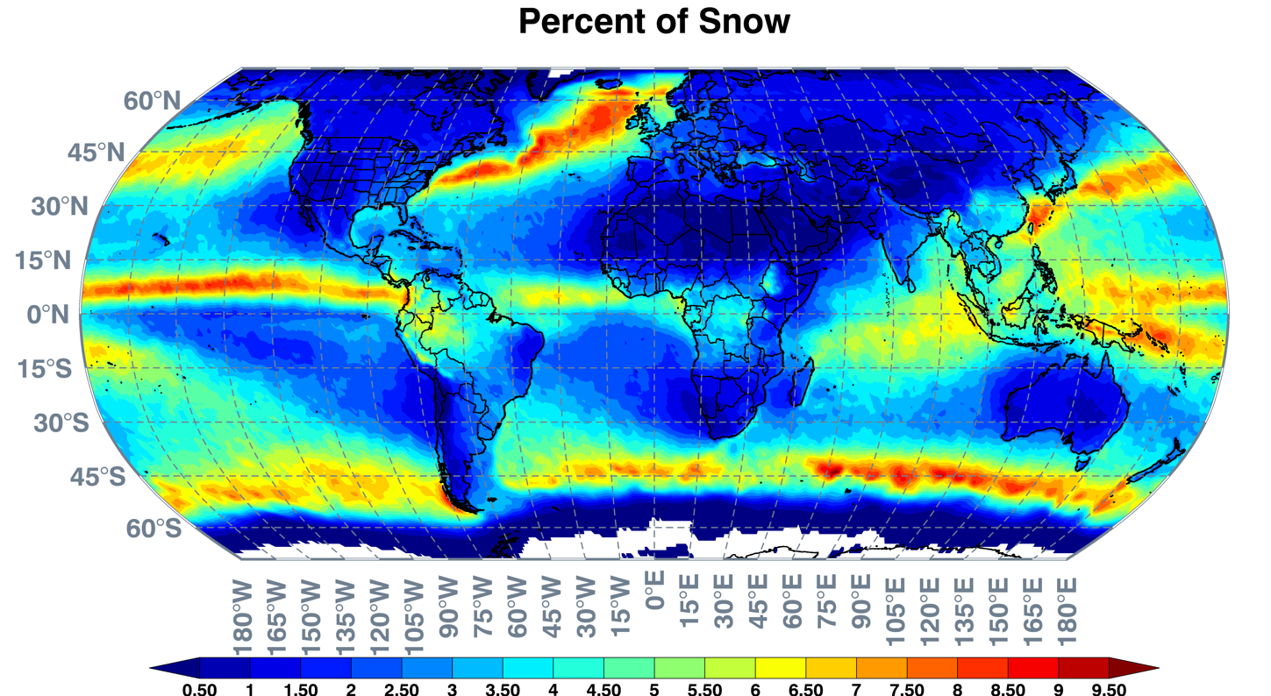
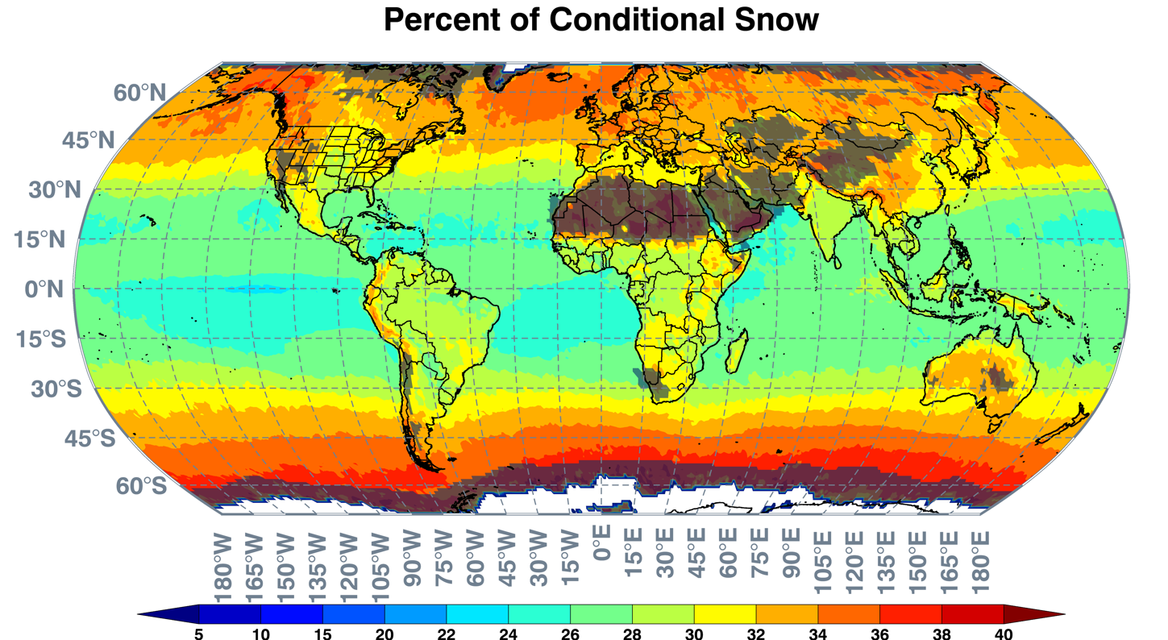
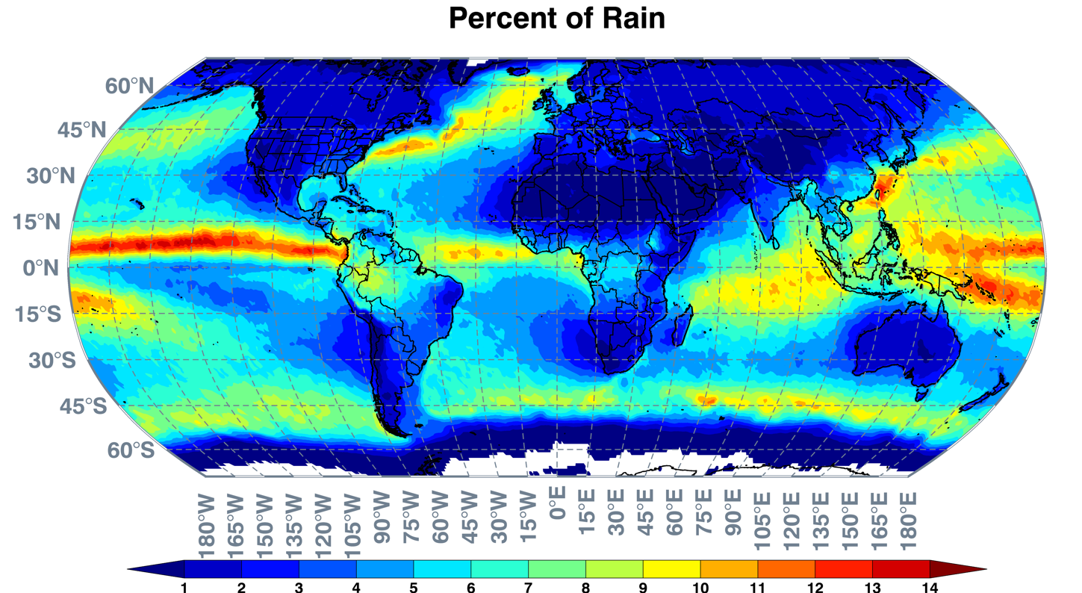
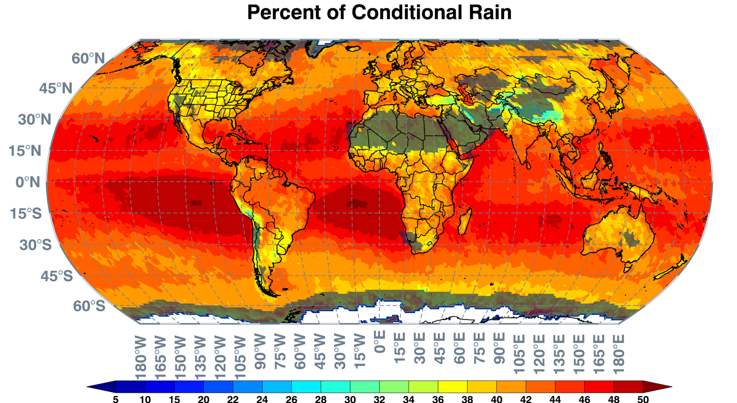
Training and validation data are limited to precipitating pixels.
LEFT:
Total occurrence of each HID, accumulating the percentage HID probabilities from each GMI pixel. The plots are dominated by regions that receive frequent precipitation.
We might overestimate hail occurrence in some high-precip regions by accumulating a large number of low probability events.
Based on verification (bar plots), graupel is under-predicted and liquid rain over-predicted.
RIGHT:
Conditional probability of each HID, when precipitation is occurring (according to GPROF).
Areas that receive low percentages of precipitation (according to GPROF) are shaded.
The top two plots highlight regions known to receive more hail and graupel.
The high percentage of rain and snow pixels located over generally arid locations is due to the conditional precipitation requirement.
Surface temperature > 5°C is used to screen out surface snow/ice.
When retrieval predicts a given HID, how often is it observed? How often are the other HIDs observed?
We test retrieval performance by checking how often a given HID is observed by the VN, as a function of its predicted probability. For example, among all retrievals where we predict a 30% probability of hail, 30% of those GMI pixels should have hail (and 70% should belong to other HID categories).
A perfect retrieval would have the red bars align with the 1-to-1 lines at right.
Underpredictions: bottom bars are above the 1-to-1 line.
Overpredictions: bottom bars are below the 1-to-1 line.
The verification plots here are based on taking the mean probabilities from all six lookup tables for each pixel. We also generate similar plots for individual lookup tables.
For most of the lookup tables, pixels that are predicted to have a very low probability of hail ( < 5% ) turn out to mostly be identified as having snow or rain. Pixels predicted to have a medium or high probability of hail ( > 10% ) turn out to mostly be identified as having hail or graupel .
Pixels predicted to have low probability of graupel have high probability of rain, medium probability of snow.
Probabilities of hail and graupel are both biased low (bars exceed the 1-to-1 line in plots below).
Pixels with a predicted high probability of snow turn out to often have rain (with no snow signature) instead, but sample size is small. Predictions of a moderate (~25-45%) likelihood of snow are most common and usually verify as either snow or rain, with around 20% verifying as graupel.
The lookup tables do not produce very high probabilities of rain (as distinct from the other HIDs), rarely exceeding 55%. Probabilities of rain are biased high. Profiles with rain-only vs those with snow aloft are not distinguished well.
From individual lookup table results (not shown here):
The 37+89 GHz lookup table and 37+Diff166 lookup table have a surprisingly high number of rain pixels (10-20%) where the predicted probability of hail is very high (>70%)… we would expect those to be dominated by hail and graupel instead of hail and rain.
The 89+Diff183 lookup table fails to produce any very high probabilities of hail in our validation set. This channel combination is better for identifying graupel, but not distinguishing it from hail.
Averaging the results of the six lookup tables minimizes such problems, but there may be benefits from adaptively weighting each lookup table before averaging instead.
CAVEATS:
Our training and testing approach only requires the presence of one ground-based radar gate with a given HID type to assign the entire GMI footprint that HID type. E.g., a footprint with one hail gate surrounded by graupel, and with mostly snow and rain at higher and lower elevations, would still be identified as “hail”. Future work may test more stringent coverage requirements.
The GPM Validation Network matching between GMI and ground-based radar does not account for varying footprint size by GMI frequency. Some matchups may be unrepresentative for particular frequencies.
Training and testing are primarily over land, using radars in USA. Does not take advantage of emission signatures over water surfaces.
Initial results were segregated by US region and season. The major differences had to do with how frequently portions of TB parameter spaces were encountered, but not with how the TB combinations mapped to HID types. This gives confidence in applying the results elsewhere.
Lookup tables may not be fully representative for regimes very different from those encountered in USA.
Training does not include echo-free profiles, so a separate rain / no-rain flag discrimination is required. We use GPROF probability of precipitation.
Snow/ice-covered surfaces give TB consistent with hail, so we screen out profiles with surface temperature below 5° C. Our training sample was dominated by warmer temperatures anyway, so application to cold scenes would have reduced confidence.
Everything here uses V05 GPM data. To be updated with V07 in future work.

