Slide 1
Advanced Thermal Capability: Relevant GCD Projects
Surface Systems Capability: Relevant GCD Projects
Angela Krenn
Principal Technologist for Thermal Management Systems
Principal Technologist for Surface Systems
Space Technology Mission Directorate
19 September 2023

Slide 2
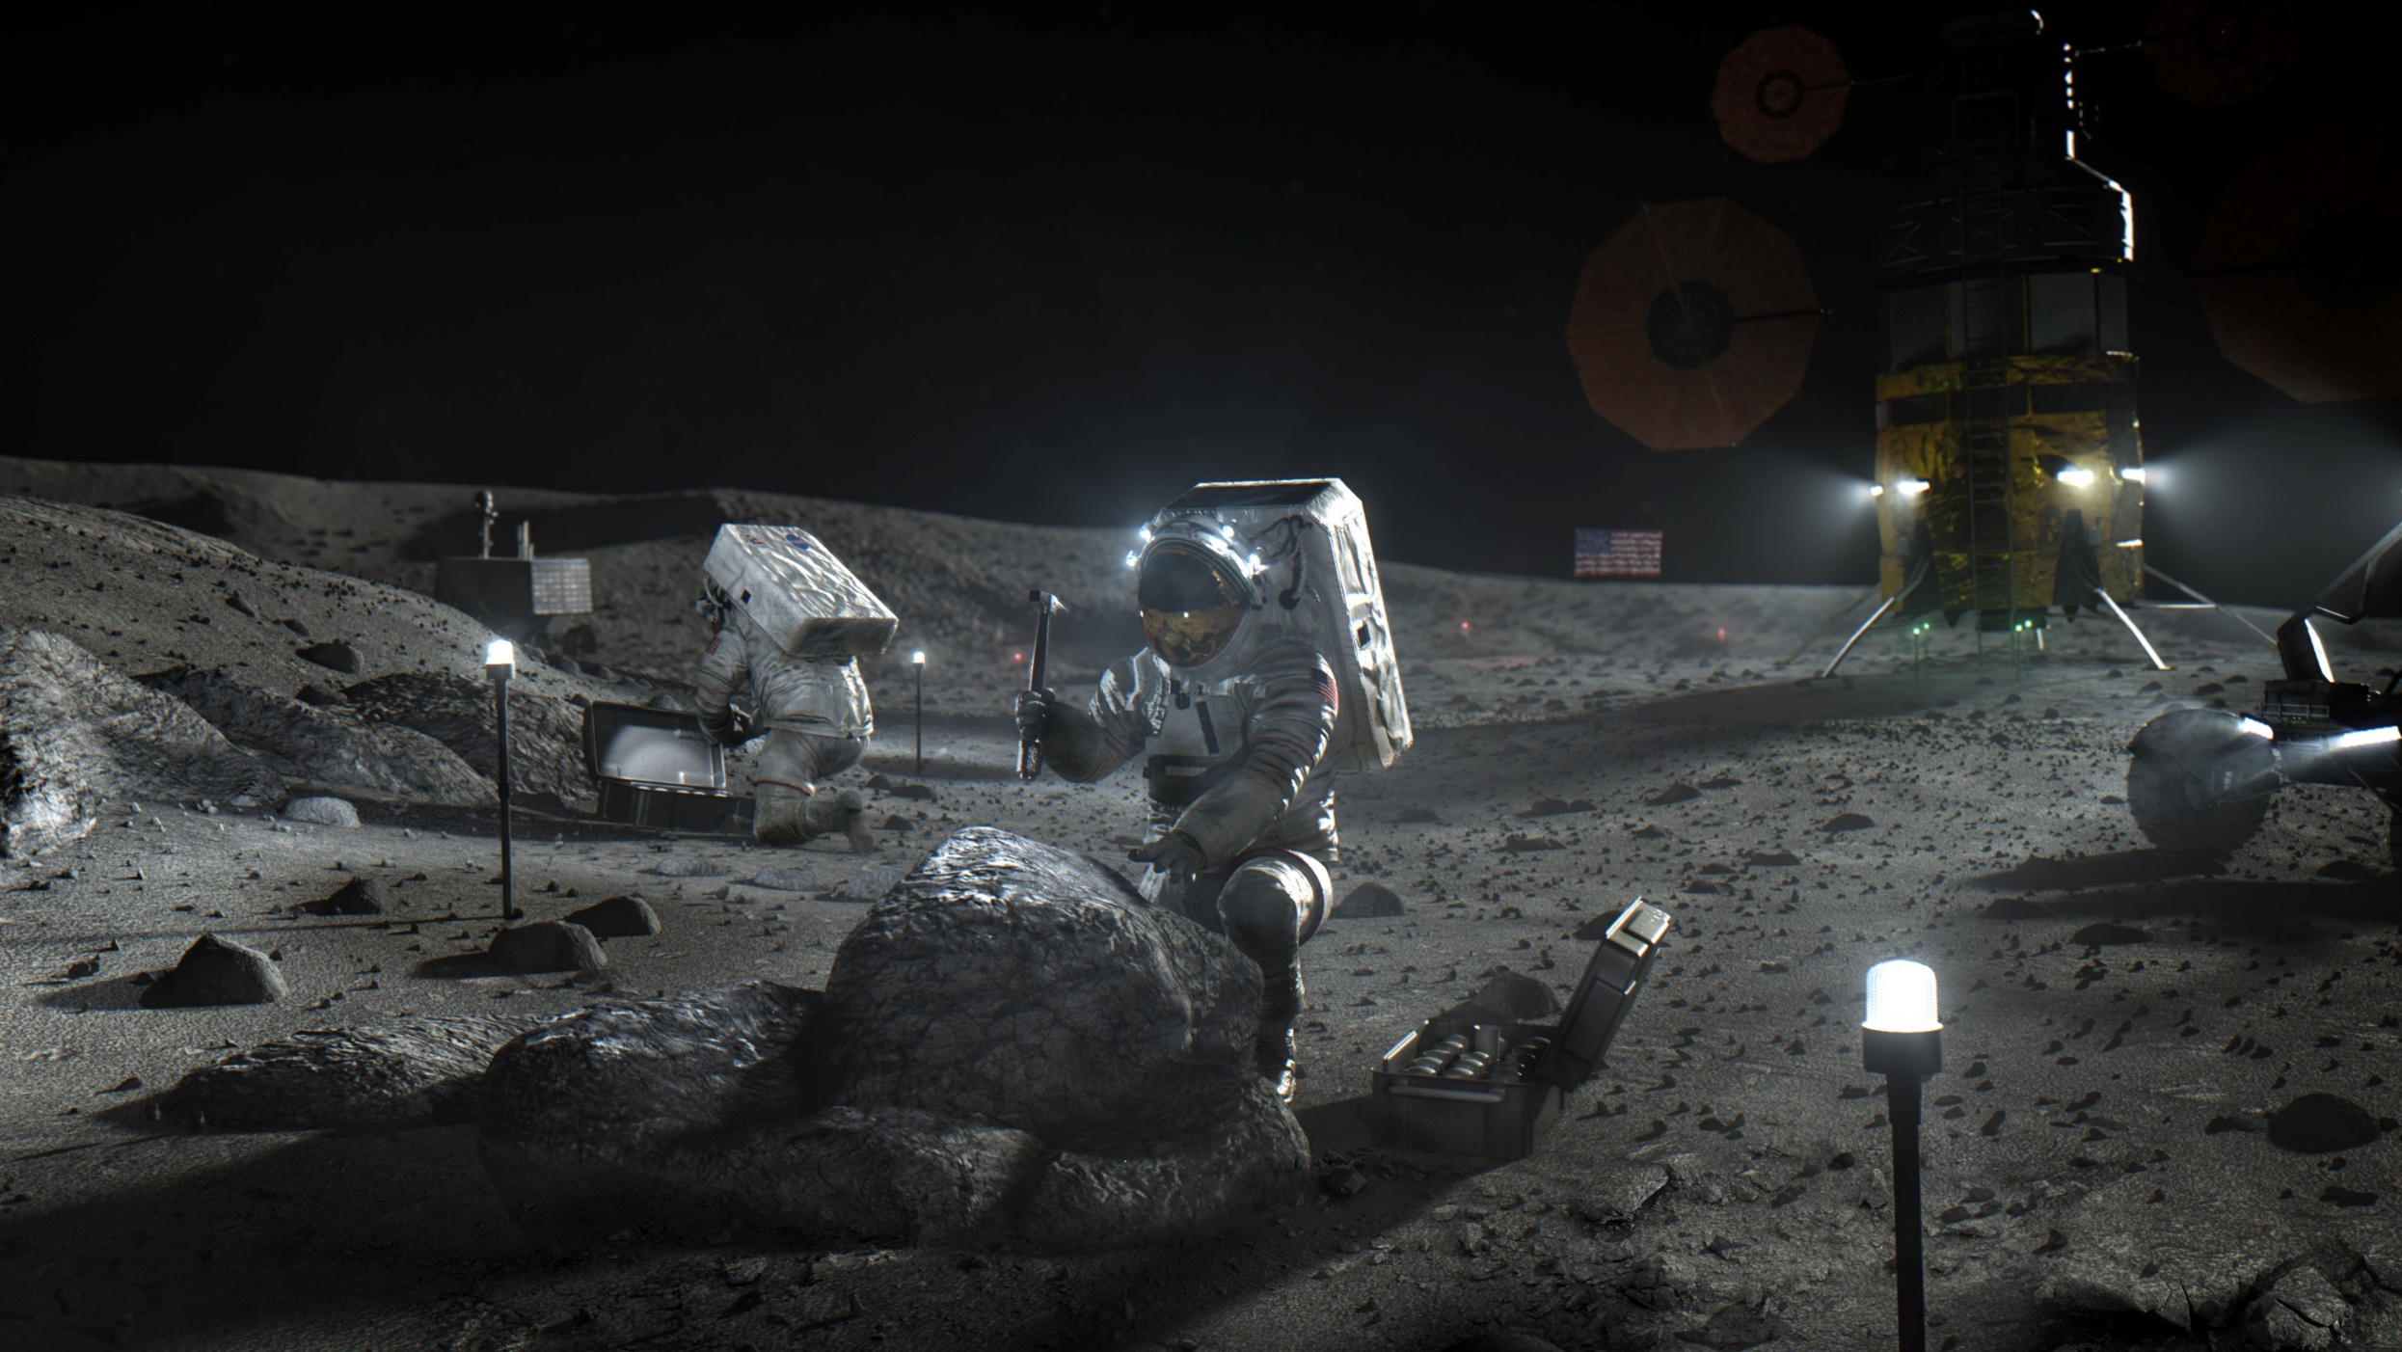
Advanced Thermal Management Technologies to Enable Lunar and Martian Missions
Envisioned Future (Surface temperatures ranging from 400 K to 35 K)
Spacesuits
Closed-loop heat rejection for extreme temperature variations to minimize consumables
Maintain optical properties in dusty environments (BOL average ratio of solar absorptivity to infrared emissivity (α/ε) of 0.21)
Power Systems
Transport heat from source to power conversion system
Reject waste heat efficiently (lightweight radiators with long-life, dust tolerant coatings)
Mobility Systems
Variable Heat Rejection to stay cool in temps up to 400 K while staying warm in temps down to 35 K
Freeze & dust tolerant thermal components
Science Instrument Survival
Variable Heat Rejection to stay cool in temps up to 400 K while staying warm in temps down to 35 K
Habitats
Variable Heat Rejection to stay cool in temps up to 400 K while staying warm in temps down to 100 K
Contamination-insensitive evaporator/sublimators
Long-life condensing heat exchangers
Efficient, non-toxic, single-loop temp control of crew quarters
Long-term cold food storage to maintain nutrients
Cold Tolerant Mechanisms
Years of continuous operation in temperatures down to 35 K
ISRU Commodity Production/Handing
Water sublimation
Commodity capture
Liquefaction and storage
Commodity management during surface transfers
All activities depicted not currently funded or approved. Depicts “notional future” to guide technology vision.

Slide 3
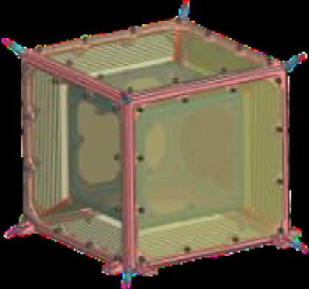
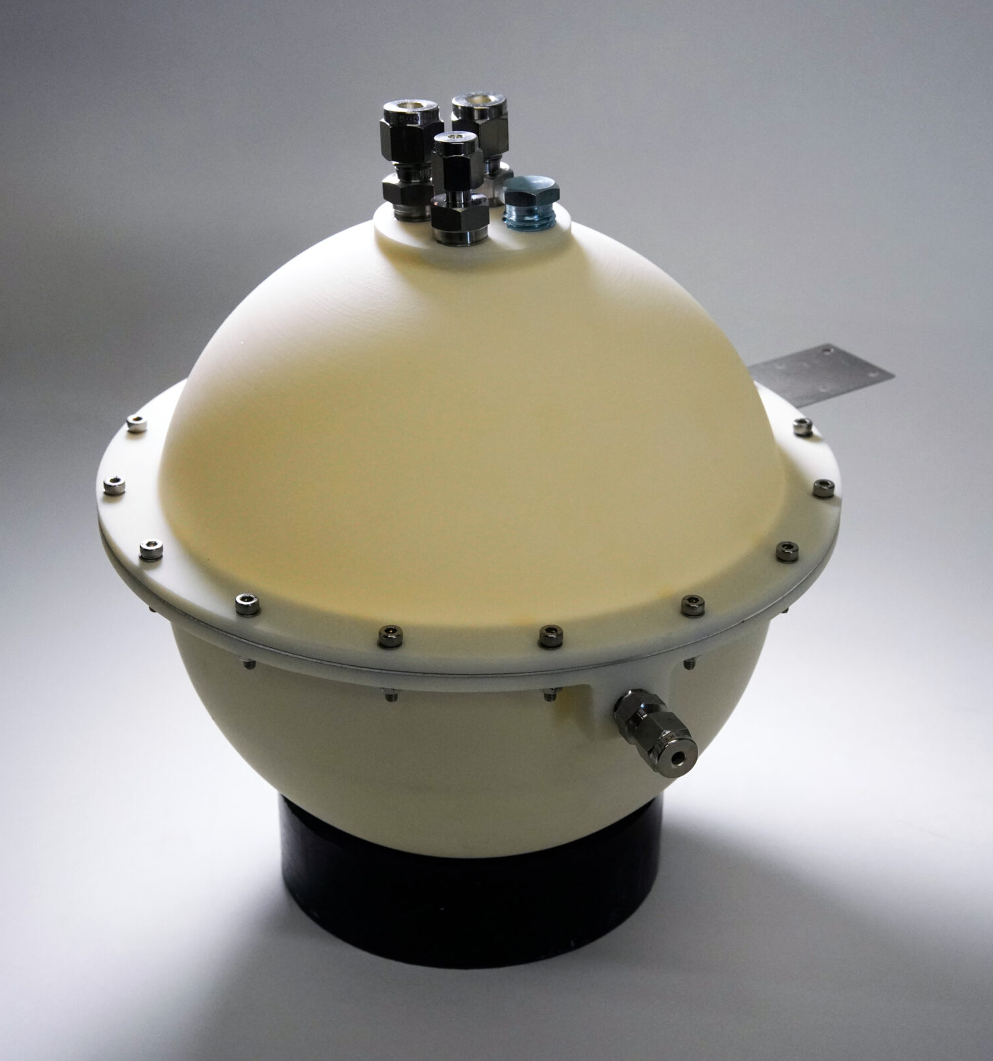
Gap: Variable Heat Rejection (thermal component of survive the night)
Description: Small, independent payloads on the surface of the moon and/or Mars will be subjected to wide environmental sink temperature variations (on the order of 35 K - 400 K) and large variations in induced heat loads. The ability to significantly vary the amount of heat being rejected from surface assets is required to enable long-duration surface operation and traverse.
Metrics: Turn Down Ratio - State of the Art 30:1, Target > 100:1 Target TDR should be achieved at maximum expected heat load. Target values represent system level TDRs. Component level TDRs may far exceed these values, but gap closure can only be achieved through system capabilities.
Note: This gap addresses system level needs. Development of variable emissivity coatings, variable view factor radiators, thermal switches, phase change materials, multi-phase flow, freeze tolerant components, advanced insulation, etc. may contribute to gap closure.
Planetary and Lunar Environment Thermal Toolbox Elements (PALETTE) – JPL
Thermal Switching
Parabolic Reflective Radiator
Spacerless MLI
Thermal Isolation
Metal Oxidation Warming System Fuel Cell (MOWS) – Tipping Point, Astrobotic
Exothermic chemical reactions
Provides heat & power to payloads
Photo Credit: Astrobotic

Slide 4
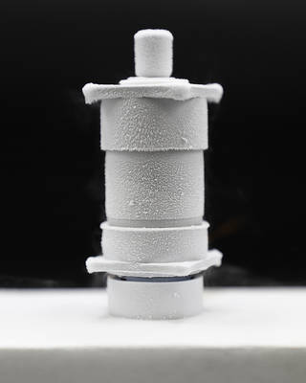
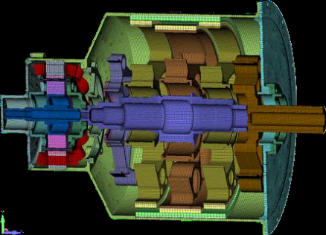
Gap: Cold Tolerant Mechanisms
Description: Mechanisms in surface applications will be exposed to a wide range of temperatures and must maintain functionality throughout.
Metrics: Minimum operating temperature: State of the Art 220 K, Target < 35 K Target operational temperature must be achieved passively (without heaters).
Note: This gap is cross-cutting with applicability to mobility systems, transfer umbilicals, logistics off loaders, excavation and construction equipment, and more.
Motor for Dusty & Extremely Cold Environments (MDECE) – GRC
Magnetically geared motor (non-contact, lubrication free gearing)
Unheated piezoelectric motor (design only)
No heating required down to 33 K
Dust tolerant
Bulk Metallic Glass Gears (BMGG) – JPL
Bulk Metallic Glass alloy mechanisms
  Planetary gearmotors
  Strain wave gear flexsplines
No heating required at or below 100 K

Slide 5
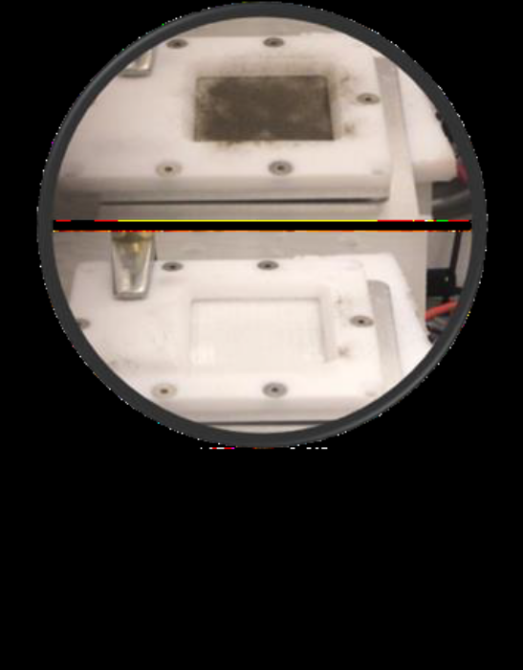
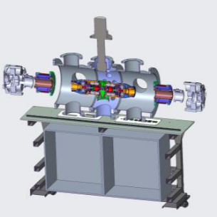
Gap: Dust Tolerant Thermal Systems
Description: Thermal Management Systems on extraterrestrial surfaces will be exposed to regolith. Radiator effectiveness, suit performance, and other system efficiencies will degrade with dust collection. New technologies are needed to either prevent dust collection or remove collected dust to minimize degradation.
Metrics: Pristine Surface Area: State of the Art 0%, Target > 90% Surfaces should achieve target metrics after a representative 10-year life.
Dust Mitigation – Electrodynamic Dust Shield (EDS) – KSC
EDS on thermal control coatings
CLPS demo planned
Dust Mitigation Development – GRC
Dust tolerant mechanism seals
Dust infiltration reduction
Increase seal life with dust infiltration

Slide 6
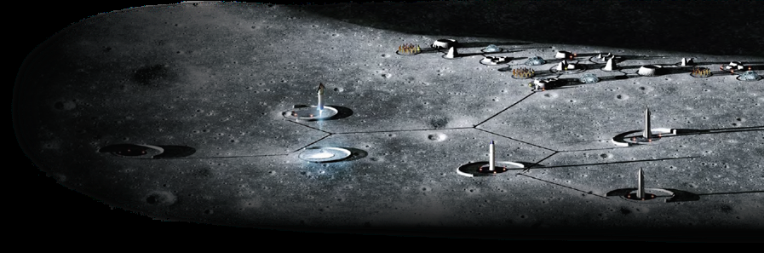
Ground and Surface Support Systems to Enable Long Duration Surface Stays
Envisioned Future (Lunar Space Port & Mars Forward Proving Ground)
Planning & Scheduling
Surface environment/weather forecasting
Autonomous, adaptive, supervisory monitoring and control of surface operations
Consumables Management
Real-time in-situ resource availability visualization
On-demand availability of all critical commodities
Autonomous, zero-loss fluid transfers
In-situ sampling and analysis
Hardware Interfaces
Interoperable, standard, robotic interfaces
Robust, reusable interface seals
Autonomous integrity verification
Autonomous mate/de-mate of interfaces
Logistics Management
Real-time, autonomous, global tracking and health monitoring of all surface assets
Recycling/reuse of 95% of Earth-born products
In-situ quality/damage assessments
Autonomous payload maneuvering
Hardware Health Management
Robotic caretakers to reduce crew-dependent maintenance and repairs
Intelligent devices to reduce troubleshooting
Prognostics for condition-based maintenance
Autonomous fault detection, isolation, and
recovery from > 85% system faults
Data fusion enabled decision-making
Site Preparations
Reference the Excavation, Construction, and Outfitting Envisioned Future Priorities
Not all activities depicted are currently funded or approved. Depicts “notional future” to guide technology vision.
3

Slide 7
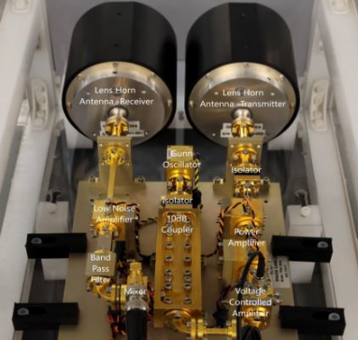
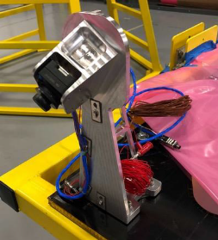
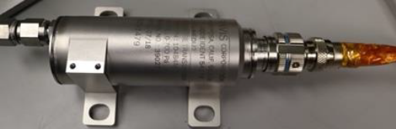
Gap: Surfaced-based Instrumentation for Full Field Debris Characterization
Description: A robust surface presence will expose surface assets to a wide variety of debris risk, including micrometeoroid, launch and landing ejecta, excavation ejecta, etc. Characterizing, predicting, warning, and reacting to this debris field will be required to minimize damage to surface assets and personnel.
Metrics: Detectable surface-borne debris size – State of the Art 3,000 microns, Target 50 microns; Detectable meteoroid diameter – SoA 5,000 microns, Target 400 microns; Debris velocity determination – SoA 8 km/s, Target 70 km/s; Sensing Distance – SoA Earth to GEO, Target 100 km; Coverage Area – SoA 230 km radius, Target > 2 km radius
Note: Closure of this gap may require a distributed network of multiple sensor types.
Stereo Camera for Lunar Plume-Surface Studies (SCALPSS) – LaRC
Stereo imaging of plume surface interactions during CLPS lunar landing
High altitude imaging prior to interactions onset
CLPS Payload for PSI Measurement Mini-Suite (CLPS-PSI) – LaRC
Includes SCALPSS
Lunar Lander Base Instrumentation
Particle Impact Event Sensor
Dust Ejecta Radar Technology
Mini-Suite Electronics

Slide 8
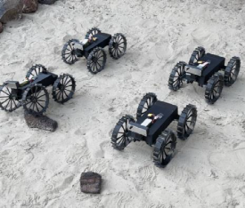
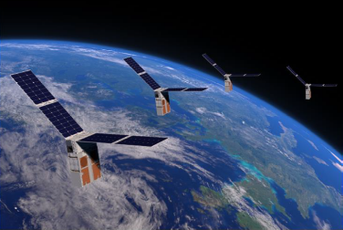
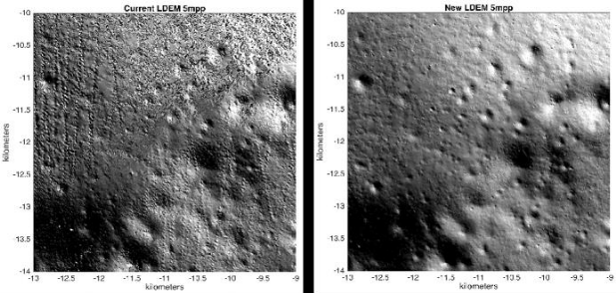
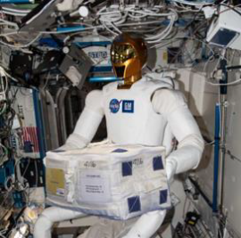
Relevant GCD projects leverageable toward multiple Surface Systems gaps
Cooperative Autonomous Distributed Explorers (CADRE) – JPL
Autonomous control of multiple surface robots
Multiple robots acting as a collective
Distributed Spacecraft Autonomy (DSA) – ARC
Autonomous control of a spacecraft swarm
Multiple spacecraft acting as a collective
Integrated System for Autonomous and Adaptive Caretaking (ISAAC3) – ARC
Integration of data from disparate sources
Control interface integration
Coordinated task execution
Lunar DEM, Mapping, Modeling, and Visualization (LuNaMaps) – GSFC
Data merging
Synthetic map enhancement

Slide 9
Roadmaps coming soon

