Slide 1


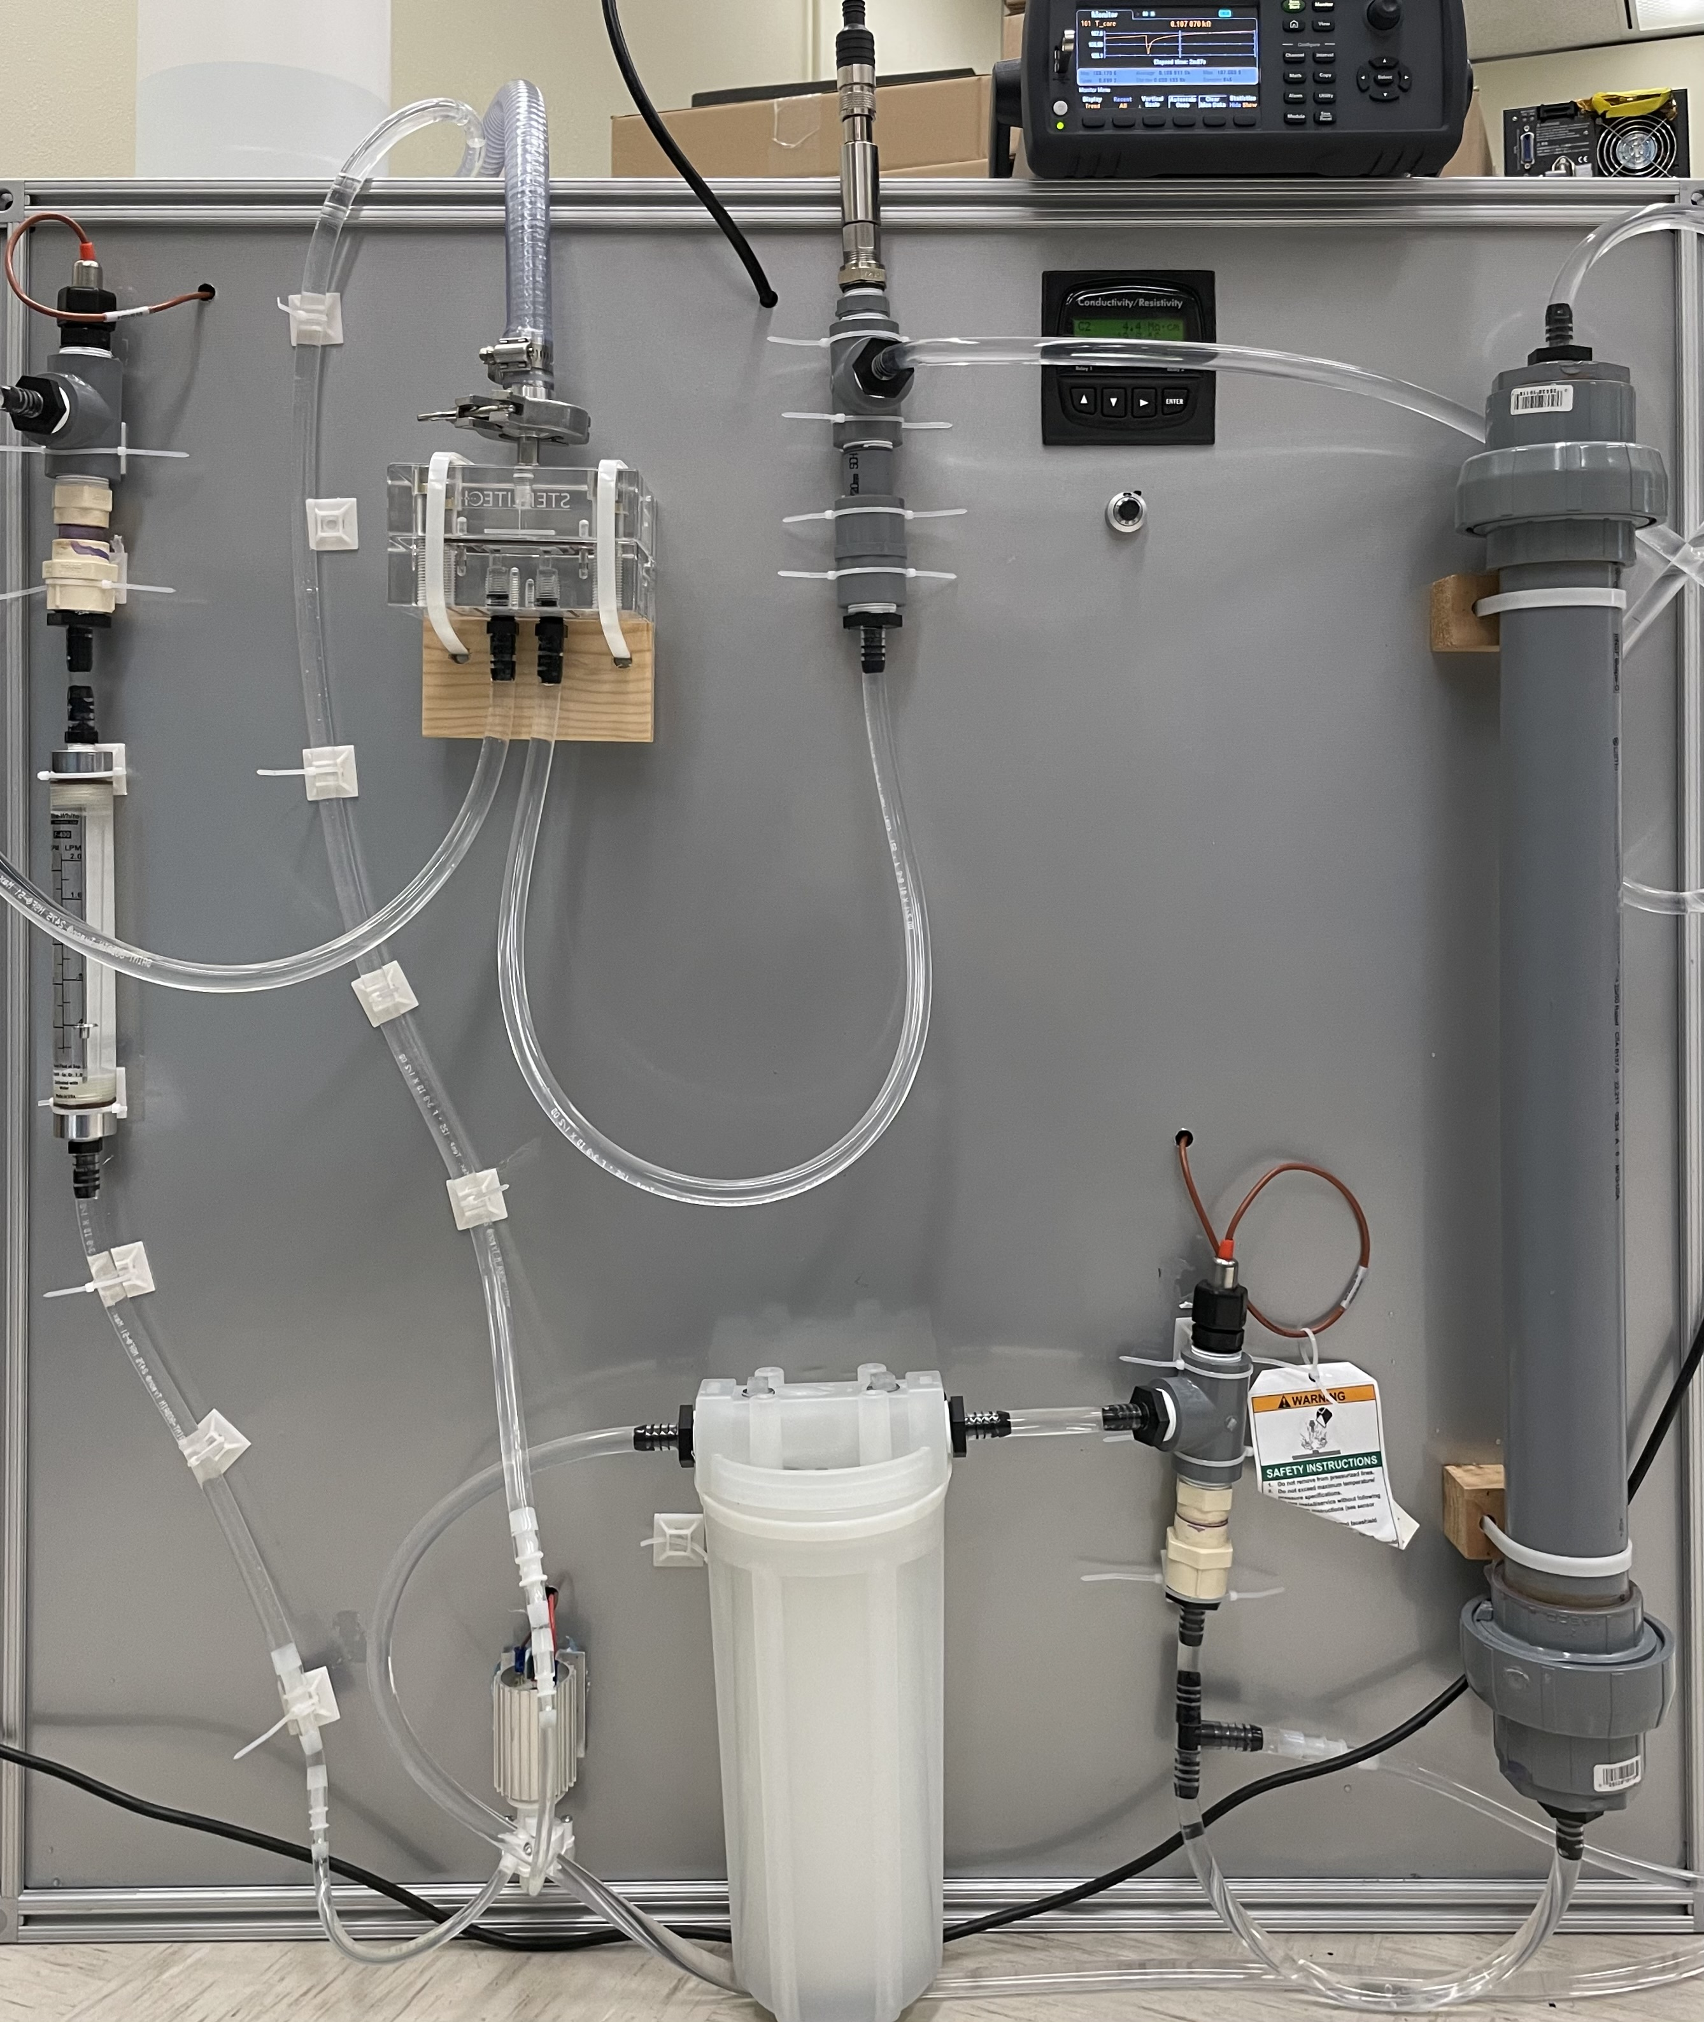
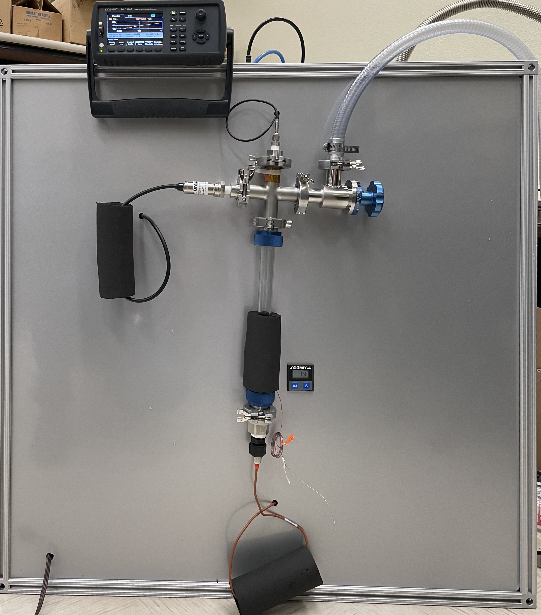
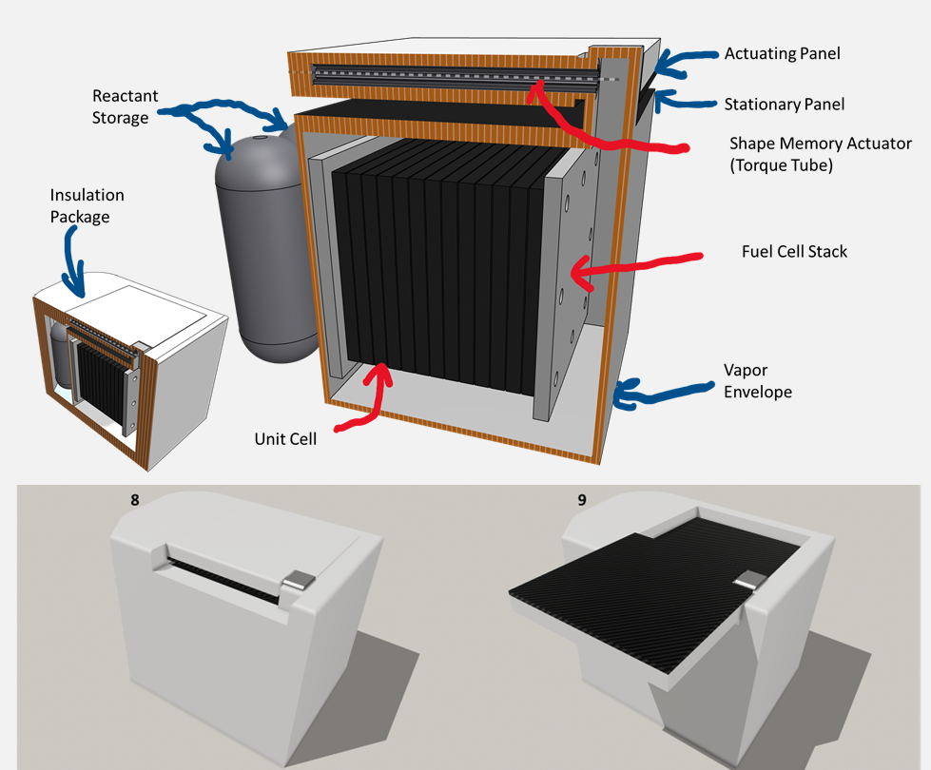
Lunar Passive Fuel Cell Technologies: Evaporator + Fluid Polishing Elements
TBD
PM / PI Info Thomas Cognata | Thomas.J.Cognata@nasa.gov
EXECUTIVE SUMMARY
This project investigates key elements of a fully-passive, fuel-cell based, surface power generation concept. The overall concept replaces the actively pumped thermal management of a state of the art (SOA) fuel cell/electrolyzer stack with a passive 2-phase thermosyphon for heat transport and a passive shape memory actuating radiator for temperature management. The elements of the concept investigated in this project are:
Evaporator element: Evaluating the compatibility of common fuel-cell interconnect materials in the evaporator of a 2-phase water thermosyphon
Fluid Polishing element: The use of membrane gas separation and resin water polishing to address non-condensable gas removal and water purity.
Innovation
The overall passive fuel cell concept eliminates wearing parts and control complexity associated with fuel cell system thermal management. It is a system-level solution that spans heat acquisition, transport, and rejection. It
Improves reliability and operating life by removing pumps and control valves/devices and electronics from thermal management subsystem.
Reduces control complexity through inherently temperature dependent material behaviors (Shape memory alloy actuates between 50C and 70C)
Improves mission flexibility (survive night, direct solar, permanent shadow) via high thermal turndown. Applies to Moon and Mars.
This effort specifically addresses elements of the overall concept:
Removal of non-condensable gases (from leaks/reactions) from the concept thermal management system via a porous hydrophobic membrane to prevent gas build-up from blocking the condenser.
Maintaining a high water purity to prevent electrolysis when cooling the fuel cell.
Identifying candidate materials that are electrically conductive and compatible with pure water when used as an evaporator in the concept.
Collaboration
Texas A&M University collaborates on the overall concept, though not in this limited effort.
Test systems built for investigating (left) Fluid Polishing and (right) Evaporator elements
Outcomes & Infusion
Two test systems were designed and built to investigate these fuel cell technology elements.
A water test loop has been built that incorporates membrane separation and resin deionization.
Gas is readily separated from a high purity water system via porous hydrophobic membrane. The approach is also effective at removing dissolved gases.
Water was maintained at >18MW by the system.
A glass/stainless thermosyphon rig was built that that provides for heating, cooling, and monitoring water quality.
High starting purity for each test proved challenging, and stock materials for evaporator testing had differing characteristics. These issues limit conclusions on relative performance.
Candidate evaporator materials have been characterized, though they do impact water resistivity in low and stagnant flows. Further investigation is warranted.
This effort advances TRL for the elements from 2 to 3.
The lessons learned in investigating these elements will be applied to the Passive fuel-Cell Surface-power System (PaCeSS) Center Innovation Fund (CIF) effort selected for FY’24.
Future Work
Fluid Polishing: Potential design approaches were identified to improve on the results of this project and will be evaluated in the PaCeSS effort using the test stand built in this effort. - Improved collection and separation of non-condensable, undisolved gas may be accomplished using a chamber design that allows for gravity separation and a strategically placed hydrophilic membrane. - A single chamber that integrates deionizing resin and gas slug separation can reduce overall footprint. - Removal of dissolved gasses may be best performed in a downstream second stage membrane device having a higher surface area to flow area ratio.
Evaporator: Updates to the test apparatus were identified to improve on results. - A simplified test (e.g. material sample placed in glass-only container) should limit interactions with test water, addressing starting purity. - Fabricating custom evaporator elements with common build parameters will provide stronger data for a downselect.
A PaCeSS sketch showing (top) components and (bottom) behavior of the concept.
DAA# | 20230013205
NTR#(s) | 1694447882, MSC-27638-1

