Slide 1
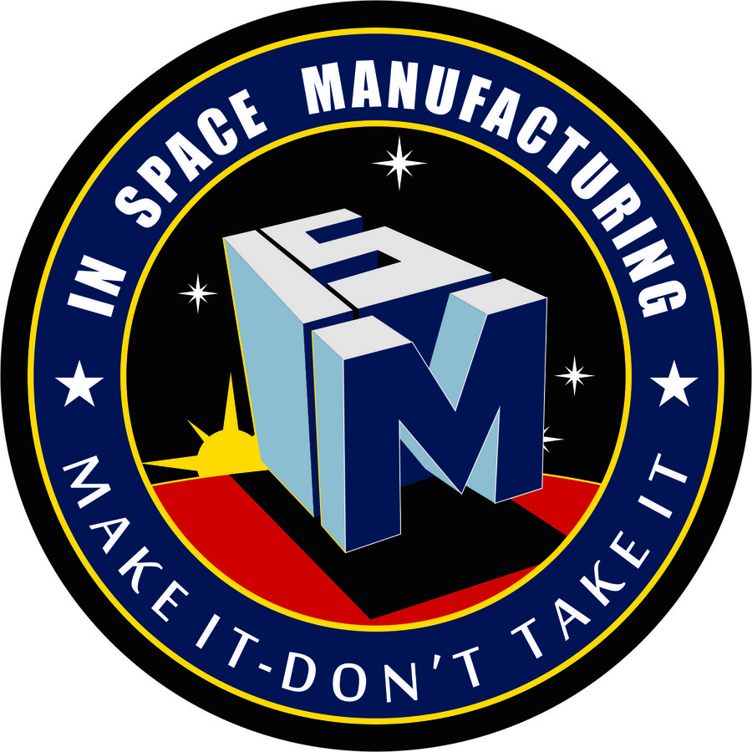
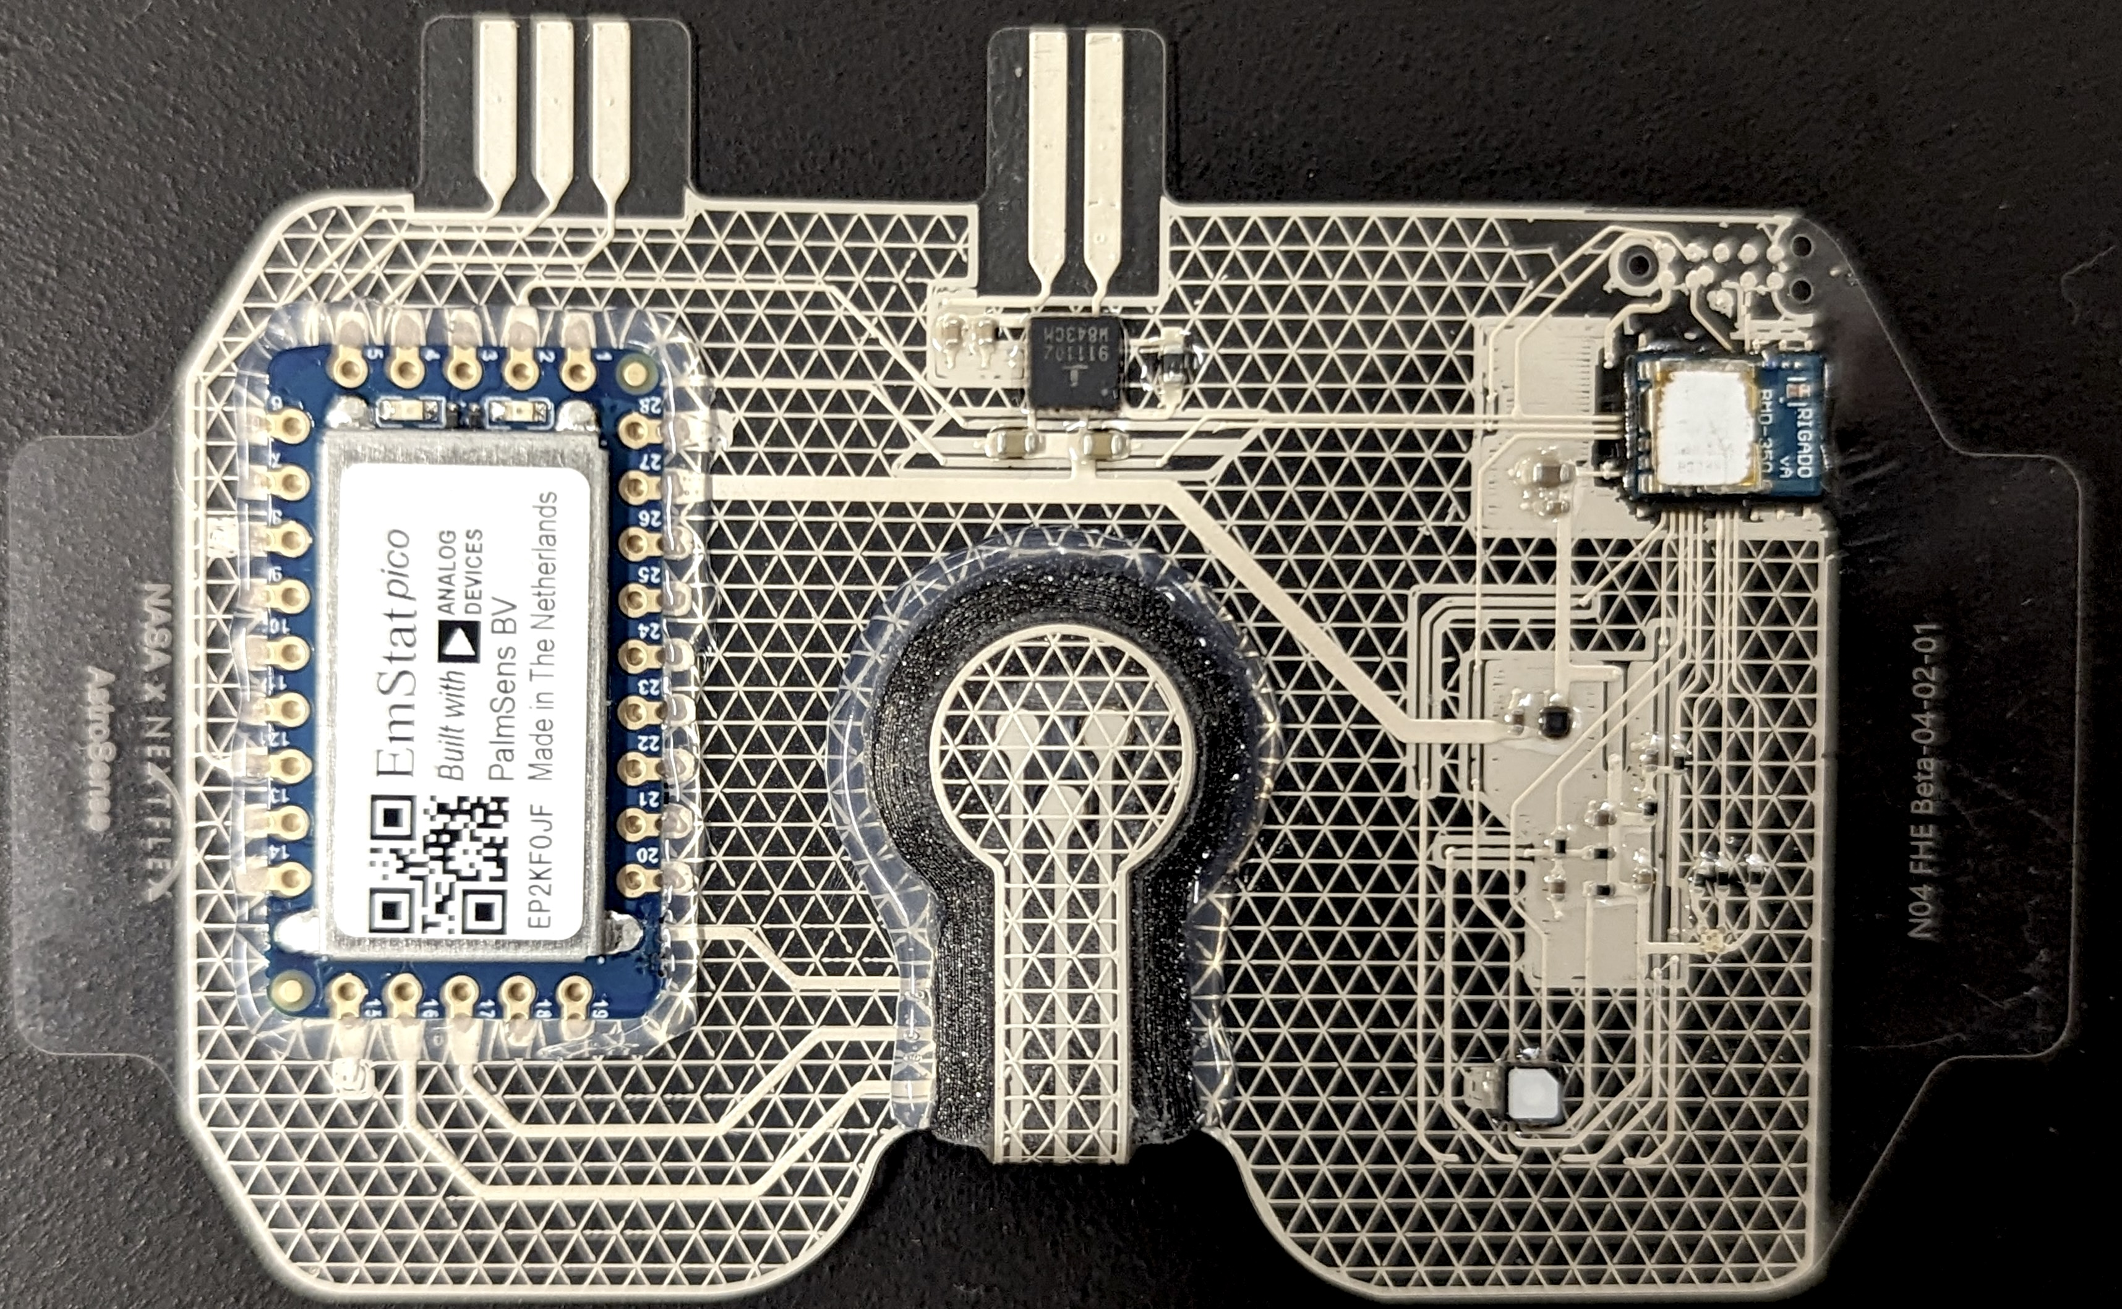
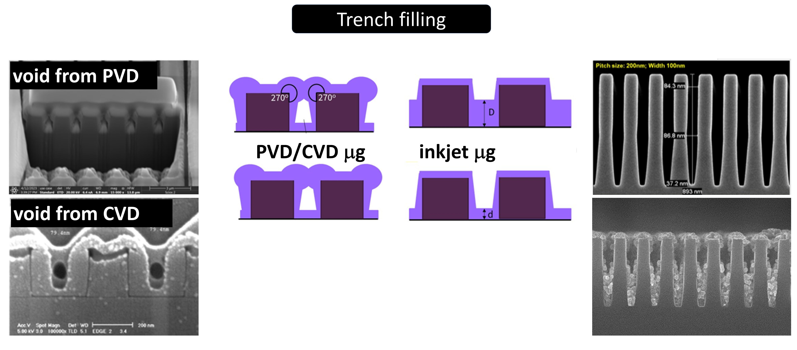
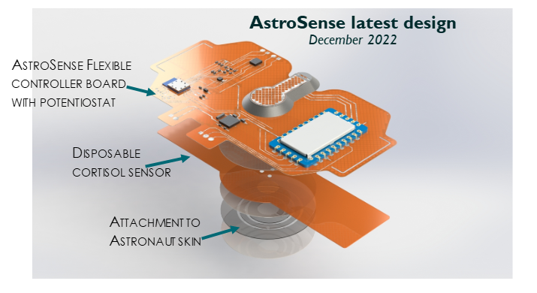
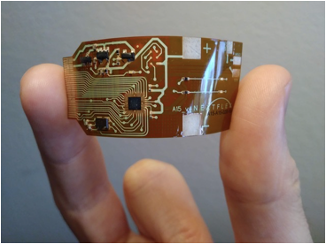
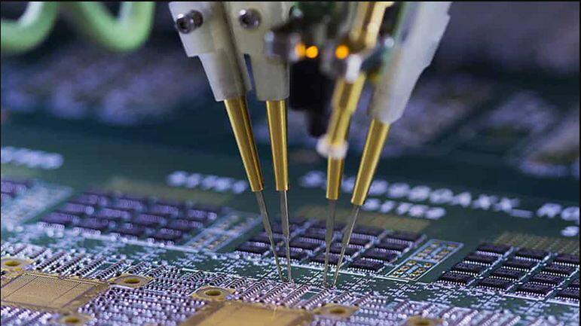
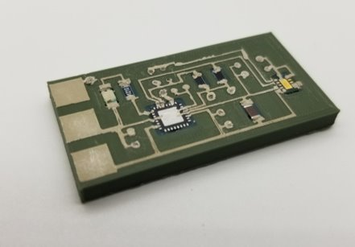
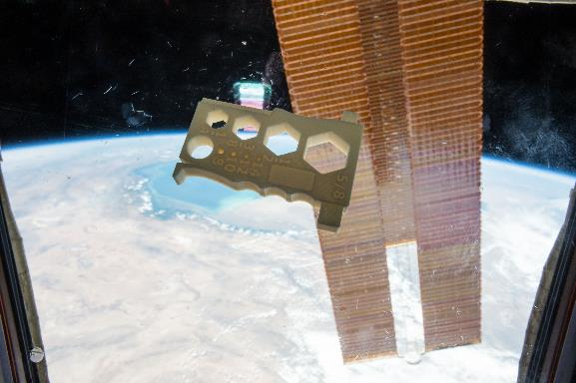
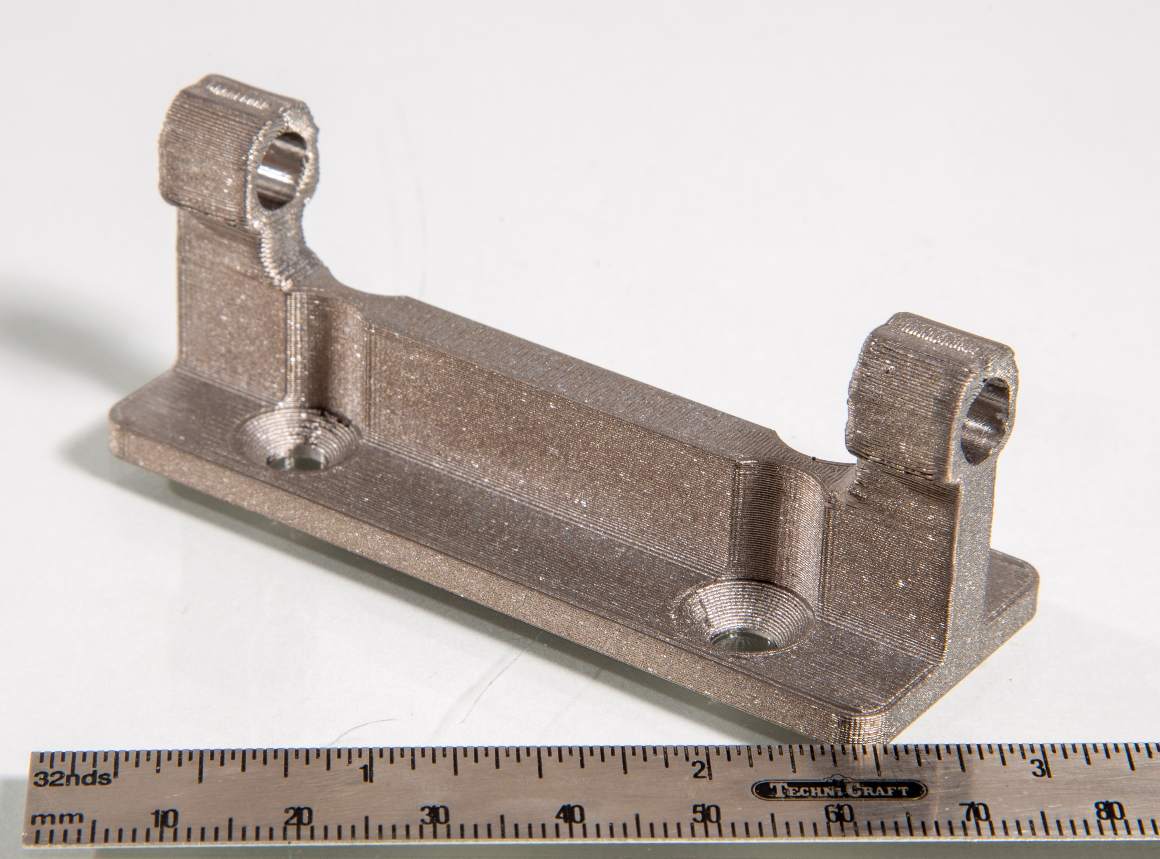
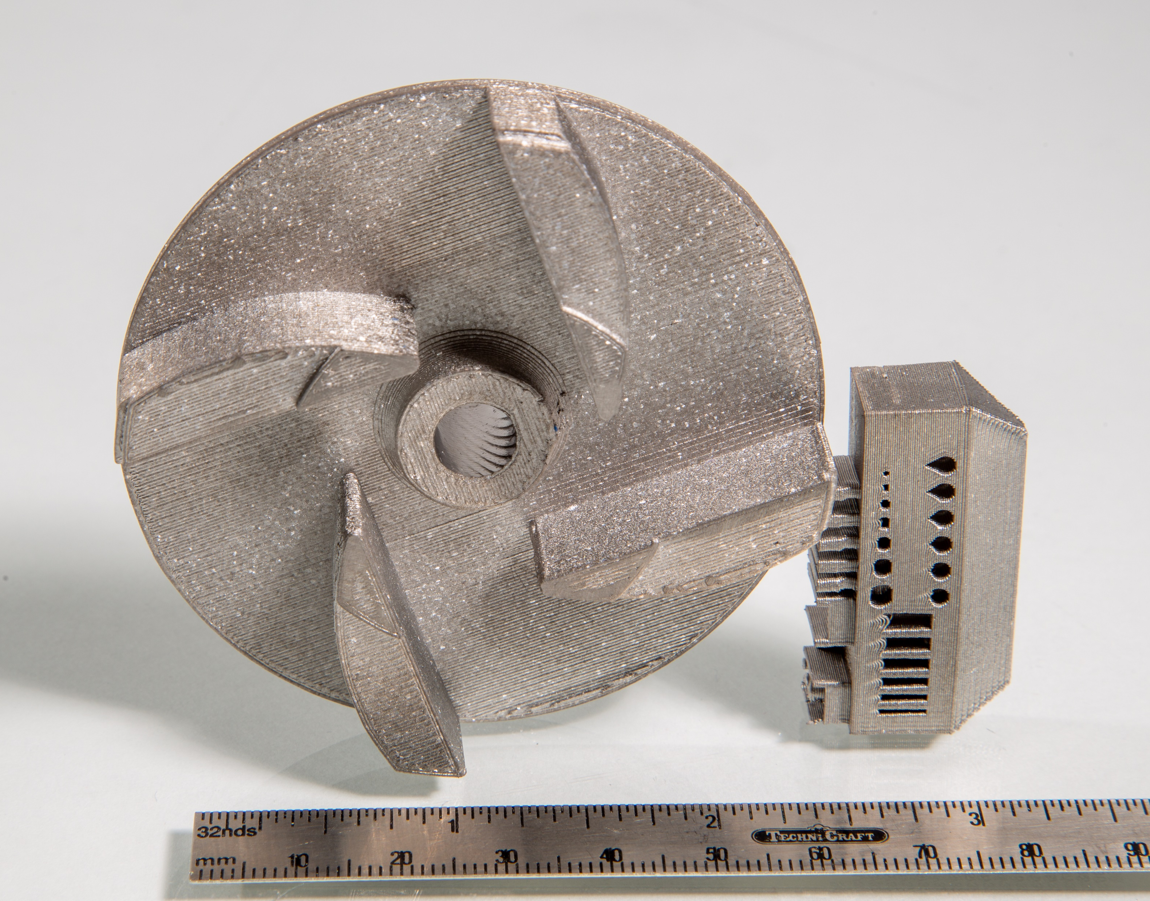
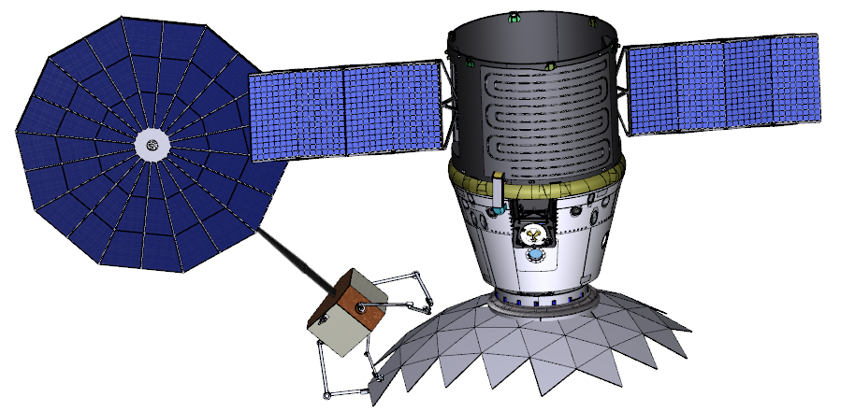
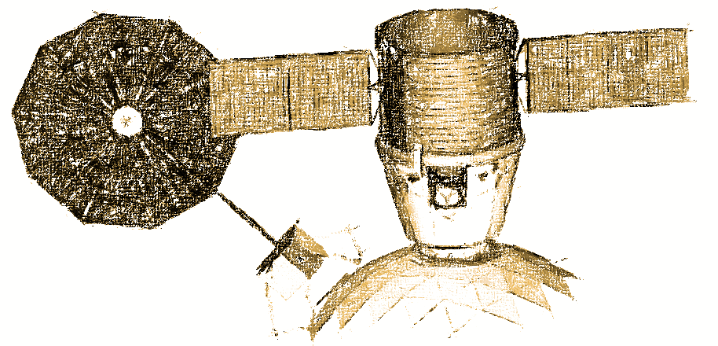
In-Space Manufacturing
Project Overview
The NASA In-Space Manufacturing (ISM) Portfolio, managed out of the Marshall Space Flight Center, is working to develop capabilities for sustainable manufacturing and the ability to repair components and infrastructure during NASA Exploration Missions (Low Earth Orbit, transit, and non-terrestrial surfaces).
Technical Approach
The ISM Portfolio seeks out opportunities to develop fundamental manufacturing processes for use in space through testing in increasingly high-fidelity environments (e.g. thermal vacuum chambers and parabolic flights to orbital demonstrations). Technology Maturation Plans are utilized to define a clear path to the advancement of Technology Readiness Level and to link development goals to NASA strategy.
Infusion Plans
The ISM Portfolio identifies infusion opportunities early in the pursuit of new technology development areas by seeking out customers and partners across NASA, industry, academia, and other government organizations. Relationships are built through collaborating on projects of progressively increasing scope, budget, and schedule demands. By incorporating persistent communication with partners and customers from ideation to execution, the ISM Portfolio develops and matures new capabilities that cater to end-users’ needs.
On-Demand Printed Electronics: Wearable Health Monitoring Patch
Printed Electronics: Higher Resolution and Fewer Defects in µg
Multilayer Printing
On-demand Manufacturing of Critical Parts and Tools
In-Space Welding
Space Environment Testing
Weld
Vacuum
μg
In-Space Welding Digital Twin

