Slide 1

NASA’s Science Discovery Engine: An Open Science, Interdisciplinary Data and Information Discovery Capability
Kaylin Bugbee
NASA Marshall Space Flight Center
September 13, 2023

Slide 2
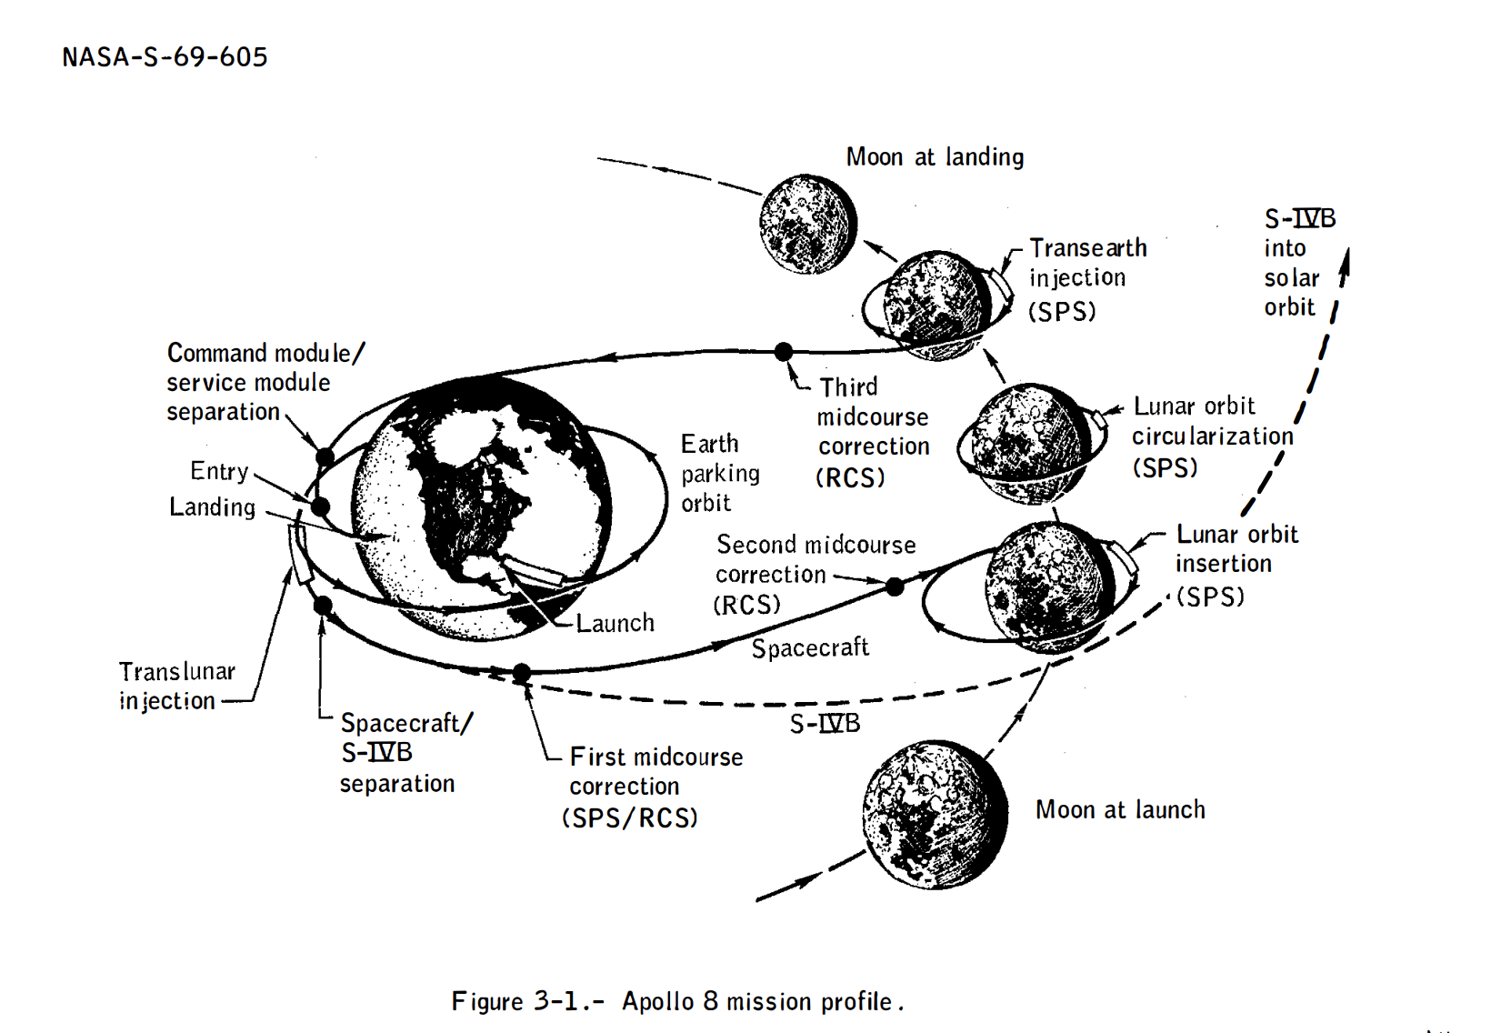
Talk Flight Plan
NASA’s diverse open science data
NASA’s Open Source Science Initiative
NASA’s Science Discovery Engine
Image Credit: NASA
Notes:
https://history.nasa.gov/alsj/a410/A08_MissionReport.pdf

Slide 3
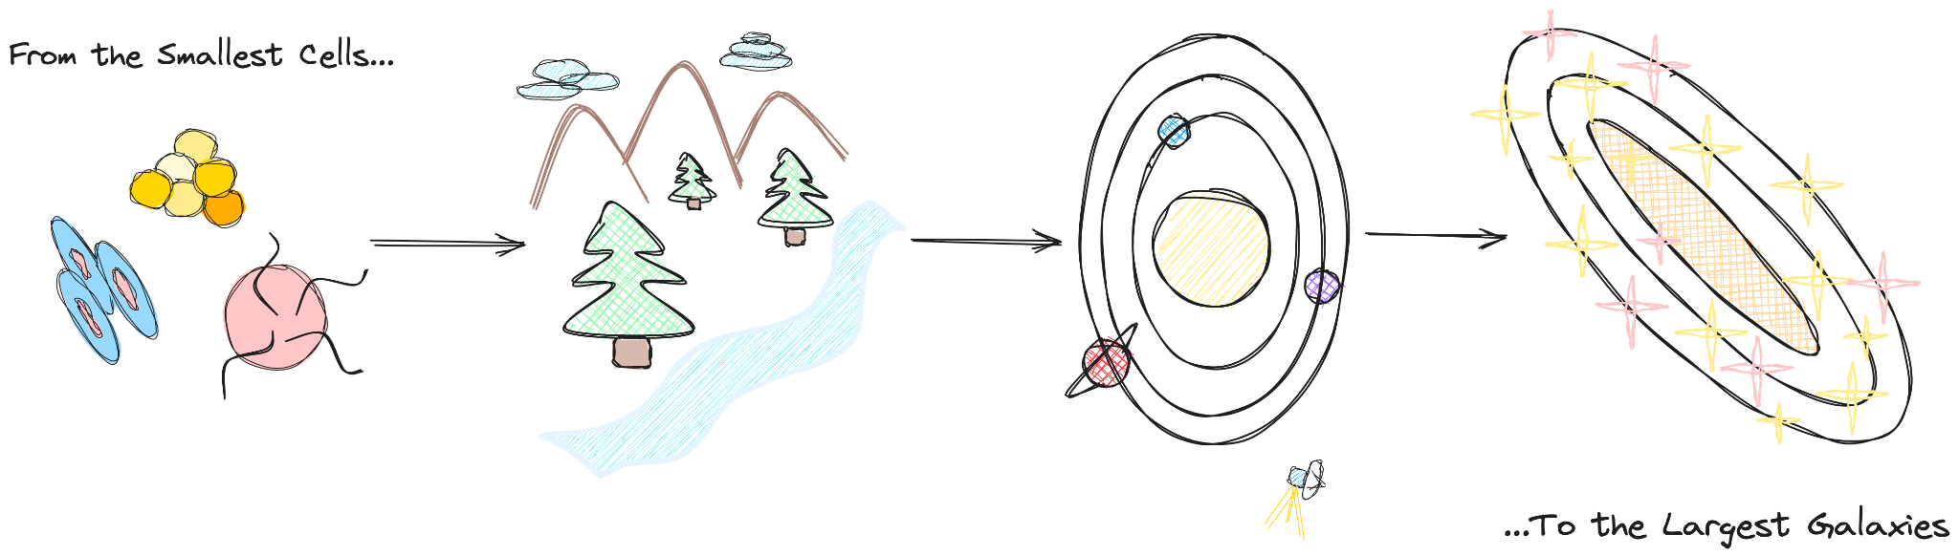
Science at NASA
“...the most powerful [ideas], the ones that are really transformative, they almost always come out of the collision between at least two or three or four different intellectual worlds or traditions or fields or disciplines. The border between disciplines is where the exciting stuff happens.”
– Steven Johnson
Image Credit: SDE team
Notes:
Image created by SDE team

Slide 4
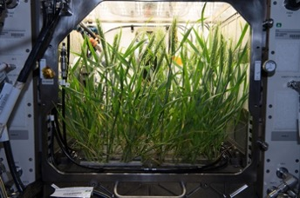
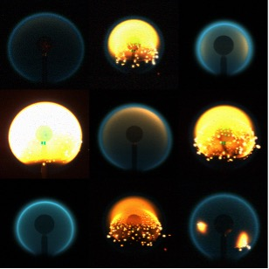
Flames from the ACME experiment, Credit: NASA
Dwarf wheat in the Advanced Plant Habitat (APH), Credit: NASA

Slide 5
Biological and Physical Science (BPS) Overview
BPS uses spaceflight environments to study biological and physical systems.
Examining phenomena under extreme conditions can help scientists better understand how they function.
This can contribute to significant scientific and technological
advancements that
make fundamental advances in science,
enable space exploration, and
benefit life on Earth.
Notes:
https://science.nasa.gov/science-red/s3fs-public/atoms/files/Kundrot%20at%20OSU%2029Sept2022_Tagged.pdf

Slide 6
BPS Repositories and Data
Life Science Repositories
Physical Science Repository
Ames Life Sciences Data Archive (ALSDA): non-human science data generated by NASA's Space Biology Program and Human Research Program
GeneLab: Open Science for Life in Space: omics data from spaceflight and corresponding analogue experiments
Open Science Data Repository: consolidates data from GeneLab & ALSDA into a single site
Physical Science Informatics (PSI) includes data from the following research areas:
  Biophysics
  Combustion science
  Complex fluids
  Fluid physics
  Fundamental physics
  Materials science
Large proportion of data acquired is “Research” data (vs. “Mission”). Data are conceptualized around the idea of an ‘experiment’ or ‘study.’
Notes:
genomics, proteomics, metabolomics, metagenomics, phenomics and transcriptomics. Omics aims at the collective characterization and quantification of pools of biological molecules that translate into the structure, function, and dynamics of an organism or organisms

Slide 7
Science at NASA
Image Credit: SDE team
Notes:
Image created by SDE team

Slide 8
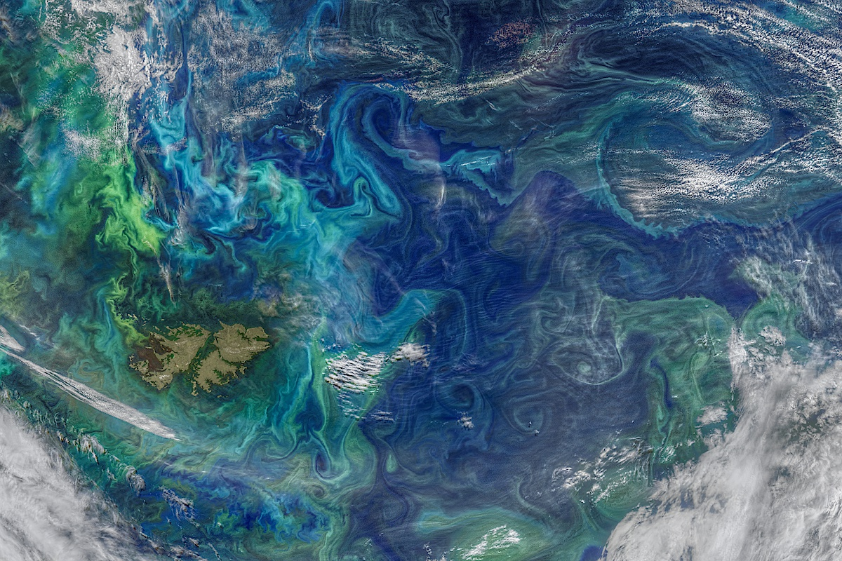
Image Credit: NASA/Goddard Space Flight Center Ocean Color/NOAA-20/NASA-NOAA Suomi NPP
Notes:
https://www.nasa.gov/sites/default/files/thumbnails/image/v2021005.swatlantic.crop_.small_.jpg

Slide 9

Earth Science Overview
Land Coverage, Topography, Surface Reflectance, Temperature, Solid Earth, Geophysics, Soils, Soil Moisture
Vegetation Indices, Monitoring large-scale changes in the biosphere
Global Precipitation
Atmospheric Composition and Dynamics, Tropospheric Chemistry, atmospheric temperature, moisture, ozone, pollution, cloud ice, pressure, gasses, Clouds, Aerosols
Hazardous Weather, Lightning, Tropical Cyclones and Storm-induced Hazards, volcanic eruptions, floods, severe storms, droughts, and wildfires
Ocean Biology, Sea Surface Temperature, ocean temperature and color
Sea Ice, Polar Processes, Frozen Ground, Glaciers, Ice Sheets, Snow
Biogeochemical Dynamics
Human Interactions, Land Use, Environmental Sustainability, Ecological Data, Environmental Processes
Solar Irradiance, Radiation Budget, Magnetosphere
Space Geodesy, Global Modeling, Prehistoric Data
Notes:
https://earthdata.nasa.gov/learn/discipline
https://science.nasa.gov/earth-science/documents

Slide 10
Earth Science Distributed Active Archive Center (DAACs) and Science Investigator-led Processing Systems (SIPS)
Socioeconomic Data and Applications Center
Human Interactions,
Land Use, Environmental
Sustainability,
Geospatial Data
Suomi National Polar-orbiting Partnership (Suomi-NPP) Atmosphere
Goddard Earth Sciences Data and Information Services Center
Global Precipitation, Solar Irradiance,
Atmospheric Composition and Dynamics, Global Modeling
Land Processes
DAAC
Land Cover, Surface Reflectance,
Radiance, Temperature, Topography,
Vegetation Indices
◉
◉
◉
Crustal Dynamics Data Information System
Space Geodesy, Solid Earth
Level 1 and Atmosphere Archive and Distribution System (LAADS)
MODIS Level-1 and Atmosphere Data Products
◉
Measurements
of Pollution in the
Troposphere (MOPITT)
◉
◉
◉
◉
◉
◉
◉
◉
SIPS
Physical
Oceanography DAAC
Gravity, Sea Surface Temperature, Ocean Winds, Topography, Circulation & Currents
◉
Ocean Biology DAAC
Ocean Biology,
Sea Surface Temperature
◉
◉
Visible Infrared Imaging Radiometer Suite (VIIRS) Ocean
◉
Microwave Limb Sounder (MLS)
12 DAACs
Oak Ridge National Laboratory DAAC
Biogeochemical Dynamics, Ecological Data, Environmental Processes
◉
Ozone Mapping
Profiler Suite (OMPS) Ozone
•
Ozone Monitoring Instrument (OMI)
•
Ozone Mapping
Profiler Suite (OMPS) Ozone
•
Ocean Data Processing System (OCDPS)
•
MODIS Adaptive Processing System (MODAPS)
•
Visible Infrared Imaging
Radiometer Suite (VIIRS) Land
◉
Tropospheric Emission Spectrometer (TES)
National Snow and Ice Data Center DAAC
Frozen Ground, Glaciers,
Ice Sheets, Sea Ice,
Snow, Soil Moisture
LaRC Atmospheric
Science Data Center
Radiation Budget, Clouds, Aerosols, Tropospheric
Chemistry
◉
◉
◉
◉
◉
◉
Suomi National Polar-orbiting Partnership (Suomi-NPP) (ATMS) and (CrIS) Sounder
Global Hydrology
Resource Center DAAC
Hazardous Weather,
Lightning, Tropical Cyclones and
Storm-induced Hazards
Advanced Microwave
Scanning Radiometer for EOS 2 (AMSR-E/2)
Alaska Satellite
Facility DAAC
SAR Products, Sea Ice,
Polar Processes,
Geophysics
Image Credit: NASA
◉
f
Notes:
ASF – Sea Ice, Polar Processes, Geophysics
PO DAAC – Physical Oceanography
NSIDC – Snow and Ice
LP DAAC – Land Processes
ORNL – Biogeochemical Dynamics, Ecological Data, Environmental Processes
GHRC – Global Hydrology
LaRC – Atmospheric Science
OB DAAC – Ocean Biology
LAADS – Level 1 Atmosphere Products
CDDIS – Crustal Dynamics, Solid Earth
GES DISC – Global Precipitation, Global Modeling, Solar Irradiance, Atmospheric Composition and Dynamics
SEDAC – Socioeconomic Data and Applications

Slide 11
Science at NASA
Image Credit: SDE team
Notes:
Image created by SDE team

Slide 12
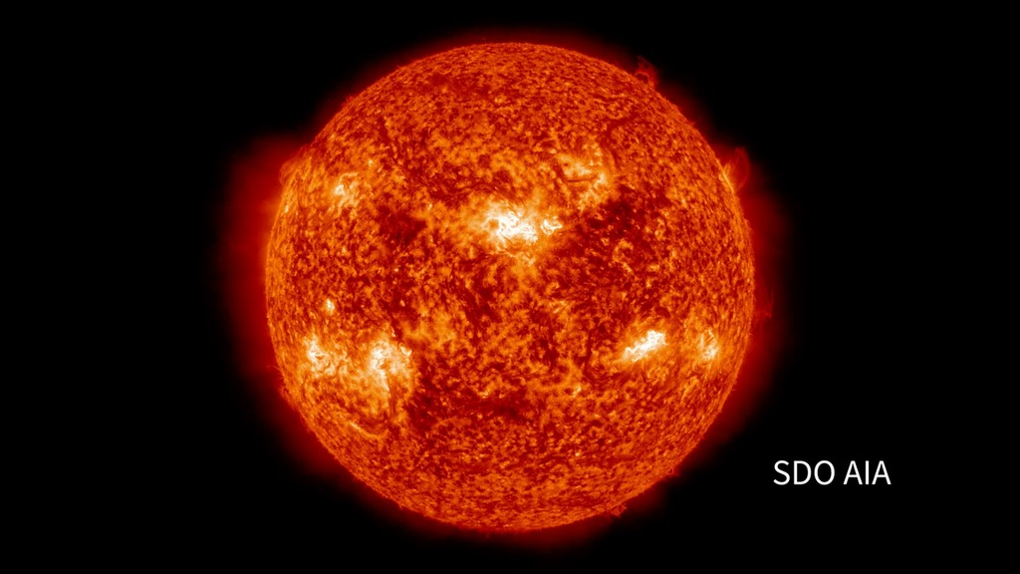
Image Credit: NASA's Goddard Space Flight Center
Notes:
https://svs.gsfc.nasa.gov/vis/a030000/a030000/a030072/heliophysics_fleet_capture_erup_cme_1280x720_print.jpg
https://svs.gsfc.nasa.gov/30072/

Slide 13
Heliophysics Overview
Heliophysics encompasses a vast range of research subjects, including but not limited to:
the sun's 11-year solar cycle
giant solar explosions such as solar flares and coronal mass ejections
the constant stream of solar particles called the solar wind
the magnetic environment near Earth
what drives change in the charged particles that surround Earth and inhabit the ionosphere
boundaries of the solar system as it travels through our interstellar neighborhood.
Notes:
https://science.nasa.gov/heliophysics/focus-areas

Slide 14
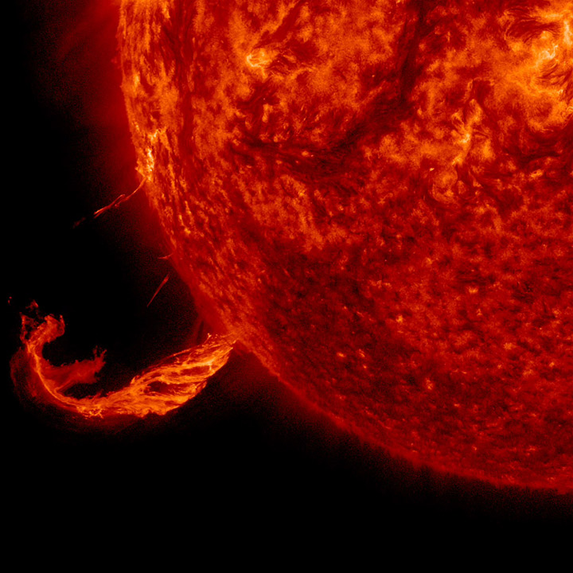
Heliophysics Repositories and Data
Space Physics Data Facility (SPDF) non-solar archive, emphasizes multi-instrument, multi-mission science
Solar Data Analysis Center (SDAC): The Solar Data Analysis Center serves data from recent and current space-based solar-physics missions, funds and hosts much of the SolarSoft library, and leads the Virtual Solar Observatory (VSO) effort
Community Coordinated Modeling Center (CCMC): established to enhance basic solar-terrestrial research and to aid in the development of models for specifying and forecasting conditions in the space environment. Multi-agency partnership to enable, support and perform the research and development for next-generation space science and space weather models.
Image Credit: NASA/SDO
Notes:
https://ccmc.gsfc.nasa.gov/faq/
https://solarsystem.nasa.gov/resources/1051/brief-outburst/

Slide 15
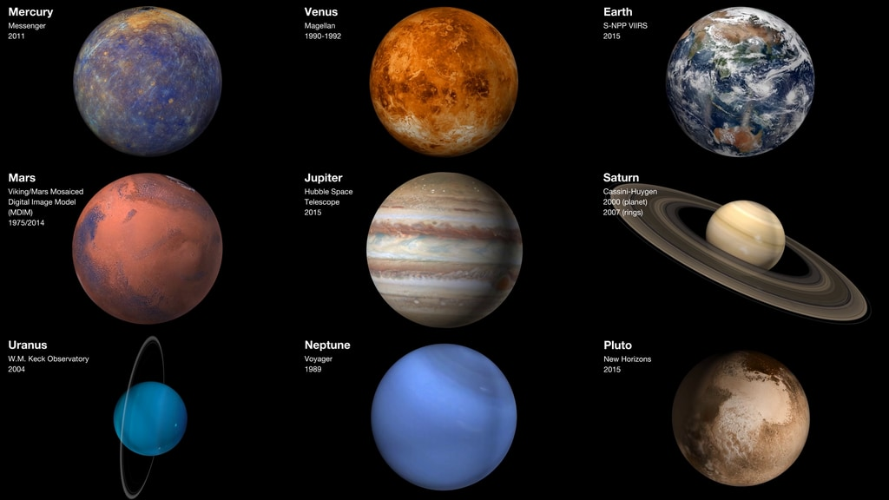
Image Credit: NASA/Johns Hopkins University Applied Physics Laboratory/Carnegie Institution of Washington (Mercury), USGS Astrogeology Science Center (Venus, Mars), NASA's Goddard Space Flight Center/Space Telescope Science Institute (Jupiter), NASA/JPL/Space Science Institute (Saturn) and NASA's Goddard Space Flight Center (Earth, Jupiter, Uranus)
Notes:
https://svs.gsfc.nasa.gov/vis/a030000/a030700/a030710/planets3x3jimgreenspaceweather2160p_1080p.00001_print.jpg
https://svs.gsfc.nasa.gov/30710/

Slide 16
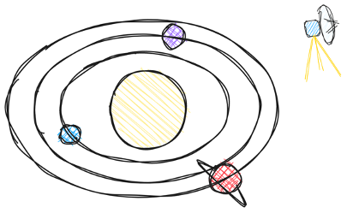
Planetary Science Overview
Understanding the planets and small bodies that inhabit our solar system help scientists answer questions about its formation, how it reached its current diverse state, how life evolved on Earth and possibly elsewhere in the solar system, and what characteristics of the solar system lead to the origins of life.
Planetary Science studies
inner solar system bodies
outer solar system bodies
small bodies in the solar system including comets, asteroids, the objects in the Kuiper Belt and the Oort cloud, small planetary satellites, Triton, Pluto, Charon, and interplanetary dust.
Image Credit: SDE team
Notes:
https://science.nasa.gov/solar-system/focus-areas

Slide 17
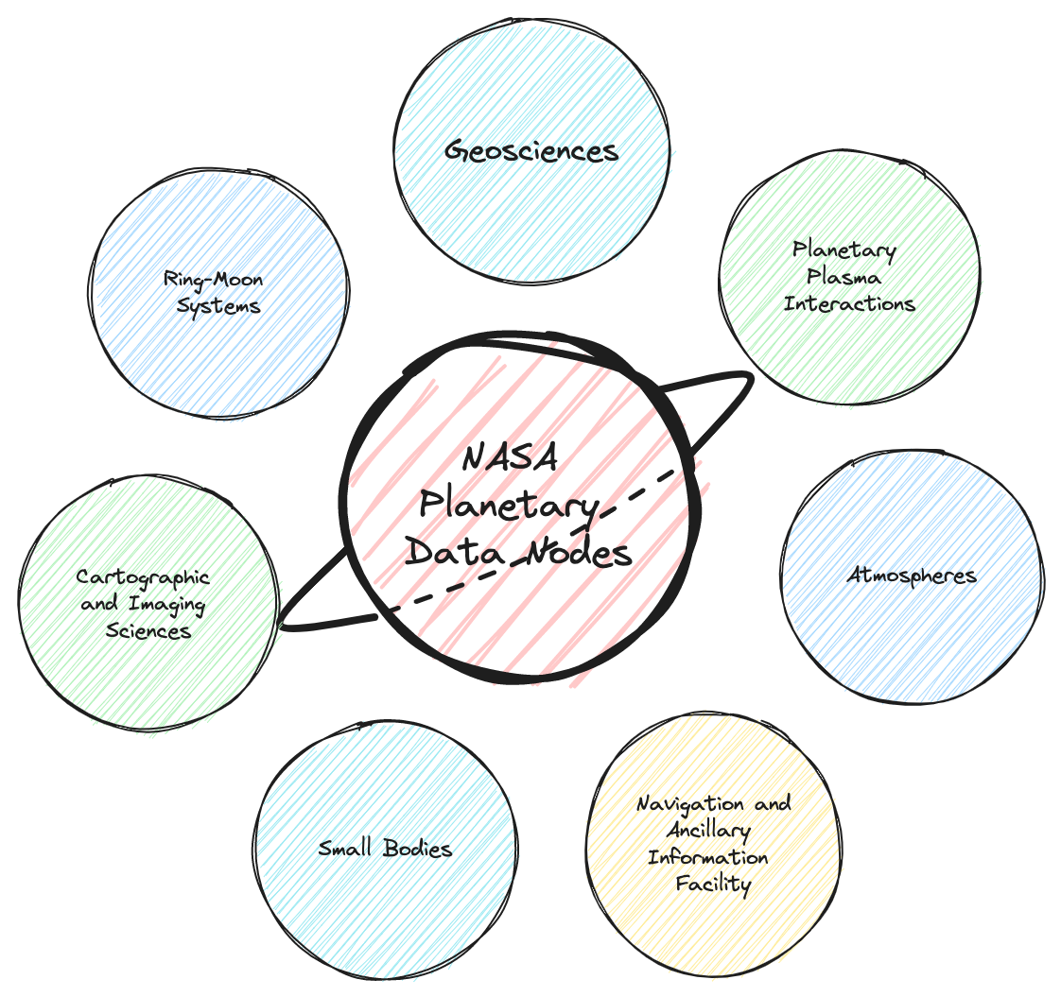
Planetary Science Repositories and Data
The Planetary Data Ecosystem includes
  The Planetary Data System (PDS) and its supporting data nodes
  JMars
  Astromat
  Solar System Treks
  NSSDCA
  Spectral data archives
Image Credit: SDE team
Notes:
https://ccmc.gsfc.nasa.gov/faq/

Slide 18
Science at NASA
Image Credit: SDE team
Notes:
Image created by SDE team

Slide 19
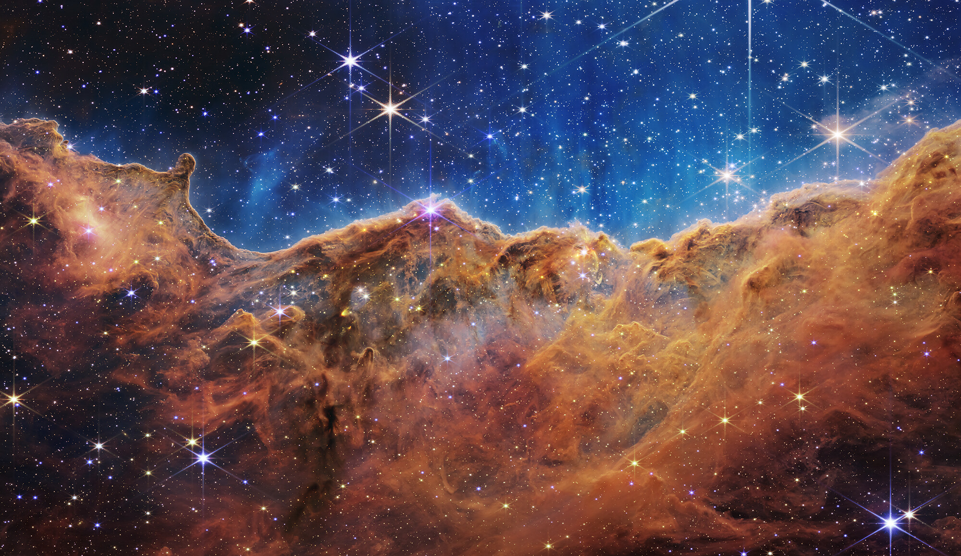
Image Credit: NASA, ESA, CSA, and STScI
Notes:
Cosmic Cliff

Slide 20

Astrophysics Overview
NASA's goal in Astrophysics is to "Discover how the universe works, explore how it began and evolved, and search for life on planets around other stars." Three broad scientific questions emanate from these goals:
How does the universe work? - Probe the origin and destiny of our universe, including the nature of black holes, dark energy, dark matter and gravity.
How did we get here? - Explore the origin and evolution of the galaxies, stars and planets that make up our universe.
Are we alone? - Discover and study planets around other stars, and explore whether they could harbor life.
Image Credit: SDE team
Notes:
https://science.nasa.gov/solar-system/focus-areas

Slide 21
Astrophysics Repositories and Data
Mission datasets including archiving, calibration, data analysis, and user support, are the responsibility of wavelength specific archives.
High Energy Astrophysics Science Archive Research Center (HEASARC)/GSFC (extreme UV/X-ray/gamma-ray data)
Mikulski Archive for Space Telescopes (MAST)/Space Telescope Science Institute (primarily UV/visible/near-IR wavelengths)
Infrared Science Archive (IRSA) at the Infrared Processing and Analysis Center (IPAC)/Caltech (infrared and sub-millimeter observations)
Keck Observatory Archive (KOA) holds ground-based data from the W.M. Keck Observatory instruments.
Thematic archives enable comprehensive views of particular classes of objects
NASA Extragalactic Database (NED) at IPAC/Caltech: fusion of multi-wavelength data and bibliography for objects beyond the Milky Way
Legacy Archive for Microwave Background Data (LAMBDA) at HEASARC: multi-mission center of expertise for cosmic microwave background (CMB) radiation research
NASA Exoplanet Archive (NEA) at NASA Exoplanet Science Institute (NExScI)/Caltech: collating data on exoplanets and their host stars
Cross-archive activity:
NASA Astrophysics Virtual Observatories (NAVO): consistent access to NASA data through international Virtual Observatory standards
The Astrophysics Data System (ADS)/Smithsonian Astrophysical Observatory: a digital library with bibliographic databases
Notes:
http://science.nasa.gov/astrophysics/astrophysics-data-centers/

Slide 22
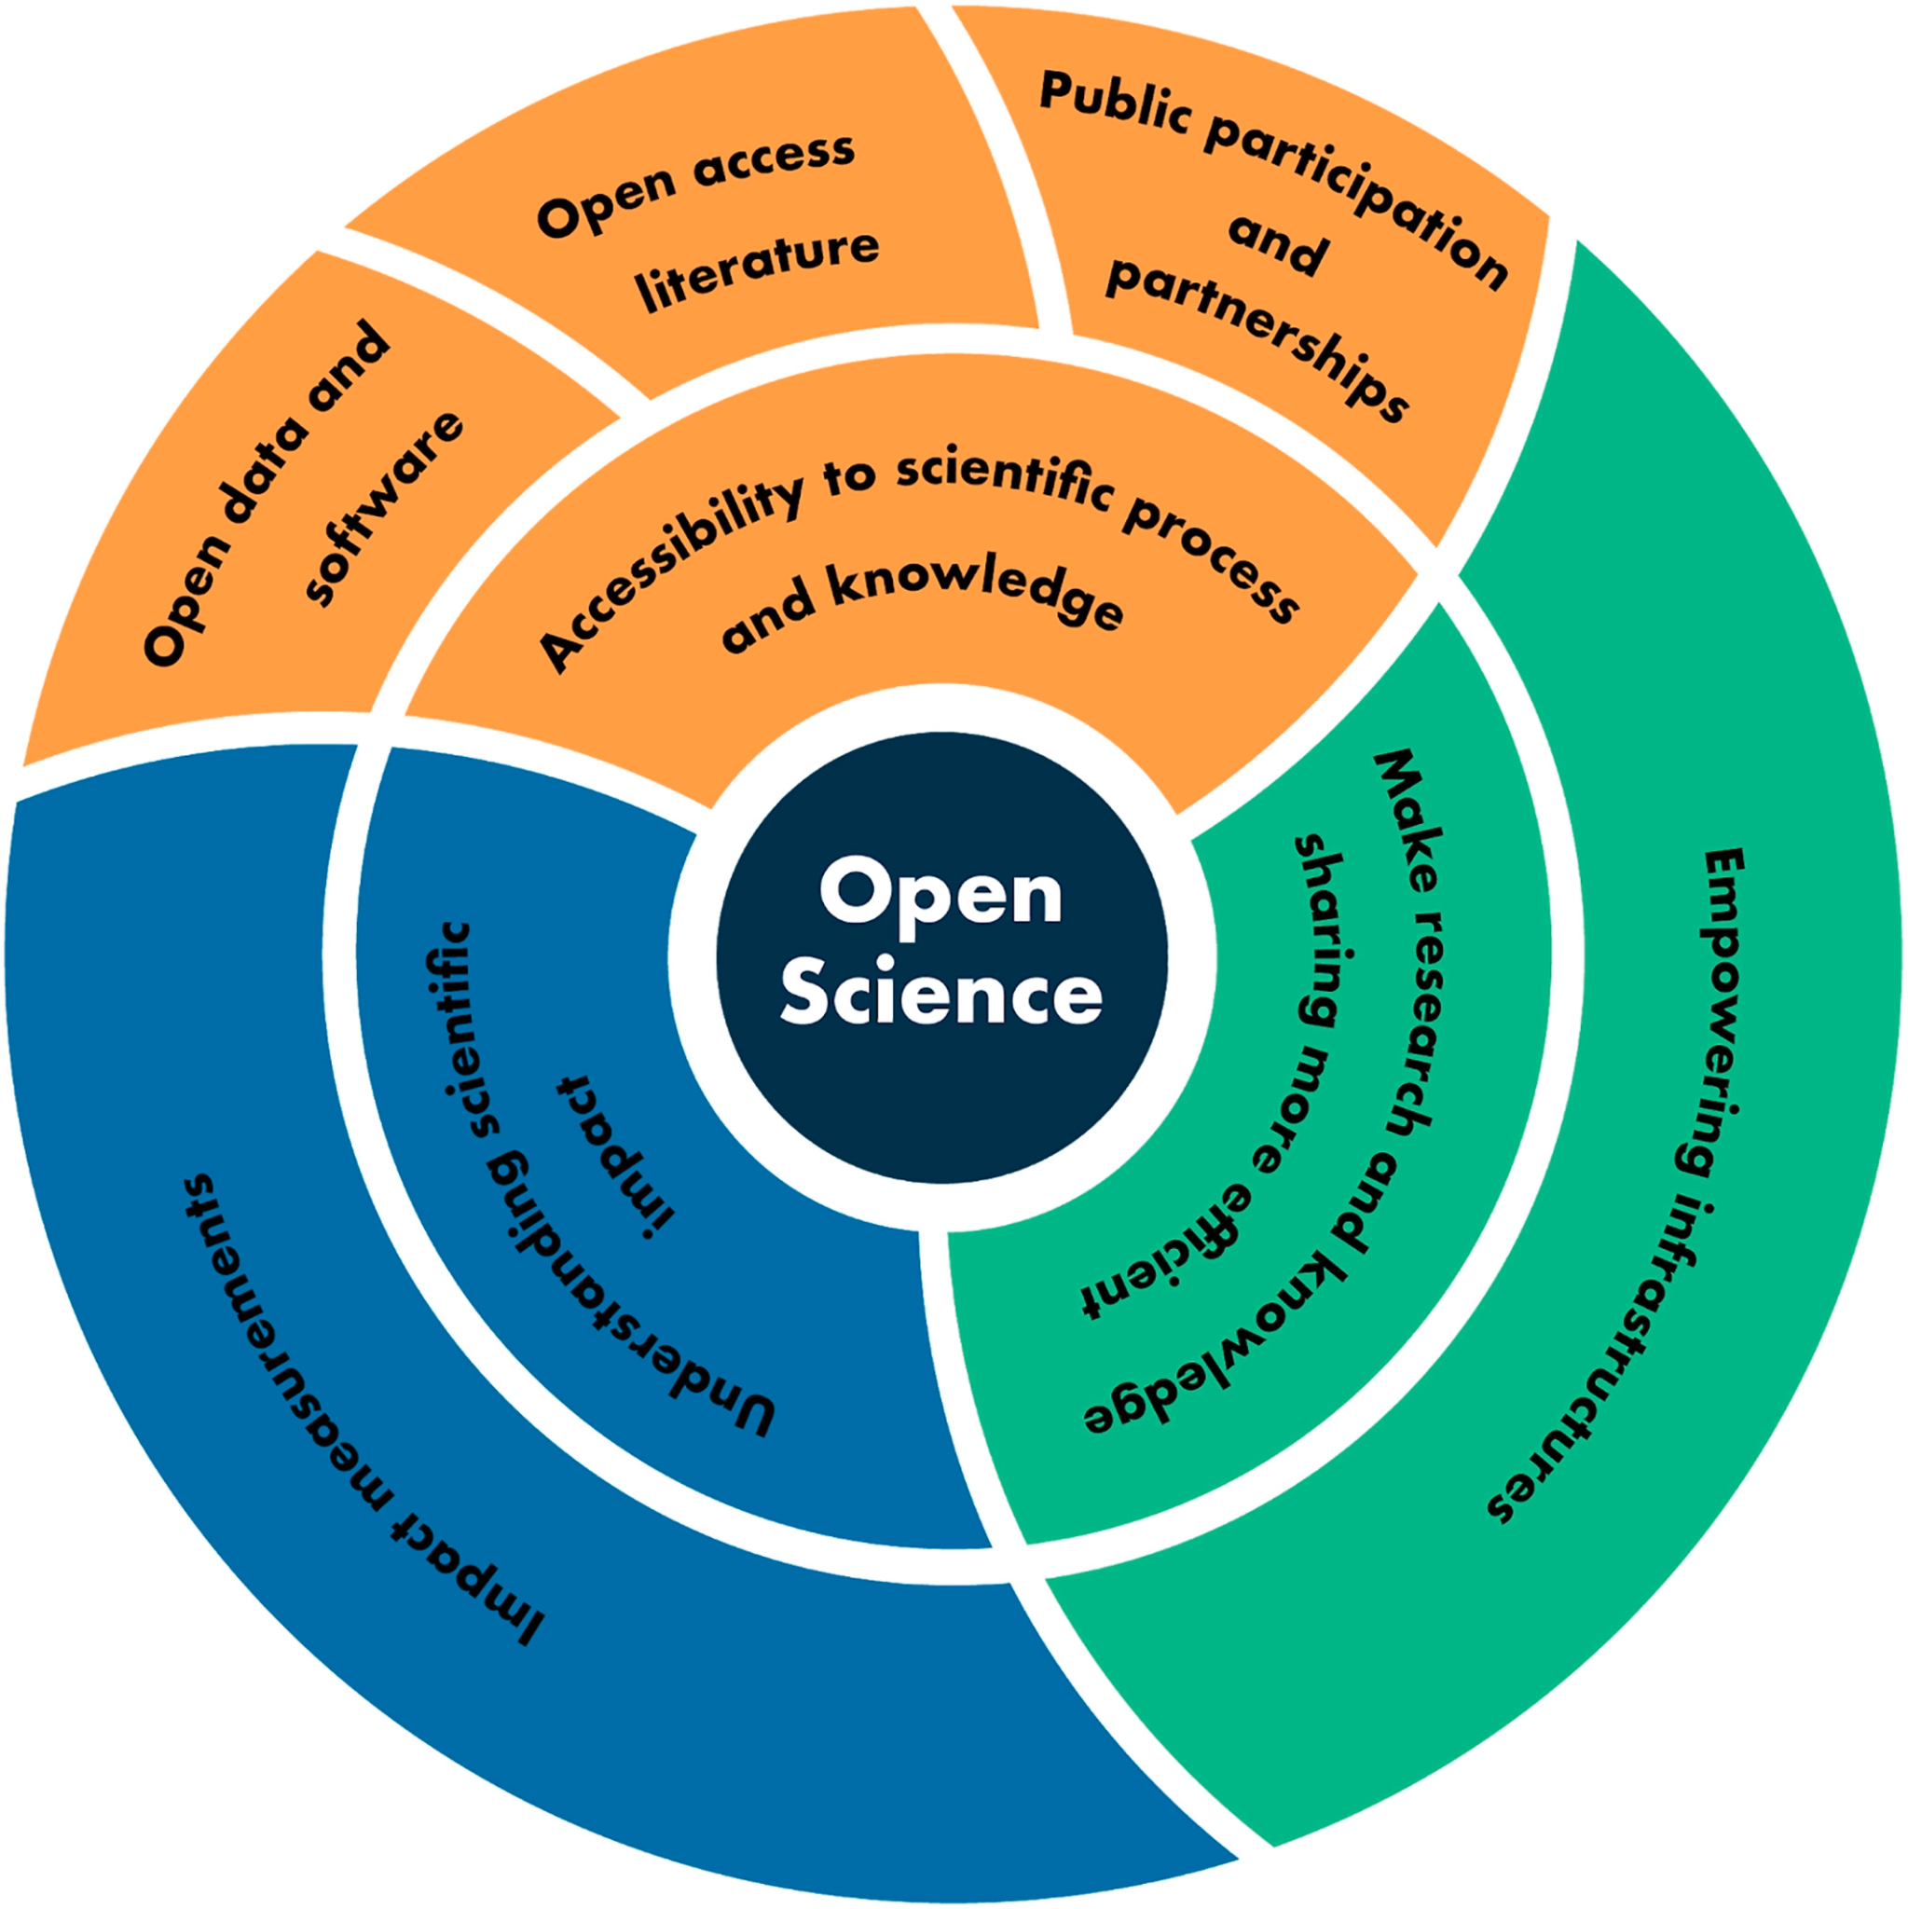
What is Open Science?
Developing empowering infrastructures to make research and knowledge sharing more efficient is critical to accelerating open science.
There are many dimensions to developing empowering infrastructures, but a key component is a centralized data and information discovery engine.
Benefits:
Less time searching for data, more time doing actionable science
Less time reinventing the wheel
Better understanding of what is happening in the community
Possibility of serendipitous discovery - opening new avenues of research
Ramachandran, R., Bugbee, K., & Murphy, K. (2021). From open data to open science. Earth and Space Science, 8, e2020EA001562. https://doi.org/10.1029/2020EA001562
Notes:
Open science is a collaborative culture enabled by technology that empowers the open sharing of data, information, and knowledge within the scientific community and the wider public to accelerate scientific research and understanding

Slide 23
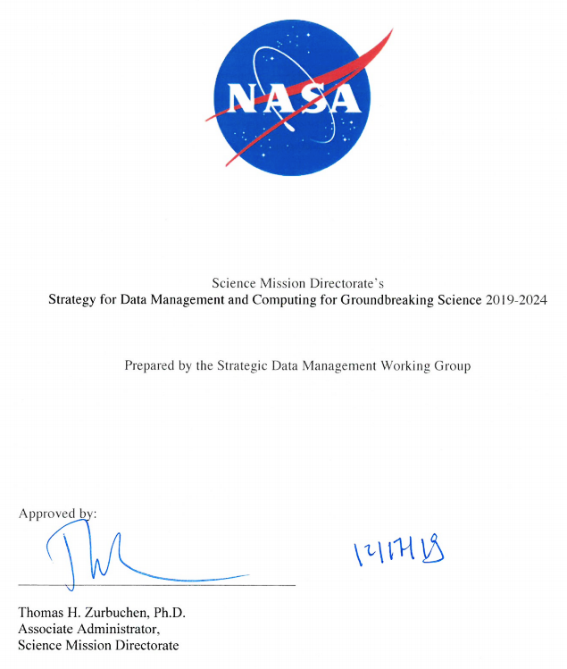
Open Science at NASA
Goal 1: Develop and Implement Capabilities to Enable Open Science
NASA SMD Strategy for Data Management and Computing for Groundbreaking Science
Open Source Science Initiative (OSSI) - “commitment to building an inclusive, open science community”
1.3: Develop and implement an SMD data catalog to support discovery and access to complex scientific data across divisions

Slide 24
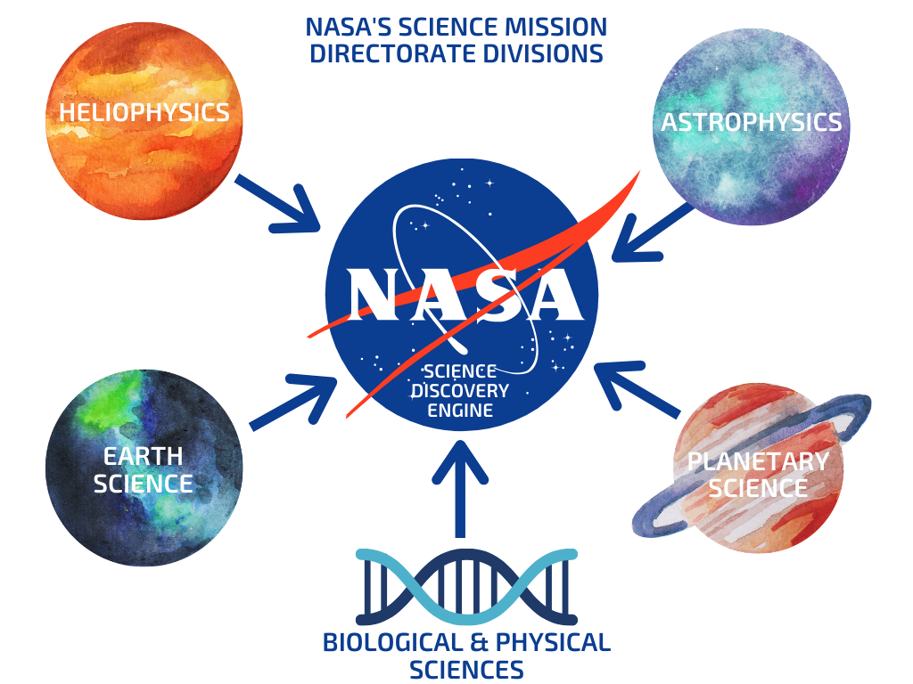
Meet the Science Discovery Engine (SDE)
Goals:
Enable rapid discovery of NASA science data, software and documentation
Support NASA’s open science goals and infrastructure
Promote interdisciplinary science
Prototype emerging technologies and search techniques including Large Language Models
Image Credit: SDE team
Notes:
Goal 1 has four strategies, and the data catalog is number three of the four strategies

Slide 25
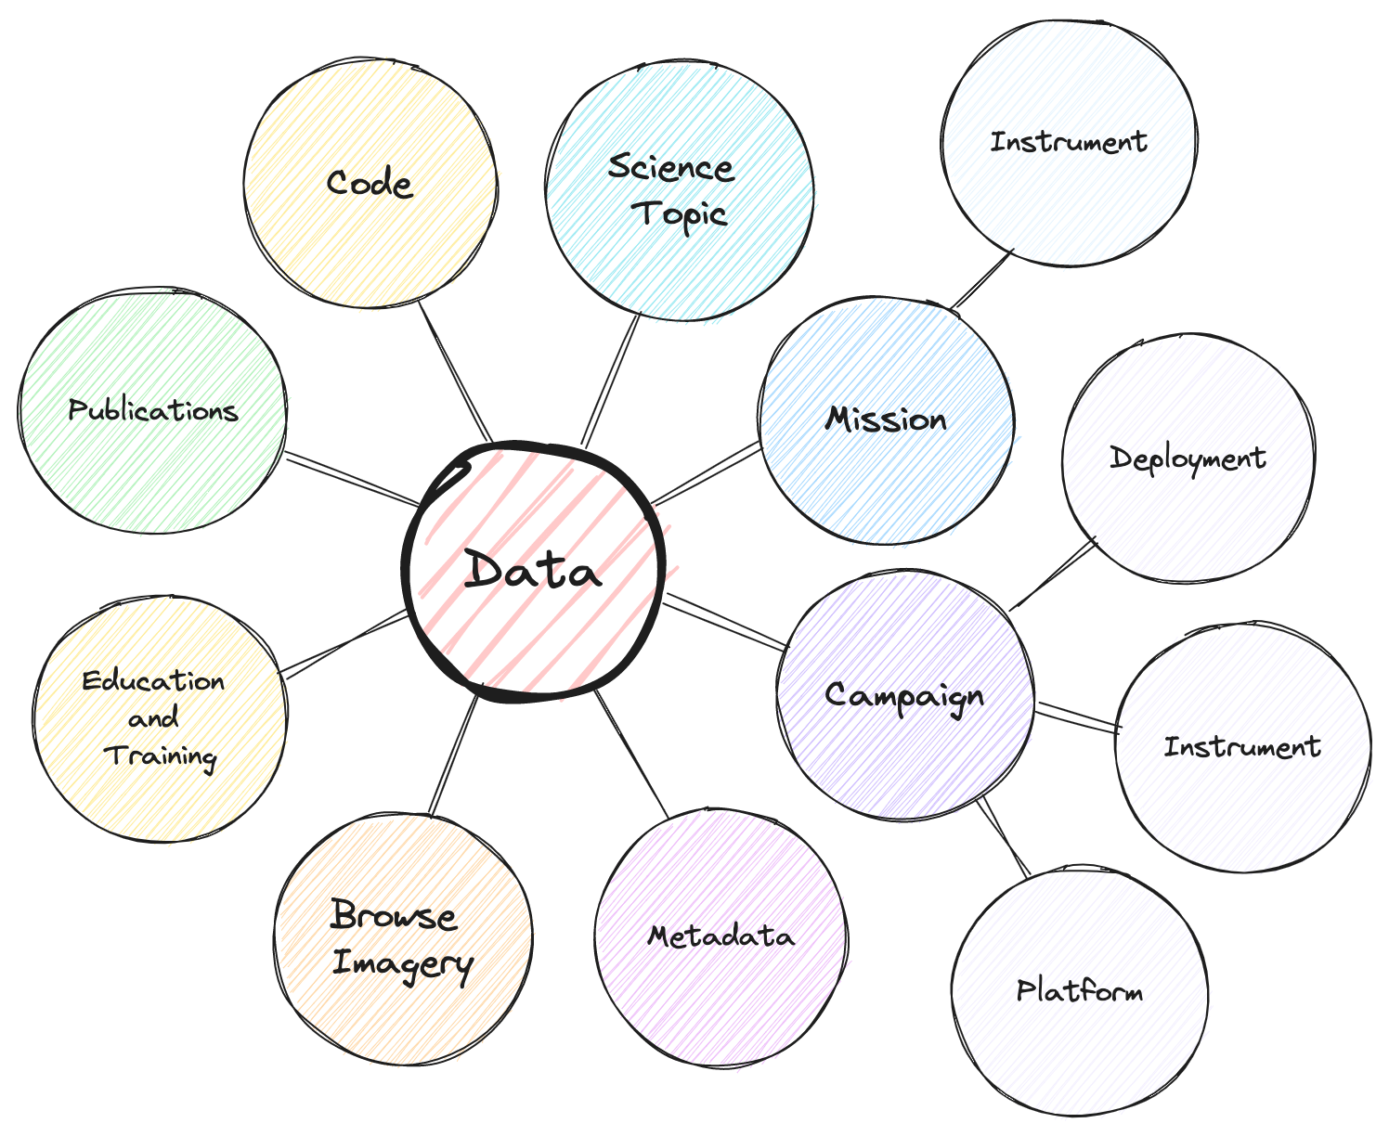
Meet the SDE: Challenges in Implementation
Bringing heterogeneous topics into a single search environment
  Domain-specific schemas
  Different science concepts across the domains
    BPS: Experiments
    All other topics: Observations/observatories/platforms
    Datasets versus catalogs
Identifying and curating dispersed content
  Where does all this data and information live?
  How do we know we have everything?
Accelerated development timeline
Image Credit: SDE team

Slide 26

SDE Technical Implementation
The SDE uses a technology called an Insight Engine to bring heterogeneous content together.
  Insight Engines apply relevancy methods to describe, discover, organize, and analyze data
  Can incorporate structured information (metadata about data), and unstructured information (web pages, algorithm documentation, user guides, code and tutorials)
  Enables richer indexes, more complex queries, elaborated relevancy methods, and multiple touchpoints to support users
  Allows for specialized user interface customization to meet the needs of the scientific community
  Leverages NLP techniques
  Using an Insight Engine technology called Sinequa for the SDE
Image Credit: SDE team
Notes:
https://thenounproject.com/icon/ideas-5159489/

Slide 27
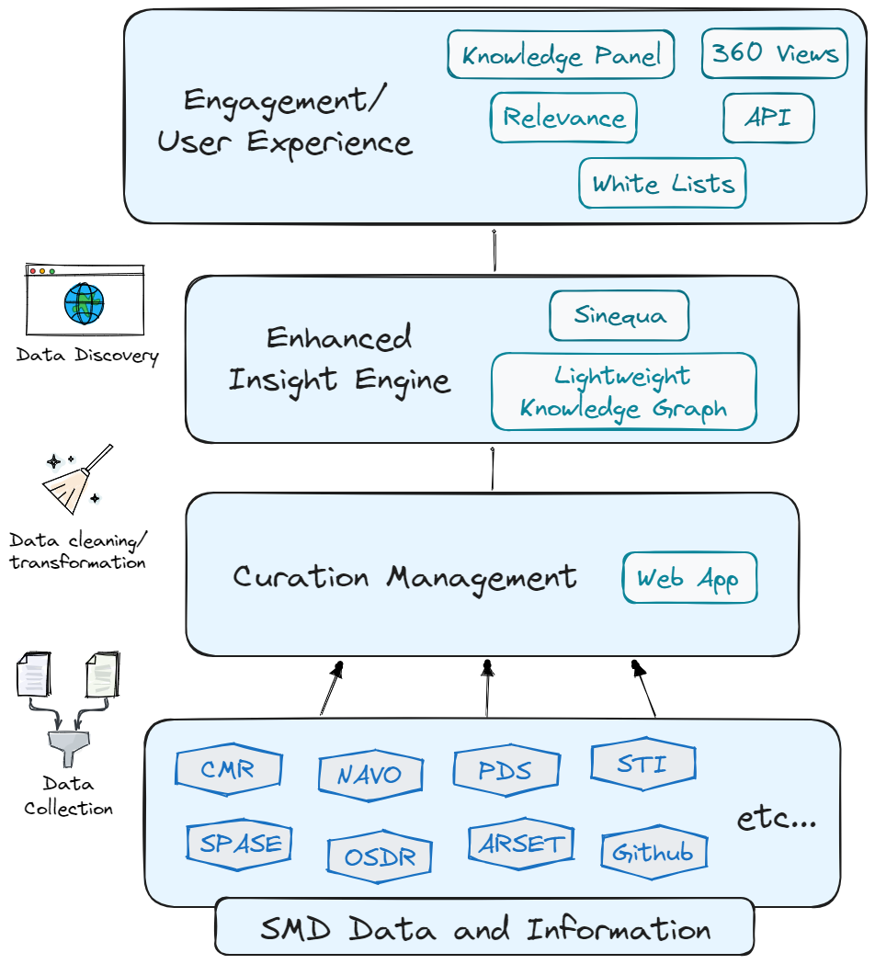
Current Functional Design
Curation management leverages custom built web app for curation of HTML sources
Uses ‘classic’ Sinequa search capability
Integrated science specific UI features
  Curated science facets (whitelists)
  Knowledge panels and 360 views for science (in development now)
Image Credit: SDE team

Slide 28
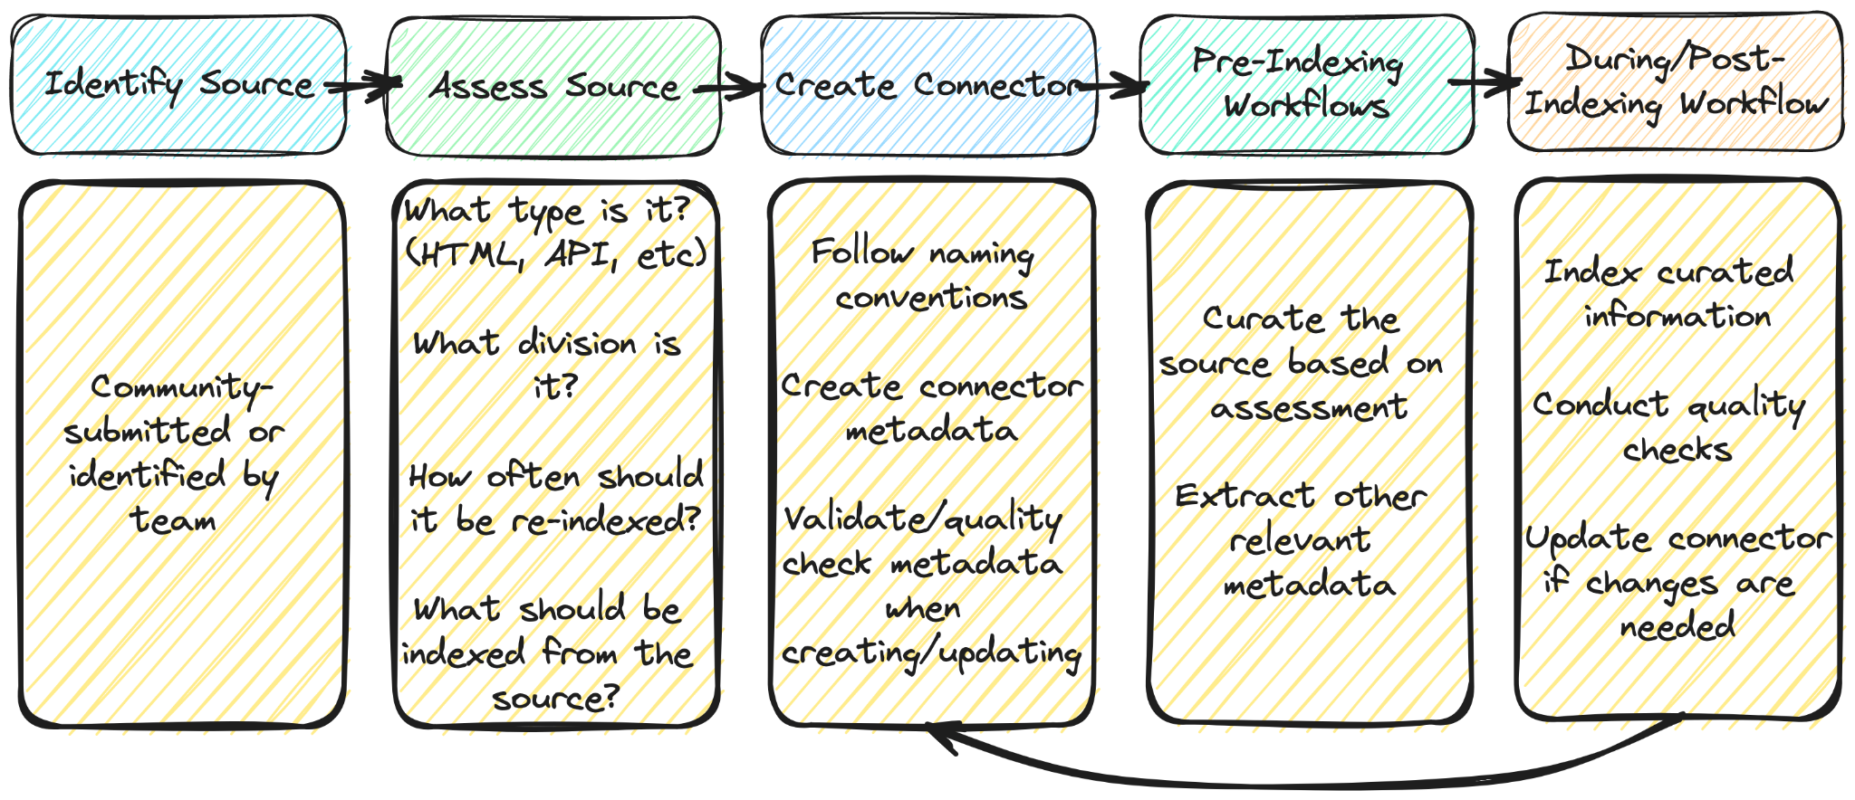
Curation Management Workflow
Image Credit: SDE team

Slide 29
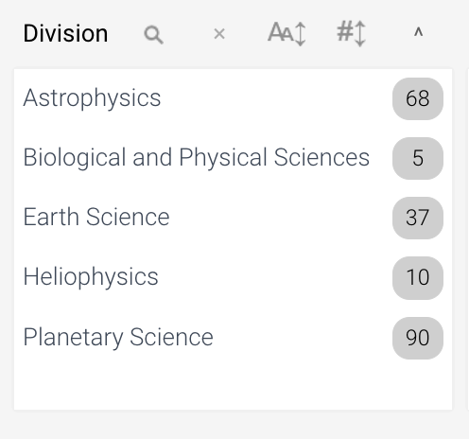
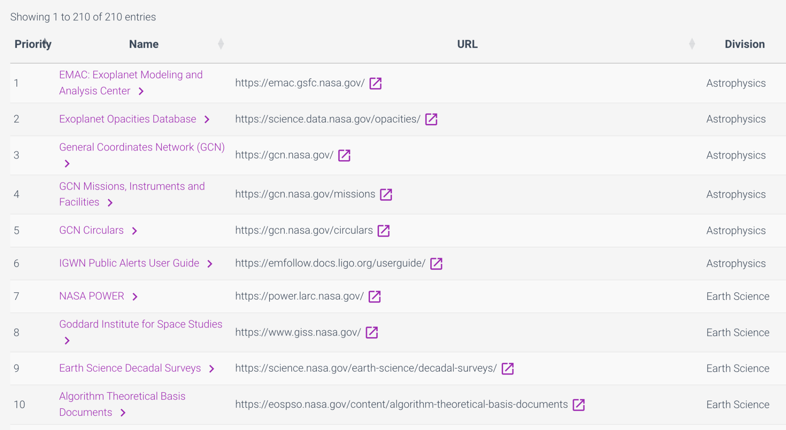
SDE Curation App
Image Credit: SDE team

Slide 30
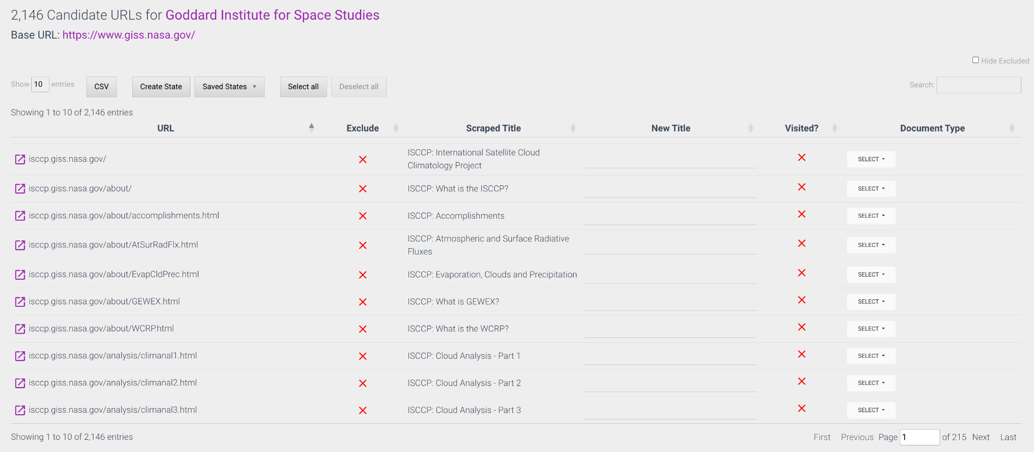
Curation of Candidate URLs
Image Credit: SDE team

Slide 31
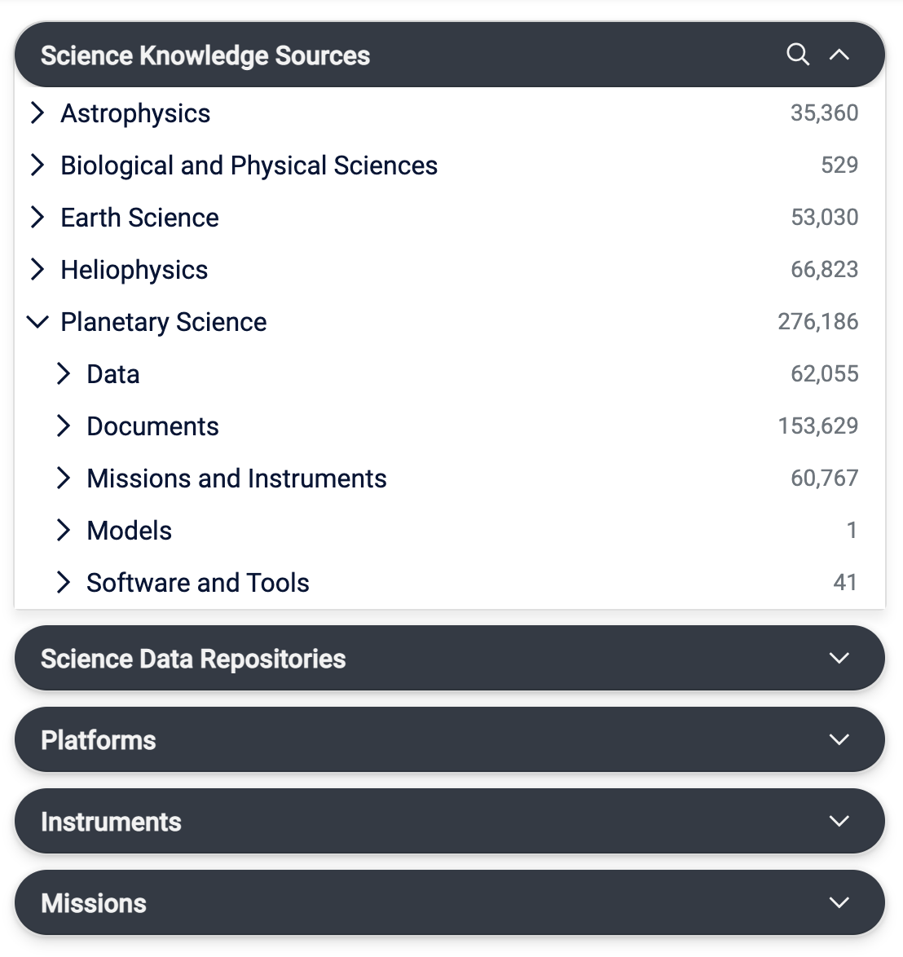
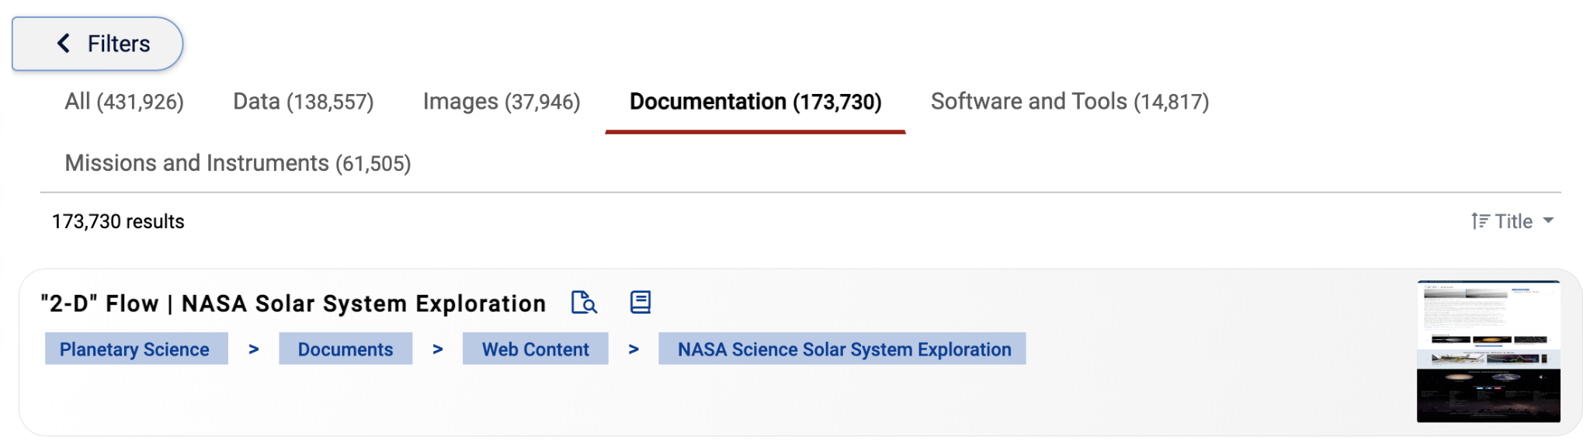
SDE User Interface (UI)
Filter by:
  Science Discipline
  Platforms, Missions, and Instruments
  Document Type
Sort by: title, relevance, and recently indexed info
  Relevance based on number of string matches
Preview
Bread Crumbs
Image Credit: SDE team

Slide 32
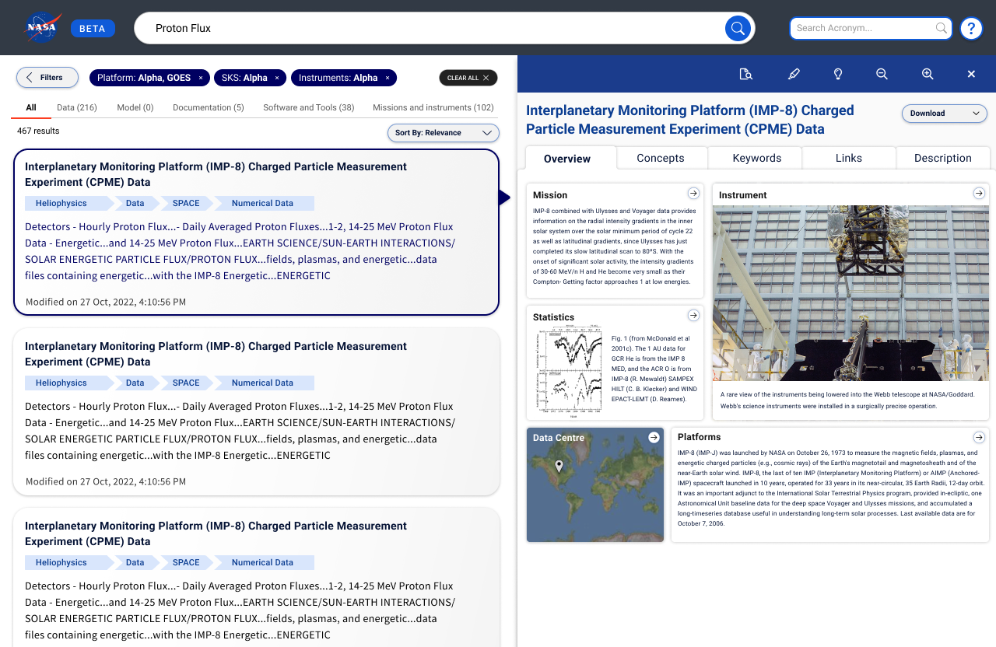
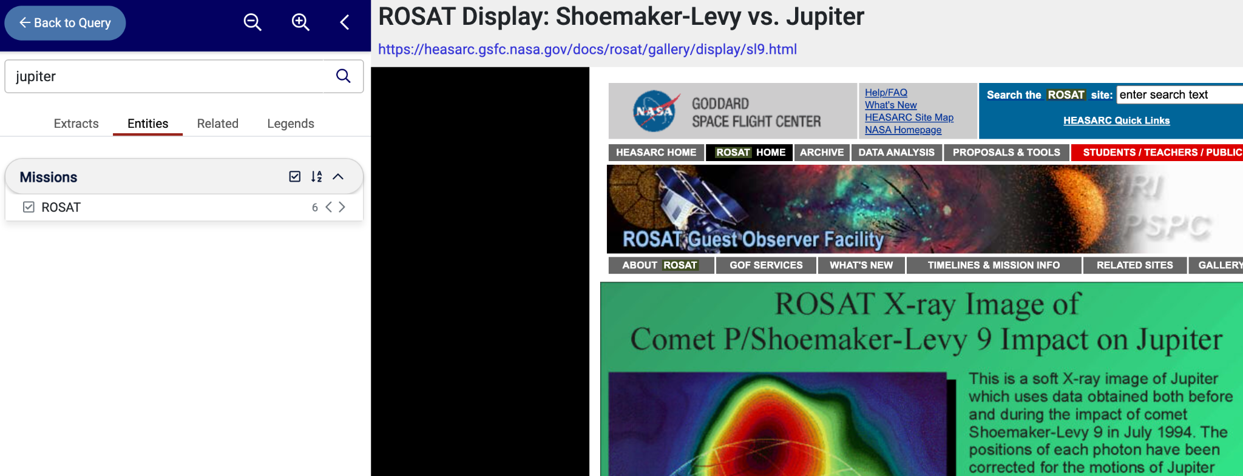
SDE User Interface (UI)
Document Navigator
360 View (sneak preview)
Origin
Approaches
Construction
API
Next Steps
Image Credits: SDE team

Slide 33
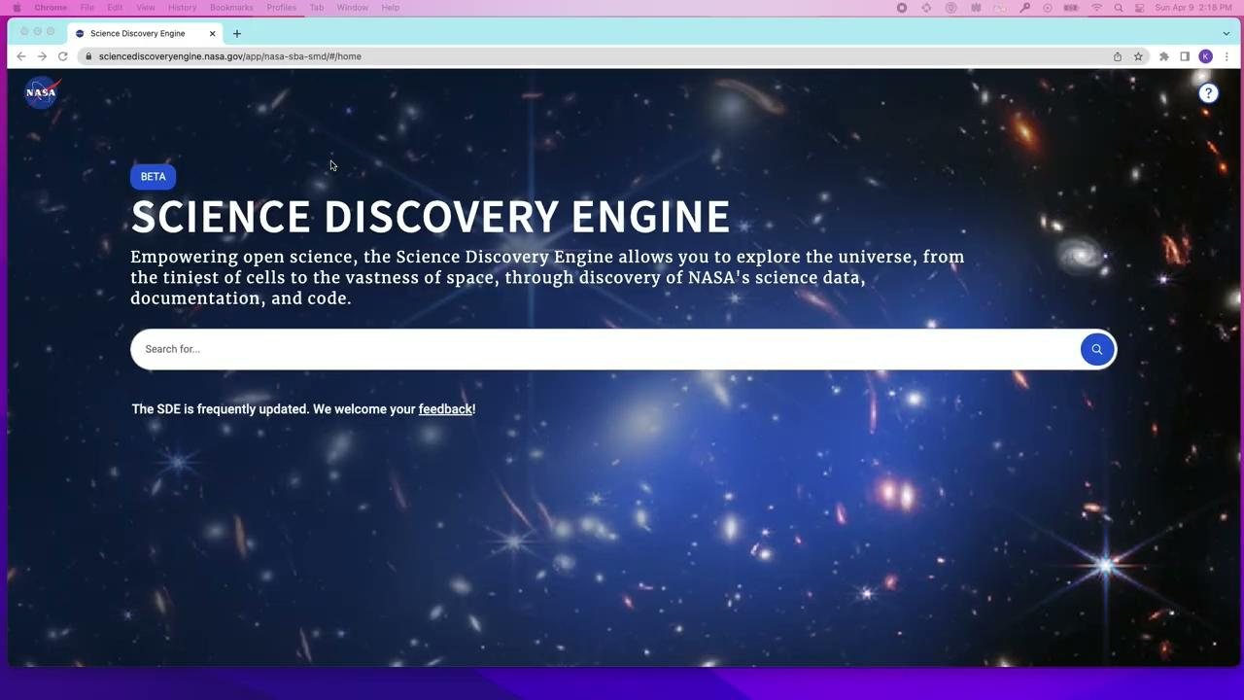

Slide 34
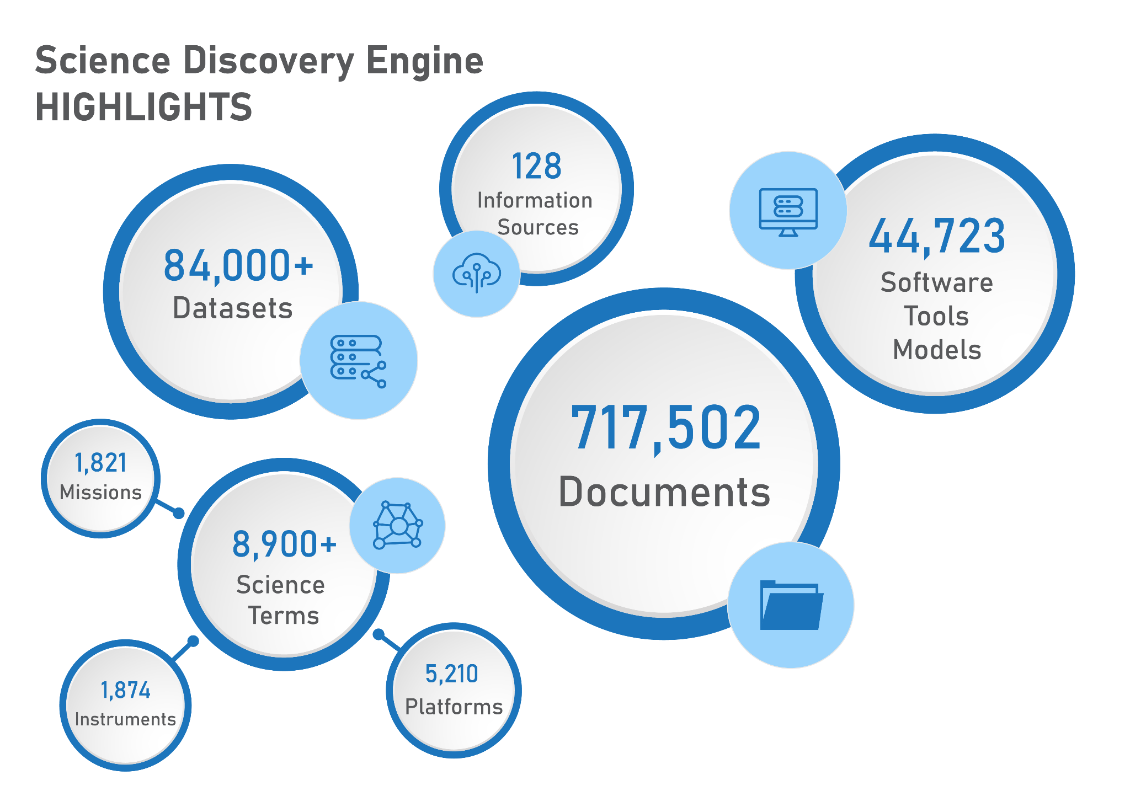
Image Credit: SDE team

Slide 35
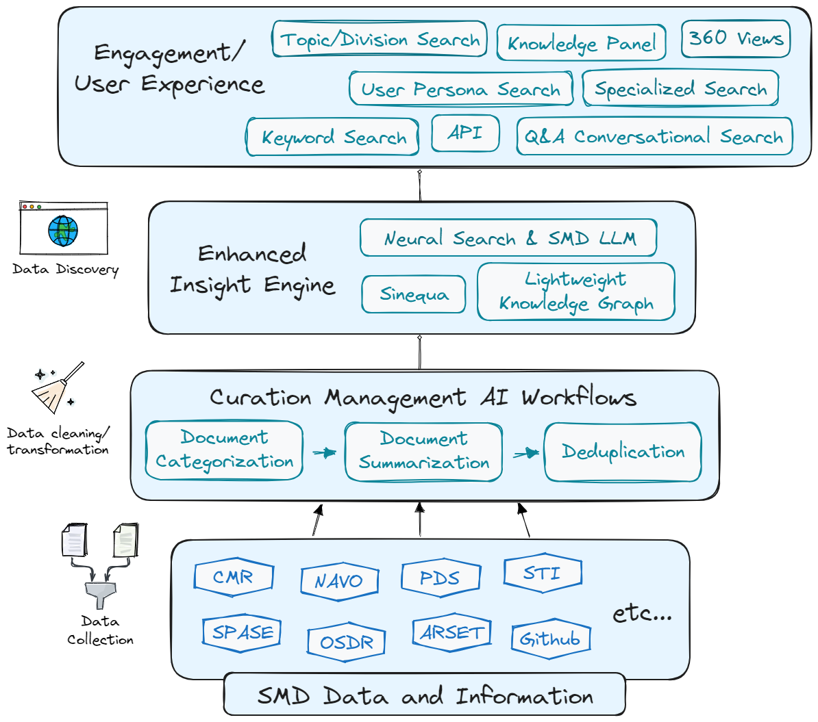
Future Design
Greater integration with Large Language Model (LLM) techniques including:
  Curation Workflows
  Sinequa’s Neural Search and SMD LLM
  Conversational/chatbot search
Enhanced services for SMD divisional customers
Novel ways to discover and interact with the metadata and information
Integration with SciEx (ADS)
Image Credit: SDE team

Slide 36
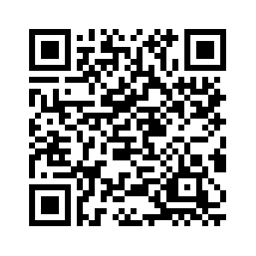
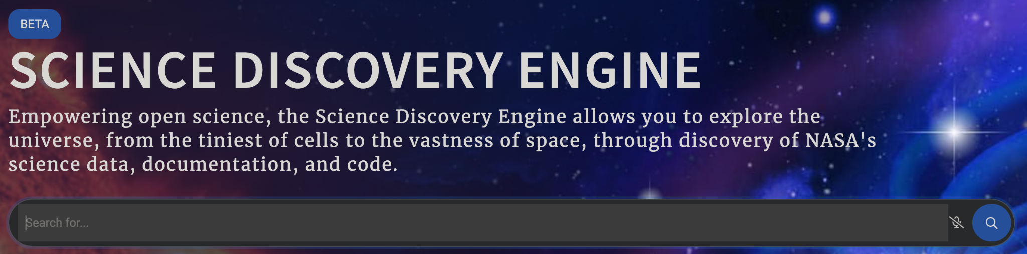
Summary
NASA’s Science Mission Directorate open data portfolio is diverse.
NASA’s Open Source Science Initiative enables and supports open science.
The beta Science Discovery Engine (SDE) enables search of NASA’s open science data and information. The beta SDE is available now. We welcome feedback on how we can improve the SDE and are especially interested in hearing from the astrophysics community.
sciencediscoveryengine.nasa.gov
Image Credit: SDE team

Slide 37
Thank You to Our Project Team & Collaborators
SDE Core Team
Kaylin Bugbee (NASA MSFC)
Shawn Foley (MITS II)
Ashish Acharya (UAH)
Emily Foshee (UAH)
Carson Davis (UAH)
Rachel Wyatt (UAH)
Xiang Li (UAH)
Stephanie Wingo (UAH)
Muthukumaran Ramasubramanian (UAH)
SMD Working Group
Alan Smale (Astrophysics)
David Ciardi (Astrophysics)
Robert Candey (Heliophysics)
Brian Thomas (Heliophysics)
Samrawit Gebre (Biological & Physical Sciences)
Thomas Morgan (Planetary Science)
Steve Hughes (Planetary Science)
Jordan Padams (Planetary Science)
Erich Reiter (Earth Science)
Rahul Ramachandran (NASA)
Kartik Nagaraja (Left Right Mind)
Shravan Vishwanathan (Left Right Mind)
Nikita Balsara (Left Right Mind)
Justin Johns (Sinequa)
John Monroche (Sinequa)
NASA CIO and Enterprise Data Platform Teams
Corey Portalatin-Berrien (NASA)
Joe Foster (NASA)
Chris Bowerman (SAIC)
Melania Stewart (SAIC)
We also wanted to say thank you to the Astrophysics Data System (ADS) team for the collaborative, knowledge sharing discussions we have had to date.

Slide 38
Thank You
Contact:
Kaylin Bugbee
kaylin.m.bugbee@nasa.gov

