Slide 1
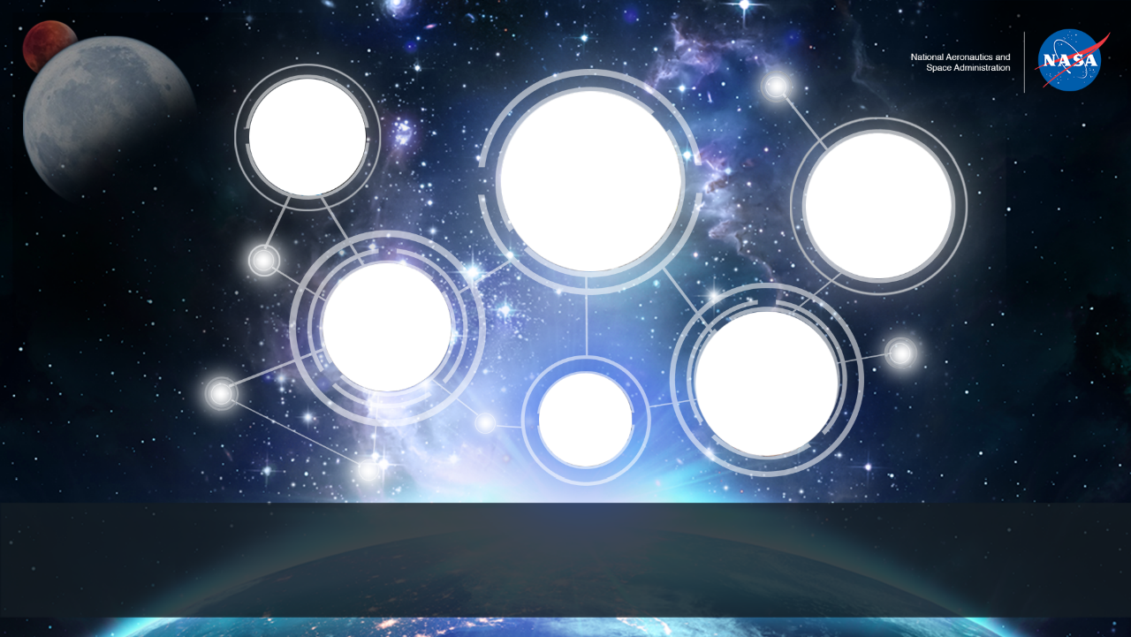
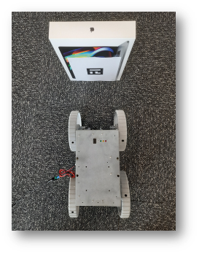
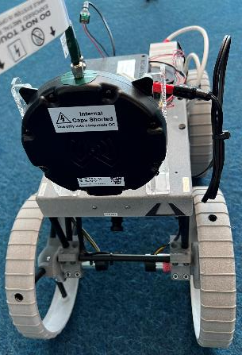
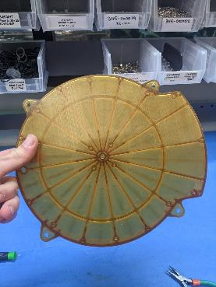
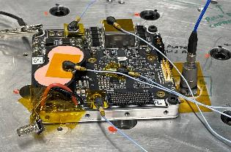
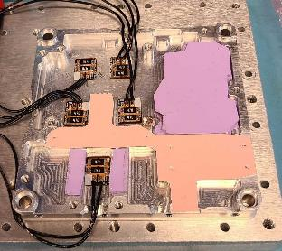
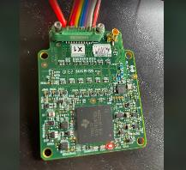
Space Technology Mission Directorate
Game Changing Development Program
Space Technology Mission Directorate
Game Changing Development Program
Space Technology Mission Directorate
Game Changing Development Program
Presenter: James Eckard | FY23 Ultra Fast Proximity Charger (UFPC) TP Annual Review Presentation | 09.20.23
Name/Email POC: Jay Eckard/ james.eckard@astrobotic.com
Presenter: James Eckard | Moderator: Chad Gray | FY23 Ultra Fast Proximity Charger TP Annual Review Presentation | 09.7.23
Name/Email POC: Jay Eckard/ james.eckard@astrobotic.com
Notes:
Please provide pictures specific to your Project for each circle in this coversheet
Please make sure the pictures are Publicly Available and have been cleared by your Center

Slide 2
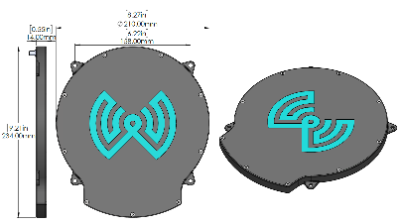
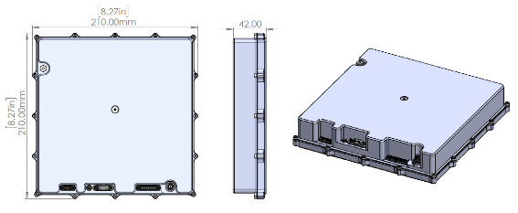
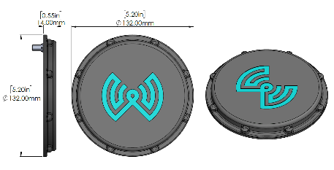
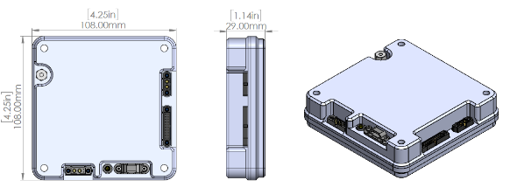
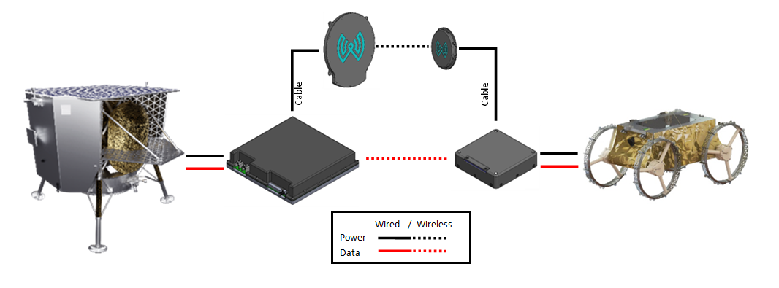
Project Overview
Technology Product Capability
A space-qualified charging system capable of near field wireless power transfer
Technical Capabilities
Develop a rover with integrated power receiver, and a base station, both capable of operating in a lunar environment
Demonstrate wireless charging as a feasible means of power transfer for lunar missions
Demonstrate that the system can enable lunar night survival
Exploration & Science Applicability
Supporting marsupial roving missions, enabling robotic systems that do not contain onboard nuclear or solar power generators
Charging toolkits on crewed lunar terrain vehicles (LTVs), human landers, and in LEO
Powering the heaters of critical devices to survive the lunar night, particularly in the case of equipment with small or limited on-board battery capacity
Notes:
Provide an overview of the Project/Task
The slide content is intended to remain static unless significant changes are made to the Project
Pictures are encouraged, please provide new pictures as frequently as possible

Slide 3
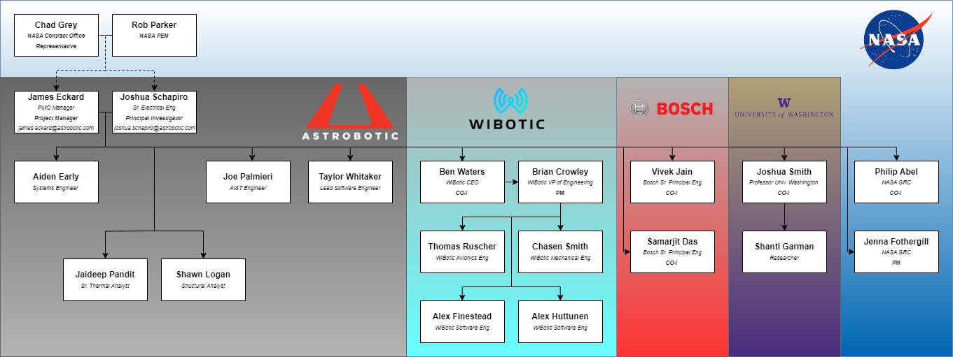
Team Members / Project Org Slide
Notes:
If you have submitted a Project Plan, you could utilize the Organizational Chart found in section 8.3 – Management Structure

Slide 4
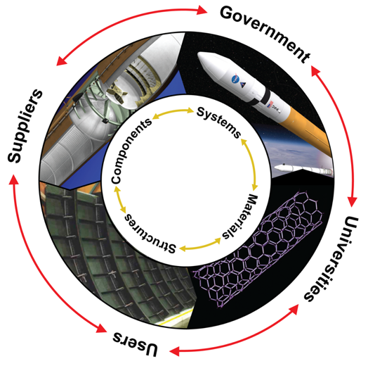
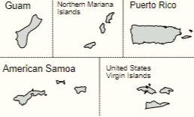
Collaborations & Partnerships
NASA Centers
GRC
LaRC
KSC
Public/Private Partnerships
WiBotic Inc
Bosch
Industry/Academia
University of Washington
Collaborative multidisciplinary partnerships to leverage fiscal resources, ideas, knowledge & expertise.
Notes:
Detailed Example Only for context
https://www.mapchart.net/usa.html

Slide 5
Ultra Fast Proximity Charger (UFPC) Technology Goals & Project Objectives
Technology Goals
Goal #1 | Qualify and commercialize a space-based wireless charging product line through demonstrating the feasibility of wirelessly recharging a rover in a lunar night analog environment.
Project Objectives
Objective #1 | The program shall develop an integrated Onboard Charger (OC), and a Transmitter (TR), both capable of flight qualification.
Objective #2 | The program shall demonstrate wireless charging as a feasible means of power transfer for lunar missions.
Objective #3 | The program shall demonstrate wireless charging as a feasible means of night survival for lunar surface assets.
Objective #4 | The program shall demonstrate a self-docking algorithm that enables CubeRover to align wireless charging antennas without the need for direct drive commands.

Slide 6
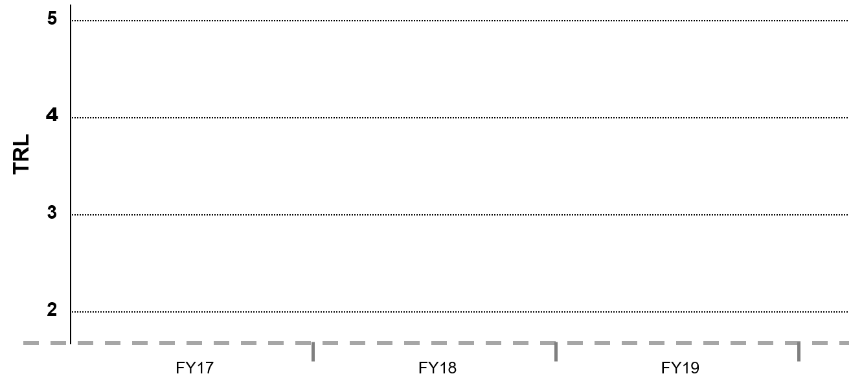
TRL Progression Ultra Fast Proximity Charger
Project Milestone
GCD (Key) Milestone
Controlled Milestone
TRL Progression
Final Report and Presentation
Qual / Demo with FM in Dirty TVAC
7
6
5
4
EM2 Performance Testing
CDR/TAPR
TRL
FM Fabrication
EM1 Performance Testing/ Model Validation
ATP/ Kick Off
PDR
Complete ICD and Manual
Current Date
SRR
EM1 Fabrication
CY21
CY22
CY23
CY24

Slide 7
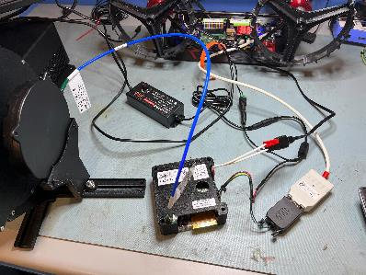
Accomplishments
Technical Accomplishments (March 2023)
Astrobotic:
Thermal Analysis refined test procedures and system level design for both in-house TVAC testing as well as Dirty TVAC testing with GRC.
Design for MLI enclosures have been released for quote.
Electrical Engineers successfully brought of EM1 with an electronic load to de-risk for use in TVAC.
Created harnessing and a manual to allow Bosch to integrate their EM1 unit into the development rover.
WiBotic:
Mechanical Engineering integrated bonding points into the avionics enclosures as well as EMI gasketing.
Electrical Engineering continues to focus on design and update of the TR power/RF board for EM2.
Software Engineering continues to port the code from the terrestrial grade digital board to the new processor on the space rated digital board.
TR/OCEM2 Space Rated Digital Board (Wibotic)
OCEM1 Rover Integration (Astrobotic)

Slide 8
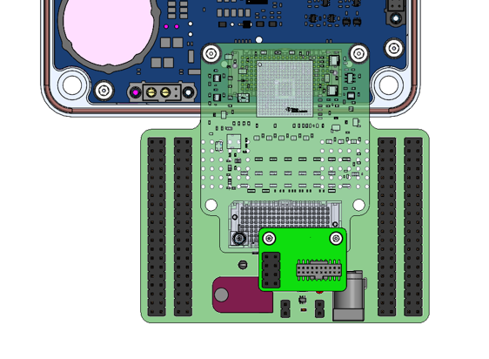
Accomplishments
Technical Accomplishments (April 2023)
Astrobotic:
Thermal Analysis refined test procedures and system level design for both in-house TVAC testing as well as Dirty TVAC testing with GRC.
Design for MLI enclosures have been released for purchasing.
WiBotic:
Mechanical Engineering is investigating different venting methods for the avionics enclosures due to sourcing issues with current part selection.
TC enclosures have been ordered for the EM2 delivery.
Electrical Engineering continues to focus on design and update of the TR power/RF board for EM2.
Electrical Engineering created small PCB heaters to test different heating methods of the avionics enclosures. These heaters are custom designed Kapton pads utilizing off shelf resistors. Heaters are inexpensive, short lead time. Efficacy to be determined through modeling and test.
Adapter boards were designed to breakout the functionality of the digital board further, as to assist with testing and development.
Adapter boards for assisting in testing and development of digital board (WiBotic)

Slide 9
Accomplishments
Technical Accomplishments (May 2023)
Astrobotic:
Thermal Analysis has developed a Thermal Desktop model of the OC with integrated Kapton heaters.
Structural Analysis has created updated models of the TC, RC, and enclosures to update vibe analysis to latest design.
Bosch:
Fiducial trade studies are underway to understand how a fiducial can be detected effectively with 48,000lm sources placed at different positions to induce shadowed areas.
Studies are underway to determine the feasibility of using wifi CSI and RSSI in order to determine the location of the rover without camera-based navigation. Study shows promise for use when the RF environment does not change.
Studies are underway to calculate predictive path planning based on location of the rover with relation to the transmitter. It shows a lot of promise with it’s ability to dynamically recalculate it’s path based on any unpredicted environmental changes.
Bosch team was able to successfully integrate their EM1 system into the development rover. They successfully gather telemetry from the OC in order to inform the charging status of the system while docking.
Astrobotic CubeRover outfitted with EM1 charger for autonomous docking development (Bosch)

Slide 10
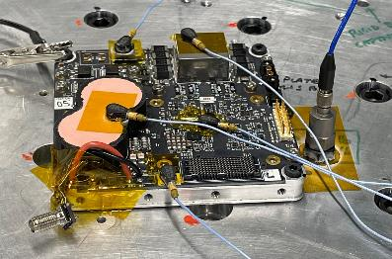
Accomplishments
Technical Accomplishments (June 2023)
Astrobotic:
AI&T team performed a vibration test on the EM1 OC assembly. The data was given to the Structural Analysis team to compare the results against their predicted model. All this information will be fed into the models for the EM2 units.
Conversations between Astrobotic and the radiation analysis and test supplier continue. We are working to fine tune the scope of the work.
WiBotic:
Software Engineering demonstrated the new SLIP interface for the space rated units. This is one of the larger architectural shifts that needed to be completed by the software team.
Experiments were complete using custom heaters designed by Wibotic incorporated into the OCEM1 baseplate. Several tests were run using different materials under the enclosure to vary the conductivity
Bosch:
Bosch team is currently gathering charge status data from their EM1 unit with the coils at different distances apart. Their current testing allows them to reliably align the coils within 8cm using the camera and fiducials. Using the charging status data should allow the rover to decrease the current alignment distance to the required 4cm.
OCEM1 Vibration testing (Astrobotic)
OCEM1 Heater testing (Wibotic)

Slide 11
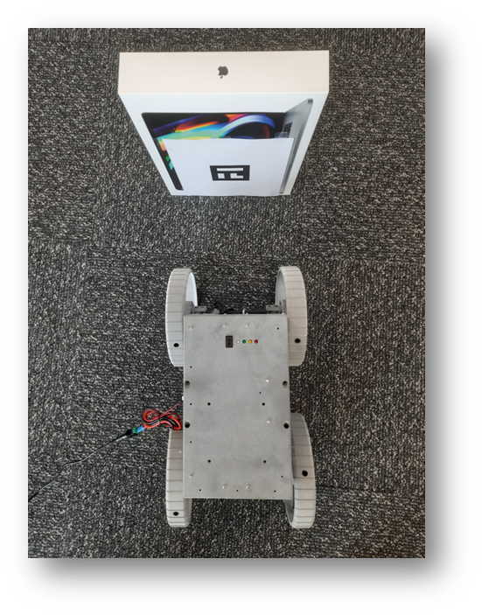
Accomplishments
Technical Accomplishments (July 2023)
Bosch:
The team continues to optimize their path planning based on camera input from the rover. Current results show them reliably aligning the rover within 8cm of the rover using the camera data alone.
They continue to gather charge status data from their EM1 unit with the coils at different distances apart. Their current testing allows them to reliably align the coils within 8cm using the camera and fiducials. Using the charging status data should allow the rover to decrease the current alignment distance to the required 4cm.
Another source of telemetry to assist in docking is the RSSI data from the wireless charger radio itself. Current tests show the data unreliably, but an experiment is being planning for testing the docking outdoors in order to mimic the lunar environment and reduce the effects of reflections off walls and ceilings.
UW
Completed the dust adhesion testing for their EM1 unit and reported the results back to Astrobotic and Wibotic. Some of the specific parameters tested, for example temperature rise and frequency shift we different than the previously tested terrestrial unit. None of them are presently a cause for concern but will be interested to get a better idea as the source of the shift.
Preliminary results for autonomous docking with camera (Bosch)

Slide 12
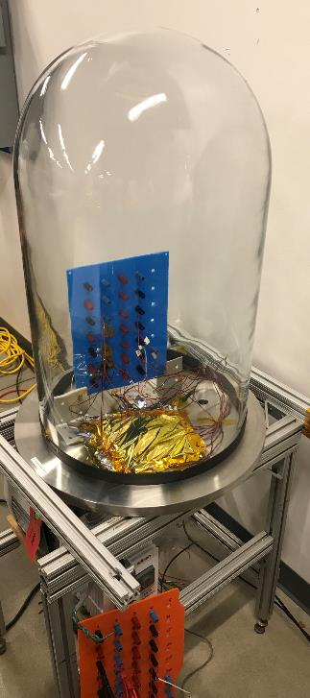
Accomplishments
Technical Accomplishments (August 2023)
Astrobotic:
MLI enclosures for the TVAC testing are on order.
AI&T began Bell Jar testing of the Kapton heaters designed by WiBotic, ensuring they survive the maximum anticipated power output in vacuumed without failure. First test case is complete and showing promising results for survivability of the heaters.
WiBotic:
Software Engineering is working to incorporate the safety library on the TI Hercules processor, as well as are working to communicate with the local radio.
Electrical Engineering continues to focus on design and update of the TR power/RF board for EM2. Schematic for the digital portion of the board is complete, and the power section is nearing completion. Layout for the board has begun.
Bosch:
Bosch team continues to optimize their path planning based on camera input from the rover. Current results show them reliably aligning the rover within 8cm of the rover using the camera data alone.
Bell Jar testing of Kapton heater (Astrobotic)

Slide 13
Project Assessment Summary
Project Name | Performance |  |  |  | Comments
 | C | S | T | P
Mid Year | G | R | G | G | Schedule - Challenges related to WiBotic significant underestimate of the time required to complete the TR RF/Power board design which has pushed critical path – This is NOT related to any technical challenges. Astrobotic has carefully managed resource allocations to preserve budget and furthermore has taken advantage of additional time to retire a number of risks.
Annual | G | R | G | G | Schedule – Status has remained the same from MYR, lost schedule due to TR RF/Power board design was not recovered, but further slippage has mostly been contained. Astrobotic and NASA have verbally agreed to a no-cost extension based on the fact that technical fidelity has not been impacted and budget remains healthy. Formal execution of the NCE will be complete upon WiBotic closeout of delayed design task to ensure projected schedule confidence. Following NCE – Schedule can move back to Green

Slide 14
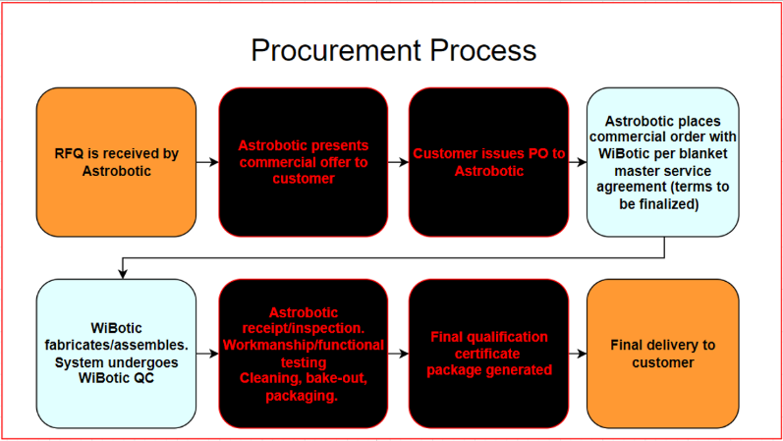
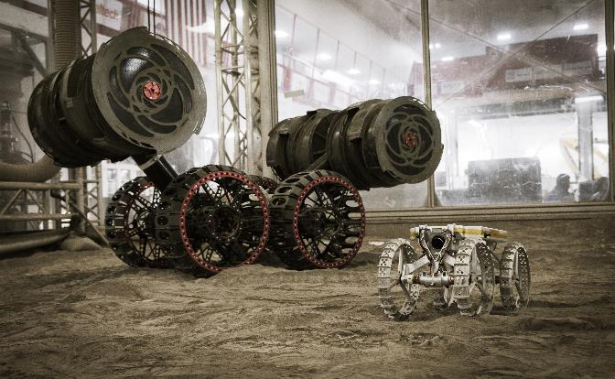
Plans Forward and Transition / Infusion Plan
Astrobotic remains heavily committed to commercializing the UFPC as a product offering to other commercial space companies and NASA project teams.
Astrobotic and WiBotic are formalizing commercial agreements to define the procurement model of the jointly developed UFPC
The UFPC remains baselined as the power system for the IPEx rover demonstration, another GCD project being lead by NASA KSC

Slide 15
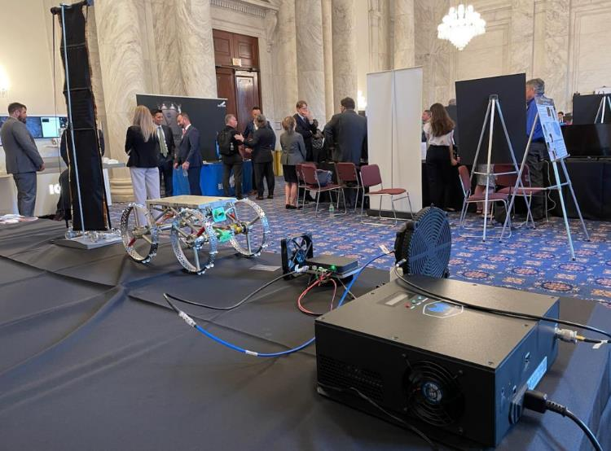
Education/Public Outreach
EPO Involvement
EPO Calendar Outlook (High Priorities):
6 Month Look-Ahead
LEAG Annual Meeting | September 20-22th
International Astronautical Congress 2023 | October 2-6th
LSIC Fall Meeting 2023 | October 10-11th
The UFPC team was present at LSIC Spring Meeting 2023 where a table was set up with a hardware demonstration of the UFPC. Team members actively engaged with the community and answered questions
Mike Provenzano, LSS Dept Director, is attending the Sept 7 Tech Day on the Hill to present Astrobotic’s work in Lunar power systems including a hardware demonstration of the UFPC prototype. Audience includes industry members and government/ congressional stakeholders
Jay Eckard, UFPC Project Manager, was interviewed for Yahoo News video feature story discussing the UFPC development and the challenges of lunar exploration it aims to solve, projected publication date Sept 2023
Notes:
Summary of the EPO activities (papers, conferences, outreach events) participated in over the last 6 months and the forward outlook for 6 months

Slide 16
Summary
Accomplishments for the Year
The project has endured schedule challenges attributed to underestimate of subcontractor design time
Despite schedule challenges, the project boasts a healthy budget and resource availability
Most importantly, Astrobotic has not made any compromises on the technical fidelity of the product to be developed, nor have we considered removal of any scope
Additional time along the critical path has been utilized to buy down risks, and work ahead on environmental simulations and analysis
Initial release of the ICD and Users Guide.
EM1 has successfully been delivered and is beginning to undergo testing.
The project aims to advance the technology readiness level of the wireless charger system to TRL 6 after the testing of EM2 is complete. The project will culminate with an operational demonstration of docking and wirelessly charging in a dirty TVAC environment, thus advancing the TRL to 7.

