Slide 1
Ground-Based Capabilities for Lunar Infrastructure Testing
Aaron Weaver, Jacquelynne Houts, Lee Mason, Jeffrey Csank, James Nessel, Michael Zemba, Bryan Schoenholz
National Aeronautics and Space Administration
John H. Glenn Research Center
74th International Astronautical Congress (IAC)
Baku, Azerbaijan
2-6 October 2023

Slide 2

NASA has established an objectives-based approach to create a blueprint for sustained human presence and exploration throughout the solar system
These objectives provide goals for exploration and allows a framework to be developed to meet those goals
The objectives are aligned to four main areas:
  Science
  Transportation and Habitation
  Operations
  Infrastructure
2

Slide 3
Moon-to-Mars Infrastructure Objectives
Lunar Infrastructure (LI) Goal: Create an interoperable global lunar utilization infrastructure where U.S. industry and international partners can maintain continuous robotic and human presence on the lunar surface for a robust lunar economy without NASA as the sole user, while accomplishing science objectives and testing for Mars.
  [LI-1] Develop an incremental lunar power generation and distribution system that is evolvable to support continuous robotic/human operation and is capable of scaling to global power utilization and industrial power levels.
  [LI-2] Develop a lunar surface, orbital, and Moon-to-Earth communications architecture capable of scaling to support long term science, exploration, and industrial needs.
Mars Infrastructure (MI) Goal: Create essential infrastructure to support initial human Mars exploration campaign.
  [MI-1] Develop Mars surface power sufficient for an initial human Mars exploration campaign.
  [MI-2] Develop Mars surface, orbital, and Mars-to-Earth communications to support an initial human Mars exploration campaign.
3

Slide 4
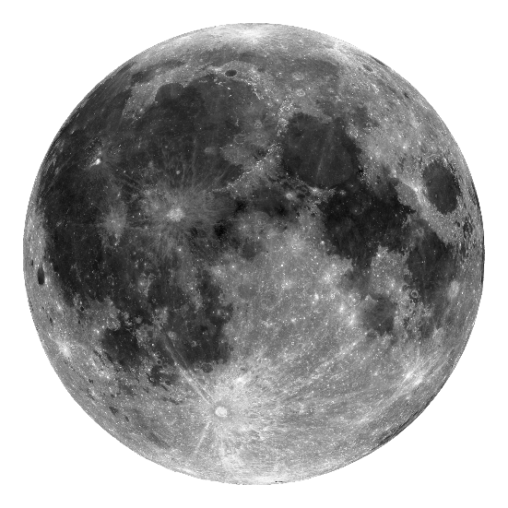
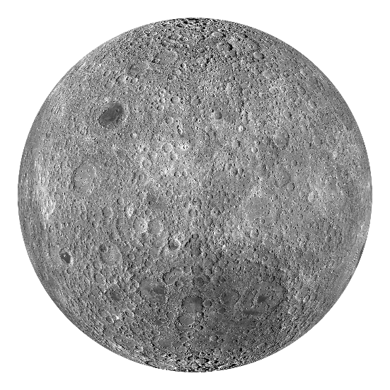

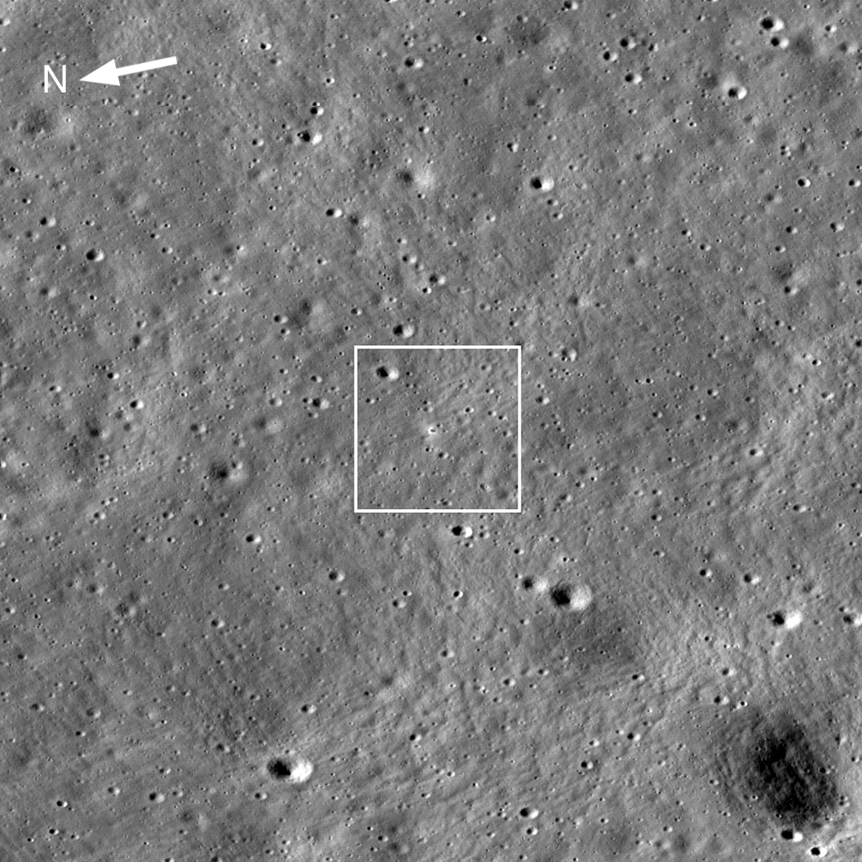



The Rapid Increase in Lunar Missions
Surveyor
Apollo
Luna
Chang’e
Chandrayaan
Apollo 11
July 1969
Surveyor 7
Feb 1968
Apollo 12
Nov 1969
Surveyor 6
Nov 1967
Apollo 14
Jan 1971
SLIM
Apollo 15
Jul 1971
IM-3
Surveyor 5
Sept 1967
AB1
VIPER
Apollo 16
April 1972
Blue Ghost
IM-2
Hakuto-R2
Surveyor 3
April 1967
IM-1
Starship Demo
Apollo 17
Dec 1972
SERIES 2
Beresheet 2
Surveyor 1
June 1966
Blue Ghost M2
Astrolab
AB3
1960
Luna 9
Feb 1966
1970
1980
1990
2000
2010
2020
2030
Luna 24
Aug 1976
Chang’e 3 Dec 2013
Chang’e 8
Luna 13
Dec 1966
Chang’e 7
Luna 16
Sept 1970
Luna 21
Jan 1973
Chang’e 4 Jan 2019
Chang’e 6
Luna 17
Nov 1970
Luna 20
Feb 1972
Luna 27
Chang’e 5 Dec 2020
Chandrayaan-3
Total Successful Soft Lunar Landings: 22
Chang’e-4
  1350 km from the south pole (far side)
Chandrayaan-3
  600 km from the south pole
Lunar Reconnaissance Orbiter Camera (LROC) Imagery of Chandrayaan-3 site

Slide 5
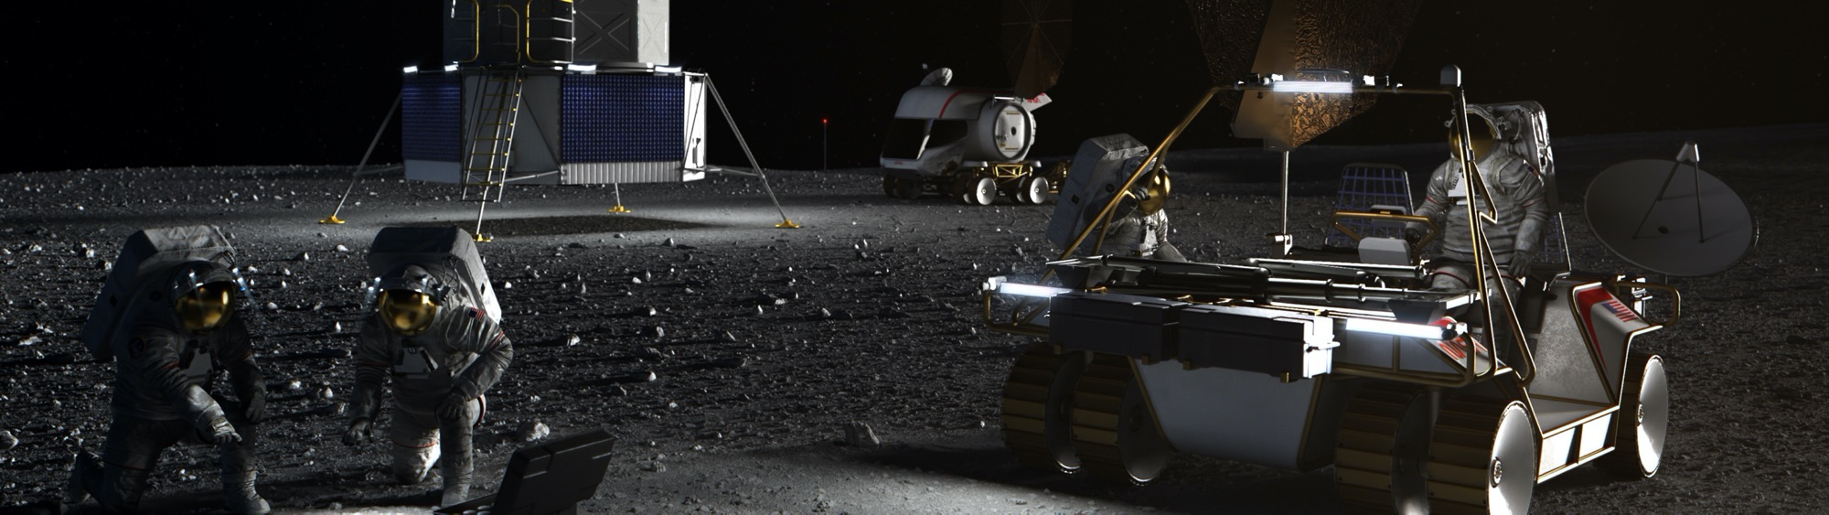
The Role of Ground-Based System Testing
Important to test integrated systems before critical operations
  Another objective is to “Conduct … technology demonstrations on the surface of Earth … to reduce risk and shorten the timeframe for system testing”
NASA Glenn Research Center is aiming to establish testing capability to support both the emerging lunar communications and power infrastructure.
5

Slide 6

Multiple Asset Testbed for Research in Innovative Communications Systems (MATRICS)
MATRICS is a proving ground designed to operate a communications system, or its digital twin, in an accurately recreated, complex, and dynamic environment
The Aerospace Communications Facility houses the MATRICS, which brings together state-of-the-art communications facilities including:
  10m-class Planar Near-Field Range
  Spherical Near-Field Range
  Compact Antenna Test Range
  Fast-tracking 3.7 m S/Ka-band ground station
The Aerospace Communications Facility at NASA’s Glenn Research Center
6

Slide 7
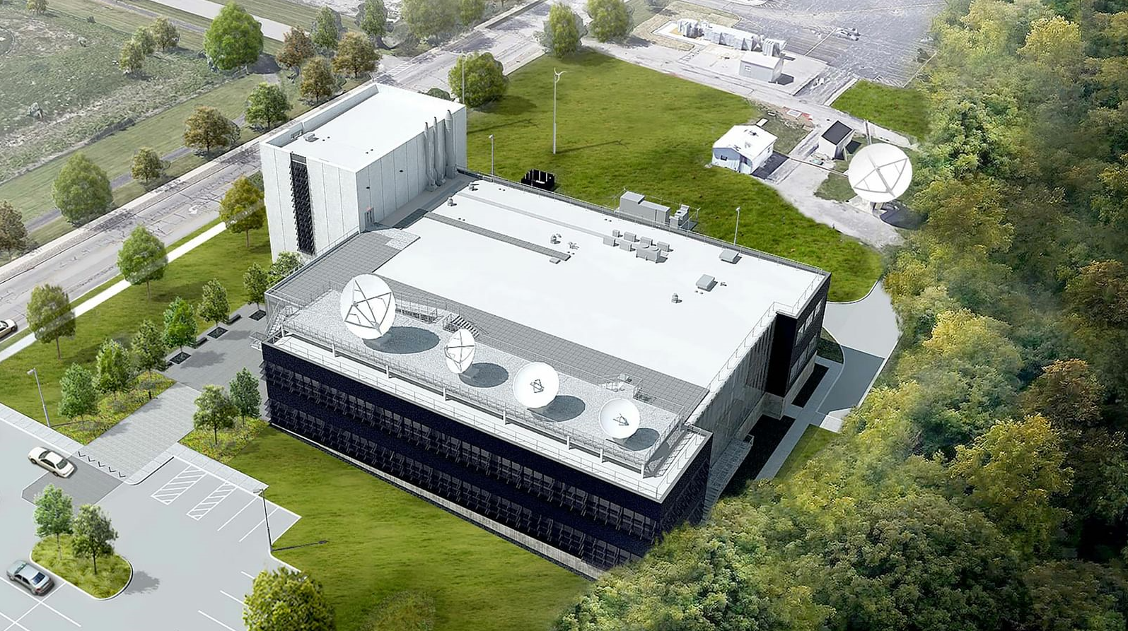
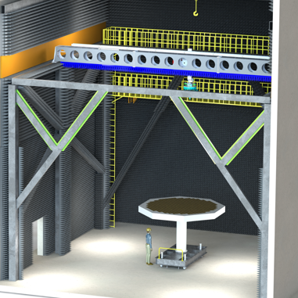
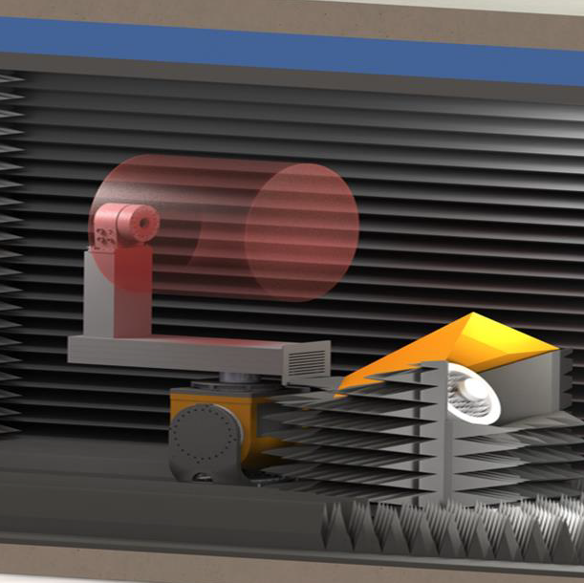
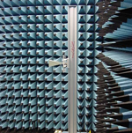
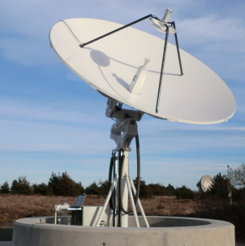
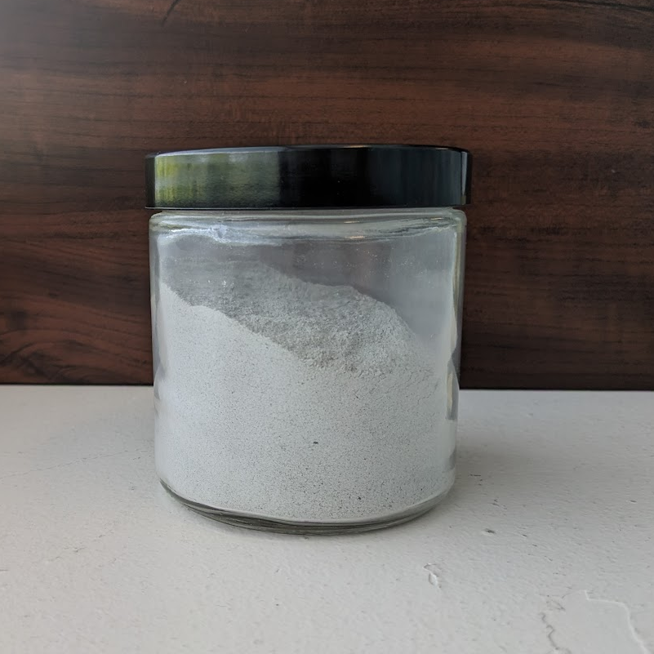
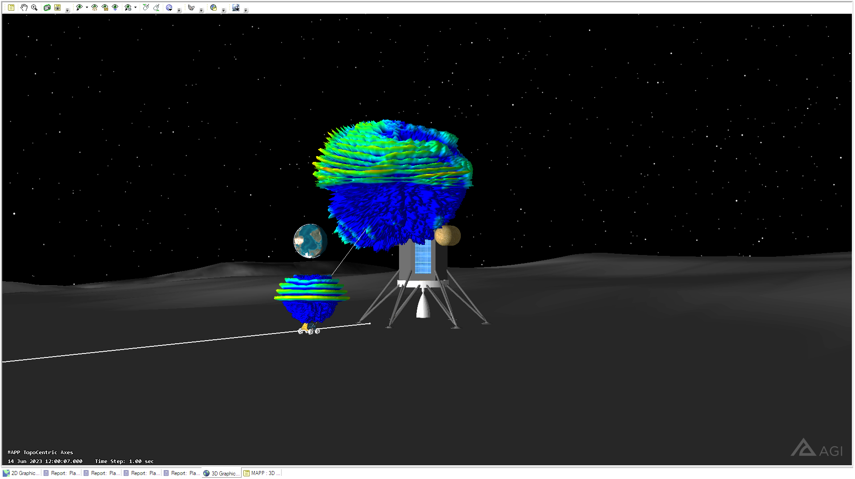
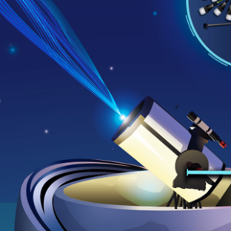
GRC Aerospace Communications Facility
10m Horizontal Planar
Near Field Range
Compact Antenna
Test Range
Cylindrical / Spherical
Near Field Range
3.7m Fast Tracking
Ground Station
RF Characterization
of Materials
Advanced HITL Emulation
for Communications
Optical Communications
Technology Development

Slide 8

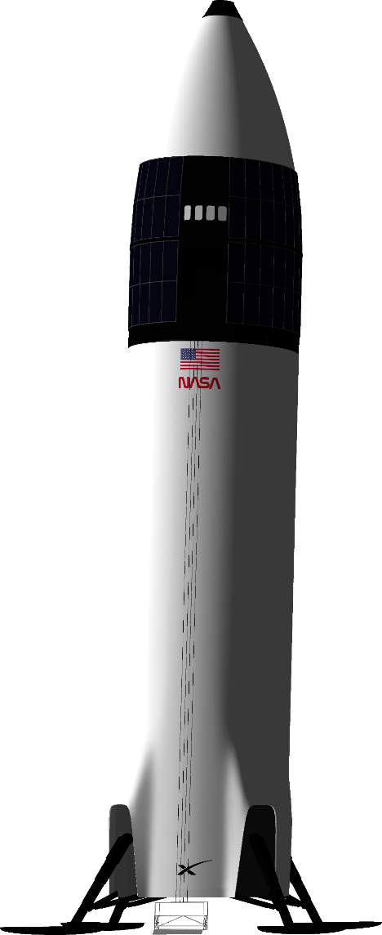

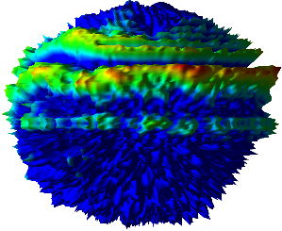
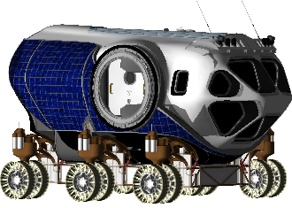

Benefits of Lunar Proving Grounds for Communications
End-to-End Link Analysis
Assess end-to-end performance of interconnecting communications and navigation assets, including relays.
Hardware T&E, V&V
Place hardware in an accurately simulated/emulated environment for test, evaluation, verification, and validation. Ensure interoperability between different users and providers.
Model Refinement
Compare RF propagation models against in situ performance data to refine existing models and develop new models representative of unique lunar surface propagation phenomena.
Anomaly Investigation
Provide a realistic tool to investigate the source of anomalies.
Mission Planning
High fidelity assessment of performance pre-flight offers opportunity to plan missions around connectivity, e.g., define optimized rover paths that maintain connectivity

Slide 9



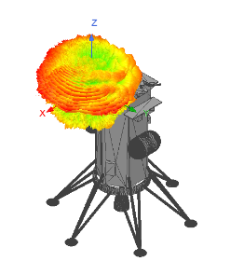
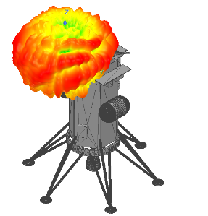
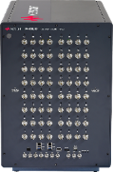
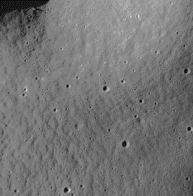
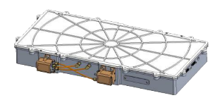
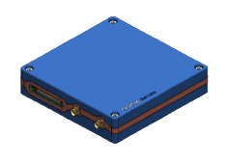
MATRICS Lunar Surface Emulation Capability Overview
Simulation
Emulation
Outcomes
KEYSIGHT
Propsim F64
PROPSIM F64
Installed Performance
Lunar Surface Performance
Channel Emulation
End-to-End Link Analysis
Antenna Design
& Simulation
Hardware T&E, V&V
Antenna
Measurements
Model Refinement
Vehicle Geometry
Anomaly Investigation
Channel Model
Mission Planning
LTE BTS
LTE UE
Regolith Model
Pathfinding &
Optimization
Dust Cloud Model
Multipath Model
Development Status
Workflow Classification
Operational
Input Data
Demonstrated
Modeling and Simulation
LRO Terrain Data
Time Dynamic
Position & Attitude
In Development
Hardware
Future Work
Outcomes
9

Slide 10








Adaptable Surface Power Integration & Research (ASPIRE)
ASPIRE aims to provide a common, integrated testing platform to test and evaluate power technologies for the moon and Mars
  Provides a test capability to characterize lunar technology options in a representative mission context and demonstrate lunar power capabilities to inform requirements
Solar Array
Field
Battery
Emulator
Battery
Emulator
Solar Array
Simulator
PV/Batt
Inverters
PV/Batt
Inverters
AC
UMIC
DC Grid
Emulator
HVAC Distribution
Rover
Charging
Station
HVDC Distribution
AC Grid
Emulator
Long Distance
AC Cable (3kV)
1kV
DC-DC
Conv.
Grid Tie
Converter
Legend:
TBD
120/208 VAC 60 Hz
120 VDC
1 kVDC
3 kVAC
DC
Energy
Router
AMPS HW
Loads
AC
UMIC
120 VDC
AMPS
Loads
Long Distance
DC Cable (1kV)
AC
UMIC
RFC
Fuel
Cell
Autonomous
Power Controller
120 VDC
10

Slide 11
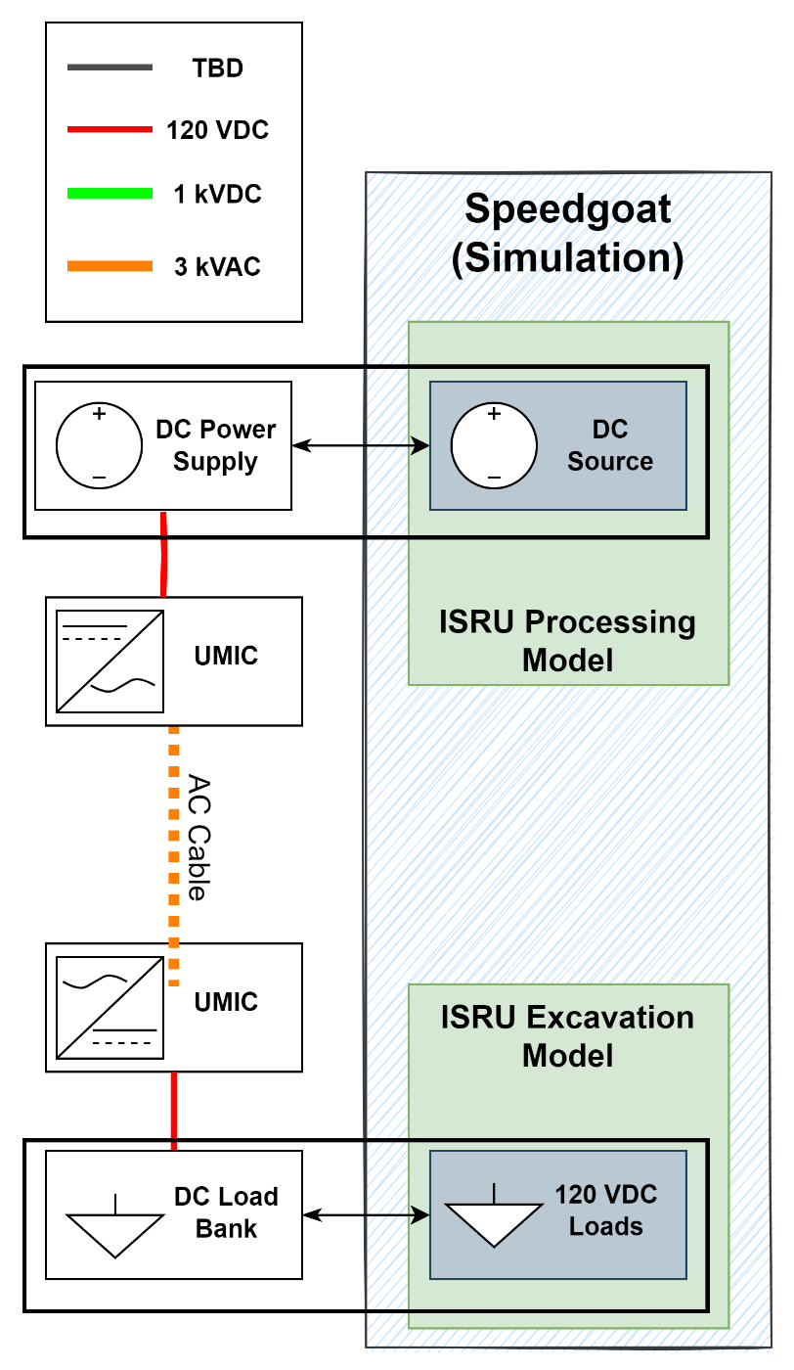
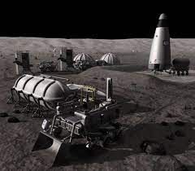
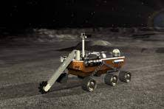
Adaptable Surface Power Integration & Research (ASPIRE)
Initial phase of ASPIRE will focus on:
  Representative Artemis lunar base power levels (10s of kW)
  Simulated power sources and loads (solar arrays, fuel cells, fission power, habitats, ISRU)
  Long distance power transmission (kilometer scale)
  High voltage cabling with both AC and DC transmission
  Open, modular architecture for component demonstrations in system context
  Combination of Breadboard and COTS electronics hardware fidelity
  Flight-like control software, with pathway to interface standardization
  Transient day/night operations with source and load scheduling
11

Slide 12
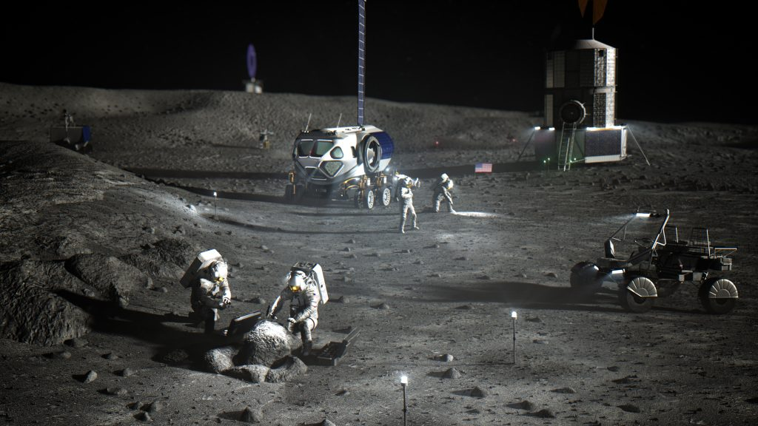
Adaptable Surface Power Integration & Research (ASPIRE)
Future phases of ASPIRE will incorporate:
  Real sources and loads
  Digital Twin computer models
  Wireless power transmission
  Lunar environments: temperature, dust, vacuum
  Industrial-scale lunar power levels (megawatts)
  Human Mars missions
The capabilities of ground-based testing will need to evolve as the lunar infrastructure evolves
12

Slide 13
Summary
It is envisioned that the MATRICS and ASPIRE facilities can be integrated to test both the communications and power infrastructure in a fully representative, lunar environment
  Intended as testbeds for collaboration between NASA and its partners in industry, academia, and other government agencies
These testbeds aim to accelerate the development of technologies for the lunar surface infrastructure
  Helps to ensure the compatibility, interoperability, and reliability of the lunar infrastructure, replicating the lunar environment and the interconnectivity of lunar technologies
13

Slide 14


