Slide 1
Roman virtual lecture series: History of the Roman observatory design, and current build status
Dave Content
September 2023

Slide 2
One-Page Mission Background
WFIRST (widefield infrared survey telescope, prior mission name) was creation of 2010 NWNH Decadal
Based on JDEM “Omega”, Microlensing Planet Finder, and NIR Surveyor mission concepts
All were three mirror anastigmat near IR staring concepts
JDEM Omega was hardware starting point, but needed to be slightly modified to accommodate continuous viewing periods of the galactic bulge for microlensing
Multiple different surveys rolled into one mission
Imaging, imaging spectroscopy, and precision photometry are all required among the surveys
Cooler than HST optics are required for 2.0um red limit
HST is background limited near room temperature and 1.7um red limit
Mission concepts through 2011 were 1.5m on axis or 1.3m off-axis apertures
2.4m aperture (NRO transferred to NASA, we were directed to us, in 2012)
Larger primary mirror has 3x area and 0.5x PSF size, ~20x discovery potential
Realized best design has undersampled PSF with survey strategy to recover full sampling, best compromise of sampling vs wide area coverage
Concept evolved significantly with our understanding of the existing optics
Started with “use as is”; evolved over time towards current concept
Overall design has been very stable after early evolution described here
Renamed in 2020 after Nancy Grace Roman; progressing toward launch readiness in Oct2026
Notes:
When you talk through first major bullet, describe 34/W150 crowd at Decadal announcement time. We submitted JDEM/Omega, but WFIRST won (1st in new large space mission category) ? How could a mission no one had ever heard of win? And where did they get our graphics? OH! It’s US !!!
Then talk about the ambivalence we felt when we heard about the existing telescope coming our way– science would be better in some ways, worse in others with a larger telescope. Re-use of Existing hardware always brings its own issues. No way an increase in the scale of the observatory would end up saving us money, in practice.
Enabling technology was the new H4RG detector with smaller pixels, and 4x increase in pixel count. If you keep the field area the same, you need this to sample the better PSF.

Slide 3
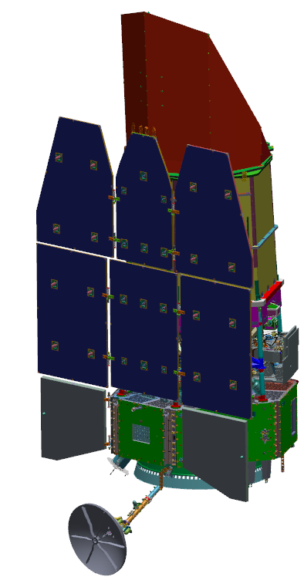
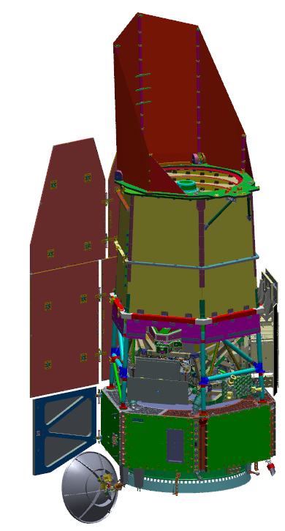
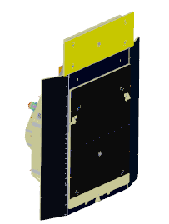
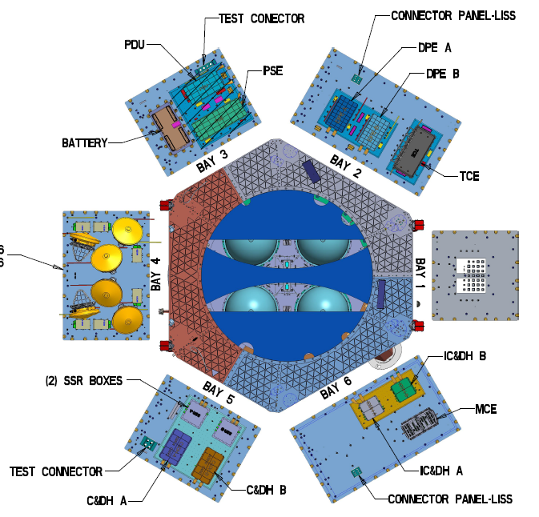
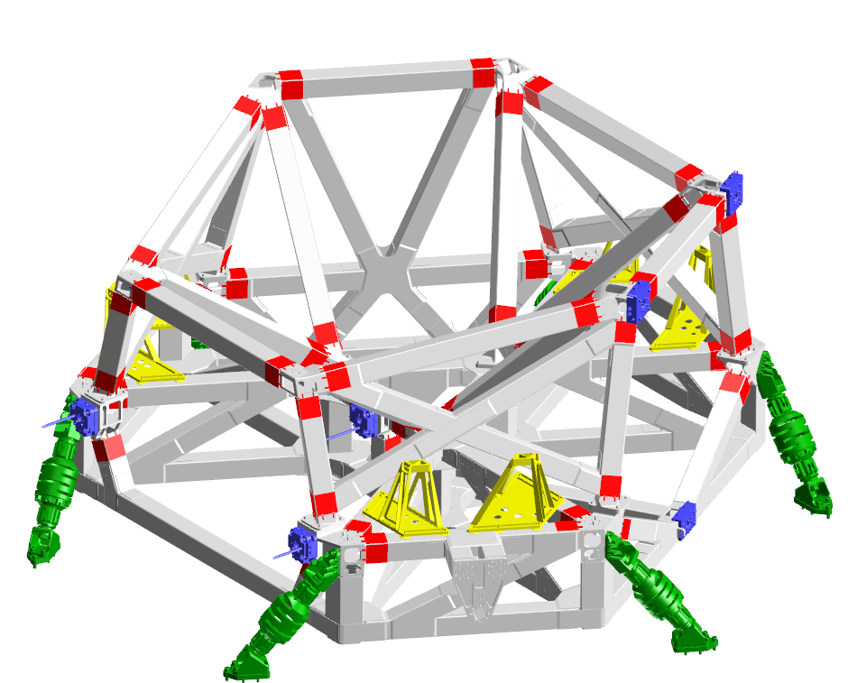
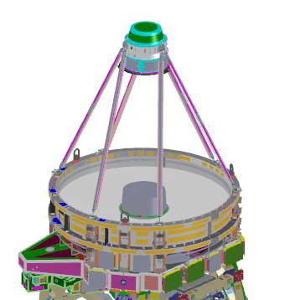
Roman Observatory Hardware
Spacecraft
Payload
Elements
Deployable Aperture Cover (DAC)
12.7 m
Wide Field Instrument (WFI)
Solar Array Sun Shield (SASS)
Outer Barrel Assembly (OBA)
Instrument Carrier (IC)
Lower Instrument Sun Shades (LISS)
Coronagraph Instrument (CGI)
Spacecraft Bus &
Avionics Panels (x6)
Bay 3
Bay 4
Optical Telescope Assembly (OTA) next page
High Gain Antenna
System (HGAS)
2-axis gimbaled
Star Tracker (ST) / Inertial Reference Unit (IRU)

Slide 4
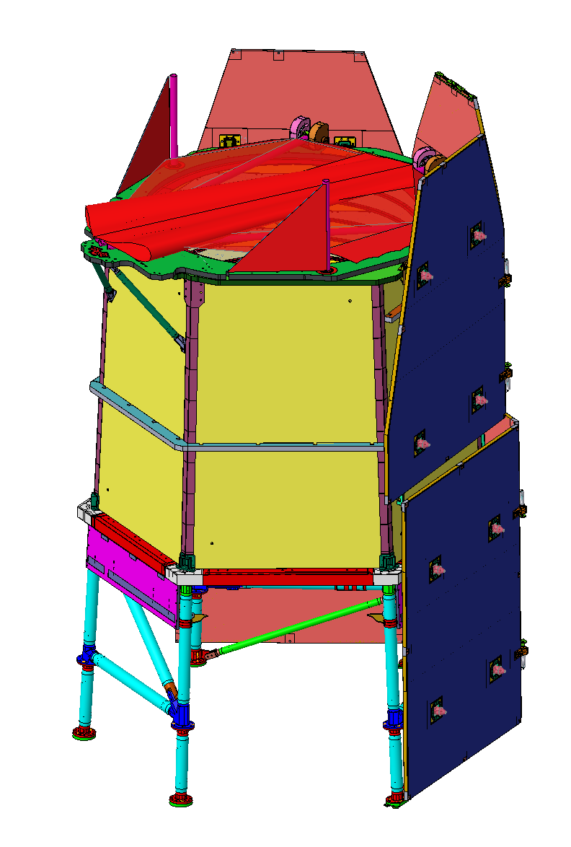
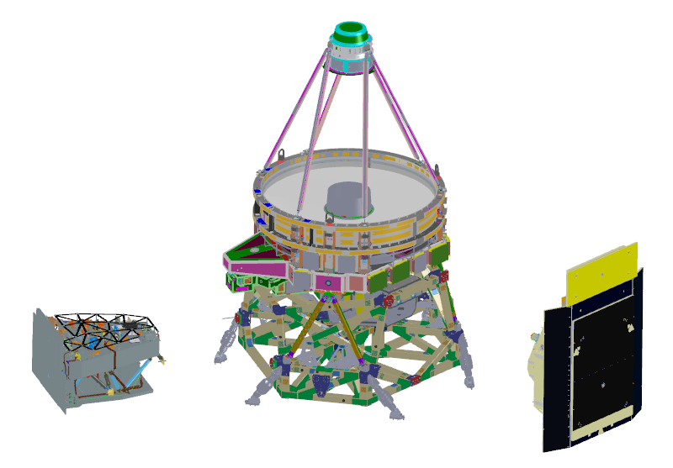
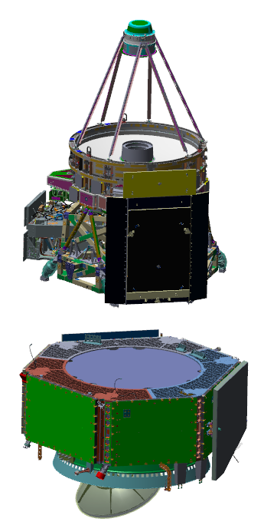
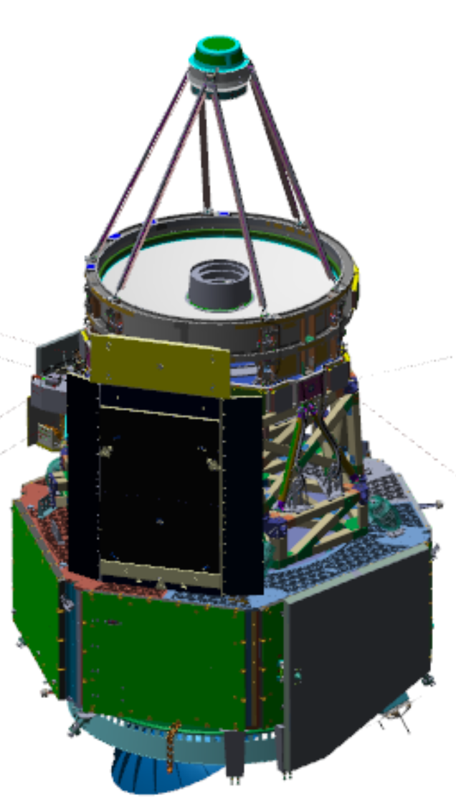
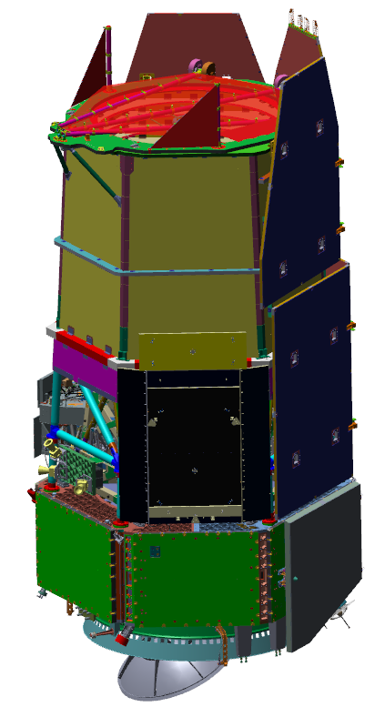
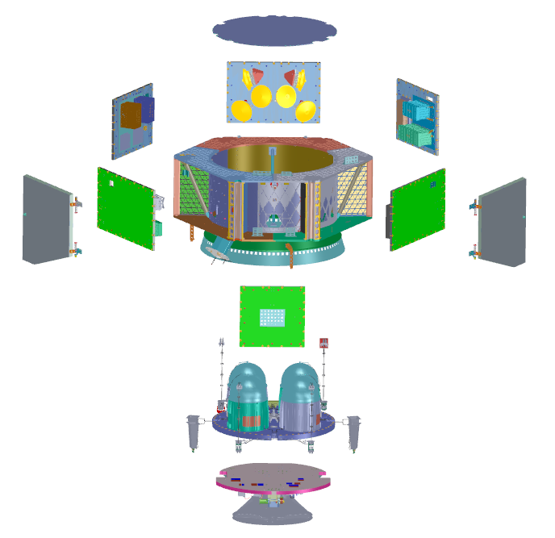
Roman Observatory Expanded View with Integration Flow
OSD = OBA + SASS + DAC
Imaging Optics Assembly (IOA)
optics and structure of the Optical Telescope Assembly (OTA)
Deployable
Aperture Cover (DAC)
Integrated Payload
Assembly (IPA)
Solar Array Sun Shield (SASS)
Wide Field
Instrument (WFI)
Instrument
Carrier (IC)
Outer Barrel
Assembly
(OBA)
Coronagraph
Instrument (CGI)
SCIPA = Spacecraft Bus + Integrated Payload Assembly
SCIPA
Spacecraft Bus Avionics Panels
Spacecraft Bus
Propulsion Module
Communications
Module
Observatory
SCIPA + OSD

Slide 5
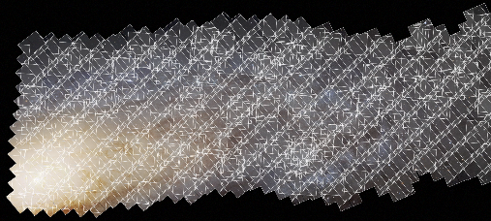
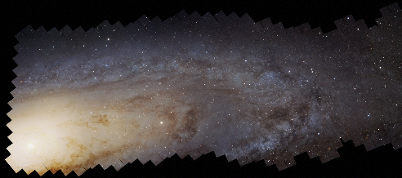

Roman Science (1 of 3) Roman as a Precise Survey Facility
The power of Roman is not just the large field of view:
Very efficient observations: >1000x HST survey speed
Rapid slew & settle
No Earth occultations
No South Atlantic Anomaly
Well understood and stable PSF
Stable thermal environment (L2 orbit, thermal control of all parts of the optical system)
Rigid optical structure with vibration isolation from the spacecraft
Stable attitude control
Excellent flux calibration
onboard Relative Calibration System

Slide 6
Roman Science (2 of 3) Roman Observations
Three Core Community Surveys address the 2010 Decadal Survey science goals while providing broad scientific power
High Latitude Wide Area Survey
Wide area multiband survey with slitless spectroscopy
Enables weak lensing and galaxy redshift cosmology mission objectives
High Latitude Time Domain Survey
Tiered, multiband time domain observations of 10s deg² at high latitudes
Enables Type Ia supernova cosmology mission objectives
Galactic Time Domain Survey
~<15 min cadence observations over few deg² towards galactic bulge
Enables exoplanet microlensing mission objectives
Minimum 25% time (>1.25 yr) allocated to General Astrophysics Surveys
90 days for Coronagraph technology demonstration within first 18 months of mission

Slide 7
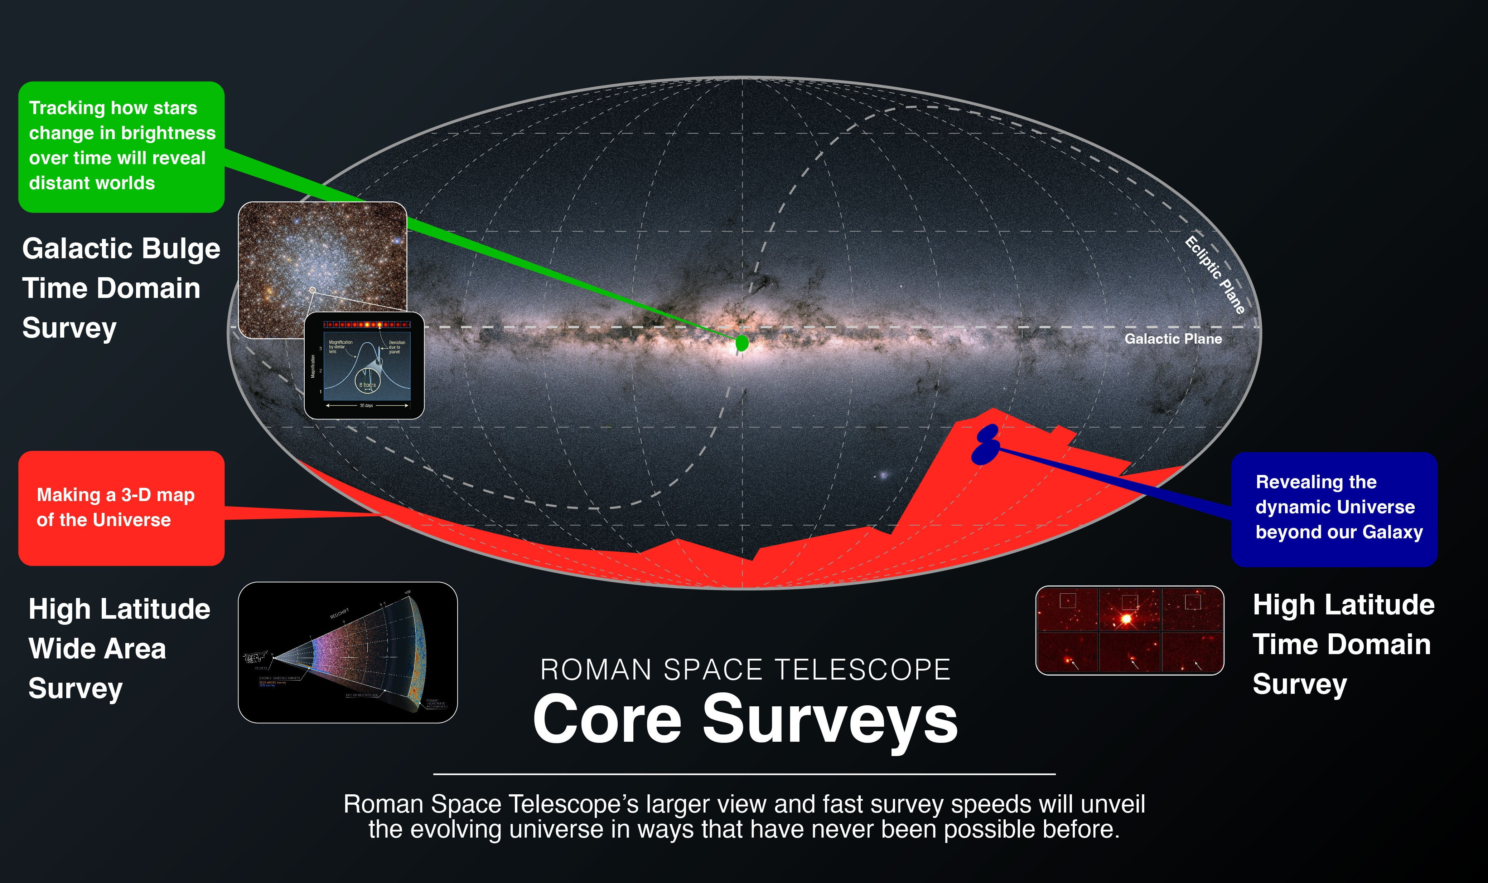
Roman Science (3 of 3) Core surveys mapped to the sky
All-sky projection in Galactic coordinates, with Roman core Survey areas color-coded

Slide 8
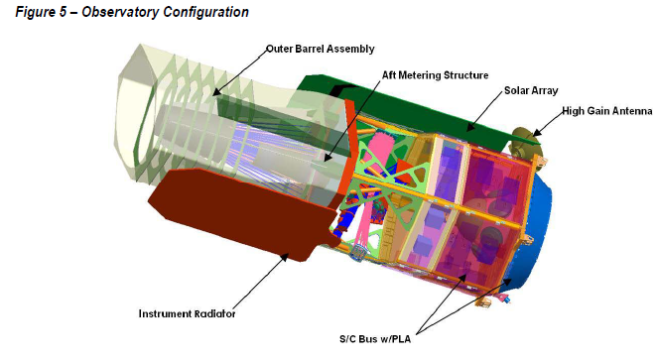
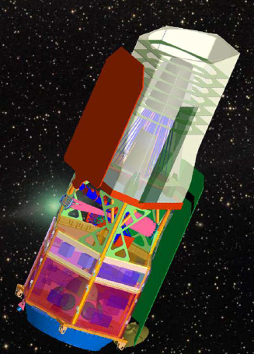
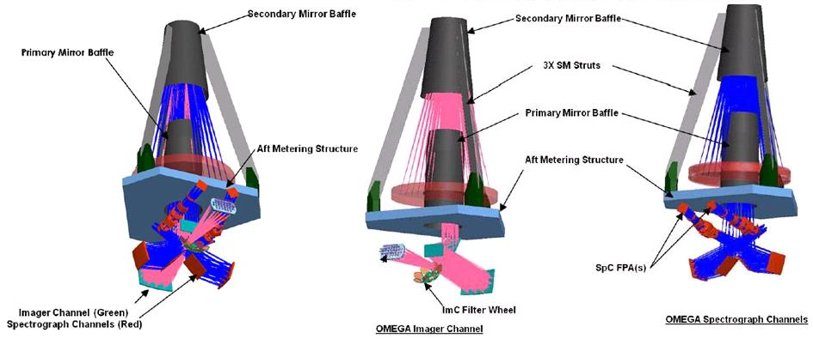
Omega – decadal winning point design

Slide 9
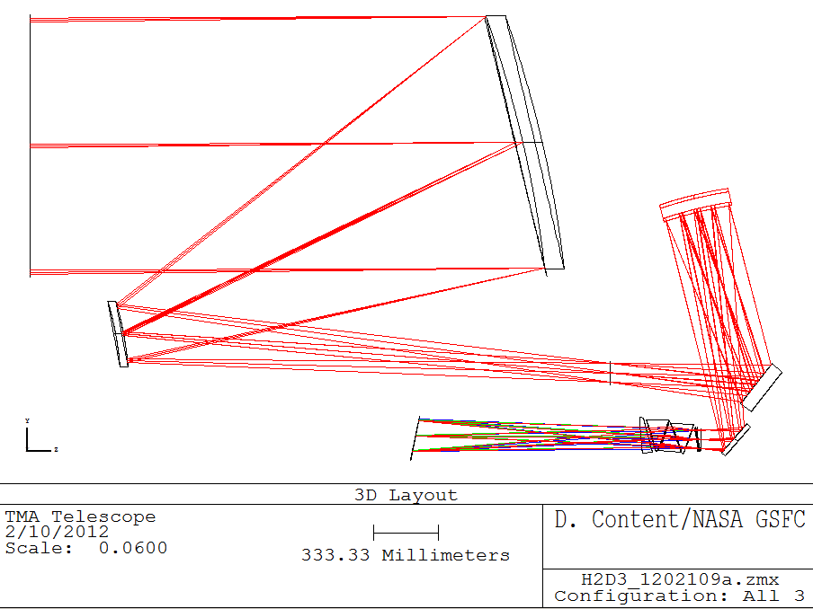
DRM1 (2012)– 1.3m off axis telescope; single larger field of view, focal prism for spectroscopy
Warm side
PM
TM
Prism assembly
SM
F1
Cold stop & Filter
FPA
F2
cold side

Slide 10
Early thinking on 2.4m optical & thermal design
Soon after transfer of optics to NASA in 2012, we learned:
Based on PM, SM prescription, several GSFC optical designers realized original design would not provide a sufficiently wide field. Design change and adjustment of optics would be needed to optimize the science
Mirrors inspected; Protected Ag coatings had aged, needed to recoat
Ion figuring uses same hardware configuration as recoating, and is quick
Therefore conic constant change is low incremental cost
SM would be relatively quick and inexpensive to regrind & polish
Constraint to keep intervertex spacing close to original value so redesign of secondary metering struts and other supporting structures would not be necessary
These are very different design constraints from a “clean sheet” new design
Worked to determine how cold the existing hardware could operate
PM, SM at ~265-270K, new back end for WFI ~220K, consistent with 2.0um red limit
The utility of a coronagraph is a very strong function of telescope diameter; thus the move from 1.5m to 2.4m generated a consideration and finally baselining of the coronagraph (built by JPL, with contributions from university and foreign partners)
CGI specifics were consistent with both “Hybrid Lyot” and “Shaped Pupil” types of coronagraph
Notes:
Verbally spell out acronyms on first use
First subbullet – tell the story of Neil Gehrels’ call on Memorial Day 2012 “we need a “use-as-is” design by Wednesday, or we’re dead!”. Produced something wild and not buildable that worked in Zemax and said “for God’s sake don’t ask us to build this!”
End of first set of subbullets – tell story, sat down with P Hertz/APD and K Grady/PM and went through all this in detail pushing to get off of “use as is”. This was beginning of the process of making the design practical and buildable.

Slide 11
“Phase B” == Flight design
Optics
Very undesirable/difficult to test optical interface w/ tertiary (optically powered) mirror (TM) in WFI. Placed TM and fold mirrors in telescope
Final optical prescription is f/8 “vanilla” Three Mirror Anastigmat; coaxial conic PM & SM, near axis conic TM. CGI is fed using a steerable collimated beam picked off from a separate field of view
Curved field layout (“smile”) preserves axisymmetric TMA form with workable CGI and large field for WFI, and no vignetting, and a pupil placed (just) far enough from the telescope for WFI/OTA clearance
Spectroscopy elements: Grism (higher resolving power, ~1-2um) and prism (lower resolving power, more sensitive) use novel optical designs to achieve large field of view and survive and perform at 170K operating temperature
Wide field spectroscopy optics at 170K were challenging to design/build/test, at least 5 year effort
Filters are spherical surfaces, designed for loosest alignment tolerances in a converging beam
Thermal
Dedicated “external” radiator for cooling WFI focal plane was improved to an integrated multistage radiator by Ball once they won the contract for the widefield instrument optomechanical component, and by tweaking the design to push the focal plane radially outward
A lot of work to enhance thermal stability, active control of IC, OBA, OTA
Pointing – WFI focal plane is the fine guider
4k x 4k HgCdTe sensors include guide window capability
Mechanical isolation at S/C interface to payload (“launch load & vibration isolation system”, LLVIS, and local isolation at S/C reaction wheels)
Procured high torque reaction wheels, enables faster slews

Slide 12
Design drivers
Cost has been a driver. We get all of the attention one might expect for the first flagship after JWST.
Funding has been very steady. When government has been funded, we have been fully funded. This has helped tremendously with keeping up momentum.
Stability – thermal and optical stability drive key science survey systematics. We anticipate nm level optical wavefront stability over our short observations, which meets even the most stringent science need.
Novel tests at telescope level to assist stability model correlation
Rigorous integrated modeling with external audit team
Reuse of existing hardware – the existing OTA components rippled through the whole design, setting the observatory scale and driving many aspects of the design
Data flow – the raw data rate from WFI is ~2Gb/sec and must be handled and averaged down to daily download limit
Large onboard data recorder; 1.7m Ka antenna for download
Calibration – need to understand systematics drove this
Simplified relative calibration system built at GSFC is now integrated into the WFI

Slide 13
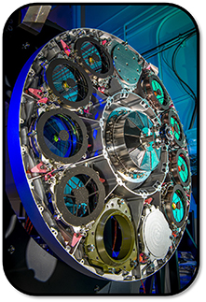
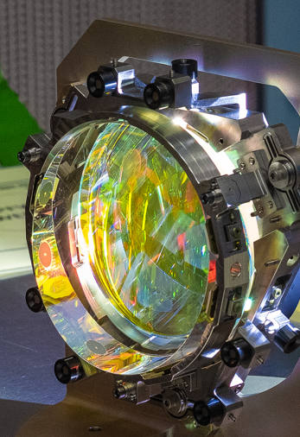
Technology development
Early funding for detector, grism and coronagraph technologies
10um pixel pitch and 4k format a new development, 18um, 2k used for (e.g.) JWST, Euclid
Detector readout ASIC (“ACADIA”), lower noise and easier to use/program
External review for detector and coronagraph early TRL milestones –
History of all of this kept on project website roman.gsfc.nasa.gov
Successful, retiring much early technical risk
Grism successful, EDU, ETU, mechanical model, flight
After descope of IFC, added “simple” SN prism pair
Some struggle developing this, but all elements delivered by late CY22
Launch loads and isolation system not deemed new technology
Heritage from Honeywell “D strut” isolation system
Currently in flight fabrication, same-as-flight EDU nearing completion
Flight Elements installed on EWA
Flight Grism
Flight Prism

Slide 14
Current status – Summer 2023
Passed Critical Design Review (CDR) in September 2021
Due to COVID and supply chain impacts, slipped launch readiness date 4 months to Oct2026
Summer 2022, launch vehicle contract w/ SpaceX for Falcon Heavy
All elements well into integration (instruments, telescope, instrument carrier, spacecraft), scheduled to deliver to observatory integration and testing during CY2024
Eg WFI including all optics, focal plane, electronics, are integrated, working on radiators now
Observatory I&T ~2 years
Formulation science teams concluded in 2021, new science teams recently announced

Slide 15
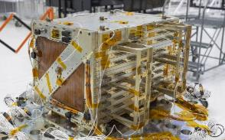
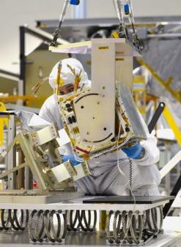
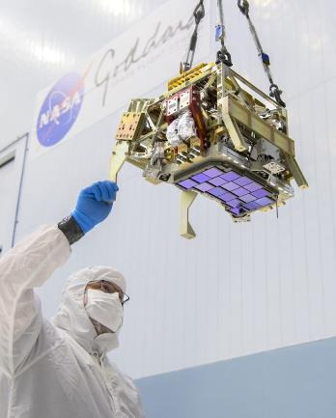
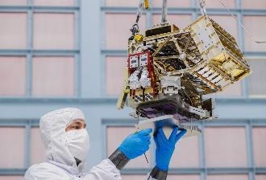
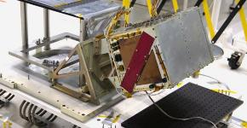
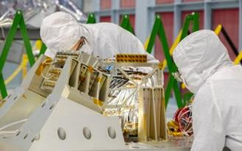
Wide Field Instrument Highlights
Focal Plane Electronics (FPE) assembly, thermal cycling, and vibration testing completed.
Focal Plane Assembly (FPA) after successful vibration testing. FPS assembly and thermal vacuum testing complete. FPS shipped to Ball in early May

Slide 16
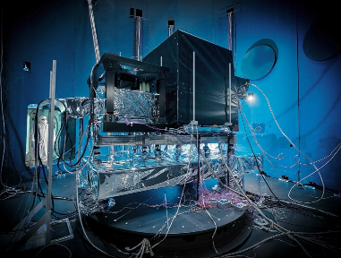
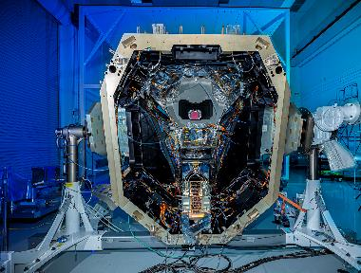
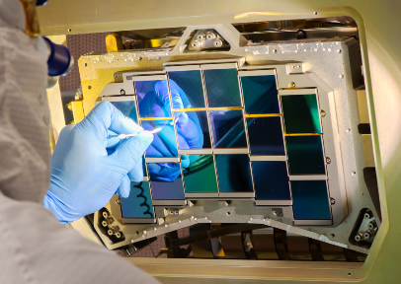
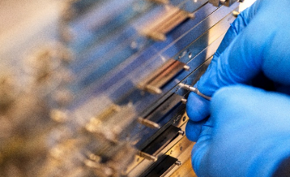
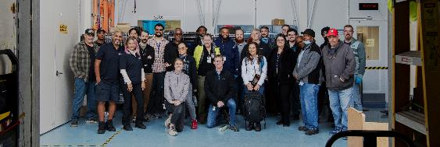
WFI Hardware Deliveries
Stimulus of Ray Cones (SORC)
Delivered to Ball
Simplified Relative Calibration System (sRCS)
Delivered to Ball
Focal Plane Assembly (FPA)
Delivered to Ball
Focal Plane Electronics (FPE)
Delivered to Ball
Goddard WFI Team

Slide 17
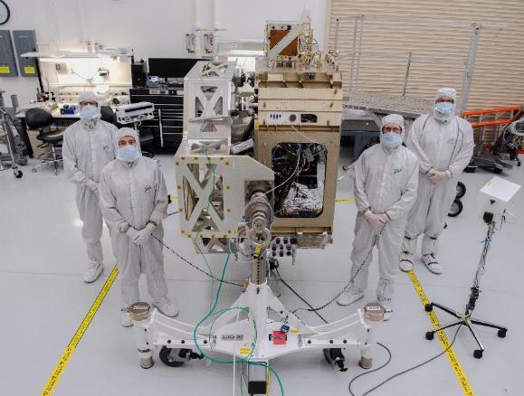
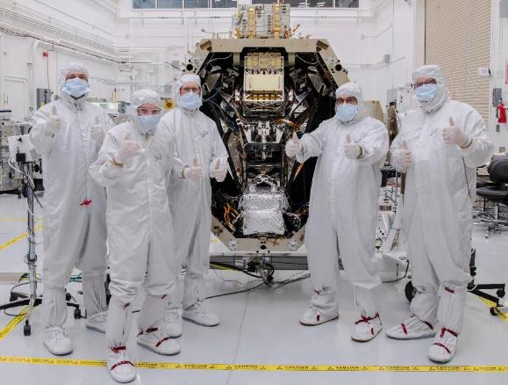
WFI Status and Accomplishments
WFI Focal Plane System (FPS) Mechanical Integration at Ball Aerospace

Slide 18
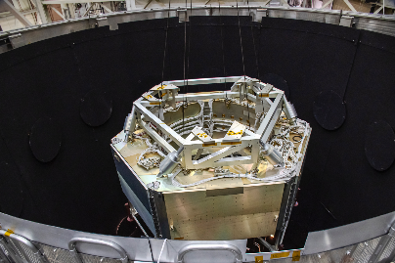
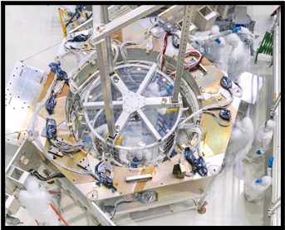
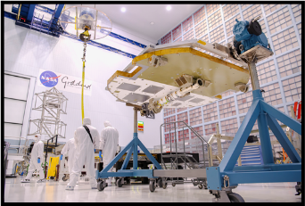
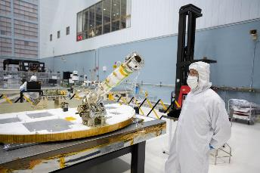
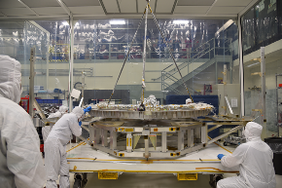
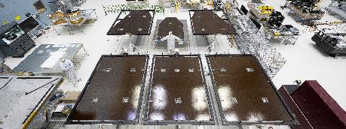
Spacecraft Highlights
Spacecraft High Gain Antenna System (HGAS) – assembly underway in SSDIF
Spacecraft Bus flight harnesses (on mockup) completed bakeout ahead of schedule.
Flight harnesses being integrated into Spacecraft Bus
Spacecraft Solar Array Sun Shield (SASS) panels –
6 flight SASS substrate panels shipped to cell vendor in March for cell laydown
Prop Deck Subassembly Lift to Prop Support Frame in B11 High Bay

Slide 19
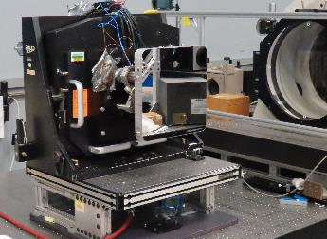
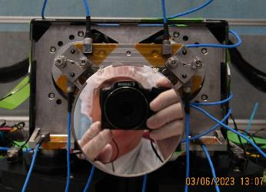
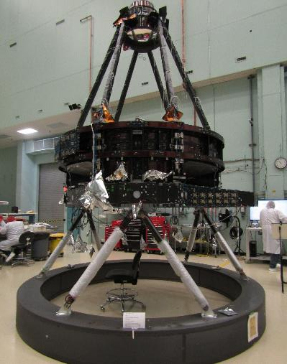
Telescope Highlights
Recent Accomplishments
Forward Optical Assembly completed
Telescope Control Electronics (TCE) Assembly completed
Tertiary Collimator Assembly (TCA) Optical Alignment completed
Completed Fold1 Assembly (in WFI feed)
Completed Tip/Tilt Fold Assembly
(in CGI feed)
Completed Forward Optical Assembly

Slide 20
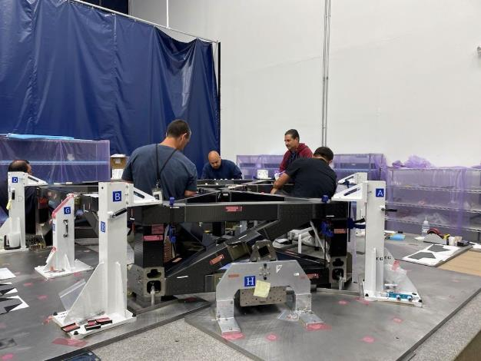
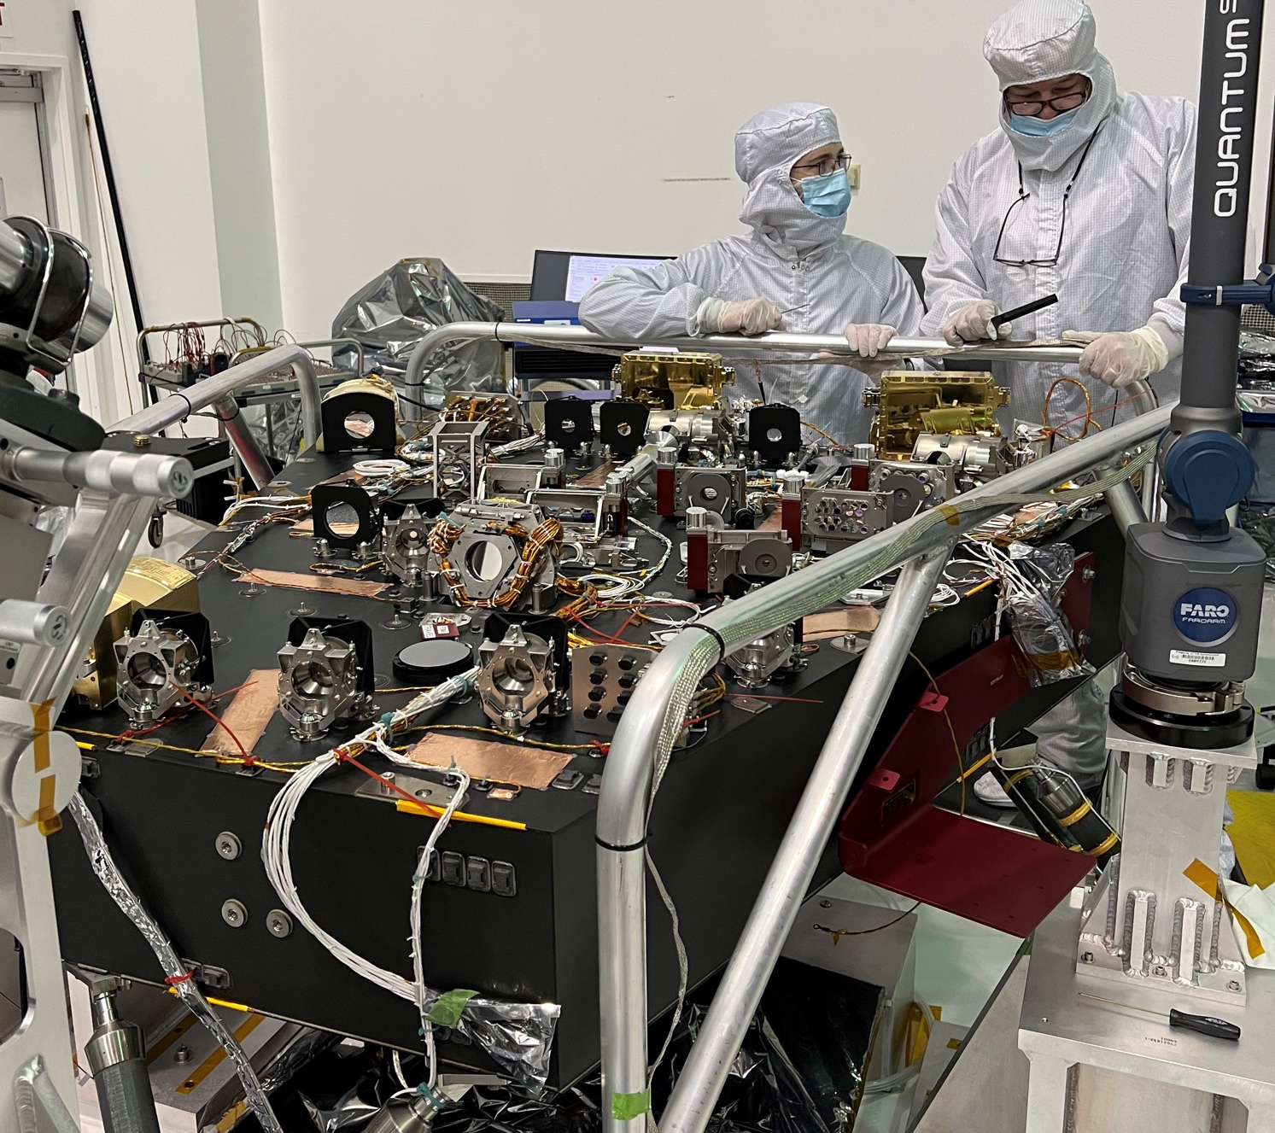
Instrument Carrier Structure & Coronagraph
IC Status and Accomplishments:
Lower Assembly recently completed
Upper Assembly started
Delivery to GSFC I&T September 2023
CGI status
Optical bench fully populated & aligned
All electronics boxes through environments, completing electronics pallet
Instrument integration ongoing

Slide 21
Backup
Thank you for your attention

Slide 22
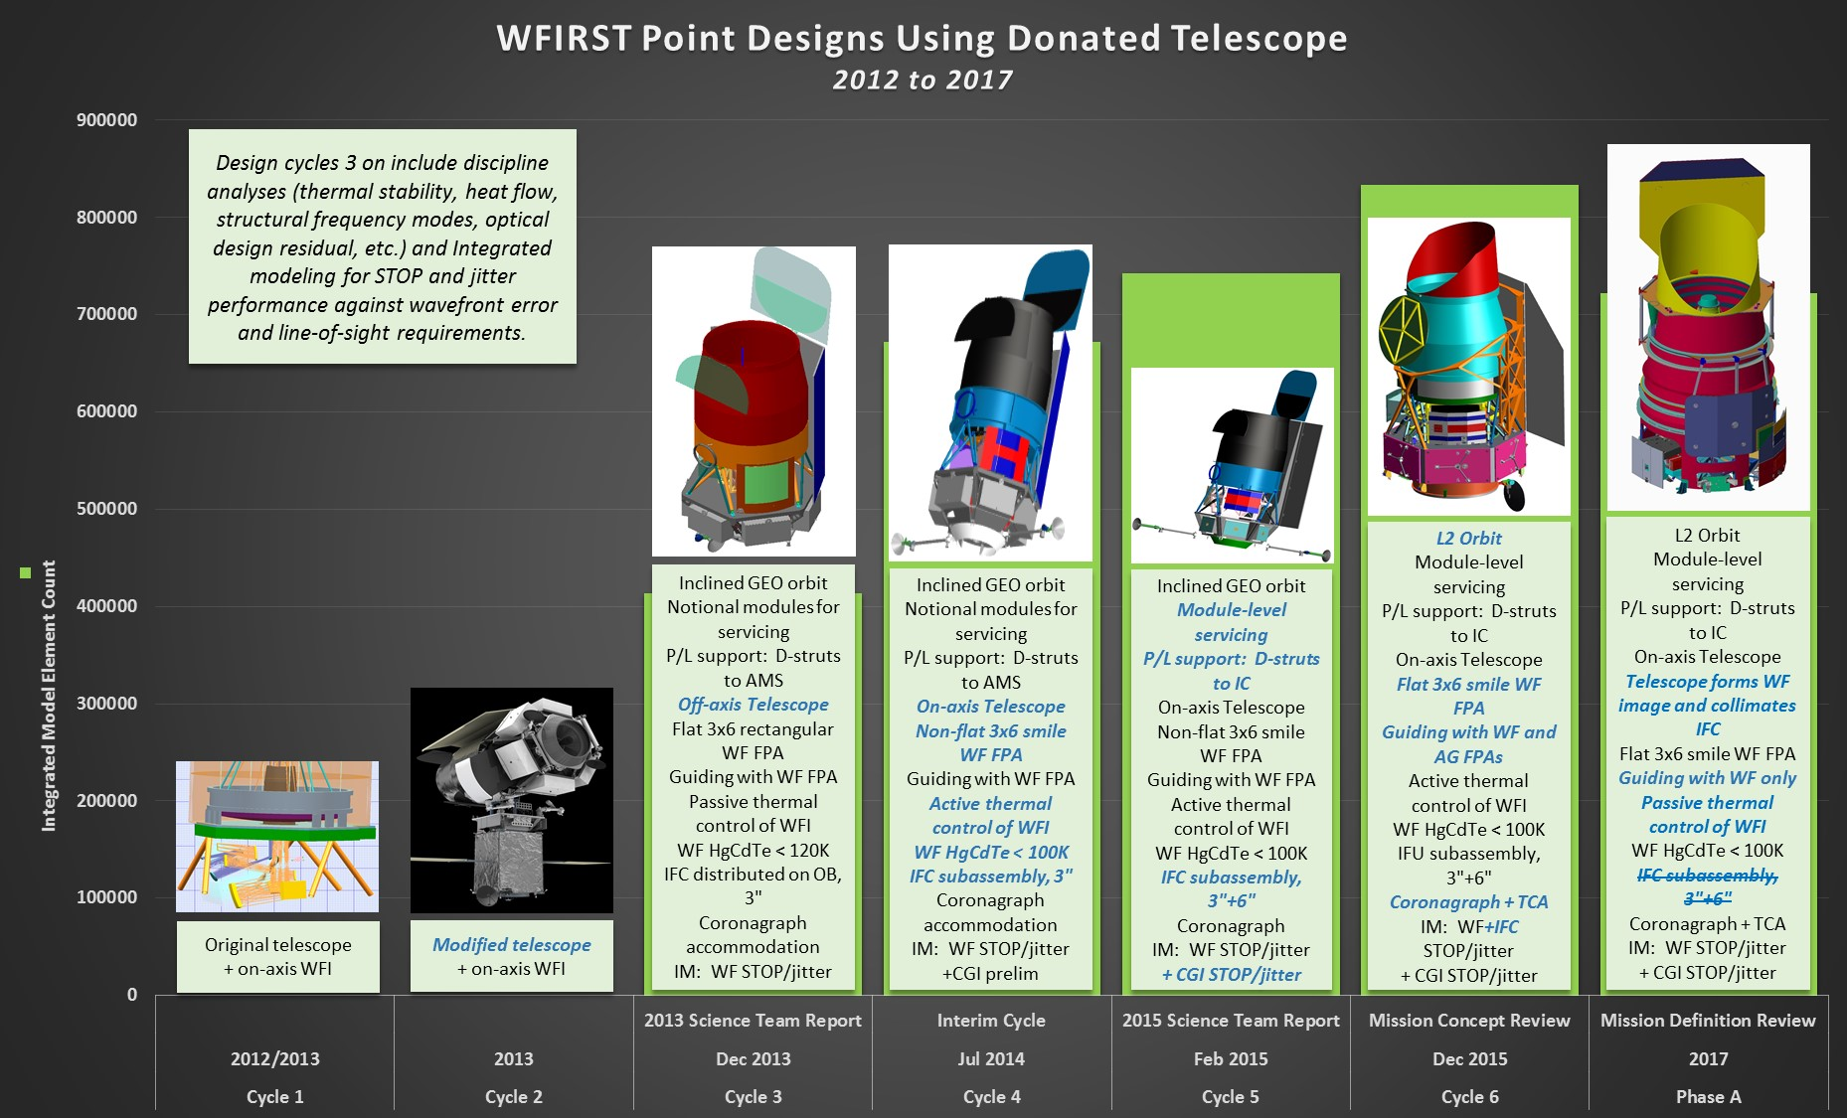
Optical, jitter suppression, thermal designs evolved over early design iterations

