Slide 1
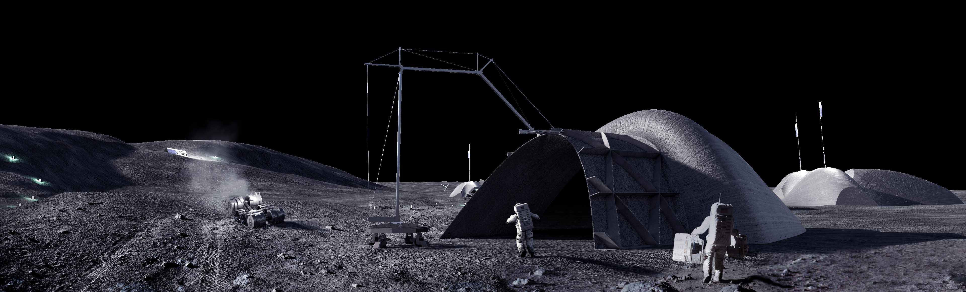
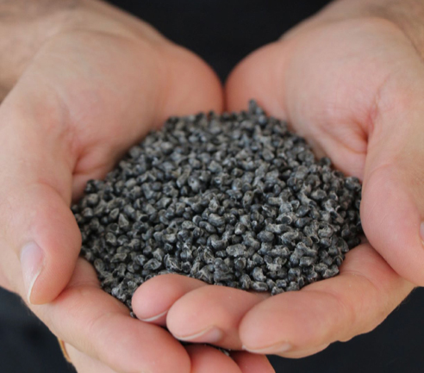
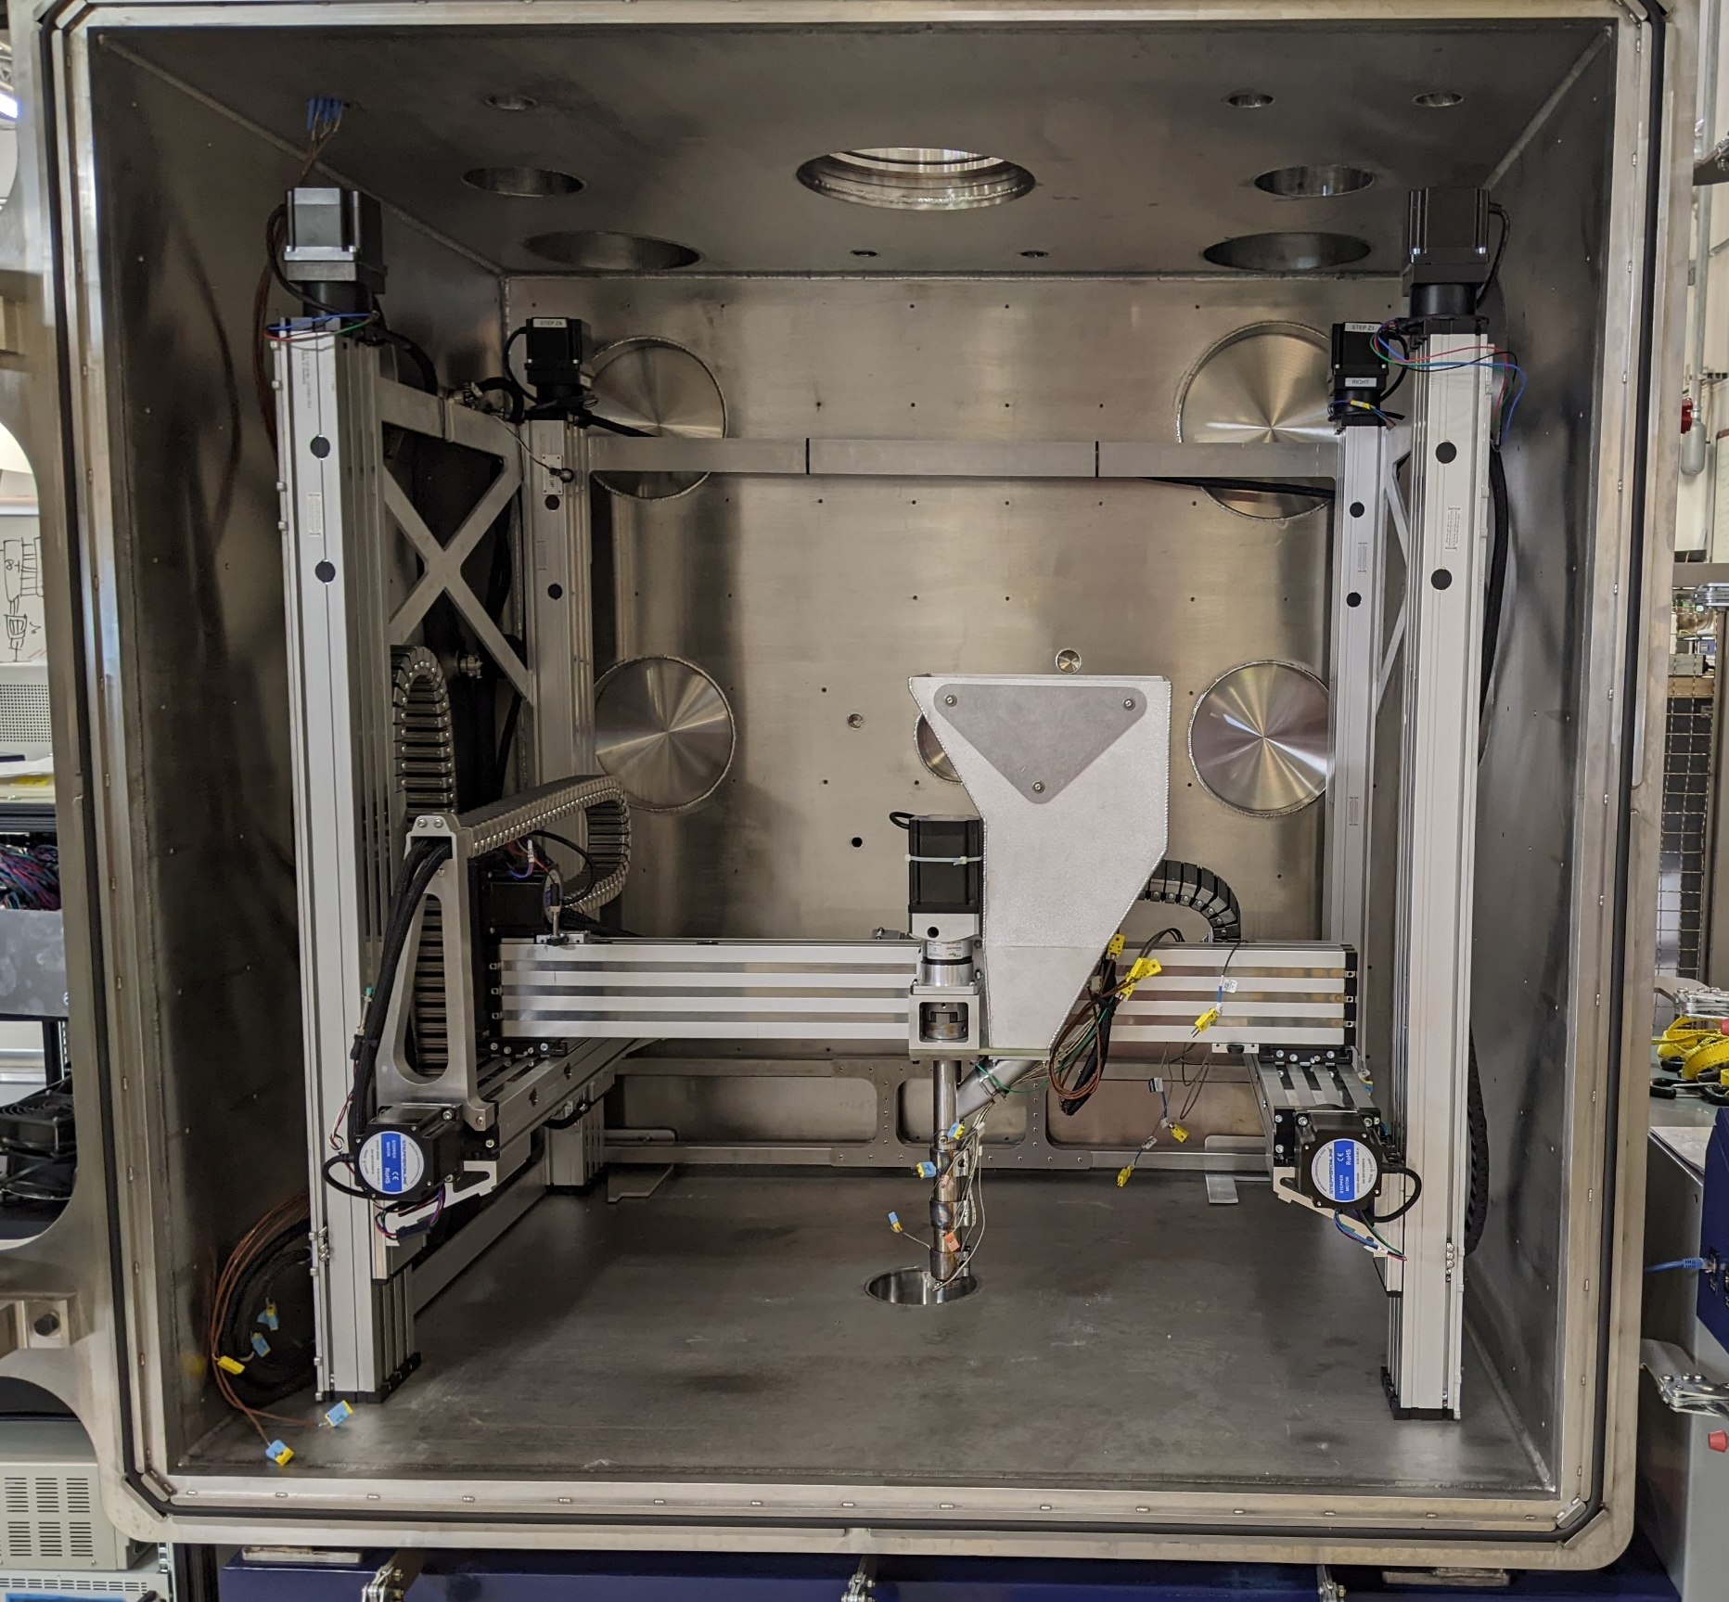
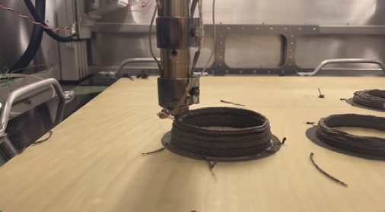
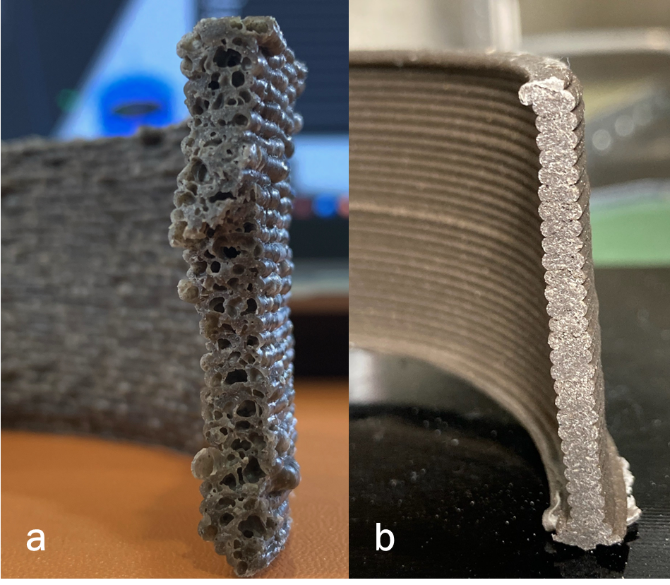
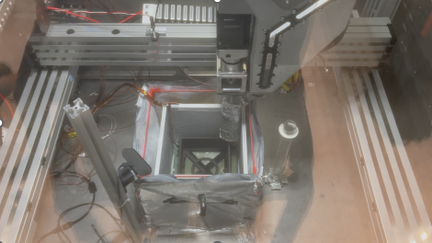
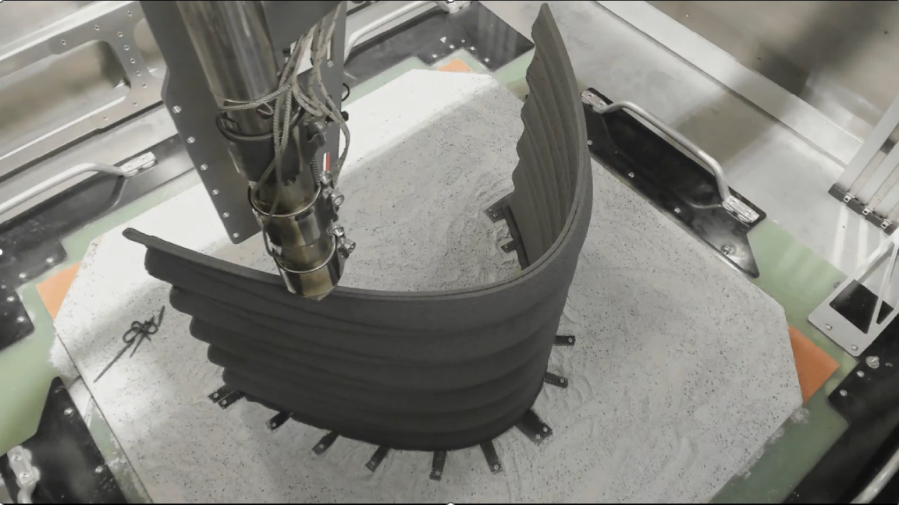
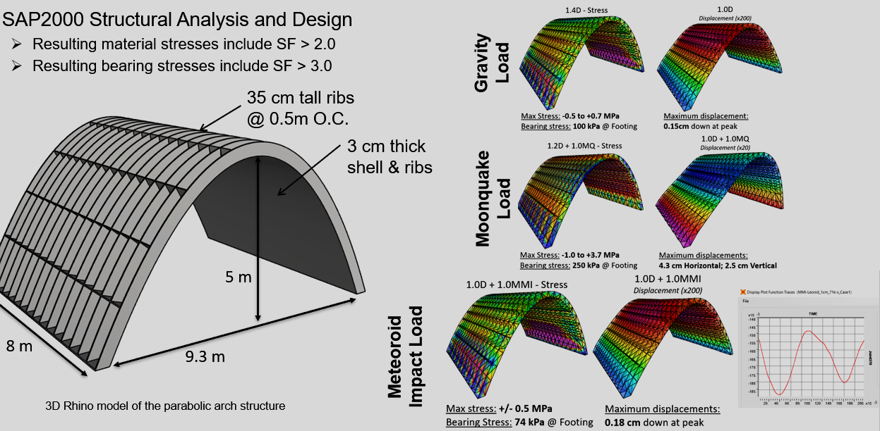
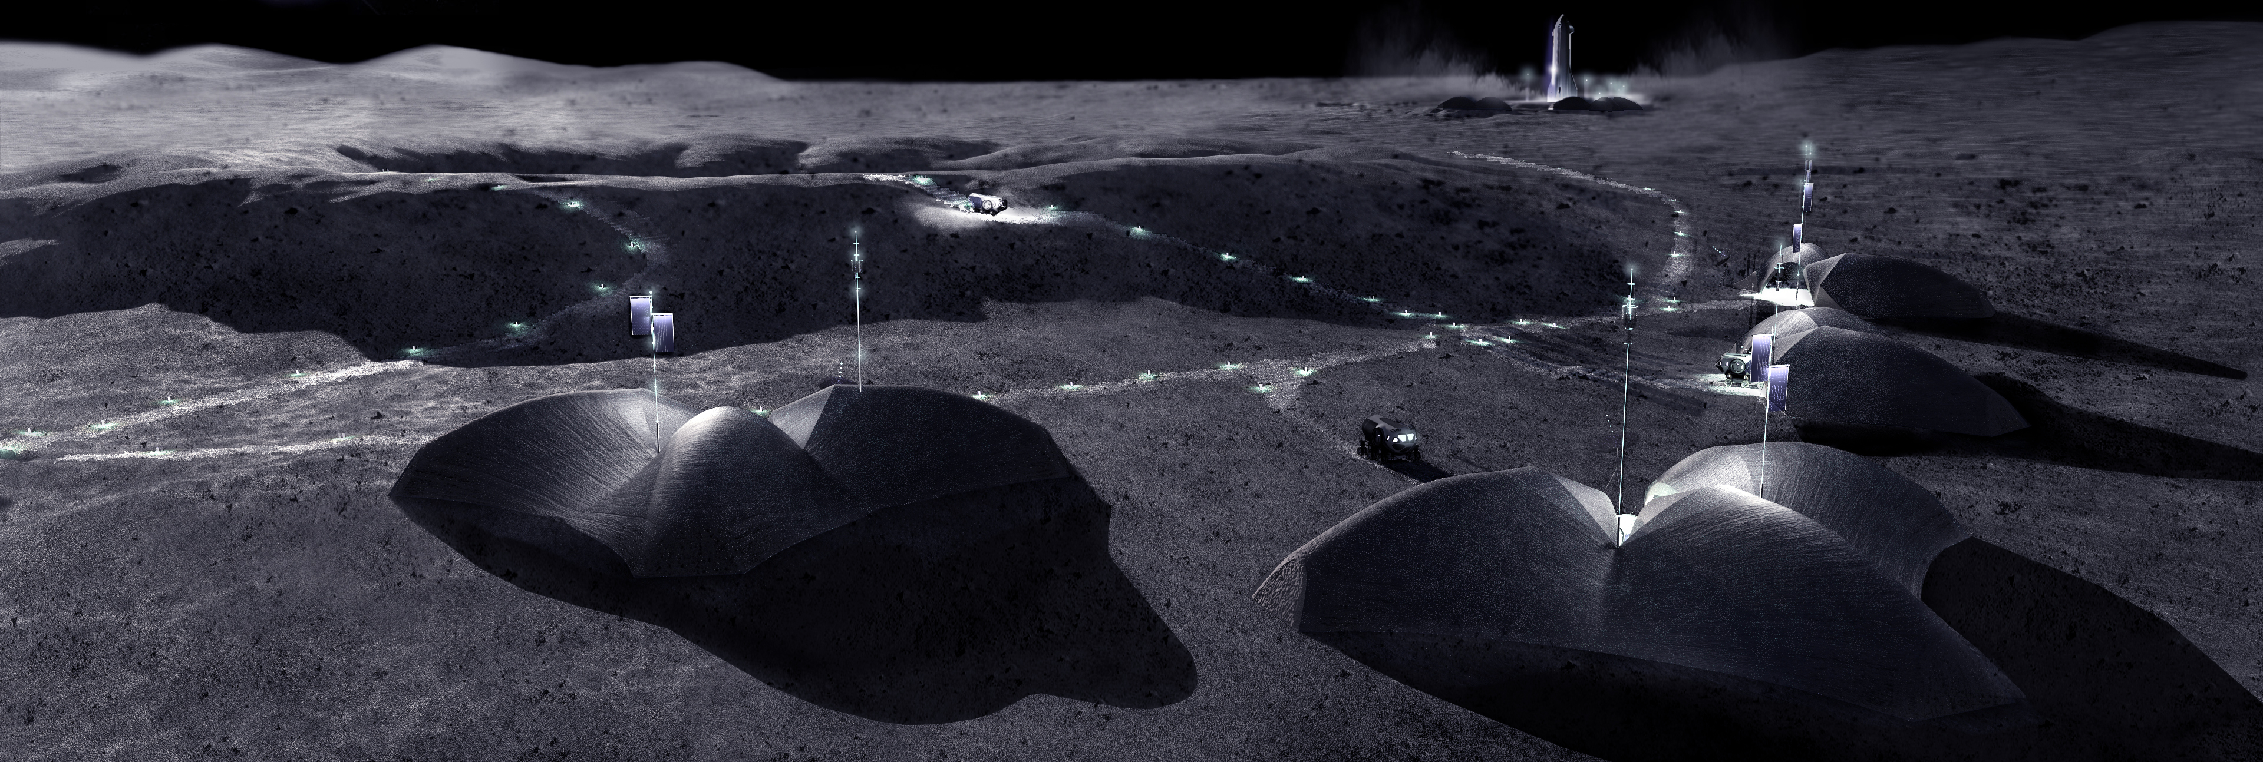
REA T
Relevant Environment Additive Construction Technology
Goal: To demonstrate construction of a civil engineered, unpressurized protective shelter in simulated Lunar conditions using regolith polymer composites in a Fused Filament Fabrication (FFF) additive process
Several regolith-polymer composite feedstock formulations were examined
The construction system is installed in a dirty thermal vacuum chamber
Initial samples were printed in vacuum (10^-3) torr
Significant porosity observed in Polypropylene: Black Point-1 (BP-1) formulations (a), but not Polylactic Acid (PLA) (b)
Formulation | Mass Ratio (wt%) | Ultimate Flexural Strength (Mpa) Perpendicular to Grain | Flexural Modulus (Gpa)* Perpendicular to Grain
BP-1: PLA | 70:30 | 12.8 | 1.8
BP-1: PLA | 80:20 | 17.8 | 2.8
BP-1: PLA: Process Aid | 80:18:2 | 14.9 | 2.9
BP-1: PLA | 85:15 | 7.3 | 2.3
LHS-1: PLA | 80:20 | 14.9 | 3.7
Formulations were printed at 10^5 torr and -170C and cut into various test samples
Flexural strength/modulus control the design. Lunar Highlands Simulant-1 (LHS-1) : PLA was selected for further investigation
The protective shelter was printed in at ~10⁻⁵ torr on LHS-1 simulant by “connecting the dot’s” between ground anchors

