Slide 1
Community Integration of Advanced Air Mobility
Nancy Mendonca, NASA ARMD Deputy AAM Mission Manager
September 27, 2023

Slide 2

Community Integration Planning Activities
Consolidating information
Developing materials
Working Groups efforts
Outreach

Slide 3
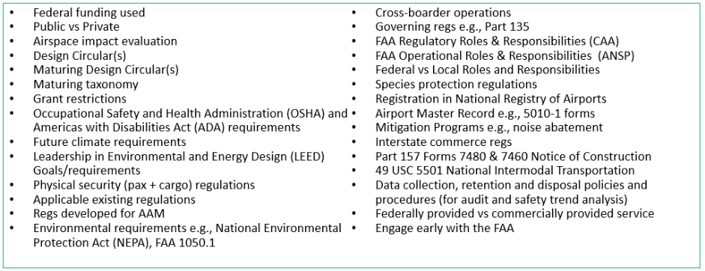




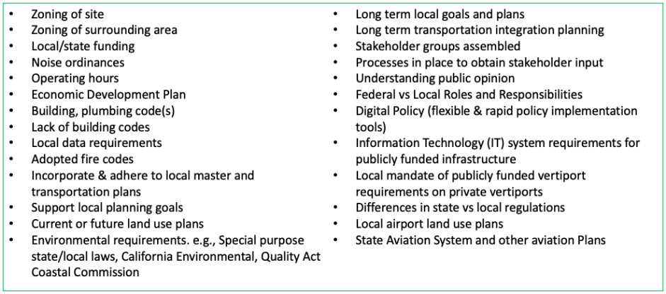
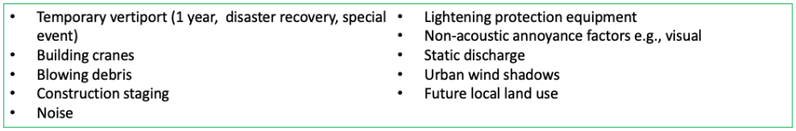
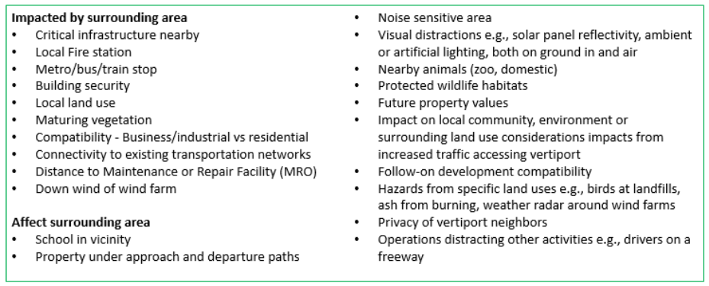
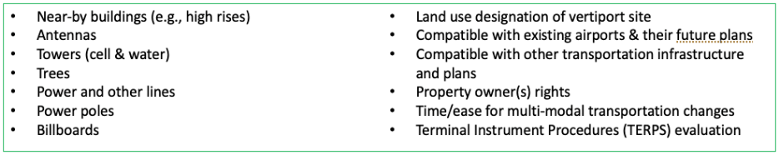
Vertiport Considerations
Federal Regulatory
Local Regulatory
Physical – fixed
Physical – mobile & temporary
Vertiport configuration
Surrounding uses
Economic considerations
Equity considerations
Demand considerations
Environmental considerations
Airspace integration considerations
Contingency considerations
Utility considerations
Communications/Data
Security – Physical, Cyber and Airspace
Safety
Automation
Others
Over 450 considerations collected covering the siting, design and operations of vertiports
https://ntrs.nasa.gov ~ May 2022

Slide 4
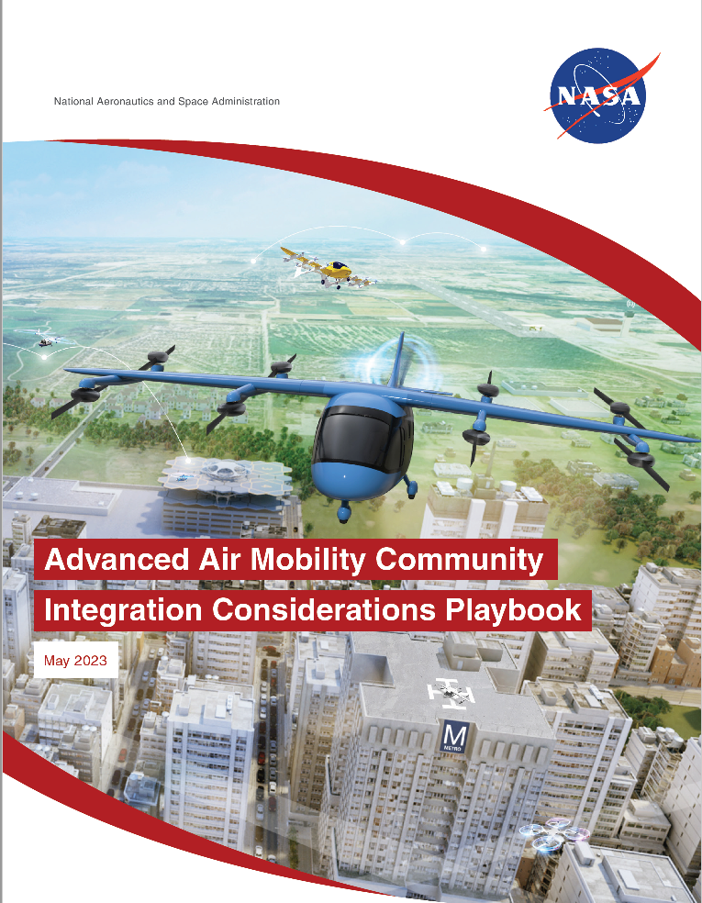
AAM Community Integration Considerations Playbook
Integration Challenges
  Institutional Readiness
  Equity
  Community Engagement
  Planning for Multimodal Integration
  Funding
  Economic Development and Workforce Readiness
  Data
  Operations and Interoperable Infrastructure
  Environmental Sustainability
Challenge considerations organized by
  Organizational Strategies
  Research
  Policy Considerations
Over 100 considerations collected covering areas of integration between AAM and Communities
https://ntrs.nasa.gov ~ May 2023

Slide 5

SBIRs
Architecture Technology Corporation
Phase II June 2023 – May 2025
Developing Local Knowledge for AAM
The goal of this research effort is to develop a robust and cost-conscious capability to support local organizations and local decision makers with materials that support community education, engagement, & outreach for AAM.
TruWeather
Phase II May 2022 – May 2024
Urban Weather Sensing Infrastructure Testbed (UWEx)
UWEx establishes an environment to accelerate deploying novel weather-sensing technologies, processing, and decision tools
Intellisense
Phase I August 2023 – February 2024
Weather Integrated Network Design Software (WINDS)
An Automated low-cost, rule-based network design synthesis utilizing a catalogue of weather sensing technologies
Release of next SBIR solicitation – January 2024 https://sbir.nasa.gov/solicitations

Slide 6

AAM Missions for Public Good
Characteristics of Public Good
40 Use cases within 10 Applications
  Agriculture
  Boarder Security
  Conservation
  Disaster Response
  Firefighting
  Inspection
  Law Enforcement
  Medical
  Search and Rescue
  Weather
Requirements Analysis
  Common requirements across 4 down selected use cases
  Requirements unique to public good missions
https://ntrs.nasa.gov ~ September 2023

Slide 7
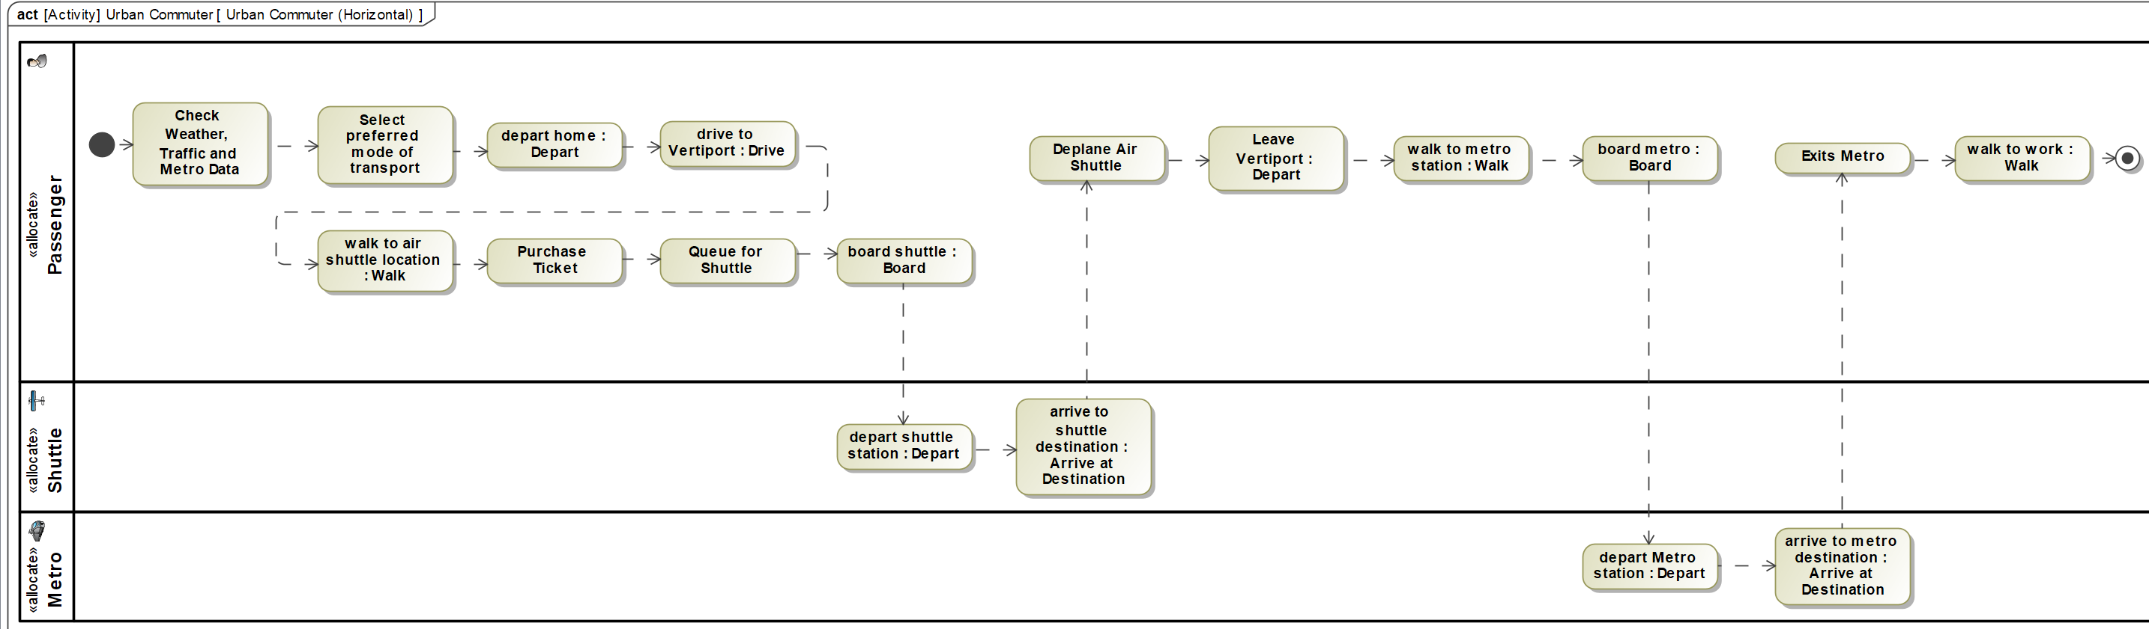
Community Informed Use Cases
Follow-on under NASA’s Space Act Agreement with 4 State/City partners
Describe and potentially model AAM use cases that are informed by community considerations
  Partners are able to leverage NASA’s knowledge of emerging AAM use cases and architecture
  NASA can better understand community derived requirements
  Encourage the use of MBSE within the AAM ecosystem
Suburban/Urban Commuter – Activity Diagram

Slide 8

AAM Ecosystem Working Groups
4 Working Groups
  Aircraft
  Airspace
  Community Integration (CIWG)
  Crosscutting
Recent and upcoming CIWG meetings
  Utah, Ohio and Orlando AAM Planning Updated
  Vertiport Design
  GAO AAM Reports
  AAM Workforce Opportunities
  AAM Workforce Strategies
  AAM Community Integration Considerations Playbook (Oct 2023)
https://nari.arc.nasa.gov/aam-portal/

Slide 9
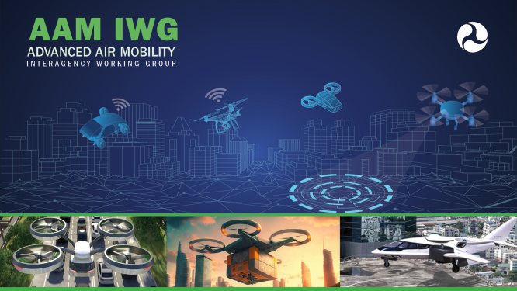
US DOT Interagency Working Groups
22 Federal departments & agencies
5 Subgroups
  Air Traffic Federation
  Automation Strategy
  Community Roles
  Infrastructure Development
  Security Requirements
Over 400 responses to the RFI
Develop a National Strategy that includes—
  Recommendations regarding the safety,
  operations, security, infrastructure, air traffic
  concepts, and other Federal investment or actions necessary to support the evolution of early AAM to higher levels of activity and societal benefit; and
  A comprehensive plan detailing the roles and responsibilities of each Federal department and agency, and of State, local, and Tribal governments, necessary to facilitate or implement the recommendations developed.
https://www.transportation.gov/mission/office-secretary/office-aviation-and-international-affairs/advanced-air-mobility/advanced

Slide 10
Outreach
2023 Outreach Events
  SAE AeroTech – March
  AUVSI Exponential – May
  Transportation Research Board (TRB) National Aviation Planning Symposium - May
  US DOT IWG - June
  AUVSI/FAA AAM Summit – Aug
  SAE Next-Gen UAM & Unmanned Aircraft Summit – Sep
  US DOT IWG - Oct
Focusing on the Community Integration Related Events

