Slide 1



Real World Applications of AI/ML in Optimizing Airspace Operations
Dr. Swati Saxena
NASA Ames Research Center
3rd World Tech Summit on
Big Data, Data Science & Machine Learning
Sep. 21-23, 2023
Notes:
Good morning/Good afternoon everyone. Thank you for joining. I am an Aerospace Engineer working at NASA Ames and one of my interests is applications of AI/ML in Optimization Airspace Operations.

Slide 2
Digital Transformation of National Airspace System
Advances in cybersecurity
Automation of operations
Establish communication standards
Real time data monitoring and analysis
AI/ML for decisions
Enable growth and integration of new operations
Performance Based Sustainable Outcomes
Interoperability in the NAS
Fully Integrated Information Environment
Access to Information
Distributed decision making
Agile Systems and Services
Collaboration among diverse service providers
Ref.: Vision for an Info-Centric National Airspace System
Notes:
Before we get into the challenges we are planning to address with the current work, I want to spend a minute describing key elements of the digital transformation journey of the NAS. As we incorporate new entrants into the operations, we want to enable automation and communication standards.
We want to move towards performance based sustainable outcomes which requires incorporation of AI/ML methods and real time data monitoring and analysis.
Systems and services need to be agile to foster collaboration and establish interoperability in the NAS.
Need to get to the integrated information environment where access to secure and reliable information is available when needed and distributed decision making can be real.

Slide 3


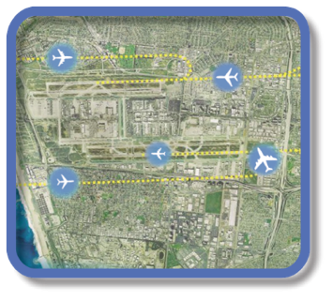

Evolution of Airspace Operations and Safety
+ Complexity, scalability,
and dynamic adaptation
+ Service oriented
architecture for tailored
missions oriented services
+ Efficiency and
proactive planning
Diversity, Density, Scalability, and Complexity
S-curves
Highly-Automated
AI/ML will enable the collaborative and automated operations in a complex environment
Collaborative
Trajectory
Digital Transformation of ATM
Automated in-time safety monitoring and alerting services
Integrated predictive risk mitigation across domains
Automatically-assured adaptive in-time safety management
Today
2035
~2050
ATM: Air Traffic Management
Notes:
https://nari.arc.nasa.gov/aam-portal/airspace/

Slide 4
Outline
Digital Transformation Challenges and Proposed Solutions
Cloud Based Platform
Machine Learning Workflow for Predictive Aviation Services
Use Cases of Machine Learning Aviation Services
Summary and Key Takeaways

Slide 5






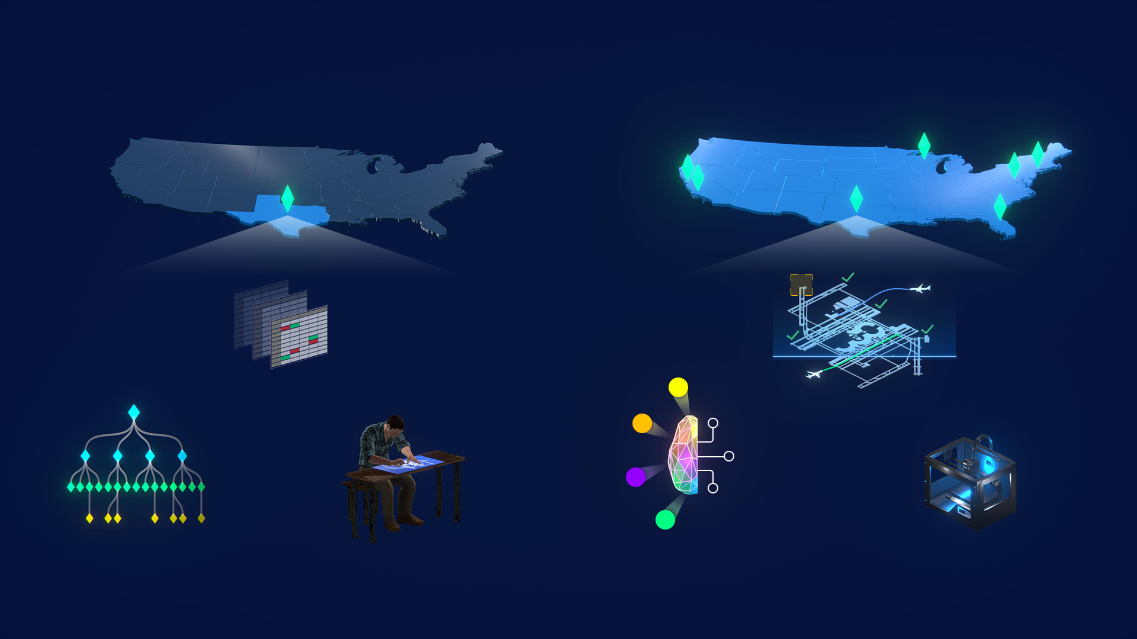
Current Challenges
Segmented Aviation Data
Monolithic Aviation Tools
FAA
Airline
Flight Operators
and Air Traffic Control
Service Provider’s
Network
Weather
Decision-Making Tools
Vehicle
Data Services
On-premise Tool Deployment
Localized Access and Adaptation
Local Network
Decision-Making Tools
Service Provider Hardware
FAA: Federal Aviation Administration
Notes:
Narrative:
The aviation data is often segmented, coming in from different sources, has gaps or can be available from multiple sources in different formats.
We need easier access to good quality and standardized aviation data to work on solution that can improve NAS operations.
The next challenge is about the development of aviation services. They are mostly monolithic is nature which means that a decision-making tools is like a black box consuming the data and outputting the decision for flight operators and ATC via the providers’ network. Its hard to re-use these services to build more complex services or use a portion of it. This leads to inefficient usage of existing services.
Another challenge is related to the way these aviation tools and services are deployed. They are mostly built for a certain region, are deployed locally on the local ATC or FO facility. This leads to limited access to the service.
These aviation services needs to be customized heavily for the airspaces they are going to be used for. In certain cases, it required lot of work to a. access these services at multiple locations and adapt them for using at these locations. As an example, the airport configuration prediction model typically needs a blueprint of the individual airport which makes it hard to adapt for other metroplex areas.
--------------------------------
Problem Statement:
Hard to access and decipher data to provide advanced digital services for digital National Airspace System (NAS) transformation
Pursued Solution:
Pave the way for improving data accessibility to enable high-reuse digital service solutions that can scale and be more quickly discovered on a platform
Hard to access and decipher aviation data to provide advanced digital services for improving airspace operations.
Platform will accelerate NAS transformation for advanced, data-driven, digital services to promote efficient aviation operations.
Cloud-based ecosystem that takes data from many sources and turns it into easily accessible, easy-to-use digital information to expand the development of reusable aviation services

Slide 6
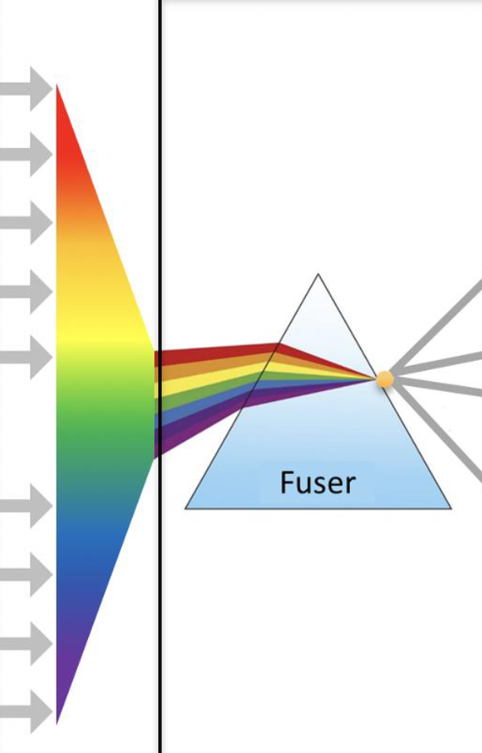
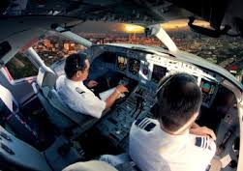


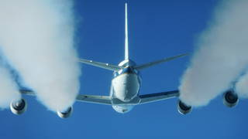

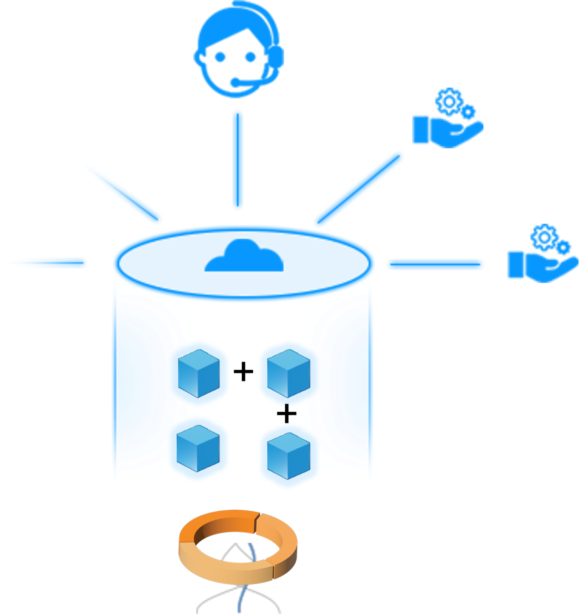

Proposed Solutions to Accelerate Digital Transformation
Integrated (Fused) Aviation Data
Micro-services Based Architecture
FAA Data
Sources (SWIM)
NASA Fuser
Other
Airline, Airport
Vehicle, Weather
Cloud-based Access
NAS-wide Access with Scalable Solutions
Flight Operators
and Air Traffic Control
Service
Providers
NAS: National Airspace System FAA: Federal Aviation Administration SWIM: System Wide Information Management
Notes:
Narrative:
The current work addresses the NAS challenges by building a reference implementation of a cloud-based software platform called Digital Information Platform (DIP)
So, here is our proposed solution to address these challenges through this platform. NASA has developed its own integrated aviation data service which consumes data from multiple sources, integrates it and is currently available for users. This real time data stream and archival data is made available on the platform. The platform will be able to provide easy access and secure to the data services.
The current approach is to build the services in a micro-services based framework so that the individual blocks can be re-used to build complex services.
The current framework will provide easy access to the services through common reusable APIs.
The platform is deployed on cloud so that we can leverage all the benefits of a cloud based infrastructure such as easy web-based portal, easy access and implementing a scalable architecture.
The platform architecture is developed in such a manner that it has features like low latency, supports machine learning based prediction services and through the cloud based infrastructure, the services can be adapted and accessed easily across the NAS.
So, by enabling these solutions through the platform, we are addressing the current aviation industry challenges as presented before.
--------------
The main objective of the current work is to create an ecosystem for easier and efficient development and consumption of digital flight services and information.
The current framework will provide easy access to aggregated and organized aviation data through common reusable APIs.
The microservices based architecture will enable and promote the reuse of services to develop more complex aviation services. Few examples include ML based prediction service, decision support tools and flight planning tools with different sets of constraints.
Revised third bullet-point based on the following information
Provide advanced services to increase efficiency and predictability
Improve data accessibility to enable machine-learning based services to scale services
digital aviation services such as Machine Learning based prediction services, decision making services, flight planning services etc.
Create an ecosystem for easier and efficient development and consumption of digital flight services and information.
Provide easy access to unified, aggregated, validated and organized airspace data through common reusable APIs
Support microservices based architecture for developing and enabling access to the flight services such as Machine Learning based predictions, decision support tools and flight planning tools.
The current work addresses the NAS challenges by building a cloud-based software platform called Digital Information Platform (DIP)

Slide 7
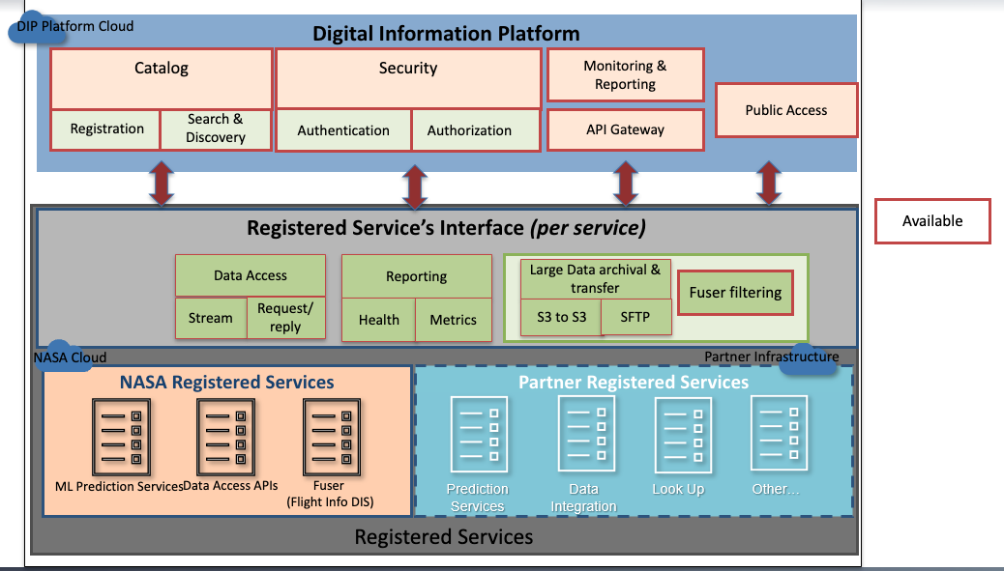
Cloud-Based Software Platform to Deploy AI/ML Solutions

Slide 8
Machine Learning Operations (MLOps)
MLOps workflow developed to implement and deploy scalable ML-based services across NAS
Open-source Python-based libraries are used to implement MLOps pipeline
(Kedro, SciKit Learn and MLFlow)
Real-time and long-term ML performance monitors

Slide 9

Machine Learning Service Workflow - Example
Flight, airport and weather data feeds
ML Model Training Pipeline
Long-Term Data Storage
Data Query
Data Engineering
Model Building and Training
Integrated Data (Fuser)
Short-Term Data Storage
Data & Model Analysis
Version Control (Bitbucket)
MLflow Registry
Model Call Storage
Airport Model
ML metrics Storage
Real-Time ML Monitor
ATC/Airlines’
Displays and
Service Inputs
Data
Data Storage
Long-Term ML Monitor
ML pipeline
Monitor/Displays
ATC: Air Traffic Control

Slide 10
NASA Services Available on the Platform
CDDR TOS Service
TOS UI
TOS Data
NAS Terminal Scheduler
Machine Learning Models for What-if Applications
On Time Prediction
Taxi Time Prediction
ML services used as building blocks to develop more complex prediction tools
Runway Prediction
Configuration Prediction
Airport Surface Model Orchestrator
TMI Service
Config Data (D-ATIS)
Weather Data
FAA: Federal Aviation Administration
SWIM: System Wide Information Management
TMI: Traffic Management Initiative
NAS: National Airspace System
CDDR: Collaborative Digital Departure Re-route
TOS: Trajectory Option Set
OIS: Operational Information System
D-ATIS: Digital-Automatic Terminal Information Service
DIP
Platform
APIs
NASA Fuser (integrated data)
FAA SWIM
Airlines
OIS
Airports
Notes:
Real-time flight TOS reroute data
Coordination of reroute submissions
Available on any machine for operational use

Slide 11
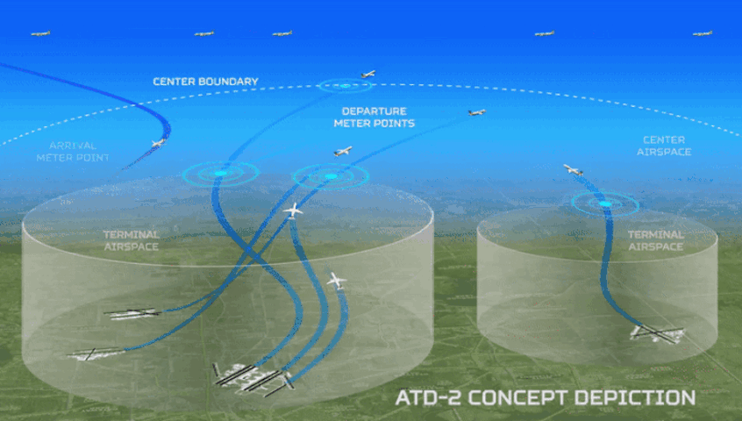
Use Case 1: Arrival Runway Prediction
Objective: Predict arrival runway for a flight based on the current airport, weather and terminal airspace restrictions.
Benefit: More accurate arrival runway prediction will enable earlier planning for taxi-in times which results in improved operations and happy customers.
Multinomial classification problem
XGBoost method used
Cross-validation and hyper-parameter tuning performed
Roughly 21.6 million rows of data*
Sample modeling features: flight plan filed, planned fix, airport configuration, time until estimated operation
*500 flights/day, a four-hour lookahead period
with a one-minute update rate, and six months of training data
Image Credit: NASA
https://github.com/nasa/ML-airport-arrival-runway/blob/main/images/ATD2_logo_animate_medium_O3.gif
Publication: https://arc.aiaa.org/doi/10.2514/6.2021-2400
Notes:
More accurate arrival runway predictions can enable earlier planning for taxi-in times. That means more time to make adjustments for early or late arrivals, improved operations, and better yet, happy travelers.

Slide 12
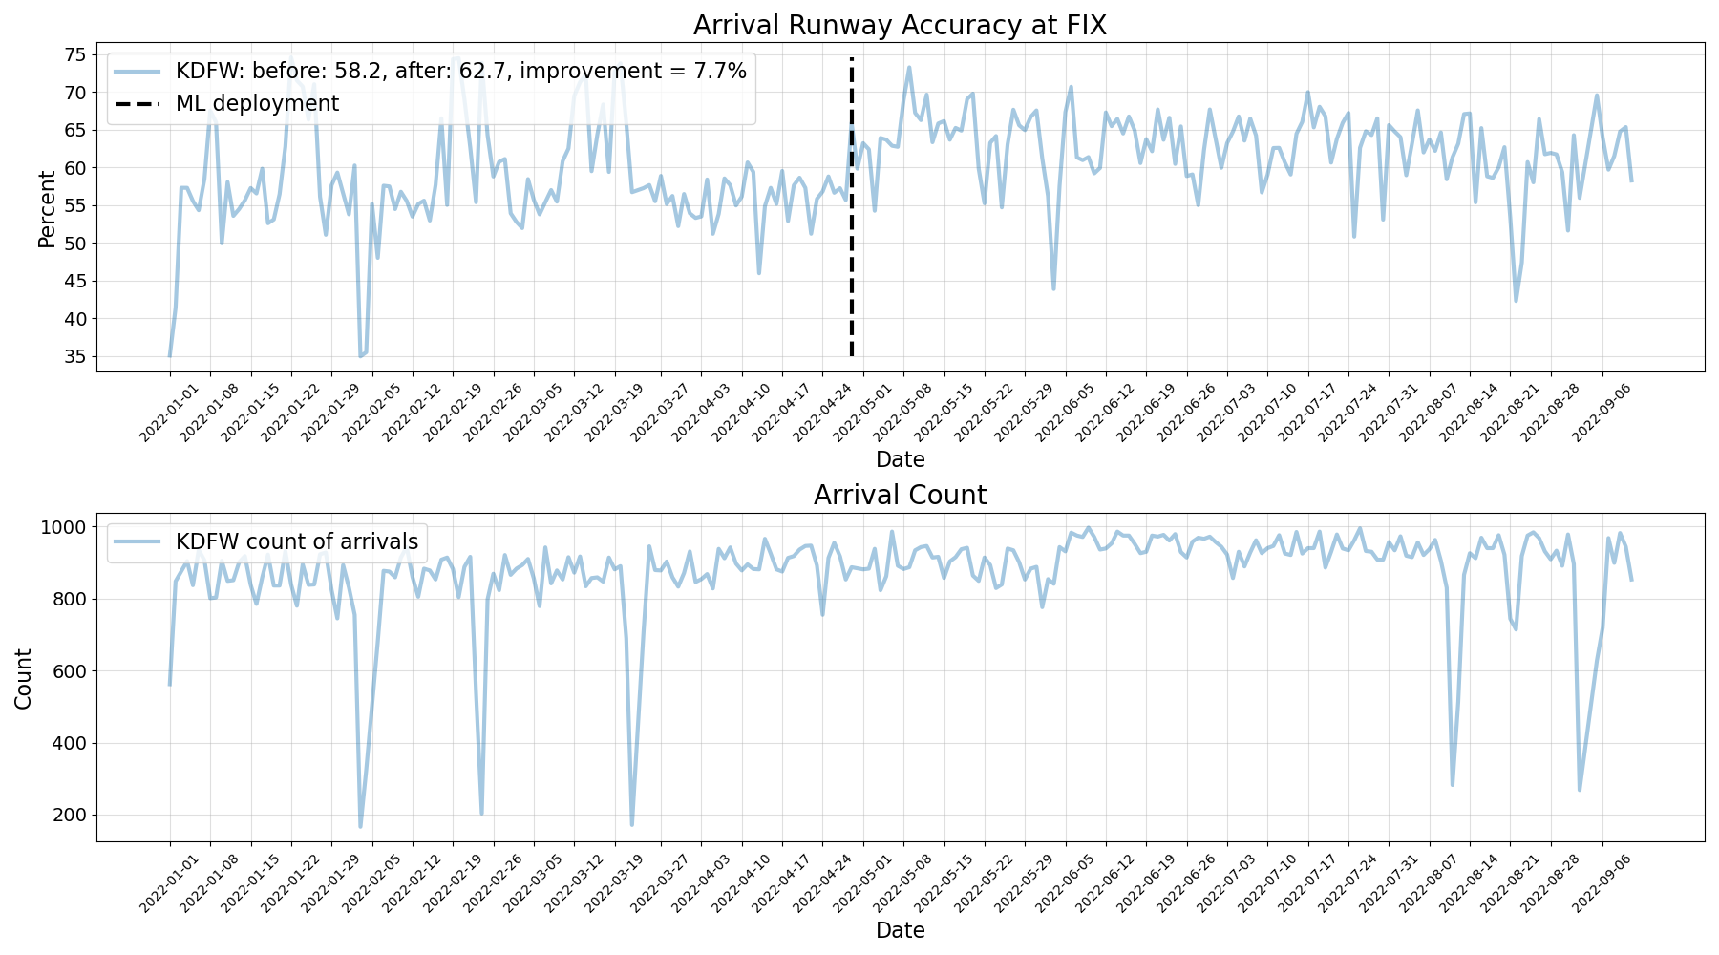
Use Case 1: Arrival Runway Prediction
Arrival Runway Prediction at Dallas/Fort Worth International Airport
Accuracy [%]
7.7% improvement
62.7%
58.2%
Legacy methods in use
ML methods in use
ML slightly outperforming legacy methods for arrival time prediction

Slide 13
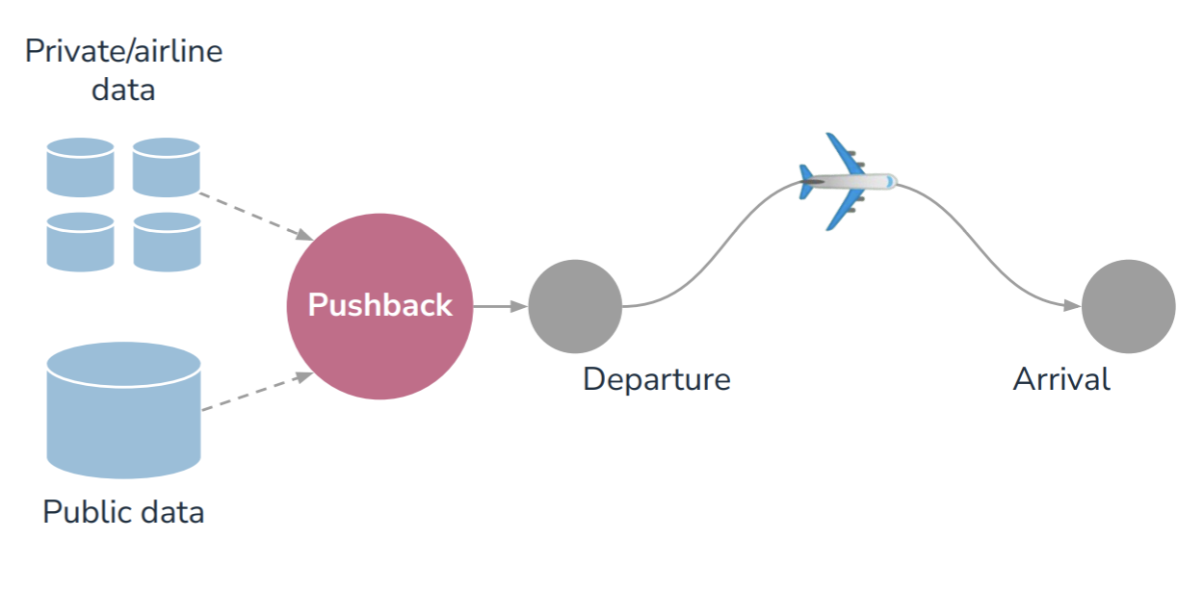
Use Case 2: Predict Pushback Time at Airports
Objective: Predict pushback time of flight from its gate.
Benefit: Accurate estimates of pushback time can help air traffic management systems more efficiently use the limited capacity of airports, runways.
University Challenge conducted in 2023 in two phases:
Phase I: Build ML model (5 winning teams selected)
Phase II: Build Federated Learning models
Dataset provided at 10 airports for the 25 most flown US airlines
Predicting pushback time depends upon factors like passenger loading, cargo loading, weather, aircraft type, and operator procedures.
Winning Model: CatBoost regression model - predicting pushback time achieved a mean absolute error of 10 min., compared to over 19 min. for the benchmark
University Challenge details: https://www.drivendata.org/competitions/group/competition-nasa-airport-pushback/
Winning Code: https://github.com/drivendataorg/nasa-airport-pushback
Notes:
like the number of passengers that have checked in for a flight or the number of bags that have been loaded onto a plane.
What is pushback time and why its important to predict it accurately
Mention in the beginning that this is a UC.
Add more information about Phase II outcome.
Convert bullet points to phrases and make it more concise
Add a graph showing model predictions from winning teams
Airlines collect information that is relevant to pushback time but this information is valuable or sensitive.
Evaluate federated learning techniques that enable airlines to safely contribute private data towards a centralized model without sharing or pooling that data.
This competition involved two phases. In Phase 1, the task was to train a machine learning model to automatically predict pushback time from public air traffic and weather data. Better algorithms for predicting pushback time can help air traffic management systems more efficiently use the limited capacity of airports, runways and the National Airspace System. In Phase 2, we invited the top 5 finalists from Phase 1 to work with NASA to train a federated version of their Phase 1 models.

Slide 14
Summary and Next Steps
Cloud based platform developed to build the digital aviation services ecosystem.
ML based prediction models to optimize airport ground operations deployed in the production environment.
Next steps
  Adapt ML models at new airports and scale the deployment.
  Develop new ML based prediction models to further make the airspace operations more efficient and sustainable.

Slide 15
Key Challenges with ML Adoption for Aviation
Successful deployment of MLOps workflow in the production environment could be a challenge.
Feature engineering of training data needs aviation domain expertise.
Field (operational) expertise needed to ensure safe and secure use of AI/ML solutions in aviation.
New AI/ML certification process needs to be implemented for ML based prediction tools.

Slide 16
Real World Applications of AI/ML in Optimizing Airspace Operations
Dr. Swati Saxena
NASA Ames Research Center
swati.saxena@nasa.gov
DIP Project: https://nari.arc.nasa.gov/atmx-dip/
University Challenge: https://www.drivendata.org/competitions/group/competition-nasa-airport-pushback/
Acknowledgements:
Dr. Jeremy Coupe, NASA Ames
Dr. Gilbert Wu, NASA Ames

Slide 17
References
Image Credits:
“Evening traffic at airport,” XavierMarchant, https://www.istockphoto.com/photo/evening-traffic-at-airport-gm92168636-2374894, iStock https://www.istockphoto.com/chased.)
https://www.nasa.gov/multimedia/imagegallery/image_feature_2466.html,
https://www.nasa.gov/centers/armstrong/news/FactSheets/FS-041-DFRC.html,
https://www.nasa.gov/feature/nasa-showcases-benefits-of-air-traffic-management-tools
https://www.nasa.gov/aero/nasa-aircraft-arrival-technology-gets-big-test-in-2017
https://www.nasa.gov/sites/default/files/atoms/files/what-is-aam-student-guide_0.pdf
https://github.com/nasa/ML-airport-arrival-runway/blob/main/images/ATD2_logo_animate_medium_O3.gif
DIP Publications:
ML Service Code on NASA GitHub: https://github.com/nasa/ML-airport-configuration
University Challenge details: https://www.drivendata.org/competitions/group/competition-nasa-airport-pushback/
Winning Code: https://github.com/drivendataorg/nasa-airport-pushback
https://www.nasa.gov/feature/ames/nasa-machine-learning-air-traffic-software-saves-fuel
https://ieeexplore.ieee.org/document/9925876
https://ieeexplore.ieee.org/document/9256509
https://arc.aiaa.org/doi/10.2514/6.2021-2400
https://arc.aiaa.org/doi/10.2514/6.2021-2401
https://arc.aiaa.org/doi/10.2514/6.2021-2402
https://arc.aiaa.org/doi/10.2514/6.2021-2406

Slide 18
Acronyms
ATC: Air Traffic Control
ACO: Announcement of Collaboration Opportunity
ATD: Airspace Technology Demonstrator
ATM: Air Traffic Management
CDDR: Collaborative Digital Departure Re-route
DIP: Digital Information Platform
D-ATIS: Digital-Automatic Terminal Information Service
ERAM: En-Route automation modernization
FAA: Federal Aviation Administration
IROP: Irregular Operations
NAS: National Airspace System
NTX: North Texas Airspace
OIS: Operational Information System
SFNP-Ops: Sustainable Flight National Partnerships – Operations
SWIM: System Wide Information Management
SWIM: System Wide Information Management
STARs: Standard Terminal Automation Replacement System
TFMS: Traffic Flow Management System
TFDM: Terminal Flight Data Manager
TBFM: Time-Based Flow Management
TMI: Traffic Management Initiatives
TOS: Trajectory Options Set

Slide 19

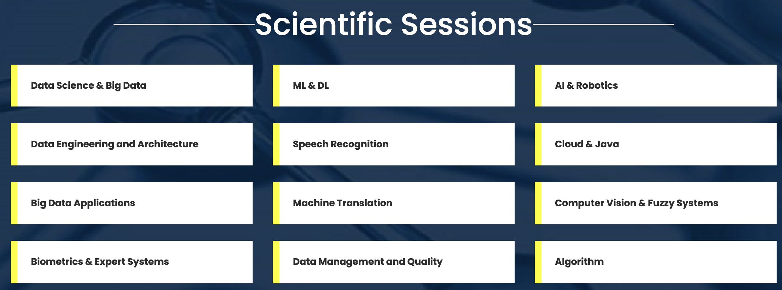
Event Details
3rd World Tech Summit on Big Data, Data Science & Machine Learning, Sep 21-23, 2023, Austin, USA (Hybrid Event)
Time-slot: 30 min (20-25 min presentation followed by Q&A)
https://datascience-machinelearning.averconferences.com/

