Slide 1
Intelligent Long Endurance
Observing System (ILEOS)
Bryan Duncan (co-I, NASA GSFC)
Meghan Saephan (PI, NASA Ames)
NASA Ames: Jeremy Frank (co-I), Richard Levinson (co-I), Eugene Turkov (co-I), Douglas Caldwell (co-I), Vinay Ravindra (co-I)
Sarah Strode (co-I, NASA GSFC)
William Swartz (co-I, JHU APL)
Kristen Manies (co-I, USGS)
IMPACT: ILEOS will provide a science activity planning system to enable new observing strategies

Slide 2
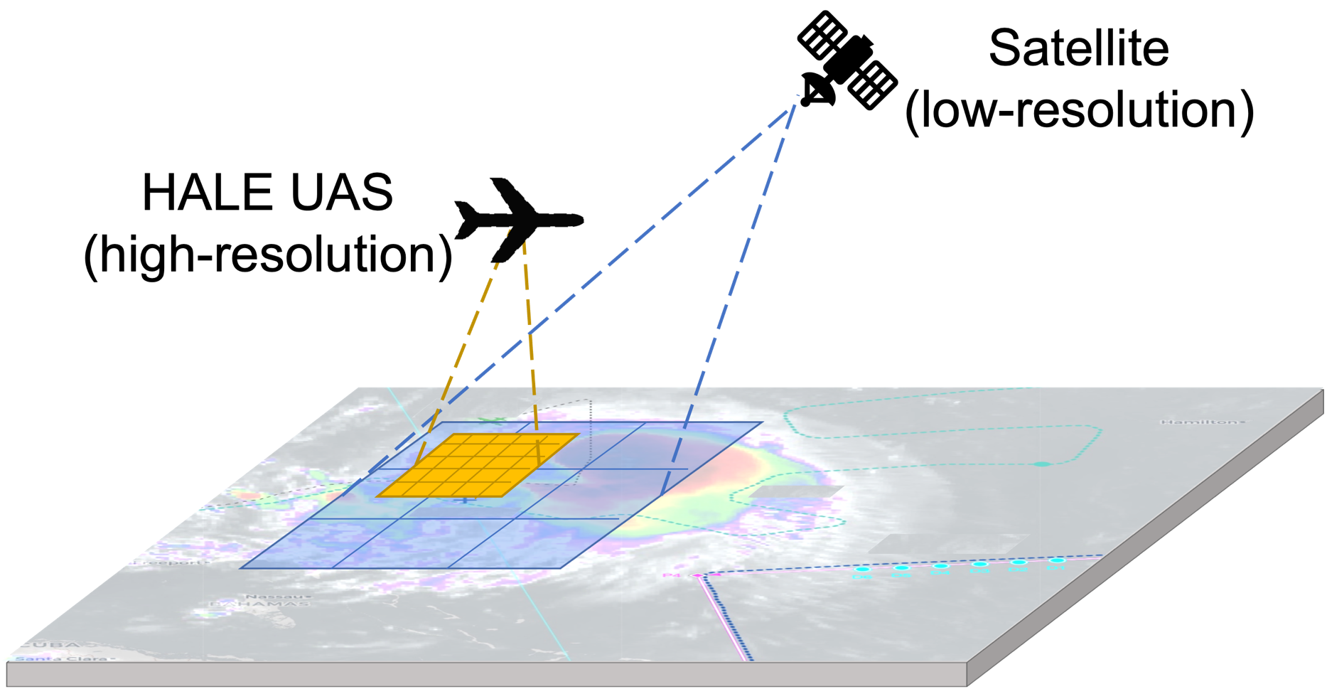
Concept of Operations
Example vehicle: High-Altitude-Long-Endurance (HALE) Unmanned Aerial Systems (UAS), but ILEOS could be applied to an airplane platform
  Advantage over airplanes: operate for months and able to loiter over targets at reduced costs
Example instruments: HALE UAS fitted with nitrogen dioxide (NO₂) or methane (CH₄) sensors
  See Bill Swartz’s talk next on a lightweight NO₂ sensor
Example applications: validating satellite data, quantifying emissions, monitoring pollution, environmental justice (neighborhood scale), etc., including in challenging environments (e.g., Arctic, urban).

Slide 3
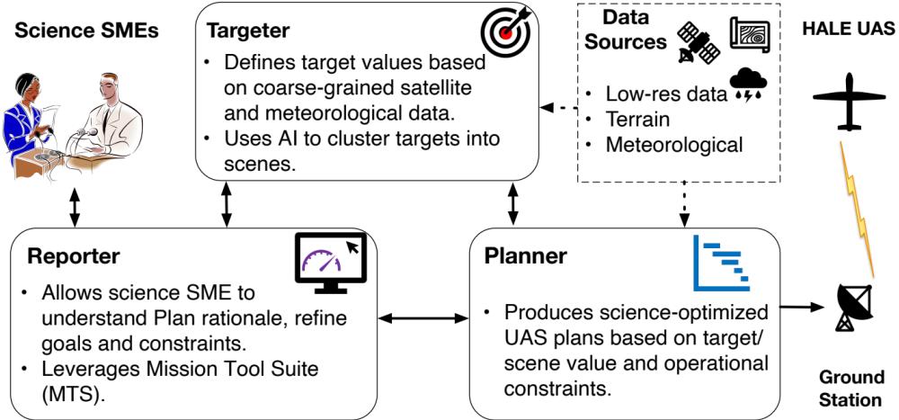
ILEOS Architecture
Targeter – leverages scientists’ expertise to fuse data (e.g., emissions, land cover, satellite data, meteorological forecasts) into pixel value maps
Planner – generates flight plan to observe best identified target scenes while enforcing HALE UAS operating constraints (e.g., winds, FAA restrictions)
Reporter – allow users to configure Targeter and Planner, visualize all data and flight plan, and request explanations

Slide 4
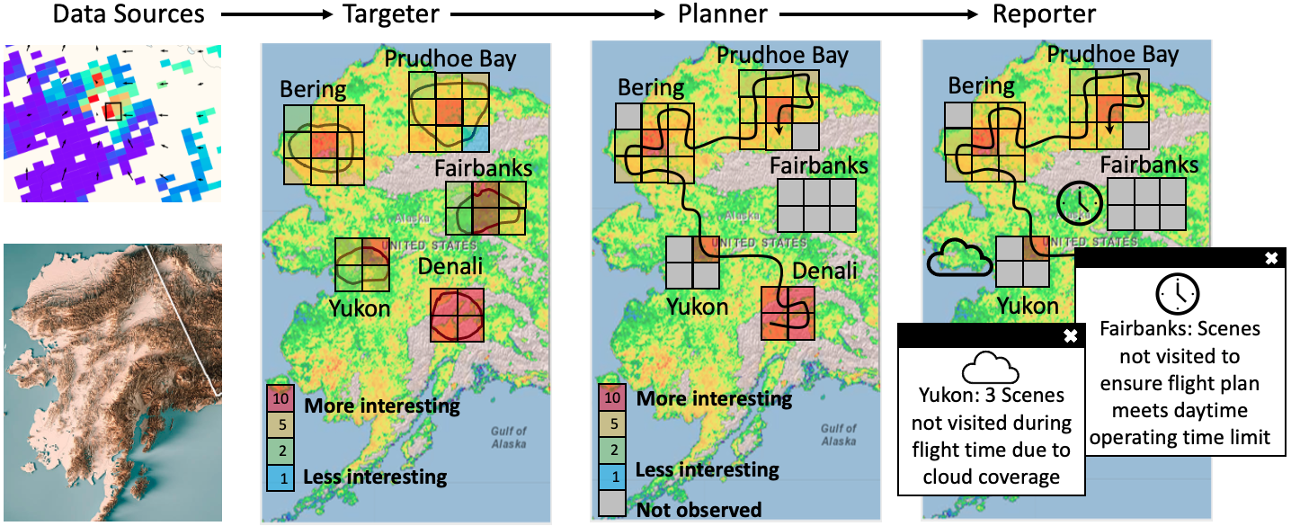

Full ILEOS Pipeline
Example: HALE UAS with a methane sensor to target wetland emissions in Alaska

Slide 5
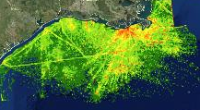

Potential Utility of ILEOS: Considering Clouds
Gulf of Mexico
Example: Use a HALE UAS fitted with a NO₂ sensor to characterize NO_{x} emissions in the Gulf of Mexico from
Oil & natural gas extraction activities (e.g., rigs, support ships, flaring)
International shipping
Intuitively, a raster flight pattern (i.e., “lawn mower” pattern) makes sense, but clouds* complicate this strategy.
*Information on cloud forecasts is just one data input that ILEOS will consider for flight planning.
Day 1
Day 2
Wind direction
.
.
.
.
.
.
.
.
.
Day 30
30-Day
Average

Slide 6
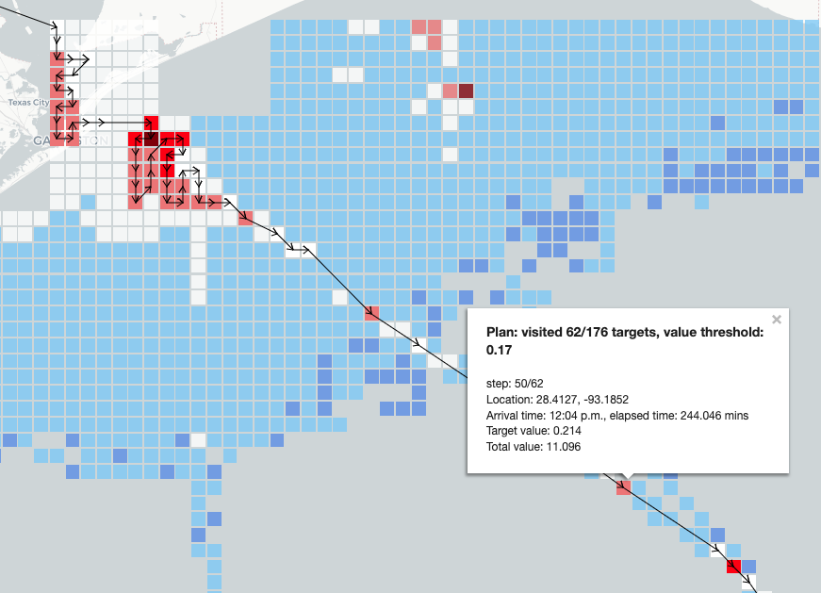
Reporter: Flight Plan
Darker red = higher target value

Slide 7
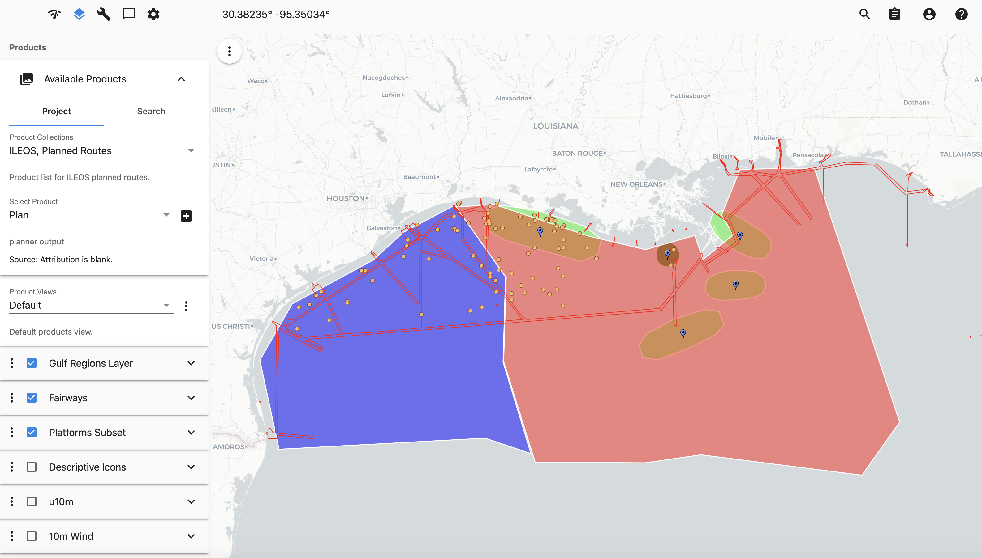
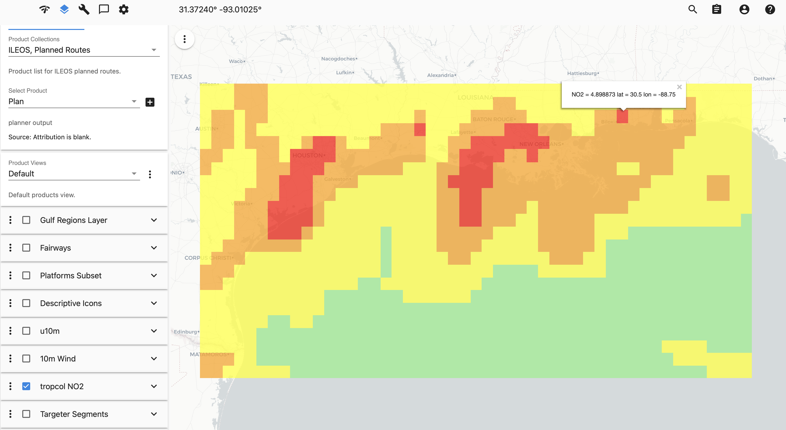
Reporter: Input Data Sources
Users may also view input data to help understand the rationale for the ILEOS flight plan:
Meteorological forecasts (clouds, winds)
Land cover types
Emissions
Point sources (latitude, longitude)
Satellite data
Shipping lanes and platform sources
Tropospheric column density of NO₂

Slide 8
Future Work
ILEOS’ first 2 years will culminate with a capstone demo featuring simulated observing campaigns overseen by scientists
  Evaluated on at least 2, ideally 4 climate-relevant gas sensing science use cases
Assess users’ ability to generate desired plans and understand relationship between scenes, priority, constraints, and their impact on plan
  Human-in-the-loop evaluation
Sensing Domain | Use Case Type
 | Nominal | Stressing
Methane | Urban emissions | Arctic permafrost thaw
Nitrogen Dioxide | Emissions Validation | Upper atmospheric lightning

Slide 9
Thank You
Byran Duncan, ILEOS co-I
bryan.n.duncan@nasa.gov
Meghan Saephan, ILEOS PI
meghan.saephan@nasa.gov

Slide 10
BACKUP

Slide 11
Objectives
Optimize fine-grained spatio-temporal resolution data collection of Earth observations, such as GHG-relevant gases
Novel automated target generation technology
Incorporates coarse-grained satellite data and near real-time environmental (e.g., wind, weather, airspace constraints) data to generate high-value fine-grained resolution data collection plans.
  State-of-the-art automated planning and scheduling algorithms
Designed for human operators; plan explanation and data provenance features will ensure science mission planners understand all key choices made while generating targets and plans.
Innovative techniques for user control and review of decision making
IMPACT: Reduced cost for Earth observations in environments ranging from arctic to urban to offshore (some previously inaccessible), continuous observations not possible for current field/in-situ campaigns, improved science outcomes

Slide 12
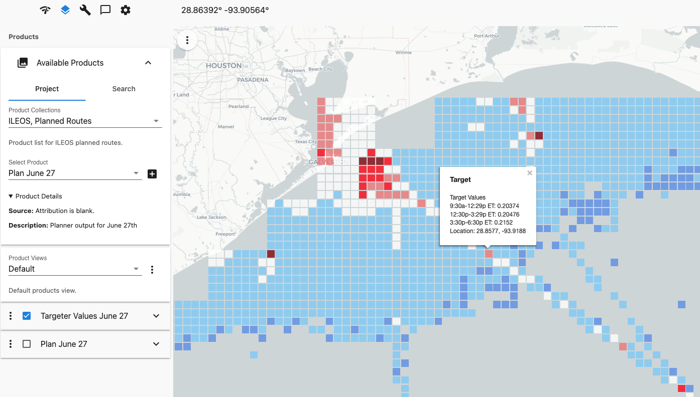
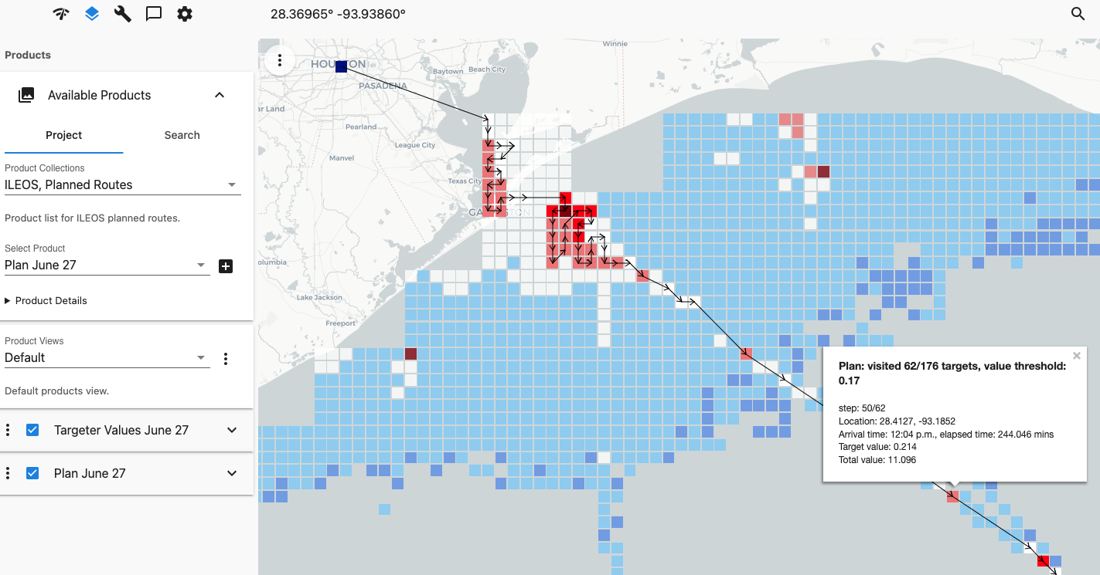
Reporter: Targets and Plans
Targets
Plan

Slide 13
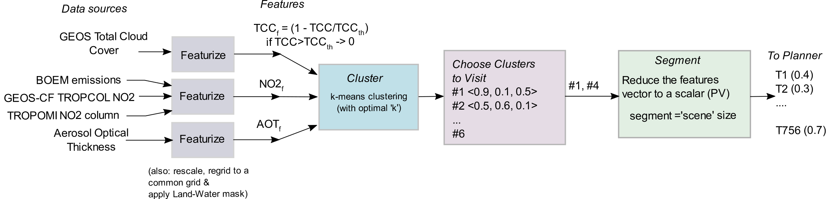
Targeter Pipeline
Data sources selected based on science case
Build the ‘features’ of a ‘pixel’
Pixel resolution ~1km
Cluster regions with similar feature spaces
Choose Clusters based on their mean values of the features
Segment Clusters of interest
Assign Segment Value based on formulation by SMEs

Slide 14
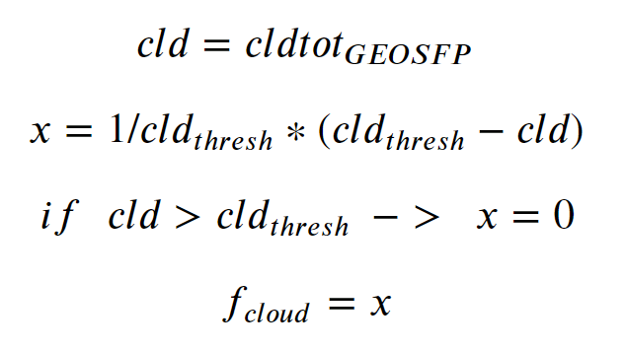
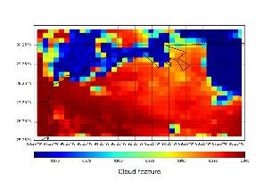
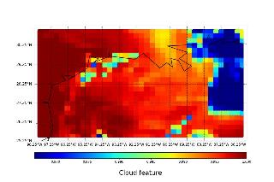
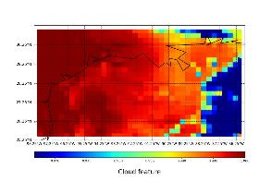
Features(1/3)
Cloud feature
Less clouds => good observation possible
If clouds are above a threshold, then the area is completely deprioritized.
(9:30 ET)
(12:30 ET)
(15:30 ET)

Slide 15
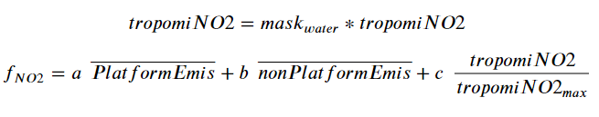
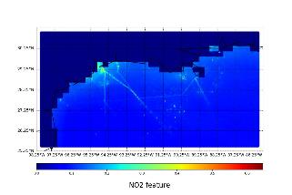
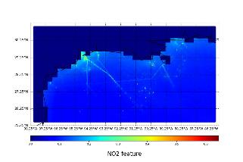
Features (2/3)
NO2 feature
The weights ‘a’, ‘b’, ‘c’ depend upon the GEOS-CF TROPCOL-NO2 which is a measure of continental influence. If the GEOS-CF TROPCOL-NO2 is above a threshold, the Tropomi NO2 reading is deemphasized.
(Land-water mask has been applied prior to normalization of the Tropomi NO2 data)
(9:30 ET)
(12:30 ET)
(15:30 ET)

Slide 16
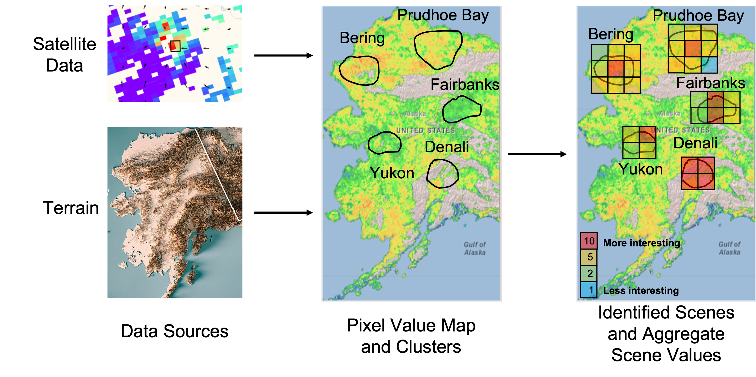
Targeter
The Targeter leverages a pixel value module to assign pixel values from varying inputs (left). It then groups similar pixels (middle), and then breaks these groups into scenes with values aggregated from the pixels within them (right).

Slide 17
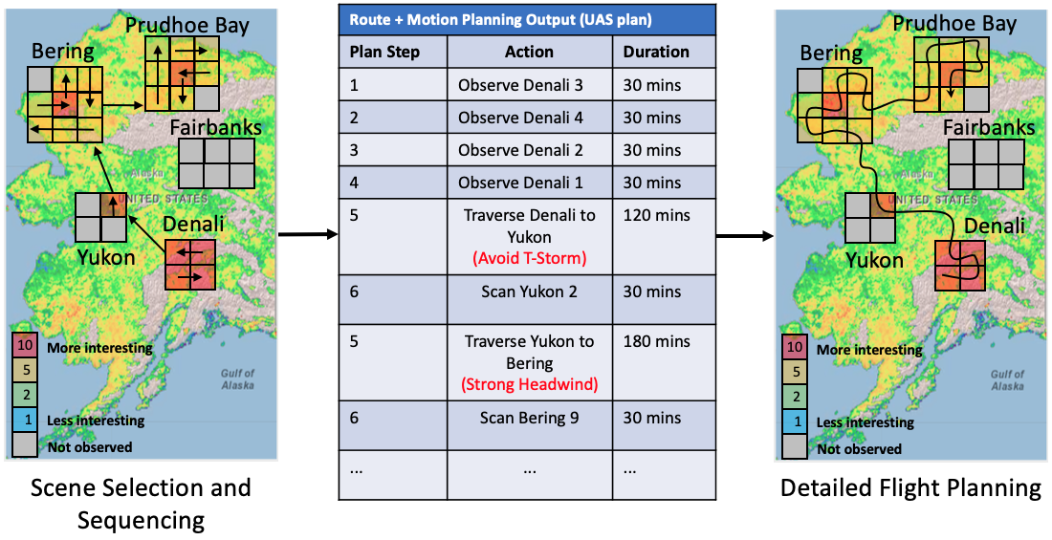
Planner
The Planner determines which scenes should be visited and in which order (left),
detailed behaviors within each scene (middle), and refines routes for traveling between and within scenes with wind speed and velocity and HALE UAS operating constraints (right).

Slide 18
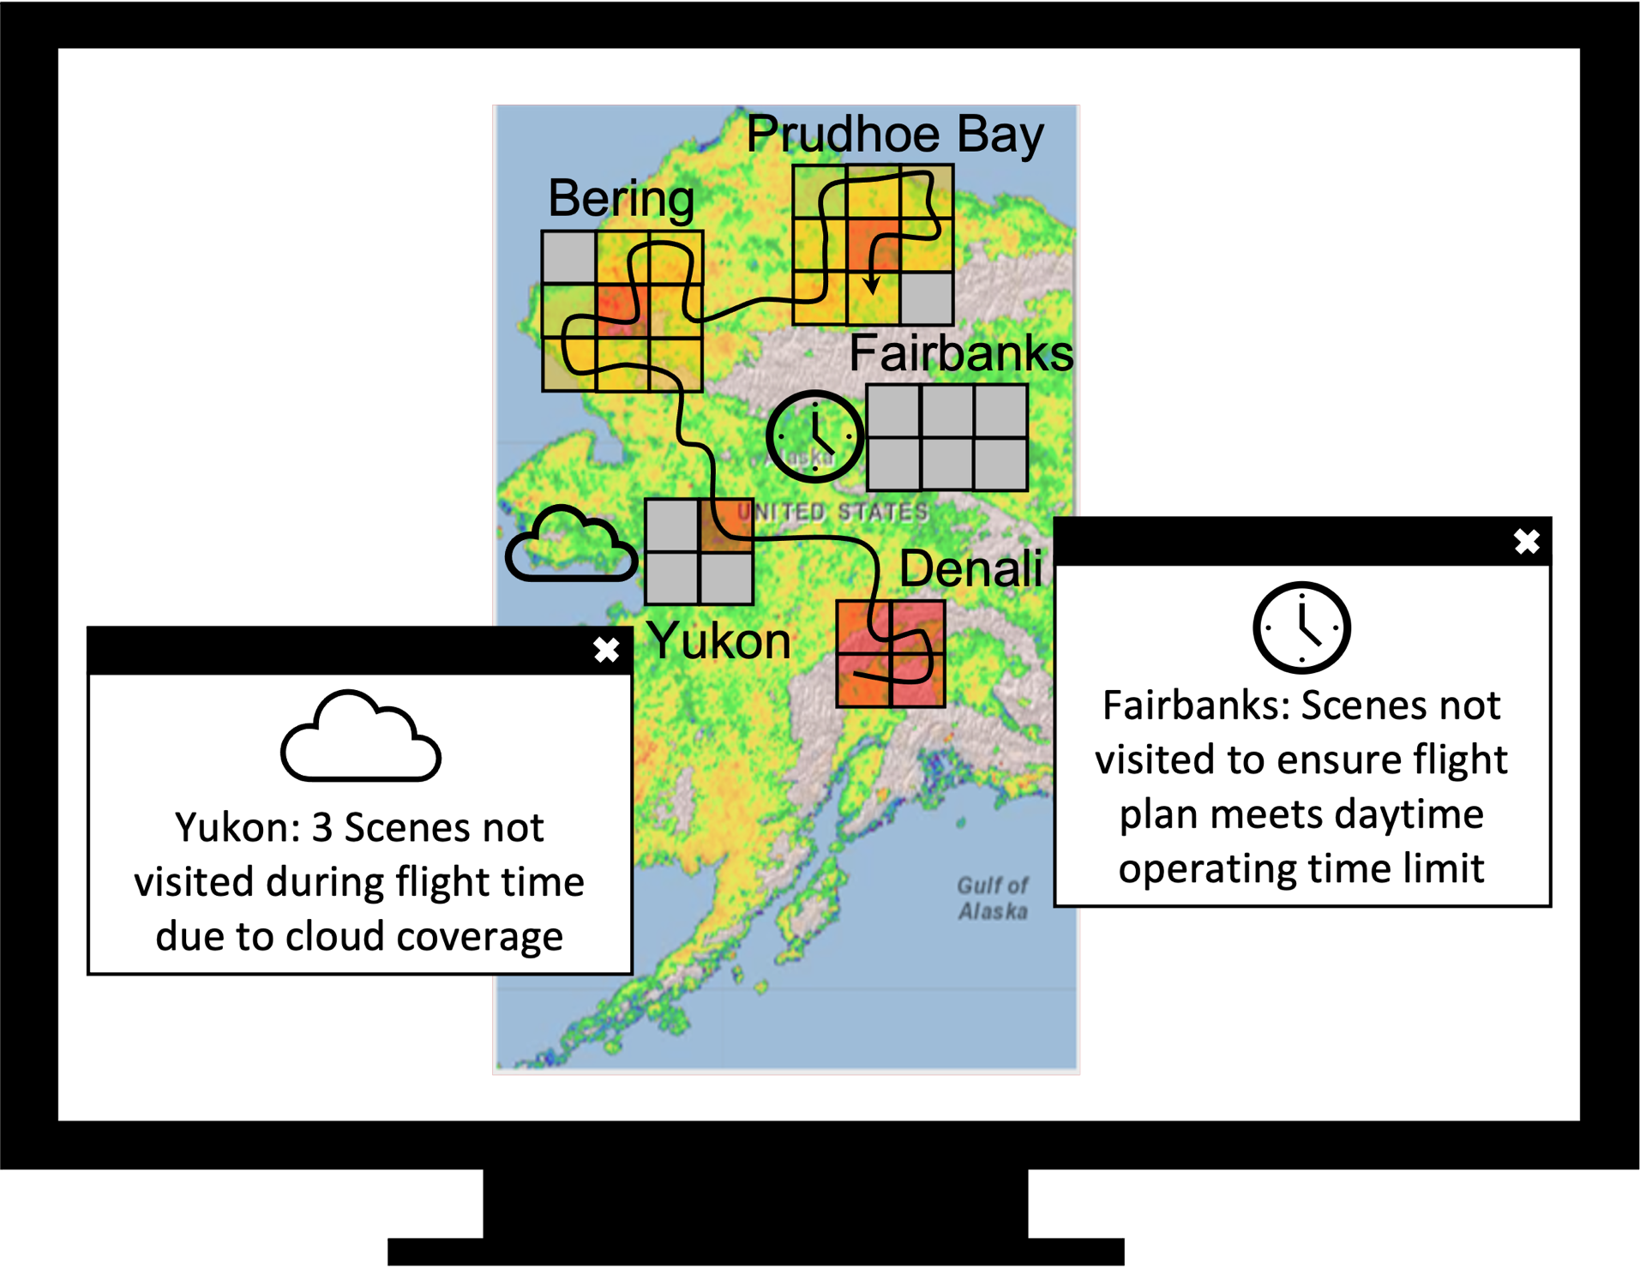
Reporter
The Reporter provides explanations for Targeter and Planner outputs to the user. For example, explanations include icon and popout descriptions of why scenes were not included in a flight.

Slide 19

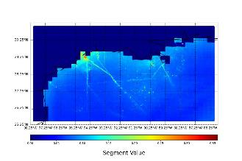
Targeter
  NO₂ Use Case Coarse Grained Data:
  Land cover (target water)
  Measured satellite NO₂
  Cloud cover
  Aerosol optical thickness
  Methane Use Case Coarse Grained Data:
  Land cover (target wetlands)
  Cloud cover
  Inundation
  Measured Methane
Interest values:
Unique for each use case
Based on available coarse-grained data (satellite measurements, meteorological, etc.)
Leverage Science SME domain knowledge to provide priority
Sample Value Map for NO₂ BOEM Inventory Use Case
Cloud Feature
Interest Values

Slide 20
Relevance to Earth Science
ILEOS will focus on use cases related to NO₂ and CH₄, which both high relevance to the science and application priorities presented in the 2019 Decadal Survey:
  NO₂, here a proxy for combustion emissions (e.g., CO₂), over oil and natural gas extraction areas of the Gulf of Mexico.
    Estimation of these emission sources(e.g., point - large rigs, line - shipping lanes, and area - small wells and support ships).
  NO₂ down to the city block level in urban environments
    Human health (unhealthy to breathe) and environmental justice
  NO₂ generated from lightning (collected from above storm clouds)
    Important ingredient in formation of upper tropospheric ozone, expensive to collect with crewed aircraft
  CH₄ over Artic-Boreal zone
    Characterize how the water table and air temperature affect the rate of emission
  CH₄ from various anthropogenic sources such as industrial processes and leaky natural gas distribution pipelines, in complex urban environments
    Pinpoint sources needing migration for safety reasons or to reduce the GHG footprint of urban areas

