Slide 1
Characterization of In-Space Propulsion Trade Space to Support Initial Human Mars Segment
Patrick R. Chai
Mars Architecture Team
Strategy & Architecture Office
Exploration Systems Development Mission Directorate
NASA Langley Research Center

Slide 2
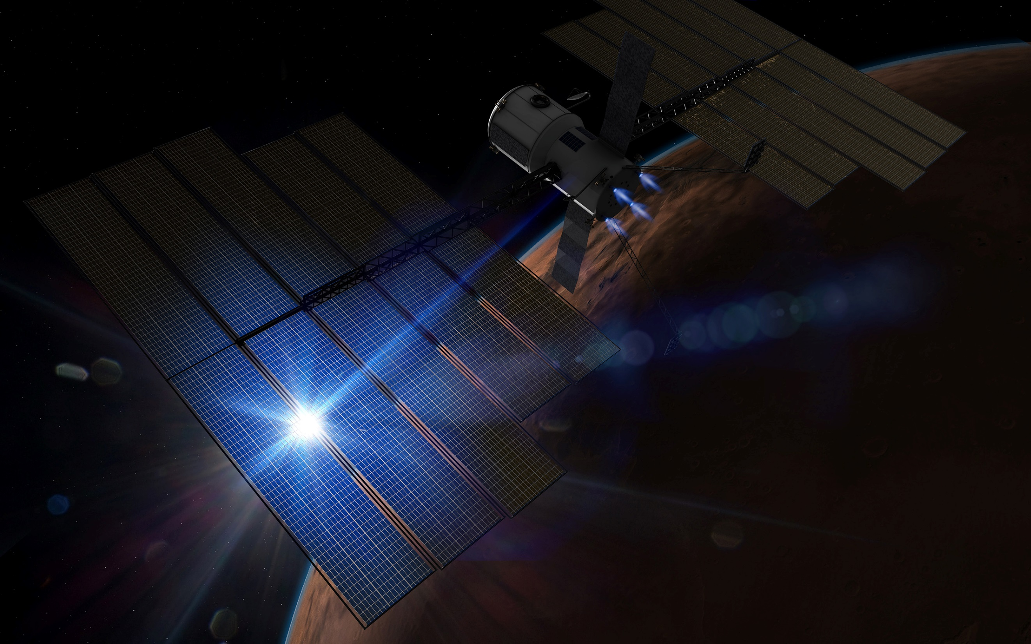
Historical Mars Architecture Approach
Von Braun Mars (1969)
Optimized around Apollo extensibility
Design Reference Architecture 5 (2009) Optimized around a long-duration stay with minimal Mars landed mass
Evolvable Mars Campaign (2016)
Optimized around minimal Earth- launched mass and Solar Electric propulsion extensibility
Mars Base Study (1987) Optimized around ISS module extensibility

Slide 3
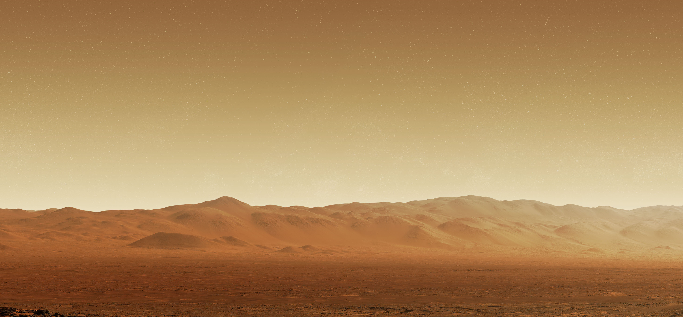






Current Mars Architecture Team Approach
To define the Mars Architecture,
we must answer 6 key questions
WHY
We Go
WHO
We Send
WHERE
We Go
HOW
We Get There & Back
WHEN
We Go
WHAT
We Do There
The answer to each question requires one or more decisions—but all of these decisions are interrelated, and order matters

Slide 4
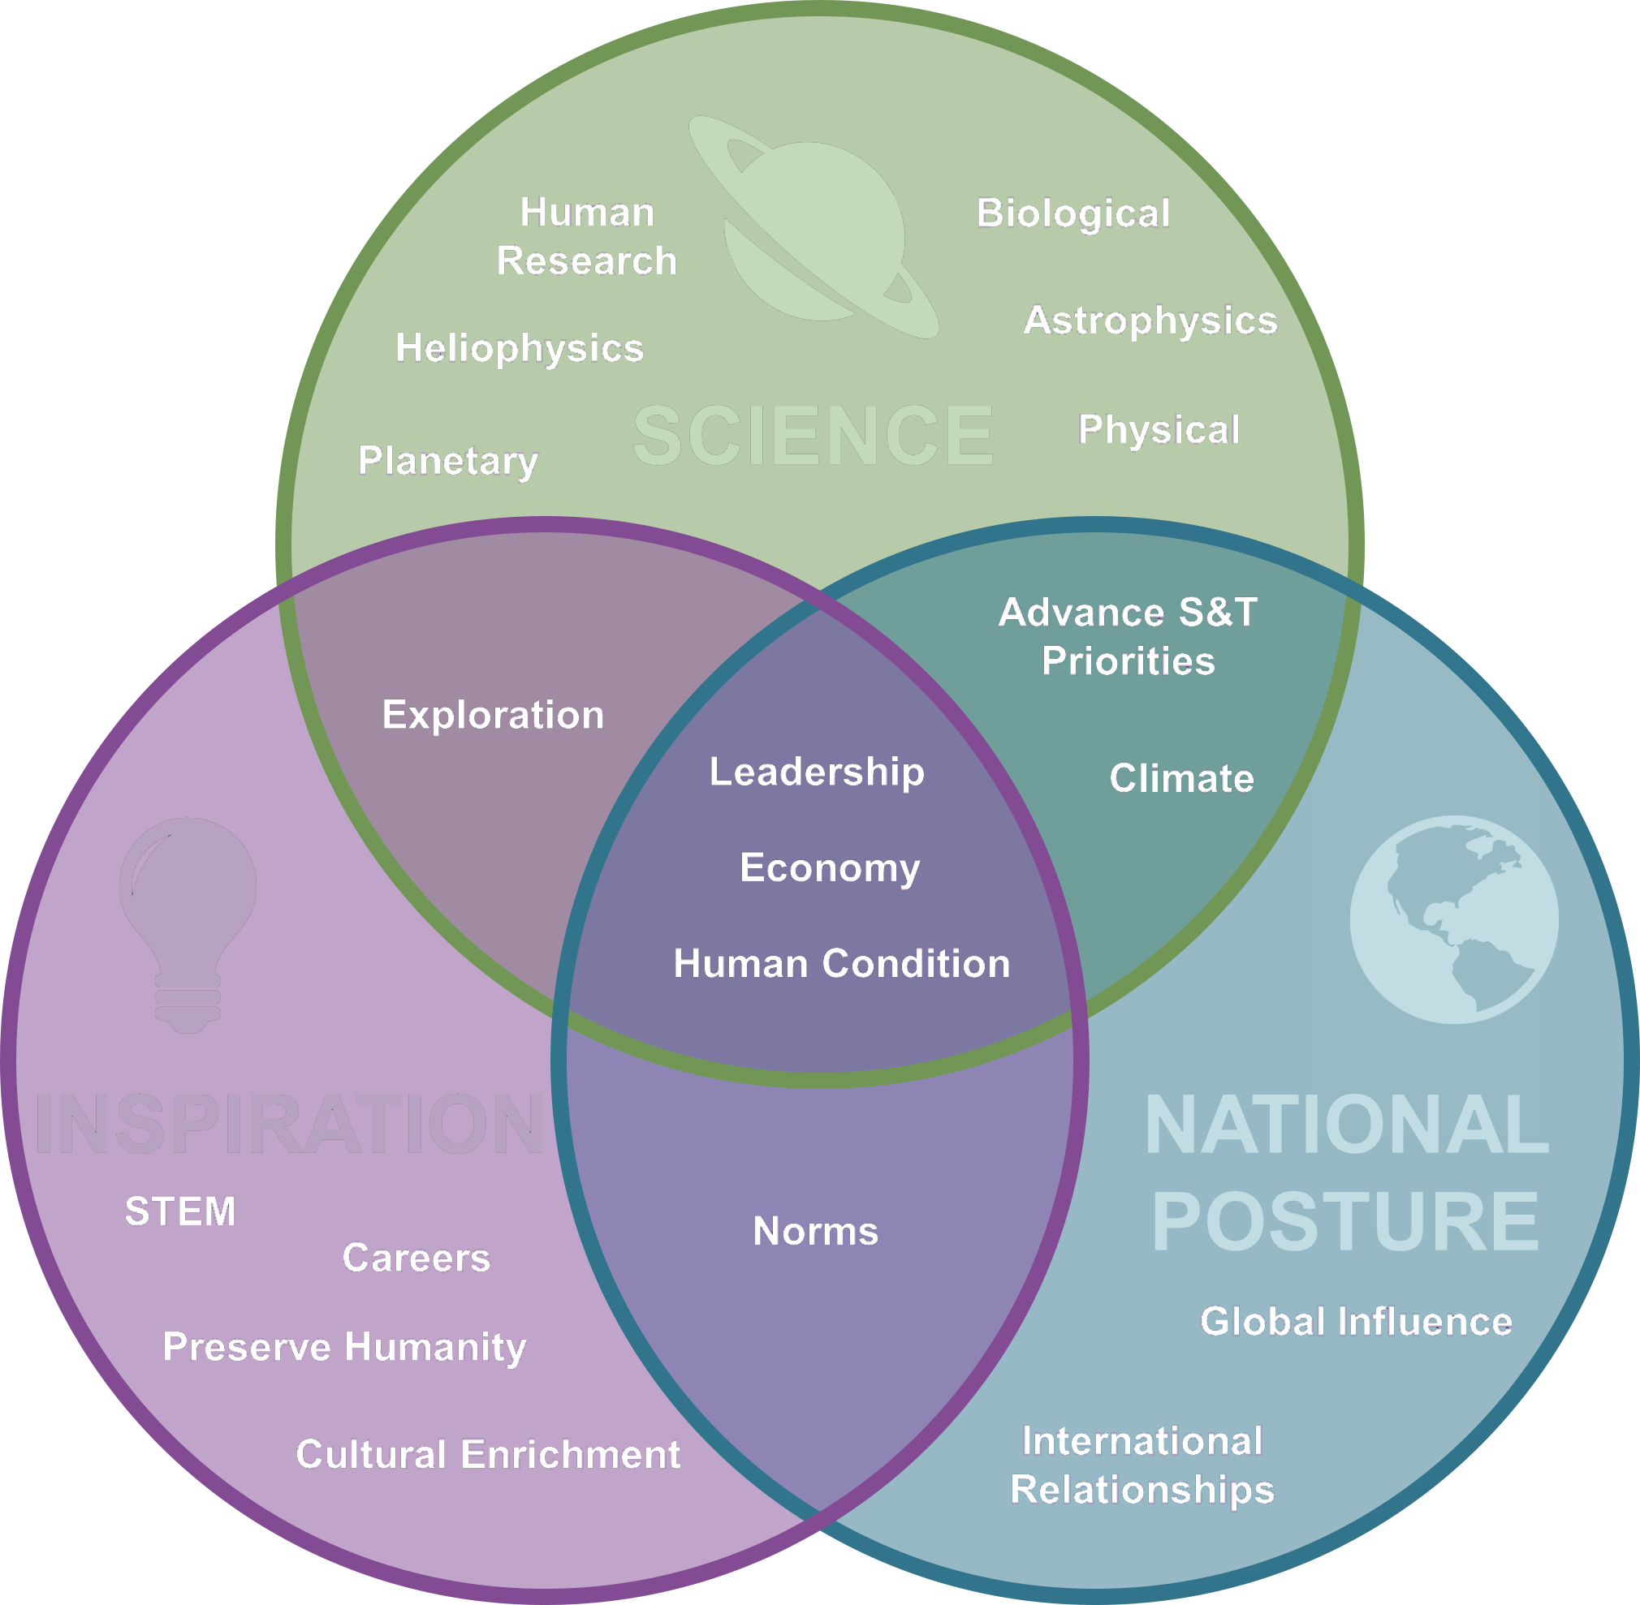
Architecting from the Right
WHY
We Go
HOW
We Get There & Back
WHO
We Send
WHEN
We Go
WHAT
We Do There
WHERE
We Go
The answers to “Why?” have been defined in the Agency’s Moon-to-Mars Objectives
go.nasa.gov/3zzSNhp

Slide 5
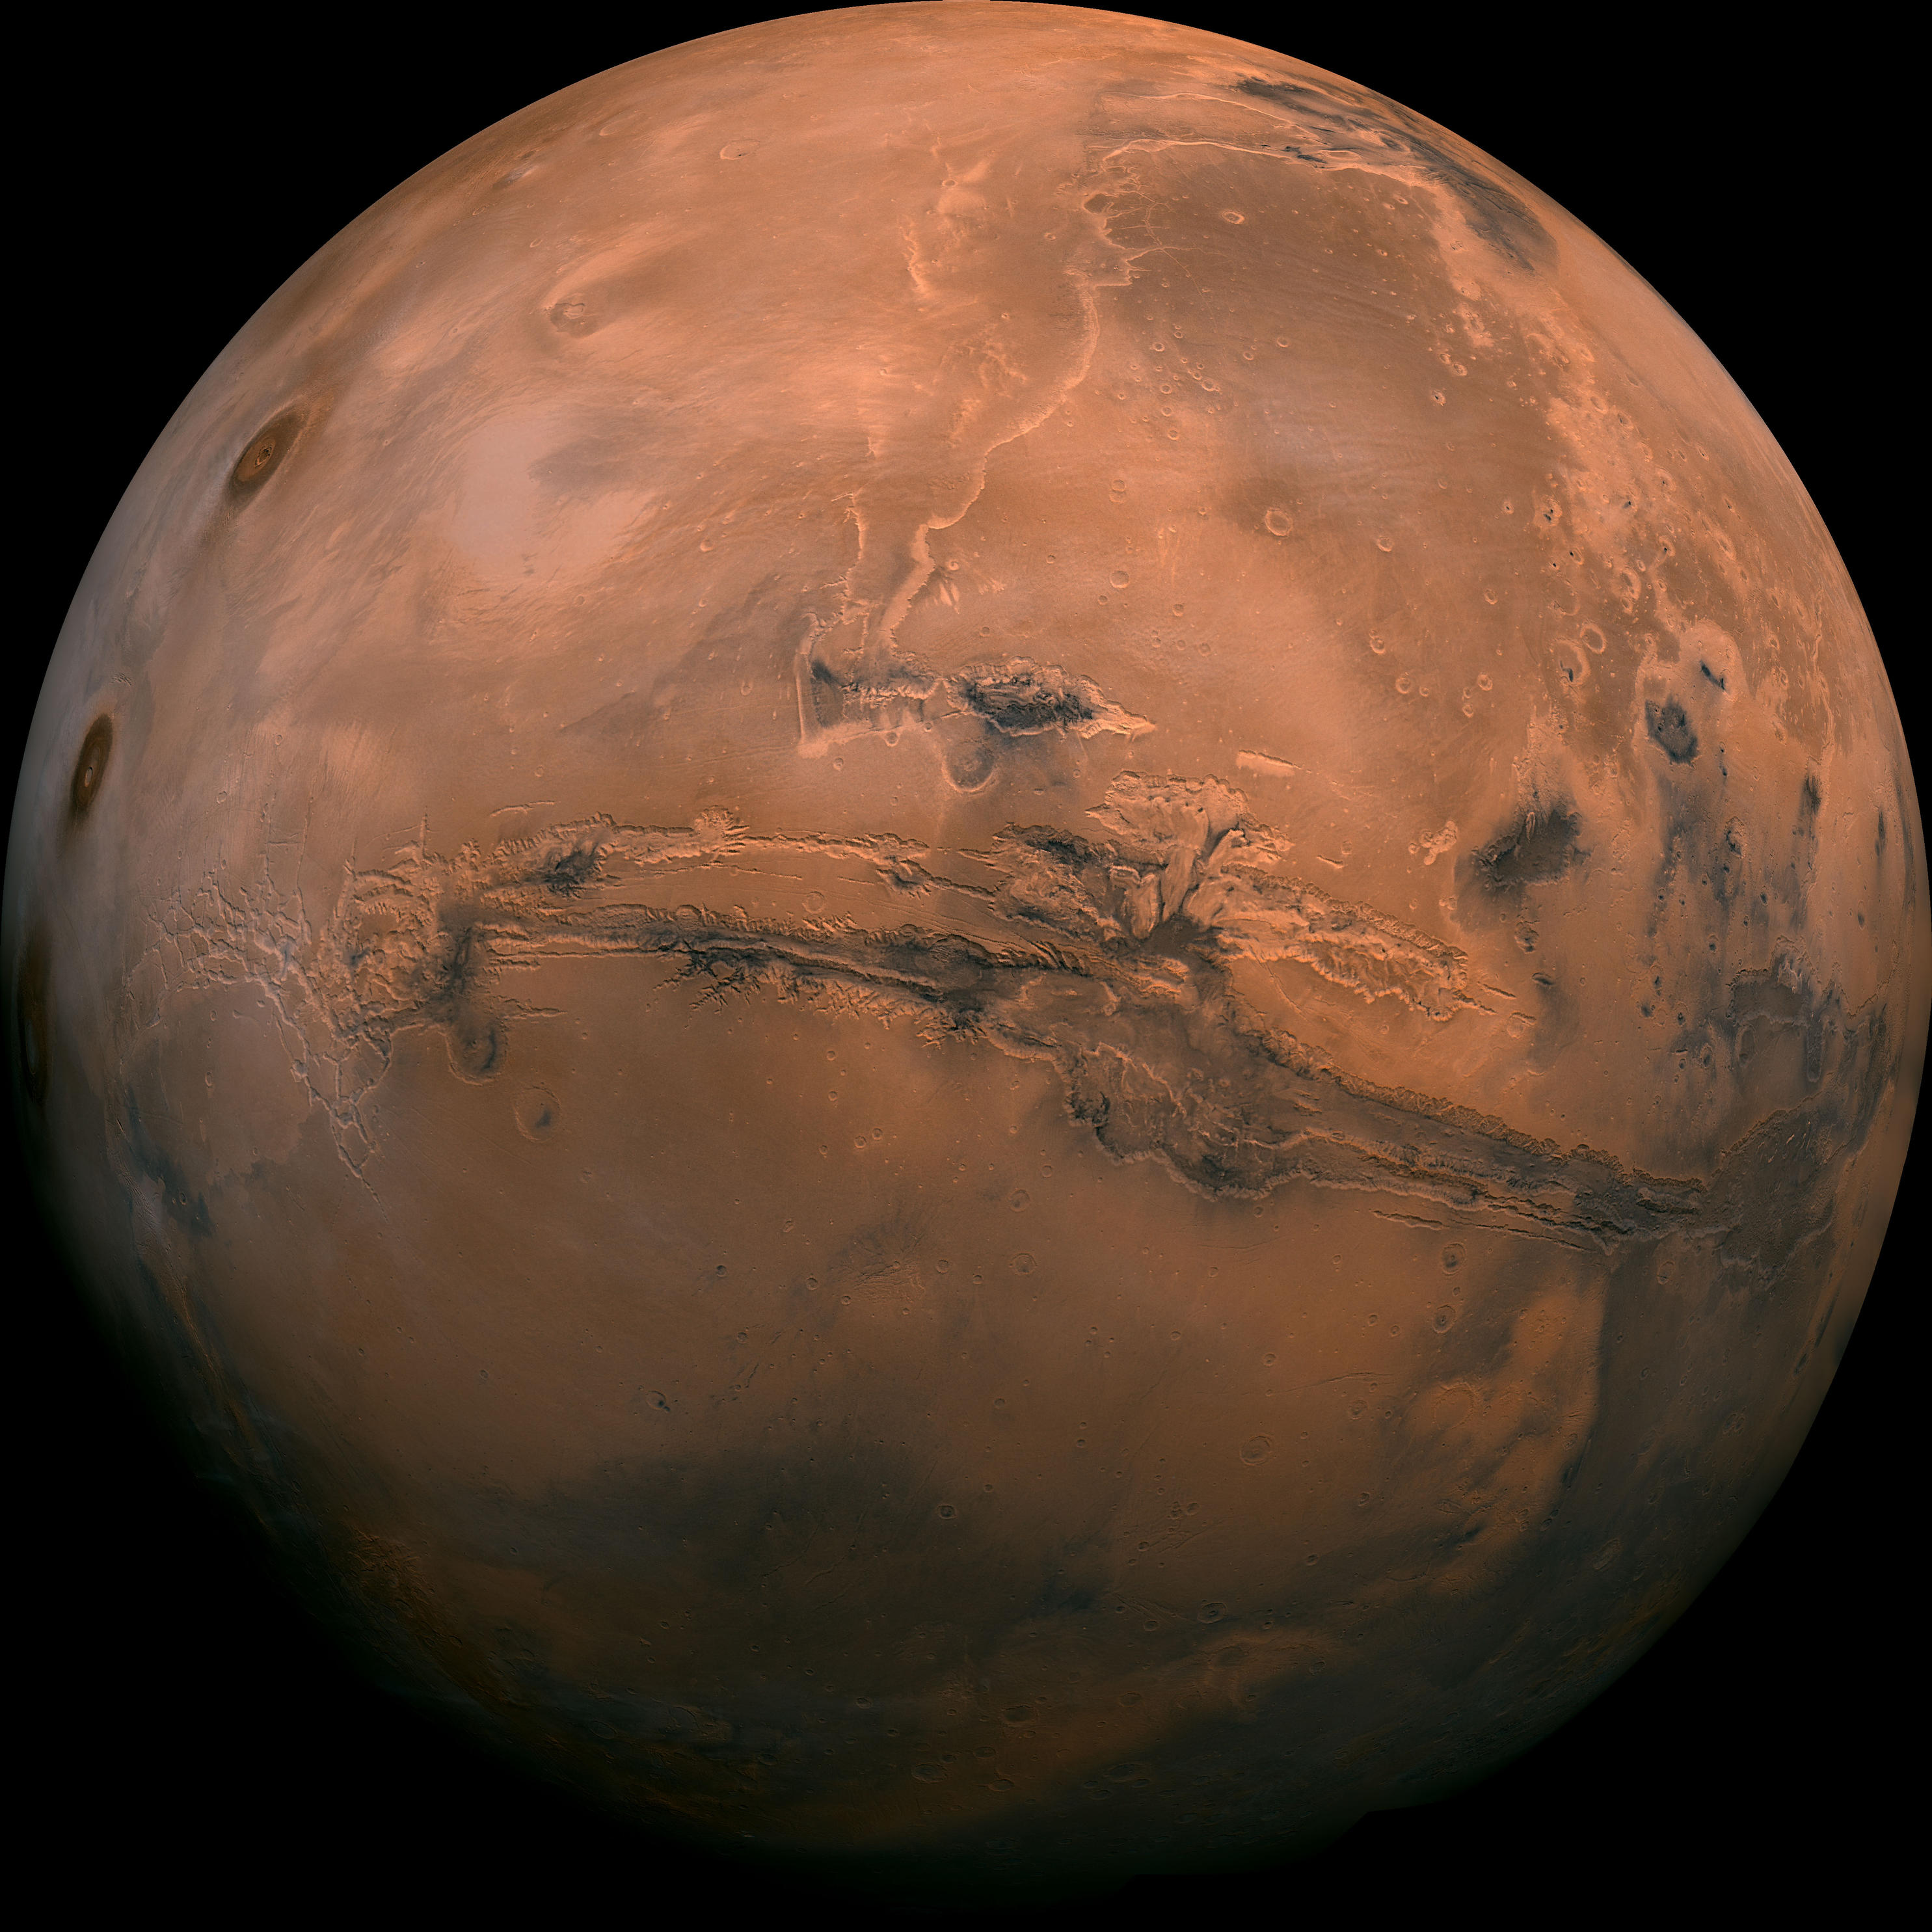
In-Space Transportation
Considerations

Slide 6


Slide 7
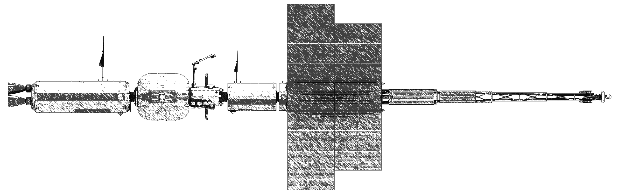
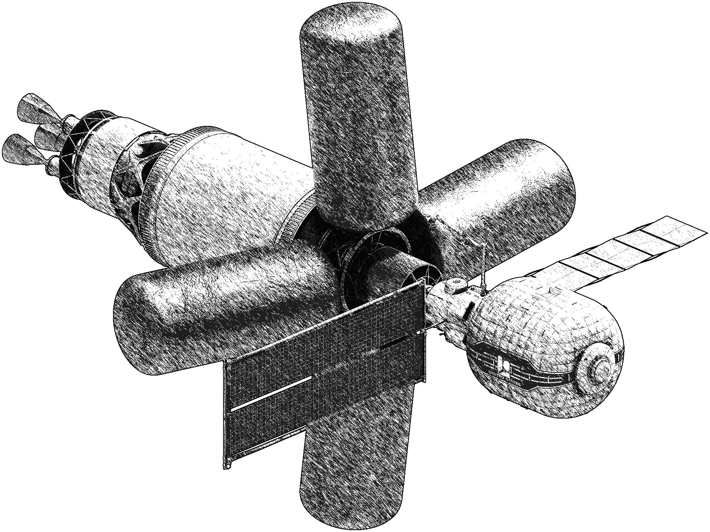
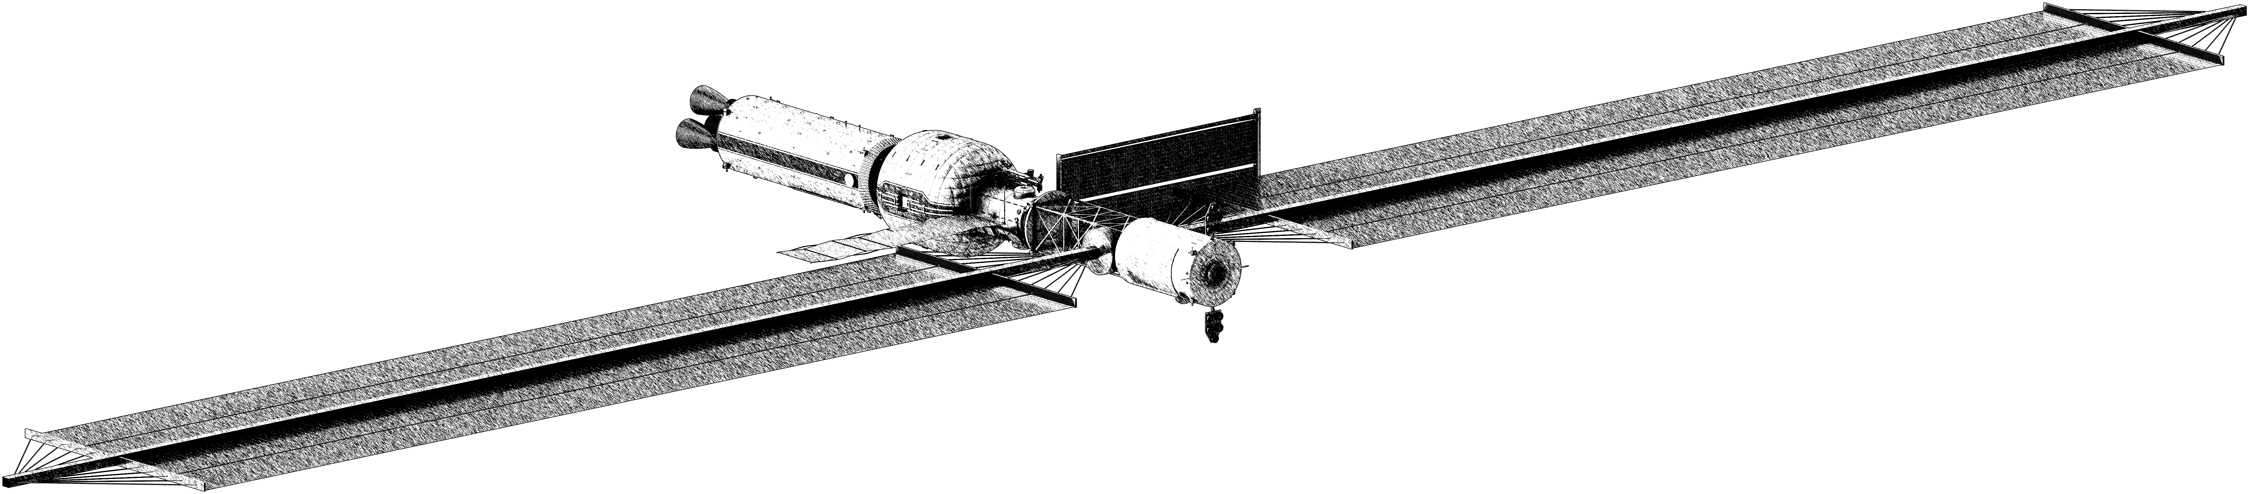
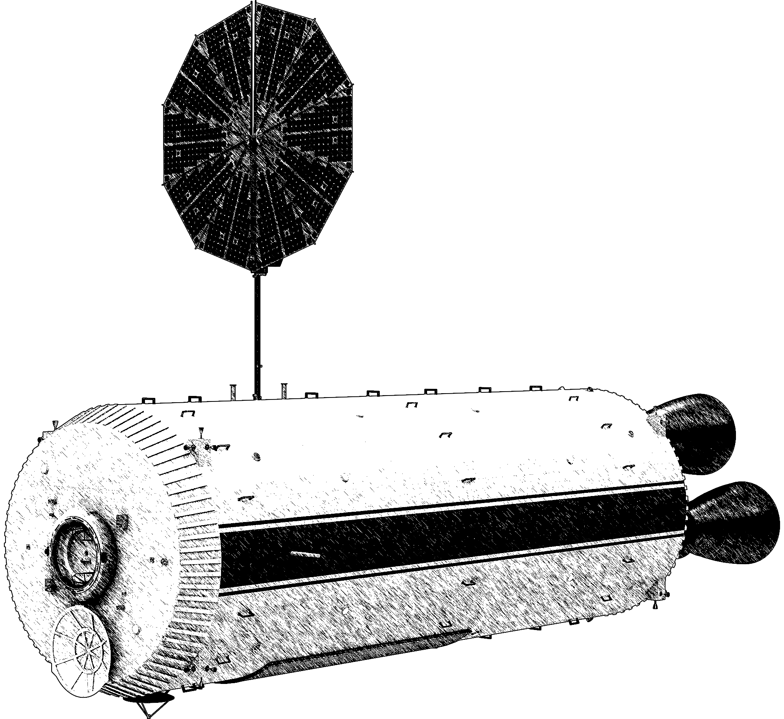
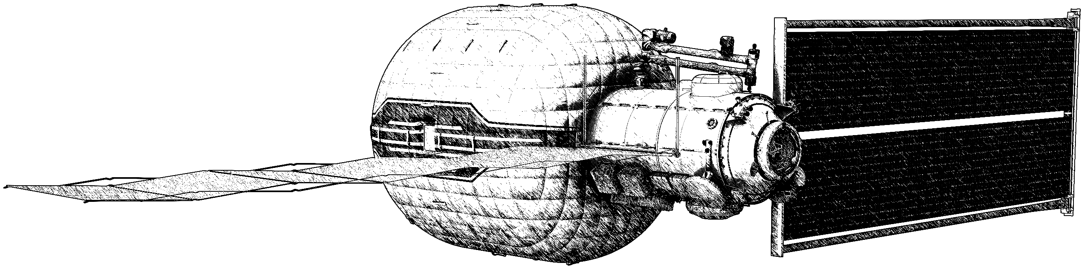
How - Transportation Options
NEP Hybrid
Nuclear Electric Propulsion
1
NTP
Nuclear Thermal Propulsion
2
SEP Hybrid
Solar Electric Propulsion
3
  ALL-CHEM
  Chemical Propulsion
4
Not to Scale
Artistic Conceptual Elements Shown

Slide 8
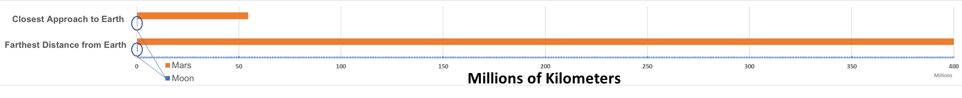
Mars Distance Considerations
Mars is much farther from Earth than the Moon is
 | Closest Approach to Earth | Farthest Distance from Earth | Typical Round-Trip “Odometer” Reading | Round-trip Duration
Moon | 360,000 km | 405,000 km | 1,900,000 km | Weeks
Mars | 54,600,000 km | 400,000,000 km | 1,800,000,000 km | Years
Round-trip Mars missions may be twice as long as our longest duration experience base
There will be no way to abort quickly to Earth
On-demand resupply will not be possible

Slide 9
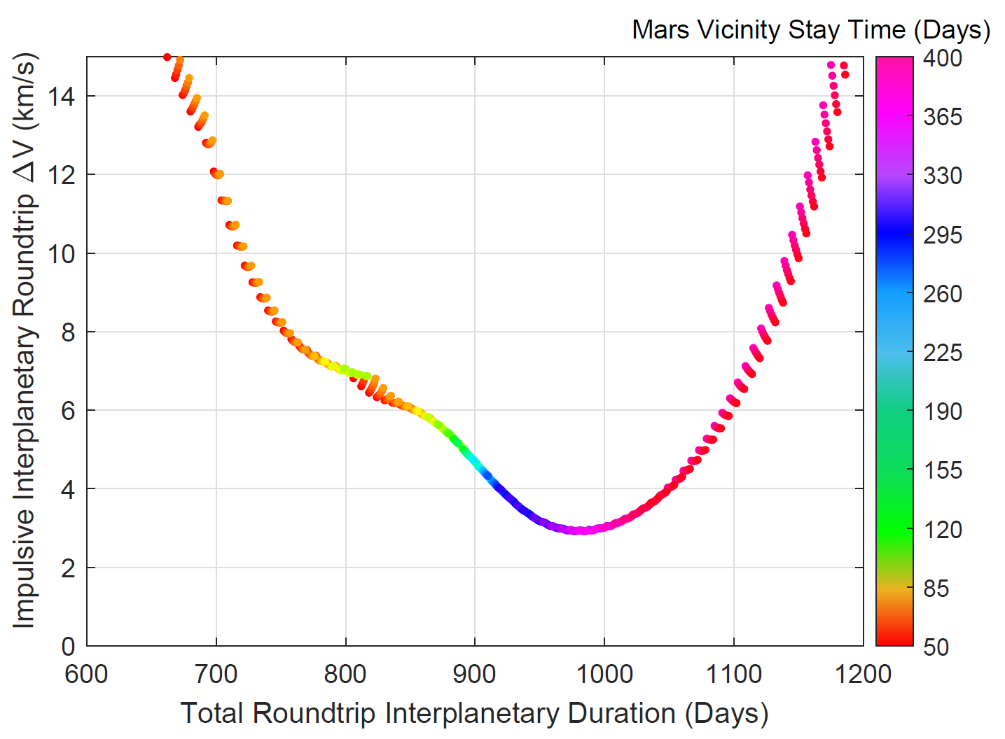
Roundtrip Mission Duration Drives Energy Need
Energy Needs Exponential for Short Durations
Optimal Roundtrip

Slide 10
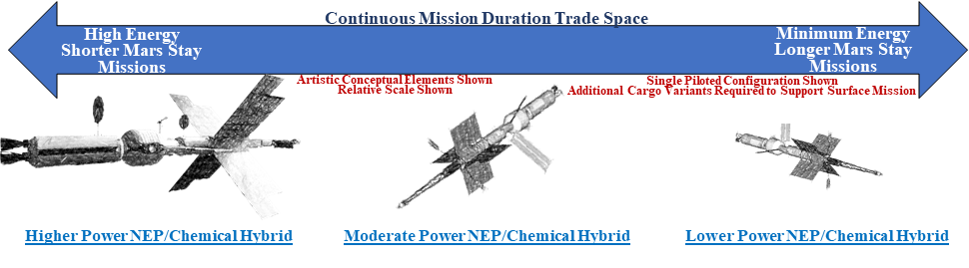
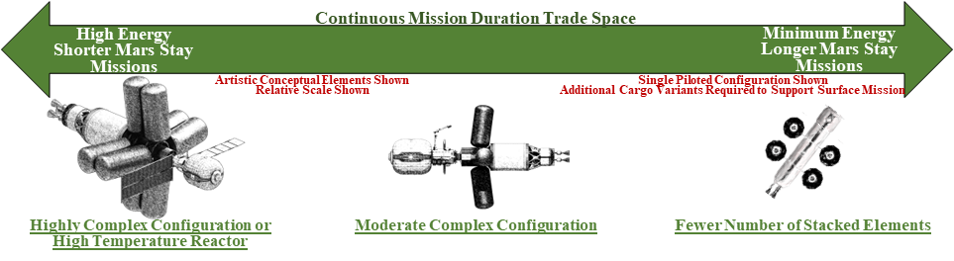
Energy Needs Drives Transportation Concept
NEP
NTP

Slide 11
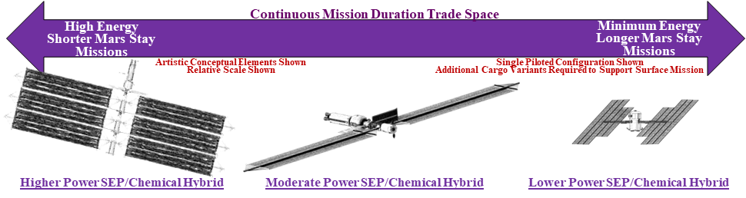
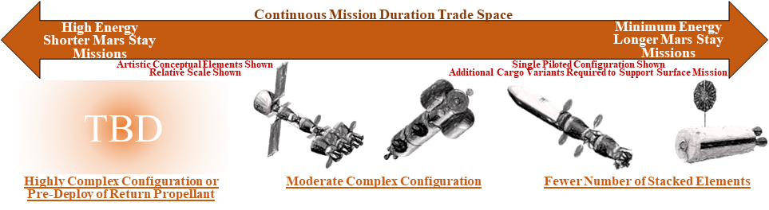
Energy Needs Drives Transportation Concept
SEP
Chemical

Slide 12
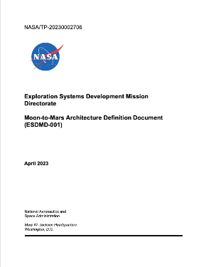

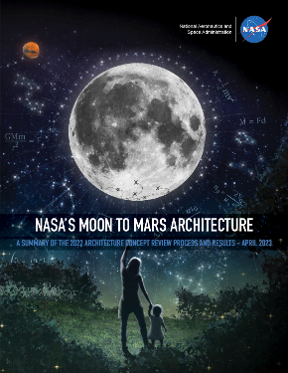
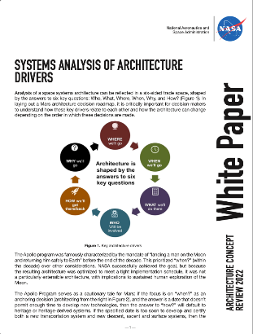
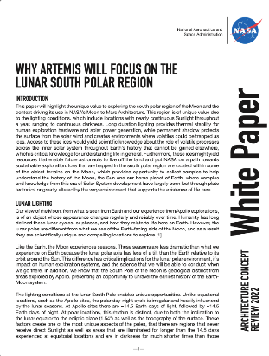
Architecture Concept Review Products
Architecture Definition Document
Detailed documentation of a snapshot of NASA’s human spaceflight architecture and exploration strategy
Moon to Mars Architecture Summary
High-level overview of NASA’s Moon to Mars architecture and exploration strategy
White Papers
Six papers on architecture study details for frequently discussed topics
www.nasa.gov/MoonToMarsArchitecture
Notes:
Jim briefs charts 17-22

Slide 13


Summary
Mars missions will require significantly more energy and much longer system service life, with more constrained departure windows, than lunar missions
Shorter total roundtrip duration missions could reduce crew health and performance concerns but pushes the challenge to the in-space transportation system
Four In-Space Transportation propulsion technologies are currently under consideration
Access Mars Transportation White Paper with this QR code or at www.nasa.gov/MoonToMarsArchitecture
13

Slide 14
BACK UP

Slide 15
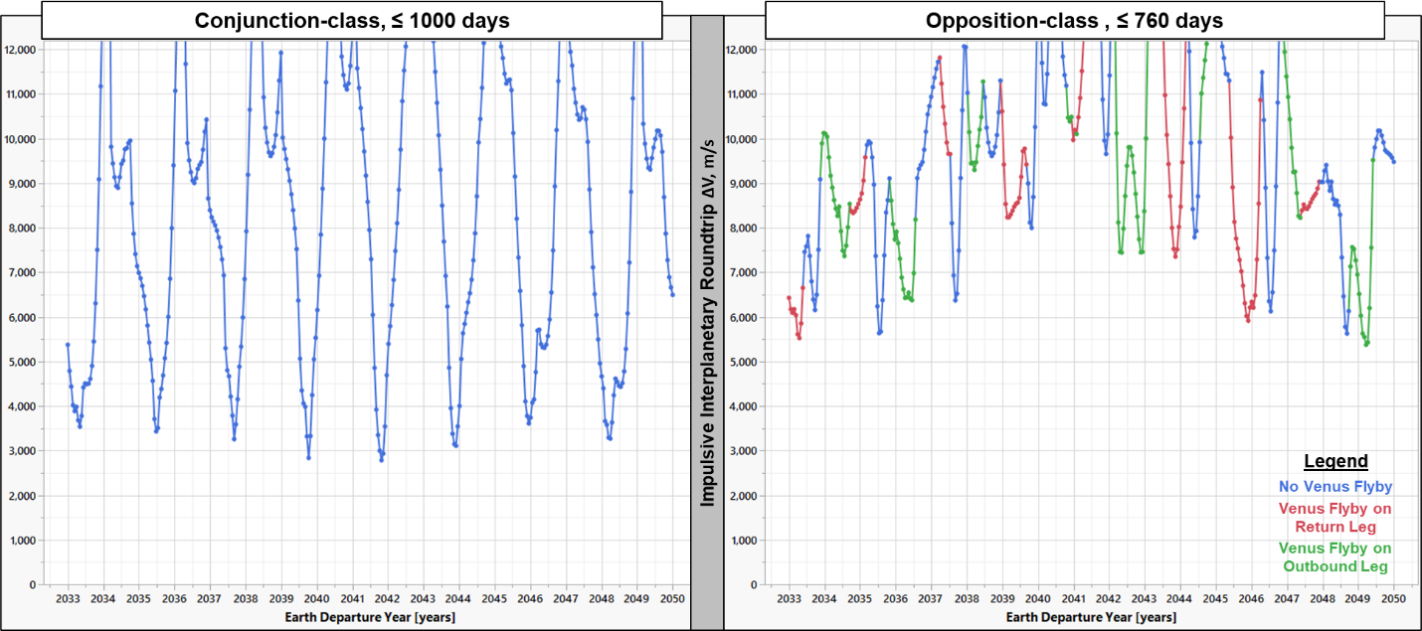
Optimum Departure Windows ~Every 2 Years
But must also consider optimum return window
Increasing Energy = Exponential Increase in Vehicle Mass
Higher energy Mars missions require vehicles that are multiple ISS mass equivalents
Minimum Energy Long-Stay Class, ~ 3 Years Roundtrip
High Energy Short-Stay Class, ~ 2 Years Roundtrip
Higher energy missions can reduce total trip time at the expense of shorter Mars vicinity stay time
Energy needs also vary more, making these missions more challenging to plan
For human mission, we need to wait for alignment for BOTH legs of the trajectory to minimize energy
Long-Stay
Short-Stay
“When” is a very complicated decision to address.
What is an acceptable roundtrip duration for humans? What are the Surface Cargo pre-deployment needs?
How many rockets do we have and how often can we launch them? What transportation system performance can we afford?

