Slide 1
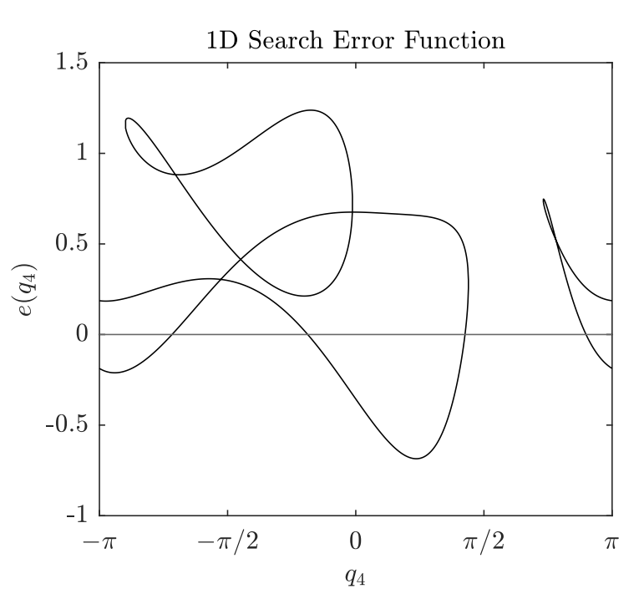
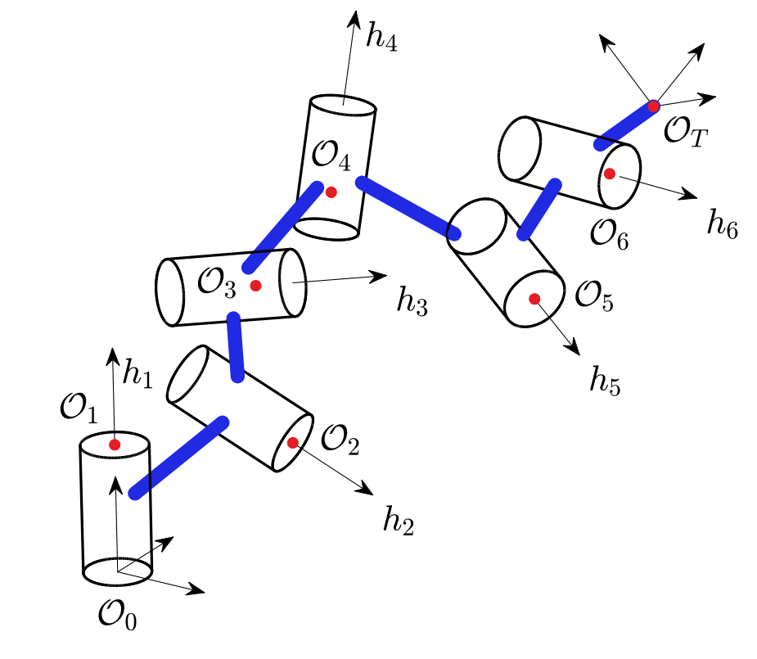
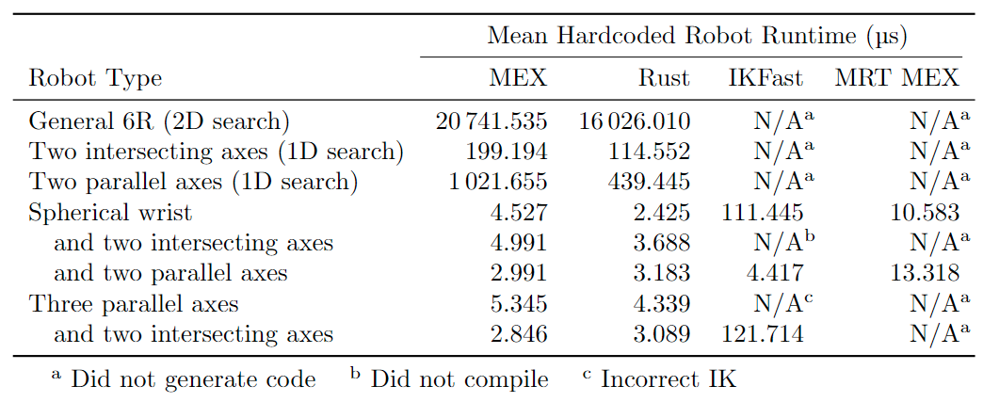
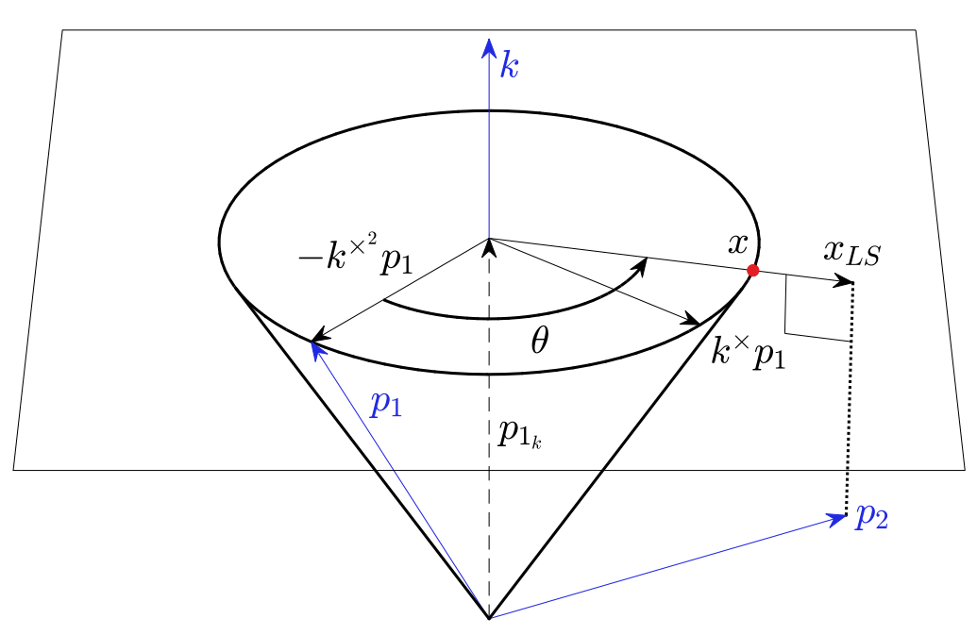
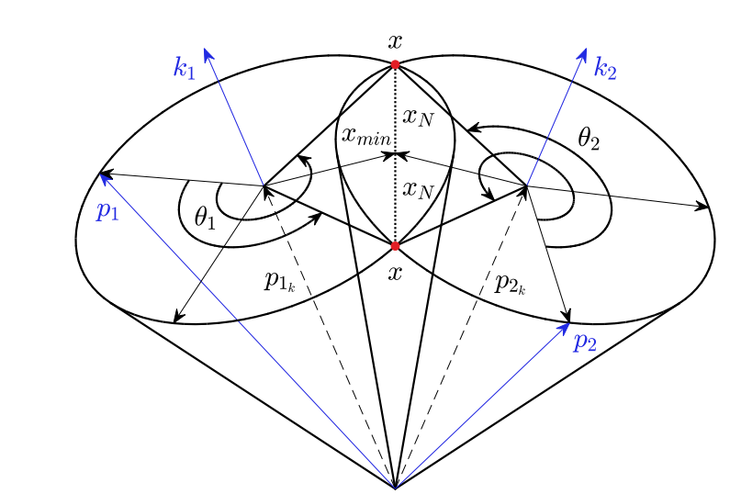
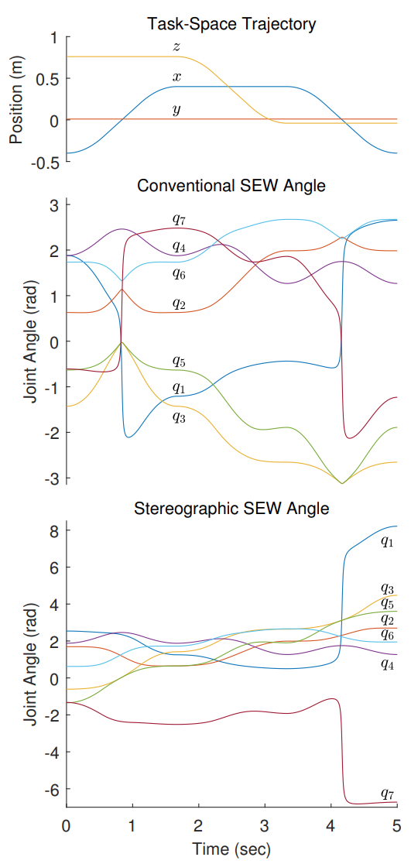
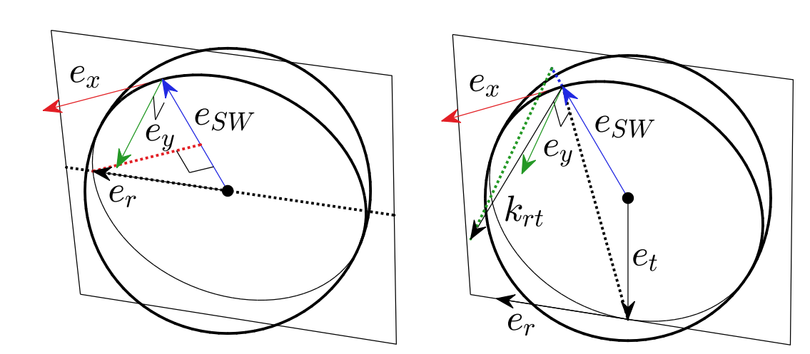
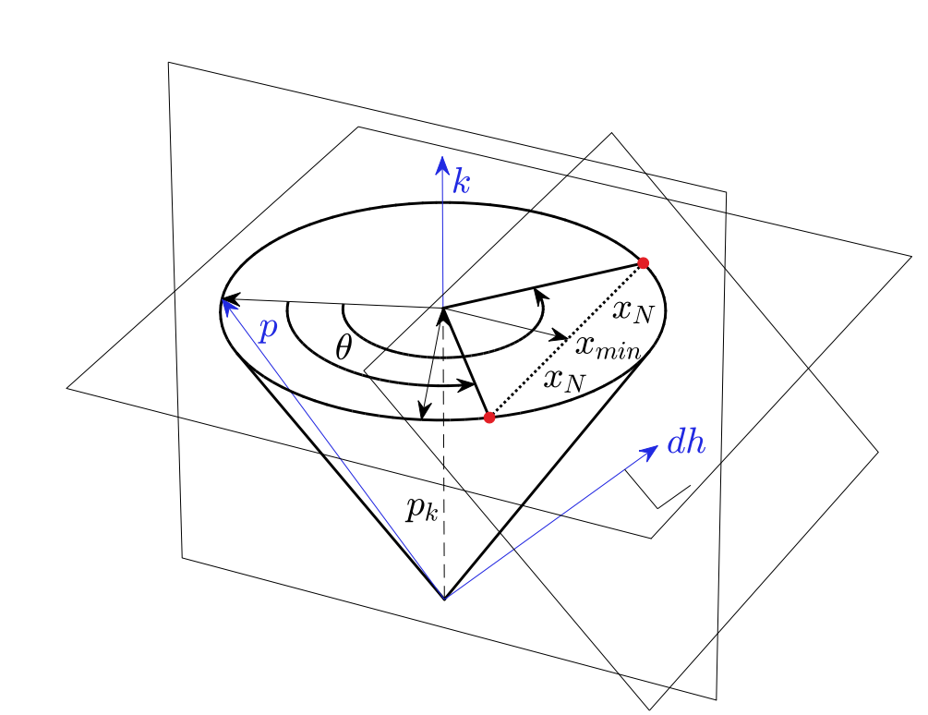
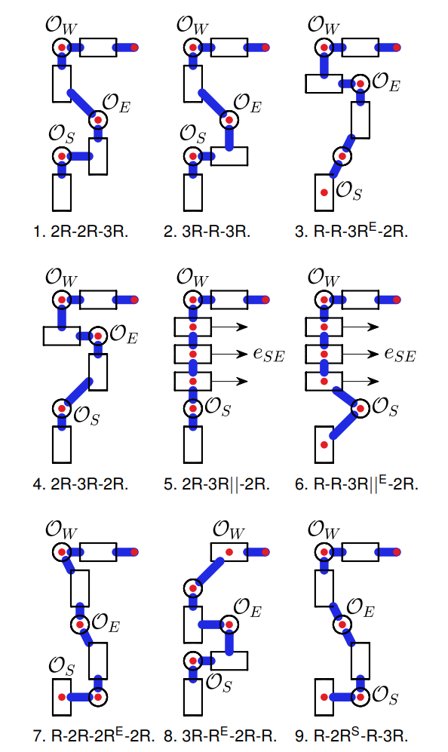
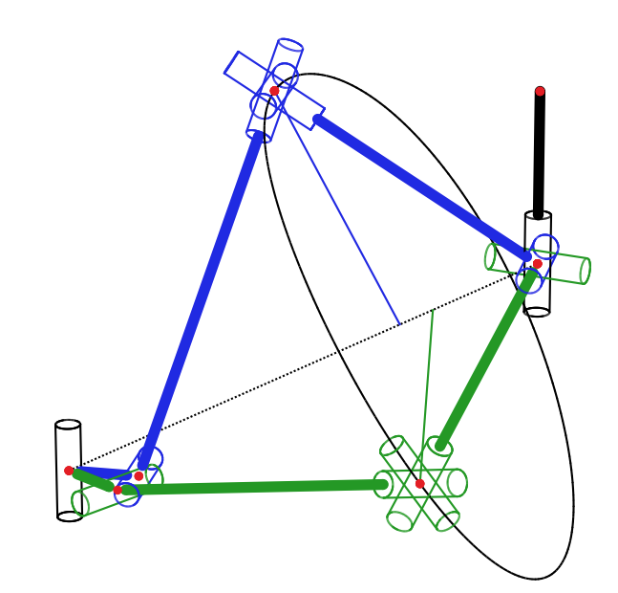
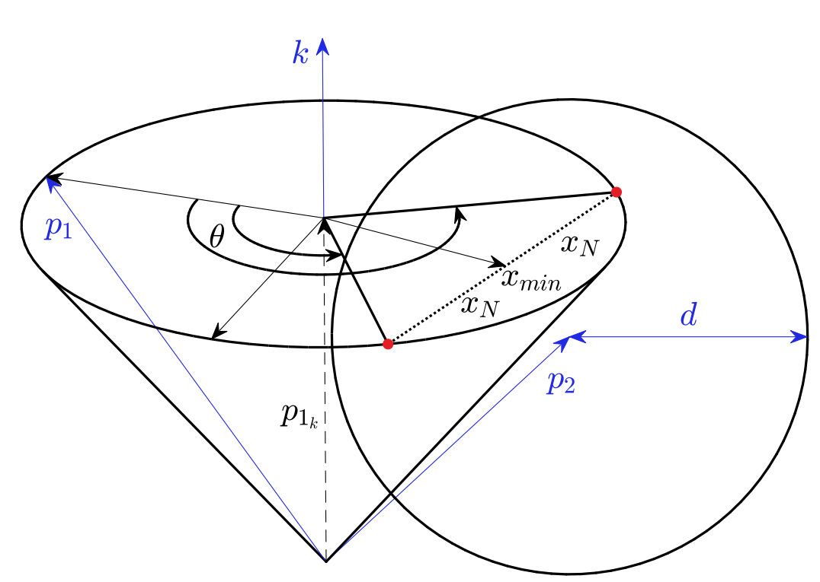
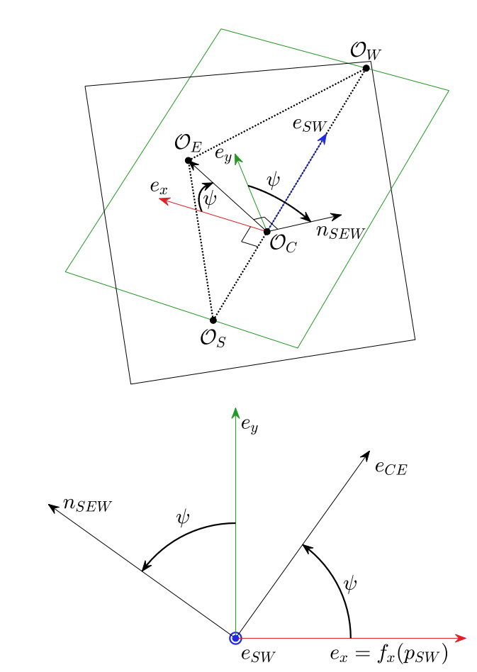
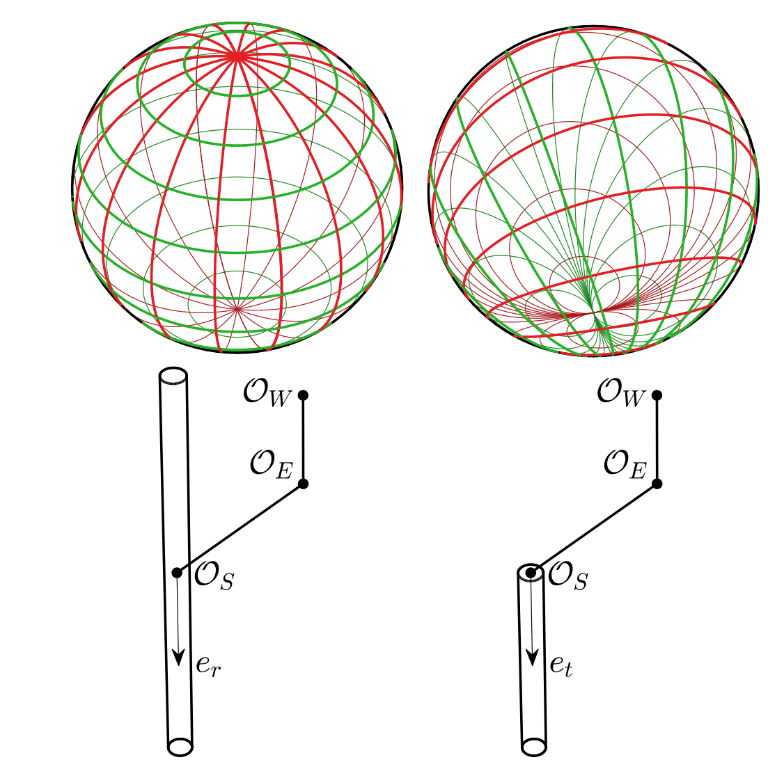
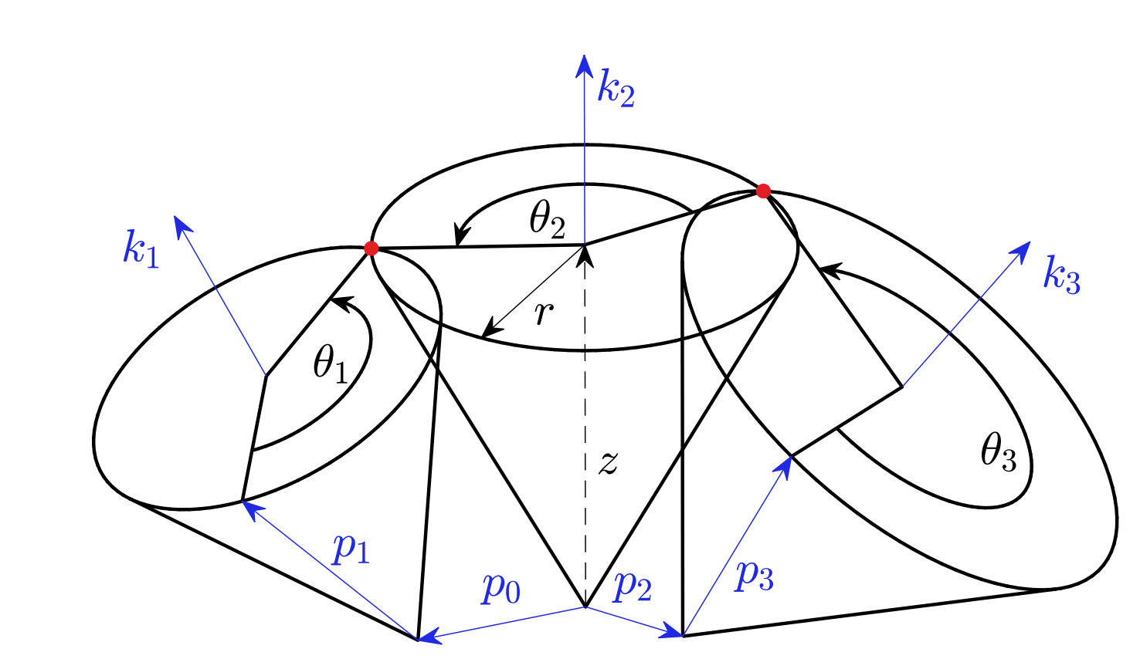
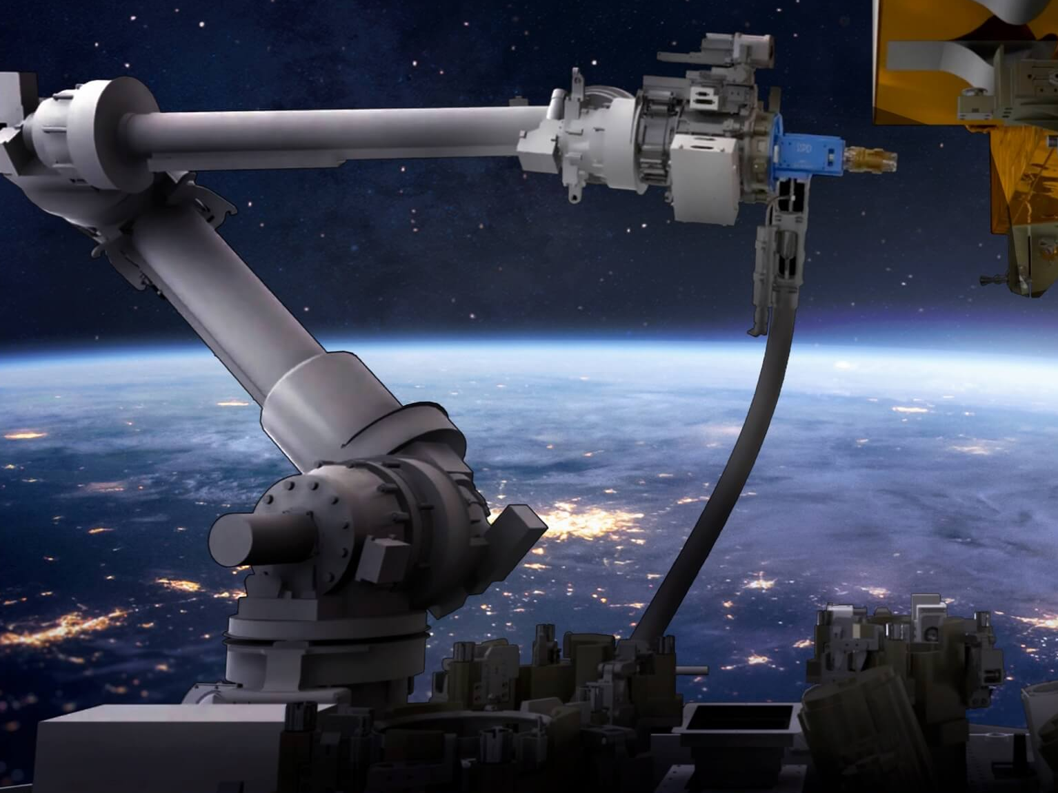
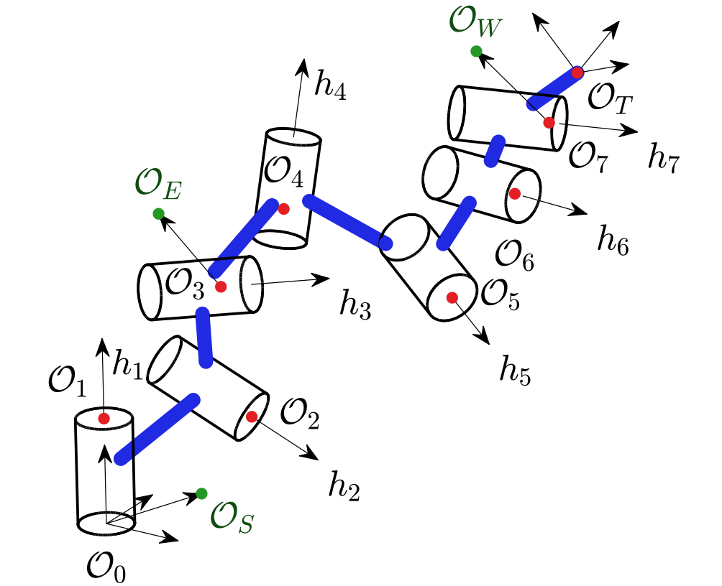
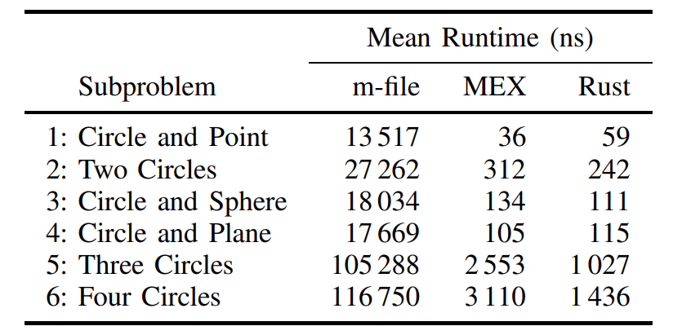
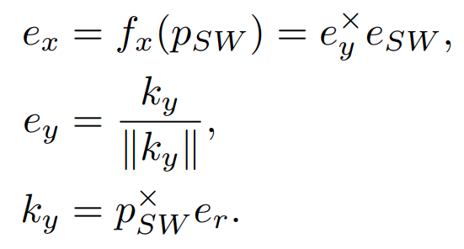
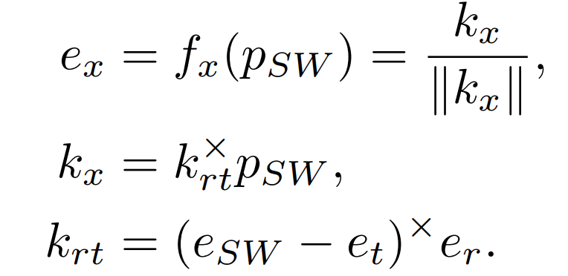
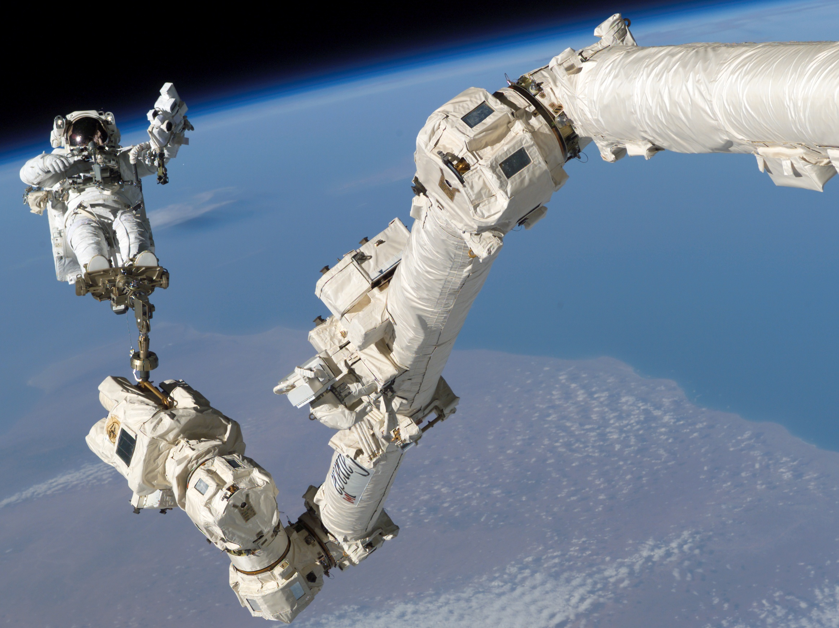
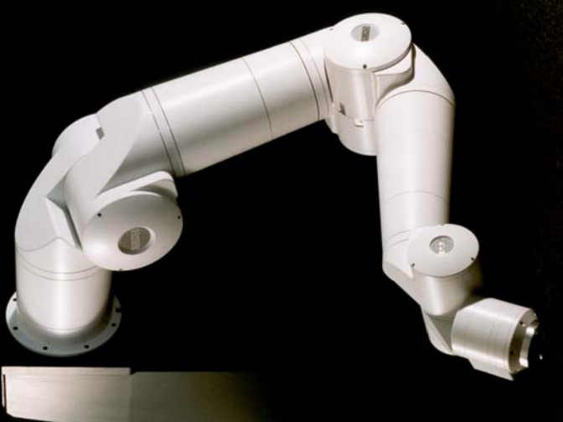
Efficient and Singularity-Aware Inverse Kinematics
for 6-DOF and 7-DOF Revolute Manipulators
Alexander J. Elias and John T. Wen · Rensselaer Polytechnic Institute
linktr.ee/iros_ik
eliasa3@rpi.edu
github.com/rpiRobotics/ik-geo
github.com/rpiRobotics/stereo-sew
Canonical Subproblems for Robot Inverse Kinematics [1]
6-DOF Inverse Kinematics using Subproblems Decomposition Method [1]
Canonical geometric subproblems: Intersection of circles with other objects
3 intersecting/parallel axes: Closed form
2 intersecting or parallel axes: 1D search
General 6R robot: 2D search
Subproblem decomposition is faster and more capable than
IKFast and MATLAB Robotics Toolbox (Pieper method)
Subproblems 1-3: Original Paden-Kahan Subproblems
Least squares (Subproblems 1-4) → Robust to boundary singularities
Detect & resolve continuum of solutions → Robust to internal singularities
Example: Spherical wrist & two parallel axes
1. Find $q_{1}$ with SP 4
2. Find $q_{3}$ with SP 3
3. Find $q_{2}$ wth SP 1
4. Find $(q_{4}, q_{5})$ with SP 2
5. Find $q_{6}$ with SP 1
1: Circle and Point (≤ 1 solution)
2: Two Circles (≤ 2 solutions)
7-DOF Inverse Kinematics using Subproblems [2]
General SEW Angle [2]
Conventional SEW [2]
Stereographic SEW [2]
7-DOF robots with SEW angle can be solved using subproblems
Parameterize by one joint angle
→ Use 6-DOF solutions
Stereographic SEW angle reduces effects of singularities (e.g., 2R-2R-3R)
7-DOF robots have a redundant DOF which must be parameterized to specify the pose.
General Shoulder-Elbow-Wrist (SEW) angle: Parameterization with arbitrary reference direction function $e_{x}=f_{x}(p_{SW})$.
Singularity if wrist on line
May limit usable workspace
Singularity if wrist on half-line
Singularity can be out of reach
3: Circle and Sphere (≤ 2 solutions)
4: Circle and Plane (≤ 2 solutions)
Closed form:
5: Three Circles (≤ 4 solutions)
6: Four Circles (≤ 4 solutions)
1D search:
General 7R robot: 2D Search
Solution method:
1. Write in terms of $x=\left[\begin{matrix}\sin{θ} \\ \cos{θ}\end{matrix}\right]$
2. Find unconstrained solutions
3. Add $‖x‖=1$ constraint
4. Return $θ=atan2{(\sin{θ},\cos{θ})}$
No $arccos$, $arcsin$, or $tan(θ/2)$
→ Robust to numerical issues
Solutions are fast with MATLAB and Rust
OSAM-1 (2R-2R-3R)
OSAM-2 (R-2R-2R-2R)
SSRMS (2R-3R||-2R)
RRC (General 7R)
Assembling Large Infrastructure in Space Using Intelligent Robots · 2023 IEEE/RSJ International Conference on Intelligent Robots and Systems (IROS), Huntington Place, Detroit, USA
October 1, 2023

