Slide 1

Durability of Passive Thermal Control Materials Exposed to Low Earth Orbit Environment
Miria Finckenor
Meghan Carrico
NASA Marshall Space Flight Center
Applied Space Environment Conference
October 2023
Huntsville, AL
Notes:
My name is Justin McElderry, and I am a materials engineer here at NASA MSFC.
When designing missiles, rockets, or other flight hardware, how do you think material data is collected when its been to space?
Here at MSFC, my team in the SEE team study what space environmental do to AM samples in space and try to characterized them

Slide 2
Overview
A variety of passive thermal control materials were exposed to the space environment on five different flight experiments.
Low Earth orbit environmental exposure
  Paints
  Chemical conversion coatings
  Thermal protection materials
Effects of molecular contamination
Future work

Slide 3
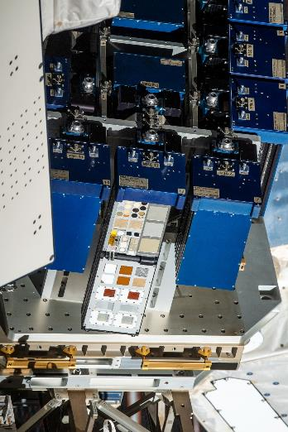
MISSE
Materials on International Space Station Experiment (MISSE) Flight Facility
MISSE-FF is a commercial test platform located on the ISS EXPRESS Logistics Carrier 2.
Operated by Aegis Aerospace with ram, wake, zenith, and nadir faces.
Experiments are robotically deployed for nominally 6 months per mission.
MISSE Sample Carriers are closed during resupply vehicle docking to minimize any contamination and inadvertent atomic oxygen exposure to wake side

Slide 4
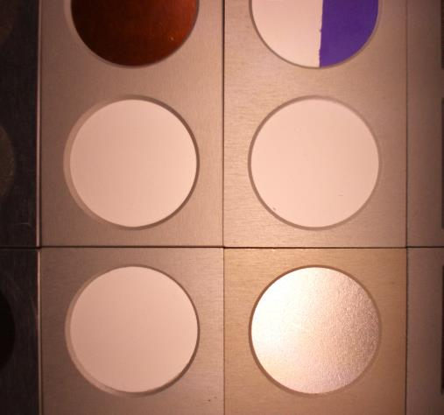
MISSE Exposure
MISSE-FF sample carriers have onboard cameras and monthly scans
MISSE-11 wake side
  April 2019 to Sept. 2020
  760 ESH of UV per diode measurements
MISSE-15 wake side
  Dec. 2021 to July 2022
  Only 57 days of UV data
MISSE-16 wake side
  August 2022 to March 2023
  Also missing UV data sets
Polymer film AZ93/AMJ-700-IBU
AZ93 AZ83
AZ93M AZJ-3700

Slide 5
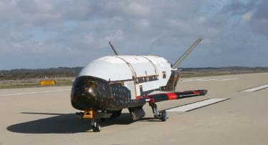
METIS
Materials Exposure and Technology Innovation in Space (METIS)
  Flown in the cargo bay of the Space Force X-37B vehicle
Environmental Exposure for METIS-1
  May 2015 – May 2017
  718 days in orbit
  ~11,488 cycles from -40 to +80 deg C
  ~2,500 equivalent sun-hours of UV
  Disagreement between model and measurement for AO, model is 6 x 10²¹ atoms/cm², measurements of mass loss/gain and thickness loss of polymer films indicate 2 to 3 x 10¹⁹ atoms/cm².
  ~600 Angstroms of contamination, mostly SiOx as determined from optical witness samples

Slide 6
METIS-2
Environmental Exposure for METIS-2
  May 2020 – November 2022
  909 days in orbit
  ~15,544 cycles from -40 to +80 deg C
  ~3,200 equivalent sun-hours of UV
  Mass gain of polymer films obscures atomic oxygen measurements.
  Greater than 1000 Angstroms of contamination, mostly SiOx as determined from optical witness samples

Slide 7
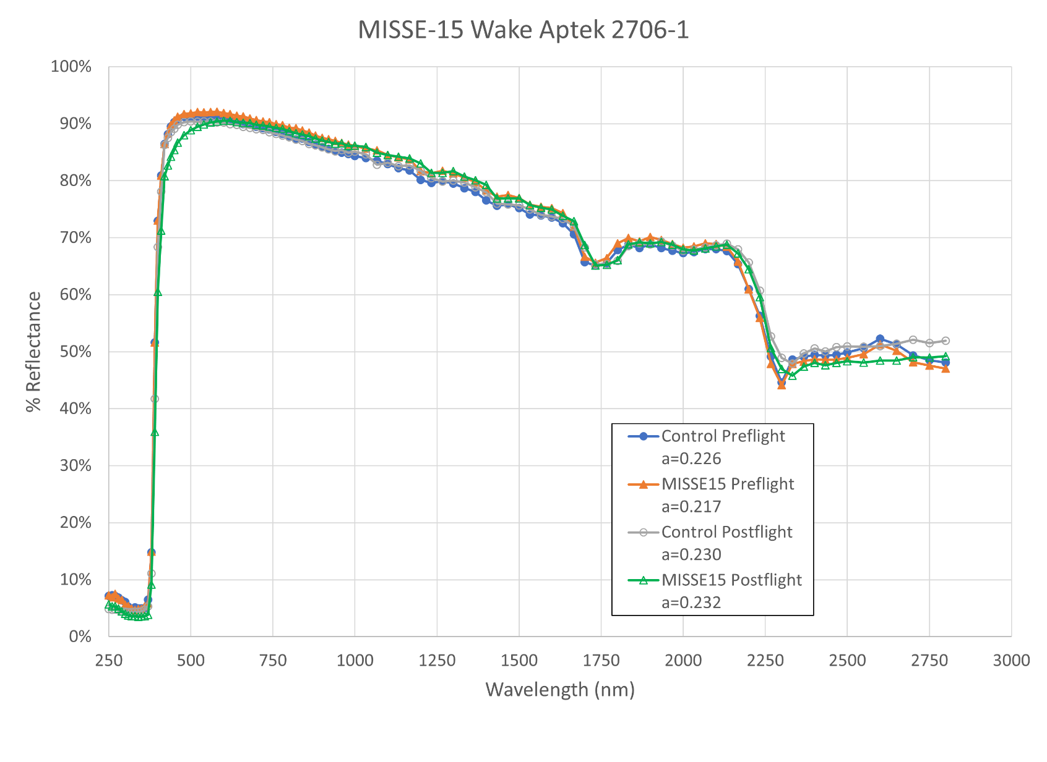
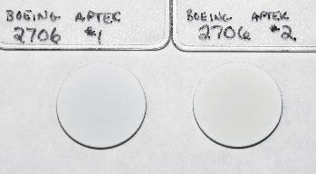
Aptek 2706-1
White silicone electrostatic dissipative coating
Slight yellowing
Selected for MLI blanket on Europa Clipper
Control MISSE-15
“Detailed Design Process of MLI Blankets for the Europa Clipper Mission” Tyler Schmidt et al, ICES-2020-115

Slide 8
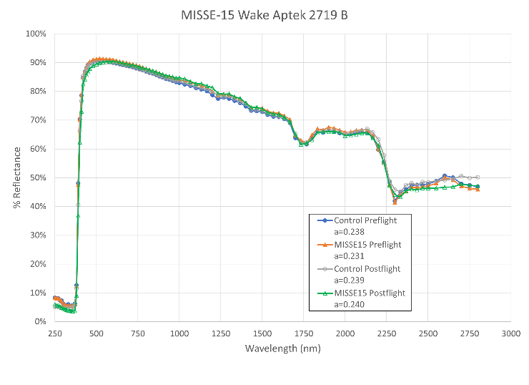
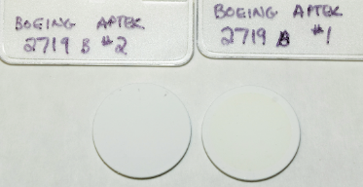
Aptek 2719
White silicone electrostatic dissipative coating
No significant difference in optical properties for exposure on MISSE-15 wake
Control MISSE-15

Slide 9
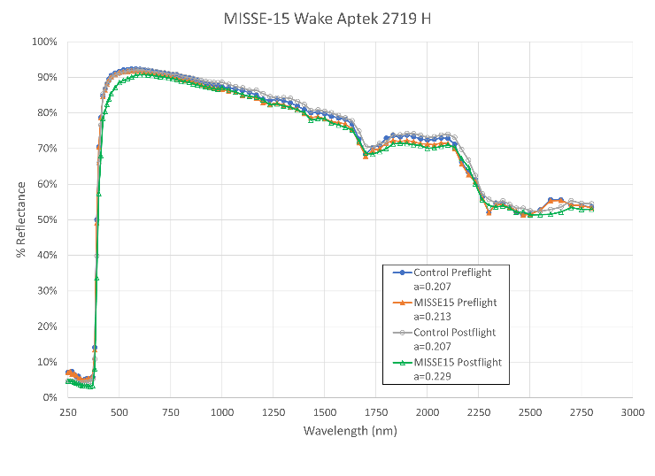
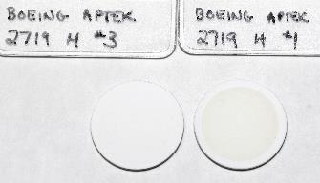
Aptek 2719-HT
Higher temperature version of Aptek 2719
Slight yellowing due to UV exposure on MISSE-15 wake side.
Control MISSE-15

Slide 10
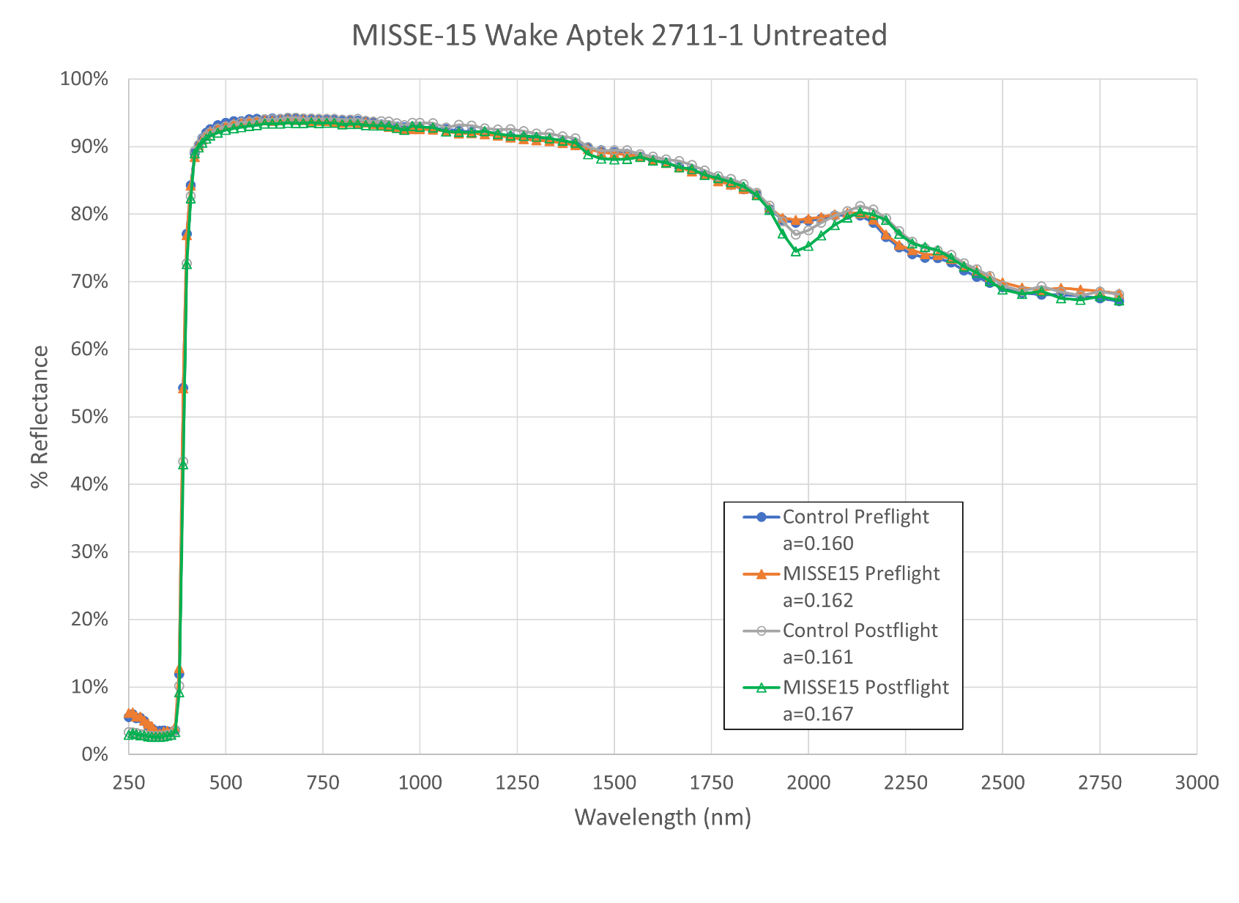
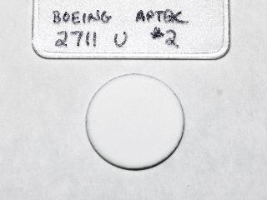
Aptek 2711-1
Inorganic, electrostatic dissipative thermal control coating.
No significant change in optical properties
MISSE-15

Slide 11
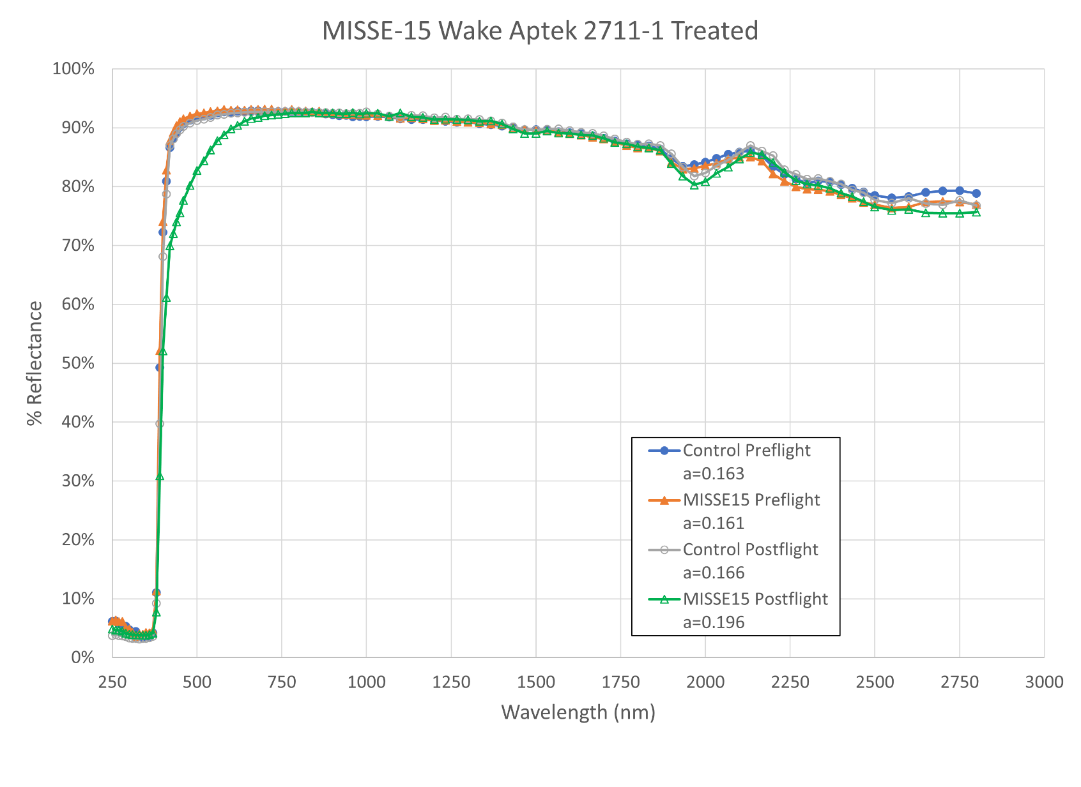
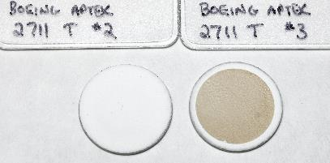
Aptek 2711-1 Treated
Inorganic, electrostatic dissipative thermal control coating
Treated with anti-microbial coating
Darkening on MISSE-15 wake side
Similar darkening observed on MISSE-16 zenith side
Control MISSE-15

Slide 12
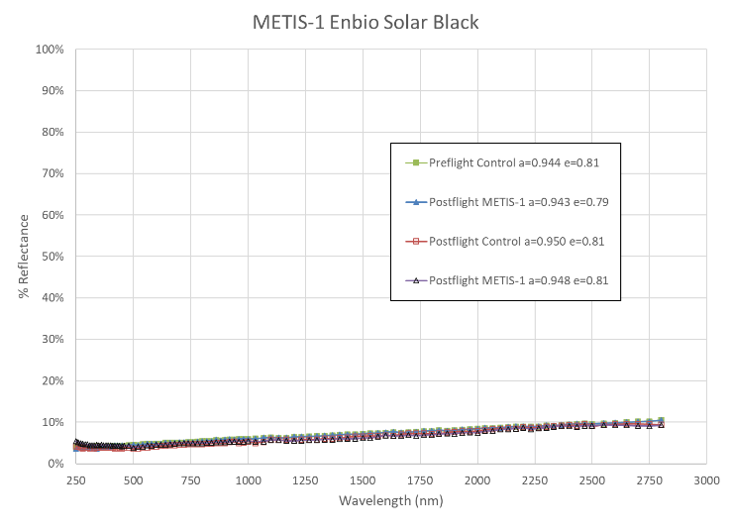
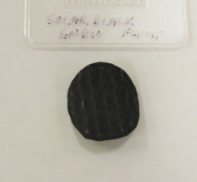
Solar Black
Solar Orbiter heatshield material
Burnt bone coating on titanium foil
Electrically conductive
No observable change
METIS-1
Foil substrate is curled

Slide 13
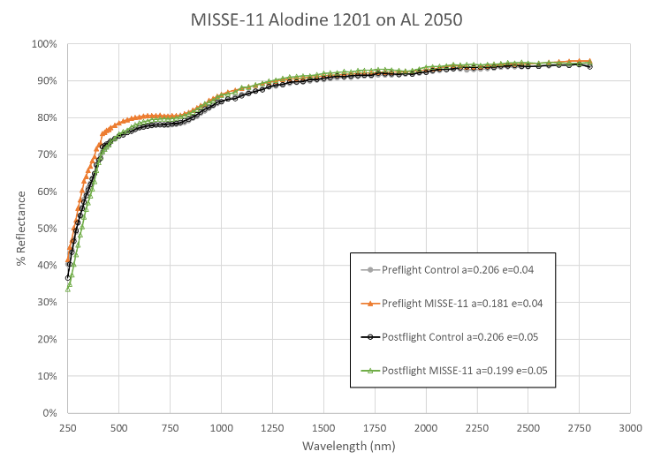
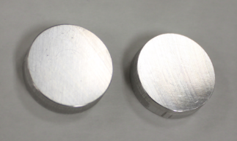
Alodine 1201 on AL 2050
Chemical conversion coating
Chromate free
Aluminum lithium substrate
Slight change in solar absorptance but still very close to control sample
Control MISSE-11

Slide 14
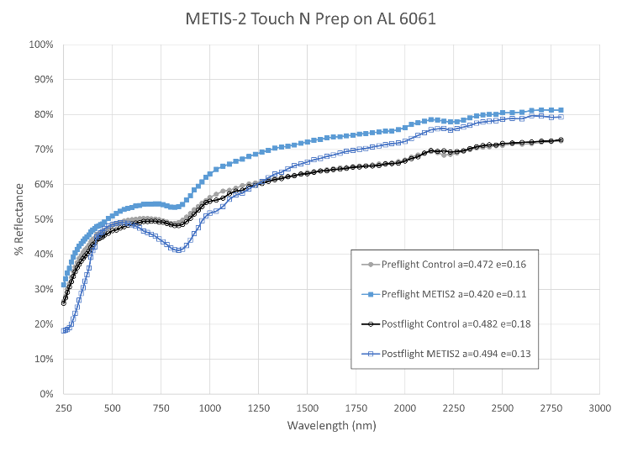
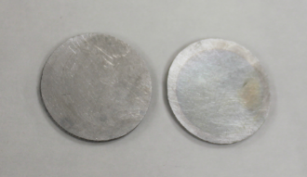
Touch N Prep on 6061
Chemical conversion coating
Bonderite M-CR 871
Chromate free
More affected by the contamination during the METIS-2 flight than the space environment
Control METIS-2

Slide 15
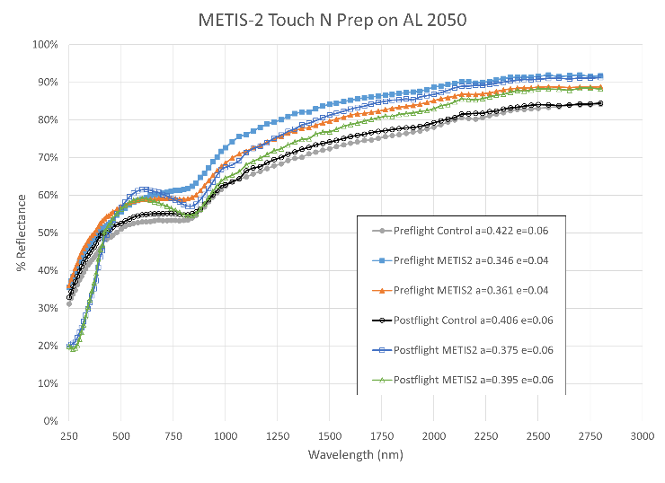
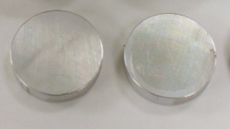
Touch N Prep on 2050
Chemical conversion coating
Bonderite M-CR 871
Chromate free
Applied to aluminum-lithium alloy
More affected by the contamination during the METIS-2 flight than the space environment
Control METIS-2

Slide 16
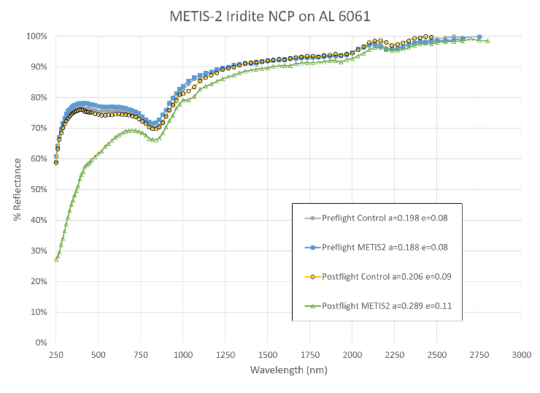
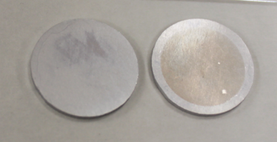
Iridite NCP on 6061
Chemical conversion coating
Chromate free
More affected by the contamination during the METIS-2 flight than the space environment
Control METIS-2

Slide 17
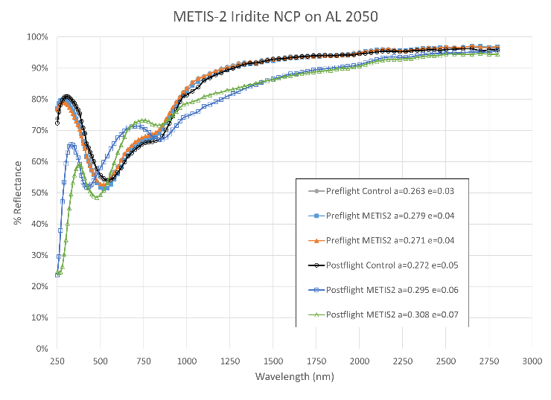
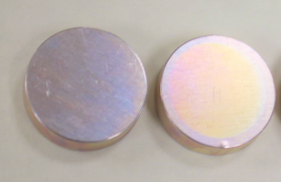
Iridite NCP on 2050
Chemical conversion coating
Chromate free
Applied to aluminum-lithium alloy
More affected by the contamination during the METIS-2 flight than the space environment
Control METIS-2

Slide 18
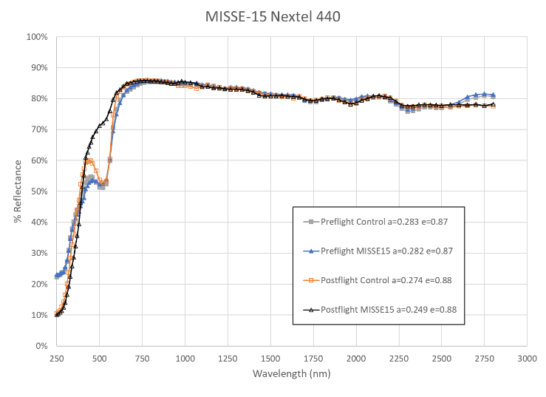
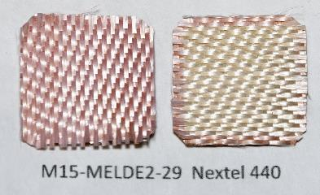
Nextel 440
Ceramic fabric
Pink coating is a boron compound, was bleached by UV radiation
Control MISSE-15 Wake

Slide 19
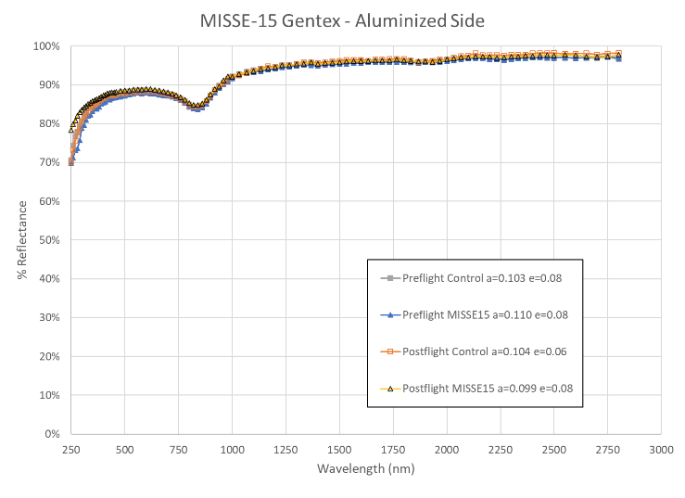
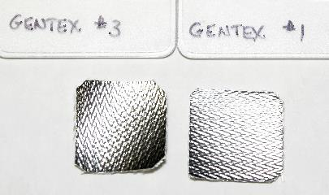
Gentex
Aluminized fiberglass fabric
No visible effect due to MISSE-15 wake exposure
Control MISSE-15

Slide 20
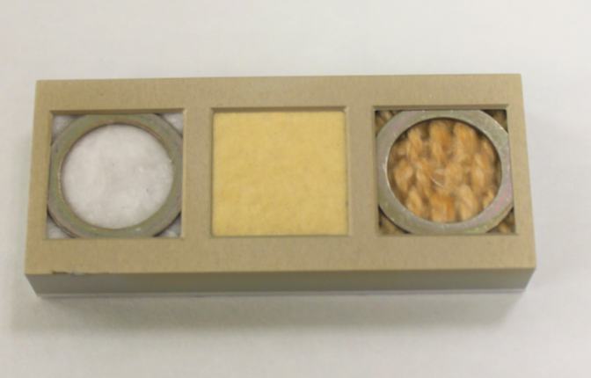
Ceratex
Aluminosilicate material flown on MISSE-11 wake.
Ceratex 3110 cloth and 3170 paper had strong reaction to UV
Ceratex 3180 blanket did not.
MISSE-11 Ceratex 3180 blanket, 3170 paper, 3110 cloth
Washers were to prevent fibers from brushing swing-side samples

Slide 21
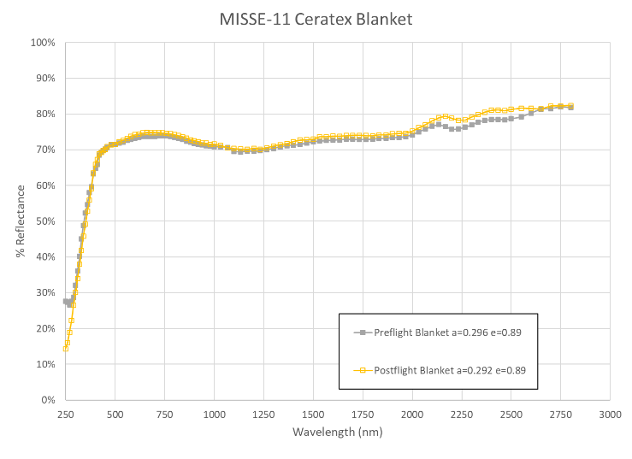
Ceratex

Slide 22
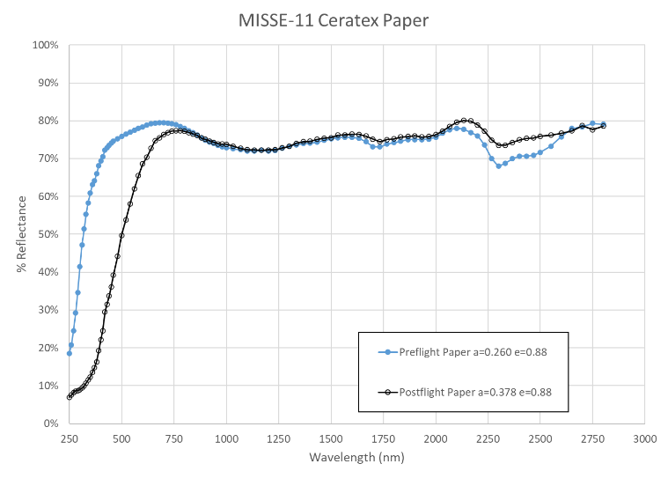
Ceratex

Slide 23
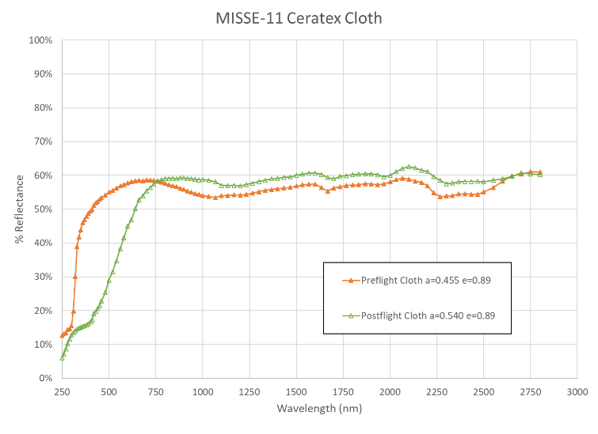
Ceratex

Slide 24
Future Work
Continue analyses of MISSE and METIS samples
Saint Gobain ceased production of beta cloth due to per- and polyfluoroalkyl substance (PFAS) issues.
  Used as outer cover on multi-layer insulation blankets
  Candidate materials flown on MISSE in addition to the Gentex and Nextel:
    Dutch glass cloth
    Ortho
    Vectran
    Nora Dell and Nora LX
    Berlin
    Quartzel veil
    Aptek 2706 over fiber reinforced film
    Aerospace Fabrication & Materials fabric

Slide 25
The authors gratefully acknowledge the following people for providing samples:
Peter Babilo – Boeing
Chip Kopicz – ESSCA
Andrew Brady – Arizona State University
Hisco Products
Dan Moore – TWR Service
Nigel Cobbe – Enbio
Tiffany Lockett – MSFC
Contact info:
Miria Finckenor miria.finckenor@nasa.gov
Meghan Carrico meghan.carrico@nasa.gov

