Slide 1



Artemis IV Docking in Radiation Belt Charging Environment
Matthew McCollum/NASA-MSFC
Emily Willis/NASA-MSFC
Anne Diekmann/Jacobs JSEG
Applied Space Environments Conference
8/9/2023

Slide 2
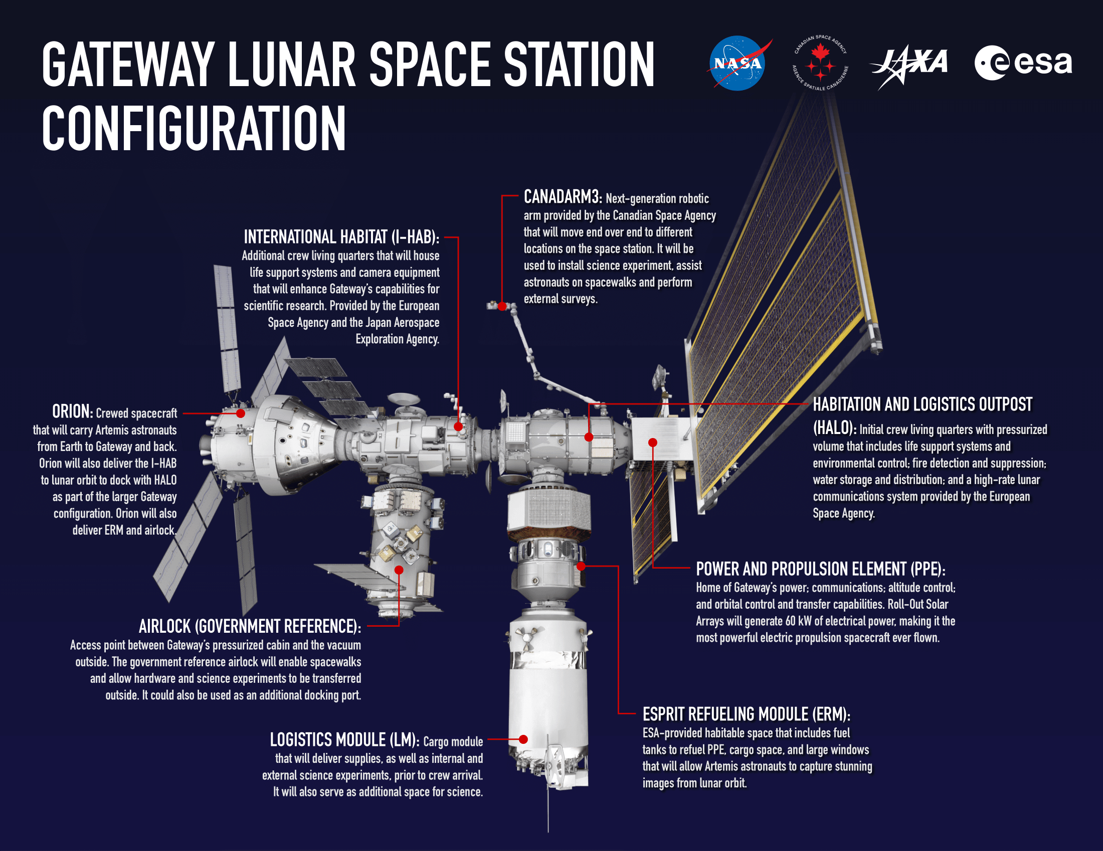
Gateway Overview
Gateway will be a small, human-tended space station in lunar orbit
  Will be built using international and commercial partnerships
The European Space Agency provided International Habitat (I-Hab) will be launched as a co-manifested payload (CPL) on the Space Launch System’s (SLS’s) Artemis IV mission
The I-Hab will dock with the Power and Propulsion Element and Habitation and Logistics Outpost when I-Hab reaches lunar orbit
https://www.nasa.gov/gateway/overview

Slide 3
Concept of Operations
The Orion spacecraft is launched co-manifested with the I-Hab
The Orion spacecraft will act as a tug to take the I-Hab to lunar orbit
  After separation and rotation, Orion will dock with the I-Hab to extract it from the Upper Stage

Slide 4
Orion Docking
Orion separation, rotation, and docking with the I-Hab may occur in high charging environment
  Orion proximity operations time illustrated by black line
During docking, Orion’s NASA Docking System, Block 2 (NDSB2), soft capture system will make first contact with the I-Hab passive docking ring
  The difference in vehicle potentials due to spacecraft charging will create voltage and current transients at first contact
    Currents flowing across the soft capture system as the two vehicles come to equilibrium could cause upset of docking system avionics
Figure 1 from NASA-HDBK-4002B

Slide 5
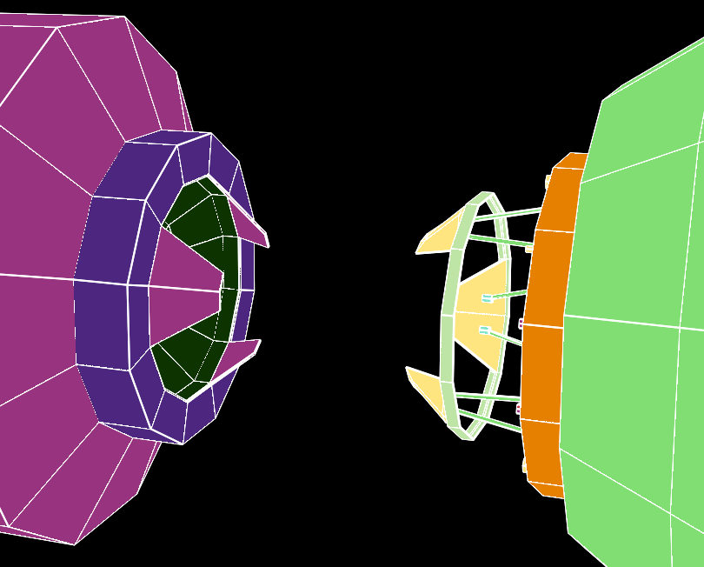
Orion Docking - Impacts
Transients could also upset Orion, SLS’s Exploration Upper Stage (EUS), or
I-Hab avionics unless properly mitigated
The Orion (NDSB2) docking system is potentially vulnerable due to extension of the soft capture ring
  Transient currents would flow on harness shield between the soft capture and hard capture rings
  These transient currents would create common mode voltages in underlying conductors potentially causing interference

Slide 6
Analysis
EUS, I-Hab, Orion docking modeled using NASCAP-2k
  NASCAP-2k developed jointly by NASA and USAF Research Laboratory
  NASCAP-2k model uses the geosynchronous environment definition of SLS-SPEC-159, Design Specification for Natural Environments
NASCAP-2k inputs (surface materials, dimensions, configurations, etc) provided by SLS, I-Hab, NDSB2, and Orion
  Model shown next page
Due to NASCAP-2k limitations, analysis limited to vehicles separated by 0.5 m
  As vehicles approach closer than 0.5 m, each will influence the charging of the other
  However, this is difficult to estimate
Vehicle potentials and vehicle capacitance (stored charge) used in electrical circuit analysis to calculate transient currents flowing from the docking system soft capture ring to the hard capture ring

Slide 7
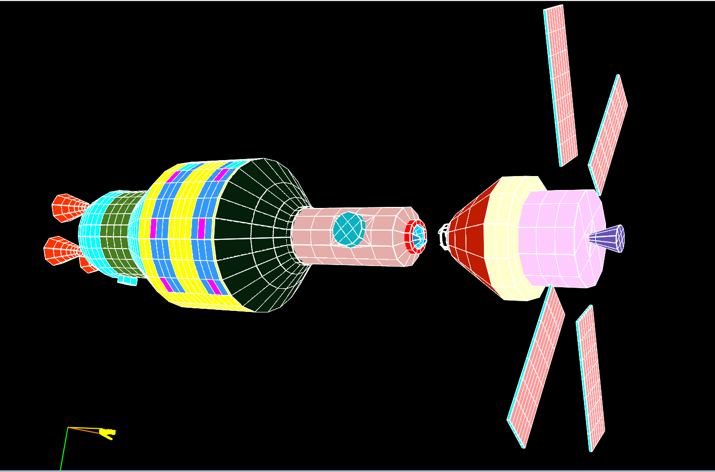
NASCAP-2k Model
EUS
I-Hab
Orion
I-Hab Passive Docking System
NDSB2

Slide 8
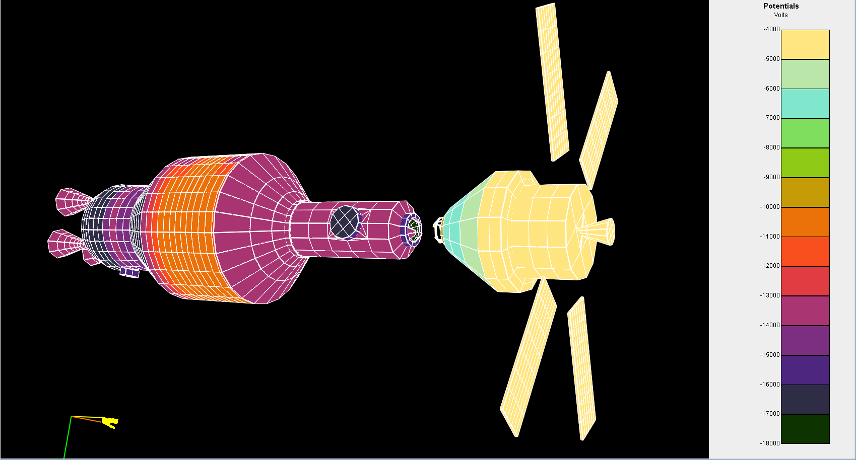
NASCAP-2k Results
The chassis voltage of the EUS/I-Hab is -13, 380 V
  Vehicle capacitance is ~700 pF
The chassis voltage of Orion is -4026 Volts resulting in a difference between the vehicles of 9, 354 Volts
  Vehicle capacitance is ~ 520 pF

Slide 9
Electrical Transient Simulation Model
Vehicle to Vehicle Capacitance
Orion
Representative electrical model treats vehicles as capacitors with stored charge
Switch mimics first contact and resistors on either side of switch mimic resistivity of first contact surface coatings
CPL
Switch
Harnesses
Soft Capture Ring
Linear Actuators

Slide 10
Electrical Transient Simulation Model - Limitations
CPL
Orion
Electrical model is a static model and is believed to be a reasonable worst-case approximation
  CPL/EUS modeled as lump element
  CPL-to-EUS bonding may affect electrical model
The slow vehicle approach (believed to be less than 0.3 m/s) could result in vehicle proximity influencing charging of the other vehicle
  Vehicle to vehicle potential may be lower
Harnesses
Soft Capture Ring
Vehicle to Vehicle Capacitance
Linear Actuators

Slide 11
Electrical Transient Simulation Model – Limitations (continued)
CPL
Orion
During approach, the vehicle-to-vehicle capacitance will increase
  Larger vehicle to vehicle capacitance results in lower first contact transient currents
As the vehicles approach, it is possible that at short ranges, the electric field between the two vehicles could stimulate electron emissions from the nonconductive surfaces (arcing) prior to docking that would reduce vehicle to vehicle potential prior to first contact
  While this is possible, studies performed at Lawrence Livermore indicate coatings used are less likely to have high current density arcs in vacuum at field strengths below 1 MV/cm
Harnesses
Soft Capture Ring
Vehicle to Vehicle Capacitance
Linear Actuators

Slide 12
Electrical Transient Simulation Model – Limitations (continued)
CPL
Orion
NDSB2 and I-Hab first contact surfaces (petals) have non-conductive coatings
Assuming breakdown, peak current across the interface is limited only by the contact resistance
  Non-conductive coating breakdown voltage less than vehicle-to-vehicle potential
Surface coating breakdown behavior unknown for high temperature low density plasma
  Testing planned to determine breakdown characteristics and contact resistance after breakdown
Harnesses
Soft Capture Ring
Vehicle to Vehicle Capacitance
Linear Actuators

Slide 13
Electrical Transient Simulation Model – Limitations (continued)
Vehicle to Vehicle Capacitance
Orion
Assuming low contact resistance, the peak current could be quite high
Current flow from Orion to CPL could be over 1 kA
  Transient duration is ~ 10 ns
CPL
Harnesses
Soft Capture Ring
Linear Actuators

Slide 14
Electrical Transient Simulation Model – Limitations (continued)
Vehicle to Vehicle Capacitance
Orion
Current transient on Soft Capture Ring-to-Hard Capture Ring harness shields is:
CPL
Harnesses
Soft Capture Ring
Linear Actuators

Slide 15
Demonstrating Immunity to Transient Events
MIL-STD-461 G conducted immunity tests may be sufficient to demonstrate immunity to docking transients
  CS115 is an impulse excitation injected on interconnecting harnesses
  CS116 is a damped sinusoidal transient injected on interconnecting harnesses
  CS118 is a personnel borne electrostatic discharge (ESD) test
    Useful to demonstrate immunity to voltage transients
  If materials testing indicates contact resistances after breakdown are high (> 10 ohms), these tests are sufficient to demonstrate immunity to docking transient events

Slide 16
Demonstrating Immunity to Transient Events – Modified Tests
If materials testing indicates contact resistances after breakdown are low (<10 ohms), other test methods are needed to demonstrate immunity to docking transient events
  Possible candidates from modification include:
    MIL-STD-1541A Arc Discharge Test
    MIL-STD-331 Helicopter-borne ESD

Slide 17
Summary
Orion docking with co-manifested I-Hab may result in high vehicle-to-vehicle potentials
  Docking may occur in radiation belt environment
Resulting voltage/current transients are dependent on surface coating behavior
  Materials testing is required to determine contact resistance after breakdown
  Contact resistance after breakdown determines peak transient current magnitudes
Standard transient immunity test methods may be feasible if materials testing shows high contact resistance after breakdown
Low contact resistance after breakdown will require modification of existing test methods to demonstrate voltage/current transient immunity

