Slide 1
Plume-surface interaction testing for crewed lunar lander risk reduction
Wesley A. Chambers, Ph.D.
Marshall Space Flight Center
Ashley M. Korzun, Ph.D.
Langley Research Center

Slide 2
Introduction
  Rocket Plume-Surface Interaction (PSI) is a complex, multi-discipline problem that describes the lander environment due to the impingement of rocket exhaust onto the regolith of planetary bodies
spacecraft rocket exhaust interacting with unimproved planetary surfaces
plume-surface interaction
fluid-granular physics
2

Slide 3
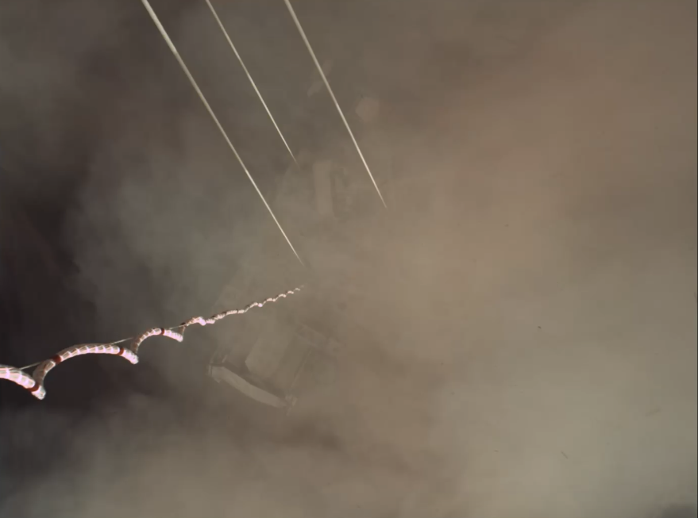
Risks Posed to Landers by PSI
All propulsive landers experience PSI
An understanding of plume-surface interaction physics enables the ability to:
  Conduct successful near-surface operations
  Mitigate surface alteration
  Mitigate effects to surrounding assets
Near total obscuration of Perseverance rover during touchdown with high velocity particulates and debris
Image Credit: NASA, JPL
Panorama with MSL plume impingement craters
3

Slide 4
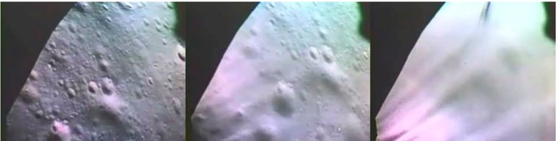
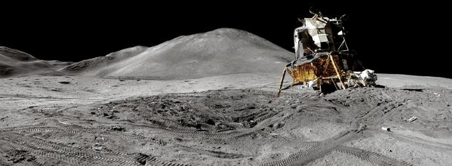
Risks Posed by PSI to Landers
  “We’ve never lost a lander to PSI [yet]” is not an acceptable risk posture
Visual Obscuration During Apollo 16 Landing (Metzger, 2010)
  Visual and sensor obscuration / degraded performance
  Vehicle stability and tilt
  Localized augmentation of heating, pressure
  Abrasion damage, debris/ejecta
11-deg Tilt on Apollo 15 Lander (NASA)
Apollo flight experience cannot be extrapolated to lunar Human Landing Systems (HLS) for PSI → new data and modeling required
4

Slide 5
Reducing Risk from PSI
  “Three-Legged Stool”
Modeling & Simulation
Experimental Data
Flight Data
Fills in testing and data gaps
Ground truth
Limited opportunities, data
Varying levels of fidelity
Better control, instrumentation
Large uncertainty, current tools need quantitative validation
5

Slide 6
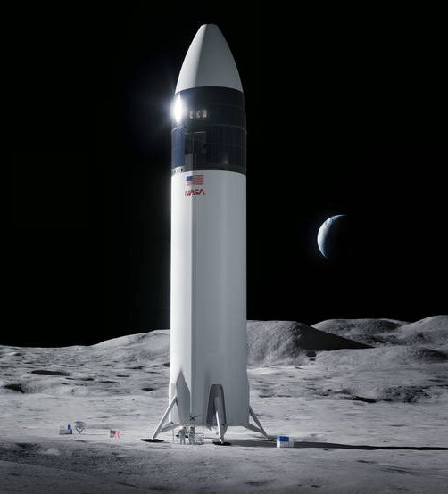
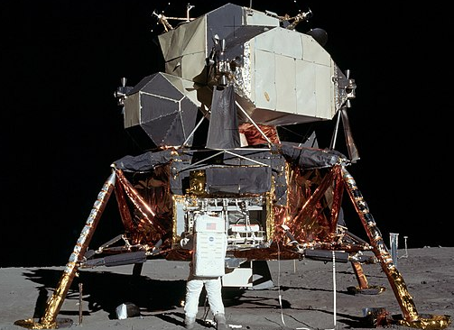
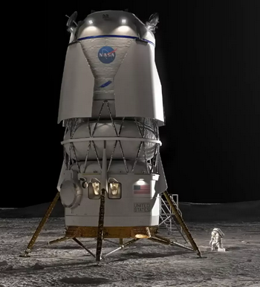
Moving Beyond Apollo
NASA’s Human Landing System (HLS) will take astronauts to the lunar surface using commercial vehicles from SpaceX and Blue Origin as part of the Artemis program
Each vehicle is considerably larger and uses a different concept of operations than that from Apollo
SpaceX
Apollo
Blue Origin
Apollo
HLS Lander Concepts
6

Slide 7
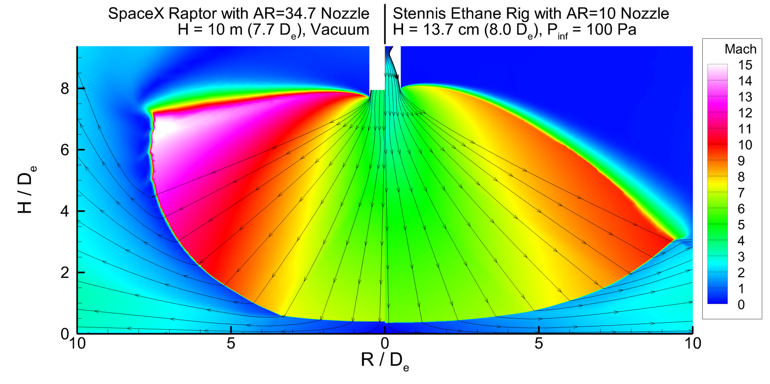
PSI Test Concept for HLS Risk Reduction
Objective: To reduce risk to the HLS lander(s) through acquisition of lunar-relevant ground test data to quantify and reduce uncertainty in PSI predictions through improvements to and validation of modeling capabilities
Target scaled flight conditions and an Apollo condition
Parameters:
  Nozzle height above regolith
  Plume total pressure
  Plume mass flow rate
Target 30 runs per propulsion type:
  Inert Ethane: June – Sept 2024
  Hybrid Motor: Jan – Apr 2025
Nozzle
Reduced Atmosphere Environment
Highly
Under-Expanded Plume
Lunar Regolith Simulant Bed
7

Slide 8
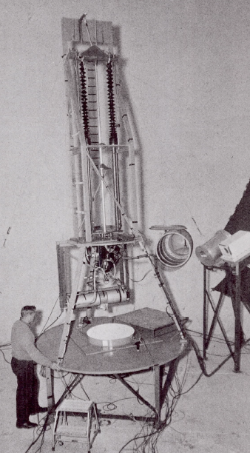
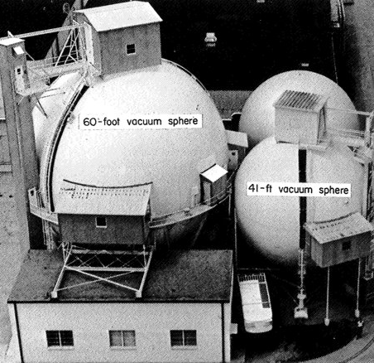
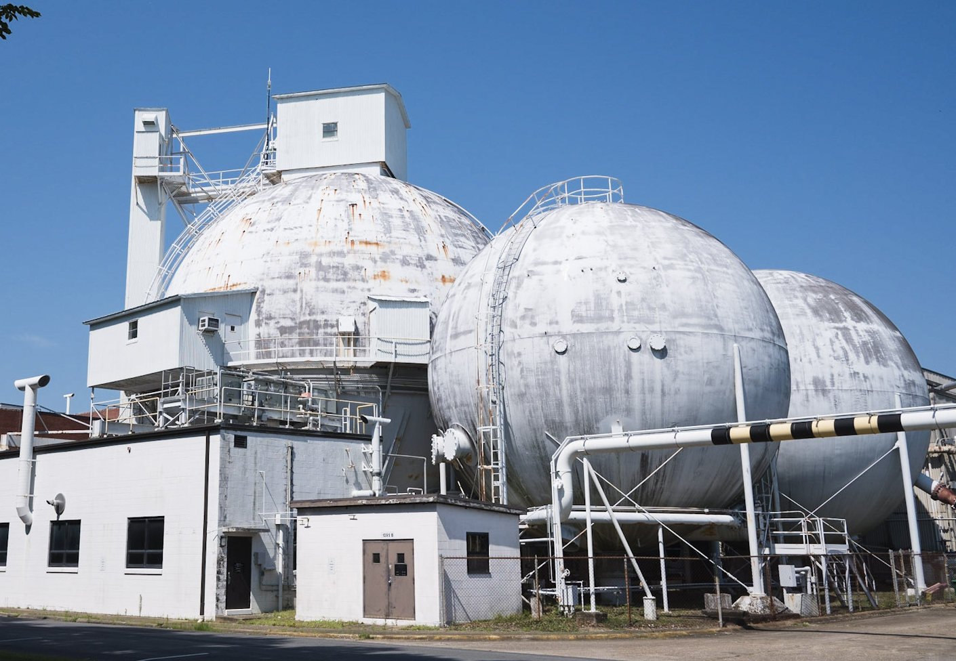
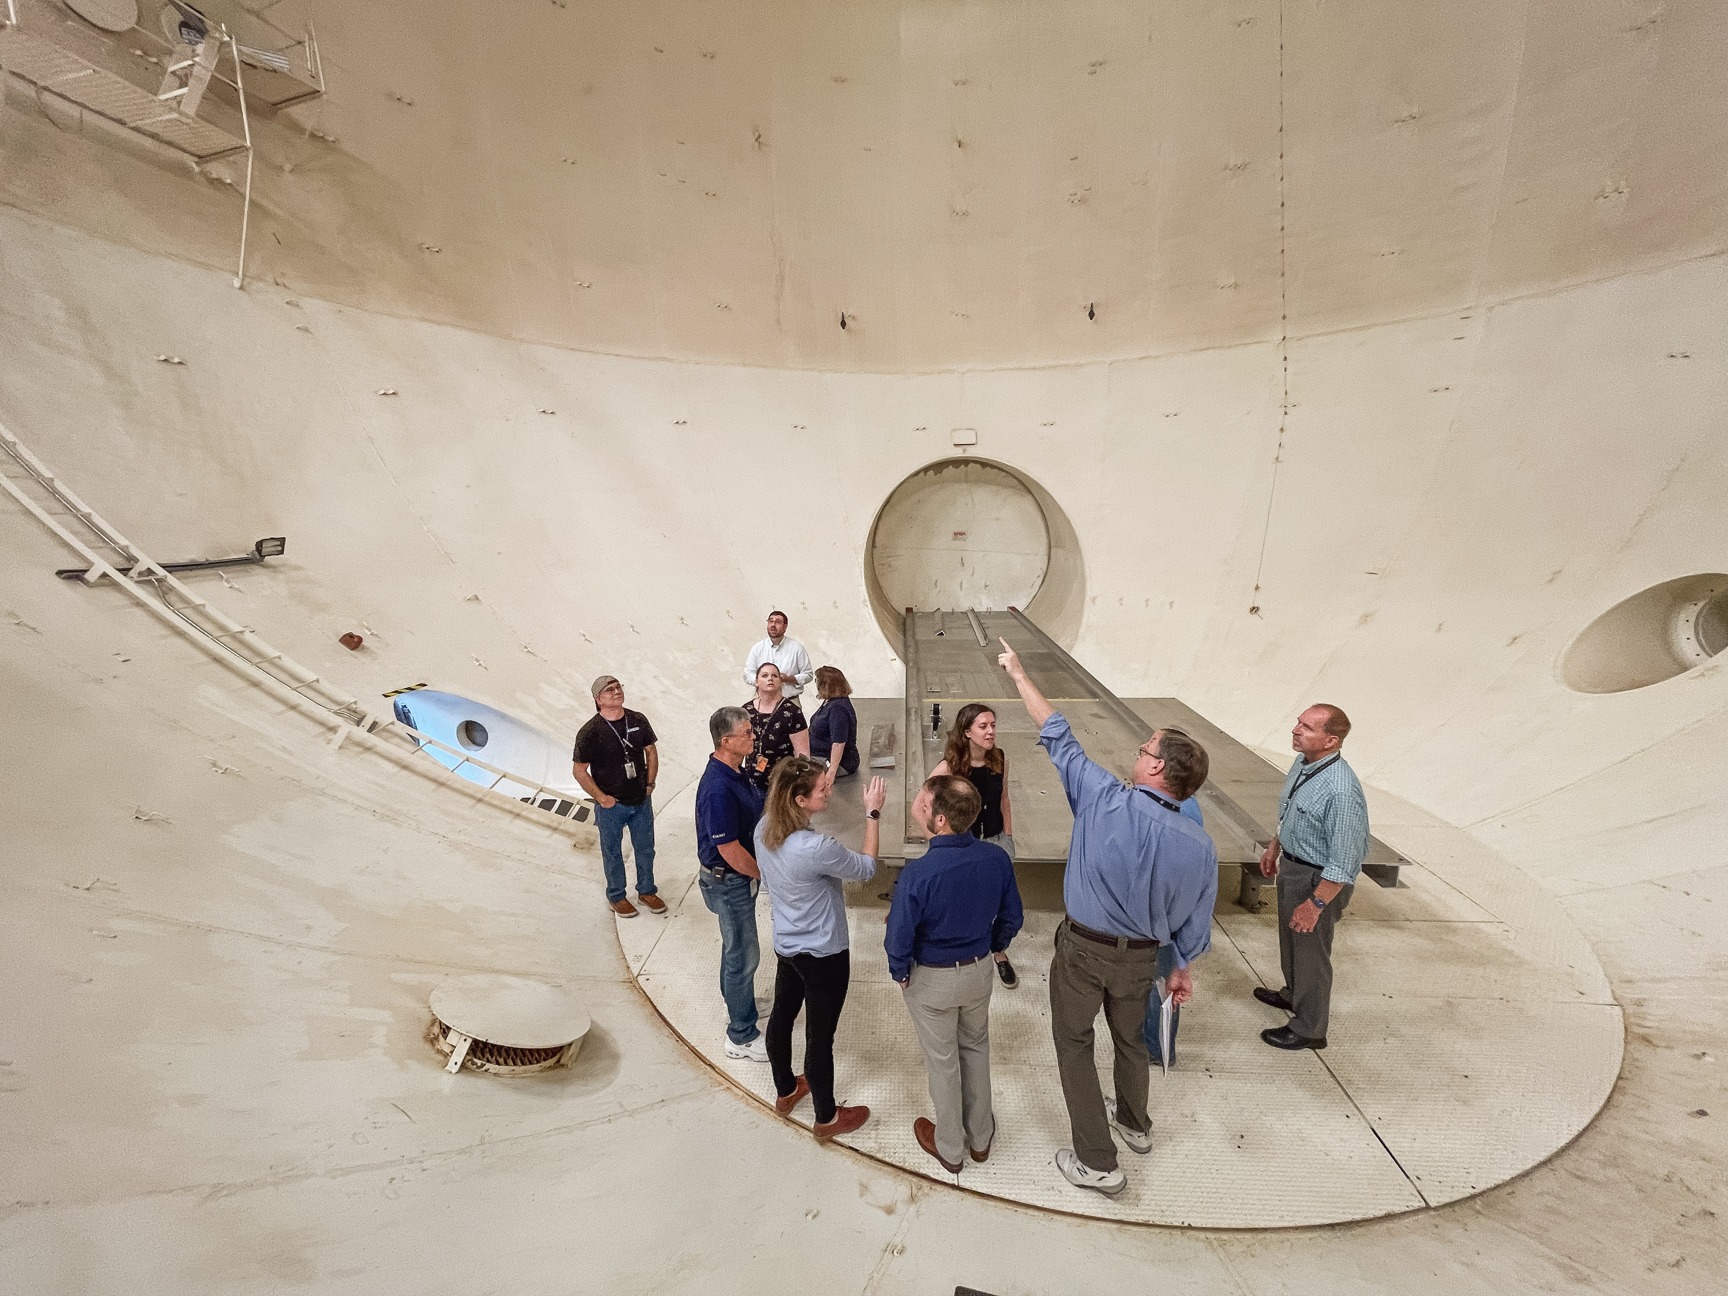
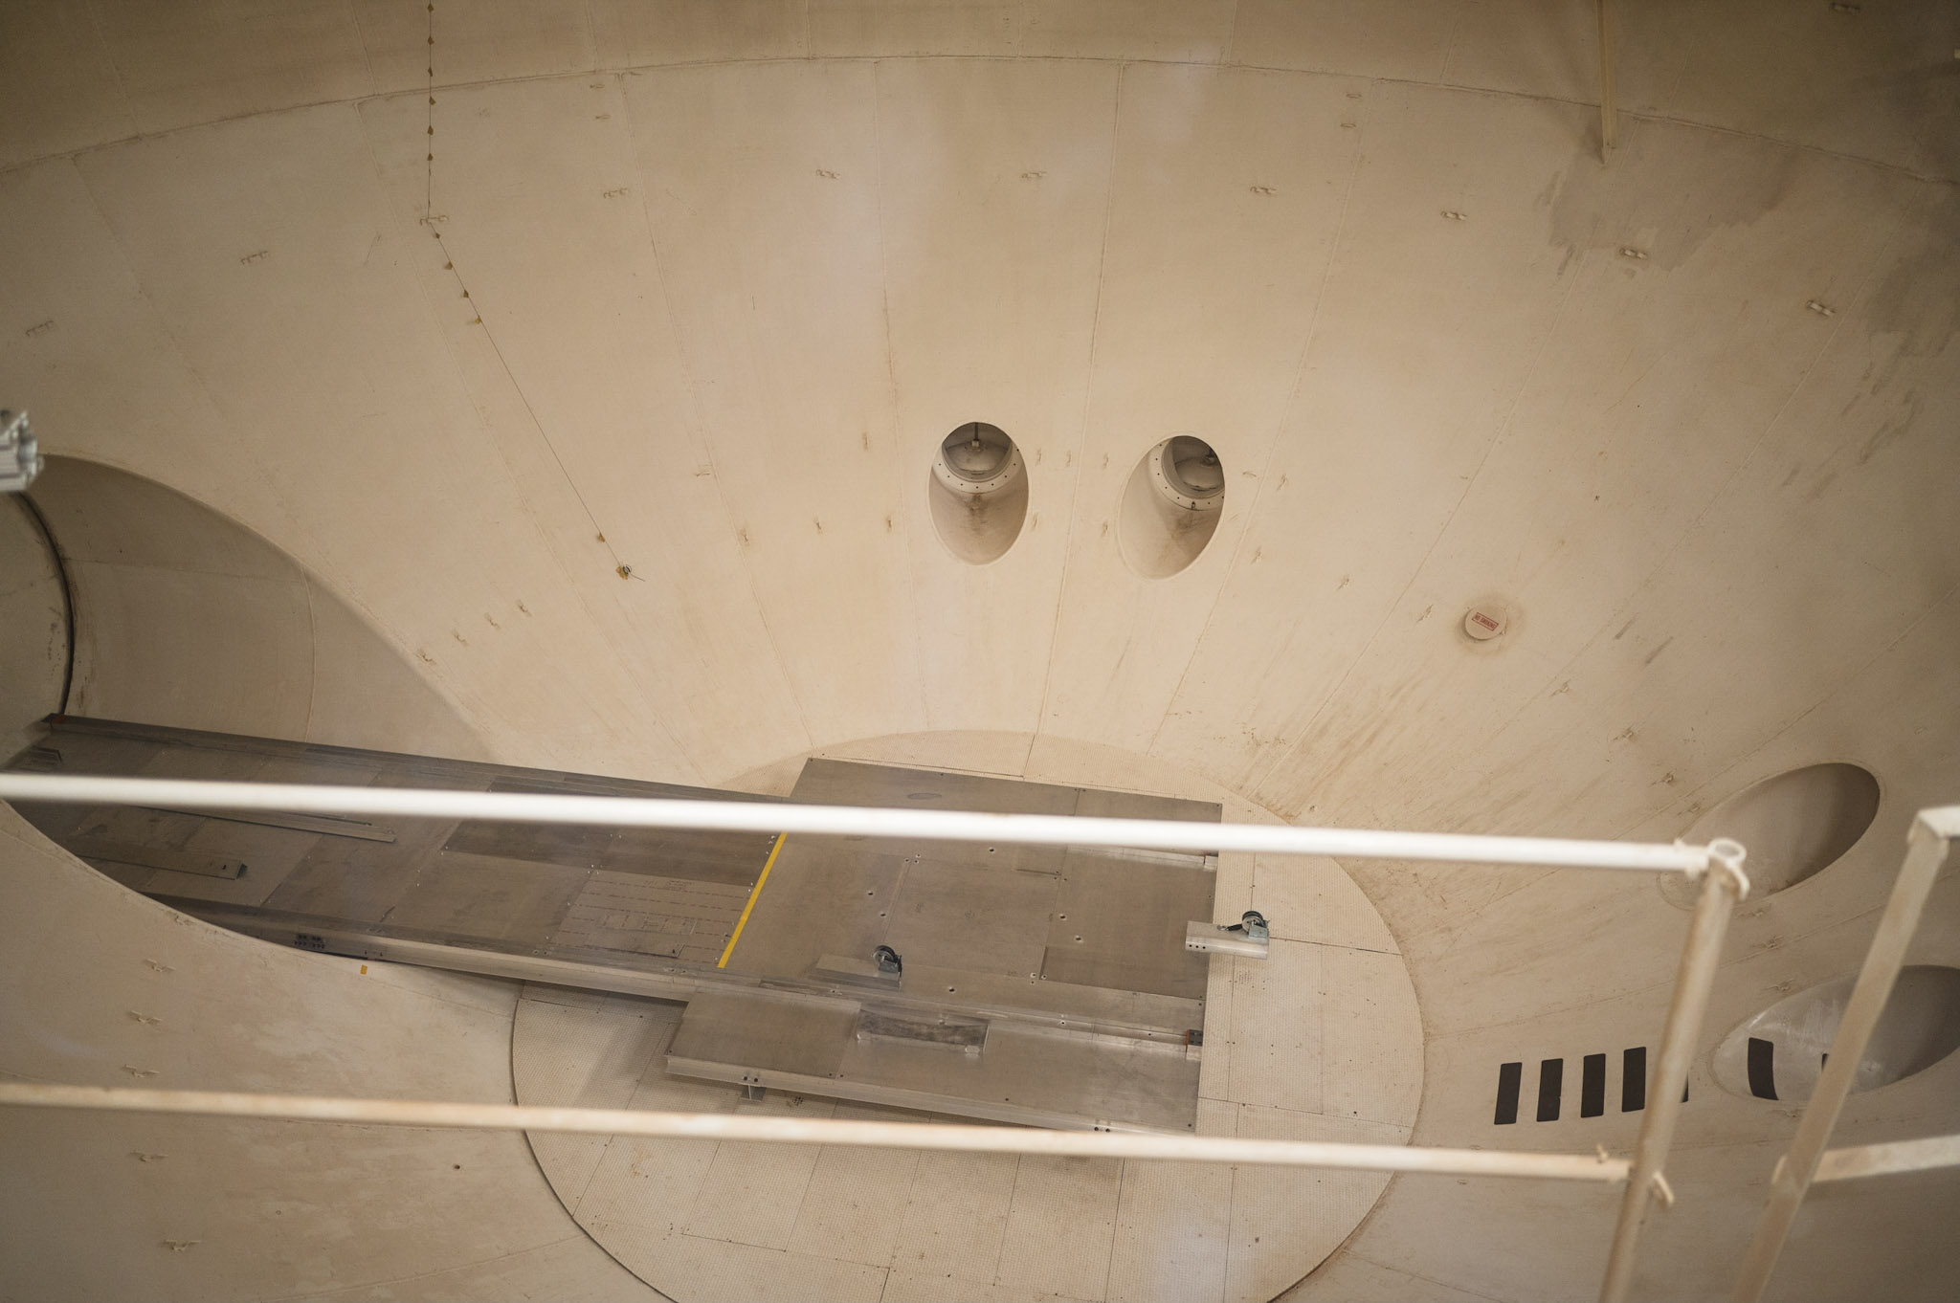
Vacuum Test Facility
60-ft vacuum sphere at NASA Langley Research Center
Historically used to test PSI for Apollo and Viking
Provides very large volume to minimize ambient pressure rise during PSI testing
Target test condition (facility capability): 0.75 Torr (100 Pa)
60-ft Vacuum Sphere (NASA LaRC)
8

Slide 9
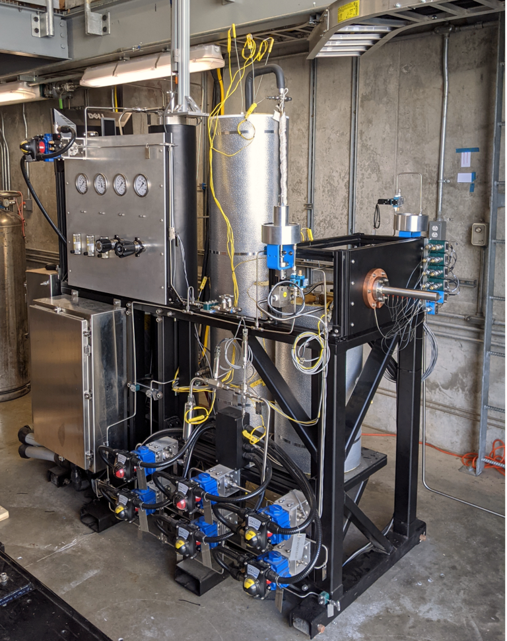
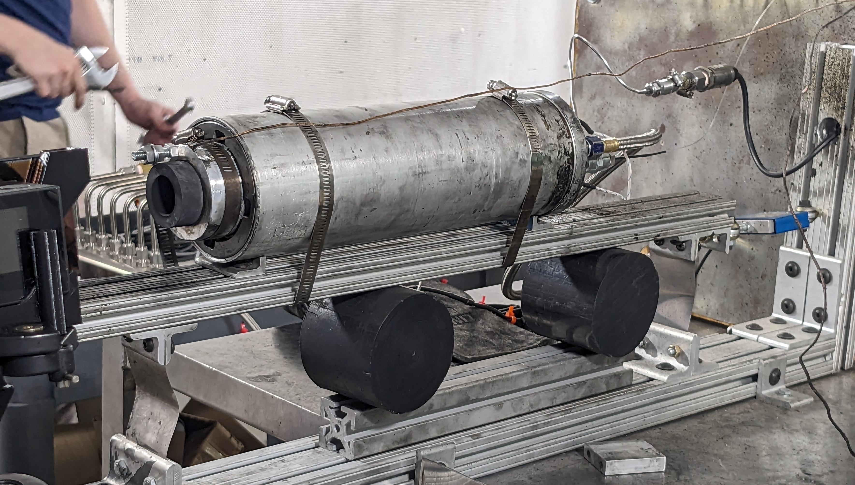
Propulsion Elements – Rocket Plume Simulant
Highly under-expanded exhaust plume matching absolute peak and radially scaled distributions for surface impingement pressure and shear
Firing durations: 4-6 seconds per test run
PSI testing using two separate propulsion elements
  Inert, heated ethane plume (Purdue Univ.)
  GOX/ABS hybrid rocket motor (Utah State Univ.)
  Thrust < 50 lb_{f}
Portable Ethane Cart (NASA SSC / Purdue)
98 mm GOX/ABS Hybrid Motor (Utah State)
9

Slide 10
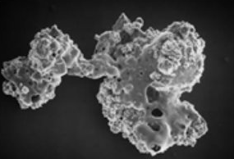
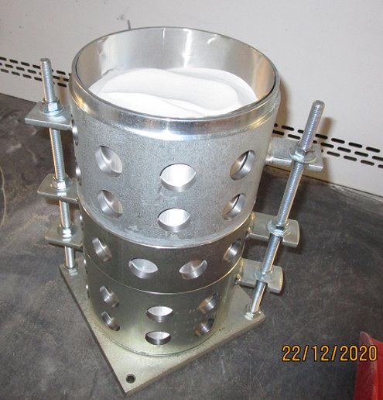
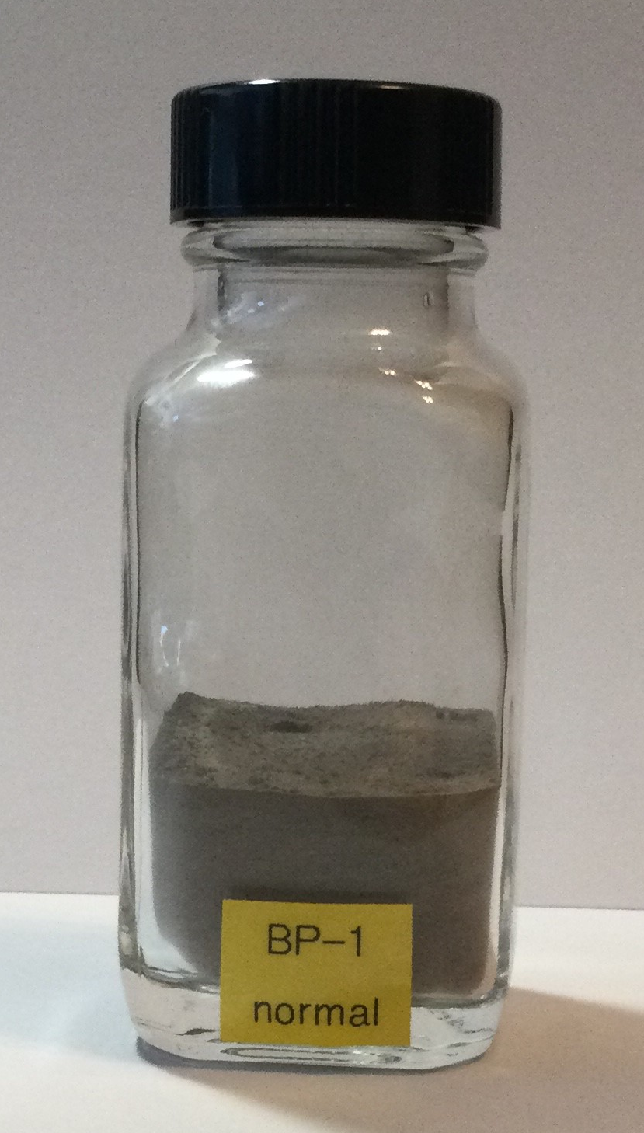
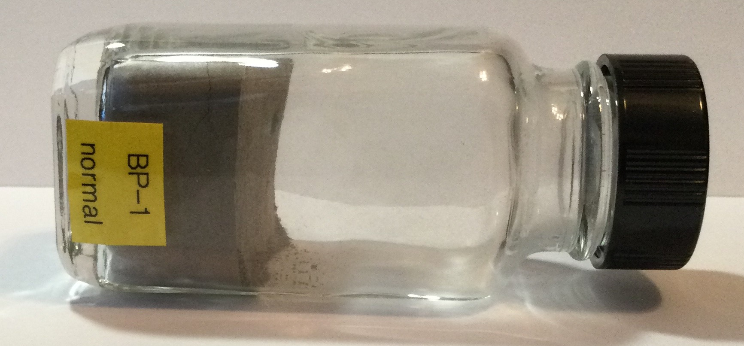
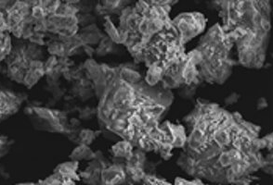
Lunar Regolith Simulant
BP-1 crushed basalt lunar regolith simulant with similar geotechnical properties to HLS landing sites at the lunar South Pole
Handling, preparation, and hardware design requires drying, venting, PPE, and specialized procedures for use
Apollo 11
Cohesiveness of BP-1 (NASA KSC)
Vented Prototype Regolith Bin Design (NASA KSC)
BP-1
10

Slide 11
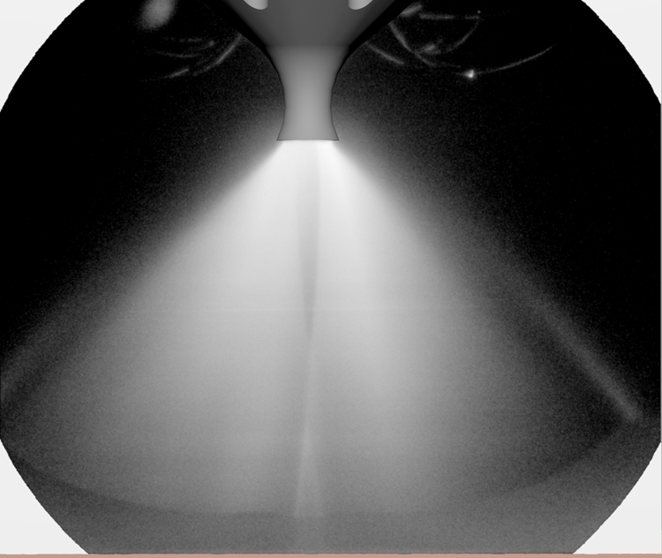
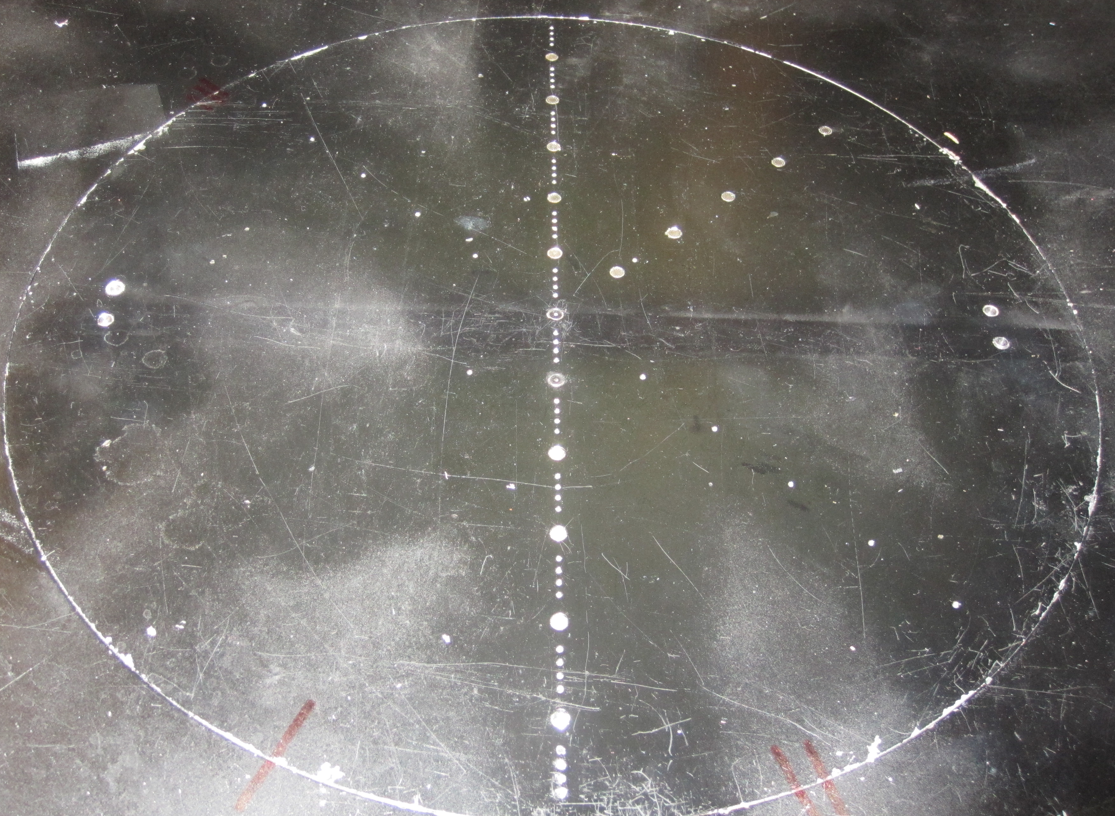
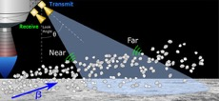
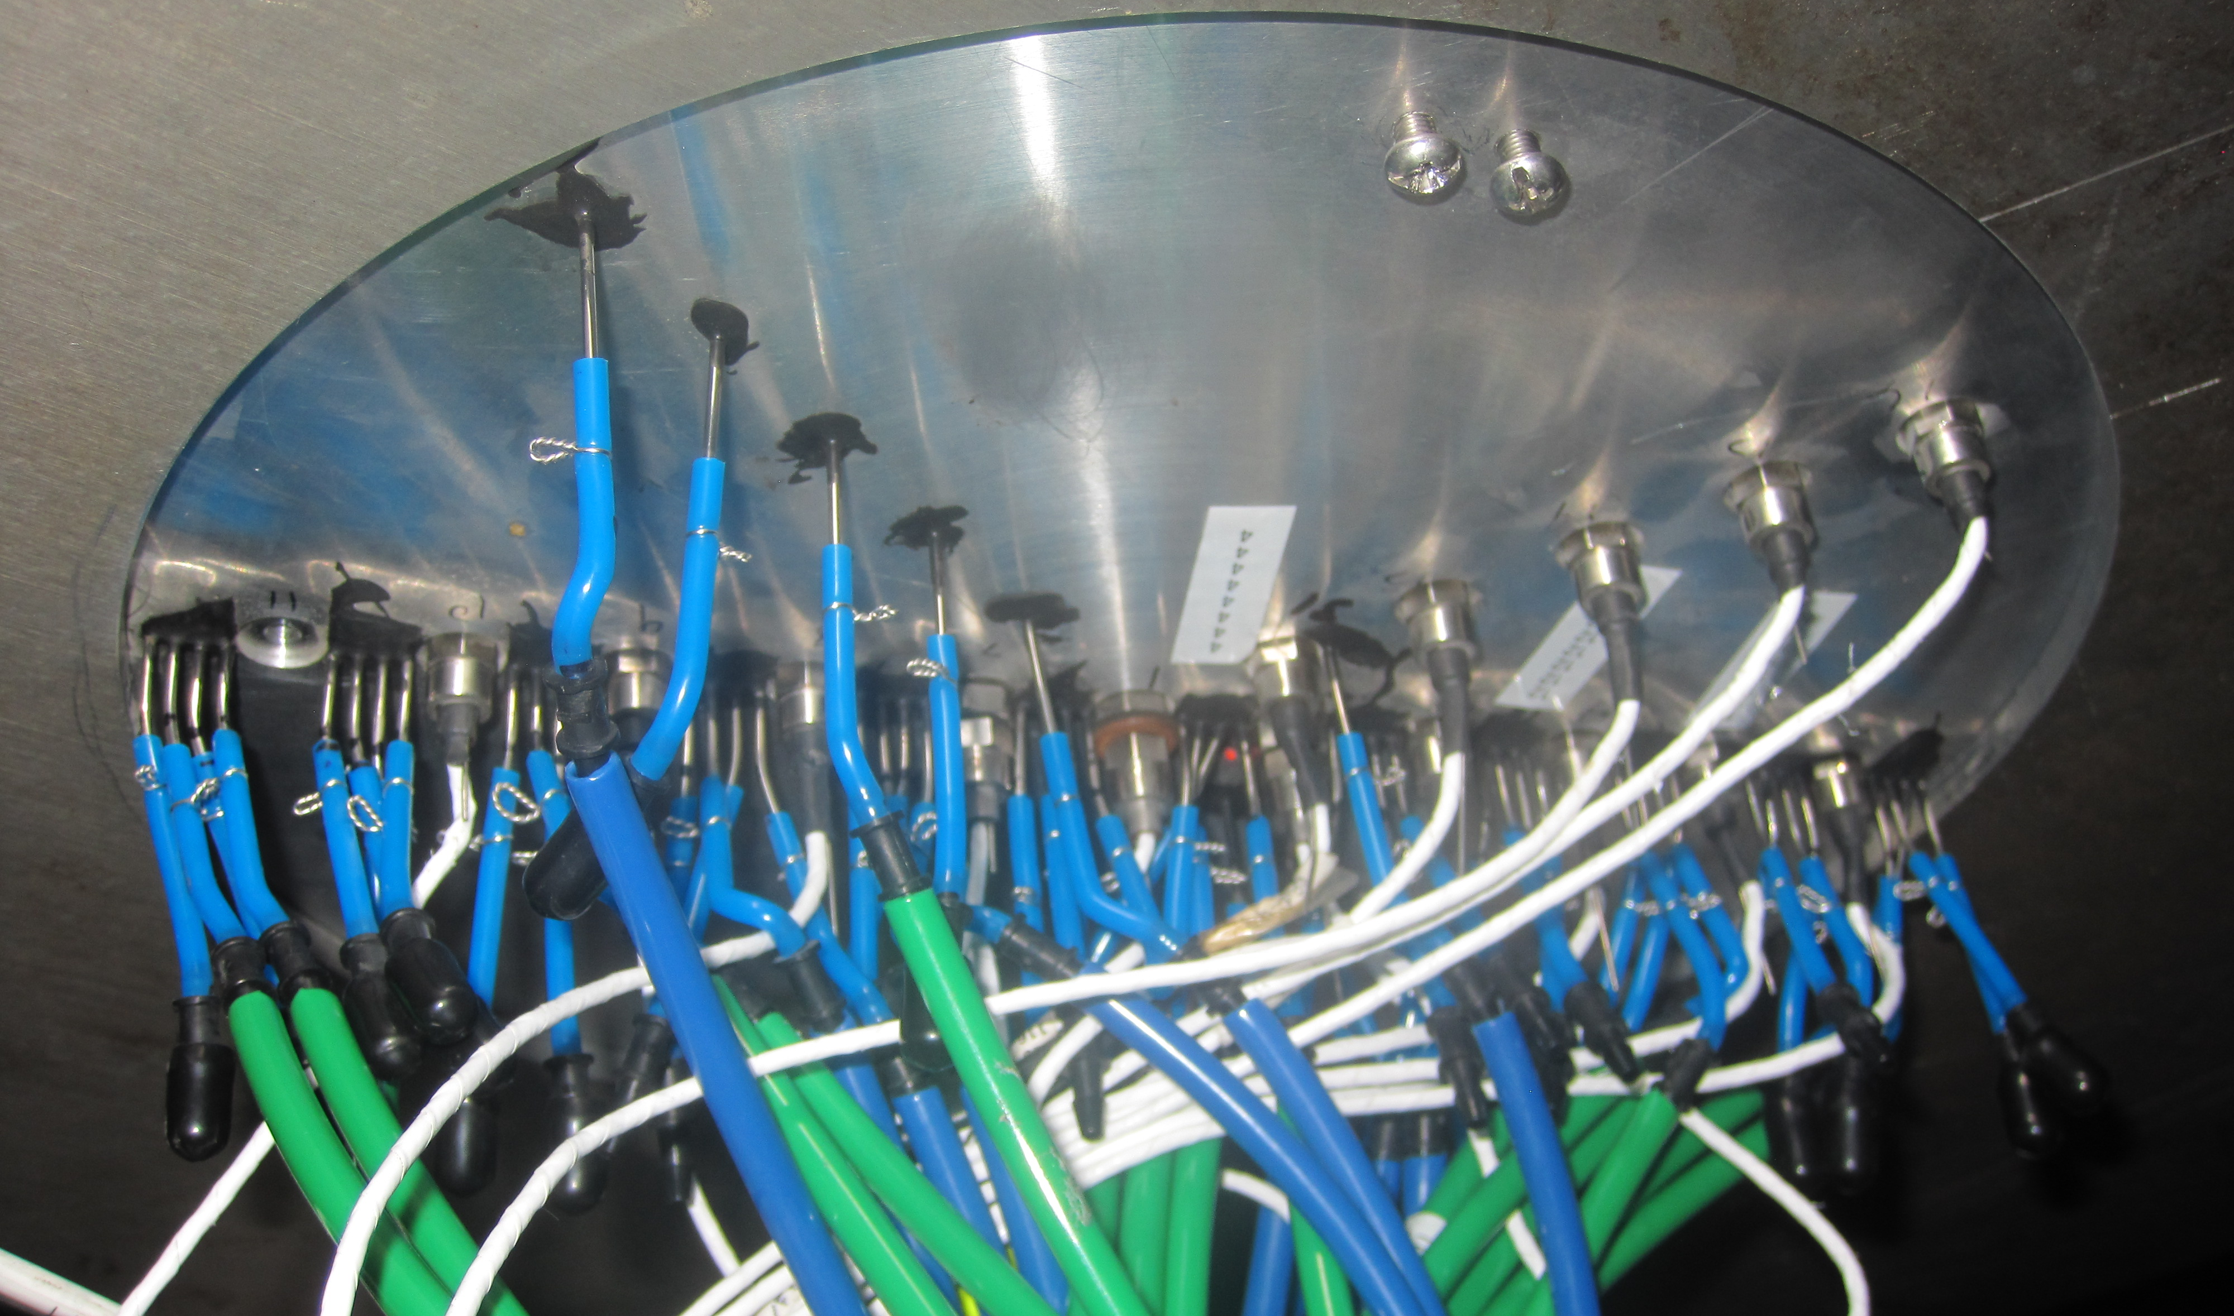
Instrumentation and Diagnostics
Primary
Secondary
Capture erosion onset; transient and final surfaces in 3D
Ejecta energy measurements at discrete locations
Direct measurement of facility and propulsion conditions
Direct quantitative verification of plume impingement conditions (pressure, shear)
Plume flow visualization and characterization
mm-Wave Doppler Radar (NASA KSC)
PLIF Plume Flow Visualization
(NASA LaRC)
SCALPSS (NASA LaRC)
Instrumented Impingement Plate (NASA LaRC/MSFC)
*Will also have passively collected data for dust (witness plates, coupons and mechanisms with special coatings)
11

Slide 12
Data Use for Risk Reduction
Are we outside Apollo-informed experience?
Rapid Modeling
Erosion-rate based, test-derived rapid methods
One-Way / Loosely Coupled Models
CFD inputs to physics-based/engineering models
Two-Way Coupled Models
Data products used to validate high-fidelity models
Qualitative Comparison
12

Slide 13
Summary
PSI poses risks to all propulsive landers, as well as nearby surface assets and infrastructure
PSI testing will reduce risk to HLS lunar landers operating outside of environments and experience from Apollo
Targeted PSI testing of this type was last conducted using vacuum facilities for the Apollo and Viking programs
13

