Slide 1
Navigation Sensor Technology Assessment Capability for Data-Driven Systems Analysis
October 2023
Esther Lee, Paul V. Tartabini, Brett R. Starr, Paul D. Friz, Christopher D. Karlgaard, and Jamshid Samareh
NASA Langley Research Center

Slide 2
Outline
Motivation
Method
  Technology Survey
  Simulation Model Overview
Approach
Selected Results
Key Takeaways
Future Work

Slide 3
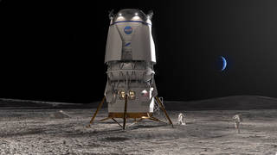
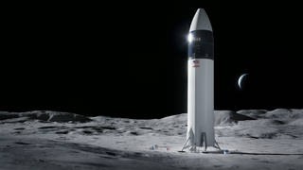
Motivation
NASA is planning missions to land crew and cargo on the Moon (and later, Mars)
More innovative navigation technologies will be available to benefit these landers
How to assess each technology’s impact on mission success?
3

Slide 4
Motivation (Cont’d)
This technology assessment capability was developed and is refined to perform system-level assessment for innovative technologies
  Identify trends, technology critical parameters, and potential improvements for selected technologies
Data-driven results to quantify technological impact to:
  Facilitate stakeholders’ decision-making
  Inform/guide research developments to decide critical parameters for improvements

Slide 5
Method
Technology Parameters from Technology Survey
Evaluate sensors from an integrated performance perspective and their impact on the overall system performance
  Perform technology survey for existing and emerging advanced navigation technologies
  Leverage existing six degree-of-freedom, physics-based engineering simulation for government reference lunar lander as testbed
Caveat & Assumption:
  Results are dependent on vehicle configuration and mission
  No alterations to guidance software, focus is on technology hardware assessment
Lunar Lander Simulation
Technology Assessment
Quantifiable Results w.r.t. Mission Success

Slide 6
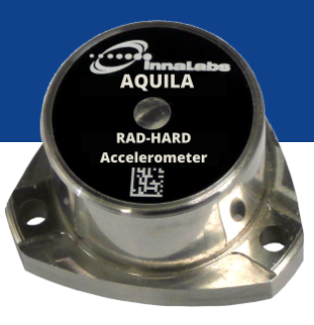
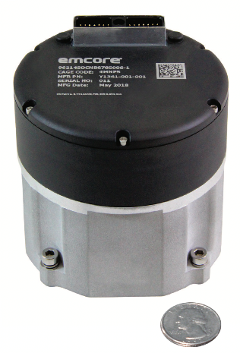
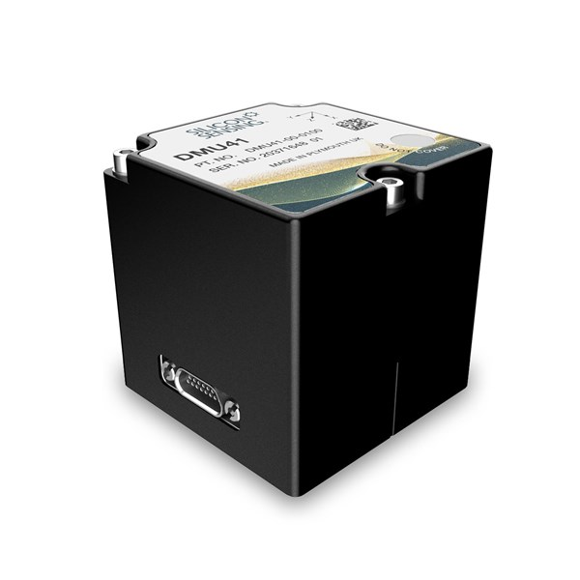
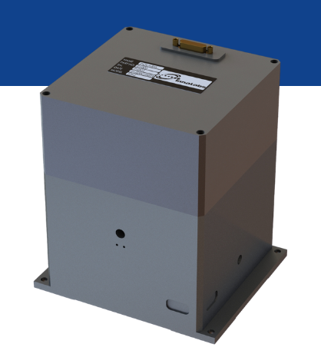
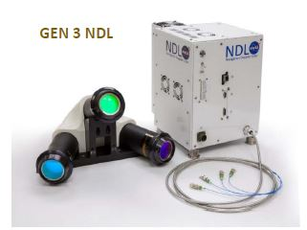
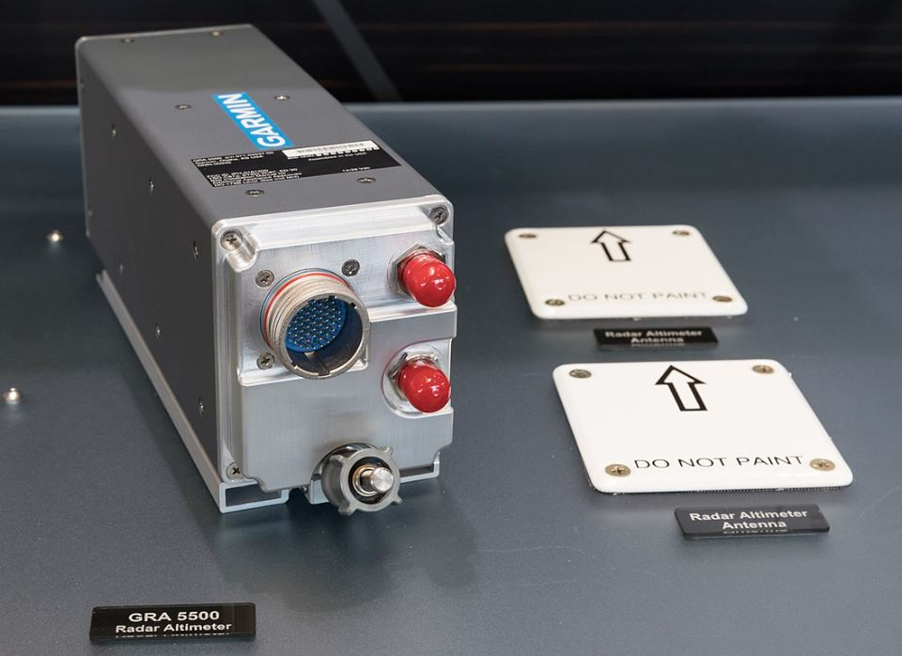
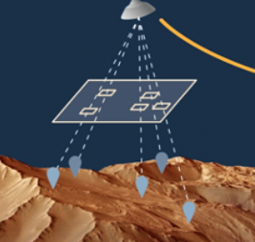
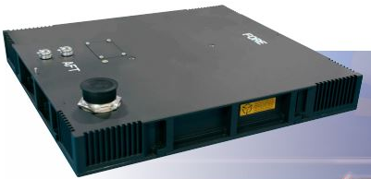
Technology Survey
Advanced navigation sensors surveyed in this study:
  Inertial Measurement Unit (IMU)
  Navigation Doppler Lidar (NDL)
  Radar Altimeter
  Radar Velocimeter
  Terrain Relative Navigation (TRN)
Critical parameters for these sensors were gathered by collecting publicly available data from online sources
1. IMUs
2. NDL
3. Radar Altimeter
4. Radar Velocimeter
5. TRN
Source: “Position Navigation Timing Survey Results Final Report-2021-08-27-HLS-Approved.pptx”
Trade names and trademarks are used in this report for identification only. Their usage does not constitute an official endorsement, either expressed or implied, by the National Aeronautics and Space Administration.

Slide 7
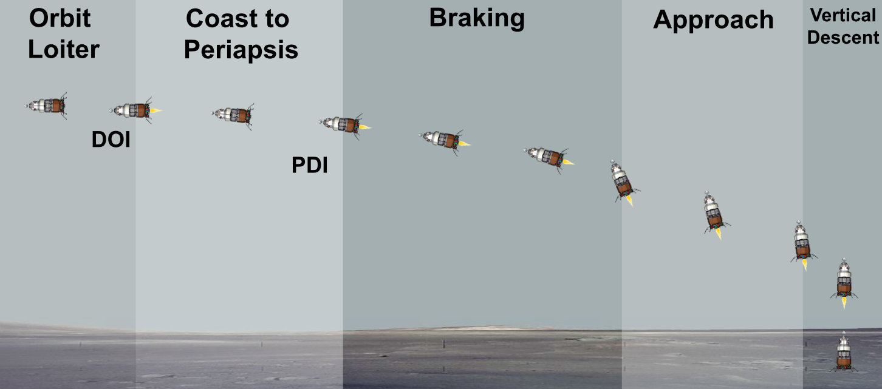
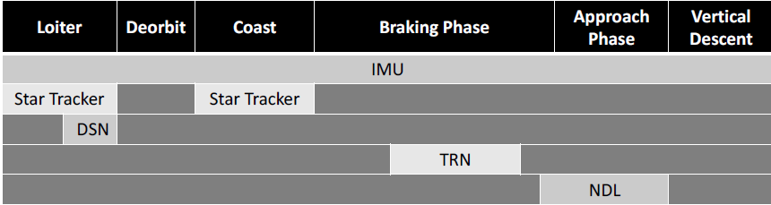
Lunar Lander Simulation Overview
Six degree-of-freedom, physics-based engineering simulation used as technology assessment testbed
Vehicle configuration: Government reference mini-DAC (Design Analysis Cycle)
  Two elements: Descent Element and Ascent Element
    Three Main Engines and 16 Reaction Control Systems
  Navigation sensor suite:
    IMU, Star Tracker, DSN, TRN, and NDL
Source: Lugo et al., “Precision Landing Performance and Technology Assessments of a Human-Scale Lunar Lander Using a Generalized Simulation Framework,” AIAA 2022-0609.
DOI = De-Orbit Initiation
PDI = Power Descent Initiation
DSN = Deep Space Network

Slide 8
Approach
Perform Technology Survey
Technology parameters are modeled in the lunar lander simulation framework
Multiple series of 8,000 runs Monte Carlo simulations were performed
Evaluated against performance metrics defined for landing success
  All requirements must be met:
  Landing precision: range to the target at touchdown is 100 m or less.
  Horizontal velocity at touchdown is less than 1 m/s.
  Vehicle angle is less than 3 degrees off vertical at touchdown.
  Maximum vehicle angular rates about all axes are less than 0.5 deg/s.
Run 6DOF Simulation
Perform Technology Assessment
Evaluate Against Performance Metrics
Success metrics
Notes:
Use the sim framework as a test bed to assess these technologies.
This team are looking at these 5 tech
Allows us to plug in different sensors or sensor parameters.
Use perf metrics to evaluate and quantify each tech
*broad survey, sen study, how does particular param make a diff*

Slide 9
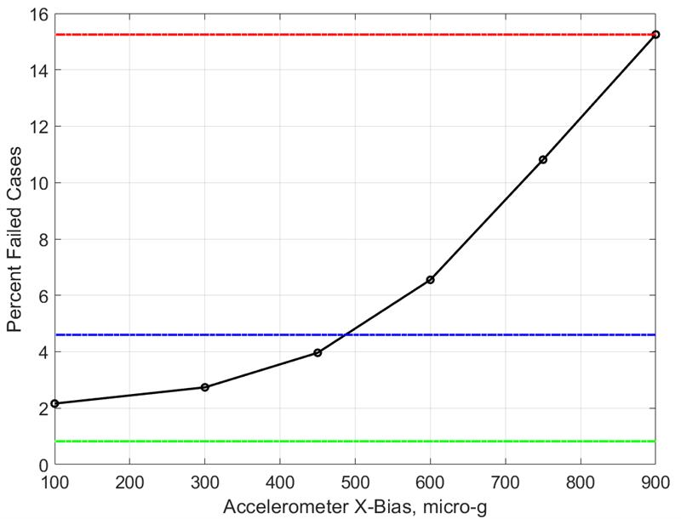
Capability Demonstration:
Successful Landing Sensitivity to IMU Bias
Low-Quality IMU Failure Rate
Monte Carlo studies showed that the IMU Accelerometer X-axis Bias was the most sensitive parameter that influenced mission failure rate
Evaluated three IMU quality-levels for landing performance
The Low-Quality IMU performance could be improved by reducing only the Accelerometer X-Bias
Impact: identified critical parameter and indicate where further improvements would be most beneficial
Reducing Low-Quality IMU X-Bias
Medium-Quality IMU Failure Rate
High-Quality IMU Failure Rate
*Results only valid for mini-DAC government reference vehicle with SPLICE sensors suite.
Notes:
Sen study of list of parameters -> X-bias
3 IMUs, Started w/ low qual and changing ONLY x-bias error
Can get results better than a similar medium qual imu re: landing
*How to improve the existing tech?

Slide 10
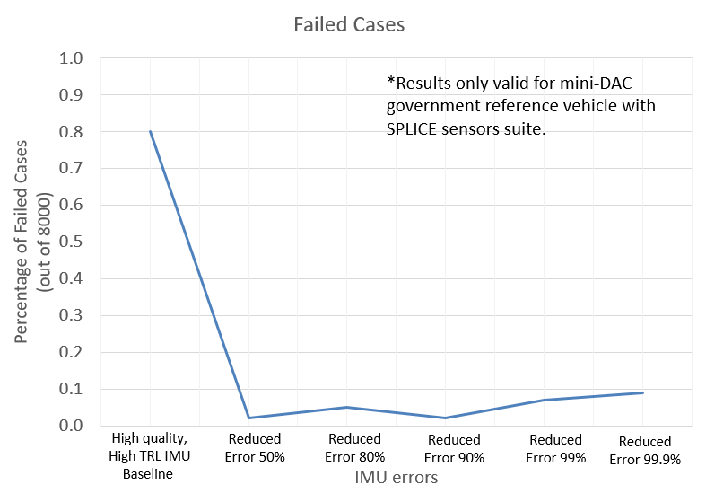
Capability Demonstration:
Evaluated Low Technology Readiness Level (TRL) Technology
Scaled parameters of an existing high quality, high TRL IMU are used to represent the Low TRL IMU (i.e., Quantum Positioning System) parameters
Monte Carlo studies showed that number of failed landings are reduced when high quality, high TRL IMU errors were reduced.
Reducing the error by more than ½ does not improve landing accuracy
Impact: identified improvement threshold with diminishing return
Notes:
Found low TRL IMU through tech research. Represented low TRL IMU w/ scaled parameters of High Q, High TRL IMU. This low TRL IMU claimed 1000x improvement.
MC to evaluate level needed to improve landing performance
Results show failed landing decreases when errors were reduced, but reducing errors to below ½ does not improve landing accuracy. (no need to improve more than ½ for resources purposes)
*point of diminishing return*
*How to improve future tech?*

Slide 11
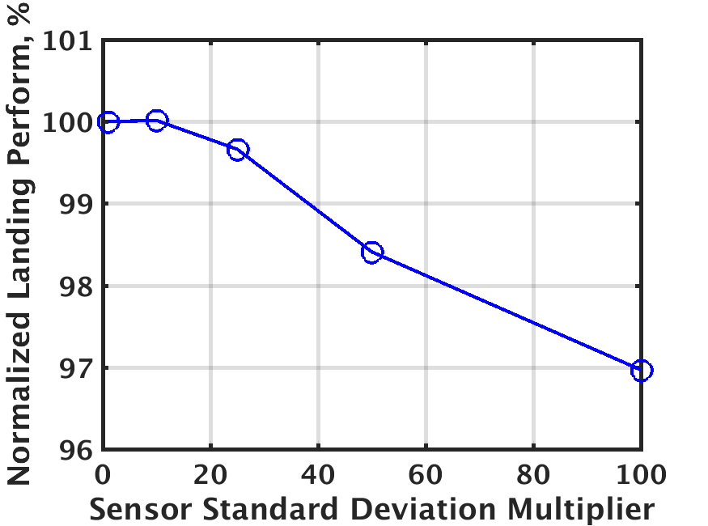
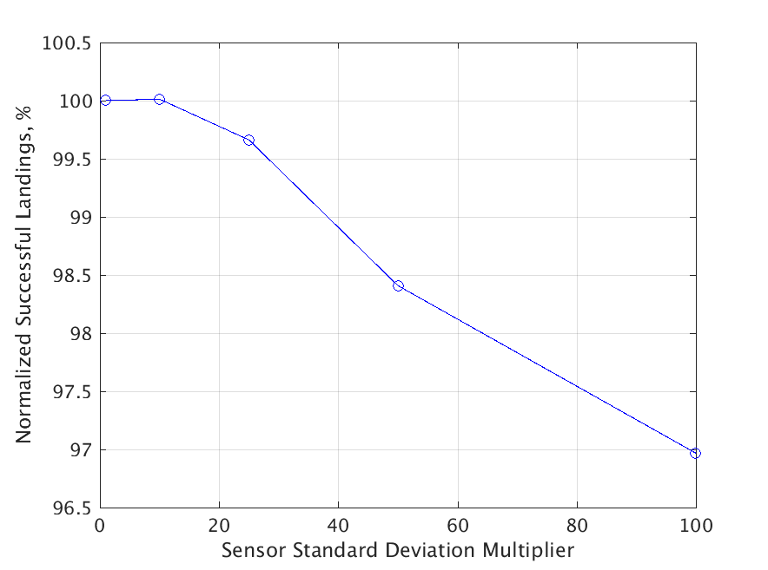
Capability Ongoing Development:
Evaluating Radar Altimeter-Velocimeter combination
  Evaluated altimeter-velocimeter performance relative to Gen-3 NDL
    Set altimeter-velocimeter measurement precision to be equivalent to 10X, 25X, 50X, and 100X less precise than Gen-3 NDL
  Results indicate landing success degrading nearly linearly as altimeter-velocimeter measurement precision decreases more than 10X
  Low fidelity sensor models may be overpredicting performance
    Models do not include parameters such as pointing or attitude knowledge errors that affect measurement accuracy
  Impact: trends revealed threshold to ensure landing success
*Results only valid for mini-DAC government reference vehicle with SPLICE sensors suite.

Slide 12
Key Takeaways
An overview of navigation sensor technology assessment capability approach applied to lunar landing mission and evaluated against landing success criteria
Quantitative results were shown
  Influential parameter for sensor type
  Diminishing returns for reducing sensor errors
Broader impact of capability
  Similar method can be applied to a Mars or other surface landing vehicle
  Perform risk assessments
  Apply the method to other disciplines

Slide 13
Future Work
Implement other sensor models into the simulation
  Upgrade Navigation Doppler Lidar model
  Explore Terrain Relative Navigation model impact
Apply rapid assessment capability with trajectory reconstruction tool NewSTEP to enhance Monte Carlo approach
  Linear covariance analysis enables rapid trade studies as it does not require Monte Carlo techniques for uncertainty assessment

Slide 14
Thank you

Slide 15
BACK UP

Slide 16
Rapid Assessment Capability: NewSTEP
The Monte Carlo approach of assessing sensor performance can be costly in terms of the time needed to run thousands of high fidelity 6-DOF simulations
New Statistical Trajectory Estimation Program (NewSTEP) is a Kalman filter code specifically formulated for solving trajectory reconstruction problems
  NewSTEP can be configured to emulate navigation system performance and can produce uncertainty estimates from linear covariance analysis.
  Linear covariance analysis enables rapid trade studies as it does not require Monte Carlo techniques for uncertainty assessment.
The rapid assessment capability can be used to explore sensor capabilities or other navigation filter assumptions
  Filter tuning parameters
However, NewSTEP’s linear covariance analysis mode does not capture dispersions as it uses a nominal trajectory to propagate uncertainty estimates
  Complements Monte Carlo approach in technology assessment

