Slide 1
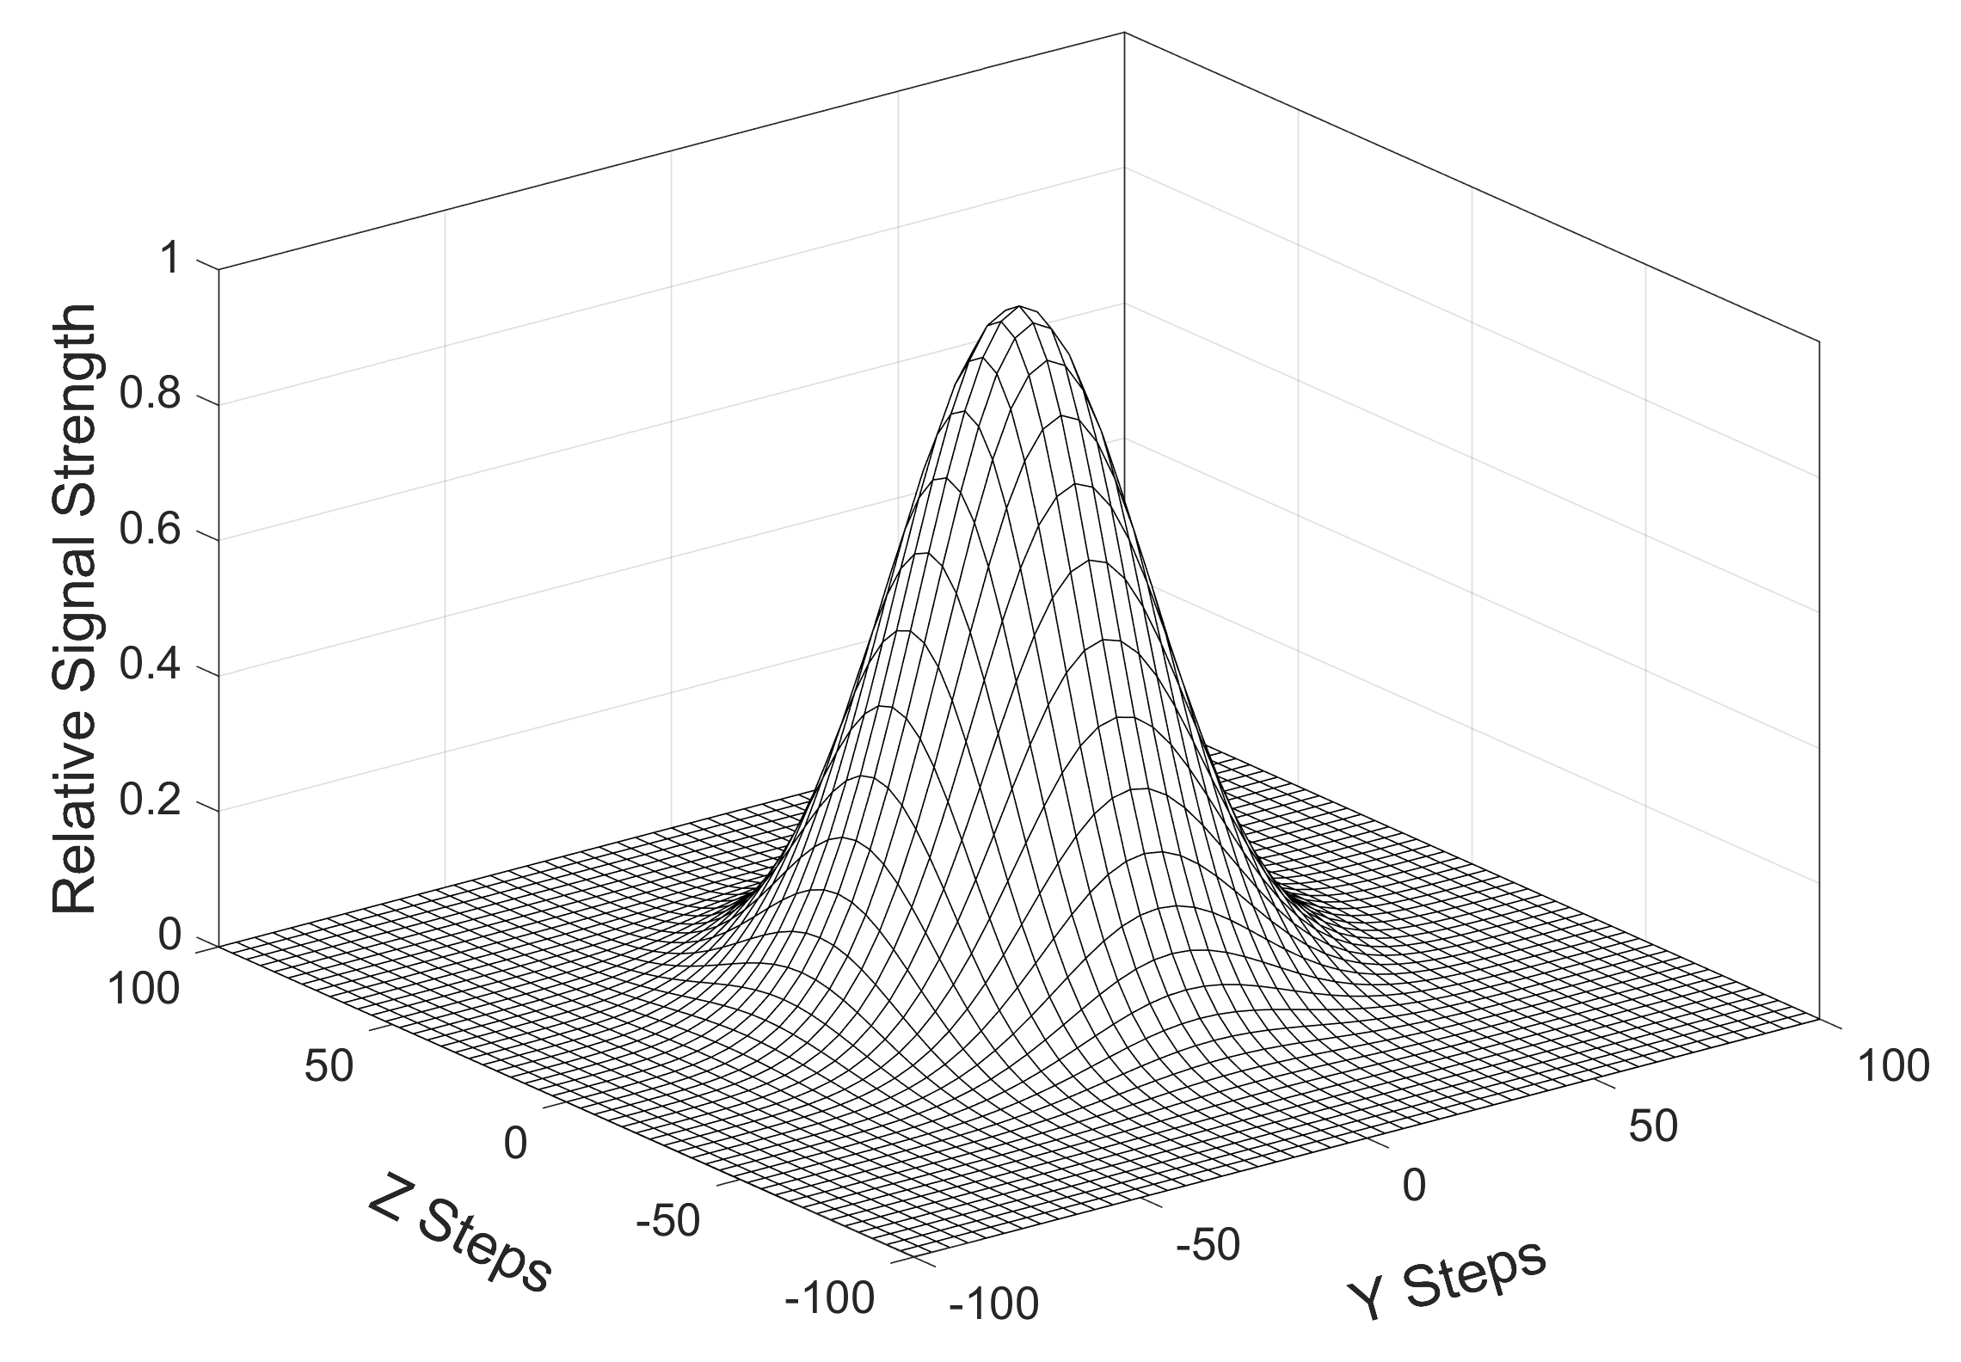
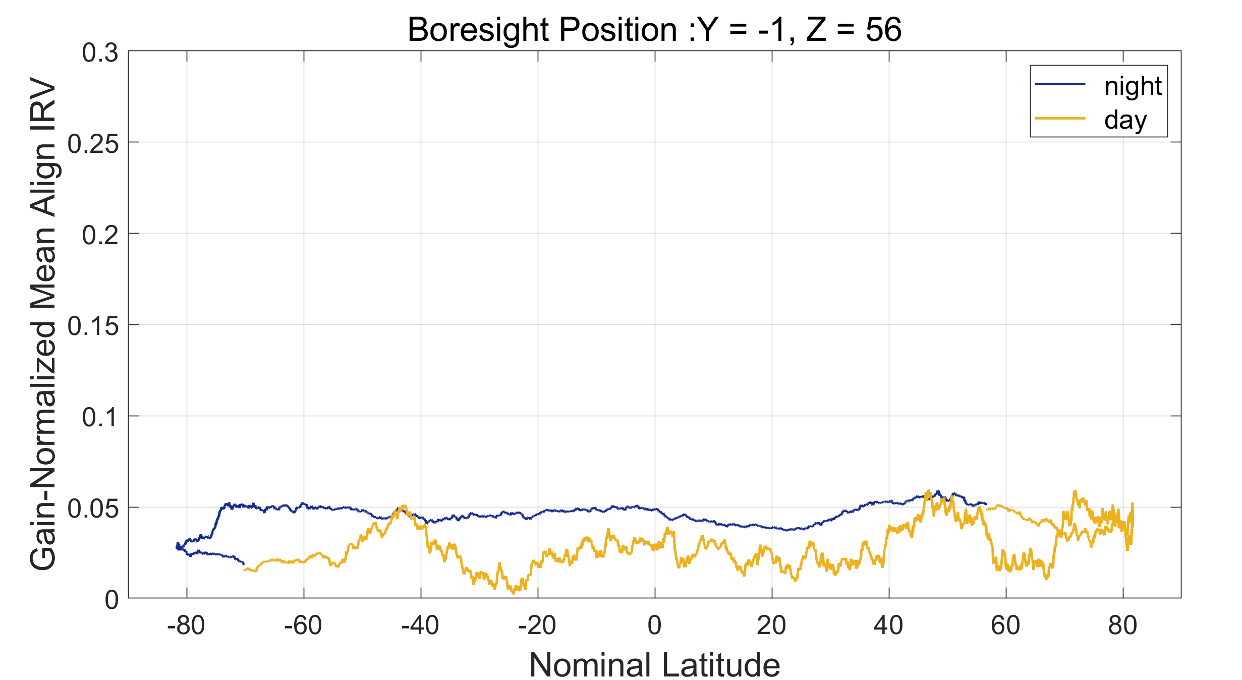
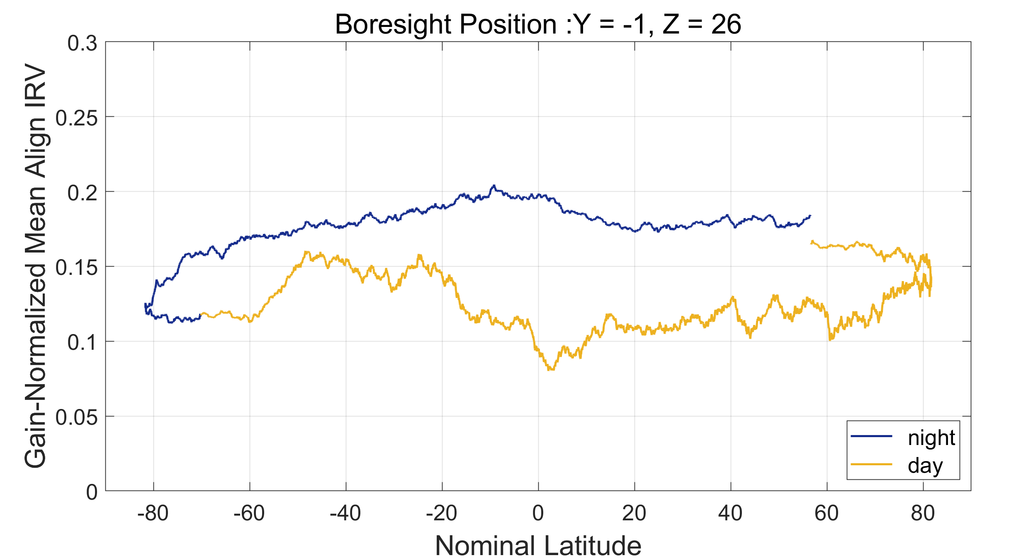
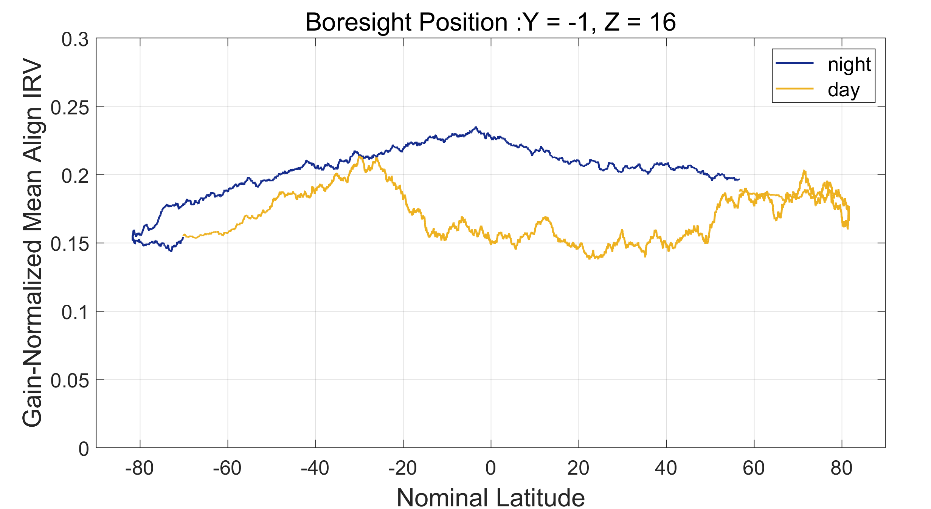
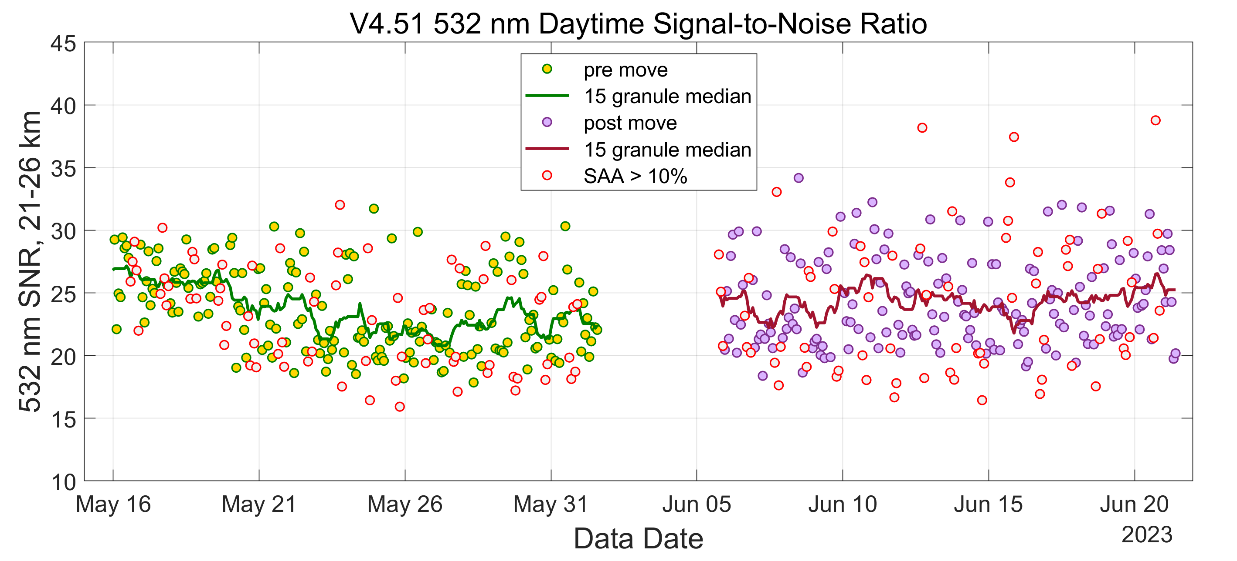
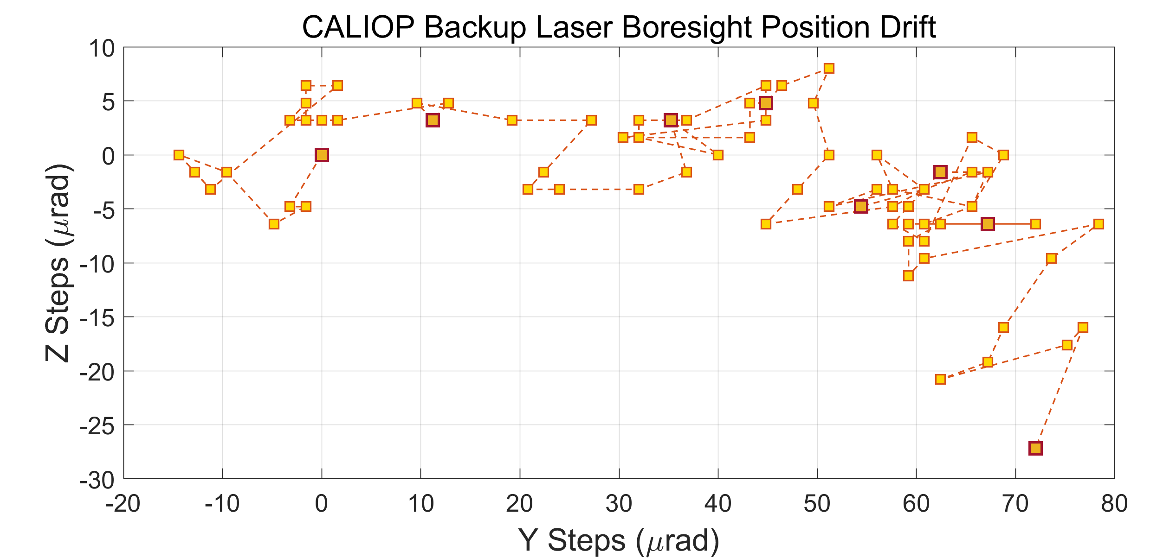
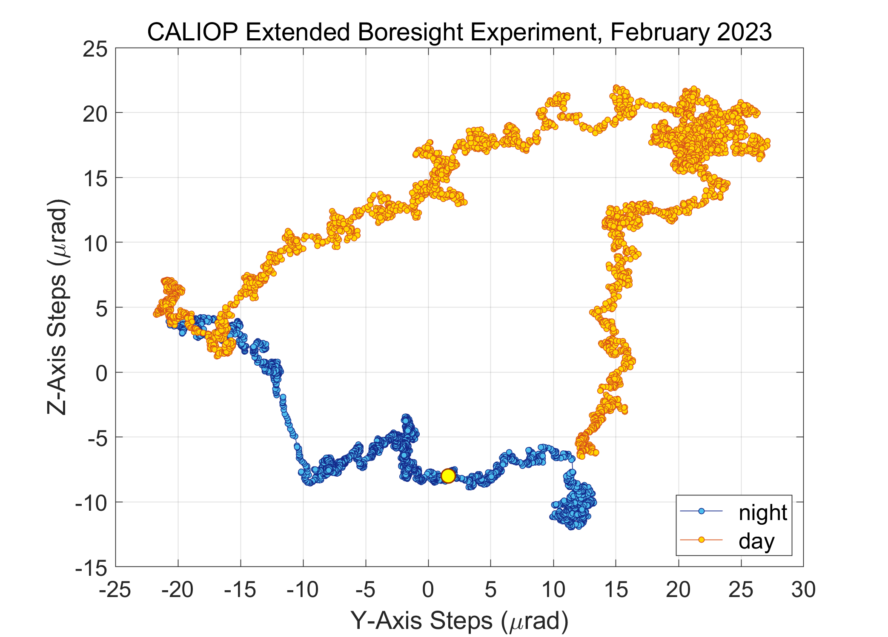
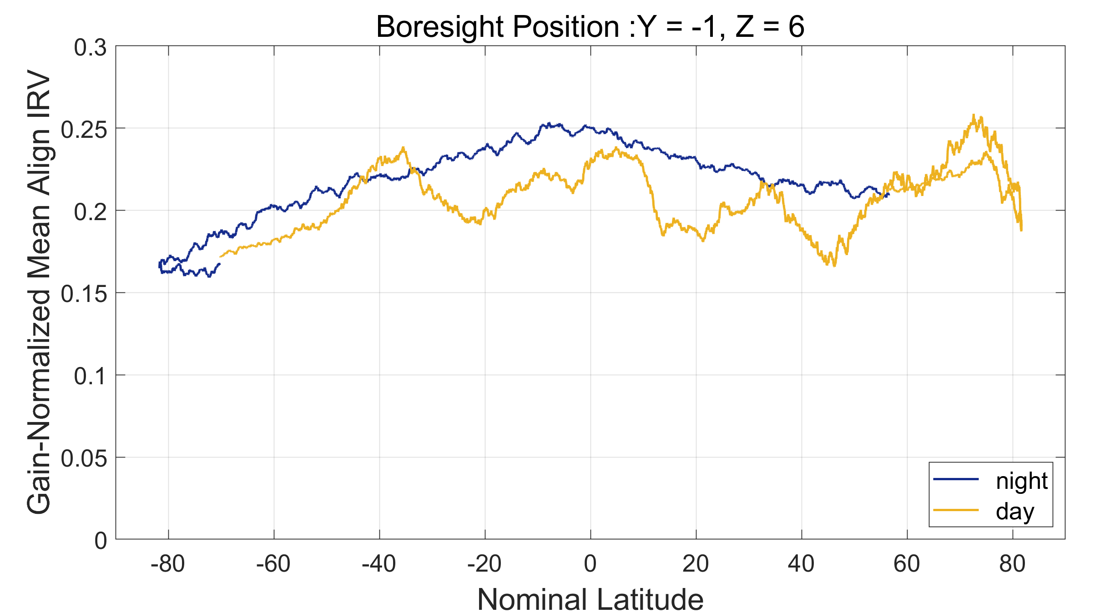
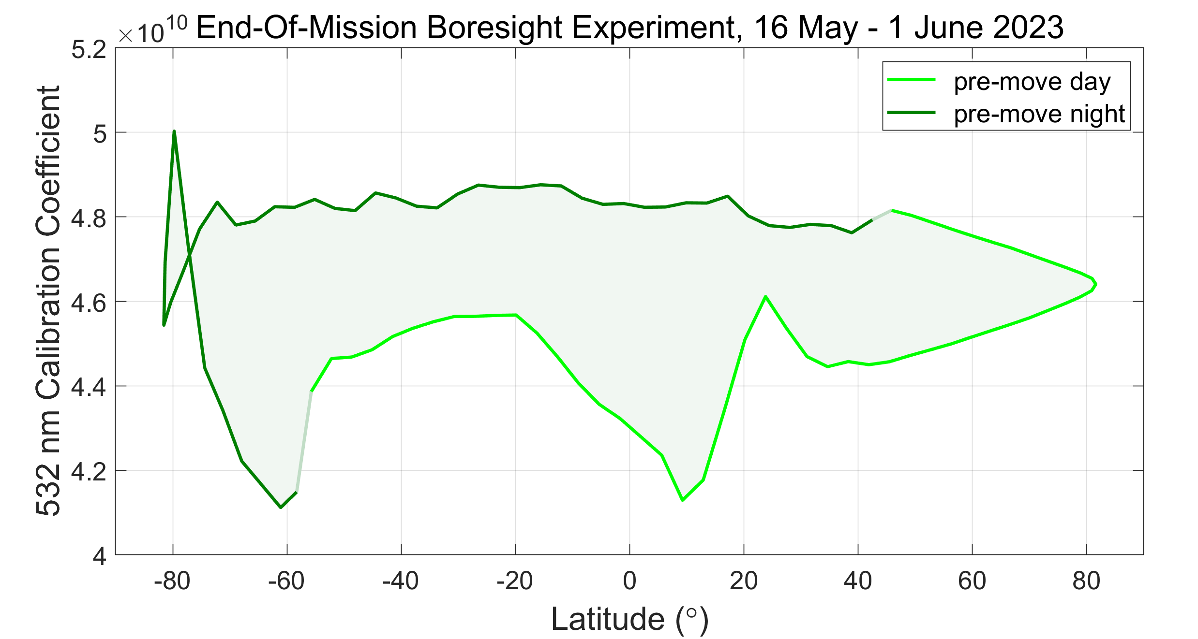
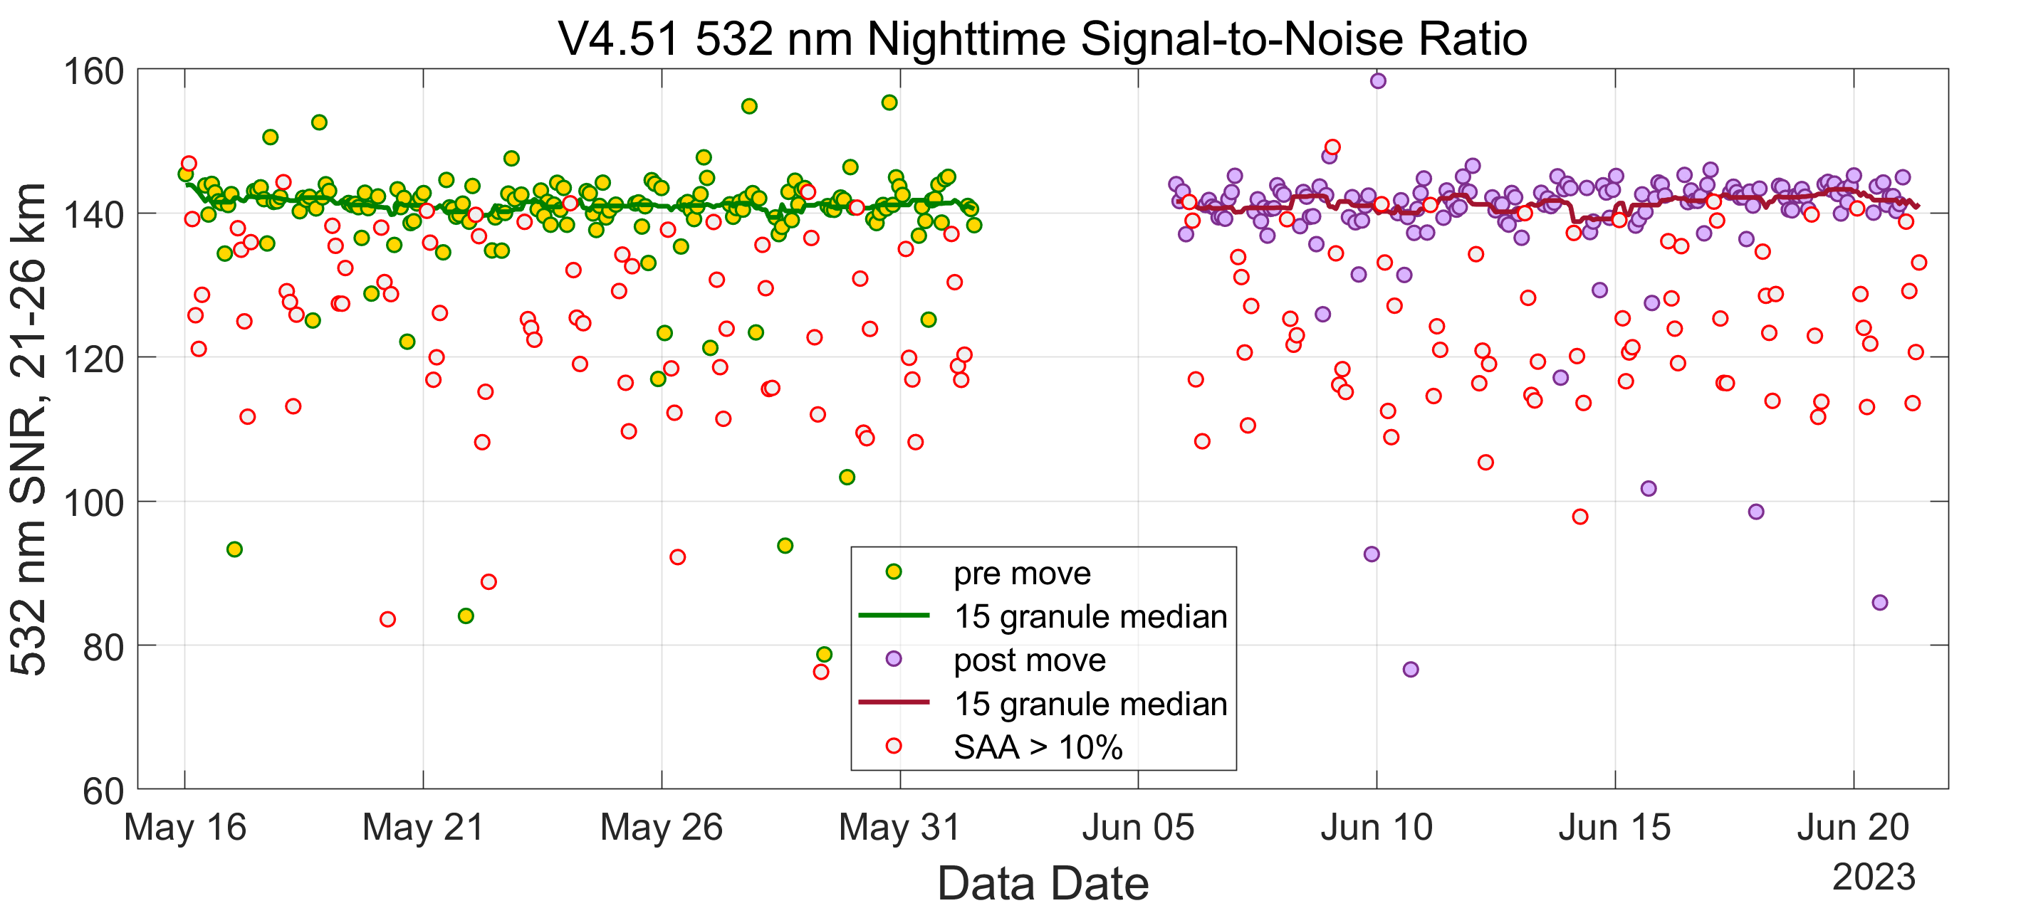
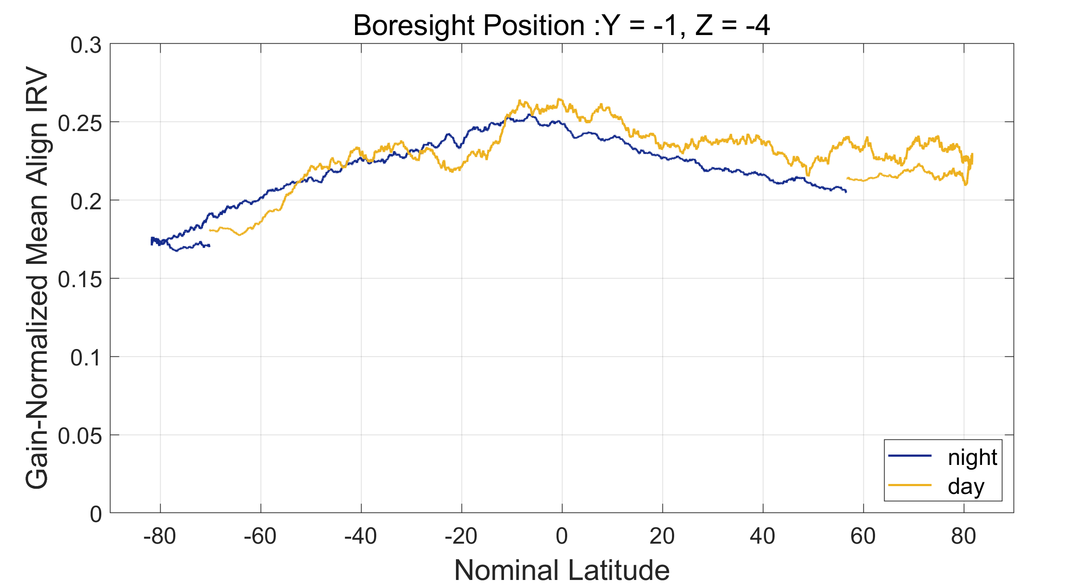
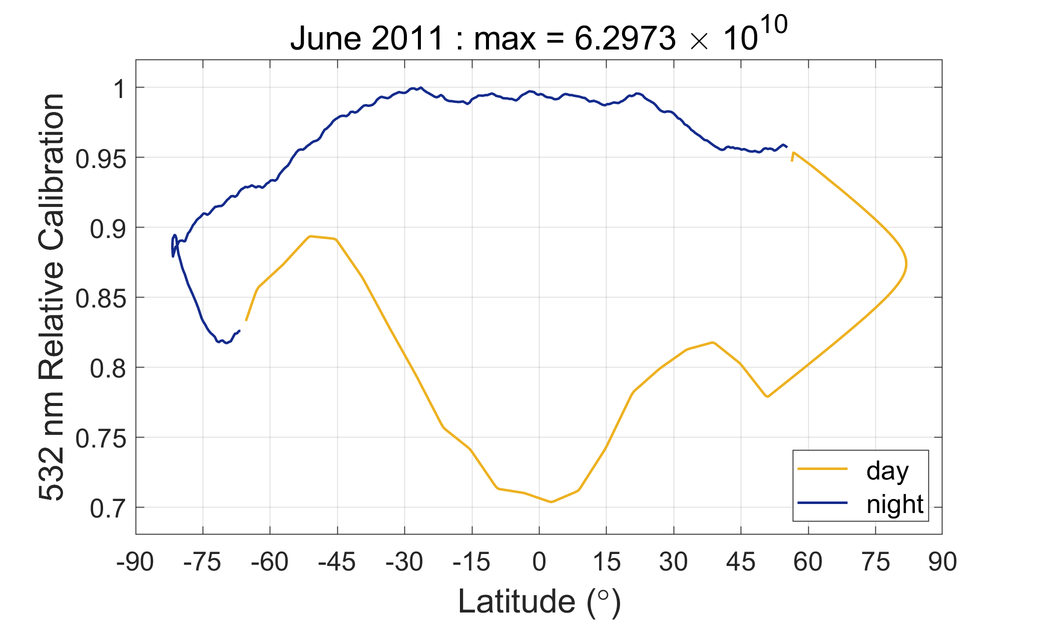
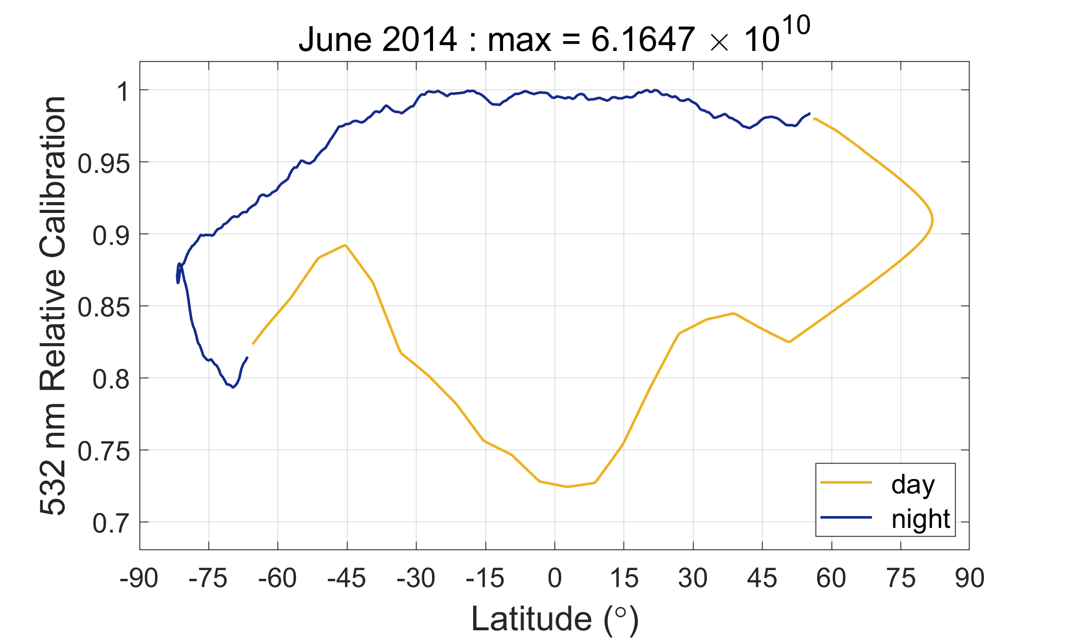
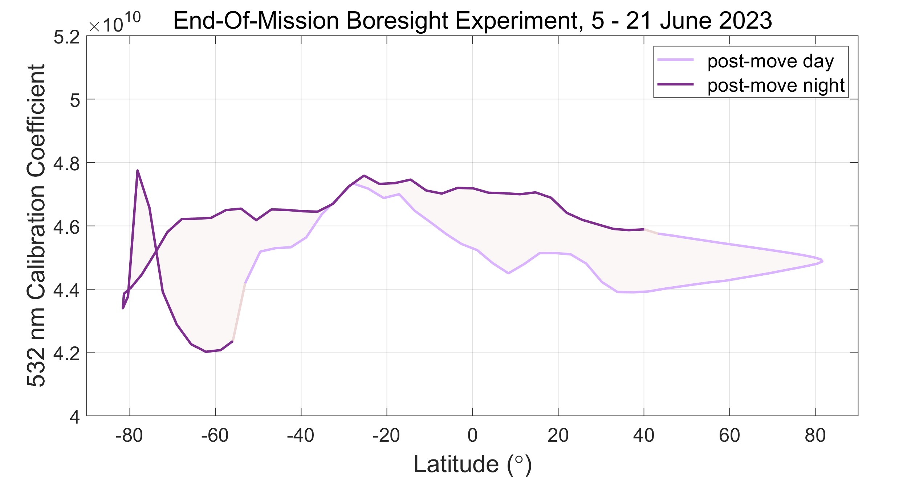
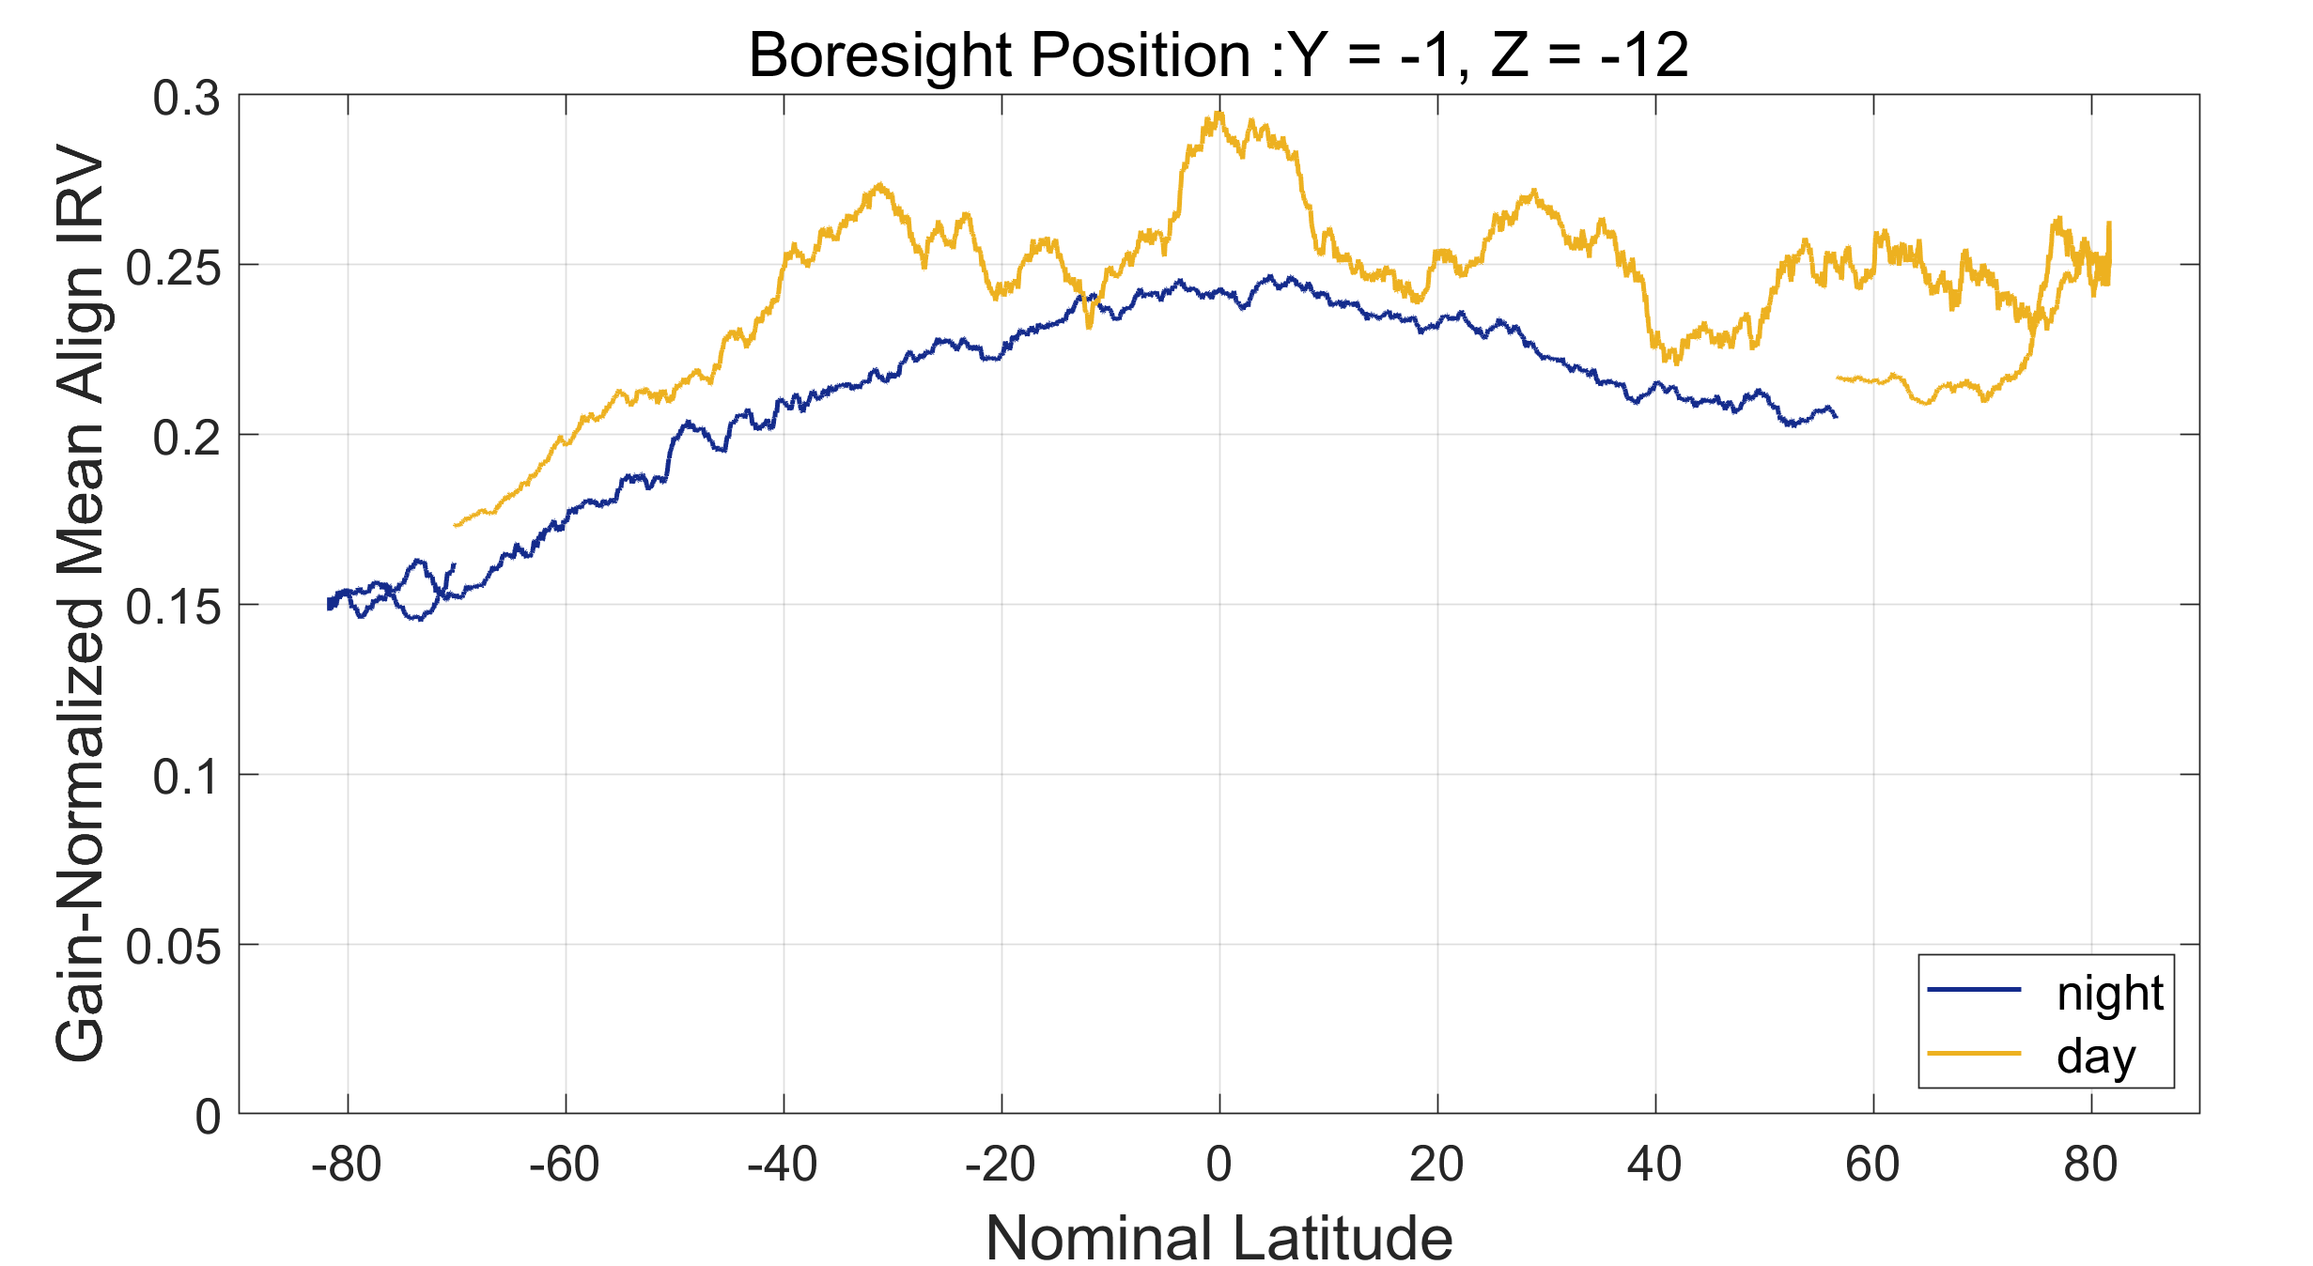

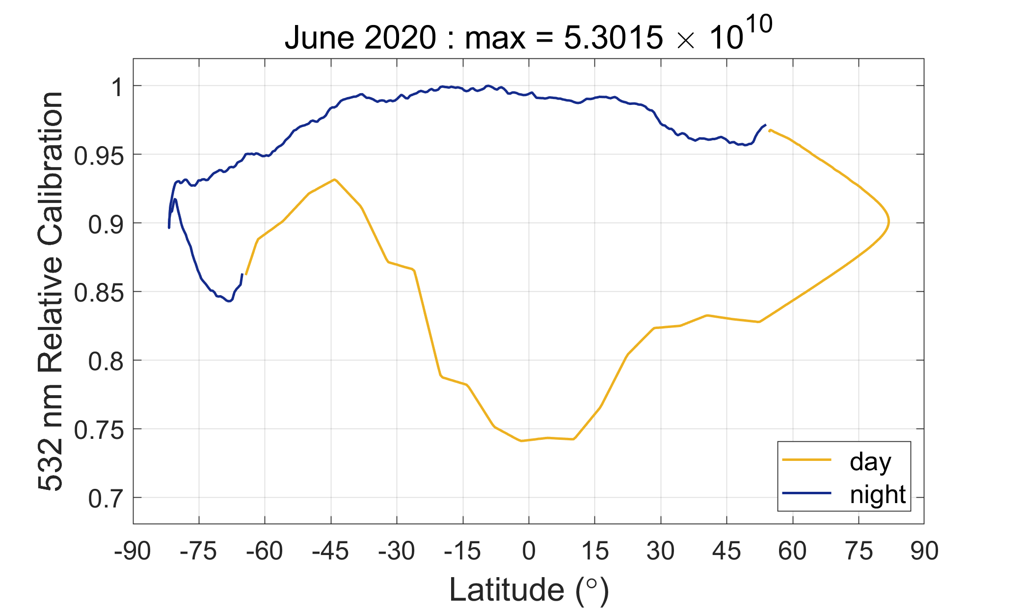
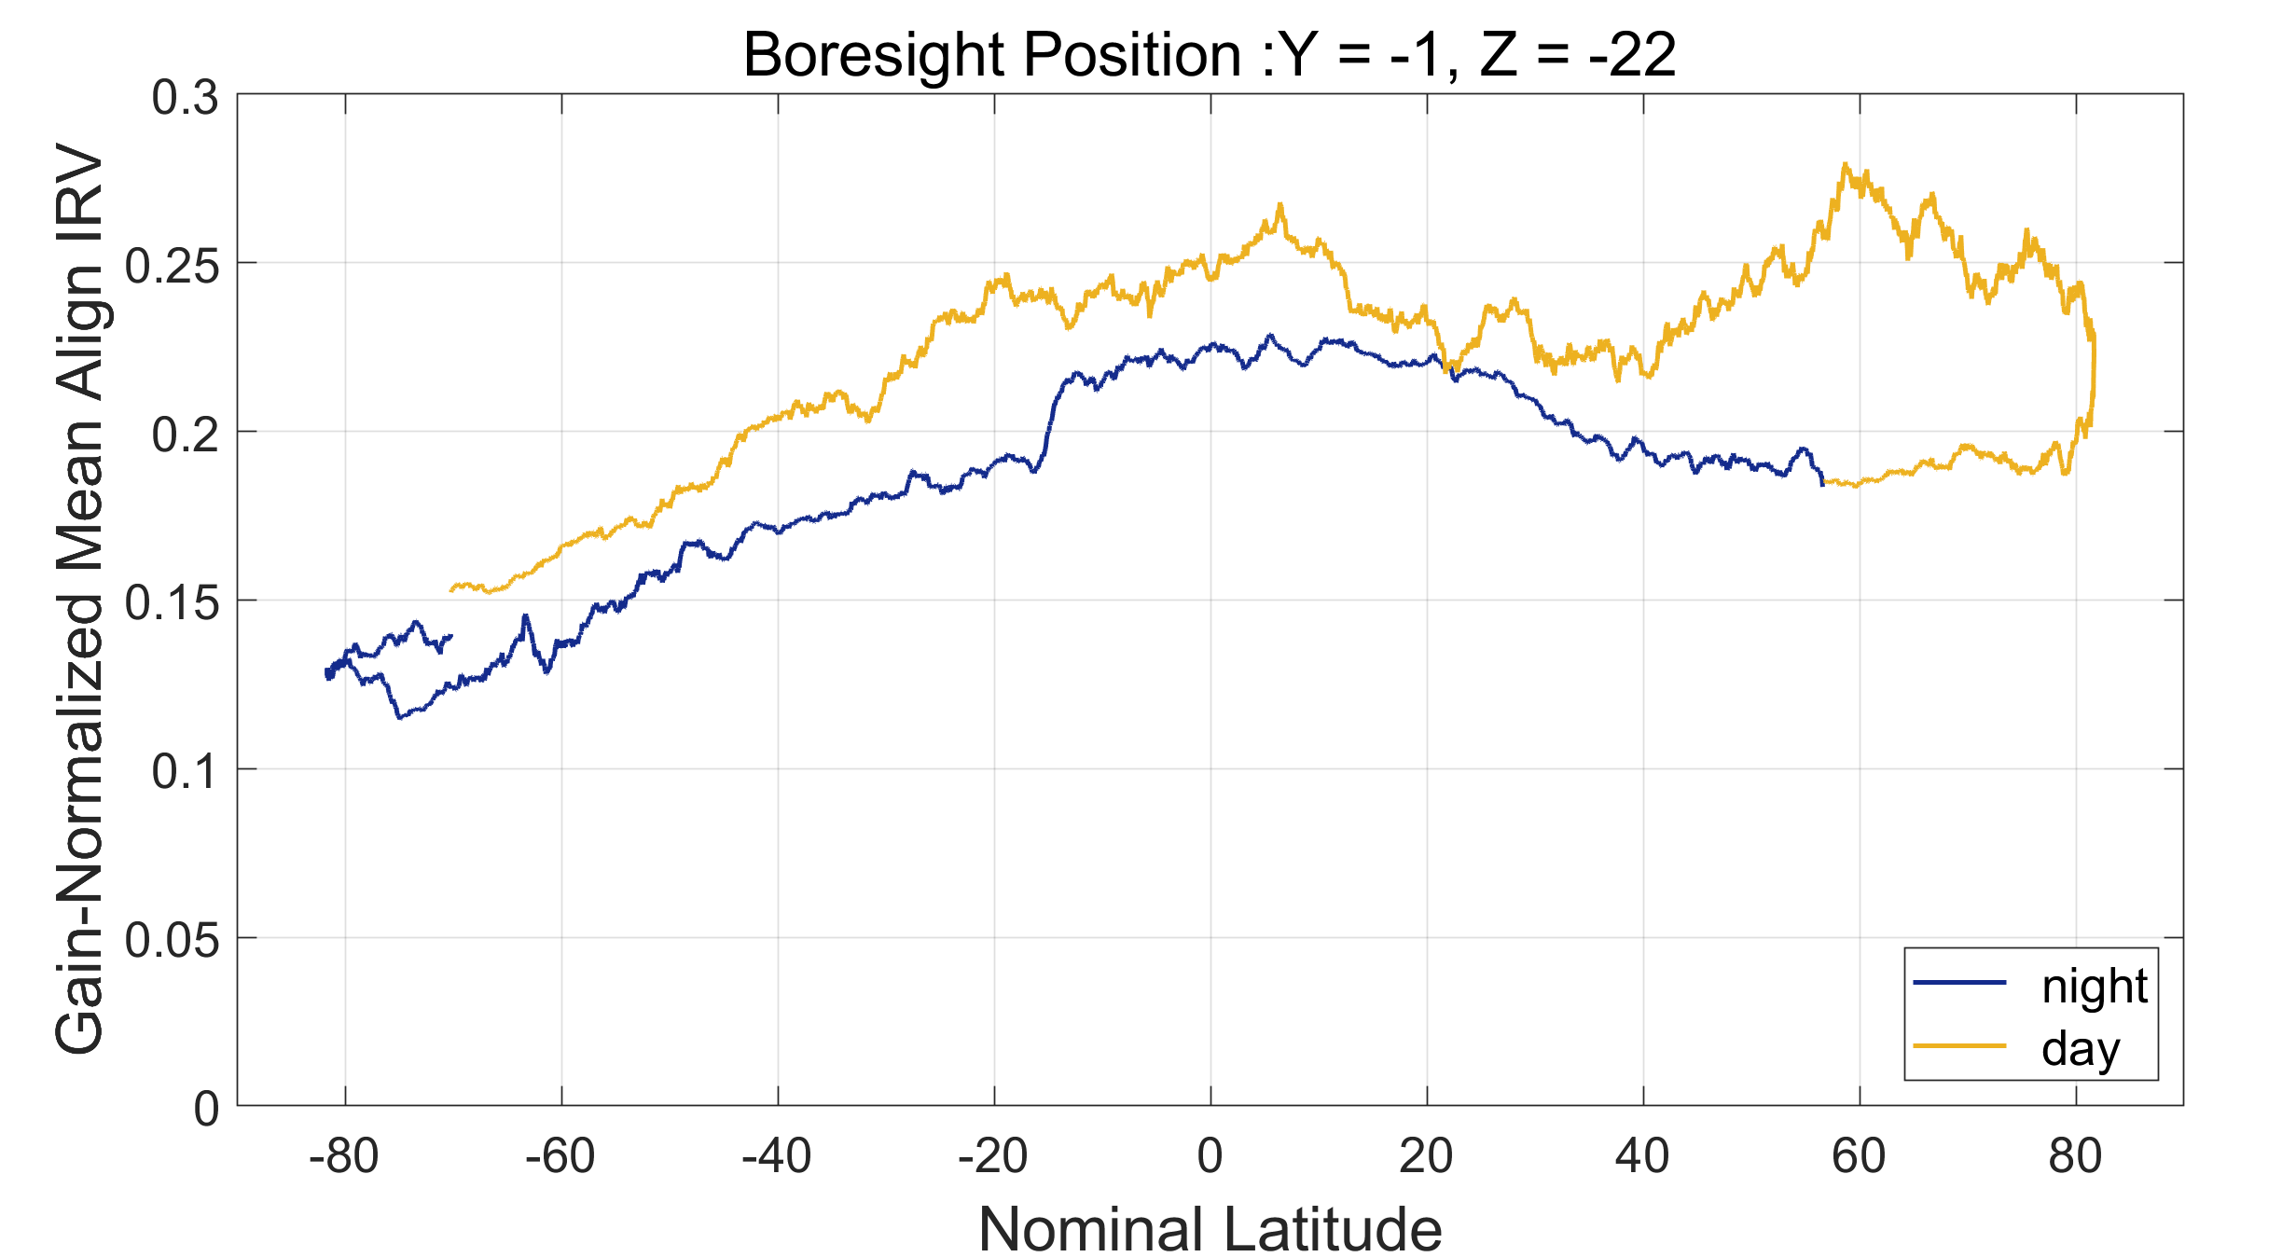
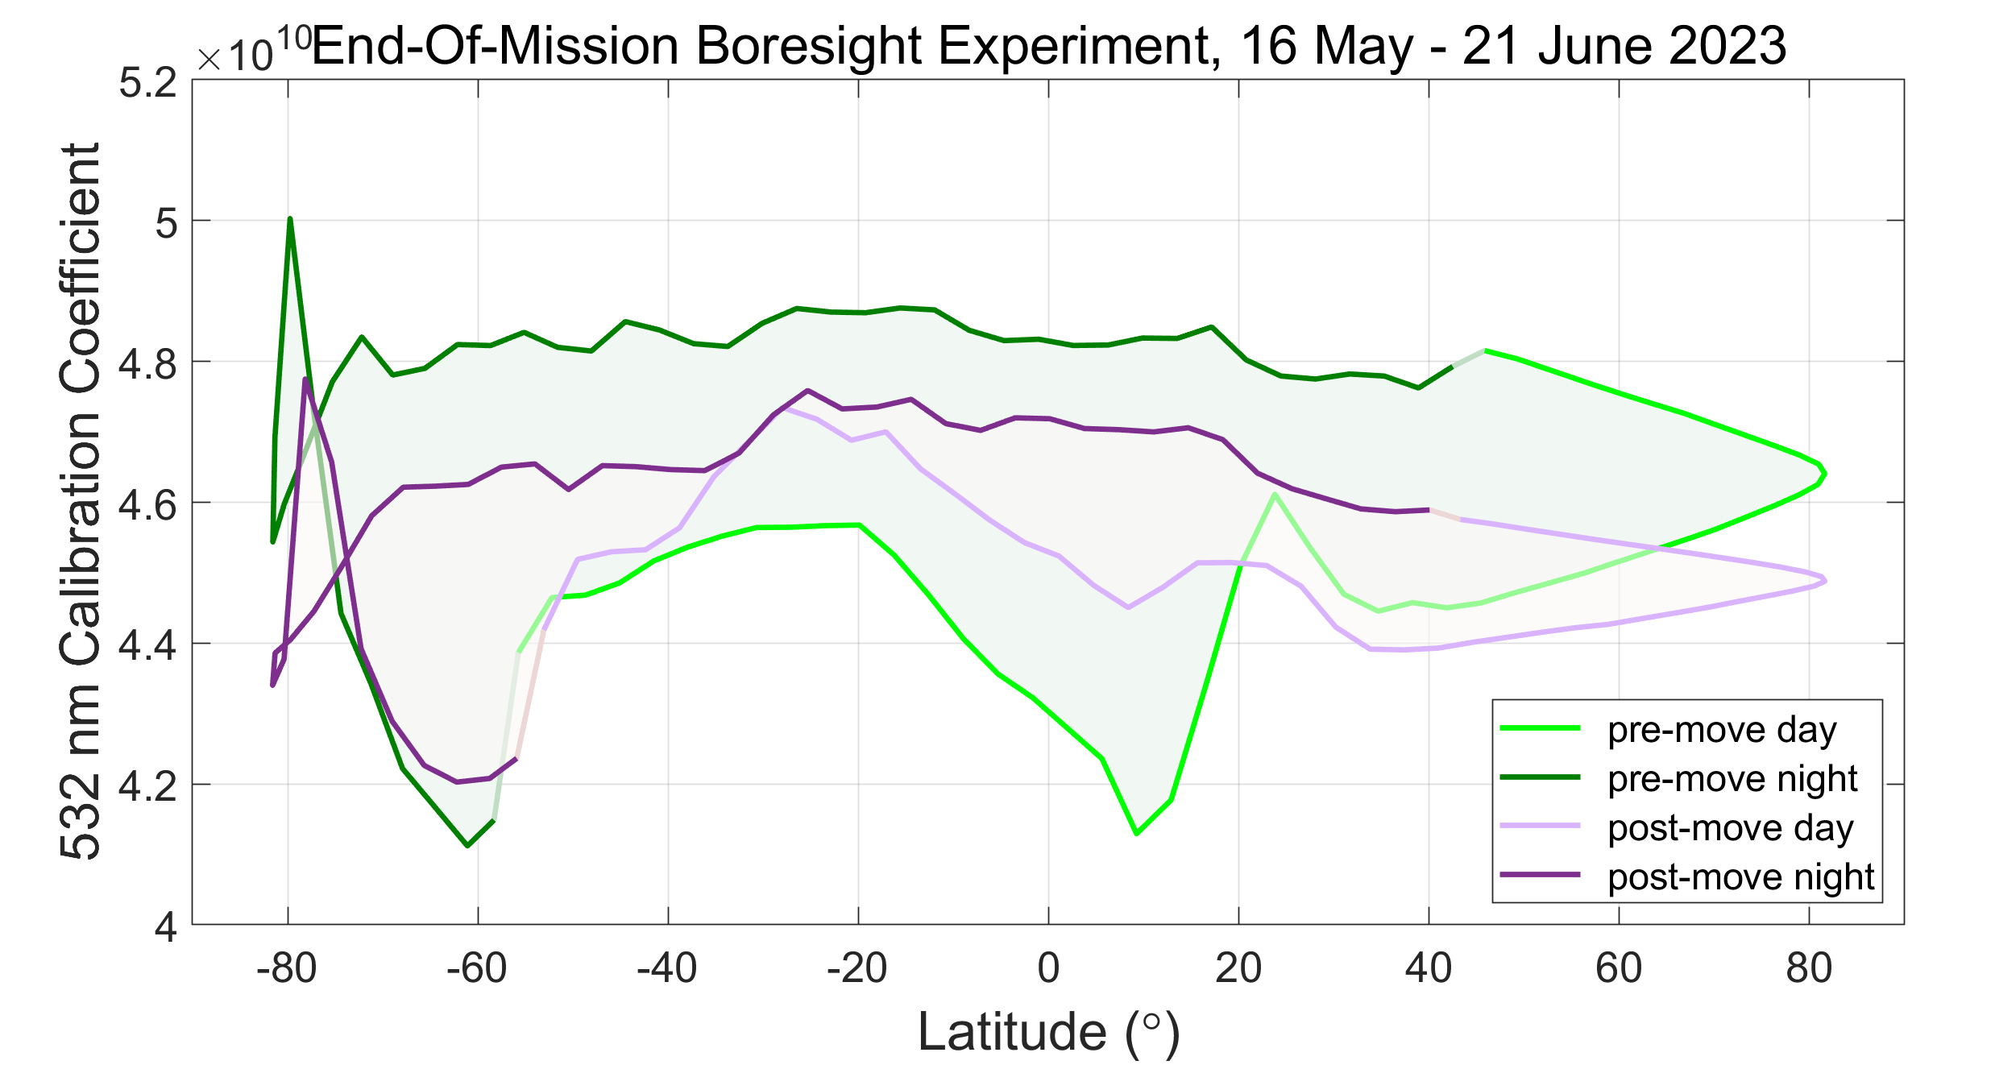
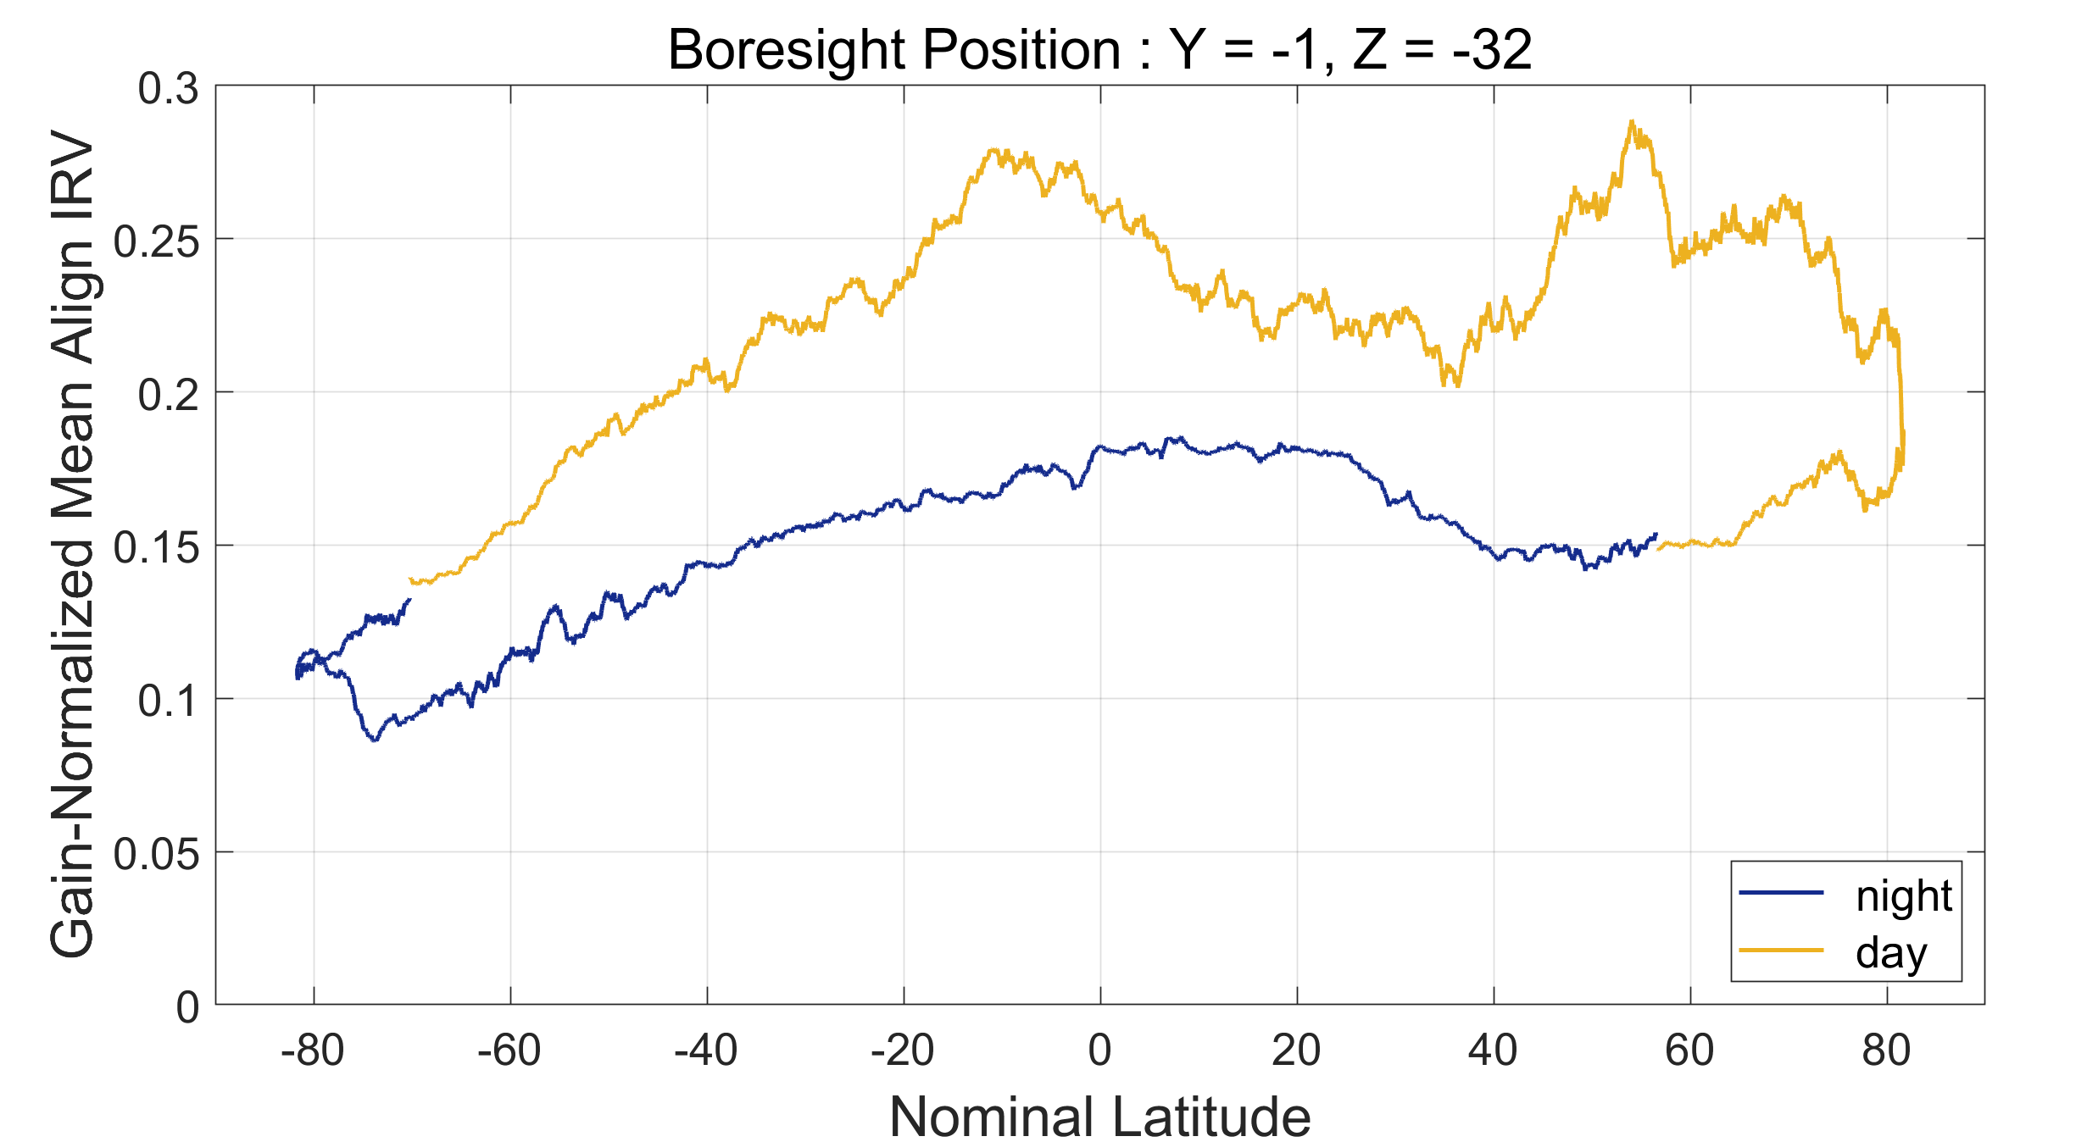
Optimizing CALIOP’s Boresight Position
Mark Vaughan¹, Lyle Rupert², Ron Verhappen^{1,3}, Chip Trepte¹, Carl Weimer², Anne Garnier^{1,3}, Brian Getzewich¹, Kam-Pui Lee^{1,3}, Sharon Rodier^{1,4}, Tim Murray^{1,4}, Ken Beaumont^{1,4}
Routine Boresight Alignment
Expected Outcomes: Signal-to-Noise Ratios
Optical alignment of CALIOP’s transmitter and receiver was accomplished using an adjustable boresight mechanism (ABM) that could be moved in steps of ~1.6 μrad in each of two orthogonal directions
Moving the ABM to the day-night optimized position was also expected to yield an increase in daytime SNR and a simul-taneous decrease in nighttime SNR. As seen in the plots and table below, while the move did produce a slight increase in daytime SNR, it left the nighttime SNR essentially unaffected.
For this study, SNR is defined as the mean divided by the standard error of the 532 nm parallel channel backscatter signals measured between 21 km and 26 km vertically and 45° N and 45° S along track. Profiles with CALIOP level 1 QC flags ≠ 0 are excluded, thus eliminating data having laser energies ≤ 10 mJ.
Note that the presence of intermittent bright clouds make the daytime SNR values highly variable. In general, the data quality available for this study is too low and the sample sizes are too small to draw useful conclusions from the SNR comparisons.
Alignment was periodically optimized by executing an ALIGN command to move the AMB from its current position through a fixed set of four offsets ±40 steps (64 μrad) along each axis. Dwell time at each step was ~1 minute.
Figure 1: schematic of beam aligned to ABM position [0,0]
Intra-Orbit Variability: Thermal Beam Steering
Figure 5a
Expected Outcomes: Calibration
P0
Gaussian beam profile
During 4–12 February 2023, CALIPSO conducted an extended time boresight operation that mapped out thermally-driven changes in the boresight position as a function of elapsed time throughout a single orbit. As in the standard ALIGN operation, the ABM was moved through a fixed set of four offsets positioned ±64 μrad along each axis. To ensure sufficient SNR during daytime data acquisition, dwell times in each position were increased from ~1 minute to 2 days.
The ‘Align IRV’ (i.e., integrated return value) is the integral of the raw backscatter signal computed on-board the satellite and used in the standard ALIGN operations. IRVs are calculated between 27 km and 35 km.
At the conclusion of the second extended boresight experiment, the ABM was manually moved to its initial starting point (Y, Z = [-1, -4]). A subsequent ALIGN command repositioned the ABM by -3 steps in both axes, where it remained during the data analysis phase of the study. This analysis concluded that a “day-night optimized” position would be achieved by moving the ABM by +2 steps in Y and -7 steps in Z from its final position at the end of the experiment. Following the conclusion of an extended time polarization gain ratio calibration on 5 June 2023, the ABM was moved to this “day-night optimized” position.
This move was expected to produce generally lower nighttime calibration coefficients and generally higher daytime calibration coefficients. As shown below, this expectation was met. However, as suggested by the intra-orbit variations shown in Figure 4, the calibration changes are not uniform in either the daytime or night-time orbit segments. Maintaining uniform calibration coefficients throughout the orbit would most likely require an active boresight system, perhaps similar in concept to the ICESat-2 Alignment Monitoring and Control System (Palm et al., 2021).
P2
P4
An updated optimum pointing direction was calculated using the mean backscatter signal acquired in each position. To maximize backscatter SNR and minimize perturbations to standard data acquisition, boresight alignments were con-ducted during night granules only. A typical align operation generated a relative boresight movement of just under 5 μrad. Total movement over the backup laser lifetime was 77 μrad.
Figure 5b
The image below shows the estimated changes in the mean boresight position within a single orbit computed over the course of the 8-day experiment. The maximum distance from the initial starting position (yellow circle) is ~36 μrad. The distance traveled during this intra-orbit repeat cycle is slightly less than half the total transit distance (~77 μrad) spanned in all ALIGN operations conducted during the 14-years lifetime of the backup laser.
Figure 5c
more than 10% of the profiles were within the South Atlantic Anomaly (SAA)
2013-03-08
2015-03-06
2019-03-15
extended polarization gain ratio calibration
2011-03-07
For the extended boresight measurements, Align IRV values were computed using level 1 science data downlinked via x-band.
2009-03-12
77 μrad
2017-03-17
2021-02-26
orbit elapsed time
Figure 7a
initial boresight position at experiment start
Figure 5d
Figure 2
2023-03-24
orbit elapsed time
Figure 6a
Engineering Note: the ABM was originally designed to be used only twice on-orbit; i.e., to establish the alignment for each of the two lasers. In practice, there were 183 movements over the course of the mission.
extended polarization gain ratio calibration
Figure 4
Intra-Orbit Variability: Diurnal Calibration Drift
Figure 5e
Optimizing Alignment to Improve Daytime Data
polygon area = 56.51 (arbitrary units)
Figure 7b
more than 10% of the profiles were within the South Atlantic Anomaly (SAA)
Based on knowledge gained from the initial extended time boresight operation, CALIPSO conducted second extended time experiment in which the boresight was moved exclusively along the z-axis of the ABM. ABM positions, in steps, and dwell times in each position are shown in the table below. By quantifying the redistribution of daytime and nighttime signal strengths as a function of ABM position, we subsequently determined a new optimized boresight position that relinquished some nighttime pointing accuracy (and SNR) in exchange for improved daytime pointing accuracy (and SNR). The column of plots to the right illustrates the changes in day and night signal magnitudes in various ABM positions.
The ground-based Align IRV calculations are gain-normalized to compensate for differences in the electronic gains used for daytime and nighttime data acquisition.
Figure 6b
SNR statistics for the green and purple dots in the plots above
Figure 3a
Figure 3b
Figure 5f
 | pre-Day | post-Day | pre-Night | post-Night
min | 17.86 | 18.39 | 78.72 | 34.93
max | 31.72 | 34.17 | 155.35 | 158.35
median | 22.90 | 23.40 | 141.18 | 141.53
MAD | 2.65 | 2.96 | 1.68 | 6.10
mean | 23.59 | 24.32 | 138.99 | 138.49
stdev | 3.34 | 3.53 | 10.19 | 13.23
orbits | 172 | 161 | 162 | 154
polygon area = 22.26 (arbitrary units)
Figure 3c
Figure 3d
Figure 5g
Figure 6c
References
From the beginning of the mission, large diurnal variations were observed in the 532 nm calibration coefficients (Hunt et al., 2009; Powell et al., 2009). As seen above, the temporal pattern of the diurnal changes is largely consistent from year to year, though the magnitudes and temporal shapes change seasonally. While thermally driven intra-orbit alignment variability was predicted prior to launch, both the magnitude of the variations and their impacts on the 532 nm calibration coefficients were much larger than expected. Post launch analyses conducted by Ball Aerospace & Technologies Corp. showed that the time of the ALIGN command within an orbit plays a critical role in alignment variability (Lieber et al., 2007).
position number | start time | stop time | Y position (steps) | Z position (steps)
0 | 2023-04-01 00:00:00 | 2023-04-10 09:04:59 | -1 | -4
1 | 2023-04-10 09:10:30 | 2023-04-11 09:46:53 | -1 | 6
2 | 2023-04-11 09:46:53 | 2023-04-12 10:23:17 | -1 | 26
3 | 2023-04-12 10:23:17 | 2023-04-13 10:59:40 | -1 | 56
4 | 2023-04-13 10:49:39 | 2023-04-14 11:36:03 | -1 | 16
5 | 2023-04-14 11:36:03 | 2023-04-15 12:12:26 | -1 | 6
6 | 2023-04-15 12:12:26 | 2023-04-16 12:48:49 | -1 | -4
7 | 2023-04-16 13:48:59 | 2023-04-24 15:59:59 | -1 | -2
8 | 2023-04-24 16:06:00 | 2023-04-25 16:39:59 | -1 | -12
9 | 2023-04-25 16:39:59 | 2023-04-26 17:15:00 | -1 | -22
10 | 2023-04-26 17:15:00 | 2023-04-27 17:50:59 | -1 | -32
11 | 2023-04-27 18:51:00 | 2023-04-30 23:59:59 | -3 | -3
Hunt, W. H et al., 2009: CALIPSO Lidar Description and Performance Assessment, J. Atmos. Oceanic Technol., 26, 1214–1228, https://doi.org/10.1175/2009JTECHA1223.1.
Lieber, M. et al., 2007: Development of a validated end-to-end model for space-based lidar systems, Proc. SPIE, 6681, 66810F, https://doi.org/10.1117/12.731277.
Palm, S. P. et al., 2021: ICESat-2 Atmospheric Channel Description, Data Processing and First Results, Earth and Space Science, 8, e2020EA001470, https://doi.org/10.1029/2020EA001470.
Powell, K. A. et al., 2009: CALIPSO Lidar Calibration Algorithms: Part I - Nighttime 532 nm Parallel Channel and 532 nm Perpendicular Channel, J. Atmos. Oceanic Technol., 26, 2015–2033, https://doi.org/10.1175/2009JTECHA1242.1.
Figure 5h
polygon area ratio = 2.54 (pre/post)
Author Affiliations
¹ NASA Langley Research Center, Hampton VA
² Ball Aerospace & Technologies Corp, Boulder CO
³ RSES/Analytical Mechanics Associates (AMA), Hampton VA
⁴ RSES/ADNET Systems, Inc., Hampton VA

