Slide 1
Science Research and Projects Division (ST10)
Neil Martin
Neil.Martin@nasa.gov

Slide 2

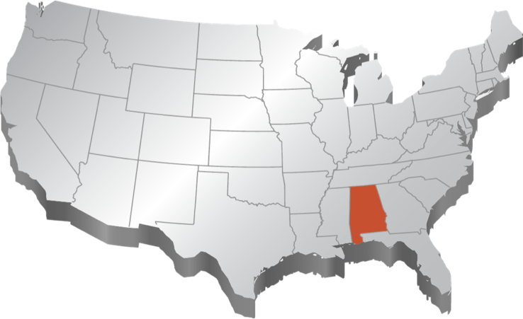
Marshall Space Flight Center
Ames Research Center
Moffett Field, Calif.
Glenn Research Center
Cleveland, Ohio
Armstrong Flight
Research Center
Edwards, Calif.
Goddard Space
Flight Center
Greenbelt, Md.
NASA Headquarters
Washington, D.C.
Langley Research Center
Hampton, Va.
Jet Propulsion Laboratory
Pasadena, Calif.
Kennedy Space Center
Cape Canaveral, Fla.
Johnson Space Center
Houston, Texas
Michoud
Assembly Facility
New Orleans, La.
Marshall Space
Flight Center
Huntsville, Ala.
Stennis Space Center
Bay St. Louis, Miss.

Slide 3

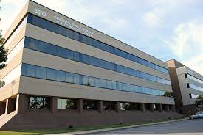
Science Research and Projects Division (SRPD): Who are we?
Mission: SRPD leads scientific missions, innovative technology development, and ground-breaking research to explain the universe, inspire and advance exploration, and improve life on Earth.
Located at the National Space Science and Technology Center (NSSTC; aka “Cramer Hall”) on the University of Alabama in Huntsville (UAH) campus.
250+ science and support staff interacting with counterparts in industry, academia, and resident agencies (e.g., NOAA-National Weather Service)
Unique multi-institutional environment including UAH Space Sciences and Atmosphere and Earth Sciences Departments, IT/Data Centers, labs, and offices
Collaborative research and instrumentation development
World-unique Science Test Branch/capability resident on MSFC Center
Notes:
Both Chief Scientist and us in SRPD have been working on those things, making sure we all align

Slide 4

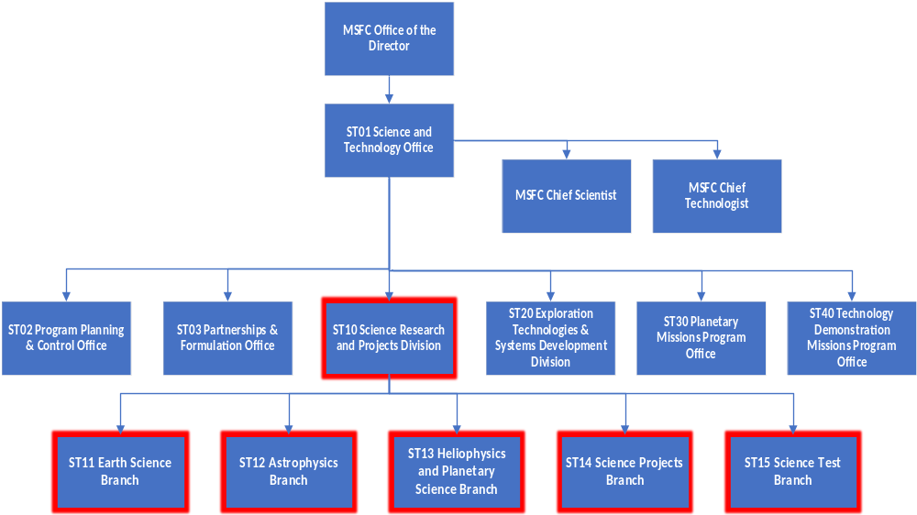
MSFC Science Research and Projects Division (ST10)
ST10
Science Research & Projects Div.
ST11 Earth Science Branch
ST12 Astrophysics Branch
ST13 Heliophysics & Planetary Sci. Branch
ST14 Science Projects Management Branch
ST15 Science Test Branch
Notes:
Both Chief Scientist and us in SRPD have been working on those things, making sure we all align

Slide 5
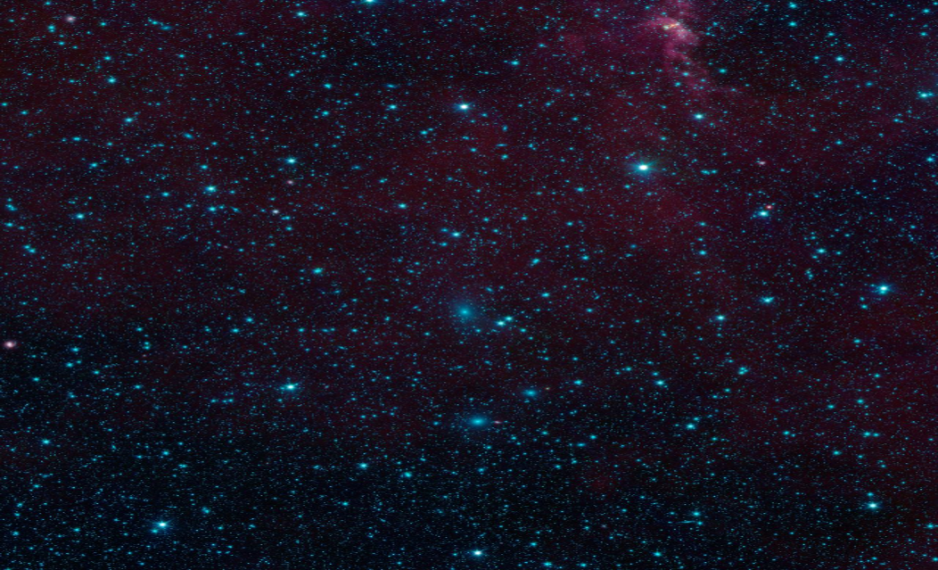
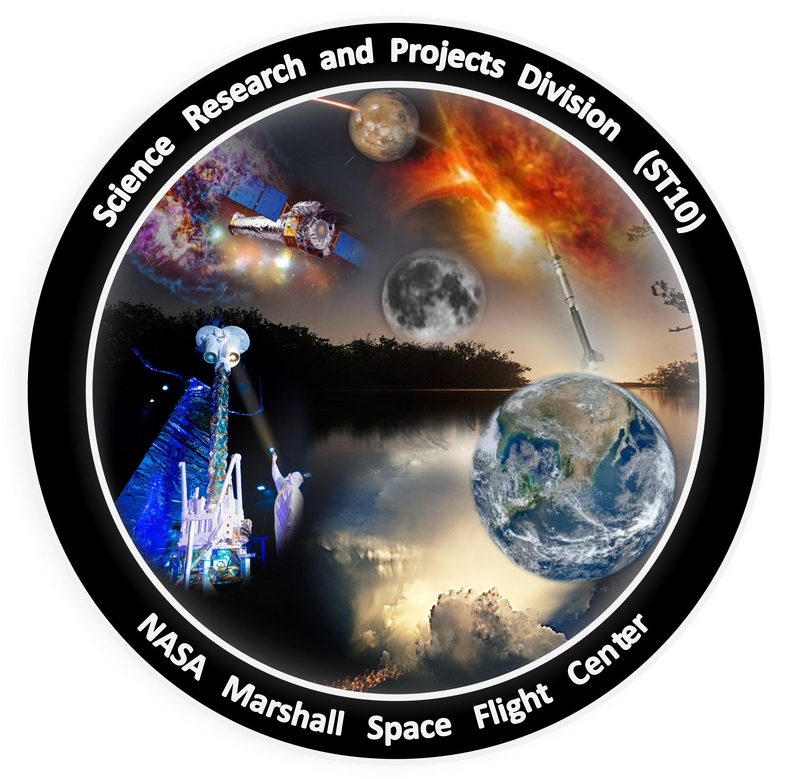
SRPD: Research Spanning the Universe
Astrophysics: Origins and Physics of the Cosmos
Heliophysics: Understanding the Sun and its impact on the solar system.
Science Test and Tech Development: Enabling the next generation science missions
Planetary Science: Science of the Moon, Mars and beyond
Science Project management: Science projects technically complete, on time and within budget
Earth Science: Understanding Earth - Improving life on Earth

Slide 6
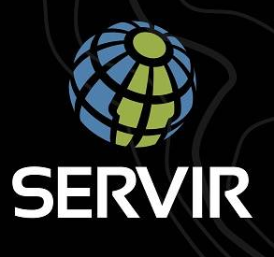
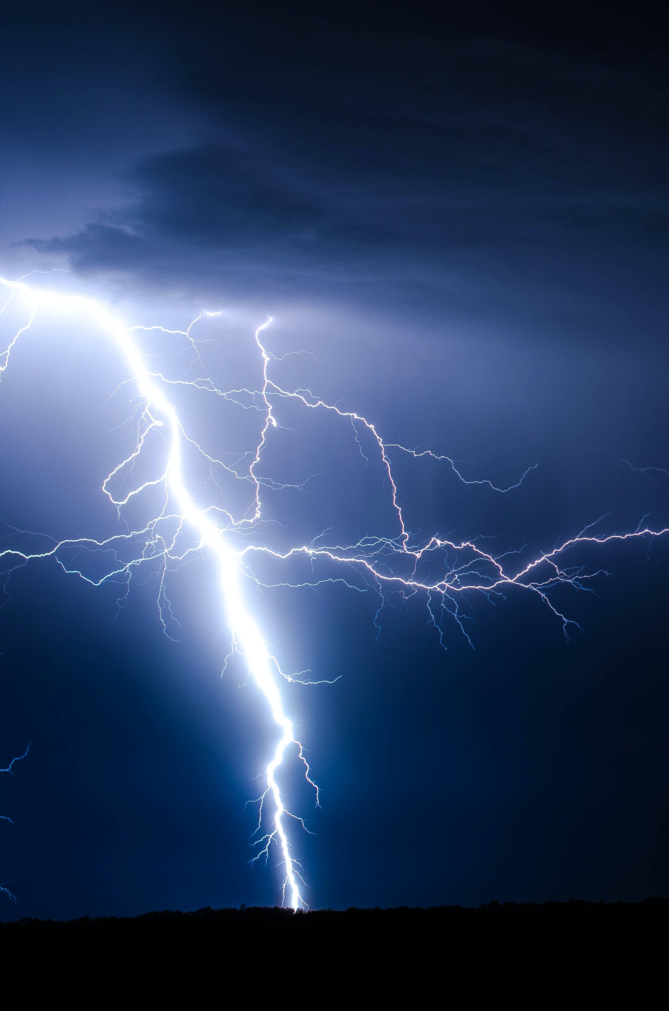
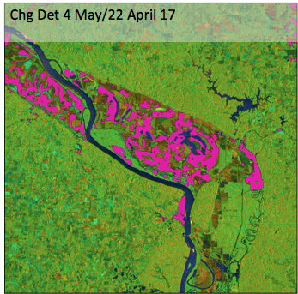
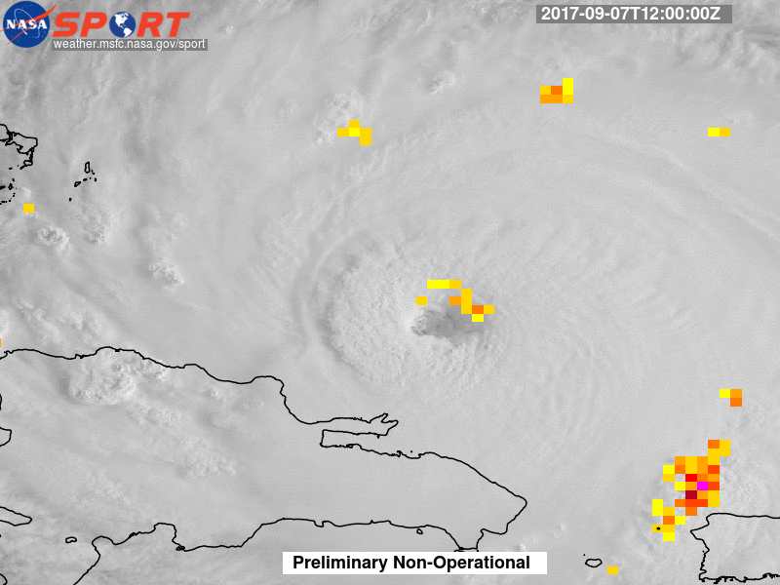
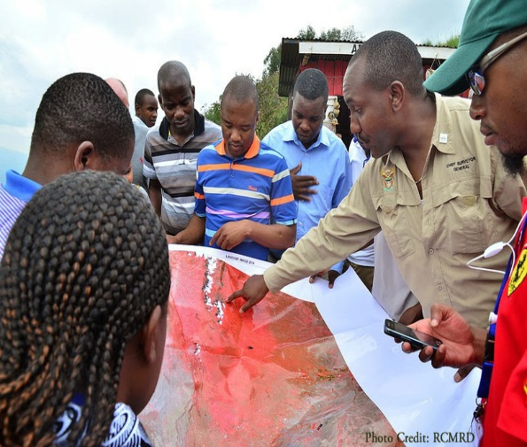
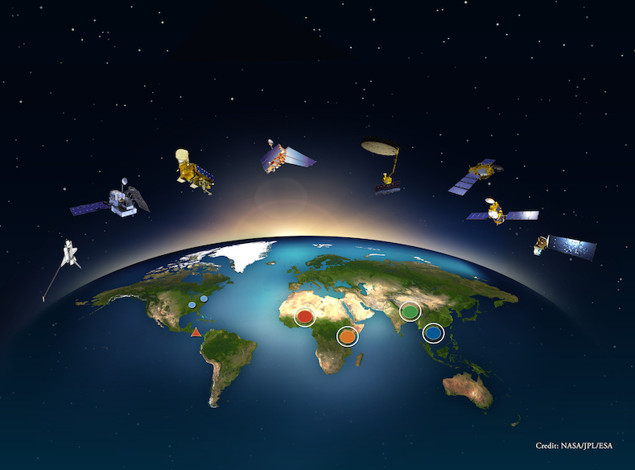
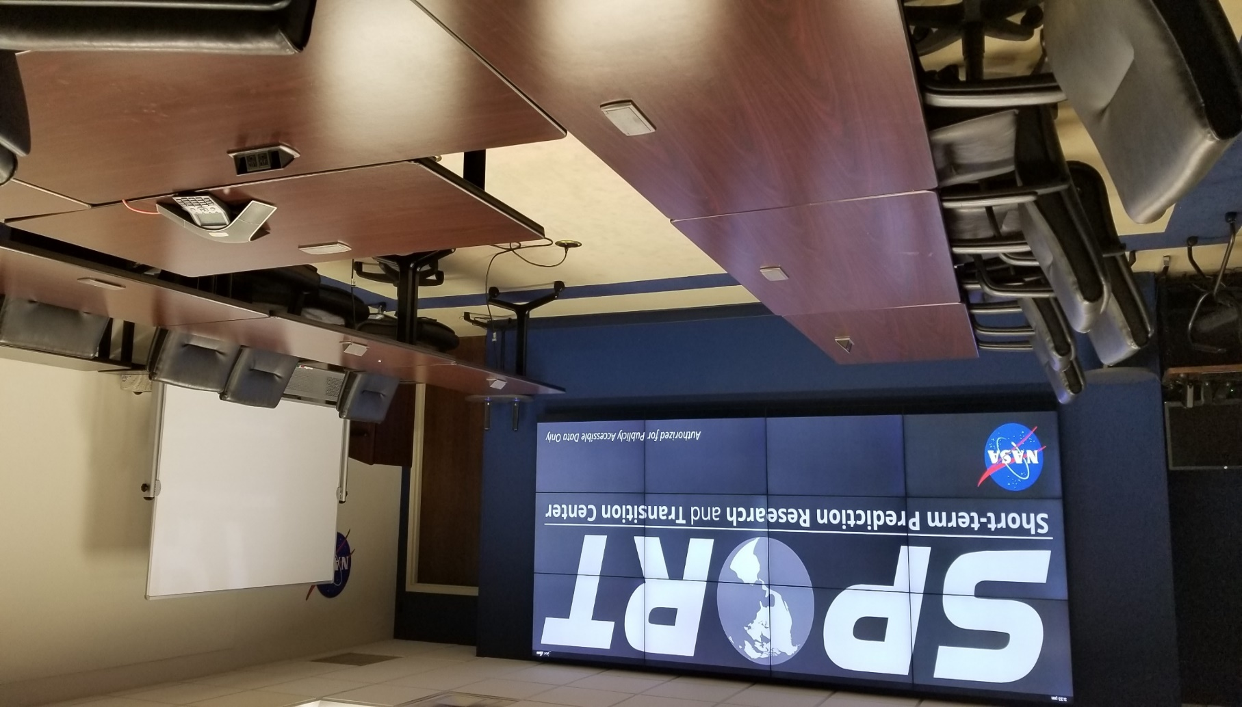

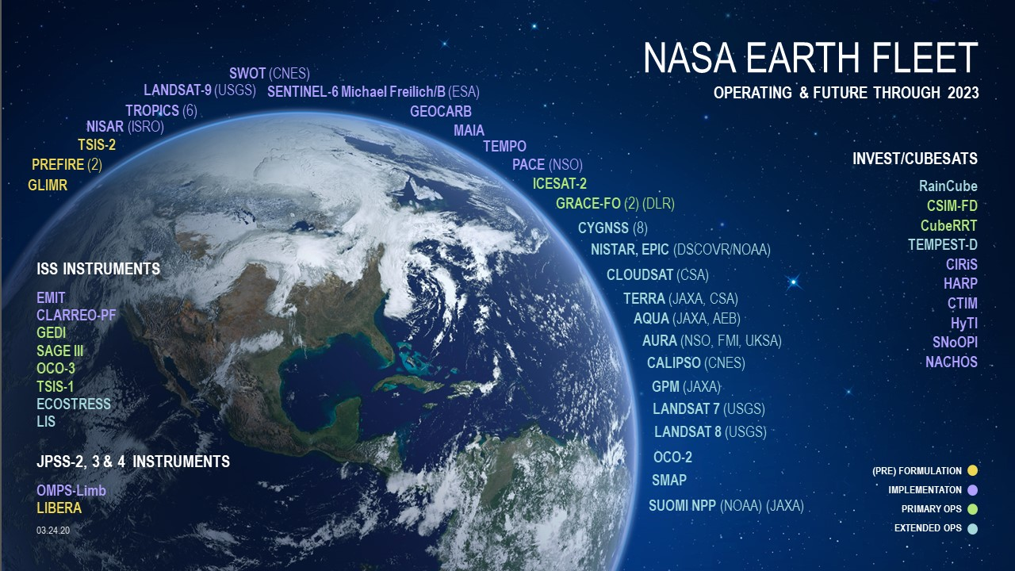
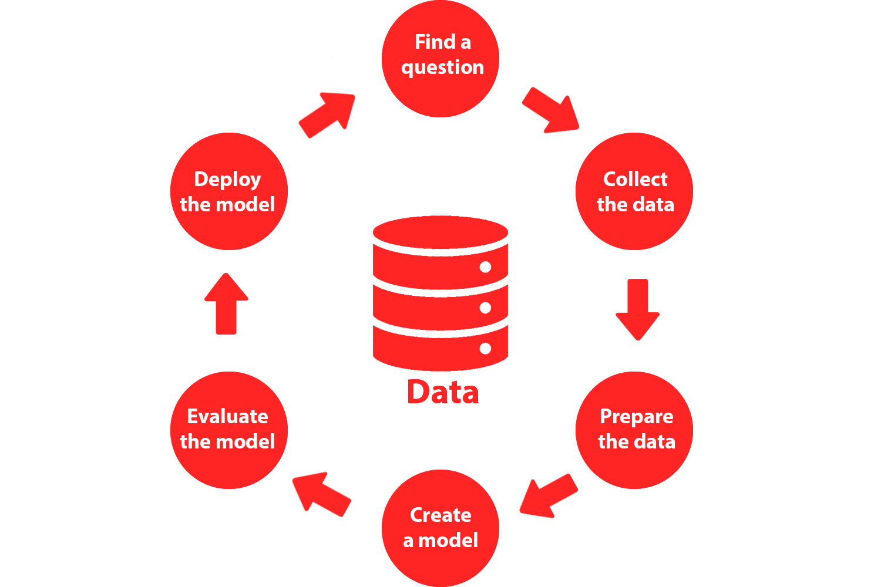

Earth Science Branch (ST11)
Research for knowledge and understanding….Research for application to societal needs
Research: Severe storms, lightning instrumentation, water and energy cycles, land surface change.
R2A/O2R- NASA research transitioned to societal applications in weather forecasting, disaster response, capacity building, climate resilience
Data Science-
  Informatics, curation, and interagency products
  AI/ML tools
  Open-source science/data
Notes:
Script:
The Earth Science Branch mission is integrating unique, space-borne observations, data and models to advance understanding of the Earth’s weather and its energy and water cycles, develop scientific and technical solutions to challenging coupled Earth-atmosphere systems problems and transition research to applications that enable decision support for societal benefit.
To support our mission, we will be expanding our role Agency leaders and innovators of Earth science discovery and focused technology development for capacity-building and societal benefit.
We provide expertise in remote sensing, modeling, and data analysis in atmospheric electricity and lightning, precipitation, the energy and water cycles, atmosphere dynamics and weather, and surface processes studies. We have considerable expertise in data management such as archival, mining, and machine learning for big data problems. We provide leadership to Agency projects including SPoRT, SERVIR, ISS LIS, GHRC DAAC, IMPACT, and Disaster monitoring. We also provide instrument development, validation, and science for spaceflight and suborbital missions. We are involved in decadal survey study team activities supporting future Earth science missions.

Slide 7
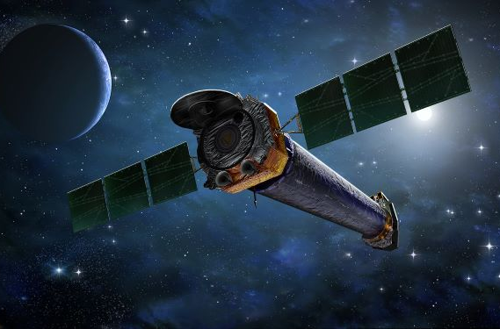
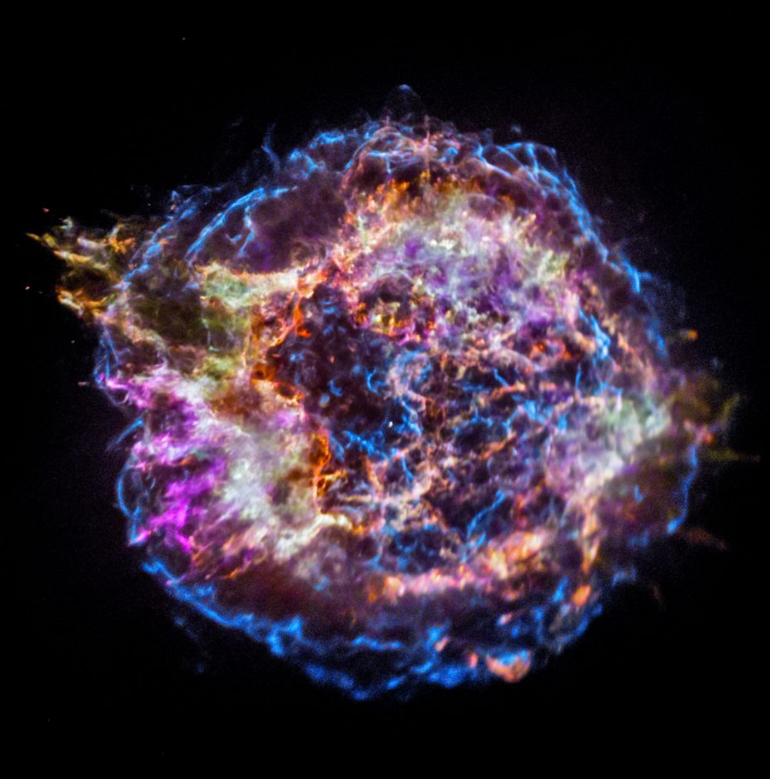
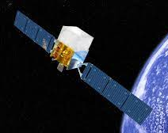
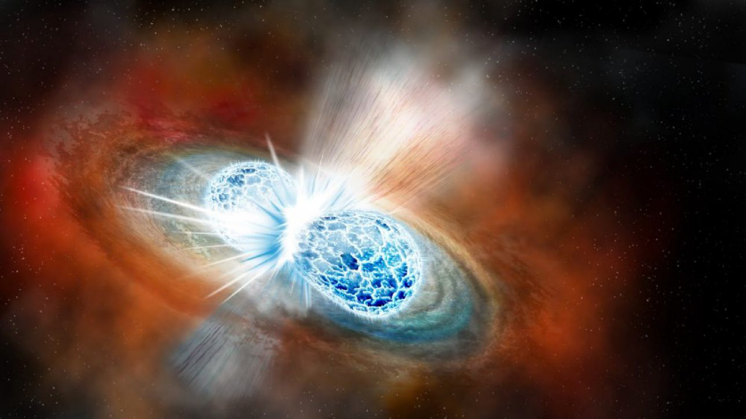
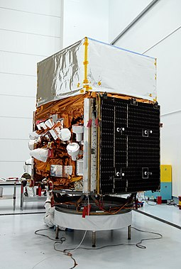
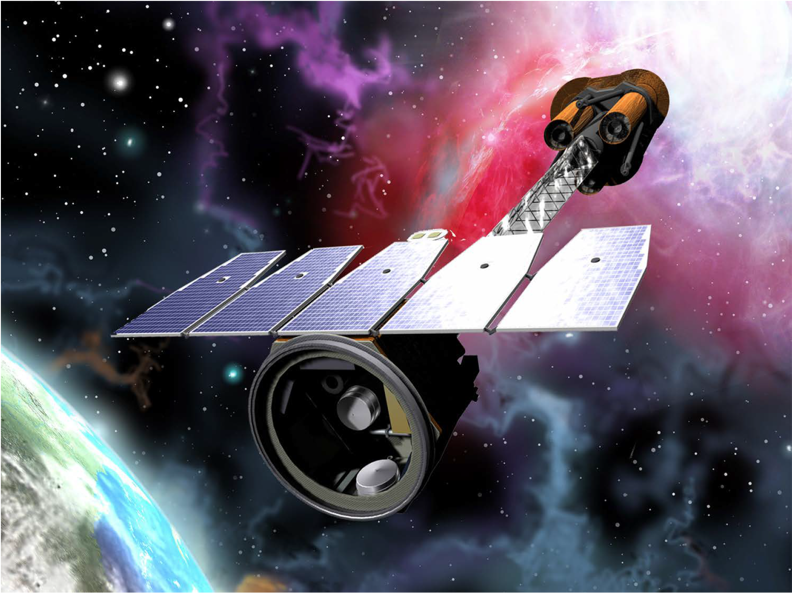
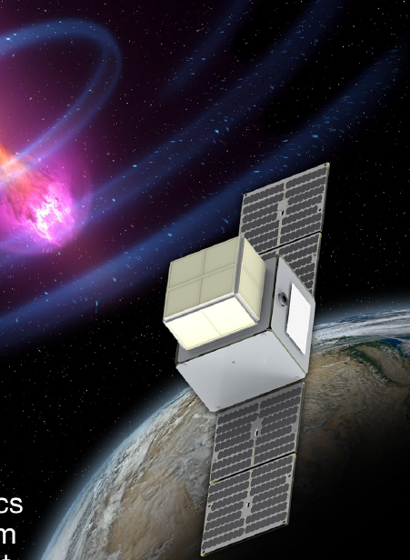
Astrophysics Branch (ST12)
Unlocking the secrets of the Universe through the study of high-energy astrophysics
  X-rays from Blackholes, Neutron Stars, X-ray high resolution grazing incidence and replicated optics
  IR, Optical, UV Normal incidence optics and telescope technology development and testing
  Relativistic and “multi-messenger” Astrophysics, gamma ray sensors and detection
Fermi-GBM
Chandra
StarBurst
Gravitational waves and multi-messenger Astrophysics
IXPE
Notes:
Script:
Our mission at the Astrophysics Branch is to unlock the secrets of the Universe through the study of high-energy astrophysics.
In support of this mission, we perform cutting edge science that leads to discovery and use that to develop new technology that will enable future missions of exploration in high energy astrophysics.
Our technical capabilities are implemented by three teams, the X-ray team, the Relativistic Astrophysics Team, and the Cosmic Ray/Neutron Detector Team.
Our X-ray Team is composed of experimentalists known for their expertise in X-ray Optics, as well as astronomers known for their expertise in X-ray polarimetry and their contributions to the understanding of neutron stars and ultra-luminous X-ray sources. In addition, our astronomers are provide scientific and technical leadership of flagship NASA missions Chandra and Lynx.
Our relativistic astrophysics team are experts in time-domain astrophysics research in the areas of gravitational waves and their electromagnetic counterparts, gamma-ray bursts, X-ray binaries, variable hard X-ray and gamma-ray sources, and counterparts to neutrinos and other transient phenomena. They are active in the development of future X-ray and gamma ray instruments and missions that enable time-domain research in the era of multimessenger astrophysics. They develop and deploy data science solutions for the detection, characterization, and interpretation of gravitational wave observations from the ground for the Laser Interferometer gravitational-wave Observatory (LIGO) and gamma ray burst detection via the Gamma-Ray Burst Monitor, or GBM, in low earth orbit. They also provide software and data analysis for GBM target searches for joint events, as well as software to increase the availability of the data to the community. Finally, the perform data science research and development for the LISA gravitational wave mission.
Our Cosmic Ray/Neutron Detector Team investigates cosmic ray sources and properties through direct measurements via ATIC, JACEE, and TaSEPS and indirect measurements through EUSO and POEMMA. They contribute to science instrument design, data analysis, and interpretation. Their experiments include particle accelerator based testing, sub-orbital high-altitude balloon platforms, and space flight missions. Their instrumentation design and fabrication skills are applied to astronaut radiation dosimetry and planetary science neutron detection.

Slide 8
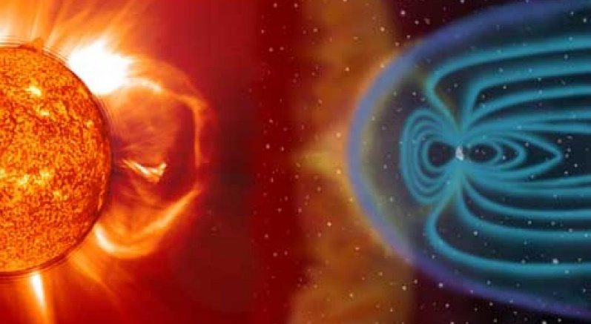
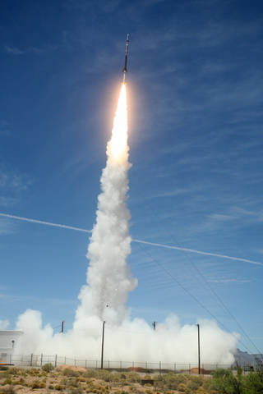
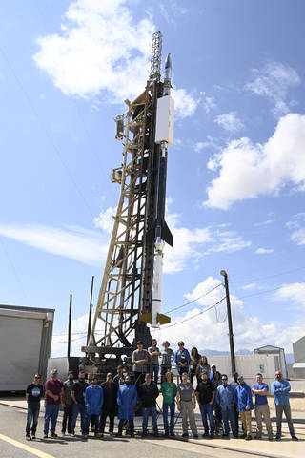
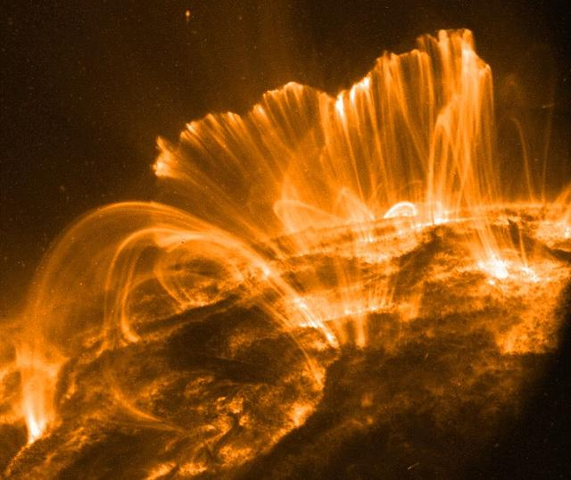
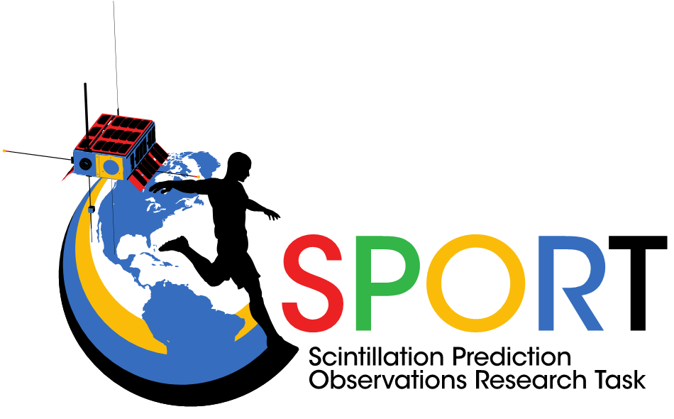
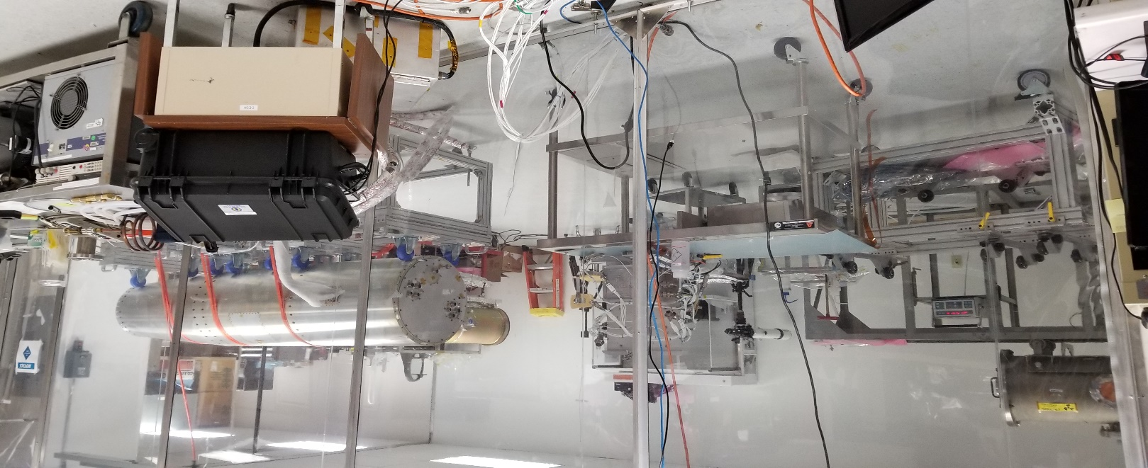
Heliophysics and Planetary Science Branch (ST13)
Research of Solar Processes and their Impacts on the Solar System
Energy transfers in the solar atmosphere
Solar-observing sounding rocket flight program and instrumentation development (a bridge to flight!)
Laboratories for instrumentation development, assembly, integration and test
Space weather, plasma and ionospheric research, instrument development, research to applications
Notes:
Script:
The Earth Science Branch mission is integrating unique, space-borne observations, data and models to advance understanding of the Earth’s weather and its energy and water cycles, develop scientific and technical solutions to challenging coupled Earth-atmosphere systems problems and transition research to applications that enable decision support for societal benefit.
To support our mission, we will be expanding our role Agency leaders and innovators of Earth science discovery and focused technology development for capacity-building and societal benefit.
We provide expertise in remote sensing, modeling, and data analysis in atmospheric electricity and lightning, precipitation, the energy and water cycles, atmosphere dynamics and weather, and surface processes studies. We have considerable expertise in data management such as archival, mining, and machine learning for big data problems. We provide leadership to Agency projects including SPoRT, SERVIR, ISS LIS, GHRC DAAC, IMPACT, and Disaster monitoring. We also provide instrument development, validation, and science for spaceflight and suborbital missions. We are involved in decadal survey study team activities supporting future Earth science missions.

Slide 9
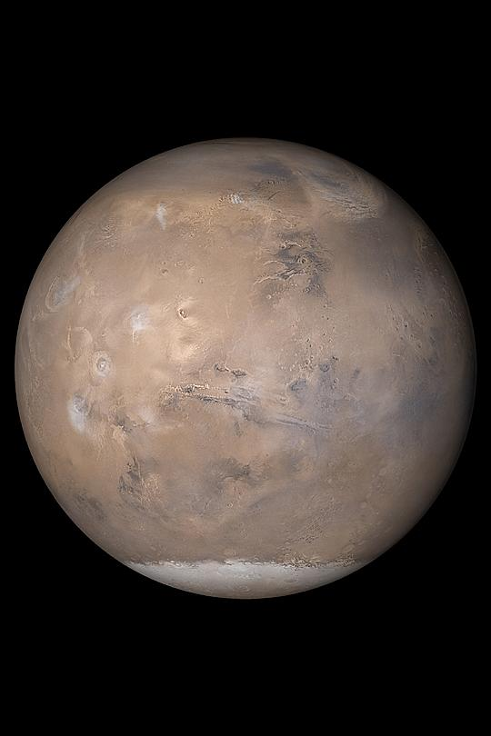
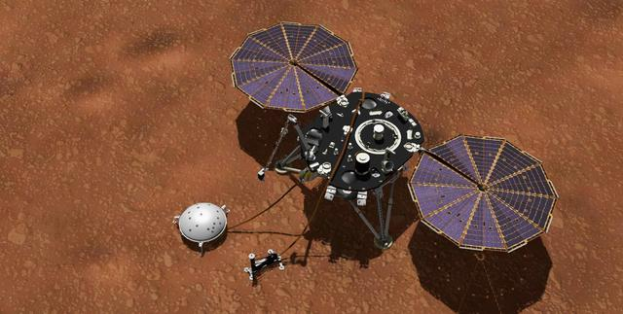
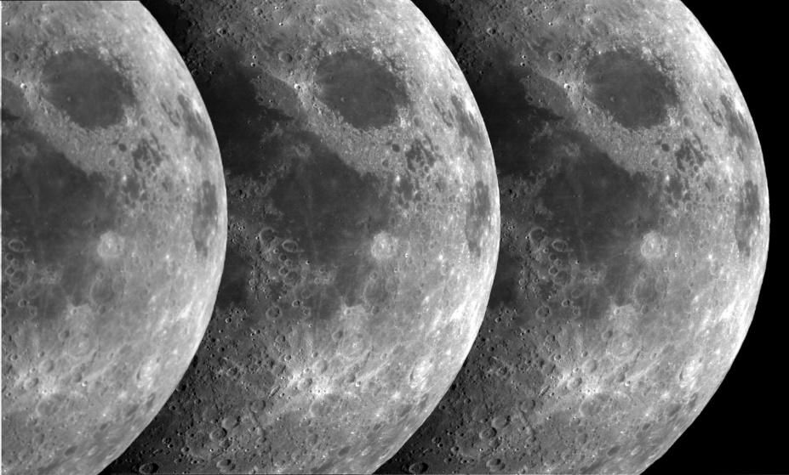
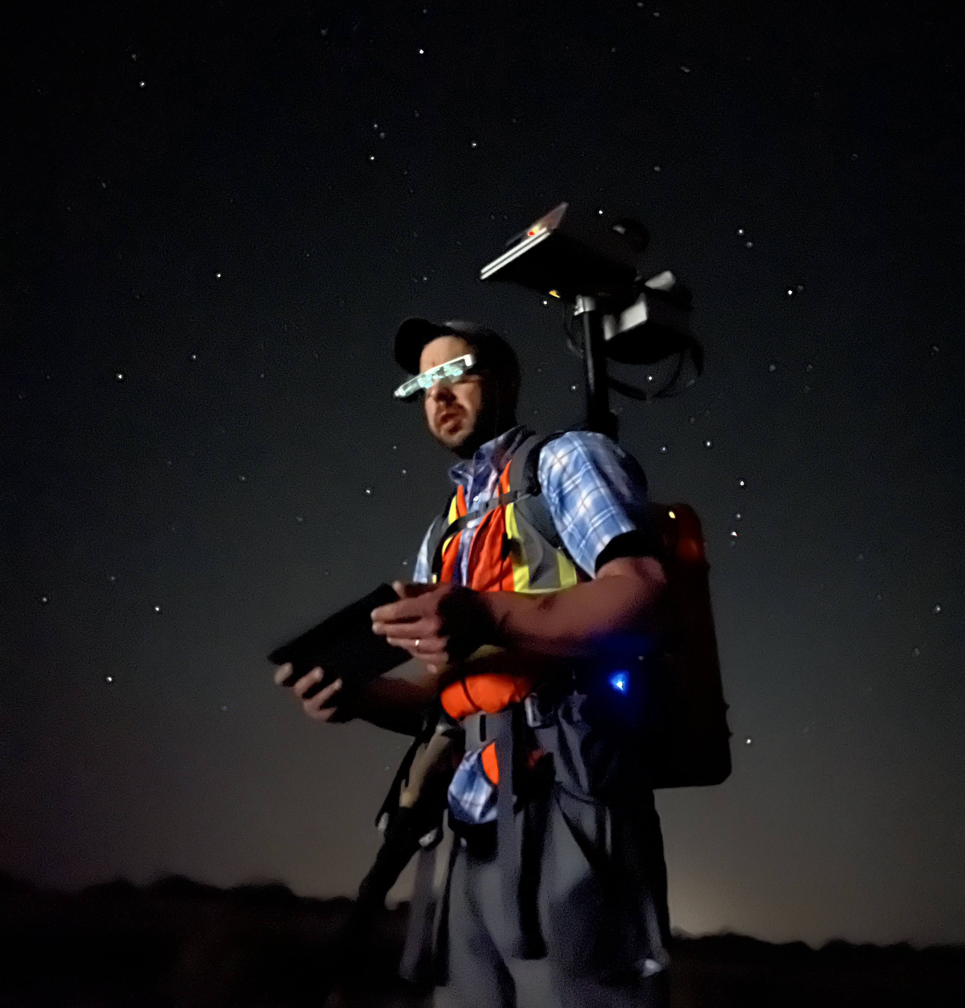
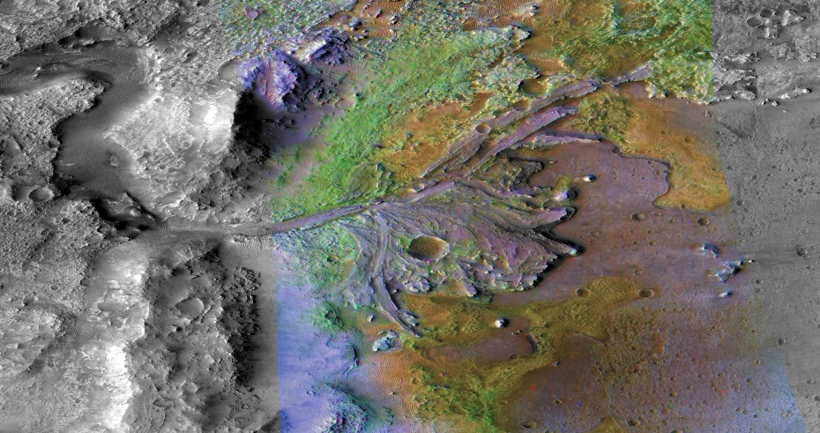
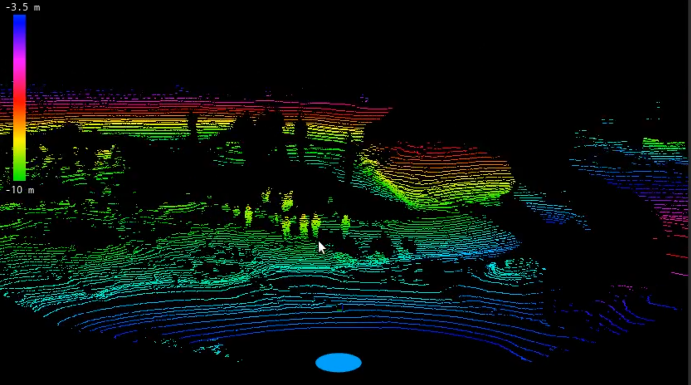
Heliophysics and Planetary Science Branch (ST13)
Science to the Moon, Mars and Beyond
Planetary Surfaces and Interiors (geology, geomorphology, geophysics/seismology….)
Planetary Terrain Mapping and Navigation
Science Integration with Exploration Capabilities
Notes:
Script:
The Earth Science Branch mission is integrating unique, space-borne observations, data and models to advance understanding of the Earth’s weather and its energy and water cycles, develop scientific and technical solutions to challenging coupled Earth-atmosphere systems problems and transition research to applications that enable decision support for societal benefit.
To support our mission, we will be expanding our role Agency leaders and innovators of Earth science discovery and focused technology development for capacity-building and societal benefit.
We provide expertise in remote sensing, modeling, and data analysis in atmospheric electricity and lightning, precipitation, the energy and water cycles, atmosphere dynamics and weather, and surface processes studies. We have considerable expertise in data management such as archival, mining, and machine learning for big data problems. We provide leadership to Agency projects including SPoRT, SERVIR, ISS LIS, GHRC DAAC, IMPACT, and Disaster monitoring. We also provide instrument development, validation, and science for spaceflight and suborbital missions. We are involved in decadal survey study team activities supporting future Earth science missions.

Slide 10
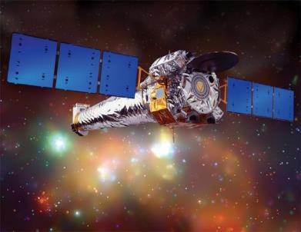
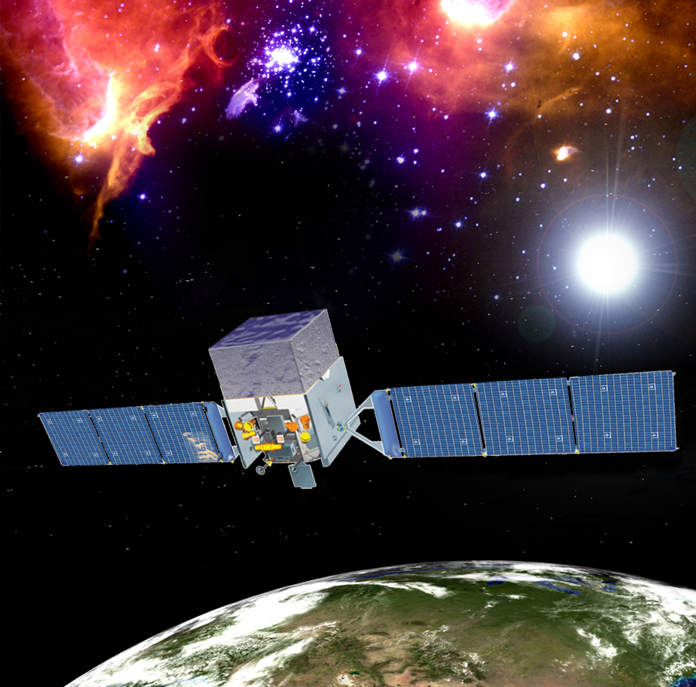
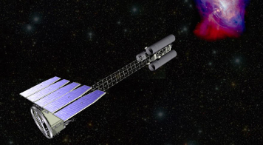
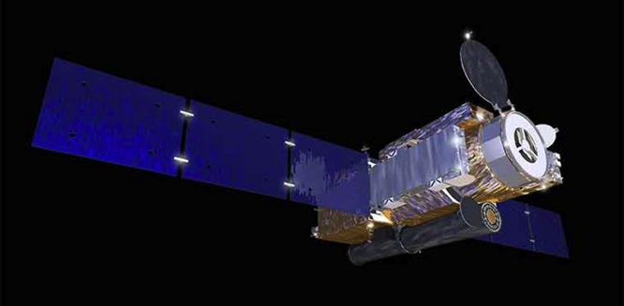
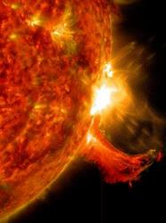
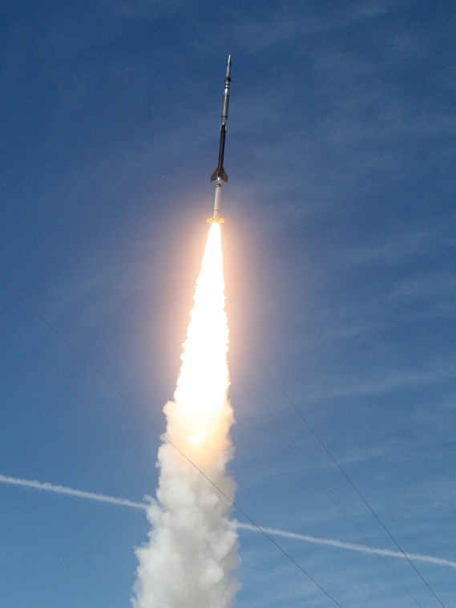



Science Project Management Branch (ST14)
Project management and oversight supporting numerous cutting-edge science missions, projects, and teams across the Division.
Chandra
Fermi-GBM
Science Project Management Capabilities
Experience with multiple sizes/class of projects (early studies, ISS, sounding rockets, instruments, cube sats, SMEX, Flagship)​
Experience in all project phases from proposal development through Phase E
Experience in non-flight project management (e.g., SERVIR, IMPACT, SNWG, TOPS)
Experience with International partners​
External Agency Customer experience and strong relationship with HQ stakeholders​
Contract oversight ​
Agency-level Decadal Study experience​
Strong working relationship with core engineering and test teams​
IXPE
Hinode
Hi-C, MaGIXS, CLASP/2.1….

Slide 11
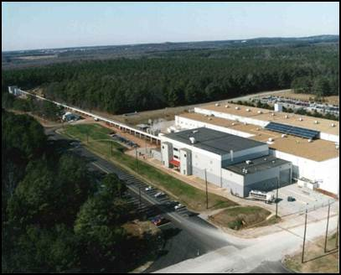
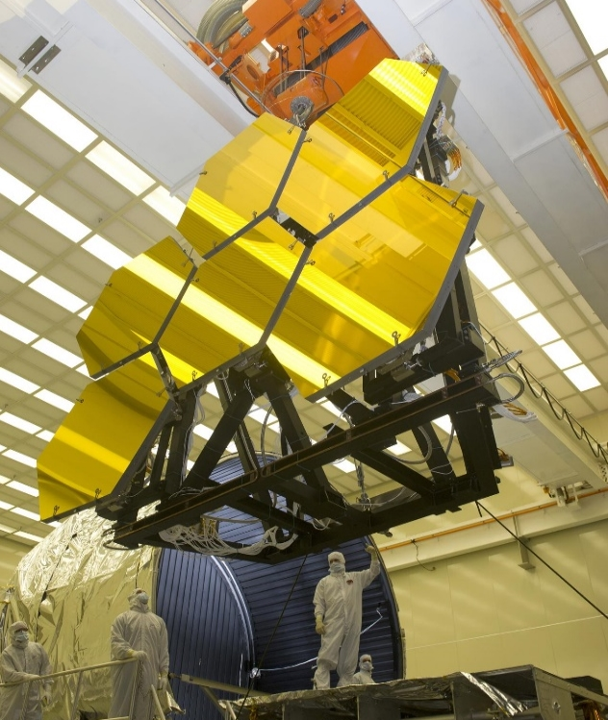
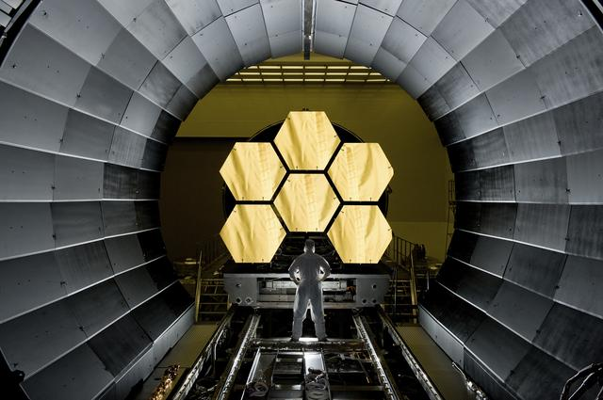
Science Test Branch (ST15)
Assembly, integration, metrology, calibration, and space environment test services for pre-flight verification of science instruments and missions.
The X-ray and Cryogenic Facility (XRCF):
World’s largest x-ray optical test facility
Provides evaluation and readiness testing for advanced telescope mirrors, video guidance systems, and other space structures in thermal environments to 20 Kelvin.
Technical Capabilities:
Thermal Vacuum Chamber
Thermal Environments
Clean Rooms
Illumination Beam Line Capabilities
Beamline/Optical Shared In-Chamber Systems
Beamline associated In-Chamber systems
Optical Test Capabilities (Optical Test Window, Metrology Positioning/Alignment, Metrology Instruments, Optical Test Stability, Mirror Test Capability)

Slide 12
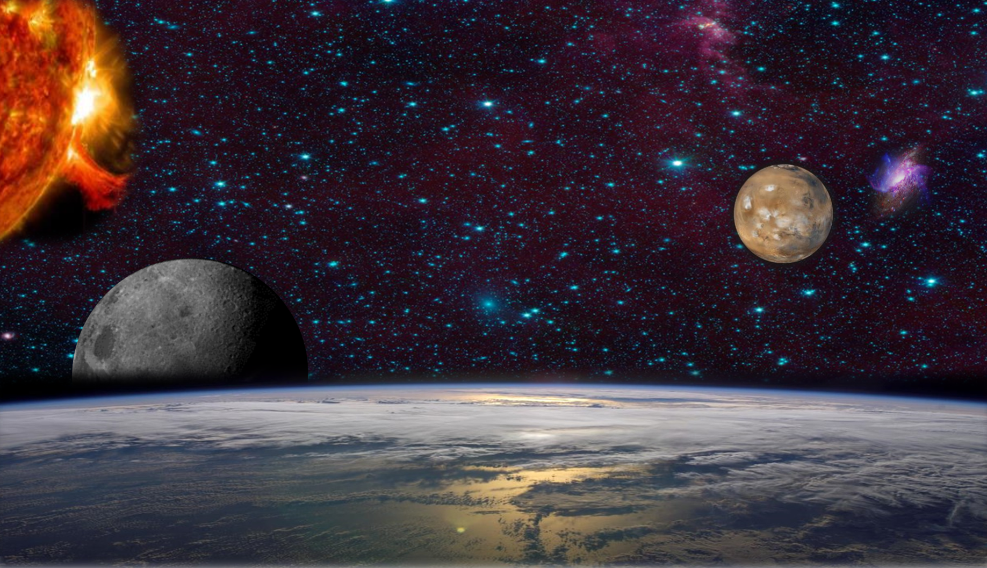
Thank You!

