Slide 1
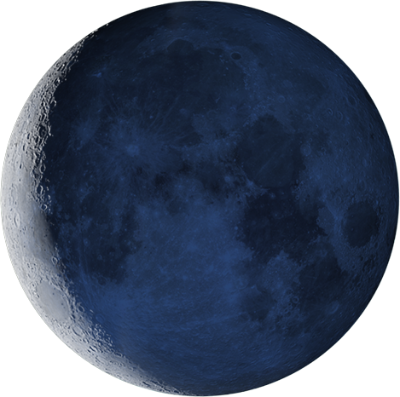
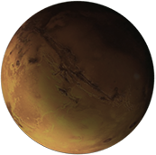

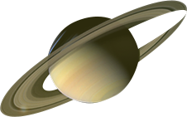
Non-volatile Reconfigurable Optics
Kiumars Aryana
Postdoctoral Fellow, Advanced Measurements and Data Systems Branch (ADMSB)
NASA Langley Research Center
Advisor: Dr. Hyun Jung Kim
1

Slide 2
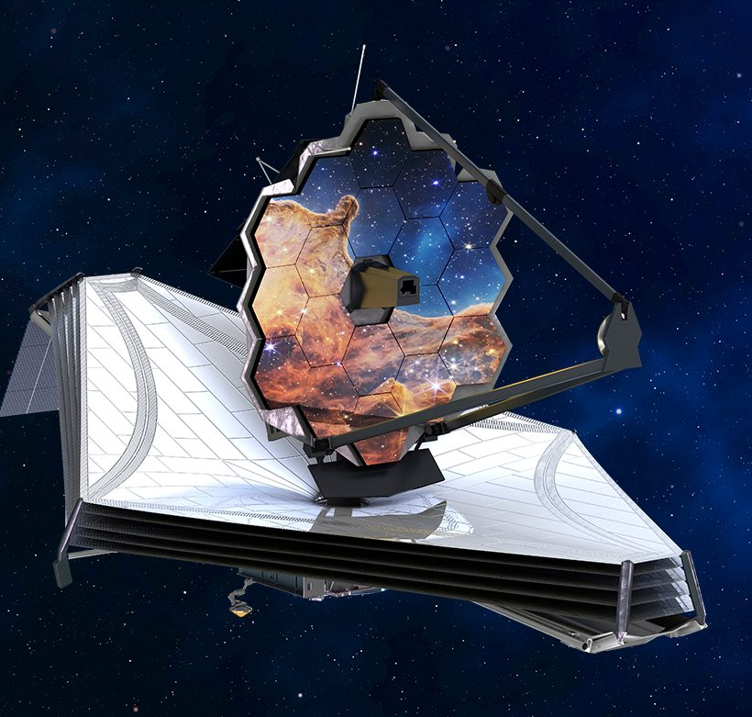
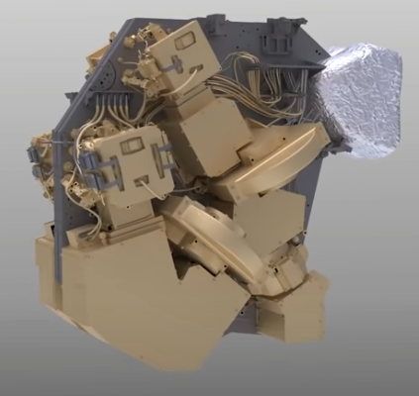
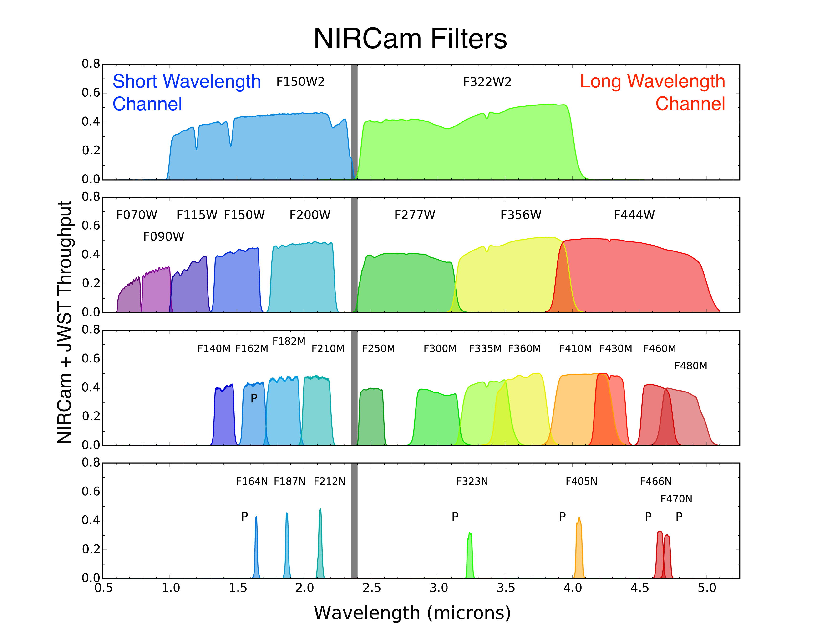
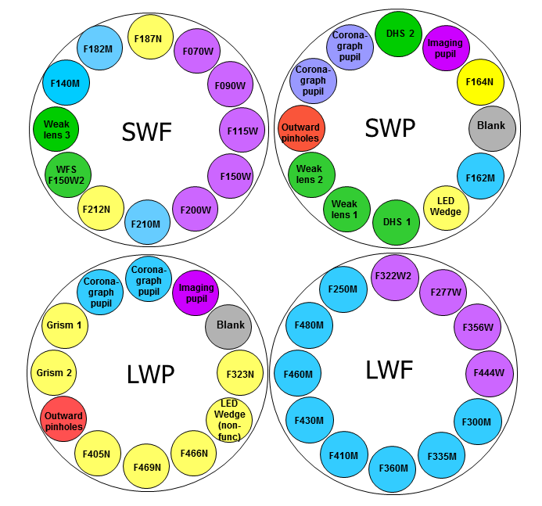
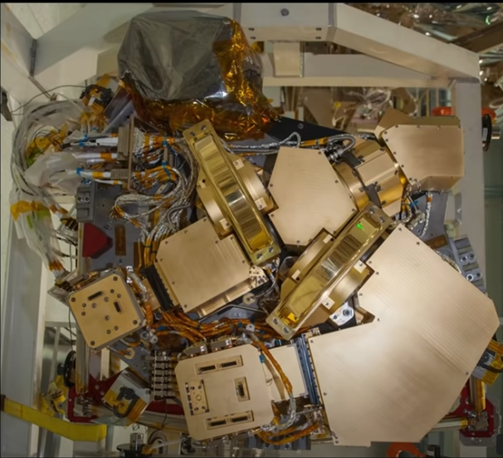
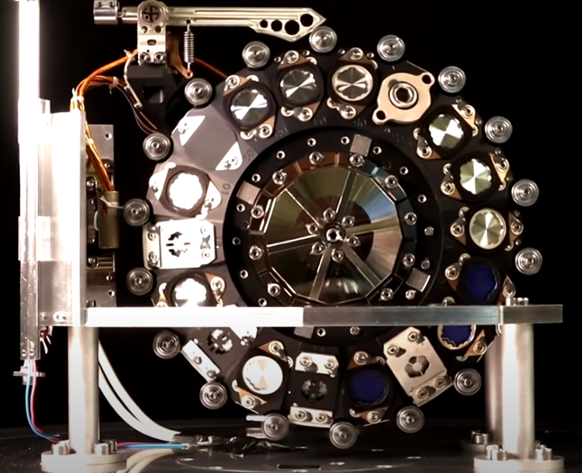
Tunable Optics for Space Explorations
JWST
NIRCam
https://www.youtube.com/watch?v=MzWfUK0yvdY
0.6-5 µm
Long Wavelength Filter Wheel
Short Wavelength Filter Wheel

Slide 3
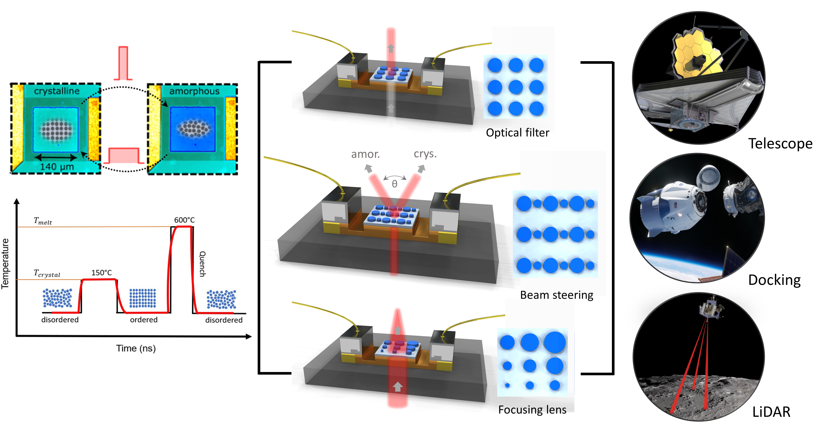
Tunable Optics for Space Explorations

Slide 4
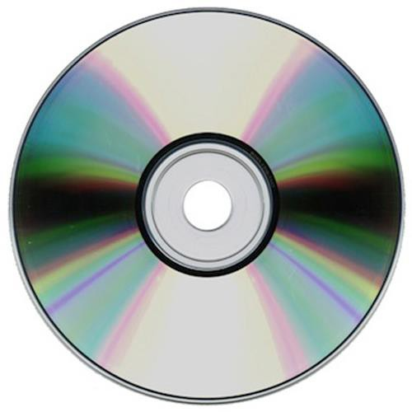
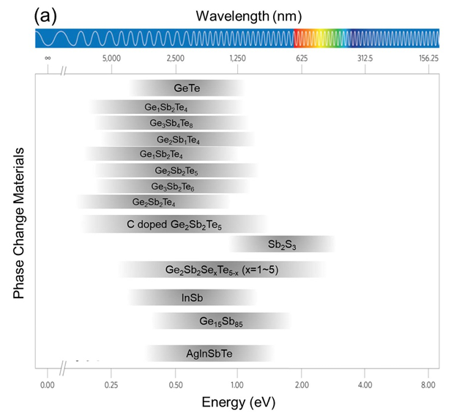
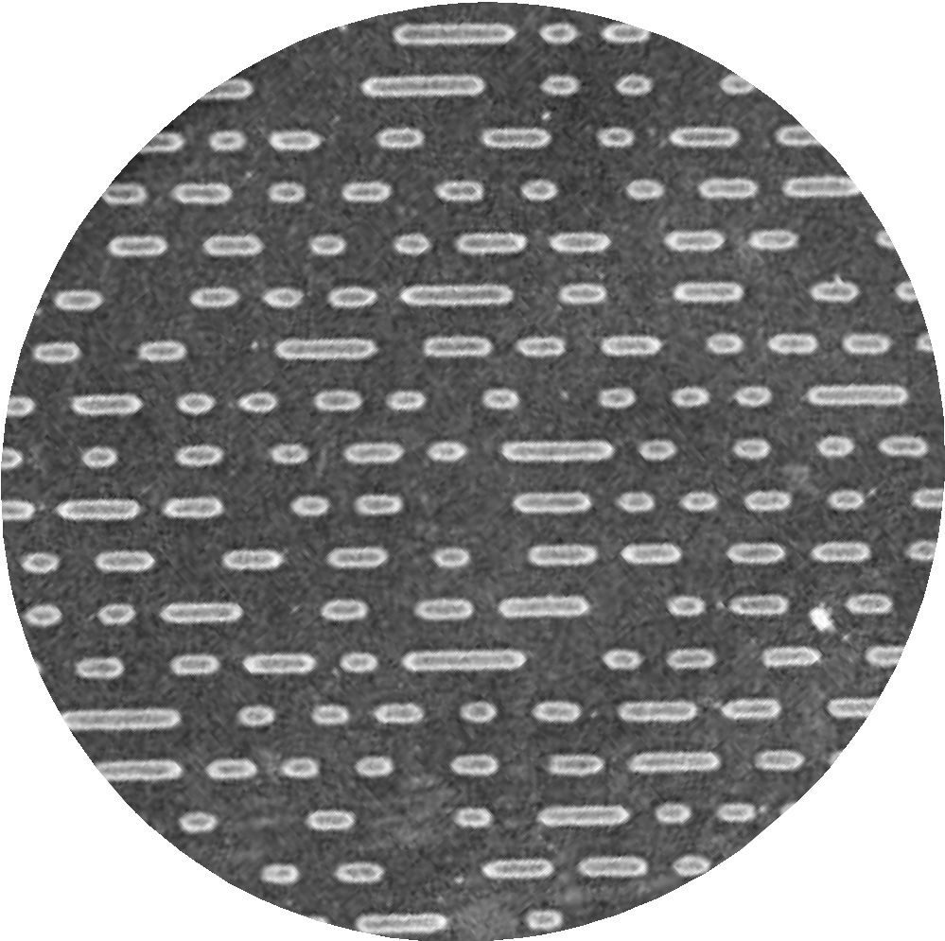
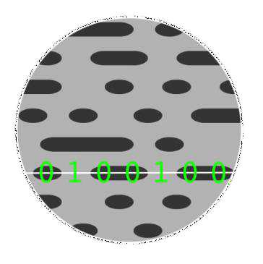
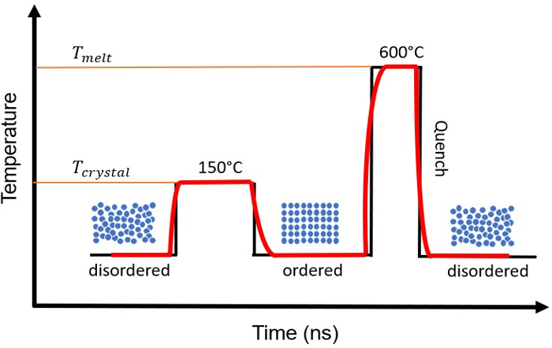
Phase Change Materials - Chalcogenide
Rewritable DVD
Journal of Physics: Photonics 3.2 (2021) 024008
4
Notes:
PCMs are a class of materials that can be reversibly switched back and forth between their amorphous and crystalline structure for millions of cycles via thermal excitation. One of the earliest application of phase-change materials have been associated with data storage, or rewritable CD and DVDs. Because of their large optical contrast between amorphous and crystalline structures, it was possible to optically deliver heat and raise switch them between the two phases. For this, if the temperature of the amorphous phase is raised to above its glass transition temperature, the material becomes crystal and if the material temperature is raised above it melting point and quickly cooled down to room temperature, the atoms will not have sufficient time to reorient into their more stable ordered structure, and thus, a supercooled liquid phase or “amorphous” phase is formed. The beauty of PCMs is that depending on the application, their properties can be changed. The plot here shows the wavelength that different PCMs can operate depending on their composition.

Slide 5
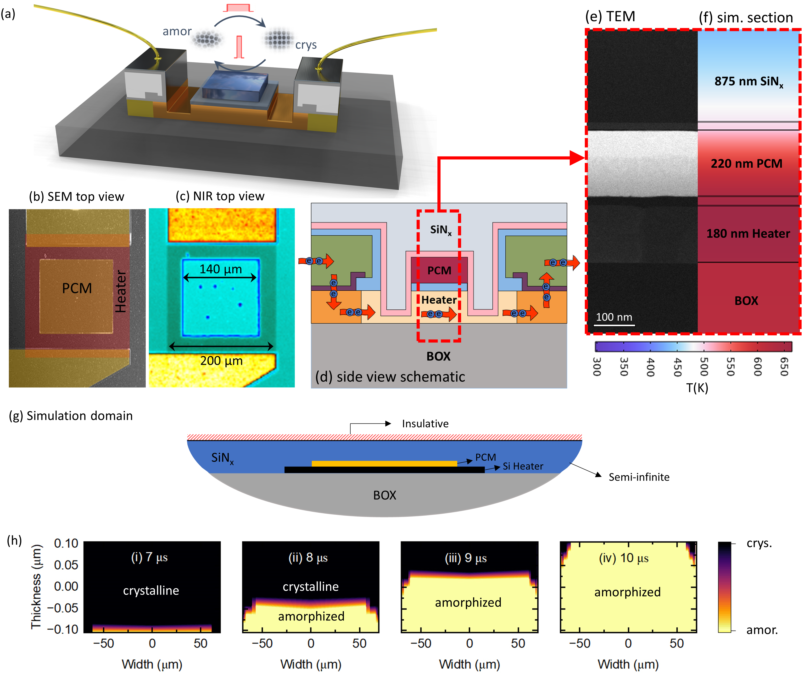
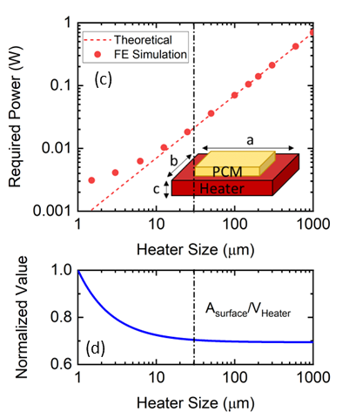
Phase Transition Thermodynamics
Aryana et al. 2023, Small

Slide 6
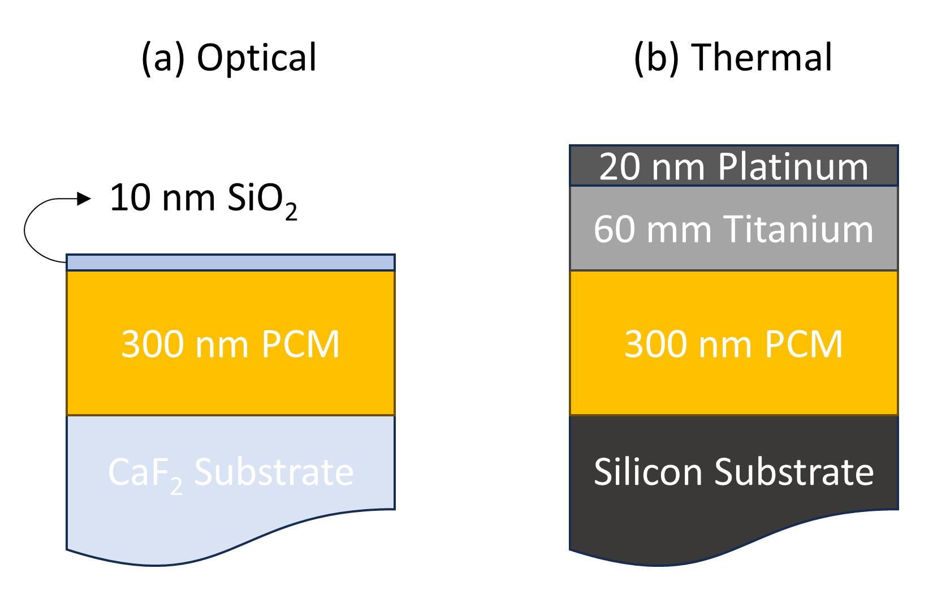
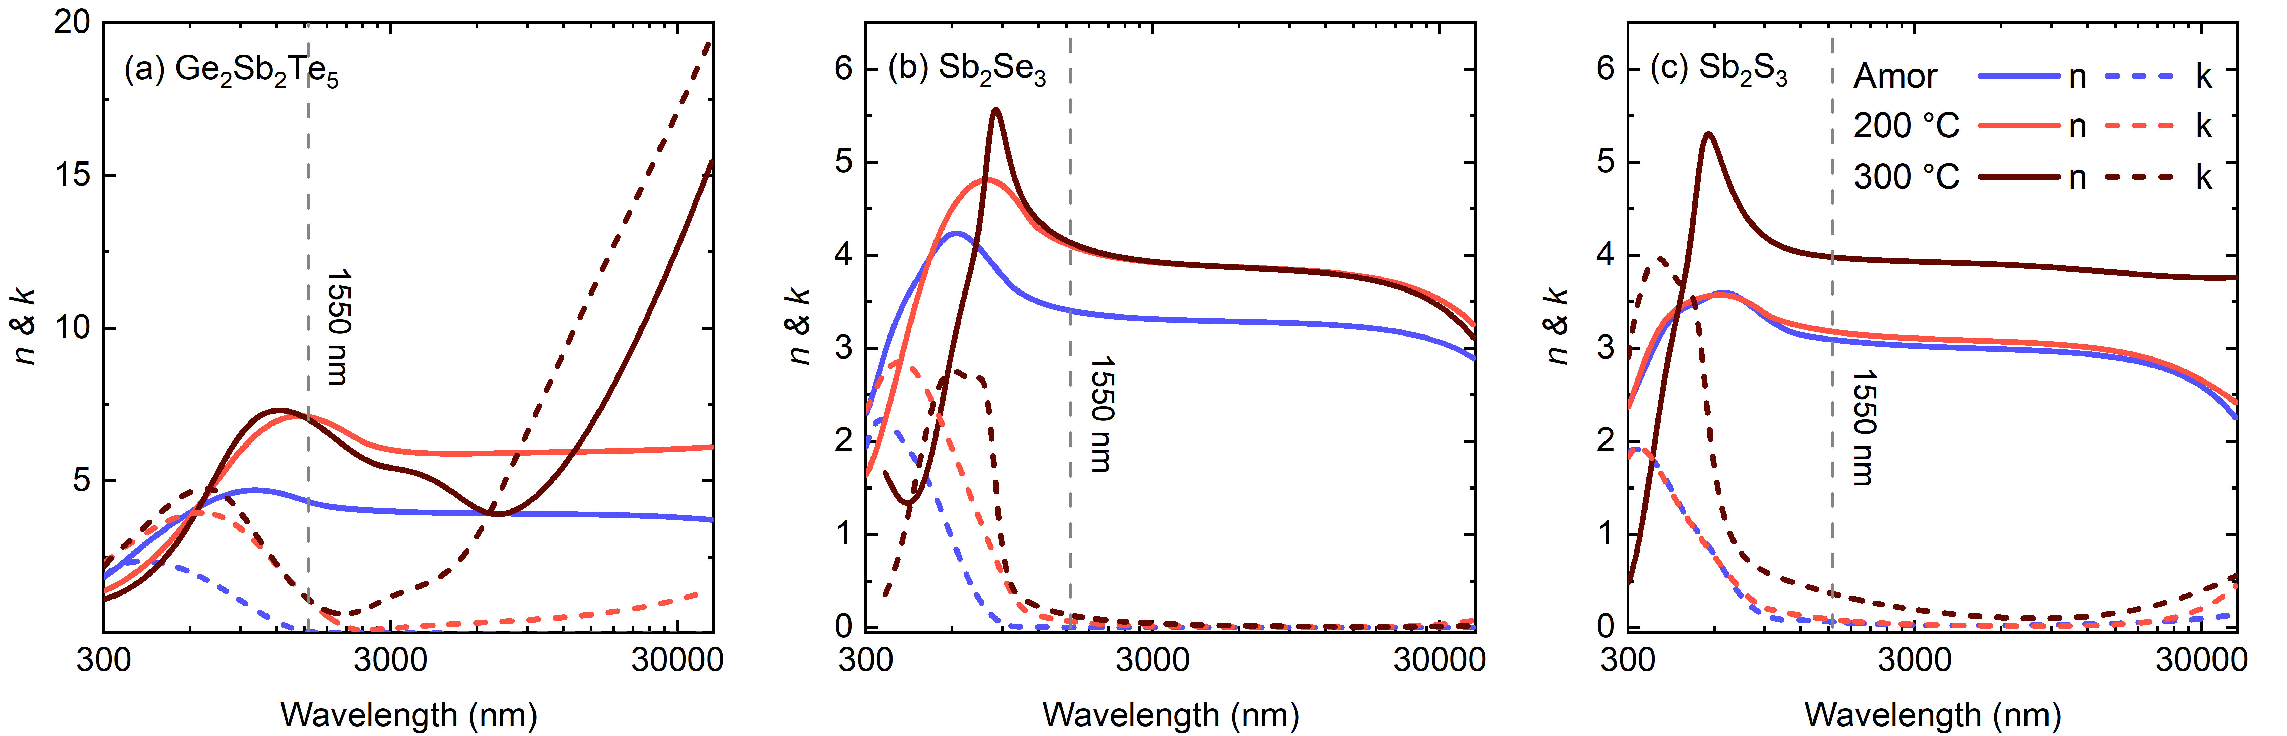
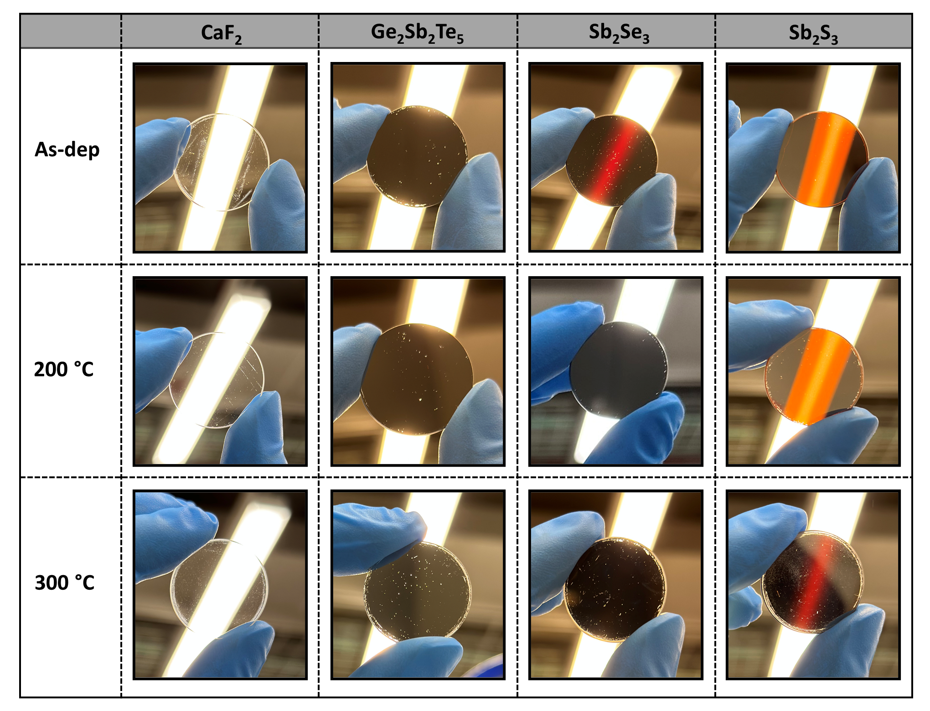
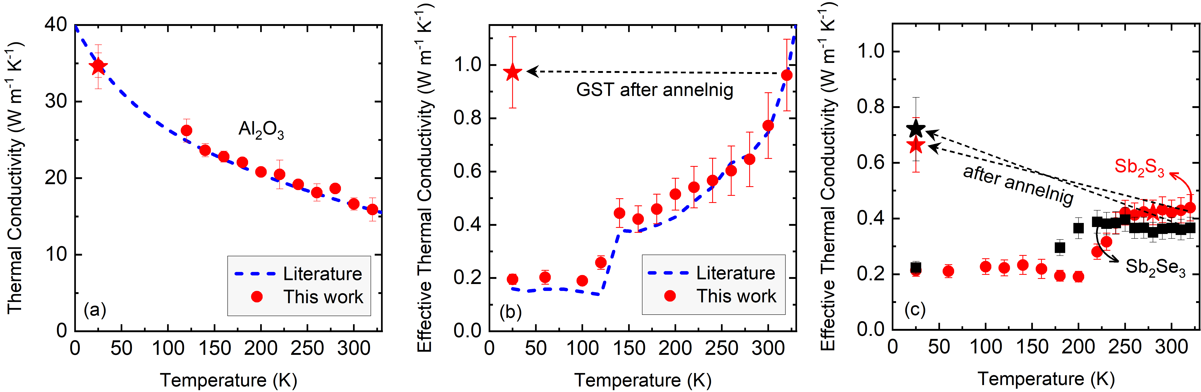
Optical and Thermal Properties
Aryana et al. 2023, Optical Materials Express

Slide 7
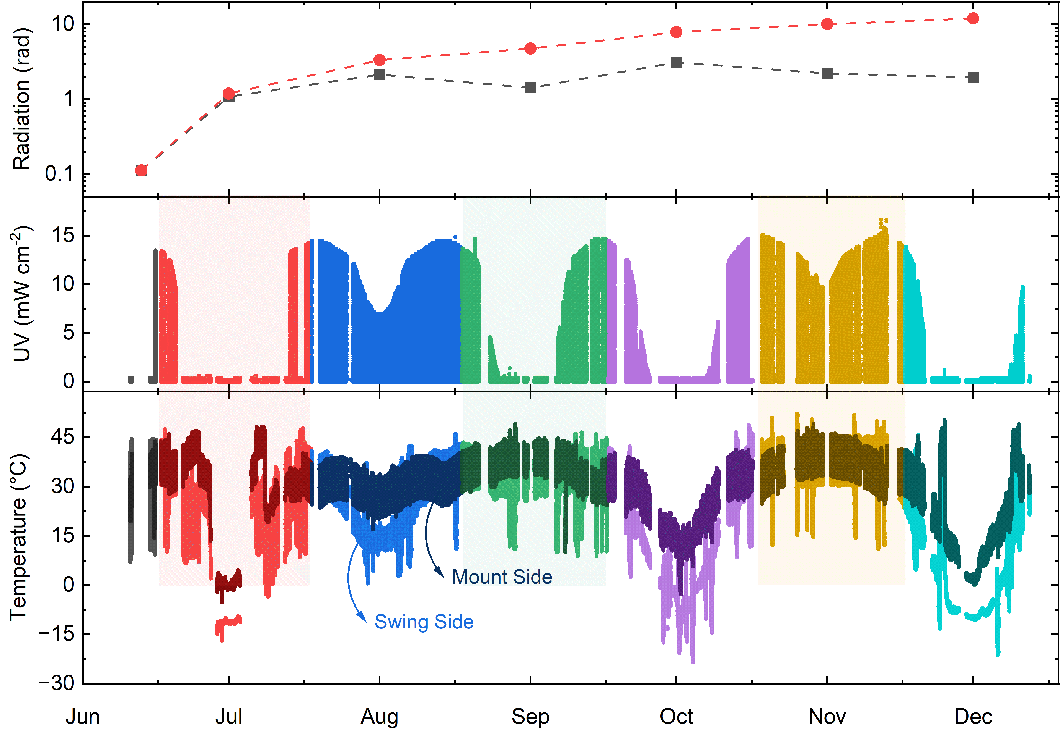
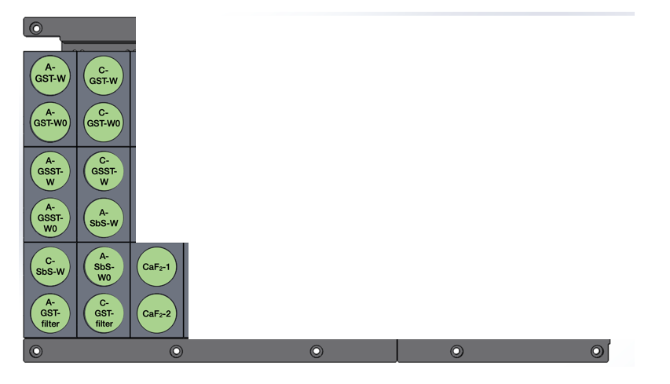
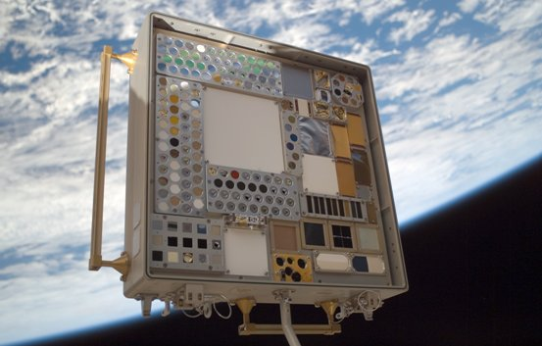
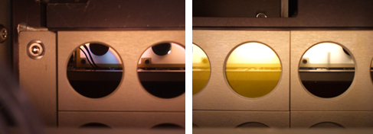
PCMs Performance in Space
Materials International Space Station Experiment (MISSE)
Under review in npj Microgravity

Slide 8
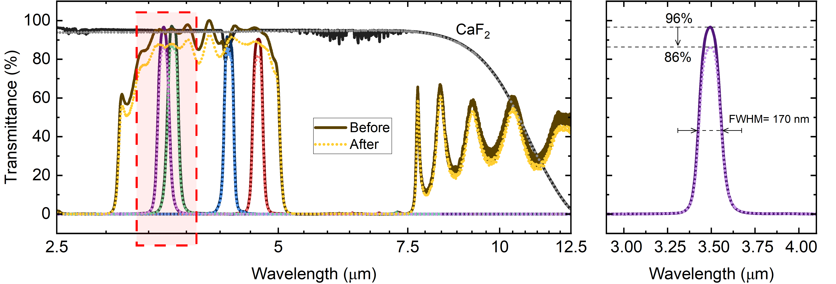
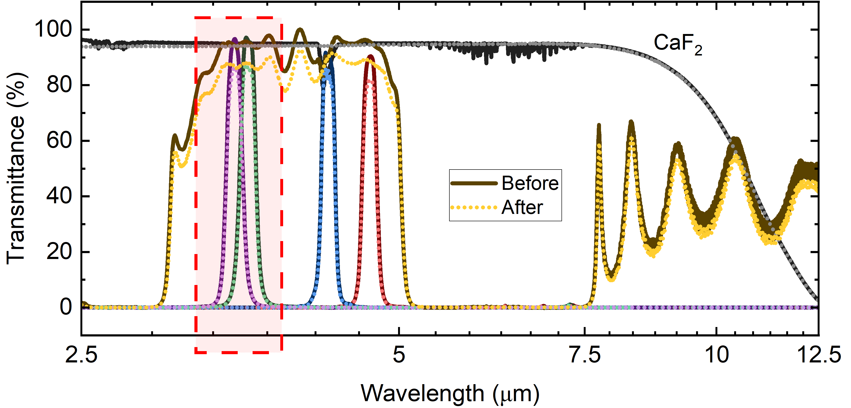
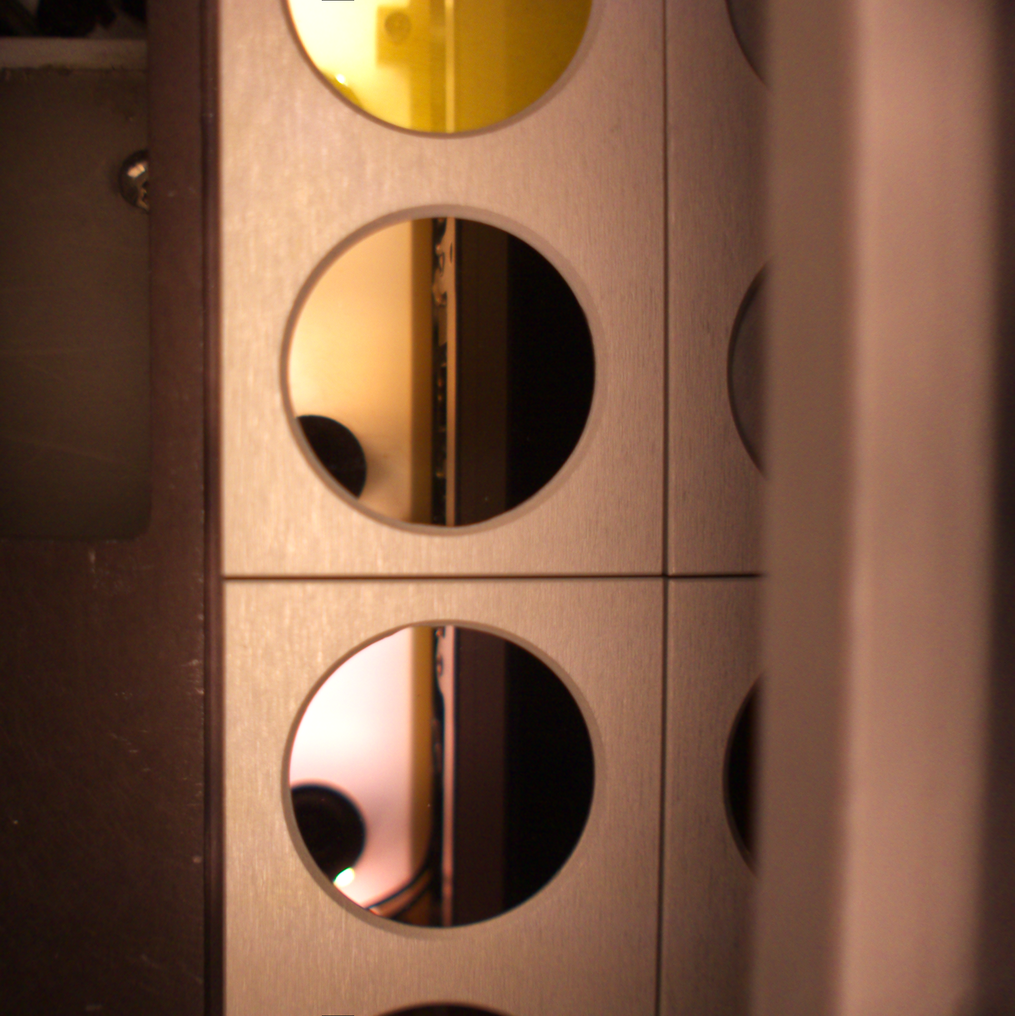
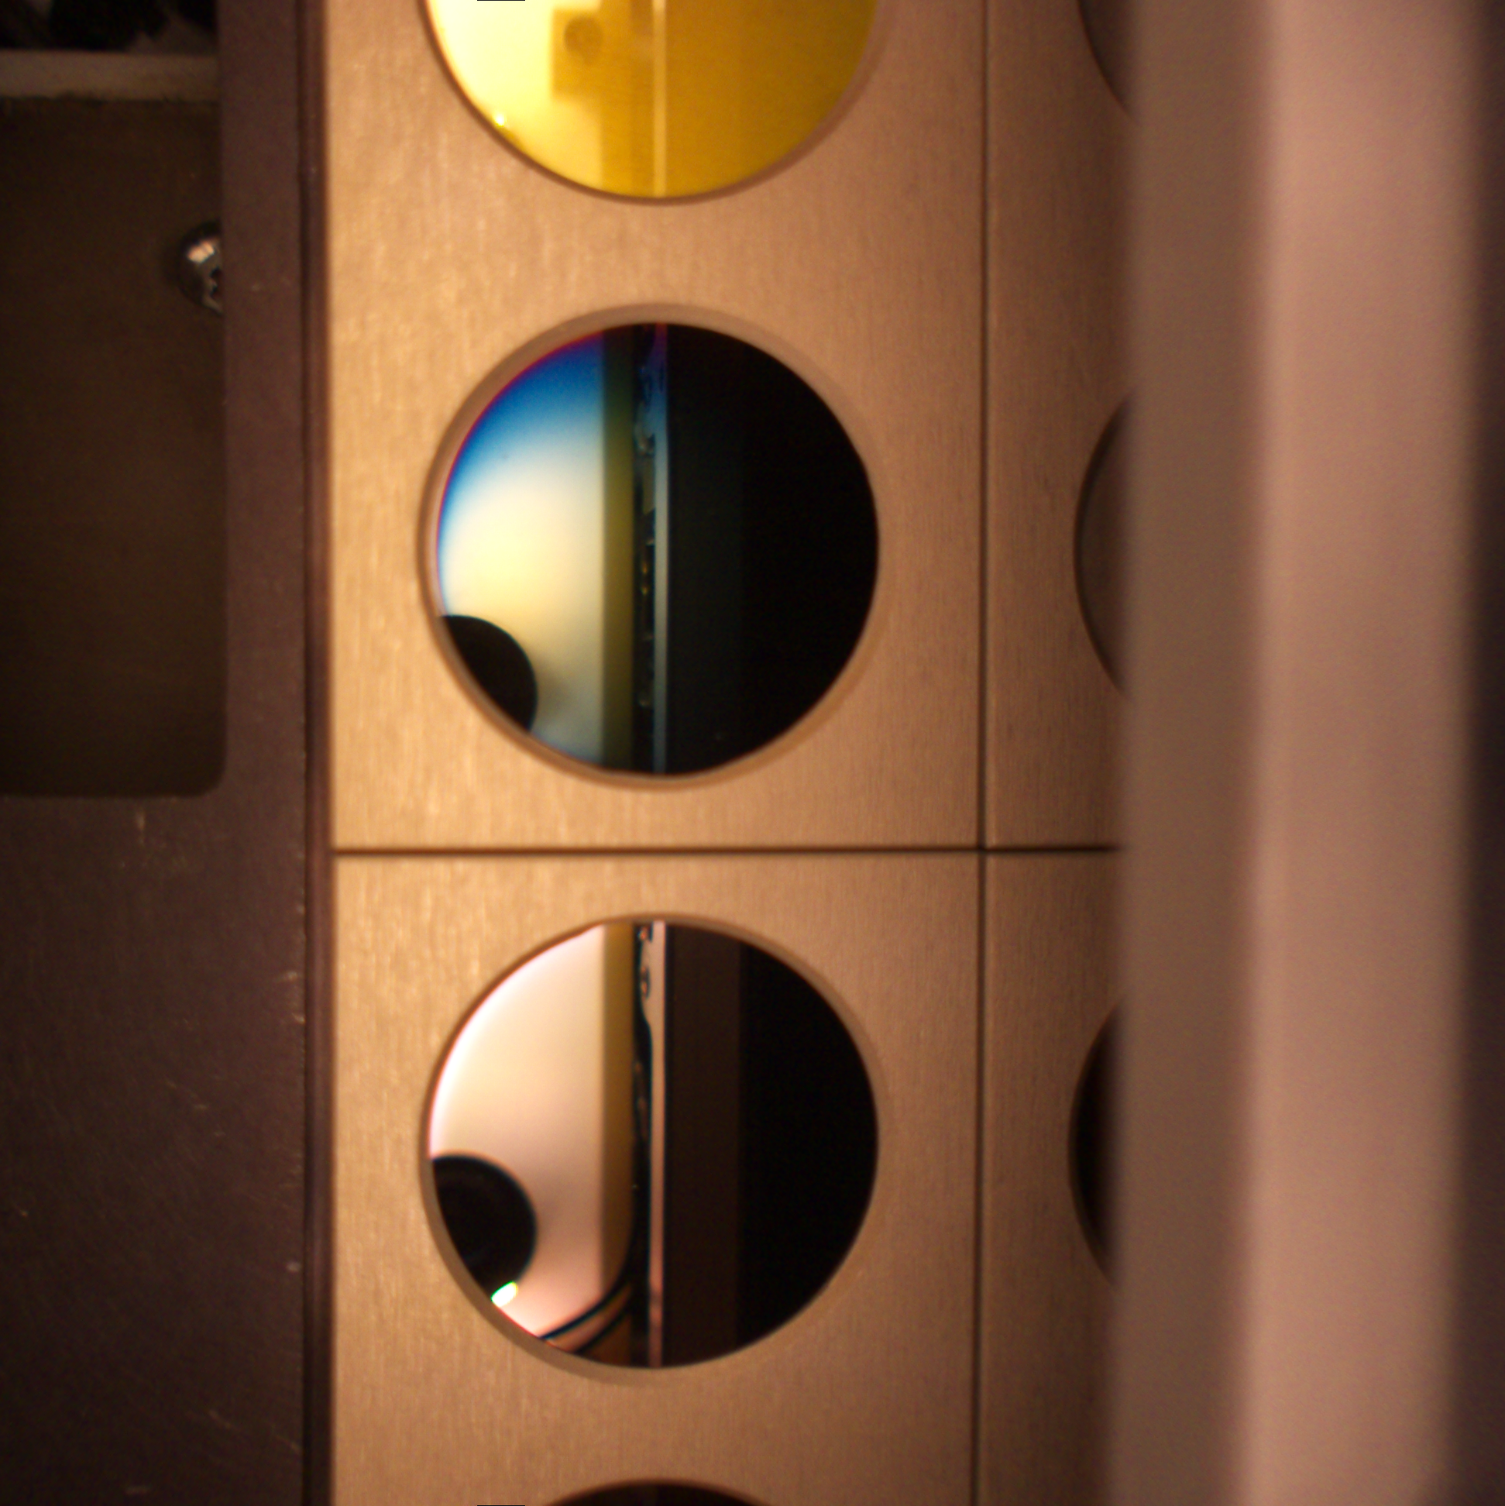
PCMs Performance in Space
(a)
(c)
Amorphous (a)
(a)
Under review in npj Microgravity

Slide 9
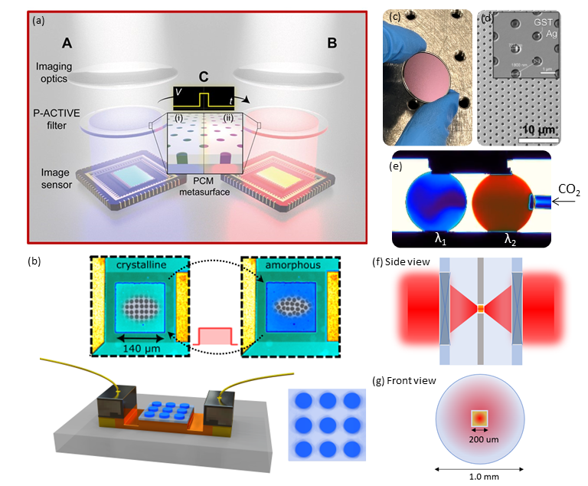
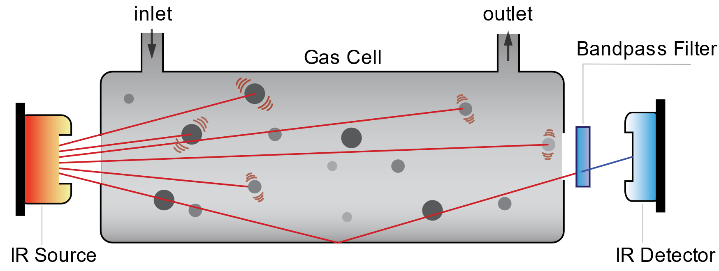
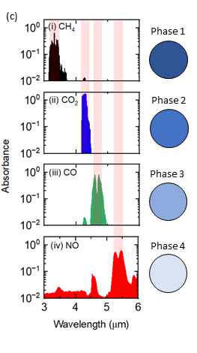
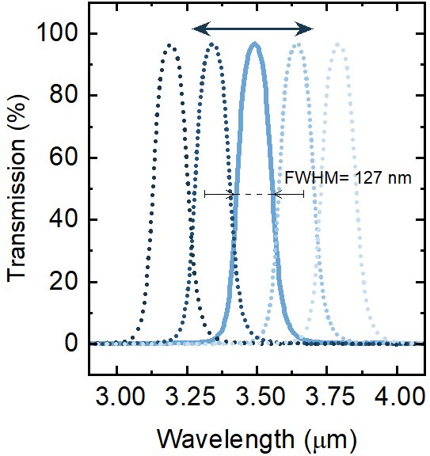
Finger-Size Adaptive Gas Spectrometer
Filed for Intellectual Property Protection in 2023

Slide 10
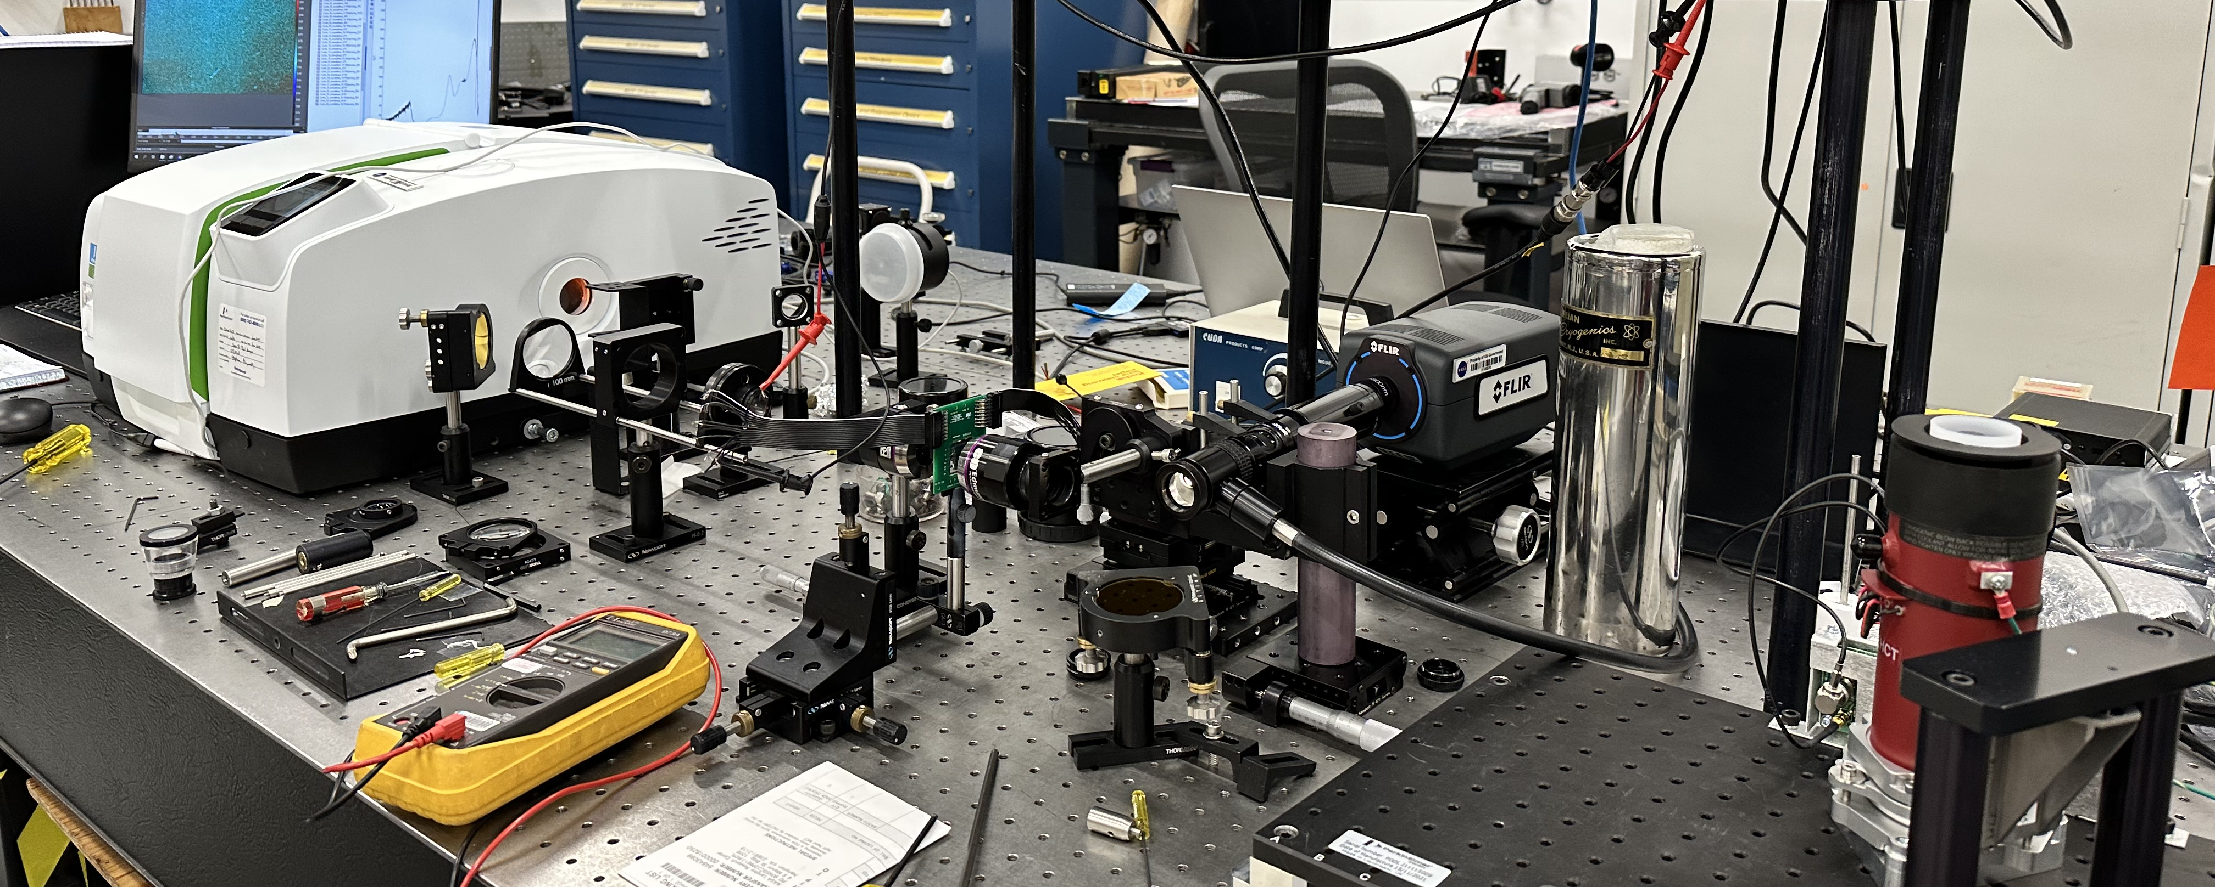
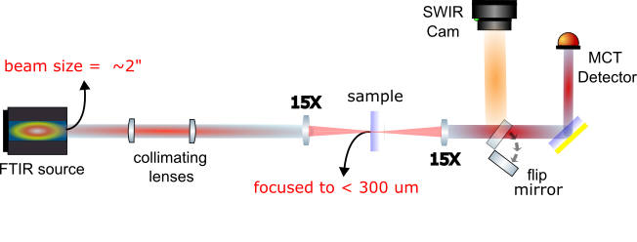
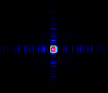
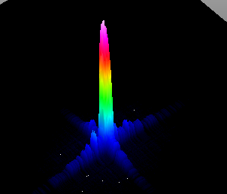
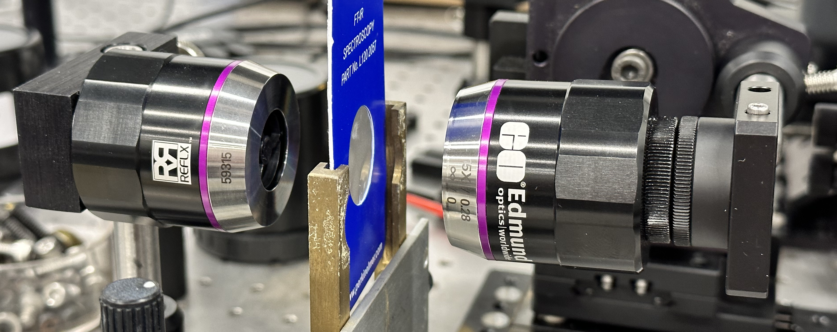
Micro-FTIR
225 µm ×260 µm

Slide 11
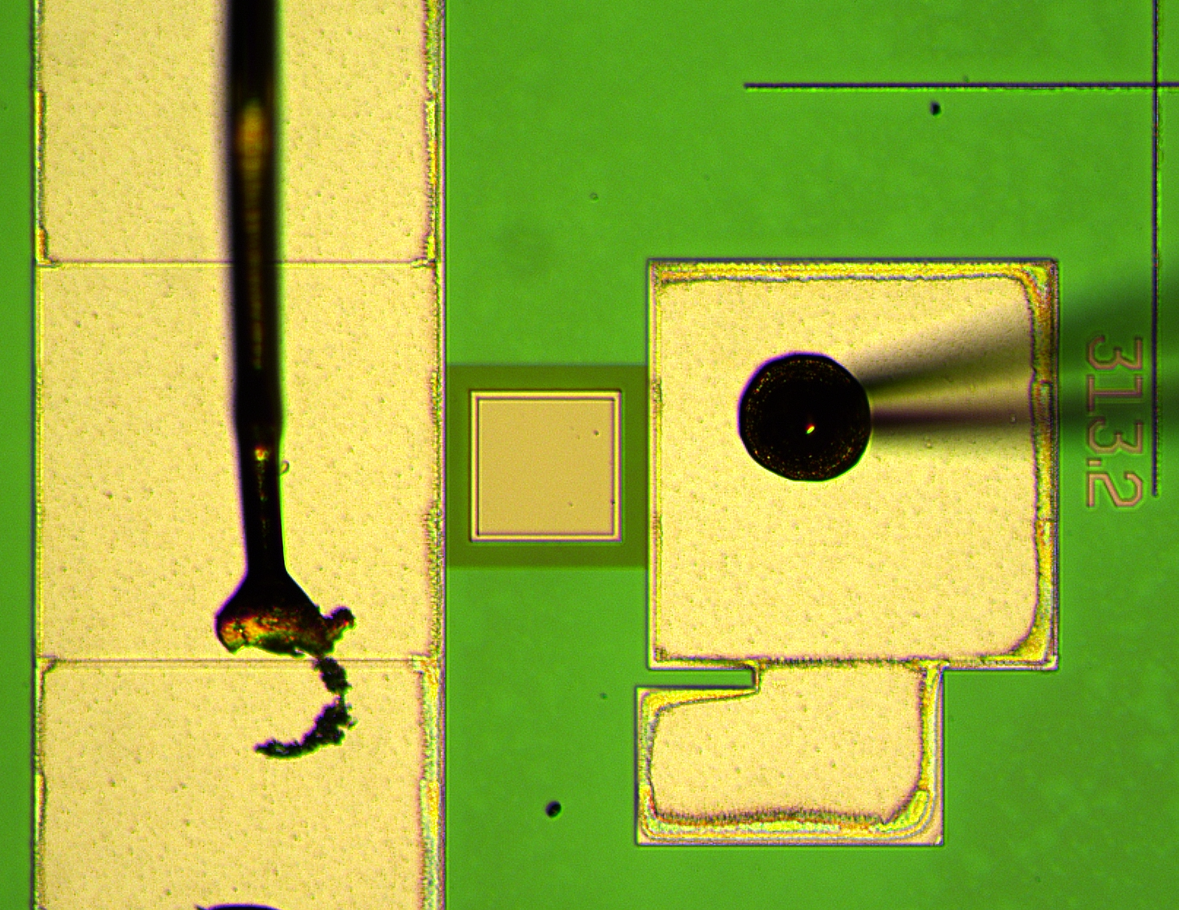
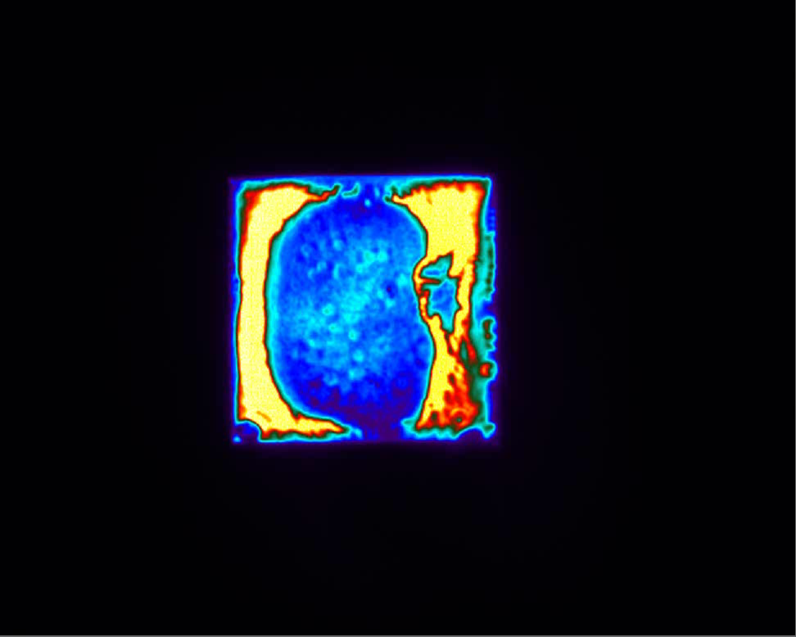
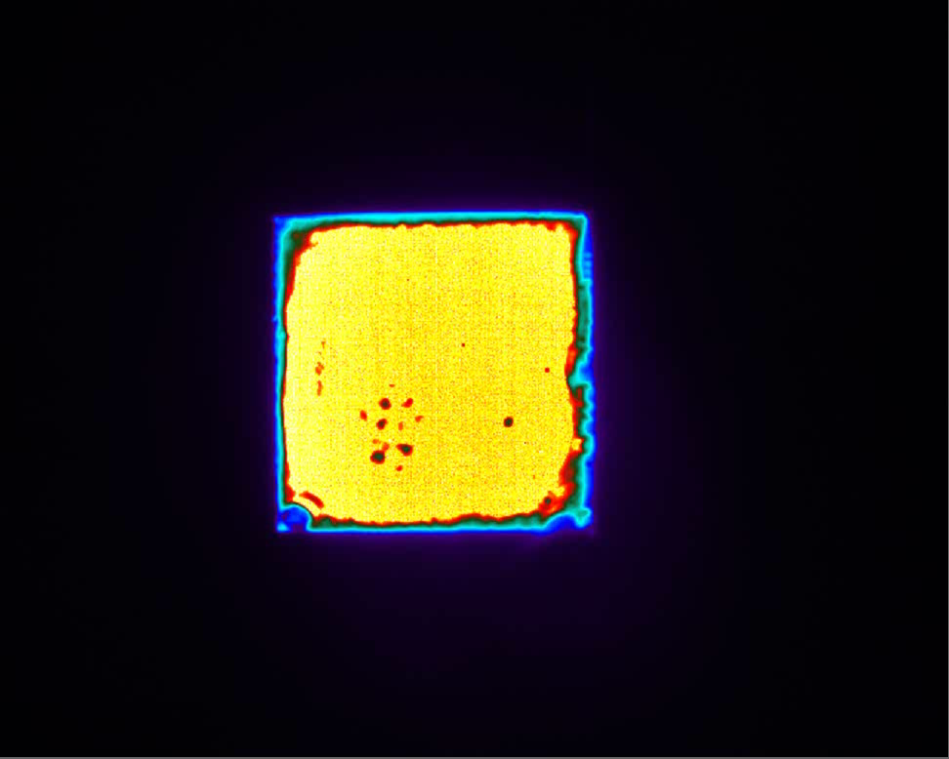
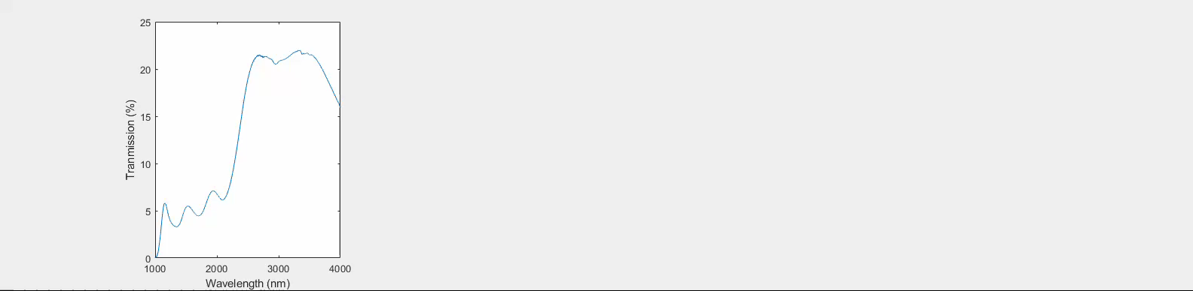
Reconfigurable Filter – under preparation
Amorphization
Crystallization
Transmission increases by 73%
Transmission decreases by 42%
Count
7842 → 13552
Count
13563 → 7863

Slide 12
Summary
Accomplishments:
Investigated the thermodynamics of amorphization process in PCMs
Thermal and optical characterization of optical PCM
Developed idea for compact in-situ adaptive spectrometer
Set up a micro-FTIR for measuring the transmission of reconfigurable meta-surfaces
Publication related to NPP appointment:
Published 2 first-author papers (2 more in preparation)
Published 3 co-author papers
Submitted a patent

Slide 13
Thank You!
NASA LaRC Team
MIT Team
UVA Team
Dr. HJ Kim
W.M. Humphreys
S. Bartram
S. Borg
Prof. J. Hu
Dr. T. Gu
C.C. Popescu
K.P. Dao
Prof. P.E. Hopkins
M.R. Islam
S. Makarem
13

