Slide 1

Excavation, Construction, and Outfitting (ECO)
Envisioned Future Priorities
The 2023 IEEE Conference on Systems, Man, and Cybernetics
October 2, 2023
Presented by: Robert P. Mueller, NASA Kennedy Space Center
Mark Hilburger - Principal Technologist for Materials, Structures, and Construction – STMD mark.w.hilburger@nasa.gov
1
1

Slide 2
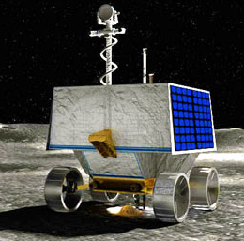
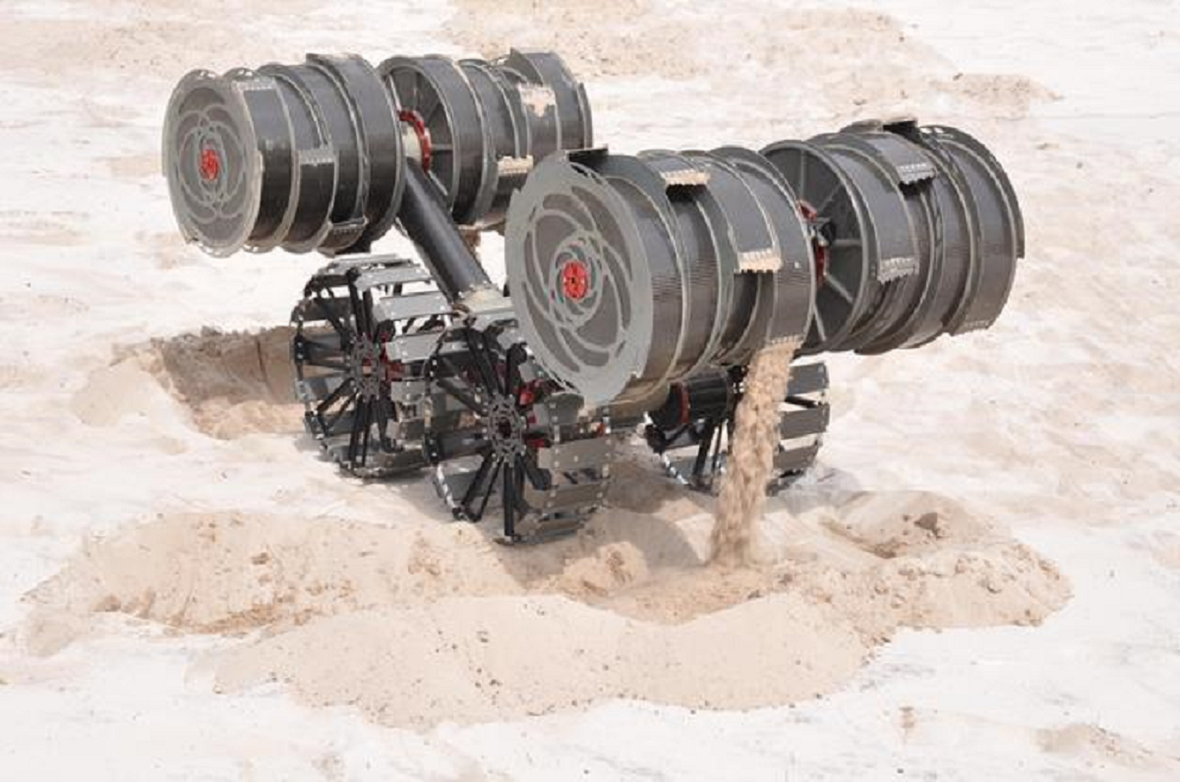
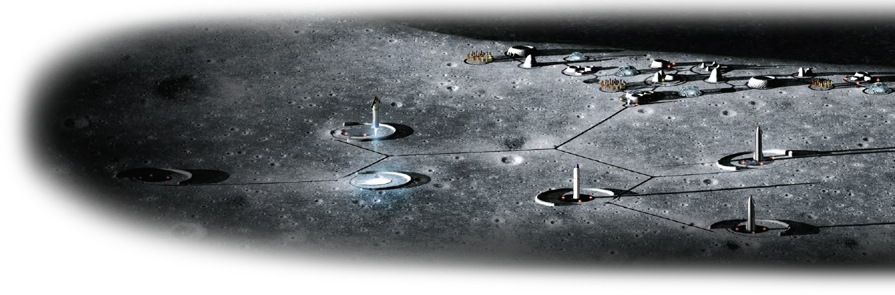
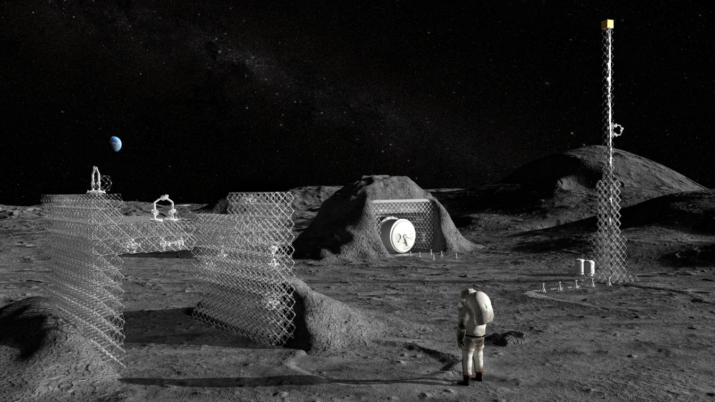
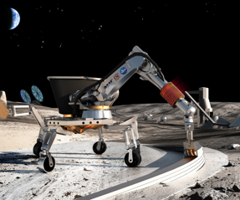
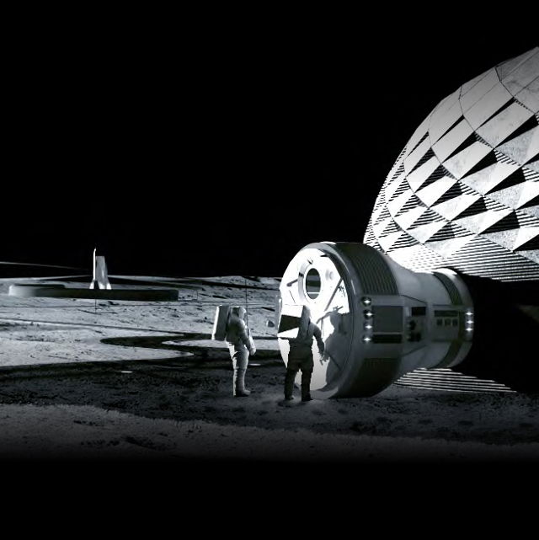
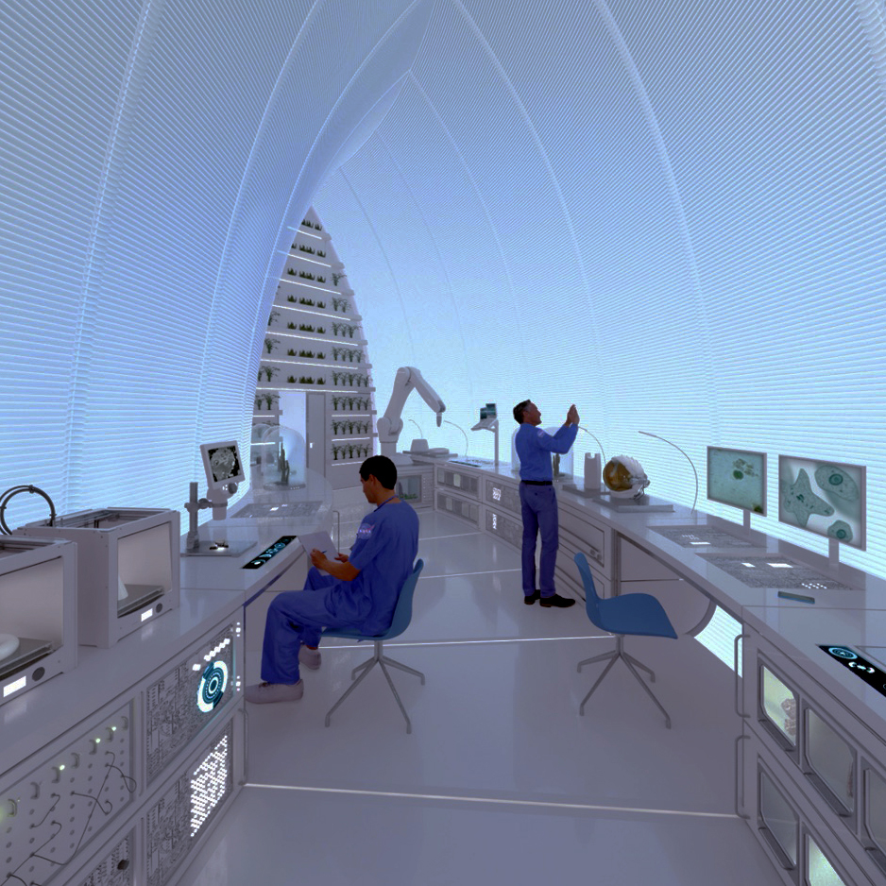

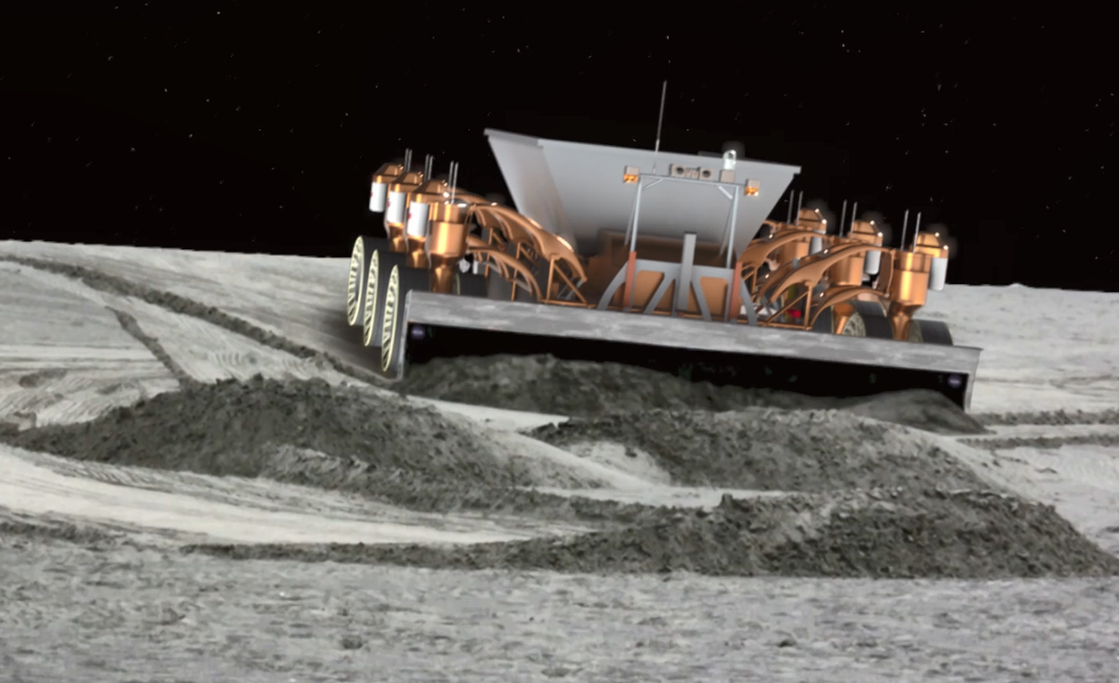
Autonomous Lunar Excavation, Construction, & Outfitting
targeting towers, roads, landing pads, and habitable buildings utilizing in-situ resources
Excavation for ISRU-based Resource Production
Ice mining & regolith extraction for 100s to 1000s metric tons of commodities per year
Regolith for production of construction materials
  100s to 1000s metric tons of regolith-based feedstock for construction projects
  10s to 100s metric tons of metals and binders
Construction and Outfitting
Assembly of tall towers for solar power generation, communications, navigation
Landing pad construction for CLPS and human lander systems
Unpressurized structure evolving to single and then multi-level pressurized habitats
Outfitting for data, power & ECLSS systems
100-m-diameter landing pads, 100s km of roads, 1000s m³ habitable pressurized volume
Commercial ECO Capabilities for Sustainable Infrastructure & Economy
Regolith Manipulation & Site Preparation
Commercial capabilities to construct tall towers, landing facilities, roads, and habitable structures
Fully outfitted facilities and buildings to support a permanent lunar settlement and vibrant space economy
Capabilities extensible to future ESDMD, SMD and Mars missions
Site preparation: obstacle clearing, leveling, compacting & trenching
Bulk regolith manipulation for berms and overburden
Foundations for large infrastructure elements
Not all activities depicted are currently funded or approved. Depicts “notional future” to guide technology development vision.
Notes:
This is the envisioned future slide for ECO
The background image shows a future that includes various infrastructure elements including solar power towers, landing pads, habitats, roads, ISRU refineries and more…
Obviously, ECO plays a major role in providing this infrastructure.
In the foreground, you can see that we have broken ECO into four (4) areas of emphasis including Excavation for ISRU, Excavation for Construction, Construction and Outfitting, and Commercialization of ECO Capabilities.
Our overarching goal is to develop and demonstrate critical ECO technologies, in partnership with industry and other government agencies, that will eventually lead to commercial capabilities.
The planned ECO technologies will enable large-scale commodities production and ISRU-based construction of infrastructure for a permanent lunar settlement.
It is also expected that these capabilities will be applicable to future science missions and Mars exploration.
The remainder of this presentation high-level description of the four (4) different ECO capability areas and some of our top priority needs. Much more detail can be found in the conference paper so I will go through these quickly.

Slide 3

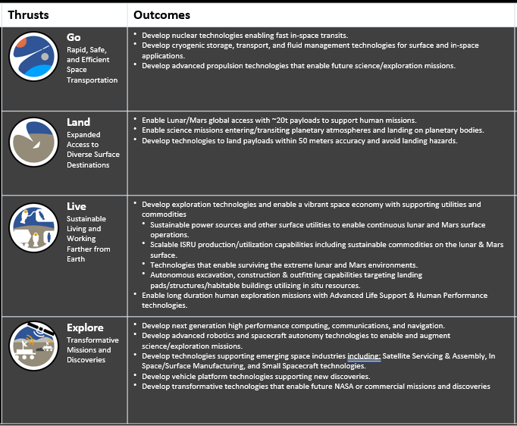
LIVE: Autonomous excavation, construction & outfitting capabilities targeting landing pads/structures/habitable buildings utilizing in situ resources
TX 07.2 Mission Infrastructure, Sustainability, and Supportability - Provide landing sites, blast containment shields, landing aids.
TX 03 Advanced Power – Receive power; Provide excavation and construction services necessary for power infrastructure
TX 07.1 In-Situ Resource Utilization – Provide regolith for commodities and feedstock production; receive resource information and manufacturing/construction feedstock.
TX 07.2.5 & TX 12.1 Advanced Materials and Dust Mitigation – providing and using technologies for surviving extreme environments
TX 10 Autonomous Systems – Receive Autonomous Systems & Robotics technologies for complex Excavation, Construction, & Outfitting operations (see backup slide on Autonomy)
TX07.2 Assembly, TX12.3 Mechanical Systems - Shared capability areas with Servicing & Assembly (OSAM)
TX 12.4 Manufacturing – Receive manufactured parts for Lunar surface Construction and Outfitting from Adv. Manufacturing

Slide 4
ECO Mapping to M2M Blueprint Objectives
M2M Obj. | Description | Regolith Excavation/Delivery | Regolith Manipulation and Site Prep | Assembly, Construction, Outfitting
LI-1 | Develop an incremental lunar power generation and distribution system that is evolvable to support continuous robotic/human operation and is capable of scaling to global power utilization and industrial power levels | x | x | x
LI-2 | Develop a lunar surface, orbital, and Moon-to-Earth communications architecture capable of scaling to support long term science, exploration, and industrial needs | x | x | x
LI-4 | Demonstrate advanced manufacturing and autonomous construction capabilities in support of continuous human lunar presence and a robust lunar economy | x | x | x
LI-6 | Demonstrate local, regional, and global surface transportation and mobility capabilities in support of continuous human lunar presence and a robust lunar economy |  | x | x
LI-7 | Demonstrate industrial scale ISRU capabilities in support of continuous human lunar presence and a robust lunar economy. | x
LI-8 | Demonstrate technologies supporting cislunar orbital/surface depots, construction and manufacturing maximizing the use of in-situ resources, and support systems needed for continuous human/robotic presence. | x | x | x
MI-4 | Develop Mars ISRU capabilities to support an initial human Mars exploration campaign. | x
OP-11 | Demonstrate the capability to use commodities produced from planetary surface or in-space resources to reduce the mass required to be transported from Earth. | x |  | x
TH-3 | Develop system(s) to allow crew to explore, operate, and live on the lunar surface and in lunar orbit with scalability to continuous presence; conducting scientific and industrial utilization as well as Mars analog activities. | x | x | x
RT-2 | Industry collaboration | x | x | x
RT-4 | Crew Time: maximize crew time available for science and engineering activities |  |  | x
RT-9 | Commerce and Space Development | x | x | x
DEMONSTRATE: Deploy an initial capability to enable system maturation and future industry growth in alignment with architecture objectives.
DEVELOP: Design, build, and deploy a system, ready to be operated by the user, to fully meet architectural objectives.

Slide 5
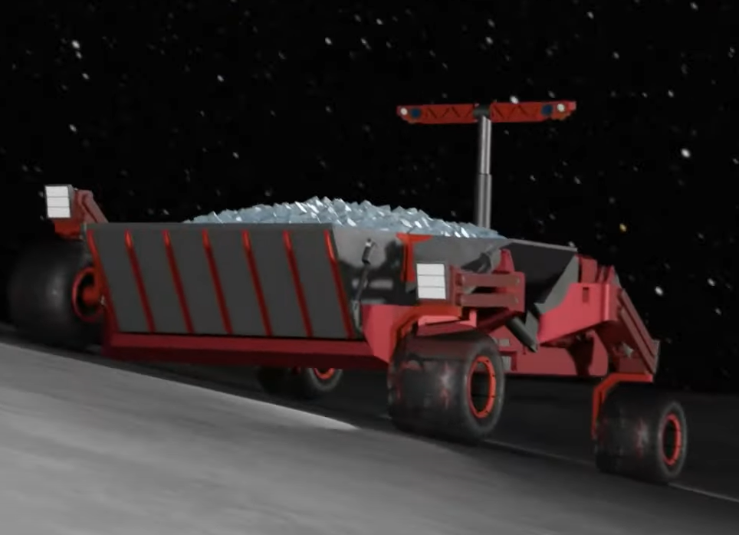
Excavation for ISRU
Capability Description, Outcomes, and Goals
ISRU resource prospecting and geotechnical characterization (ISRU dependency)
Capability Description
  Autonomous resource excavation and delivery to ISRU plant –1000s t/year
  Distance traveled with repeated trafficking – 1000s km/year
  Recharging – 100s times (assuming no on-board PV charging)
  Operational Life – 5 years
  Reliability and Repair – MTBF = 10 lunar days, MTTR = <2 hrs
Outcomes
  Regolith for O₂
  Icy Regolith for H₂O and volatiles - hydrogen, carbon oxides, hydrocarbons, and ammonia
  Regolith for ISRU-based construction feedstocks and binders – Metals, Silicon, Slag
State of the Art: Current lunar excavation technologies can only dig into surface regolith, not deep or icy regolith.
Resource excavation and delivery
Capability or KPP | SoA | Threshold | Goal
Regolith Excavation and Delivery | Surveyor Scoop: < 10kg | 100s t/year | 1000s t/year
Dist. Traveled | Opportunity Rover: 46 km | 100s km/year | 1000s km/year
Repeated Trafficking | Apollo rover: 5X | 100s X | 1000s X
Operational Range between resource & delivery site | None | 500 m | > 1 km
Recharge Cycles (assuming no on-board PV charging) | None | 10s X | 100s X
Operational Lifetime | Chinese Yutu Rover Many lunar day/night cycles | 1 year | 5 years
Reliability & Repair | None | MTBF: 2 lunar day MTTR: <24 hrs | MTBF: 10 lunar days MTTR: <2 hrs
MTBF = Mean Time Before Failure
MTTR = Mean Time to Repair
Not all activities depicted are currently funded or approved. Depicts “notional future” to guide technology development vision.
Notes:
First capability area is Excavation for ISRU.
This capability is required to provide ISRU with raw regolith material from which 100’s to 1000’s of tons of commodities can be produced per year…Commodities such as water, O2, and rare Earth metals.
Close coordination with ISRU Capability to define these requirements.
Specific requirements include the need for 1000s t of regolith excavated and delivered to ISRU processing facilities per year, delivery systems traveling 1000s km/yr. Systems with long-life, high reliability, and designed for repairability…
and you can see some of the specific KPPs that we have developed along those lines.

Slide 6
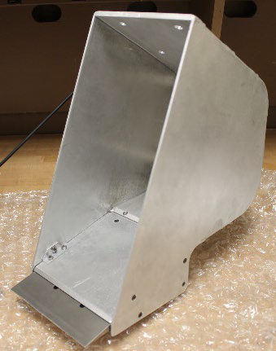
Excavation for ISRU
ISRU Pilot Excavator (IPEx)
Capability State of the Art, Current Activities, and Technology Gaps
SoA & Current Activities
Granular Regolith Excavation – ISRU Pilot Excavator Flight System Development (TRL 5/6)
10mT excavated over a 15 day period, with limited autonomy, includes wireless recharging
Not designed for lunar night survival, long-duration and long-distance operations, or repair
Critical activity to inform next-gen design of lunar surface ECO systems
Icy/Consolidated Regolith Excavation – Proof of Concept Systems and Implements (TRL 2-5)
Break the Ice Lunar Challenge Phase 2: develop/demonstrate icy regolith excavation and delivery system (TRL 3-4)
Several excavation implements under development, e.g., hammer-chisels (TRL 2/3) and vibratory blades (TRL 4/5)
Not flight rated, limited relevant environment testing of implements, not designed for lunar survival
Technology Gaps
  Multi-functional low mass rugged robotic platforms for regolith excavation and delivery
  Modularity and interfaces for reconfigurability and repairability
  Autonomy for high throughput and cooperative operations
  Lunar survivability, reliability, and repair
    Survive multiple lunar nights or shadowed regions
    Wear-resistant materials and wear characterization
    Long-life lubricants, motors, avionics
    Dust mitigation for actuators, seals, joints, mechanisms; Dust-tolerant thermal control system
    Autonomous maintenance and repair
    Health and fault management
  Regolith flow/interaction with implements (simulation and test)
  Scale-up from pilot scale (10mT) to initial commercial scale (1000mT/yr)
  End-to-end system demonstrations that lead to lunar surface demo, need time on equipment
Many technology gaps are shared with Regolith Manipulation and Site Preparation capability area
Break the Ice Lunar Challenge (BTIL) Phase 1 Concept Hauler
FLEET Ultrasonic Blade Bucket Prototype
Notes:
We have some investments in this area including the ISRU Pilot Excavator for granular regolith excavation (shown in the middle right) which is looking to fly on a 2026 CLPS mission, and represents a critical first step in developing excavation capabilities and understanding how we can work with regolith in the extreme lunar environment…We also have some recently awarded work for concept development for icy regolith excavation and material conveyance.
However, there are many technical gap areas listed here with limited to no funding currently that we will have to work through to enable long-life excavation capabilities, and we are developing plans as to how to close these gaps.

Slide 7
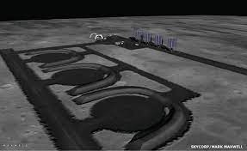
Regolith Manipulation and Site Preparation
Capability Description, Outcomes, and State of the Art
Leveling and grading
Capability Description - Similar Capabilities as Excavation for ISRU, plus…
  Site survey – geotechnical, topography
  Load, Haul, Dump
  Bulk regolith manipulation – berms, piles, overburden, and gravel
  Level, grade, and compact
  Rock removal and gathering
  Trenching and burying
Outcomes
  Site preparation for construction - 1000s of m² of prepared surface
  Provide bulk regolith berms and overburden for shielding
  gravel surfaces for dust mitigation
SoA: Excavation for construction has never been attempted on an extraterrestrial body. Prototypes have been built at low TRL.
Similar KPPs as Excavation for ISRU, plus the following:
Early-phase infrastructure
Capability or KPP | SoA | Threshold | Goal
Bulk density and bearing and shear strength measurement of regolith | cone penetrometer, shear vane, coring | 1 measurement per 100 m² | 10 autonomous measurements per 100 m²
Topology characterization | LIDAR, Photogrammetry | 10mm resolution | 5mm resolution
Bulk Regolith Manipulation – berm building and piling | None | 3 m tall | 7 m tall
Site Level, Grade & Compact (1.9 g/cc) | None | 25 m radius | 50 m radius
Rock Removal and Gathering | Rake (Apollo): 1-10 cm | <10 cm | <50 cm
Trenching | Apollo & lunar surveyor scoop: several cm’s deep | 1.0 m deep | 3.0 m deep
Not all activities depicted are currently funded or approved. Depicts “notional future” to guide technology development vision.
Notes:
Next we have excavation for construction…This capability provides several functions needed to support construction activities and site preparation including rock clearing, leveling, compaction, and trenching. Excavation also can provide some basic infrastructure needs such as road construction, structural foundations, and berms, and regolith overburden for radiation shielding
This capability area shares many of the same KPPs as Excavation for ISRU plus the ones noted here. These additional capabilities revolve around bulk regolith manipulation as well as geotechnical and topology characterization and site prep verification.

Slide 8
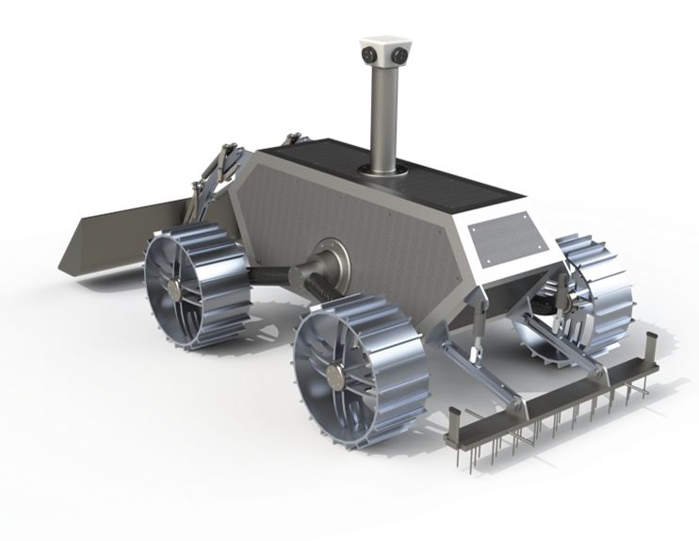
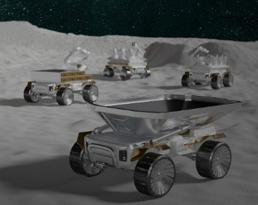
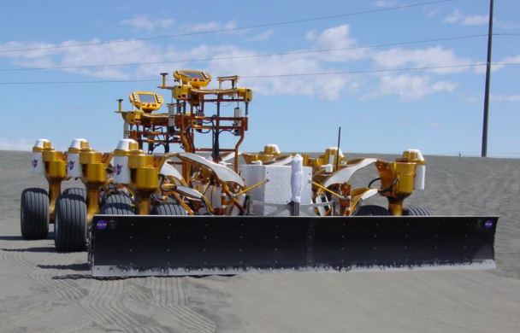
Regolith Manipulation and Site Preparation
Autonomous Site Preparation: Excavation, Compaction, and Testing (ASPECT) – Colorado School of Mines
Capability State of the Art, Current Activities, and Technology Gaps
SoA & Current Activities
Site Preparation Systems – Proof of Concept (TRL 3-4)
LuSTR project - Autonomous Site Preparation: Excavation, Compaction, and Testing (ASPECT) (TRL 3-4)
  10m-diam area, moving/manipulating ~4mT of loose regolith and small rocks
Four STTR Ph1 Study to develop site prep system requirements, TRL 3/4 systems, ConOps, and analytical tools for site design
Site Preparation Implements – Proof of Concept (TRL 2-5)
Several lab-scale studies on regolith compaction (TRL 3/4)
Several grader and compactor implements under development, e.g., vibrating plates/rollers (TRL 2/3) and grading blades/buckets (TRL 4/5)
Not flight rated, limited relevant environment testing of implements
Technology Gaps
  Site survey – geotechnical, topography
  Implements and Systems: excavation, haul, dump, rock handling, grading, leveling, compaction, berm building, trenching
  Site prep inspection techniques and sensor systems
  Feasibility testing for regolith manipulation and system development leading to lunar surface demo
  System scale-up to initial commercial scale; 100’s m² areas, 10,000’s mT regolith moved
  Additional shared gaps listed for Excavation for ISRU
STTR Ph1 Site Prep System Study – Astroport Space Technologies, Inc.
NASA Chariot with LANCE dozer blade
Notes:
Current investments are somewhat limited, however, just this past spring we awarded a LuSTR award as part of STMDs Space Technology Research Grant program for the development of an autonomous system for surface grading and compacting. We also recently awarded several small business awards related to site preparation for landing pads.
Many open technology gaps that require work in very near term related to all the different regolith manipulation tasks and site survey and inspection techniques. Working to define some system-level feasibility ground testing that will lead to lunar demonstration.

Slide 9
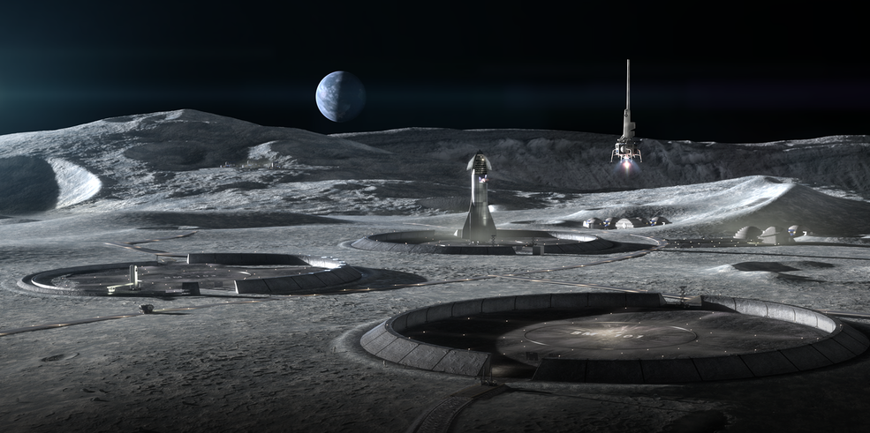
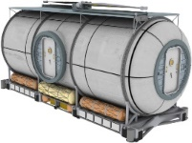
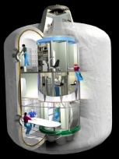
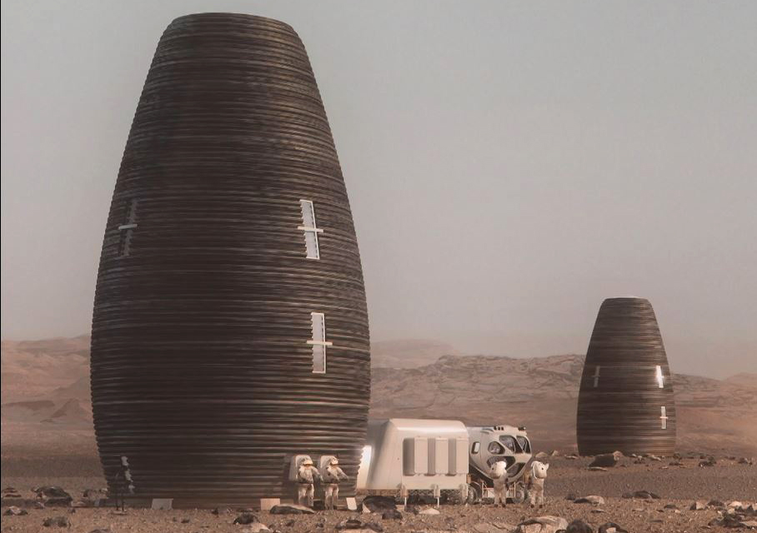
Surface Construction Classifications
Delivery of large habitable volumes will require a different approach from the "cans on landers" concepts that have been depicted for decades
How can we build?
Classification | Key Characteristics
CLASS I Pre-integrated module | Earth Manufactured Pre-Integrated & Tested Prior to Launch Space Delivered with Immediate Habitation Capability Volume and Mass Constrained by Launch Vehicle Capability
CLASS II Surface Deployed & Assembled | Requires Surface Deployment, Assembly & Outfitting May Include Partial Integration of Subsystems Critical Subsystems are Earth Based and Tested Prior to Launch Requires Checkout Prior to Human Occupancy Larger Volumes/Sizes Capable (e.g.., Transhab ~3X the Volume of a Standard ISS Module) Reduced Restriction on Volume Due to Launch Vehicle Shroud Size Restricted to Launch Mass Capability. Deliver on Multiple Vehicles Earth-sourced elements for assembly can transition to ISRU-based elements
CLASS III In-Situ Derived and Constructed | Manufactured In-situ, Derived from Local Resources (Lunar or Mars) In-space Construction and Outfitting (Integration of Subsystems) Critical Subsystems are Earth Based and Tested Prior to Launch Requires Assembly & Checkout Prior to Human Occupancy Larger Volumes Capable, Constrained by Limitations of Construction Equipment and ISRU materials Construction Equipment Constrained to Launch Vehicle Mass and Volume.
CLASS III:
In-Situ Derived/Constructed
CLASS II: Assembled/ Deployable
HIGHER
In-Situ Materials
CLASS I:
Pre-integrated
Earth – Parts
TECHNOLOGY LEVEL
Earth - Modular
LOWER
CURRENT
EVOLUTION BY TIME
ADVANCED
Notes:
Hybrid Class II/III structures: ISRU-derived components for Class II assembly, premanufactured/precision components for Class III integration
Shared capability areas with Servicing & Assembly, e.g., autonomous assembly, docking interfaces, outfitting, V&V
Notes:
I now want to spend a little time on this slide to talk about different ways we might build this infrastructure? This graphic to the left plots 3 different classes of construction as a function of technology level.
First we have Class 1 – pre-integrated modules: similar to what was used to construct the international space station. It is fabricated on Earth, preintegrated with all the systems, and delivered to its final destination ready to use. It has the benefit of being ready to use with immediate habitation capability. However, this approach is limited by the launch vehicle payload size and mass.
Next we have Class 2 – deployable or assembled structures: corresponding to prefabricated deployable structures, or in-space assembly of structures from piece parts
Deployables can include inflatables such as the Bigelow Expandable Activity Module (BEAM) on ISS, or deployable hard structures such as the James Webb Space Telescope, or ISS solar arrays. Assembled structures are what you would imagine. Structural elements such as trusses or panels can be brought from Earth and then assembled robotically. However, we plan to develop capabilities to produce ISRU-based structural elements and eventually replace the need for Earth-sourced components. ..representing an exciting opportunity to integrate ISRU-based construction into the infrastructure early in the game.
Inflatables and deployables have the benefit of having a very compact stored volume and can expand to very large volumes. Class 2 shares similar benefits with class 1 in that many of the subsystems can be pre-integrated and tested prior to launch, however, it is expected that some assembly and checkout will be required prior to occupancy. Deployable or in-space assembly of structures helps reduce the the payload size and mass restrictions the you have in Class 1. However, you are still launching everything from Earth.
Finally Class 3, construction which is based on in-situ derived resources. Resources derive from the local materials. This approach can significantly reduces our reliance on launching materials and structures from Earth. Provides tremendous flexibility in the size and shape the constructed structure as well as future expansion capability. However, as you will see in the coming slides, we have some work to do in order to realize this ultimate capability. It is by far the least mature of the 3 classes of construction.
We are currently following a strategy that includes Class 2 and Class 3. Class 2 construction is at a higher TRL and something we can do now to get us started. Then we evolved to include more Class III construction and the use of in-situ resources as those technologies mature.

Slide 10
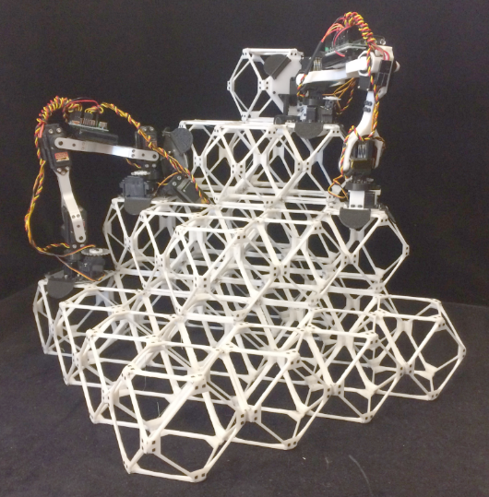
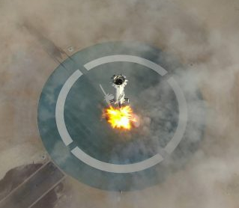
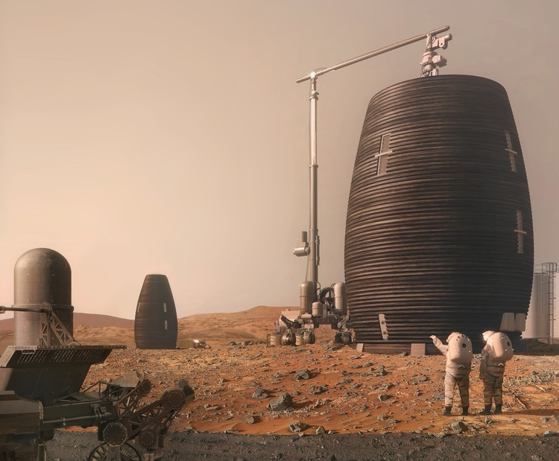
Surface Construction
Capability Description, Outcomes, and State of the Art
Class II: Assembly & Deployables
Capability Description:
  Class II: Assembly of components into built-up structures (e.g., Earth-sourced or ISRU-based truss, panel, paver, bricks); deployment of human-rated preassembled or inflatable structures
  Class III: In-situ additive construction (e.g., 3D printed regolith-based construction)
  In-situ testing and inspection techniques for certification (material and structural)
  Structural enhancement and repair
  Construction Systems: design for lunar survivability, reliability, and maintenance
Outcomes
  Towers (50+ m tall for Power and Communication)
  10s km of roads
  100-m-diameter launch/landing pads (LLPs)
  Blast containment shield (BCS)– 7m-tall, 100s m long
  Shelters & habitats (1000s m³ volume) to provide asset and crew protection (thermal, radiation, etc.)
SoA: Extraterrestrial surface construction has never been attempted. Terrestrial prototypes at low TRL.
Class III: In-situ Construction
Capability or KPP | SoA | Threshold | Goal
Class II: Deployable and assembled structures | ISS: deployable trusses for solar arrays and radiators; inflatable volumes (not human-rated). | Assembly of tower and blast cont. shield (BCS) with 50% ISRU-based components | Autonomous Construction of most major infrastructure elements with 100% ISRU based components and materials. Towers, roads, LLPs, BCS, shelters, and habitats
Class III: In-situ construction | Low TRL development work | ISRU-based roads, LLPs, BCS with limited Earth-sourced materials (20%) | 100% ISRU-based LLPs, BCS, shelters and habitats
In-situ testing & inspection | ISS inspection: visual, thermography, eddy current, ultra-sound, strain gage, accels. | Voids & cracks, material strength and stiffness. Material degradation | full volumetric inspection of material and structural properties w/ real-time corrective actions
Structural enhancement & repair | ISS enhancement: swap-out of modular components and orbital replacement units ISS structural repair: none | Manual repair; post-construction enhancement/modification | Selected auto. repair and post-construction enhancement
System Operational Lifetime | None | 2 year | 10 years
Reliability & Repair | None | MTBF: 2 lunar days, MTTR: <24 hrs | MTBF: 10 lunar days, MTTR: <2 hrs
MTBF = Mean Time Before Failure
MTTR = Mean Time to Repair
Not all activities depicted are currently funded or approved. Depicts “notional future” to guide technology development vision.
Notes:
We are pursuing the development of Class 2 and Class 3 construction technologies and plan to phase them in to various infrastructure applications as they mature.
In addition to these construction technologies, we also need to develop in-situ testing and inspection techniques, and techniques for maintenance and repair.
Near-term construction priorities include 50+ meter tall towers, 10s km of roads and 100m diameter landing pads. Mid-term priorities include unpressurized shelters to provide surface asset and crew protection that can evolve to pressurized structures (storage tanks) and habitats in the long-term.

Slide 11
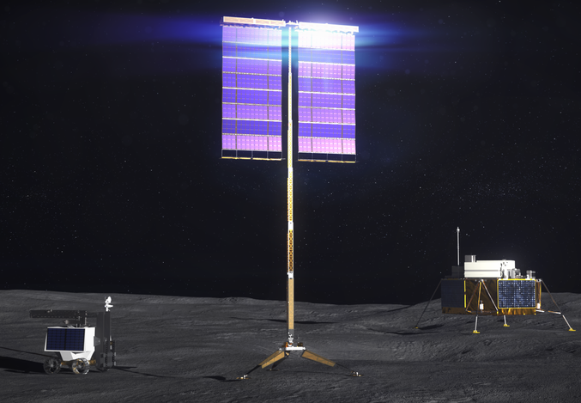
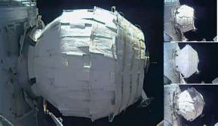
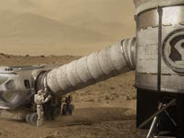
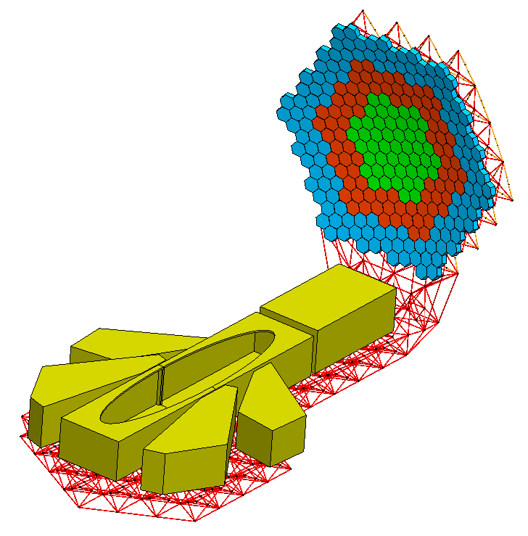
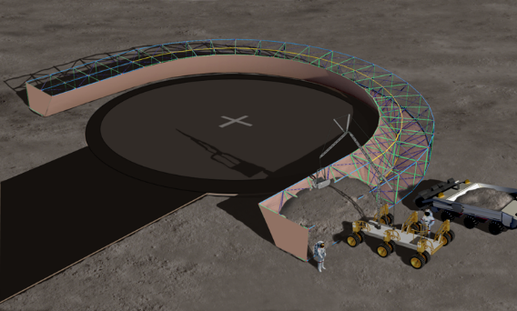

Class II Surface Construction
Investment grade: Yellow
Deployable Vertical Solar Array (VSAT)
Capability State of the Art, Current Activities, and Technology Gaps
SoA & Current Activities
Deployable Surface Solar Arrays – (TRL 2-6)
Vertical Solar Array Technology (VSAT) Flight system development (TRL 6)
Several activities to develop deployable 50kWe array concepts (TRL 2/3)
Inflatable Structures – Proof of Concept (TRL 2-6)
Multiple activities developed inflatable habitat concepts (TRL 6); Ex. Bigelow Expandable Activity Module (BEAM)
Inflatable airlocks and crew transfer tunnels (TRL 4)
Several activities on material testing (TRL 2/3) and Structural Health Monitoring (TRL 2/3)
Proof of concept, limited long-term relevant environment testing of materials
Assembled Surface Structures – Proof of Concept (TRL 2-5)
Demonstrations of autonomous robotic assembly of precision truss and voxel-based structures , mechanical joining, non-flight rated, no outfitting; Ex. ARMADAS (TRL 5), PASS (TRL 4)
Robotic assembly of a tall Power/Comm tower under development, not flight rated, no outfitting (TRL 4)
Concepts for the assembly of Blast Containment Shields and Shelters (truss and panel assemblies) (TRL 2/3)
Technology Gaps
  Accelerated materials and creep testing for inflatable structures
  Integration of hard structures into inflatables (hatches, windows, bulkheads, attachment points)
  Structural health monitoring of structures
  Advanced joining methods for assembly (e.g., in-space welding, reversable joining)
  Production of ISRU-based structural elements for Assembly
  Pressure sealing for pressurized assembled structures
Bigelow Expandable Activity Module (BEAM)
Inflatable crew transfer tunnel concept
Assembled Blast Containment Shield (BCS) concept
Precision Assembled Space Structures (PASS)
Notes:
We have some really good investments in both Class 2 and Class 3 construction technologies and are on a good path there.
What we really need are architectural studies, and some industry-led master planning exercises to help focus our technology developments. We also need to understand the geotechnical properties of the moon, this will help inform foundation and structural design, as well as the design of construction equipment.
Working towards end-to-end ground demonstrations for the construction of various high-priority infrastructure elements.

Slide 12
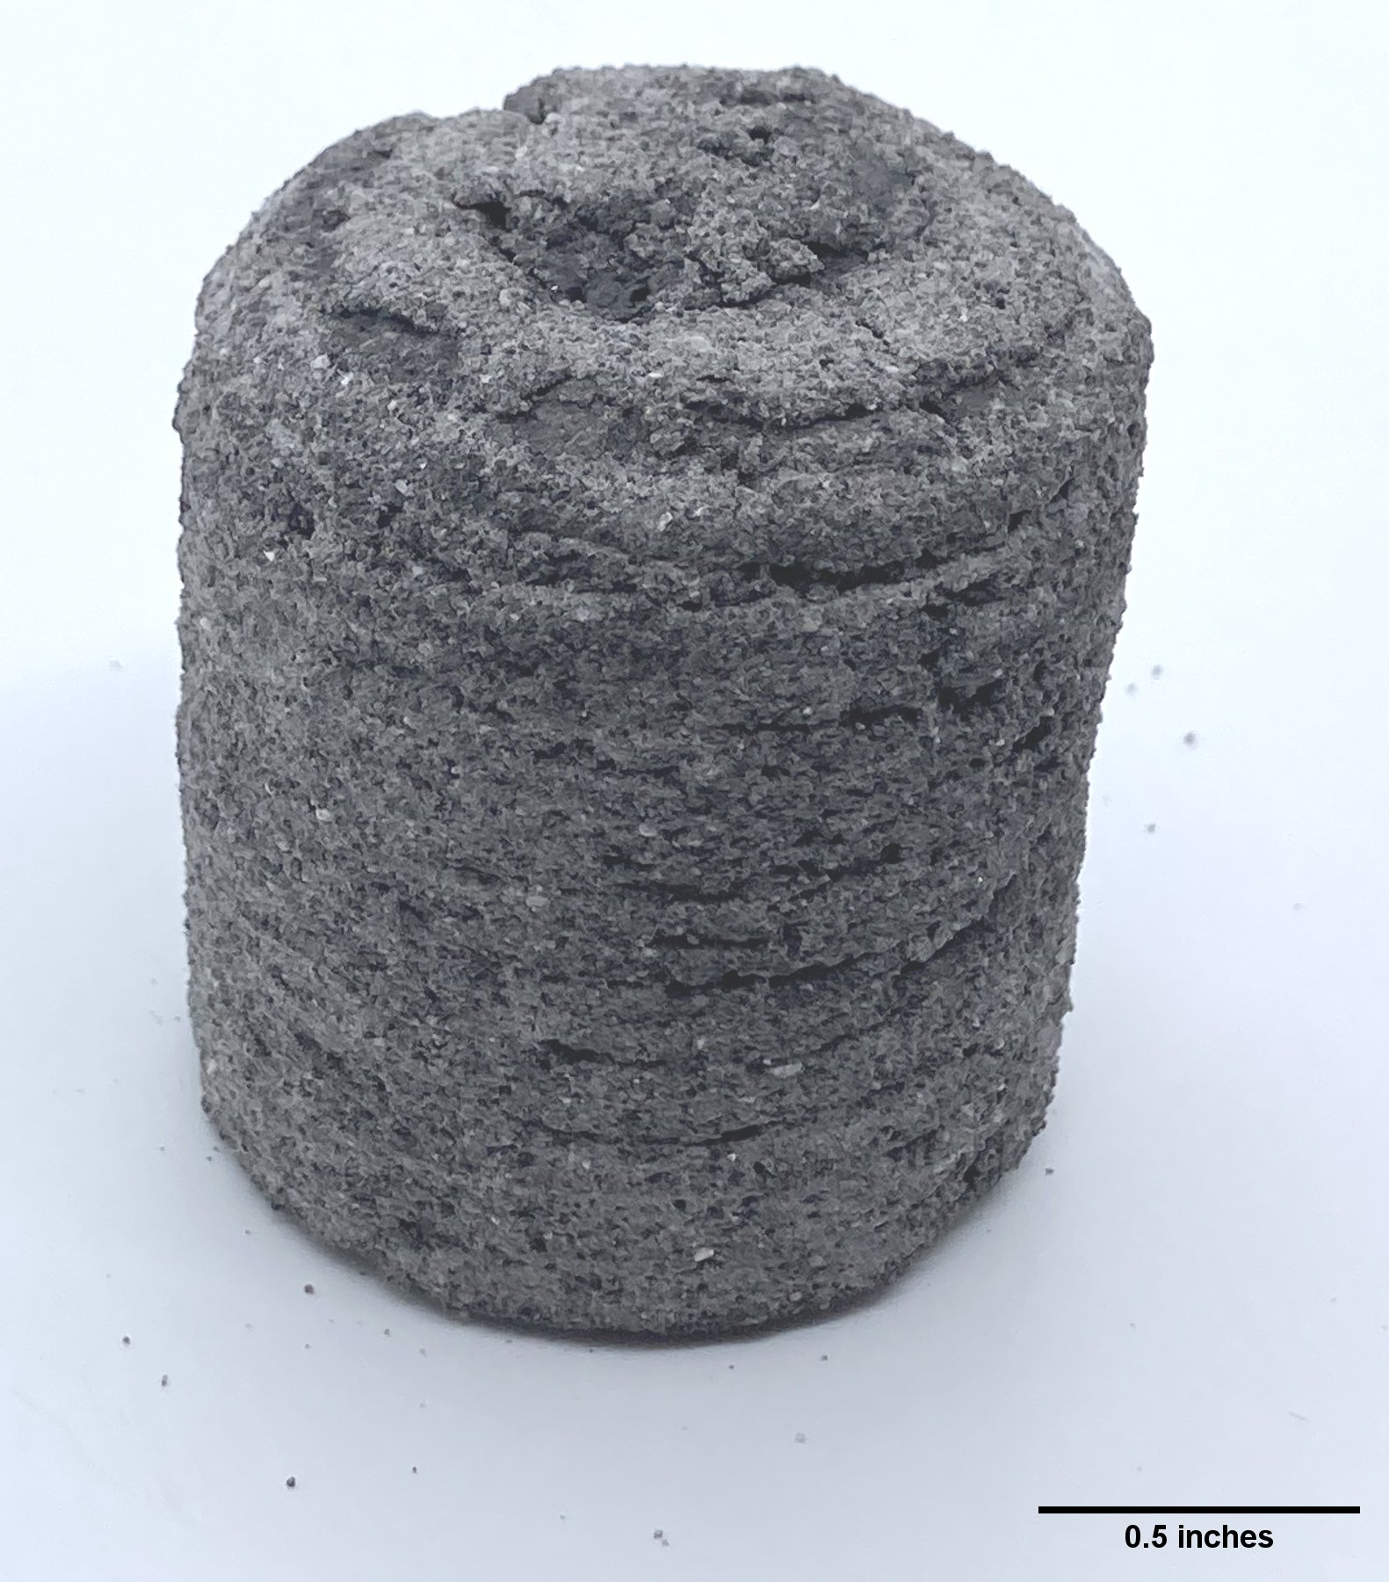
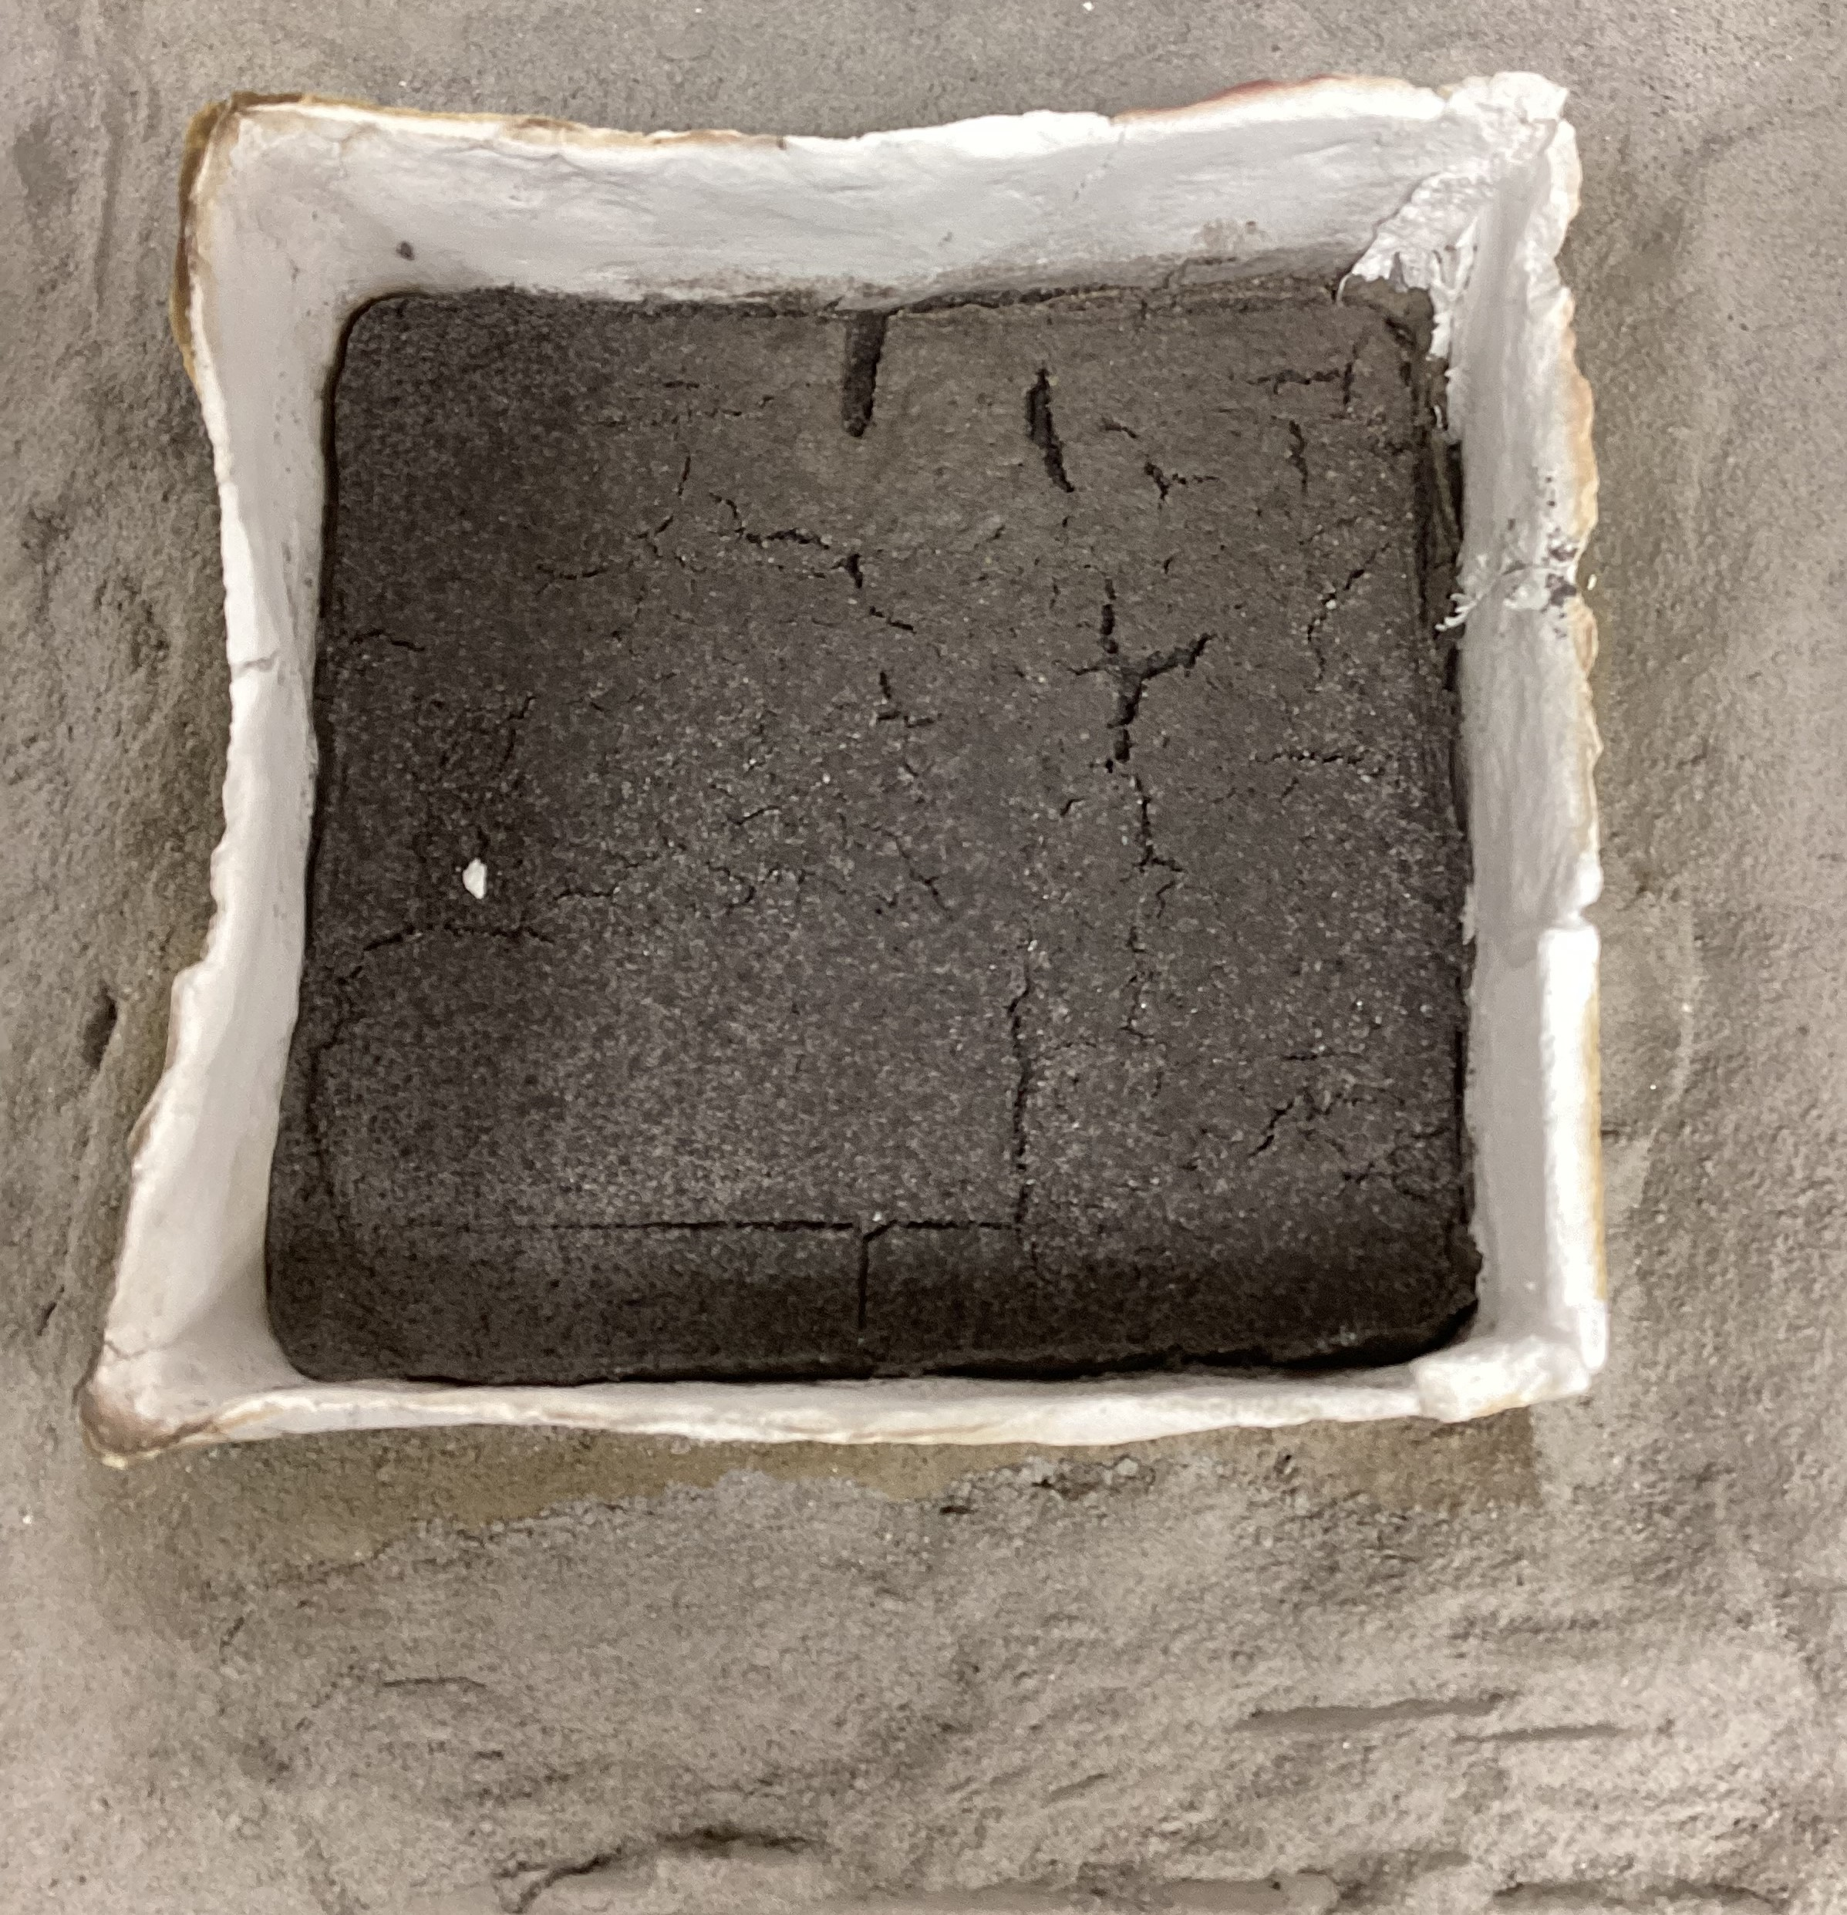
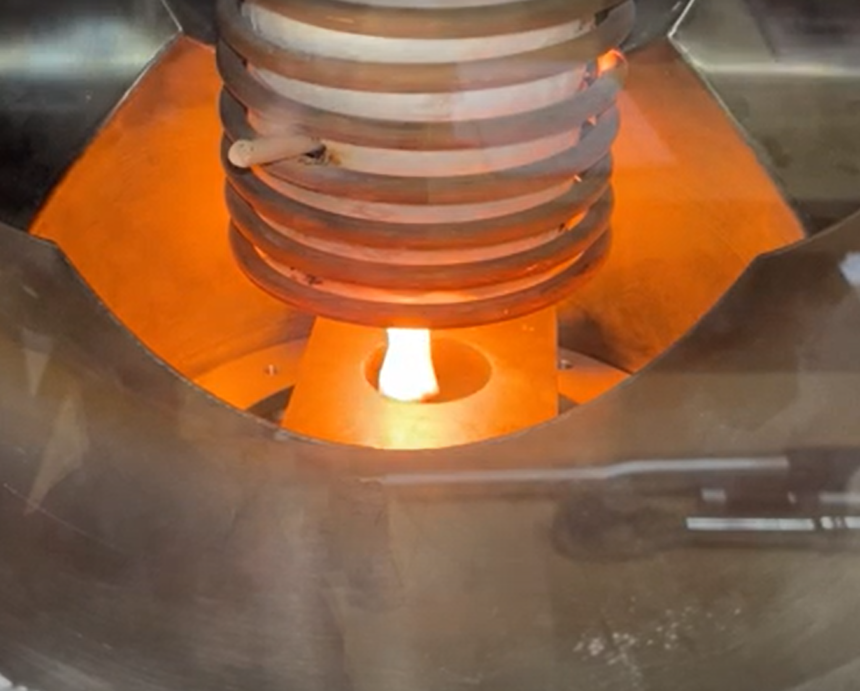
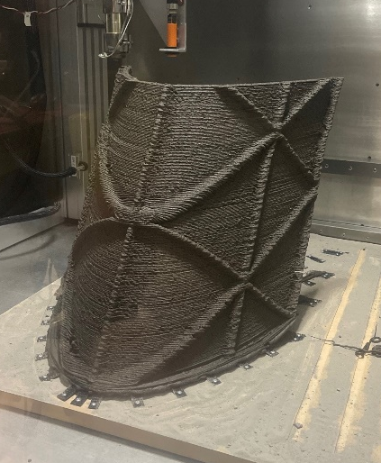
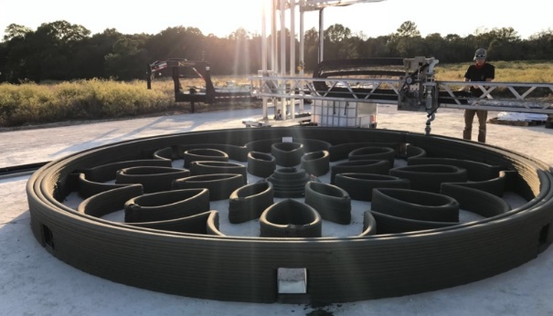
Class III Surface Construction
Investment grade: Yellow
Capability State of the Art, Current Activities, and Technology Gaps
Process Development
SoA & Current Activities
In-situ Additive Construction – (TRL 2-5)
Multiple processes in various stages of development; Most in the TRL 3/4 range of maturity
  Laser melting TRL 3/4; Cementitious TRL 2-4; Microwave sintering TRL 3/4; Molten regolith extrusion TRL 4; Polymer/regolith extrusion TRL 4/5
Challenges: deposition of material in a vacuum, process V&V, scale-up, power requirements
Surface Stabilization, Foundations, Anchors – Concepts formulated (TRL 2)
Several NIAC activities funded in past on surface stabilization for landing pads
NDE, Modeling, Analysis – Proof of Concept (TRL 2-4)
Several SBIR activities related to NDE and damage analysis; Laser ultrasonic testing for defects; smart optical spectroscopy for metal additive manufacturing
Technology Gaps
  Deposition of print material in low-pressure environment while controlling porosity
  High-temperature materials for LLPs
  LLP Paver joining
  Surface stabilization, Foundations, and Anchors
  Repair technologies
  Process inspection and control
  In-situ V&V of construction materials
Laser melting in vacuum
Microwave sintering in vacuum
Molten extrusion in vacuum
Additive Construction
Polymer-regolith printing in a vacuum
Terrestrial printing of cementitious material

Slide 13
Surface Construction
Class II: Assembly & Deployables
Additional Cross-cutting Gaps for Class II and Class III Construction
  Master Planning and ConOps studies to determine construction needs and requirements
  Geotechnical and seismic characterization to inform foundation design
  Building requirements and standards
  Long-life robotic construction equipment and tools
    Cranes, manipulators, and mobility systems for asset offloading and positioning
    Robotics and specialized tools for structural assembly and repair
    Specialized robotics/tools for in-situ additive construction
    Dust tolerant/abrasion resistant systems/mechanisms
  Autonomy for complex construction and inspection tasks
  Inspection methods (e.g., process, materials, structures)
  Outfitting
  End-to-end ground demonstrations for infrastructure construction leading to lunar surface demos (tall towers, roads, LLPs and BCS)
Class III: In-situ Construction

Slide 14
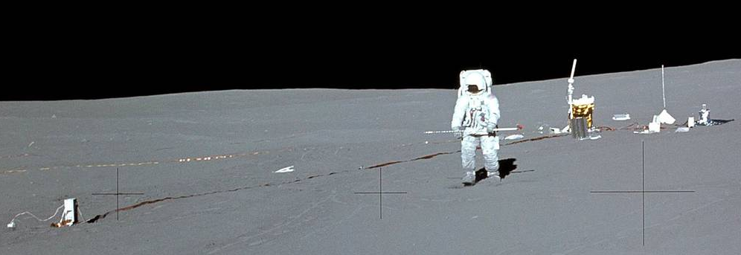
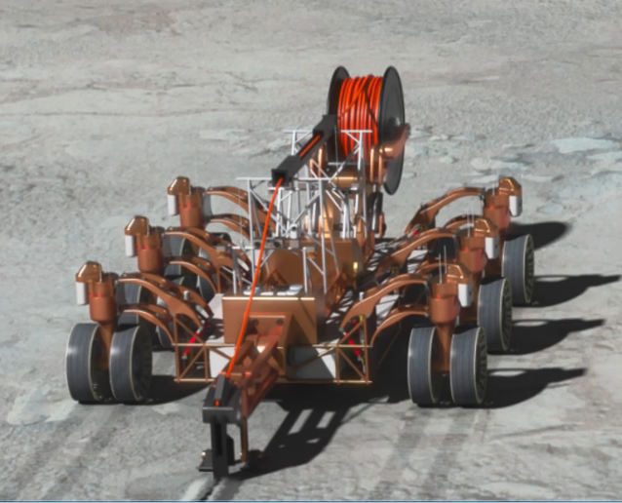
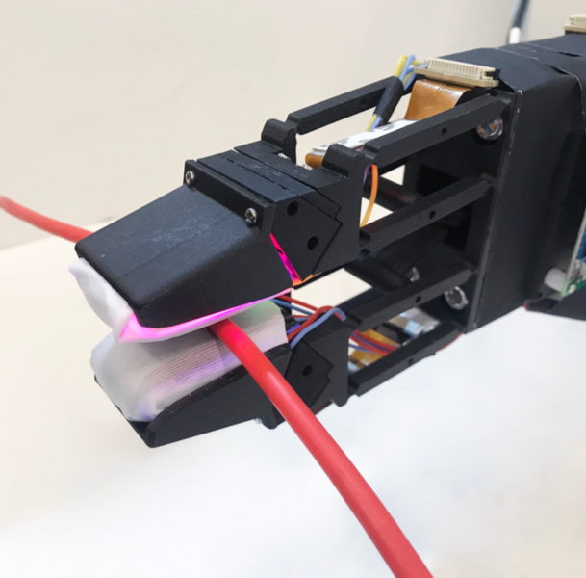

Outfitting
Capability Description, Outcomes, and State of the Art
Apollo 14: Setting up long duration experiments.
Capability Description
  The process by which a structure is transformed into a useable system by in-situ
  installation of subsystems.
    Subsystem installation
    In-situ testing/validation and inspection techniques with associated metrology
    Structural repair and enhancement
Outcomes (affects most systems that are not landed in operational self-contained state)
  Power, Lighting, Data & Communications distributed through system
  Fluids & Gasses (ISRU products) managed and stored.
  ECLSS
  Hatches and Penetrations
  Interior Furnishing
SoA: Preintegrated structures, with manual in-situ upgrades and repairs.
Wiring harness for
Instruments, beacons, etc.
Capability or KPP | SoA | Threshold | Goal
Conductor/Cable and Piping/Tubing line management (LM) | ISS Preintegrated on ground, EVA upgrades and repairs | LM during construction using Earth-sourced harness (50% auto.). Manual repair; Post-construction manual LM for facility enhancement. | LM during construction using ISRU derived harness (100% auto.). Selected auto. repair and enhancement/expansion.
Penetration management (PM) including through pressure vessels (Habitats, tanks, shelters, blast shield etc.) | ISS Preintegrated on ground, NO post launch penetrations added. | PM during construction using Earth-sourced materials (50% auto.). Manual repair; Post-construction manual PM for facility enhancement. | PM during construction using ISRU derived material (100% auto.). Selected auto. repair and enhancement
Attachment of secondary systems to structures. | ISS Preintegrated some IVA and EVA rerouting. | Attachment to arbitrary surfaces and structures. | Reversible attachment to arbitrary surfaces and structures on 3D printed structures.
Inspection systems to verify installation and functionality. |  | Pressure test piping, geometry charac. for assembly verification, load test of foundations, continuity/signal strength for communications/wiring. | Continuous process monitoring, equivalency testing, structural health monitoring for 3D printed habitat by 2035.
Not all activities depicted are currently funded or approved. Depicts “notional future” to guide technology development vision.
Notes:
Finally, in addition to developing construction technologies, we also need to develop methods for outfitting these structures with power, data, and ECLSS…that is, provide methods to install cables, pipes, air ducts and interfaces for needed sub-systems.
This is a relatively new area for us and lags some of our other capability areas, but it is becoming obvious that it is something we need to start working.
Early outfitting needs will address the installation of wiring/cables for power infrastructure and placing lights and navigation beacons for LLP and roads. Later moving towards fluid handling and ECLSS.

Slide 15
Outfitting
Apollo 14: Setting up long duration experiments.
Capability State of the Art, Current Activities, and Technology Gaps
Outfitting SoA & Current Activities
Design and Prototype Outfitting Elements– (TRL 2-4)
XHab Challenge – explore approaches to habitat outfitting; Trade and prototype components and interior goods for habitats; some testing of human and robotic outfitting tasks (TRL 2/3)
Several NASA-led activities related to printing of components that could be used in the
outfitting process (TRL 3/4)
  Printing parts using polymer binders with regolith filler
  On-demand additive manufacturing using metals, polymers, electronics
  Large-scale printing of flooring and walls.
Technology Gaps
  Architectural and ConOps studies
  Outfitting requirements and standards
  Robotic outfitting technologies for installation of lighting, harnesses, beacons, sensors, fluid systems, HVAC, etc.
  Design of pressure vessel connections/seals with penetrations
  Common interface definition
  Inspection methods & repairs
  Utility corridor design
  Autonomy for complex outfitting and inspection tasks
Wiring harness for
Instruments, beacons, etc.
Trenching and cable laying
Cable handling
Outfitted facility
Notes:
We currently have very limited investments in Outfitting, and so we are actively defining outfitting needs and investment plans. Some of the important outfitting needs are listed here.

Slide 16
Mapping Top Priority Gaps to ECO Capability Areas & Taxonomy
StarPort Gap ID | Gap Title | Excavation for ISRU and construction feedstock | Regolith Manipulation and Site Prep | Class II Construction | Class III Construction | Outfitting | ESDMD Gap/ Architecture Elements | Taxonomy
369 | Excavation of granular (surface) regolith material for ISRU consumables production & construction feedstock | X |  |  |  |  | X | 7.1.2
385 | Regolith and resource delivery system | X | X |  |  |  | X | 7.1.2
386 | Mechanisms and mobility components for long-duration operations with abrasive regolith in the lunar environment | X | X | X | X |  | X | 12.3.2
389 | Sensors for regolith collection and excavation force measurement | X | X |  |  |  | X | 4.1.1, 7.1.1
390 | Rugged low mass robotic excavation and site prep platforms | X | X |  |  |  | X | 4.2.4, 7.1.2
391 | Sensors and systems for geotechnical characterization | X | X |  |  |  | X | 7.1.1, 13.5.2
392 | Sensors and systems for high-resolution topological characterization |  | X |  |  |  | X | 7.1.1, 13.5.2
394 | Excavation - Autonomous rock clearing/collection |  | X |  |  |  | X | 7.2.3, 13.5.2
395 | Excavation - Autonomous grading and leveling |  | X |  |  |  | X | 7.2.3, 13.5.2
396 | Excavation - Autonomous surface compaction |  | X |  |  |  | X | 7.2.3, 13.5.2
416 | Deposition of print material in low-pressure environment while controlling porosity |  |  |  | X |  |  | 7.2.3.4
418 | Materials for Printing Landing / Launch pad structural elements (materials gap) |  |  |  | X |  |  | 7.2.3.4
421 | V&V: Process Inspection and Control |  |  | X | X |  |  | 12.4.2
422 | V&V: In-situ Verification and Validation of Construction Materials |  |  |  | X |  |  | 7.1.4, 12.4.2
434 | Transportation of loose regolith within an AC system for deposition |  |  |  | X |  |  | 7.2.3
617 | Assembled Truss-based Tower |  |  | X |  |  | X | 7.2.3
618 | Autonomy and robotics for tower assembly |  |  | X |  |  |  | 4.3, 7.2.3
619 | Assembled Joint Catalog |  |  | X |  |  |  | 7.2.3
620 | Assembled Shelter |  |  | X |  |  | X | 7.2.3
621 | Assembled Blast Containment Shield (BCS) |  |  | X |  |  | X | 7.2.3
623 | Outfitting: Design & Integrate Electrical Harness |  |  |  |  | X |  | 7.2.3.5, 13.5.7
624 | Outfitting: Connect Lights, Sensors, etc. |  |  |  |  | X |  | 7.2.3.5, 13.5.7
629 | Power/communication tower super gap |  | X | X |  | X | X | 7.2.3
630 | Outfit tower with photovoltaics or reflector to form power tower |  |  |  |  | X |  | 7.2.3
631 | ISRU-based structural elements for surface assembly |  |  | X |  | X |  | 7.2.2, 7.2.3
635 | Foundation anchors for surface assembly and construction |  | X | X | X |  |  | 7.2.3
636 | Structural elements catalog for assembly |  |  | X |  |  |  | 7.2.3
661 | Power and wireless recharging | X | X | X | X | X | X | 3.3.2
662 | Robotic site preparation system (parent gap to 394, 395, 396) |  | X | X | X |  | X | 4.2.4, 7.2.3, 13.5.2
663 | Outfitting - Power and Data Cable line management |  |  |  |  | X |  | 7.2.3
666 | ISRU-based Additive Construction of Horizontal Structures. |  |  |  | X |  | X | 7.2.3
673 | Regolith LLP paver joining and repair |  |  |  | X |  |  | 7.2.2, 7.2.3
674 | Road construction |  | X |  | X |  | X | 7.2.3
1293 | In-situ construction of launch/landing pads |  | X |  | X |  | X | 7.2.3
1294 | ISRU Paver/brick production for LLP structures (processing gap) |  |  |  | X |  | X | 7.2.2
1335 | Offload Payloads from Lander |  |  |  |  |  | X | 4.3

Slide 17
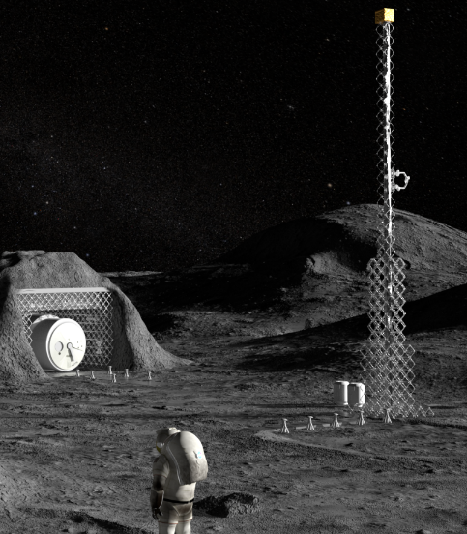
Plan to Develop ECO Capabilities
Overall Plan
  Technology development roadmaps and requirements have been developed that lead to a logical buildup of ECO capabilities and scale that culminate in a series of ground and lunar demonstrations
  Invest in technology development activities that span entire TRL space
  Leverage terrestrial civil engineering expertise through NASA solicitations and public-private partnerships
  Leverage APL/LSIC Working Groups to perform reviews, studies, & integration
Next Steps
  Continue existing high-priority activities, assess progress of funded activities towards closing gaps, identify and plan the next phase of investments.
  Continue modest internal and external pilot projects addressing top priorities and initiate new projects (top priorities presented herein)
  Identify and plan ground and lunar surface demos necessary for gap closure

Slide 18
ECO EFP – Priority Activities
Adequate investment
Some investment
Little/no investment
Complete the IPEx project and conduct the first lunar surface excavation demo
  Fully fund and complete development and ground testing of IPEx excavation system
  Pursue lunar surface test of IPEx to demonstrate the excavation and delivery of 10mT loose regolith (potential 2026 lunar demonstration)
  Icy regolith excavation technology developments on hold until better knowledge is obtained from VIPER on the nature of the regolith
Initiate internal and industry-led projects to develop pilot-scale robotic systems to support integrated ECO ground and lunar demonstrations, working towards initial commercial capability (ISRU and site prep apps)
  Initiate the development of regolith delivery systems to support ISRU commodity production and construction
  Continue and expand the development and scale-up of robotic systems and implements for site prep and regolith manipulation
  Initiate the development of cross-cutting capabilities for robotic ECO platforms (addressing both excavation and site prep)
    Low mass rugged robotic platforms
    Modularity and interfaces for reconfigurability and repairability
    Survive multiple lunar nights or shadowed regions
    Autonomy for high throughput and cooperative operations
Initiate internal and industry-led projects to develop technologies for the assembly and outfitting of large-scale truss-based structures on the lunar surface (see Integrated Demos in Priority Activity #5)
  Initiate a seedling study and follow-on project to develop and demonstrate the assembly and outfitting of a tall truss-based Power and Comm tower (leverage existing PASS, ARMADAS and TLT projects, integration of Power, ECO, Comm, Robotics)
  Initiate a seedling study and project definition for the assembly and outfitting of shelters and shields
  2023 SBIR topic added for the assembly and outfitting of tall truss-based towers

Slide 19
ECO EFP – Priority Activities
Continue and Expand Development of ISRU-based Materials and Processes for Lunar Surface Construction
  Continue to develop/demonstrate multiple viable ISRU-based structural materials and processes for the construction of structures in lunar environment (sintered regolith, binder/regolith blend, molten regolith)
  Initiate new work on metals extraction, molten material handling, casting and printing of parts for construction and repairs and spares (collaboration w/ ISRU & Adv. Man.)
    2023 SBIR topic added for the development of ISRU-based truss elements for assembly
  Develop detailed construction feedstock material requirements
Develop a series of integrated technology demonstrations (priorities in bold)
  Tall tower for Lunar Comm and 100-200 kWe power generation (ECO, Power, Comm, Robotics, Auto Sys.)
    Tall towers needed to meet Comm requirements for Artemis
    Tall power tower can provide near-continuous power for Artemis camp, tech demos, and initial commercial activities
  Modular robotic system for excavation and site preparation (ECO, Robotics, Auto Sys.)
    Large-scale system for surface grading, compacting and bulk regolith manipulation (load, haul, dump)
    Demonstrate autonomous reconfiguration and repair of sub-systems (e.g., wheels, battery, avionics, actuators, implements)
  Shelter construction and outfitting (ECO, Robotics, Auto Sys., Adv. Man., Power, Comm)
  Launch/landing facility construction and outfitting (ECO, EDL, Robotics, Auto Sys., Adv. Man., Power, Comm)
  ISRU-based material production and manufacturing (ECO, ISRU, Adv. Man.)

Slide 20
ECO EFP – Priority Activities
Master planning exercise
  Benefit from a “Master Plan” exercise for site/infrastructure which will help focus technologies and capabilities and incentivize industry investment
  Leverage input from industry on the development of architecture designs and concept of operation studies
  Deriving “requirements” and providing a clear understanding of what a sustainable and scalable lunar infrastructure and economy could look like
Maintenance and Repair
  Initiate funding in the area of development of Digital Twins of E&C assets in lunar environment with the intention of better understanding of M&R. Adopt Digital Twin as the core element of predictive maintenance of lunar E&C assets.
  Leverage learnings from Industry 4 paradigm that is being adopted by many leading companies as predictive maintenance using digital twins is a big part of Industry 4.
  Leverage NASA programs by mandating that developing M&R protocols should be an integral part of their architecture or deliverable.

