Slide 1




Using GCMs to understand
Ancient and Modern Mars
Michael Way
NASA Goddard Institute for Space Studies
MUAN/MAVEN Meeting 2023

Slide 2
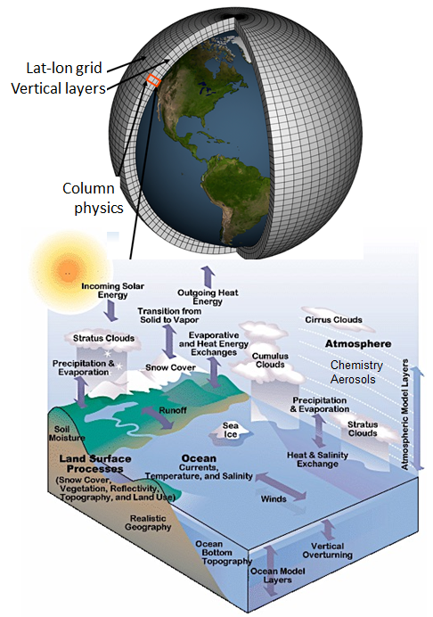
Limitations of Earth derived 3D GCMs:
Time scales ~10⁴ years
Resolution (horizontal & vertical)
Vertical height (stratosphere)
  Mesosphere & thermosphere?
  Non-LTE processes approximated
Shallow atmosphere approximation
  No mini-Neptunes
Many physical processes parameterized
  e.g. Radiative Transfer, cloud physics, etc

Slide 3
Mars GCMs currently in use
1.) LMD (Laboratoire de Météorologie Dynamique)

Slide 4
Mars GCMs currently in use
1.) LMD (Laboratoire de Météorologie Dynamique)

Slide 5
Mars 3D GCMs currently in use?
1.) The Generic Planetary Climate Model (Generic PCM): Forget et al.
2.) The NASA Ames Mars model

Slide 6
Mars 3D GCMs currently in use?
1.) The Generic Planetary Climate Model (Generic PCM): Forget et al.
2.) The NASA Ames Mars model

Slide 7
Mars 3D GCMs currently in use?
1.) The Generic Planetary Climate Model (Generic PCM): Forget et al.
2.) NASA Ames Mars Climate Modeling Center (MCMC): Haberle/Kahre et al.

Slide 8
Mars 3D GCMs currently in use?
1.) The Generic Planetary Climate Model (Generic PCM): Forget et al.
2.) NASA Ames Mars Climate Modeling Center (MCMC): Haberle/Kahre et al.
3.) planetWRF/MarsWRF (Weather Research and Forcasting) [NCAR]

Slide 9
Mars 3D GCMs currently in use?
1.) The Generic Planetary Climate Model (Generic PCM): Forget et al.
2.) NASA Ames Mars Climate Modeling Center (MCMC): Haberle/Kahre et al.
3.) planetWRF/MarsWRF (Weather Research and Forcasting) [NCAR]
4.) MarsCAM (NCAR CAM3) Urata & Toon (2013)

Slide 10
Mars 3D GCMs currently in use?
1.) The Generic Planetary Climate Model (Generic PCM): Forget et al.
2.) NASA Ames Mars Climate Modeling Center (MCMC): Haberle/Kahre et al.
3.) planetWRF/MarsWRF (Weather Research and Forcasting) [NCAR]
4.) MarsCAM (NCAR CAM3) Urata & Toon (2013) -> Now in ExoCAM (Eric Wolf)

Slide 11
Mars 3D GCMs currently in use?
1.) The Generic Planetary Climate Model (Generic PCM): Forget et al.
2.) NASA Ames Mars Climate Modeling Center (MCMC): Haberle/Kahre et al.
3.) planetWRF/MarsWRF (Weather Research and Forcasting) [NCAR]
4.) ExoCAM (Eric Wolf)
5.) MGCM (Kuroda 2005 based on a Japanese Terrestrial GCM)
DRAMATIC PMGCM Kuroda/Kamada et al (2020, …)

Slide 12
Mars 3D GCMs currently in use?
1.) The Generic Planetary Climate Model (Generic PCM): Forget et al.
2.) NASA Ames Mars Climate Modeling Center (MCMC): Haberle/Kahre et al.
3.) planetWRF/MarsWRF (Weather Research and Forcasting) [NCAR]
4.) ExoCAM (Eric Wolf)
5.) MGCM (Kuroda 2005 based on Japanese Terrestrial GCM)
DRAMATIC PMGCM Kuroda/Kamada et al (2020, …)
6.) UM/Exeter: Mars GCM based on UM (2023)
Notes:
6.) UM https://ui.adsabs.harvard.edu/abs/2023GMD....16..621M/abstract

Slide 13
Mars 3D GCMs currently in use?
1.) The Generic Planetary Climate Model (Generic PCM): Forget et al.
2.) NASA Ames Mars Climate Modeling Center (MCMC): Haberle/Kahre et al.
3.) planetWRF/MarsWRF (Weather Research and Forcasting) [NCAR]
4.) ExoCAM (Eric Wolf)
5.) MGCM (Kuroda 2005 based on Japanese Terrestrial GCM)
DRAMATIC PMGCM Kuroda/Kamada et al (2020, …)
6.) UM/Exeter: Mars GCM based on UM (2023)
7.) GEM-Mars (based on GEM weather forecast model): Neary & Daerden 2018
Notes:
6.) UM https://ui.adsabs.harvard.edu/abs/2023GMD....16..621M/abstract
7.) GEM-Mars: https://www.sciencedirect.com/science/article/pii/S0019103517302270

Slide 14
Mars 3D GCMs currently in use?
1.) The Generic Planetary Climate Model (Generic PCM): Forget et al.
2.) NASA Ames Mars Climate Modeling Center (MCMC): Haberle/Kahre et al.
3.) planetWRF/MarsWRF (Weather Research and Forcasting) [NCAR]
4.) ExoCAM (Eric Wolf)
5.) MGCM (Kuroda 2005 based on Japanese Terrestrial GCM)
DRAMATIC PMGCM Kuroda/Kamada et al (2020, …)
6.) UM/Exeter: Mars GCM based on UM (2023)
7.) GEM-Mars (based on GEM weather forecast model): Neary & Daerden 2018
8.) ROCKE-3D (includes a Mars template) based on GISS/Model_E

Slide 15
Mars 3D GCMs currently in use?
1.) The Generic Planetary Climate Model (Generic PCM): Forget et al.
2.) NASA Ames Mars Climate Modeling Center (MCMC): Haberle/Kahre et al.
3.) planetWRF/MarsWRF (Weather Research and Forcasting) [NCAR]
4.) ExoCAM (Eric Wolf)
5.) MGCM (Kuroda 2005 based on Japanese Terrestrial GCM)
DRAMATIC PMGCM Kuroda/Kamada et al (2020, …)
6.) UM/Exeter: Mars GCM based on UM (2023)
7.) GEM-Mars (based on GEM weather forecast model): Neary & Daerden 2018
8.) ROCKE-3D (Mars GCM based on Model_E)
9.) PlanetMPAS (MarsWRF physics in new NCAR MPAS GCM) Lian/Richardson 2023
Notes:
Amanda is working to couple her model to the Ames MCMC model?

Slide 16
Mars 3D GCMs currently in use?
1.) The Generic Planetary Climate Model (Generic PCM): Forget et al.
2.) NASA Ames Mars Climate Modeling Center (MCMC): Haberle/Kahre et al.
3.) planetWRF/MarsWRF (Weather Research and Forcasting) [NCAR]
4.) ExoCAM (Eric Wolf)
5.) MGCM (Kuroda 2005 based on Japanese Terrestrial GCM)
DRAMATIC PMGCM Kuroda/Kamada et al (2020, …)
6.) UM/Exeter: Mars GCM based on UM (2023)
7.) GEM-Mars (based on GEM weather forecast model): Neary & Daerden 2018
8.) ROCKE-3D (Mars GCM based on Model_E)
9.) PlanetMPAS (MarsWRF physics in new NCAR MPAS GCM) Lian/Richardson 2023
10.) There are many other upper atmosphere GCMs
(e.g. DSMC, EIMM, AEROPLANETS, M-GITM)
Notes:
Amanda is working to couple her model (VTGCM) to the Ames MCMC model?
Direct Simulation Monte Carlo (DSMC) method (Tenishev et al.) for Exosphere studies.

Slide 17
Mars 3D GCMs currently in use?
10.) There are many other upper atmosphere models
  DSMC (Direct Simulation Monte Carlo)
    Tenishev et al. 2011 / Bird 1994
Notes:
Direct Simulation Monte Carlo (DSMC) method (Tenishev et al.) for Exosphere studies.
MS-MHD = Multiple Specie Magneto HydroDynamic
PCM-M and GITM more comparable in thermosphere

Slide 18
Mars 3D GCMs currently in use?
10.) There are many other upper atmosphere models
  DSMC (Direct Simulation Monte Carlo)
  AMPS (Adaptive Mesh Particle Simulator Direct Simulation Monte Carlo)
    Tenishev et al. 2021
Notes:
Tenishev 2021 : https://agupubs.onlinelibrary.wiley.com/doi/full/10.1029/2020JA028242

Slide 19
Mars 3D GCMs currently in use?
10.) There are many other upper atmosphere models
  DSMC (Direct Simulation Monte Carlo)
  AMPS (Adaptive Mesh Particle Simulator Direct Simulation Monte Carlo)
    Tenishev et al. 2021
  DSMC-SPARTA (https://sparta.github.io/)
    Stochastic PArallel Rarefied-gas Time-accurate Analyzer
    For simulations of low-density gases in 2d or 3d
Notes:
Direct Simulation Monte Carlo (DSMC) method (Tenishev et al.) for Exosphere studies.
MS-MHD = Multiple Specie Magneto HydroDynamic
PCM-M and GITM more comparable in thermosphere

Slide 20
Mars 3D GCMs currently in use?
10.) There are many other upper atmosphere models
  DSMC (Direct Simulation Monte Carlo)
  AMPS (Adaptive Mesh Particle Simulator Direct Simulation Monte Carlo)
    Tenishev et al. 2021
  DSMC-SPARTA (https://sparta.github.io/)
    Stochastic PArallel Rarefied-gas Time-accurate Analyzer
    For simulations of low-density gases in 2d or 3d
  AEROPLANETS
    chemistry for modeling the response of the upper atmospheric region
    (up to 200 km) to the fluxes of XUV and SEP from young Sun.
    airglow
Notes:
Direct Simulation Monte Carlo (DSMC) method (Tenishev et al.) for Exosphere studies.
MS-MHD = Multiple Specie Magneto HydroDynamic
PCM-M and GITM more comparable in thermosphere

Slide 21
Mars 3D GCMs currently in use?
10.) There are many other upper atmosphere models
  DSMC (Direct Simulation Monte Carlo)
  AMPS (Adaptive Mesh Particle Simulator Direct Simulation Monte Carlo)
    Tenishev et al. 2021
  DSMC-SPARTA (https://sparta.github.io/)
    Stochastic PArallel Rarefied-gas Time-accurate Analyzer
    For simulations of low-density gases in 2d or 3d
  AEROPLANETS
    chemistry for modeling the response of the upper atmospheric region
    (up to 200 km) to the fluxes of XUV and SEP from young Sun.
    airglow
  M-GITM (<300km)
  M-GITM + MS-MHD (overlap 100–300km) + AMPS(future)
Notes:
Direct Simulation Monte Carlo (DSMC) method (Tenishev et al.) for Exosphere studies.
MS-MHD = Multiple Specie Magneto HydroDynamic
PCM-M and GITM more comparable in thermosphere

Slide 22
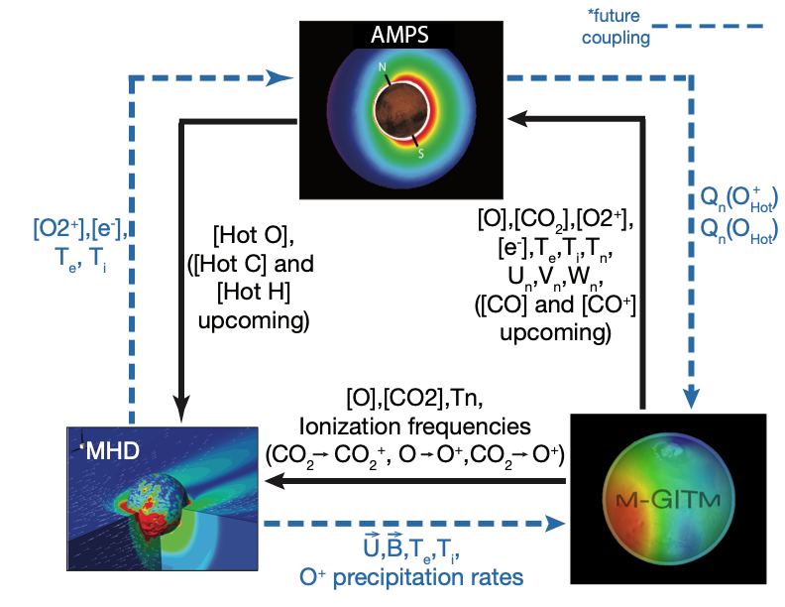
Mars Coupler Pathways and Connections
Courtesy
Steve Bougher
&
Chaunfei Dong
Notes:
Chuanfei Dong & Steve

Slide 23
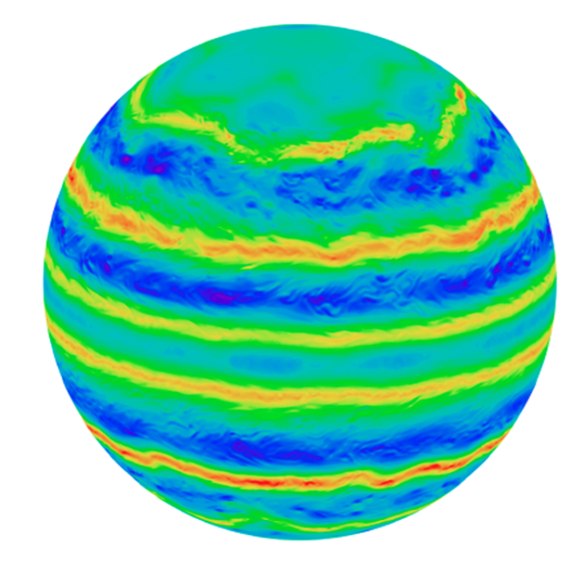
Relevant Capabilities/Shortcomings
1.) The Generic Planetary Climate Model (Generic PCM): Forget et al.
Generally acknowledged as the best planetary GCM in the business
  Why?! Excellent management + stable budgets + smart humans
Does everything from modern Mars → Venus → Jupiter!
Includes non-LTE corrections to upper Thermosphere (Gonzales-Galindo, et al.)
Now has CO2 + H2 and CIA for ancient Mars studies (lab certified by Turbet)
Includes CO2 & H2O clouds
Mars dust cycle implemented.
Limitations:
Outdated cloud convection scheme
Land-surface scheme is a bit dated
Typically does not use fully-coupled ocean (no problem for modern Mars!)
Notes:
Convective Adjustment Scheme (Clouds)

Slide 24
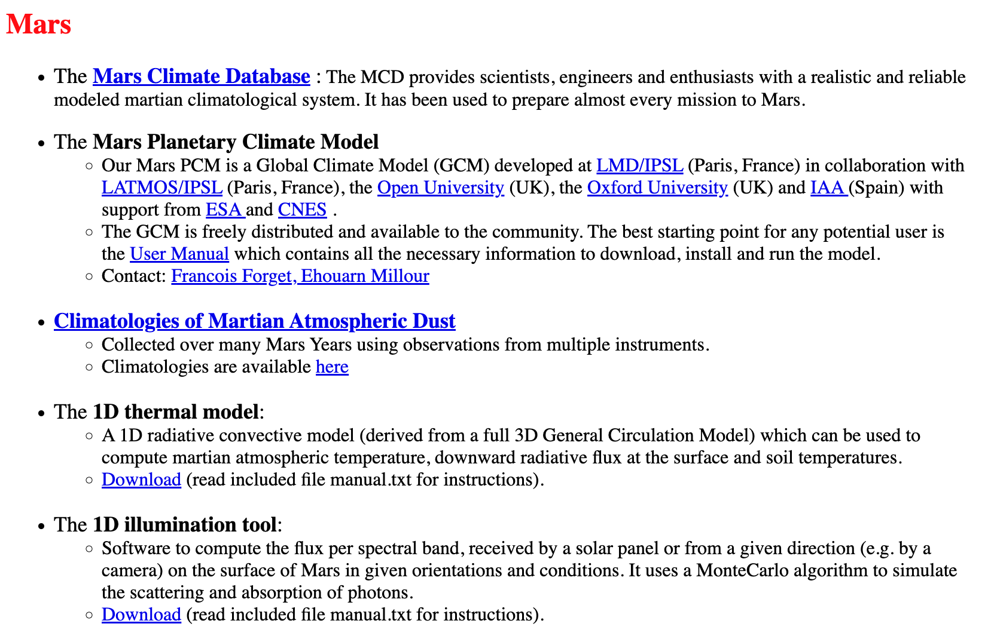
LMD Generic PCM: http://www-planets.lmd.jussieu.fr/
!!

Slide 25
3.) planetWRF/MarsWRF [NCAR]
MarsWRF GCM Toigo et al. 2012
The impact of resolution on the dynamics of the martian global atmosphere:
Varying resolution studies with the MarsWRF GCM
7.5x9° latitude by longitude (low resolution case, ‘‘LR’’)
5x5° (standard resolution case, ‘‘SR’’)
2x2° (high resolution case, ‘‘HR’’)
0.5x0.5° (global mesoscale resolution case, ‘‘GM’’)
Yang et al. (2022)
Simulation of Martian Dust Effects on Polar CO₂ Ice Caps
and Atmospheric Circulation Using the MarsWRF Model
Notes:
MarsWRF GCM https://linkinghub.elsevier.com/retrieve/pii/S0019103512002965

Slide 26
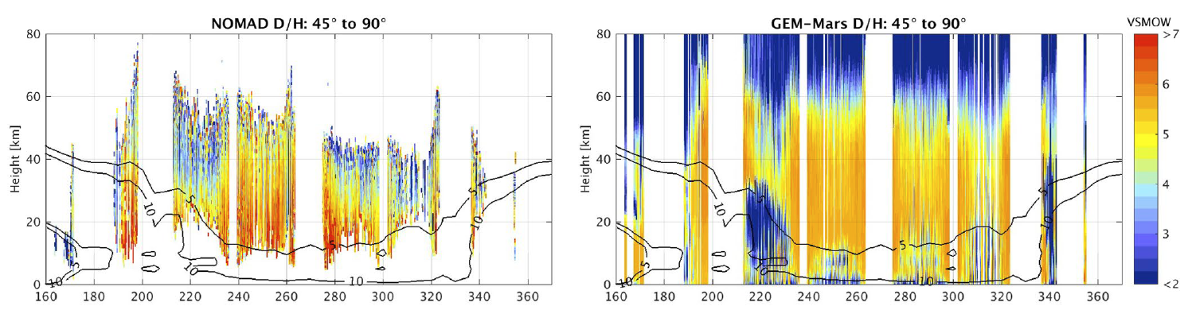
7.) GEM-Mars (based on GEM Belgian Team)
Explaining NOMAD D/H Observations by
Cloud-Induced Fractionation of Water Vapor on Mars
Daerden et al. 2022 JGR Planets
“3D global simulations of D/H in water vapor compared to vertically resolved
observations of D/H and water ice clouds taken by NOMAD during the
second half of Mars year 34.”
Notes:
https://agupubs.onlinelibrary.wiley.com/doi/10.1029/2021JE007079
Figure 16. Overview of NOMAD D/H observations (left) and model simulations (right, MY34 simulation) in three wide latitude ranges. The simulation output was
interpolated to the time and location of the observations. The black contour lines show the simulated zonal mean ice mass mixing ratio (in ppmm), averaged over the
respective latitude ranges, over all local times and over 5° Ls.
“Figure 16 shows that overall the match between simulations and observations is good, both in terms of absolute
D/H values and in terms of variability over time, latitude and altitude."

Slide 27
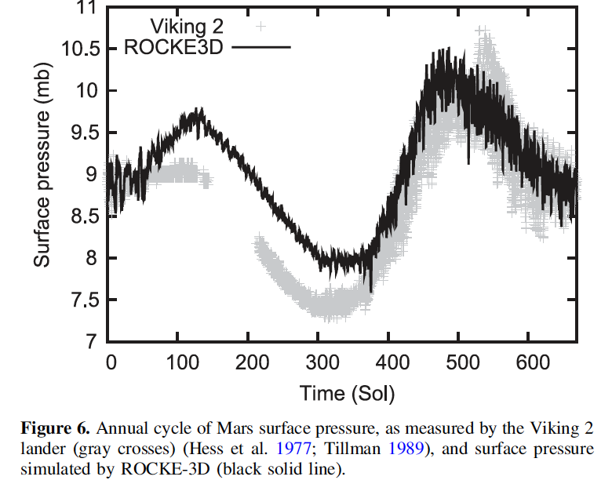
8.) ROCKE-3D GCM – GISS/Model_E
Way et al. (2017): Perhaps the easiest thing
to try and reproduce in any Mars GCM →
Recent modern Mars accomplishments:
Retuning of Earth interactive dust scheme for Mars
Overhaul of surface ices (CO2 & H2), albedos,
soil heat capacities
Notes:
New modern Mars stuff not yet published.

Slide 28
8.) ROCKE-3D Ancient Mars
Guzewich et al. (2021) JGRP:
“3D Simulations of the Early Martian Hydrological Cycle
Mediated by a H2-CO2 Greenhouse”
Testing icy highland hypothesis (mostly)
“1.5–2 bar CO2-dominated atm with ≥3% H2 can produce global mean surface temperatures above freezing, while also providing sufficient warming to avoid surface atmospheric CO2 condensation at 0–45 obliquity.”
Using Wordsworth et al. 2017 “We show that the strength of both
CO₂–H₂ and CO₂–CH₄ collision-induced absorption (CIA) has previously been significantly underestimated.” (ab initio)
Notes:
Figure 6. Percent of the year with above freezing hourly minimum temperatures for 10 ROCKE-3D simulations with
surface pressures and CO2 and H2 mixing ratios identified in the panel title. All simulations incorporate dry soil. The
black line encloses the areas with 100%.

Slide 29
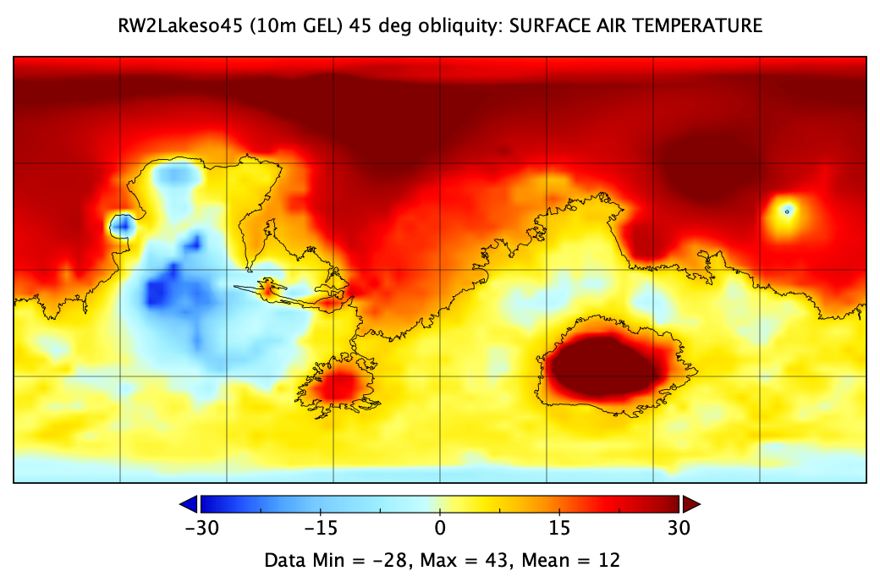
8.) ROCKE-3D Ancient Mars: 10m GEL (Lakes)
Guzewich et al. (2021) JGRP:
10m GEL (lakes)
Modern Topography
45º obliquity
Insolation=442 W/m² (75% today)
2 bar
94% CO2 + 5% H2 + 1% CH4
Global Mean T = +12C
Notes:
RW2Lakeso45: 10m GEL
Insolation is 590 today, so 442 is about 75% of modern)

Slide 30
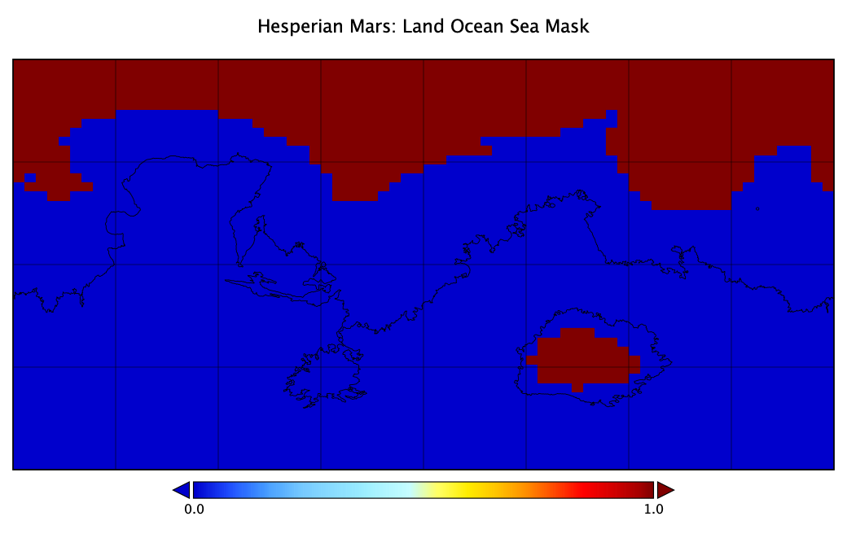
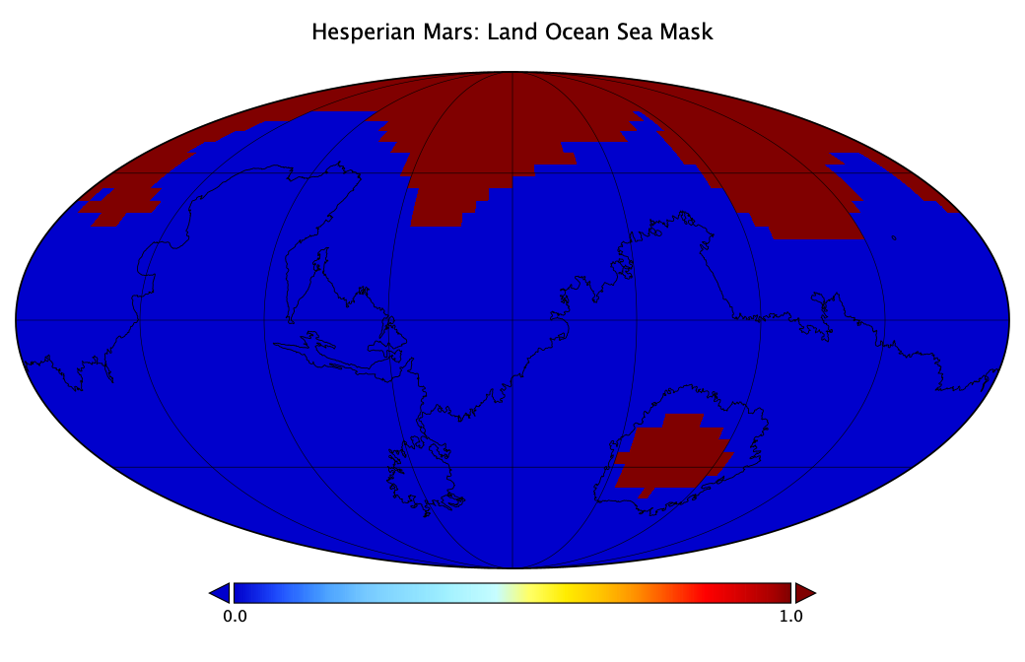
8.) ROCKE-3D Ancient Mars: N. Ocean
Schmidt et al. (2022) PNAS: “Circumpolar ocean stability on Mars 3 Gy ago”

Slide 31
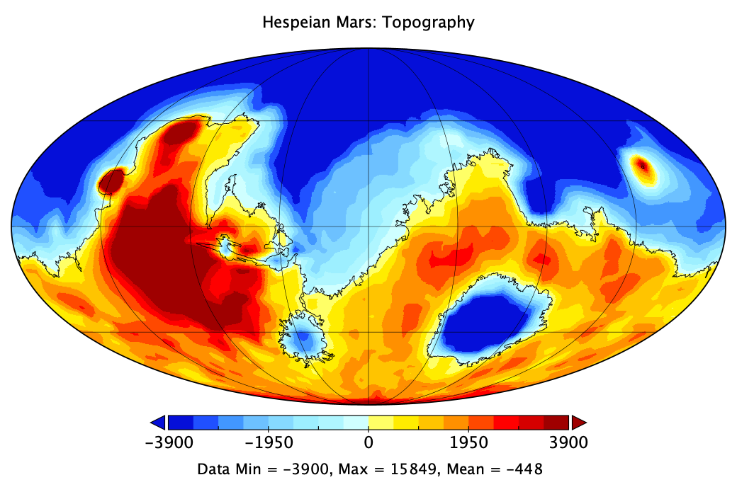
8.) ROCKE-3D Ancient Mars: N. Ocean
Schmidt et al. (2022) PNAS: “Circumpolar ocean stability on Mars 3 Gy ago”

Slide 32
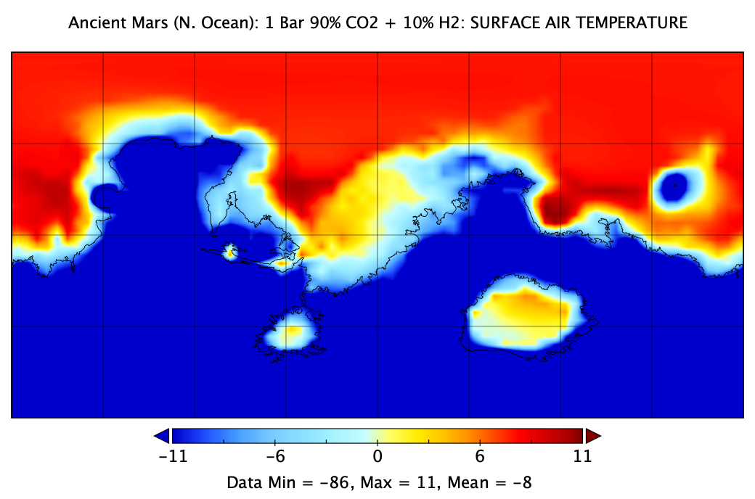
8.) ROCKE-3D Ancient Mars: N. Ocean
Schmidt et al. (2022) PNAS: “Circumpolar ocean stability on Mars 3 Gy ago”
Northern Ocean
Modern Topography
40º obliquity
Insolation=453 W/m² (79% modern)
1 bar
90% CO2 + 10% H2
Global Mean T = –8C
Wordsworth et al. 2017 (ab initio)

Slide 33
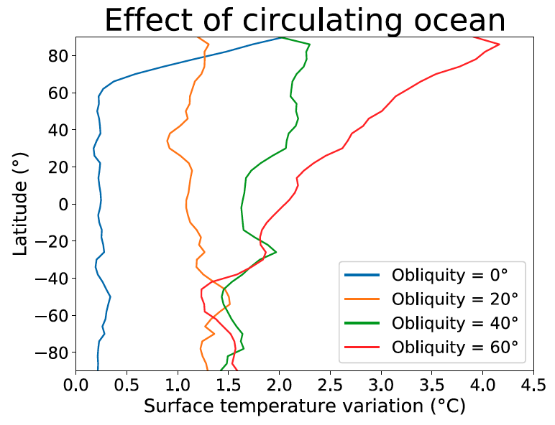
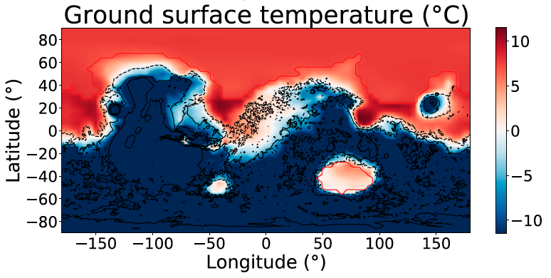
8.) ROCKE-3D Ancient Mars: N. Ocean
Schmidt et al. (2022) PNAS: “Circumpolar ocean stability on Mars 3 Gy ago”
1 bar CO2 + 20% H2: Global Mean Surface Temperature (Tsurf) > 0
1 bar CO2 + 10% H2: Tsurf<0 with Northern areas > 0
Showed that regional temperatures can be above freezing (near n. polar ocean)
While global mean remains below zero.
40 deg obliquity : 10% H2

Slide 34
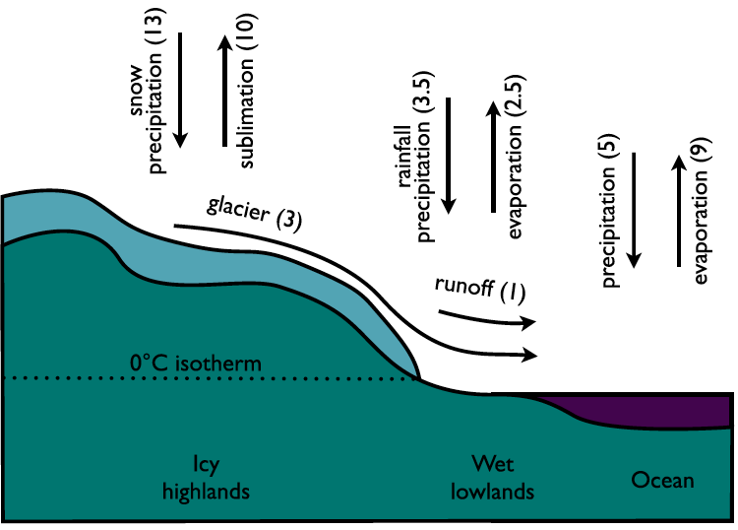
8.) ROCKE-3D Ancient Mars
Schmidt et al. (2022) PNAS: “Circumpolar ocean stability on Mars 3 Gy ago”
Big problem remains:
what about snow accumulation?
Tharsis?
Southern Highlands?
Will glacier return flow of water to
ocean balance the system?

Slide 35
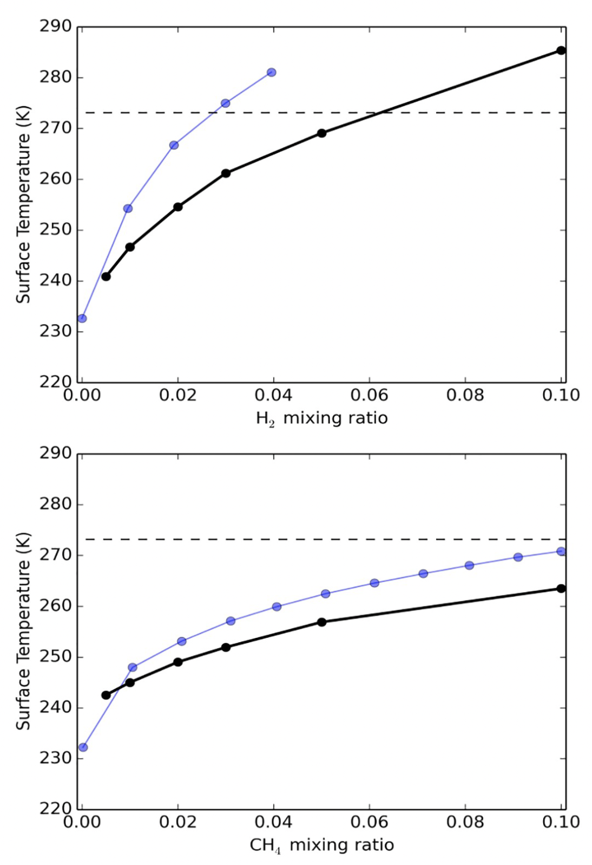
CO2-H2 CO2-CH4 ab-initio optimism!
Turbet et al. 2020: Suite of simulations (2 bar atm):
global mean surface temperature
Blue Lines Wordsworth et al. 2017 (ab-initio)
Black Lines Turbet et al. 2020 (empirical)
3% H2 + 87% CO2 → +13º ab-initio
Ab-initio overestimates warming!

Slide 36
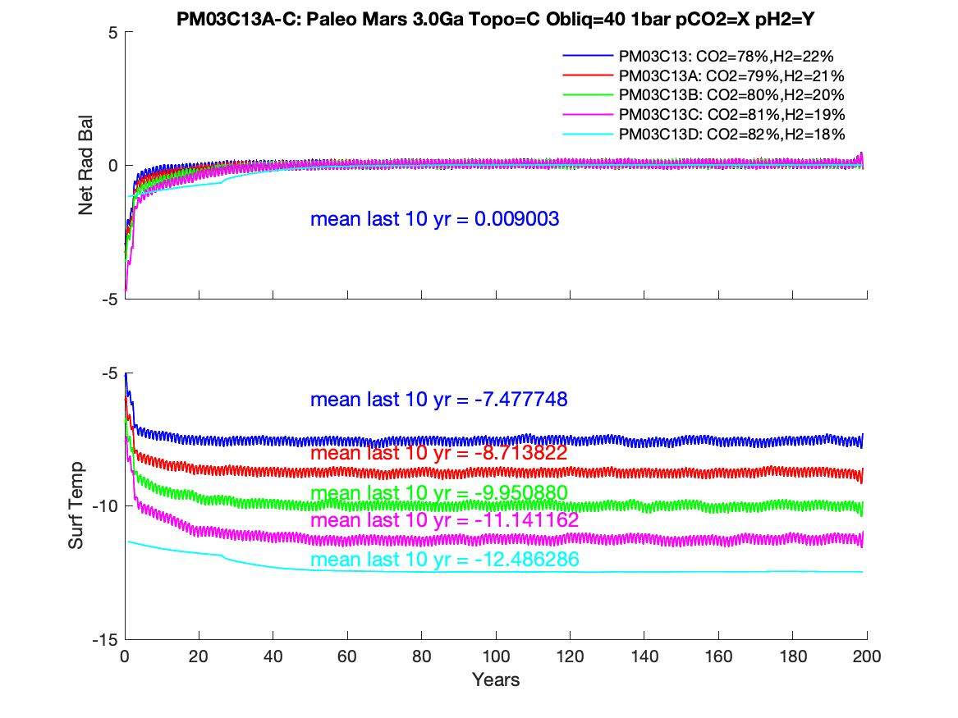
Comparing ab-initio (Wordsworth) vs empirical (Turbet) radiation tables
Ab-initio 1 bar 40º obliquity gives T_mean=–7.5
To get the same warming
22% H2 (lab)
vs 10% (ab-initio)
12% MORE H2
necessary

Slide 37
Please tell me how long It takes to get from one
atmosphere to another via H2 escape in THIS atmosphere!

Slide 38
The Future?
Models have been useful in understanding a number of processes on modern Mars:
D/H ratio
The mechanisms of global dust storms?
Atmospheric dynamics
Micrometeoric infall and possible cloud formation at VERY high altitudes
They have perhaps been even more useful in constraining our theories of ancient Mars
What atmospheric pressures and constituents can produce its ancient geology
  1-2 Bar with CO2+H2 mix is the flavor of the day
More sophistication needed in modeling of dynamic lakes, glaciers and
how any seas may have formed or dissipated over time
More constraints needed on minerology and geomorphology over time

