Slide 1
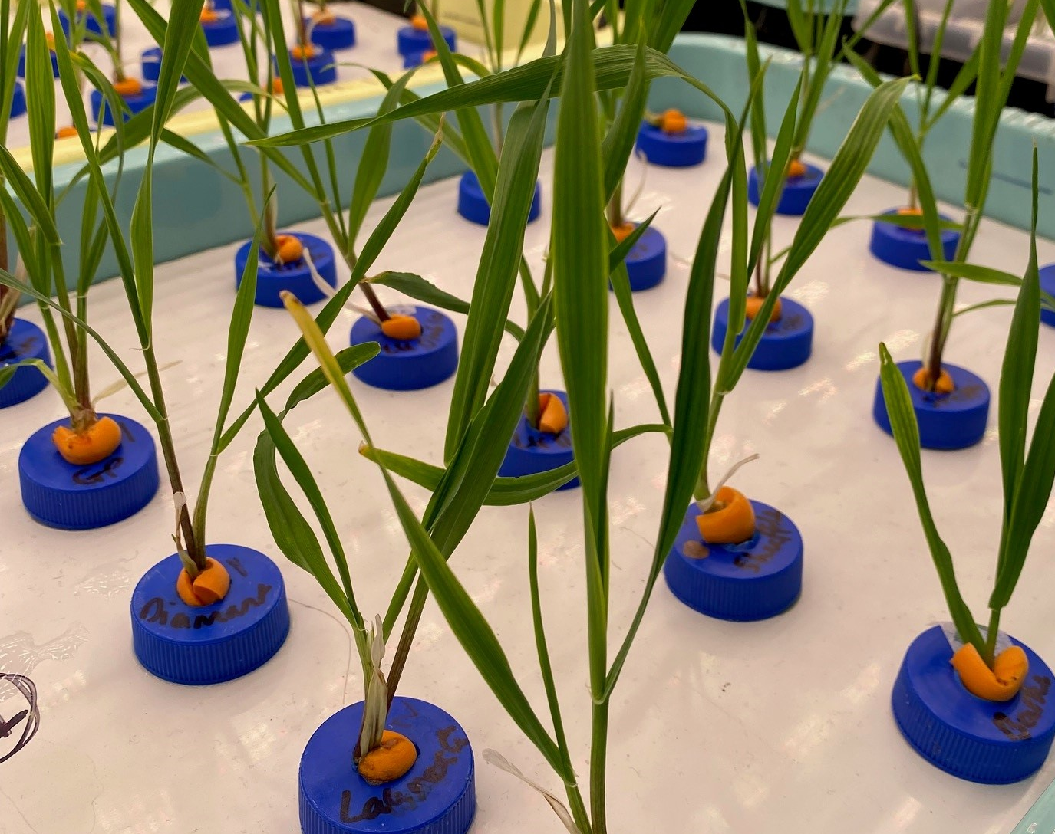

Understanding plant nitrogen form preference responses to elevated CO₂ Earth and spaceflight cabin environments.
Dr Luke Fountain
NASA NPP Fellow
Space Crop Production
John F. Kennedy Space Center
luke.l.fountain@nasa.gov

Slide 2
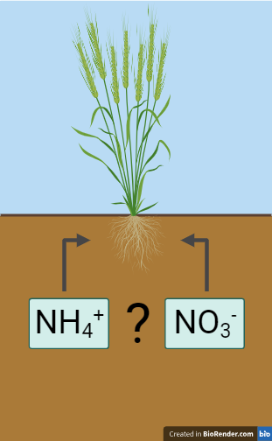
What is nitrogen (N) preference?
Figure created in BioRender
Notes:
Simply the form of N that a plant prefers to uptake. Plants can take up organic forms like amino acids but in most systems, usually inorganic N is dominant, particularly in conventional agricultural soils that are fertilized. So we’ll define N preference here as a plant’s preference for ammonium or nitrate. Important to note that it’s not that plants ONLY take up one form or the other, but that they PREFER to take up one form or the other. Plants are plastic and will respond to the environment which drives the dominant N form…

Slide 3
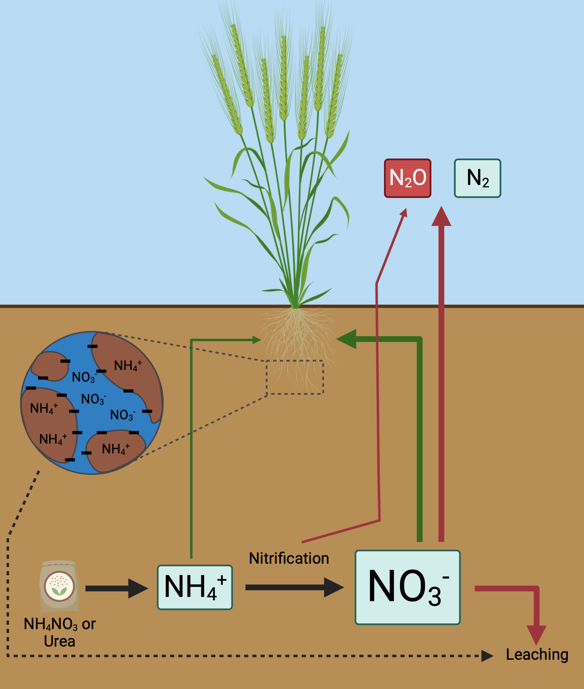
N preference and N cycling in agriculture
Figure created in BioRender
Fountain (2022). PhD Thesis, University of Sheffield.
Notes:
Preference dependent on environment. In drier, aerobic soils, nitrification is dominant driver of ammonium and nitrate pools. Since nitrification converts ammonium to nitrate, the nitrate pool is often dominant in these soil systems. This leads to loss of N from the system through leaching and denitrification (nitrate much more mobile in soil). Nitrification therefore generally considered to be a bad thing, and it means many plants ‘prefer’ nitrate because it is much more widely available over a larger area.

Slide 4
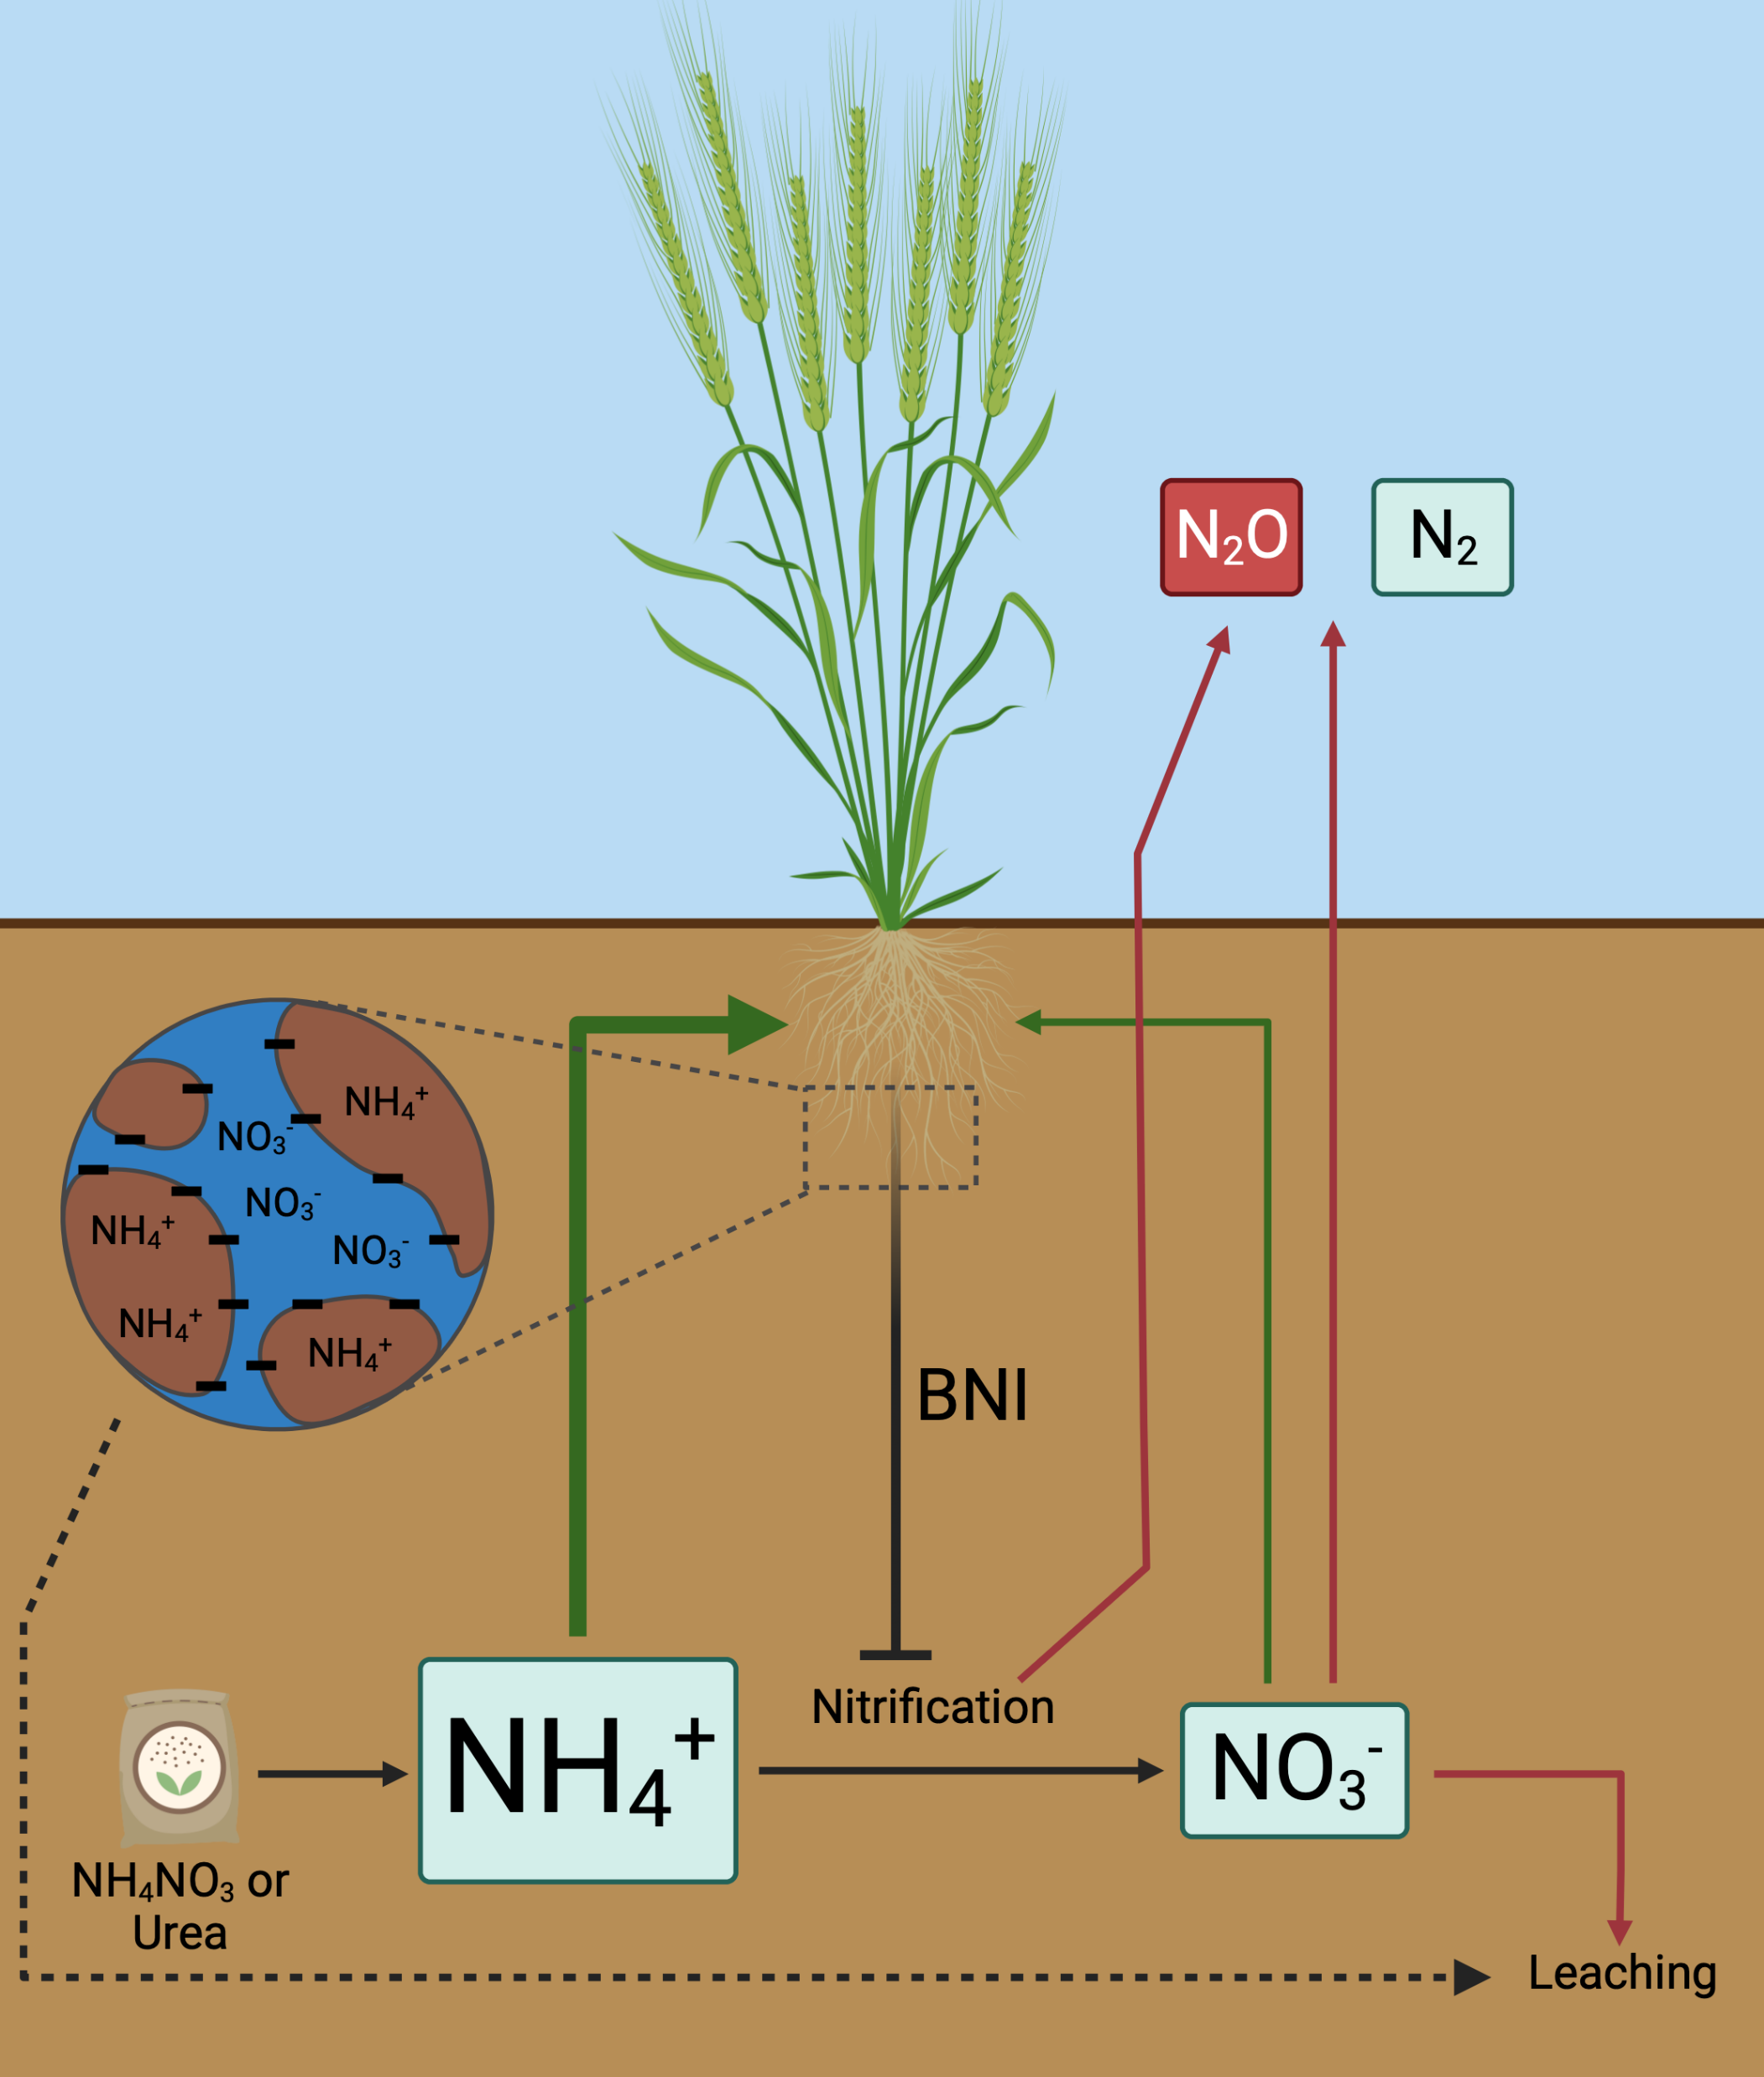
N preference and N cycling in agriculture
Figure created in BioRender
Fountain (2022). PhD Thesis, University of Sheffield.
Notes:
However, some plants are capable of inhibiting nitrification, through BNI (Biological Nitrification Inhibition). Not going into detail, but plants with high BNI activity may show increased ammonium preference, and in fact ammonium preference may itself be a form of BNI – better adapted to compete with nitrifiers for ammonium.

Slide 5
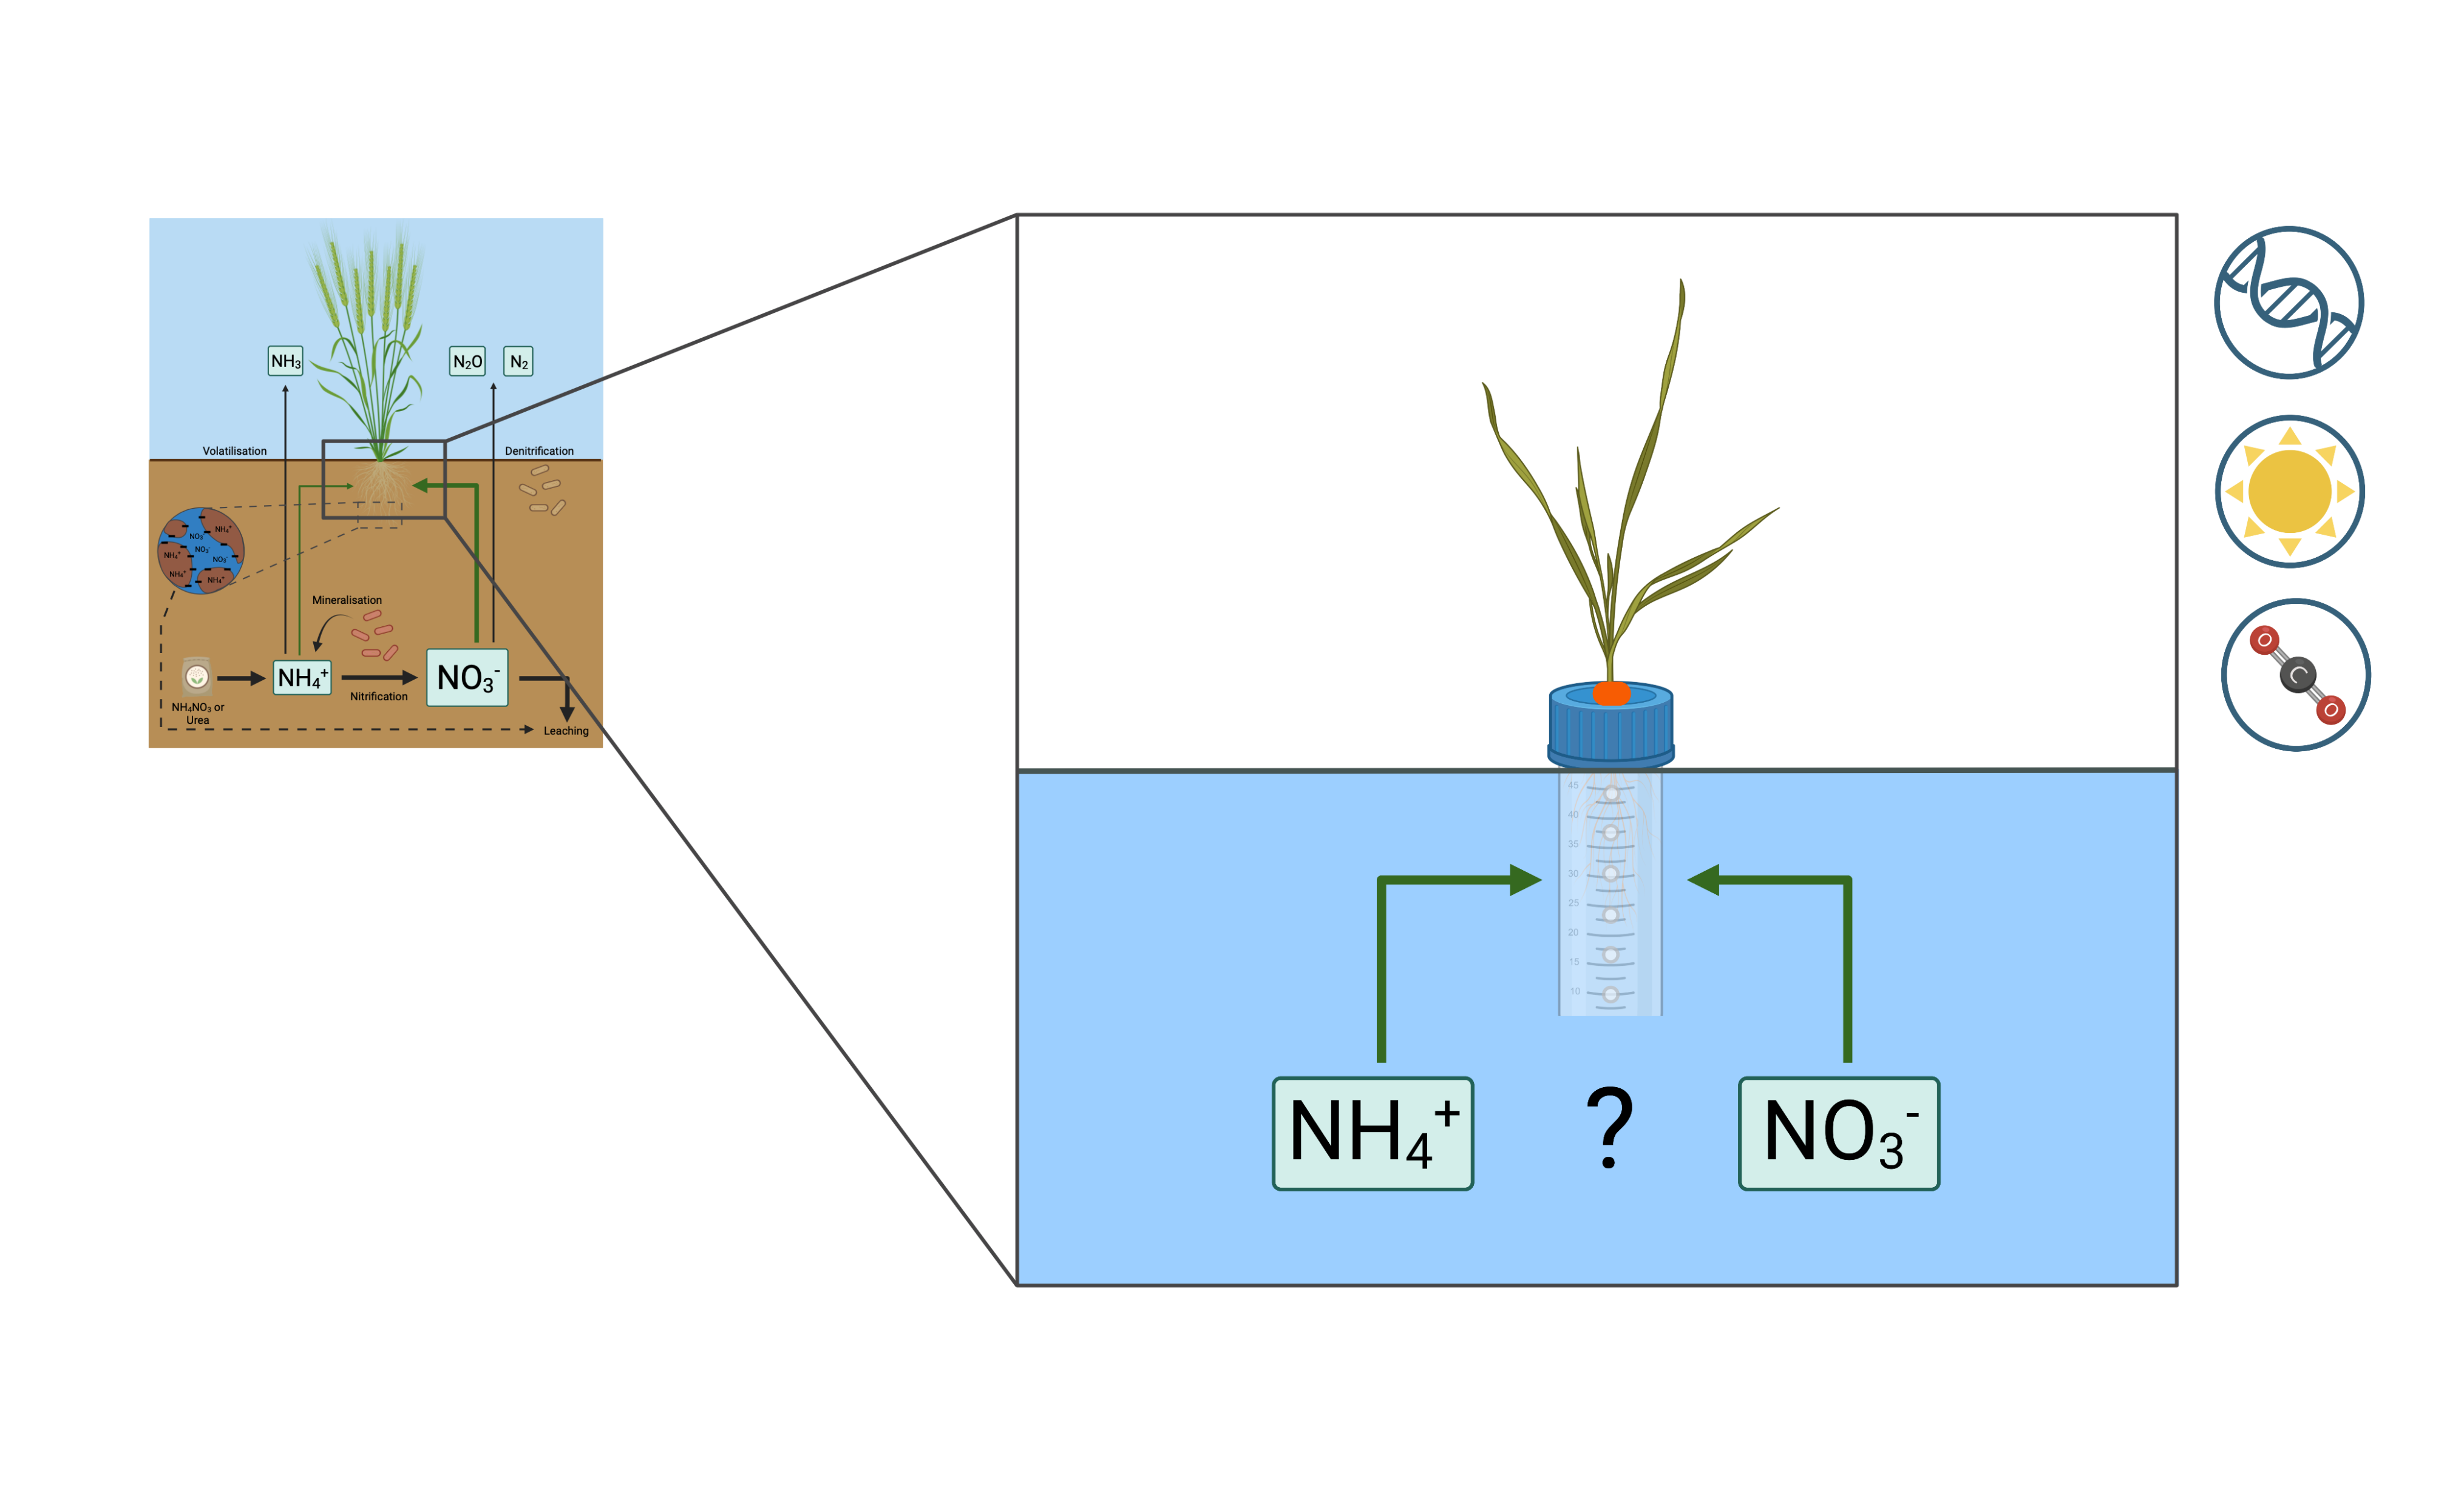
Measuring ‘innate’ N preference
Figure created in BioRender
Fountain (2022). PhD Thesis, University of Sheffield.
Notes:
Simply the form of N that a plant prefers to uptake. Plants can take up organic forms like amino acids but in most systems, usually inorganic N is dominant, particularly in conventional agricultural soils that are fertilized. So we’ll define N preference here as a plant’s preference for ammonium or nitrate. Important to note that it’s not that plants ONLY take up one form or the other, but that they PREFER to take up one form or the other. Plants are plastic and will respond to the environment which drives the dominant N form…

Slide 6
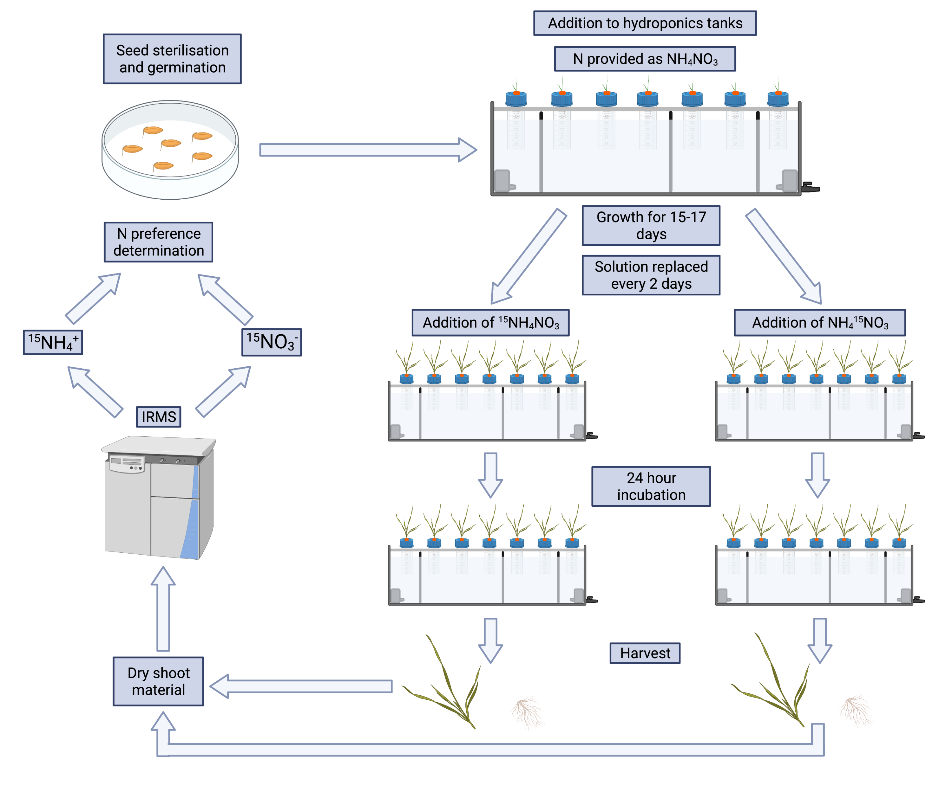
Figure created in BioRender
Fountain (2022). PhD Thesis, University of Sheffield.
Notes:
Simply the form of N that a plant prefers to uptake. Plants can take up organic forms like amino acids but in most systems, usually inorganic N is dominant, particularly in conventional agricultural soils that are fertilized. So we’ll define N preference here as a plant’s preference for ammonium or nitrate. Important to note that it’s not that plants ONLY take up one form or the other, but that they PREFER to take up one form or the other. Plants are plastic and will respond to the environment which drives the dominant N form…

Slide 7
Fountain (2022). PhD Thesis, University of Sheffield.
Notes:
Simply the form of N that a plant prefers to uptake. Plants can take up organic forms like amino acids but in most systems, usually inorganic N is dominant, particularly in conventional agricultural soils that are fertilized. So we’ll define N preference here as a plant’s preference for ammonium or nitrate. Important to note that it’s not that plants ONLY take up one form or the other, but that they PREFER to take up one form or the other. Plants are plastic and will respond to the environment which drives the dominant N form…

Slide 8
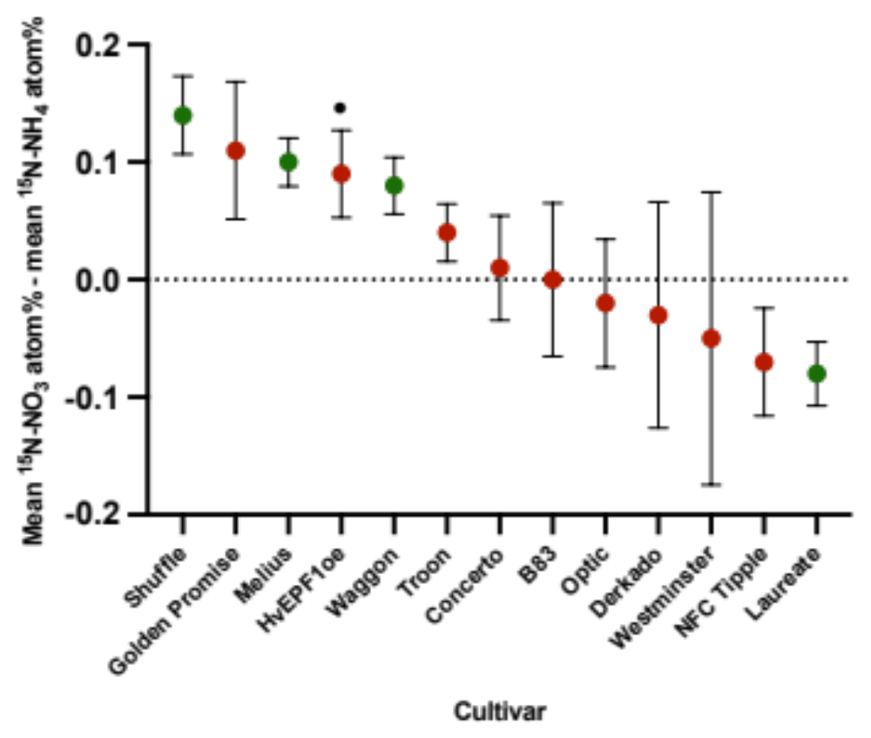
N preference variation in spring barley.
Significant preference
No significant preference
+
P<0.10
+
Fountain (2022). PhD Thesis, University of Sheffield.
Notes:
Simply the form of N that a plant prefers to uptake. Plants can take up organic forms like amino acids but in most systems, usually inorganic N is dominant, particularly in conventional agricultural soils that are fertilized. So we’ll define N preference here as a plant’s preference for ammonium or nitrate. Important to note that it’s not that plants ONLY take up one form or the other, but that they PREFER to take up one form or the other. Plants are plastic and will respond to the environment which drives the dominant N form…

Slide 9
N uptake and elevated CO₂ (eCO₂).
Plants grown at eCO₂ (720ppm) show reduced relative growth rate (RGR) when grown solely on NO₃⁻ (Bloom, 2015).
Plants grown on solely NH₄⁺ are unaffected.
Possibly due to lack of reducing power from photosynthesis and photorespiration for NO₃⁻ reduction.
Does this translate to increased NH₄⁺ preference at eCO₂?
Notes:
Simply the form of N that a plant prefers to uptake. Plants can take up organic forms like amino acids but in most systems, usually inorganic N is dominant, particularly in conventional agricultural soils that are fertilized. So we’ll define N preference here as a plant’s preference for ammonium or nitrate. Important to note that it’s not that plants ONLY take up one form or the other, but that they PREFER to take up one form or the other. Plants are plastic and will respond to the environment which drives the dominant N form…

Slide 10
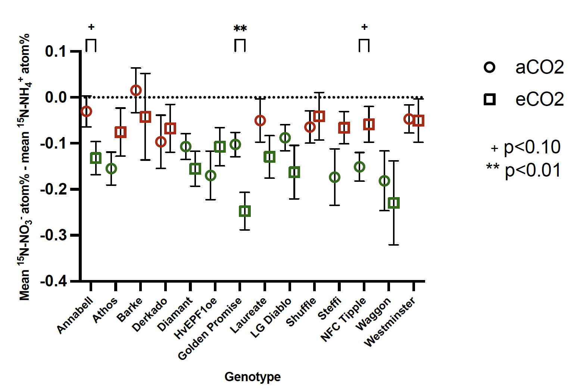
Barley N preference responses to eCO₂.
Significant preference
No significant preference
Fountain (2022). PhD Thesis, University of Sheffield.
Notes:
Simply the form of N that a plant prefers to uptake. Plants can take up organic forms like amino acids but in most systems, usually inorganic N is dominant, particularly in conventional agricultural soils that are fertilized. So we’ll define N preference here as a plant’s preference for ammonium or nitrate. Important to note that it’s not that plants ONLY take up one form or the other, but that they PREFER to take up one form or the other. Plants are plastic and will respond to the environment which drives the dominant N form…

Slide 11

Consequences for space crop production.
CO₂ concentrations on ISS often in excess of 5000ppm (Law et al., 2014).
N currently only supplied as NO₃⁻.
Reduced yield may be achieved when crops severely affected by seCO₂.
Need to maximise yield as we look toward sustaining astronauts on the Moon and Mars.
Notes:
Simply the form of N that a plant prefers to uptake. Plants can take up organic forms like amino acids but in most systems, usually inorganic N is dominant, particularly in conventional agricultural soils that are fertilized. So we’ll define N preference here as a plant’s preference for ammonium or nitrate. Important to note that it’s not that plants ONLY take up one form or the other, but that they PREFER to take up one form or the other. Plants are plastic and will respond to the environment which drives the dominant N form…

Slide 12
Future work – NPP Fellowship, Kennedy Space Center.
How widespread is variation in N preference across species and cultivars?
Do cultivars of candidate crops behave differently under eCO₂ in terms of N preference?
Does this hold true at seCO₂?
May lead to increased yield through:
Selection of varieties better adapted to an eCO₂ or seCO₂ environment.
Optimization of N provision through addition of both NH₄⁺ and NO₃⁻ in bespoke ratios.
Notes:
Simply the form of N that a plant prefers to uptake. Plants can take up organic forms like amino acids but in most systems, usually inorganic N is dominant, particularly in conventional agricultural soils that are fertilized. So we’ll define N preference here as a plant’s preference for ammonium or nitrate. Important to note that it’s not that plants ONLY take up one form or the other, but that they PREFER to take up one form or the other. Plants are plastic and will respond to the environment which drives the dominant N form…

Slide 13

References
Acknowledgements
Sheffield:
University of Sheffield
White Rose DTP
BBSRC (part of UKRI)
Contact:
Luke.l.fountain@nasa.gov
Sheffield:
Tim Daniell
Duncan Cameron
Julie Gray
NASA/KSC:
Gioia Massa
Elison Blancaflor
Ray Wheeler
Bloom (2015). The increasing importance of distinguishing among plant nitrogen sources. Current Opinion in Plant Biology 25, 10-16.
Fountain (2022). Understanding interactions of barley (Hordeum vulgare) with soil nitrogen cycling activity and links to plant nitrogen preference. PhD Thesis, University of Sheffield.
Law et al. (2014). Relationship between carbon dioxide levels and reported headaches on the International Space Station. Journal of Occupational and Environmental Medicine 56, 477-483.
Notes:
Simply the form of N that a plant prefers to uptake. Plants can take up organic forms like amino acids but in most systems, usually inorganic N is dominant, particularly in conventional agricultural soils that are fertilized. So we’ll define N preference here as a plant’s preference for ammonium or nitrate. Important to note that it’s not that plants ONLY take up one form or the other, but that they PREFER to take up one form or the other. Plants are plastic and will respond to the environment which drives the dominant N form…

Slide 14
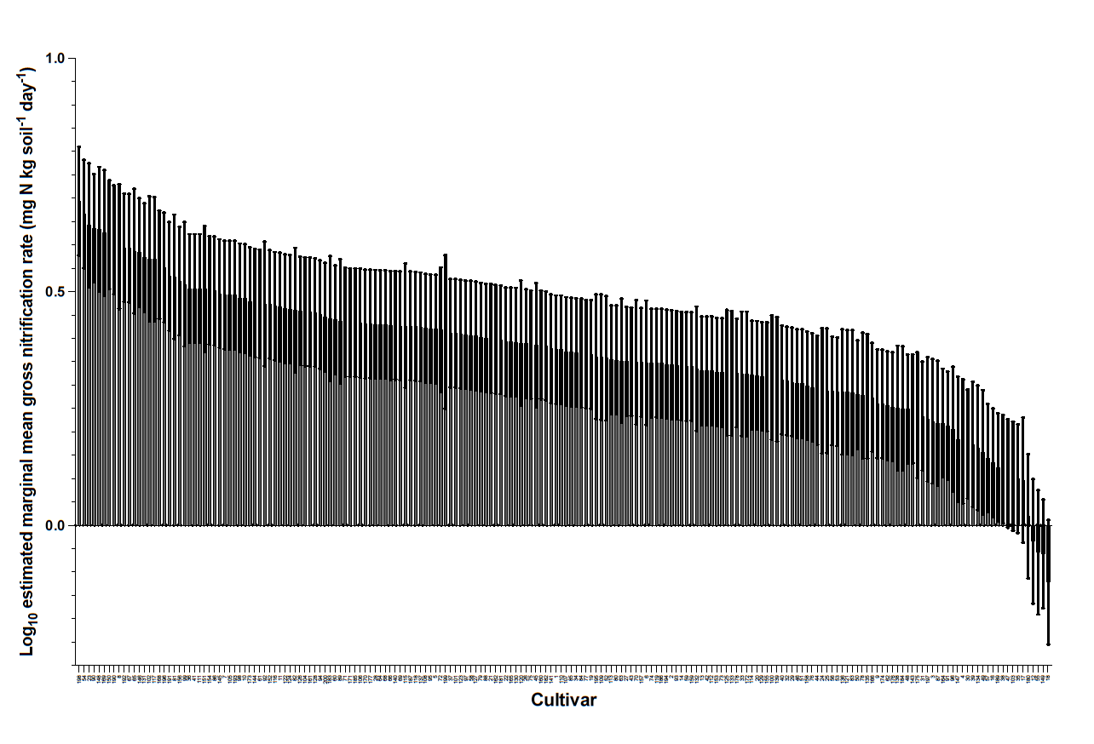
Gross nitrification rate in spring barley
Fountain (2022). PhD Thesis, University of Sheffield.

Slide 15
N preference and BNI
Fountain (2022). PhD Thesis, University of Sheffield.
Notes:
Simply the form of N that a plant prefers to uptake. Plants can take up organic forms like amino acids but in most systems, usually inorganic N is dominant, particularly in conventional agricultural soils that are fertilized. So we’ll define N preference here as a plant’s preference for ammonium or nitrate. Important to note that it’s not that plants ONLY take up one form or the other, but that they PREFER to take up one form or the other. Plants are plastic and will respond to the environment which drives the dominant N form…

