Slide 1


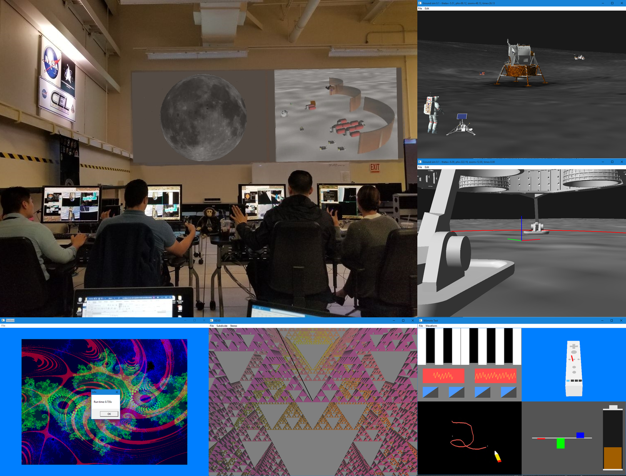
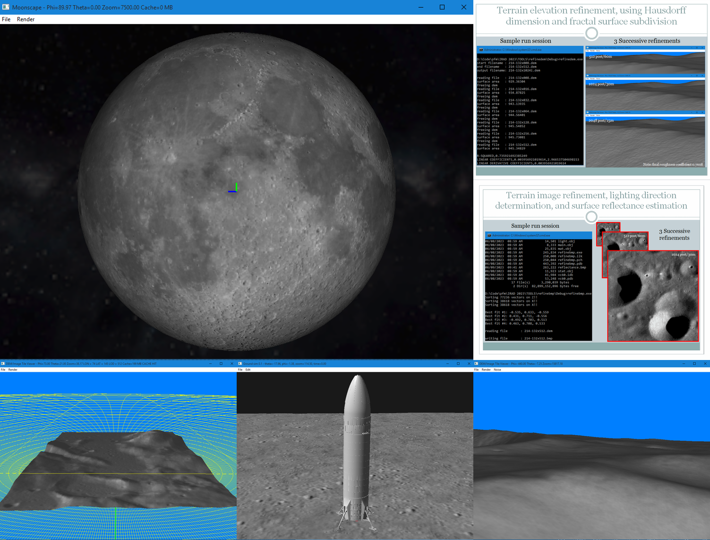
Full Lunar Surface Visualization and Simulation Platform
PM / PI Info John Euker | john.euker-1@nasa.gov
I
G
EXECUTIVE SUMMARY
This project created a visualization and simulation platform for the entire lunar surface. Given the polar targets for Artemis, the terrain, lighting and associated integrated crew / vehicle risk assessment requires a more integrated approach to mission safety certification, potentially impacting equipment design and crew activity. The results will enable Safety and Mission Assurance (SMA), Flight Operations (FOD), and EVA to collaborate to reduce human lunar exploration operational risk utilizing tools to perform mission planning and rehearsal simulations, providing the Safety Review Panel with integrated risk analysis.
Innovation
The capability for SMEs to perform simulated lunar operations will be an invaluable tool in the design / certification process. Utilizing these tools, NA, EA, SA, CA, and XA will be able to collaborate in parallel during the life cycle of lunar hardware development as well as safety certification development and lunar mission certification. These have also been made available to contractors delivering hardware. Current in-line processes are unaffected. Such collaboration will lower residual risk in the mission through earlier identification of safety issues, and fewer assumptions between the growing number of developers and contractors. The software includes the ability to verify system requirements by analysis through carefully validated procedural synthetic terrain generation algorithms, and support the ability to generate physics based synthetic images of the terrain for lighting, hi-fidelity testing of terrain-relative navigation algorithms and closed loop systems, etc.
Collaboration
Greg Baumer: JSC Code NE Director, JSC S&MA Directorate Institutional Support
Mike McFarlane: JSC Code ER7, Institutional Facility Support
Dr. Zack Crues: JSC ER7 Chief Engineer, Program Technical and Mission Expertise
Nathan Vassberg: Dep. Director SMA, SRP Support and feedback on utility of approach and capabilities
Kurt Leucht: KSC, Technical collaboration project lead for Moon Tycoon
Sam Lawrence: JSC, Technical advisor Artemis geospatial team
H
J
K
L
Application and roadmap
Outcomes & Infusion
Publically available LRO/LOLA terrain imagery and elevation data from 60m to 15km resolution was acquired
Elevation data for 32 post (960m) was generated algorithmically due to its unavailability online
A terrain elevation refinement algorithm was developed using fractal surface subdivision (sub meter resolution)
Another algorithm discovered allowed for the refinement of lunar surface imagery and estimation of surface material reflectance
Algorithms were developed to simulate higher "visual" resolution using fractal Brownian motion textures (reducing polygons by 16x)
Advanced methods of terrain/color compression were discovered that fit full LRO/LOLA lunar datasets into 99GB of space
A full surface simulator platform was created that supports 60m resolution and runs from USB drives on COTS H/W (laptops)
Multiple spacecraft models were created and acquired for testing lunar surface based simulations
A reconstructed tranquility base test case was created using historic imagery and fractal 3.5m refined terrain
The proposed Amundsen rim landing site was generated at 0.625m to assess lander topple risks for the commercial crew program
Future Work
An proposal is in place to use the CEL as a collaborative NA / EA / USSF / commercial crew lunar mission hosting environment
Add support for efficient parallel processing and load balancing on multi-core computing systems
Add support for anaglyph stereo 3D display on monitors and projectors by using low cost red-blue filtered glasses
Add a K-d tree based algorithm for user pick selection of 3D models in high polygon count lunar surface environments
Add a basic ray-casting model for simple luminance estimation and shadow computation
Add a fast / efficient viewer-object and object-object collision detection and avoidance algorithm
Add support for consumer level, sensor based/immersive input devices such as Google cardboard headsets, etc.
Add a Nintendo Wiimote library to offer inexpensive support for interaction, motion tracking, and haptic feedback
A
B
C
D
E
F
G
E
H
A
I
J
B
K
D
F
C
L
Innovation and implementation
DAA# | 20230014411
Trade names are used in this poster for identification only. Their usage does not constitute an official endorsement, either expressed or implied, by the National Aeronautics and Space Administration.

