Slide 1
Comparative Analysis of Airspace System Accessibility for Uncrewed Aircraft Systems for Regional Operations
Tim Felix Sievers DLR Institute of Flight Guidance
Jordan Sakakeeny, PhD NASA Ames Research Center
Nadezhda Dimitrova NASA Ames Research Center
Husni Idris, PhD NASA Ames Research Center
Notes:
Packed with information – slides liked best (slide 5)
Potential place to reduce: highlight these things are needed, could reduce discussion of autoland, we considered this, these are big things to hit, in the paper we looked at applicability of CAT III, these are large topics, but we focused on this thisand this
^ Slides 18 and 19
Can cut MTOW talk – did this in the paper
Make clear that ILS/GLS are currently certified for crewed aircraft but not UAS
Could cut justification for 2.2% - justifications are in the paper
Two axes (% of IFR) and IAP availability – main conclusions drawn from squeezing these two filters – additional little details in there - could we show the “knee in the curve” re: 2.2%
Previous work identified Germany, California, and Texas as good options – see other paper for more info

Slide 2
Overview
Introduction and Background
Scope and Research Questions
Accessibility Characteristics of Regional Cargo UAS Operations
Accessibility Potential of Regional Cargo UAS Operations
Conclusions and Future Work

Slide 3
Introduction and Background
Motivation
Establish a baseline to assess the accessibility potential of regional cargo UAS
Uncrewed Aircraft Systems (UAS) are projected to increase in frequency and density of operation in the coming years
Fixed-wing UAS are expected to be part of newly developing aviation markets, termed Advanced Air Mobility (AAM)
Regional flights are short-haul flight operations using primarily fixed-wing aircraft and existing runway infrastructure
Regional operations have decreased significantly in recent decades, focusing operations at major airports

Slide 4
Introduction and Background
Air Cargo Introduction
Air cargo is crucial part of modern infrastructure
Regional air cargo is lesser known, yet is a critical part of the overall air cargo network
Typical regional air cargo routes are <1,000 km (540 nmi) in length
Typical regional cargo aircraft for cargo-only flights are:
  Cargo-only includes freight and mail, excludes passengers
  Common cargo includes low weight, high value (e.g., medicine)
  Turboprop (e.g., Cessna 208, ATR-42), piston, and jet aircraft
  Carry payload <9 tonnes (<10 US tons)
  Have a maximum take-off weight (MTOW) of less than 25 tonnes (<28 US tons)

Slide 5


Introduction and Background
Key Air Cargo Issues
Pilot costs make up a large portion of the operational costs of regional air cargo operations
Pilot shortage, particularly in the regional air cargo realm
Demand for air cargo has increased significantly

Slide 6
Introduction and Background
Key UAS Issues
Landing systems technologies and availability
Contingency management, including lost command and control link
Interactions with cooperative and non-cooperative traffic

Slide 7
Introduction and Background
Air Cargo, Regional Operations, and UAS
Recent developments in aircraft technology and government efforts have led to a renewed interest in regional operations
Increasingly autonomous aircraft are strongly desired to mitigate pilot shortages and enable highly scalable operations
Regional air cargo presents an excellent initial use case for the development of these technologies:
  Short-haul flights
  No person on board, so fewer certification hurdles
  Increasing access to under-served airports and communities
  Better pilot and resource utilization
Establish a baseline and assess the accessibility potential of cargo UAS

Slide 8
Overview
Introduction and Background
Scope and Research Questions
Accessibility Characteristics of Regional Cargo UAS Operations
Accessibility Potential of Regional Cargo UAS Operations
Conclusions and Future Work

Slide 9
Scope and Research Questions
Identify airports suitable for initial cargo UAS operations
  Establish a baseline: What kind of airports are suitable for initial cargo UAS operations?
    Define those suitable for initial cargo UAS operations as potential UAS airports
    How many of these potential UAS airports provide currently certified landing systems most likely to be used for initial UAS operations?
Assess the accessibility potential of cargo UAS operations at these airports
  How many potential UAS airports would be accessible for cargo UAS operations…
    …in total?
    …based on specific regional aircraft types currently in use?

Slide 10
Overview
Introduction and Background
Scope and Research Questions
Accessibility Characteristics of Regional Cargo UAS Operations
Accessibility Potential of Regional Cargo UAS Operations
Conclusions and Future Work

Slide 11
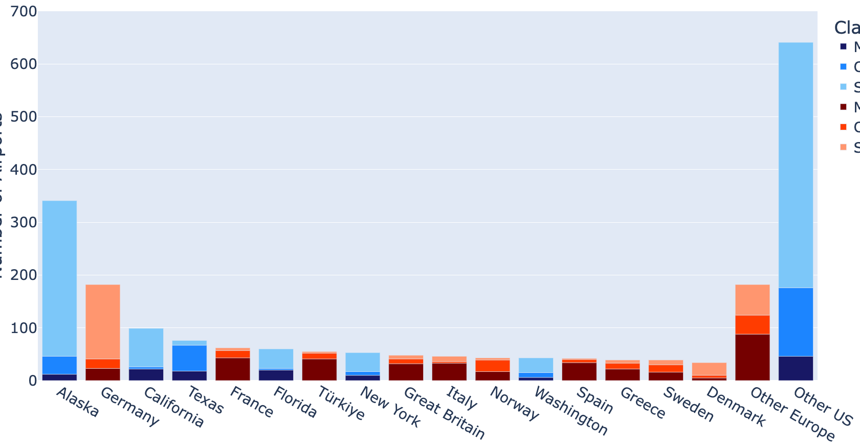
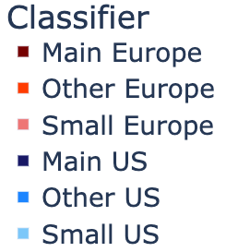


Accessibility Characteristics of Regional Cargo UAS
Country/State Comparison
Main Airport | Medium Airport | Small Airport
≥150,000 / year | <150,000 and ≥15,000 / year | <15,000 / year
Germany and California have a comparatively high number of small airports
California and Texas have a high number of intra-state flights by regional aircraft
These three areas have a comparatively high potential for the introduction of cargo UAS
Number of Commercial Airports
Passenger unit
=1 passenger or 100 kg of cargo
European country / US state
Based on data available – European data are reported country-by-country
Notes:
Alaska is a potentially very interesting use case for cargo UAS but geographically unique and
not quite comparable for other US states
Can probably merge 13/14 and say Germany, Texas, and California were chosen – see previous work

Slide 12
Accessibility Characteristics of Regional Cargo UAS
Regional Aircraft Type Comparison – Country/State
Cargo-only flight movements by regional aircraft |  | Germany | Texas | California
Total cargo-only flights | turboprop | 9,225 | 11,544 | 13,546
 | jet | 55 | 229 | 8
Intra-state cargo-only flights | turboprop | 112 | 7,058 | 13,540
 | jet | 2 | 25 | 0
The areas have a high total number of cargo-only flights by regional turboprop aircraft
Almost no cargo-only flights by regional jet aircraft
Cargo UAS are more likely to occur
  via the introduction of additional regional air cargo operations in Germany
  via the replacement of existing regional air cargo operations in Texas/California
Cargo-only flights = No passengers on board, only cargo (consisting of freight and mail)
Total flights = Flights within the US and flights to intra- and extra-European countries
Intra-state flights = Flights within a US state and flights within Germany

Slide 13
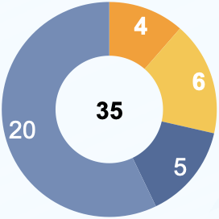
Accessibility Characteristics of Regional Cargo UAS
But which airports really qualify for initial cargo UAS operations?
Identifying a baseline of accessible airports for UAS based on
1. Type of air transport services
  Public access with or without commercial services
2. Annual number of IFR flight movements to identify less busy public airports
  Public towered* airports with annual IFR flight percentages under 2.2%
  Public non-towered airports (no record of flights)
Based on the airport classification of Germany
These 10 airports account for 87.7% of total annual IFR flights (Germany, 2022)
Hub Airports
International Access Airports (IAA1)
Each of these 10 airports has at least >2.2% of total IFR flights by all 35 airports
Each of these 25 airports has <2.2% of total IFR flights by all 35 airports
Regional Airports
International Access Airports (IAA2)
* Towered airports refer to airports with a physical air traffic control tower receiving separation by ATC

Slide 14
Accessibility Characteristics of Regional Cargo UAS
Identifying Potential UAS Airports
Why <2.2% baseline?
  Include less busy towered airports
  Most likely for initial UAS operations
Definition of “Potential UAS airports”
  Public towered airports with annual IFR flight percentages under 2.2%
  Public non-towered airports
 | Germany | Texas | California
Potential UAS airports | 22 towered (Total 173) | 40 towered (Total 376) | 44 towered (Total 231)
Potential UAS airports: Share of total IFR flights at towered airports | 12.3% | 27.5% | 21.3%

Slide 15
Accessibility Characteristics of Regional Cargo UAS
Landing Systems / Instrument Approach Procedures
What landing systems are needed?
  RTCA DO-304A highlights the need for automatic landing systems for UAS
  Instrument Landing System Category III (ILS CAT III) is the only currently certified system to enable autoland for crewed aircraft
  Ground Based Augmentation System Landing System (GLS) CAT I/II available and more likely to be upgraded to CAT III to enable autoland in the future than existing ILS CAT I/II
  Current certified Instrument Approach Procedures with a comparatively high chance to enable UAS operations are called UAS IAP in this research (i.e., ILS CAT III and GLS)
  UAS IAP could include other certified landing systems in the future
 | Germany | Texas | California
Total potential UAS airports with any UAS IAP | 9 | 1 | 1

Slide 16
Overview
Introduction and Background
Scope and Research Questions
Accessibility Characteristics of Regional Cargo UAS Operations
Accessibility Potential of Regional Cargo UAS Operations
Conclusions and Future Work

Slide 17
Accessibility Potential of Regional Cargo UAS
Potential UAS Airports – Country/State
Airspace classes | Count of potential UAS airports
 | Germany |  | Texas |  | California
All | 173 |  | 376 |  | 231
 | 24 ILS /GLS | 9 UAS IAP | 36 ILS /GLS | 1 UAS IAP | 36 ILS /GLS | 1 UAS IAP
C | - |  | 6 towered |  | 3 towered
 |  |  | 6 ILS | 0 UAS IAP | 3 ILS | 1 UAS IAP
D | 22 towered |  | 34 towered |  | 41 towered
 | 20 ILS /GLS | 9 UAS IAP | 25 ILS | 1 UAS IAP | 25 ILS | 0 UAS IAP
E/G | 151 non-towered |  | 336 non-towered |  | 187 non-towered
 | 4 ILS | 0 UAS IAP | 5 ILS | 0 UAS IAP | 8 ILS | 0 UAS IAP
Germany has 9 potential UAS airports with UAS IAP
Texas and California each have one potential UAS airport with UAS IAP (Fort Worth Alliance, KAFW, in Texas and Fresno Yosemite International, KFAT, in California)
Each area has a large amount of non-towered potential UAS airports

Slide 18
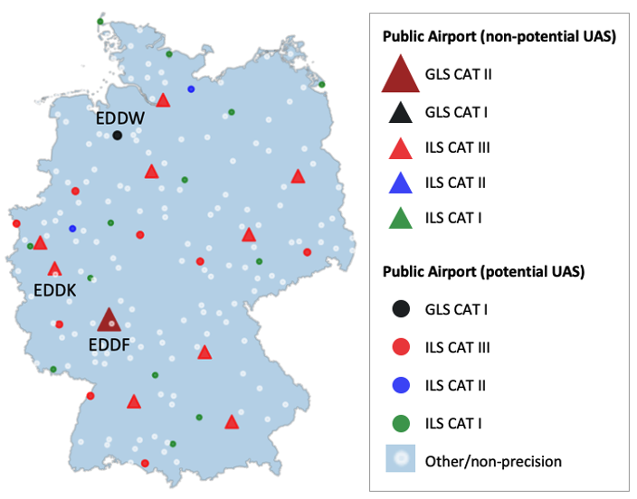
Accessibility Potential of Regional Cargo UAS
Public Airports – Germany
Germany:
Across Germany, different types of airports are well distributed
Relatively high density of potential UAS airports in the west of Germany around Frankfurt (EDDF) and Cologne/Bonn (EDDK)
Bremen (EDDW) is the only potential UAS airport with UAS IAP that provides GLS procedures

Slide 19
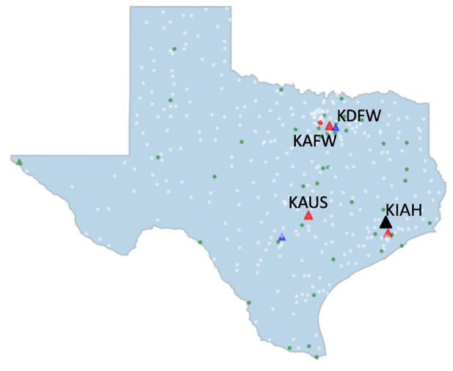
Accessibility Potential of Regional Cargo UAS
Public Airports – Texas
Texas:
Airports are concentrated around major cities – lots of empty space
Just one towered airport at the smaller cities – none have UAS IAP

Slide 20
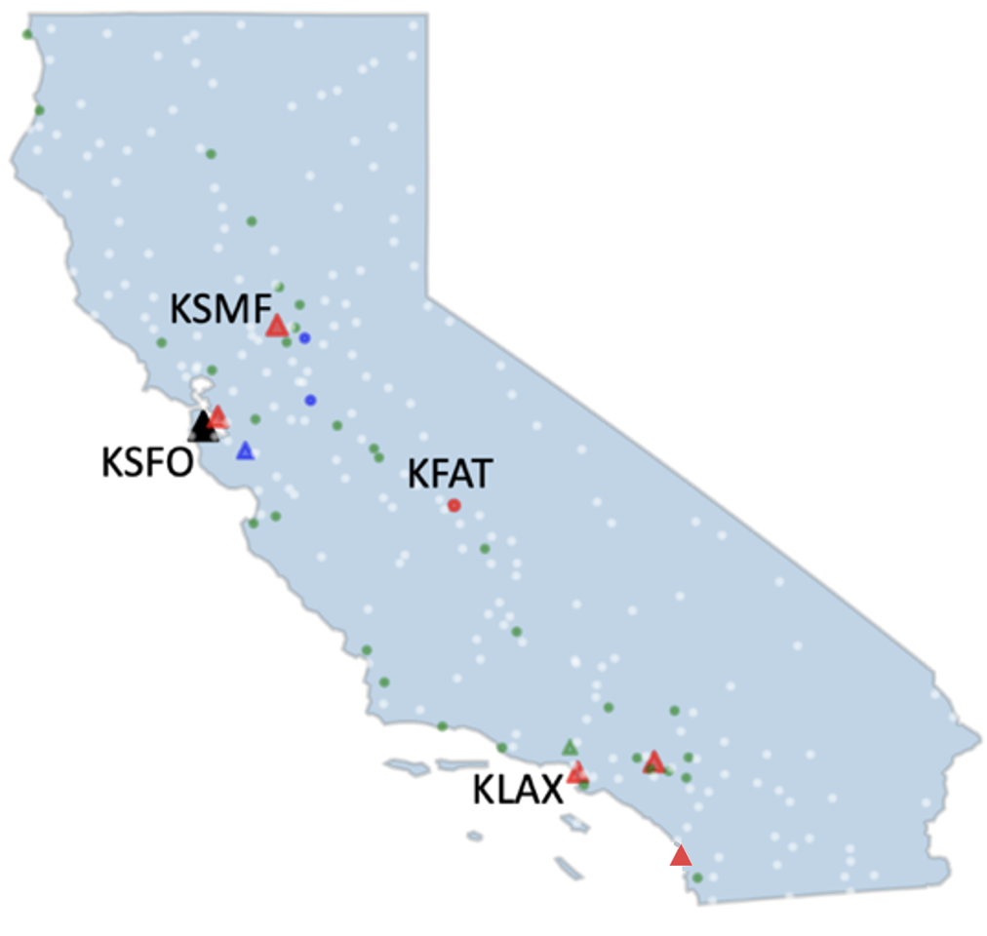
Accessibility Potential of Regional Cargo UAS
Public Airports – California
California:
Like Texas
Concentrated in metro areas
Except KFAT
Lots of empty space

Slide 21
Accessibility Potential of Regional Cargo UAS
Regional Cargo Aircraft Eligible for UAS Operations
How to use this information
  Given an aircraft, can obtain bounds of number of possible UAS airports
    Maximum Takeoff Weight (MTOW) is the maximum weight the pilot is allowed to attempt to takeoff
  That set of airports can then be analyzed
    Presence of UAS IAP
    Towered/non-towered
    Current cargo operations
Aircraft types MTOW | Count of accessible potential UAS airports MTOW
 | Germany | Texas | California
ATR 42-600 18.60 t | 40 total 20 towered 20 non-towered | 66 total 36 towered 30 non-towered | 75 total 36 towered 39 non-towered

Slide 22
Overview
Introduction and Background
Scope and Research Questions
Characteristics of Regional Air Cargo Operations
Assessing the Potential of Cargo UAS
Conclusions and Future Work

Slide 23
Conclusions
In areas of interest
  780 total potential UAS airports
  Germany has more airports with UAS IAP (9), but few current regional cargo operations
  Texas and California have only one airport each with UAS IAP, but much more robust regional cargo operations
To maximize potential of cargo UAS
  Need to increase number of airports with UAS IAP and/or
  Advance autoland technologies, such as vision-based landing systems and
  Need to be able to integrate into non-towered environments

Slide 24
Future Work and Next Steps
Baseline established, how to extend?
Could extend by using different landing systems, increasing traffic
Extend by including more factors:
  Availability of reliable command and control (C2) link performance
  Interactions with (non-)cooperative aircraft
  Availability of contingency airport(s)
  Plans to mitigate the loss of the C2 link
Fast-time simulations to assess the impact of cargo UAS and various factors on surrounding traffic
Notes:
Include final closure slide, references, and then backup figures
Takeaway – how all this analysis is relative to future UAS traffic

Slide 25
Thank You!
tim.sievers@dlr.de
jordan.a.sakakeeny@nasa.gov
Notes:
Include final closure slide, references, and then backup figures
Takeaway – how all this analysis is relative to future UAS traffic

Slide 26
Accessibility Characteristics of Regional Cargo UAS
Regional Aircraft Type Comparison – Europe/US
Domestic flight movements by regional aircraft |  | Europe | US
All operations | Total flights | 246,796 | 1,313,204
 | ATR 42 | 6.9% | 0.7%
 | ATR 72 | 16.9% | 0.6%
 | Bombardier CL-600 (jet) | 15.0% | 0.2%
 | Bombardier Dash 8-100 | 52.6% | 1.0%
 | Embraer EMB 120 | 1.4% | -
 | Embraer ERJ 145 (jet) | 1.8% | 19.5%
 | Cessna 208/208B | - | 23.5%
 | Cessna 402 (piston) | - | 5.8%
 | Beech 18 | - | 0.9%
 | Canadair RJ200 (jet) | - | 22.9%
Cargo-only | Total flights | 10,529 | 155,266
 | ATR 42 | 23.6% | 1.6%
 | ATR 72 | 43.4% | 3.3%
 | Bombardier CL-600 (jet) | 8.7% | <0.1%
 | Bombardier Dash 8-100 | <0.1% | -
 | Embraer EMB 120 | 21.9% | -
 | Embraer ERJ 145 (jet) | - | -
 | Cessna 208/208B | - | 56.0%
 | Cessna 402 (piston) | - | 1.3%
 | Beech 18 | - | 11.4%
 | Canadair RJ200 (jet) | - | 0.6%
Domestic cargo-only flights:
ATR 42, ATR 72, and Embraer EMB 120 regional turboprop aircraft account for 89% in Europe
Cessna 208/208B and Beech 18* regional turboprop aircraft account for 67% in the US
Only 8.7% are operated by regional jet aircraft (CL-600) in Europe
<1% is operated by regional jet aircraft (Cl-600, RJ200) in the US
All operations flights = Commercial flight movements with passengers and/or cargo on board
Cargo-only flights = No passengers on board, only cargo (consisting of freight and mail)
Notes:
*FedEx Express has a waiver to report all of its small aircraft as Beechcraft Beech 18 C-185 (Beech 18) to the BTS, without regard to the actual aircraft type. Therefore, it will be excluded from further investigation throughout the study.

Slide 27
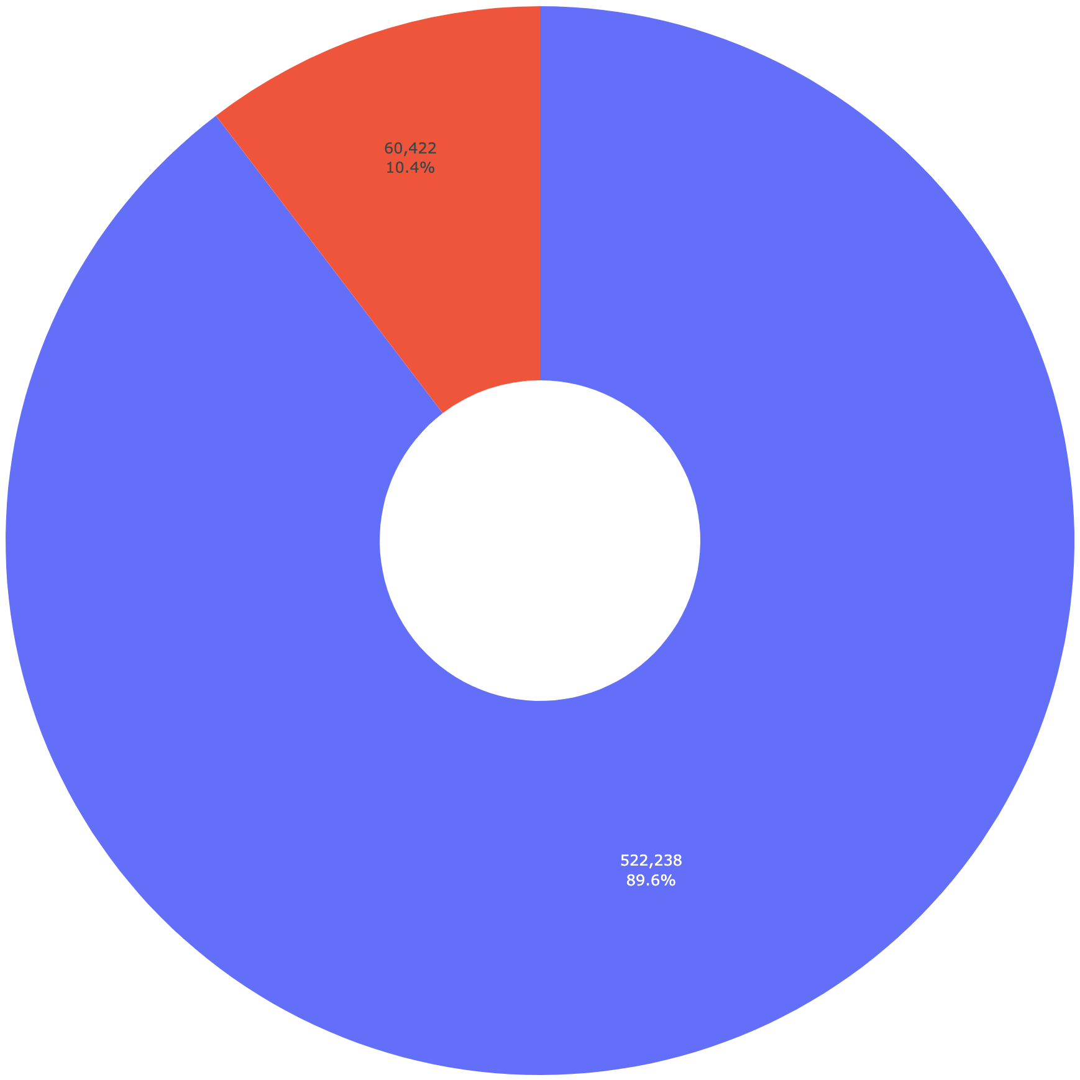
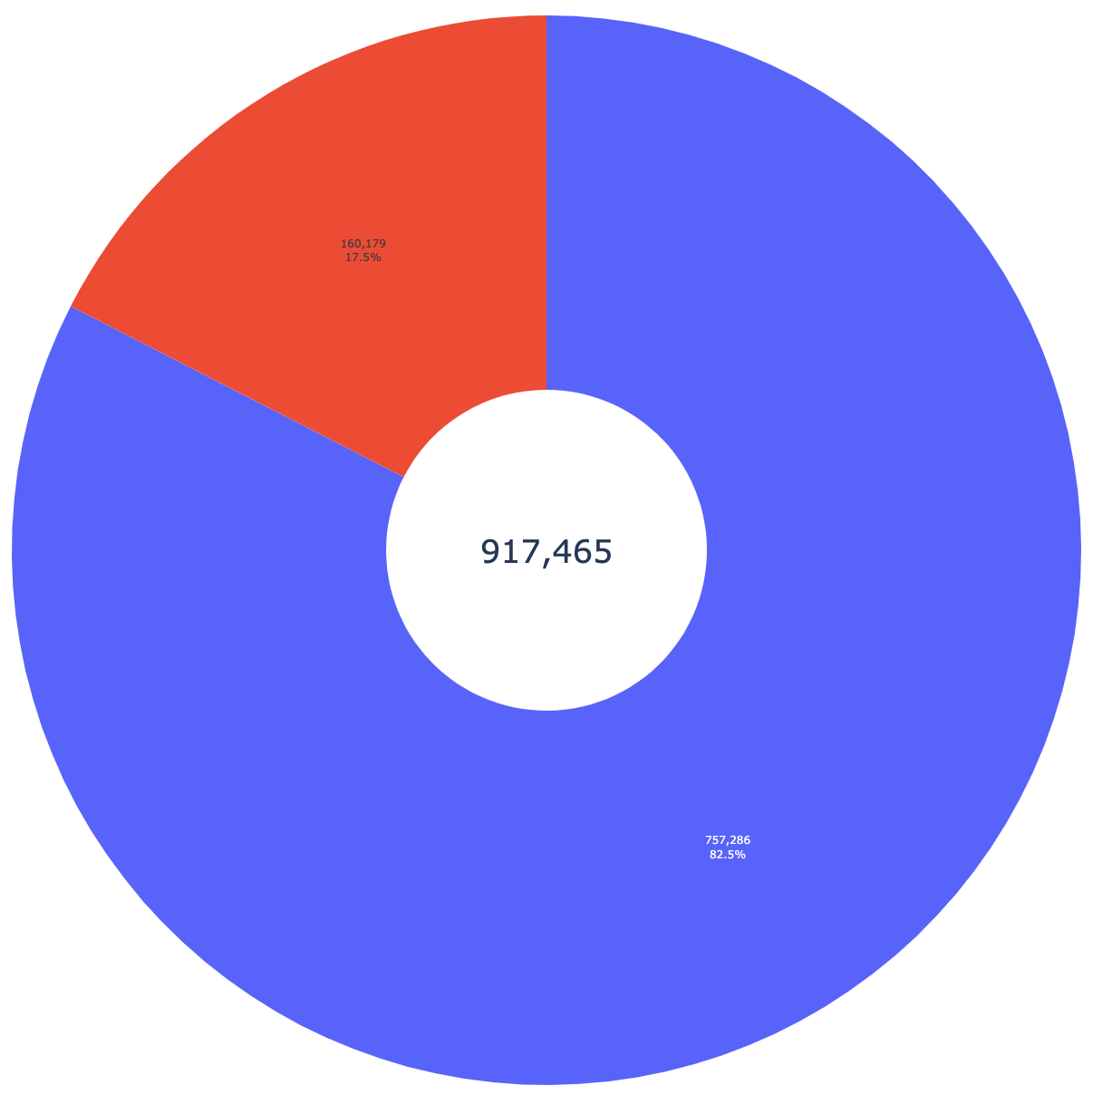
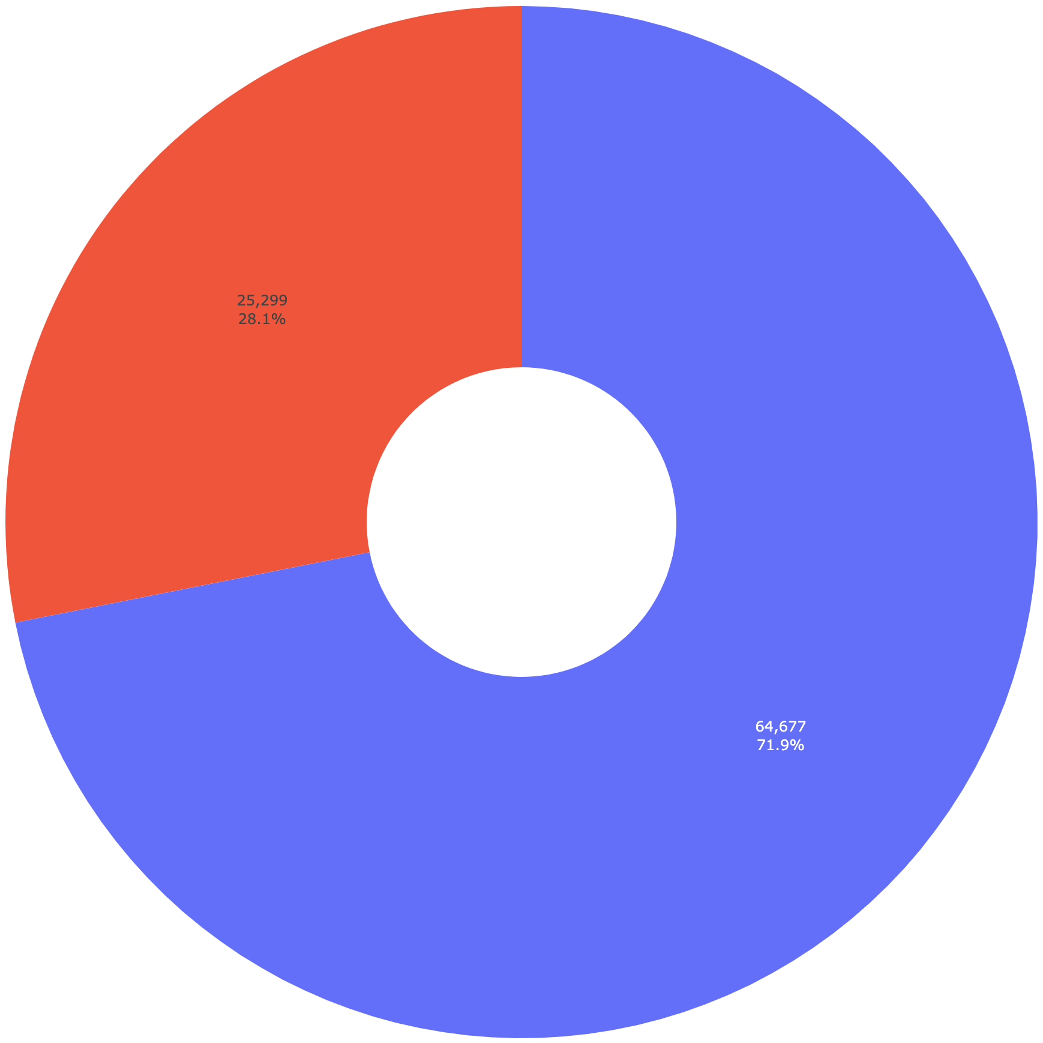
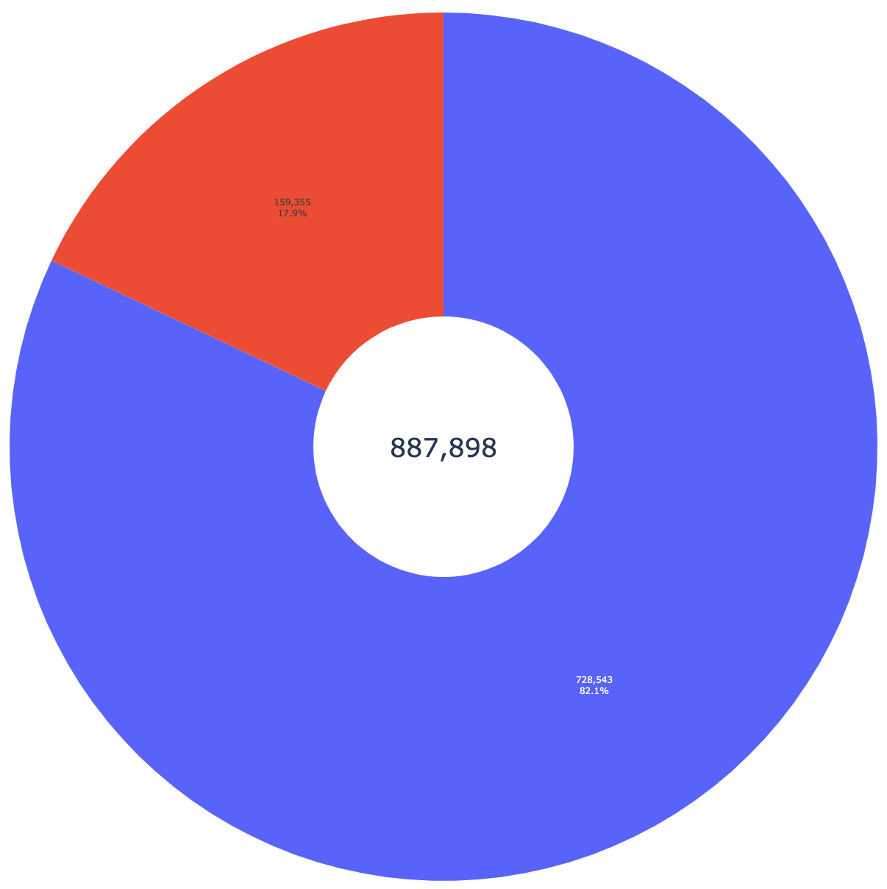
Characteristics of Regional Air Cargo Operations
European air cargo data
US air cargo data
Total European cargo flight movements (intra- and extra-Europe)
Total US cargo flight movements (intra- and extra-US)
60,422
(10.37%)
186,076
(20.3%)
Domestic European cargo flight movements
Domestic US cargo flight movements
582,660
917,465
25,299
(28.12%)
171,194
(19.3%)
522,238
(89.63%)
731,389
(79.7%)
89,976
887,898
Potential to become UAS operations for domestic European flights across all distances
64,677
(71.88%)
Potential to become UAS operations for domestic US flights across all distances
716,704
(80.7%)
27
Non-regional aircraft
Regional aircraft
Sources: Eurostat, 2022; Bureau of Transportation Statistics, 2022
Notes:
Felix

Slide 28
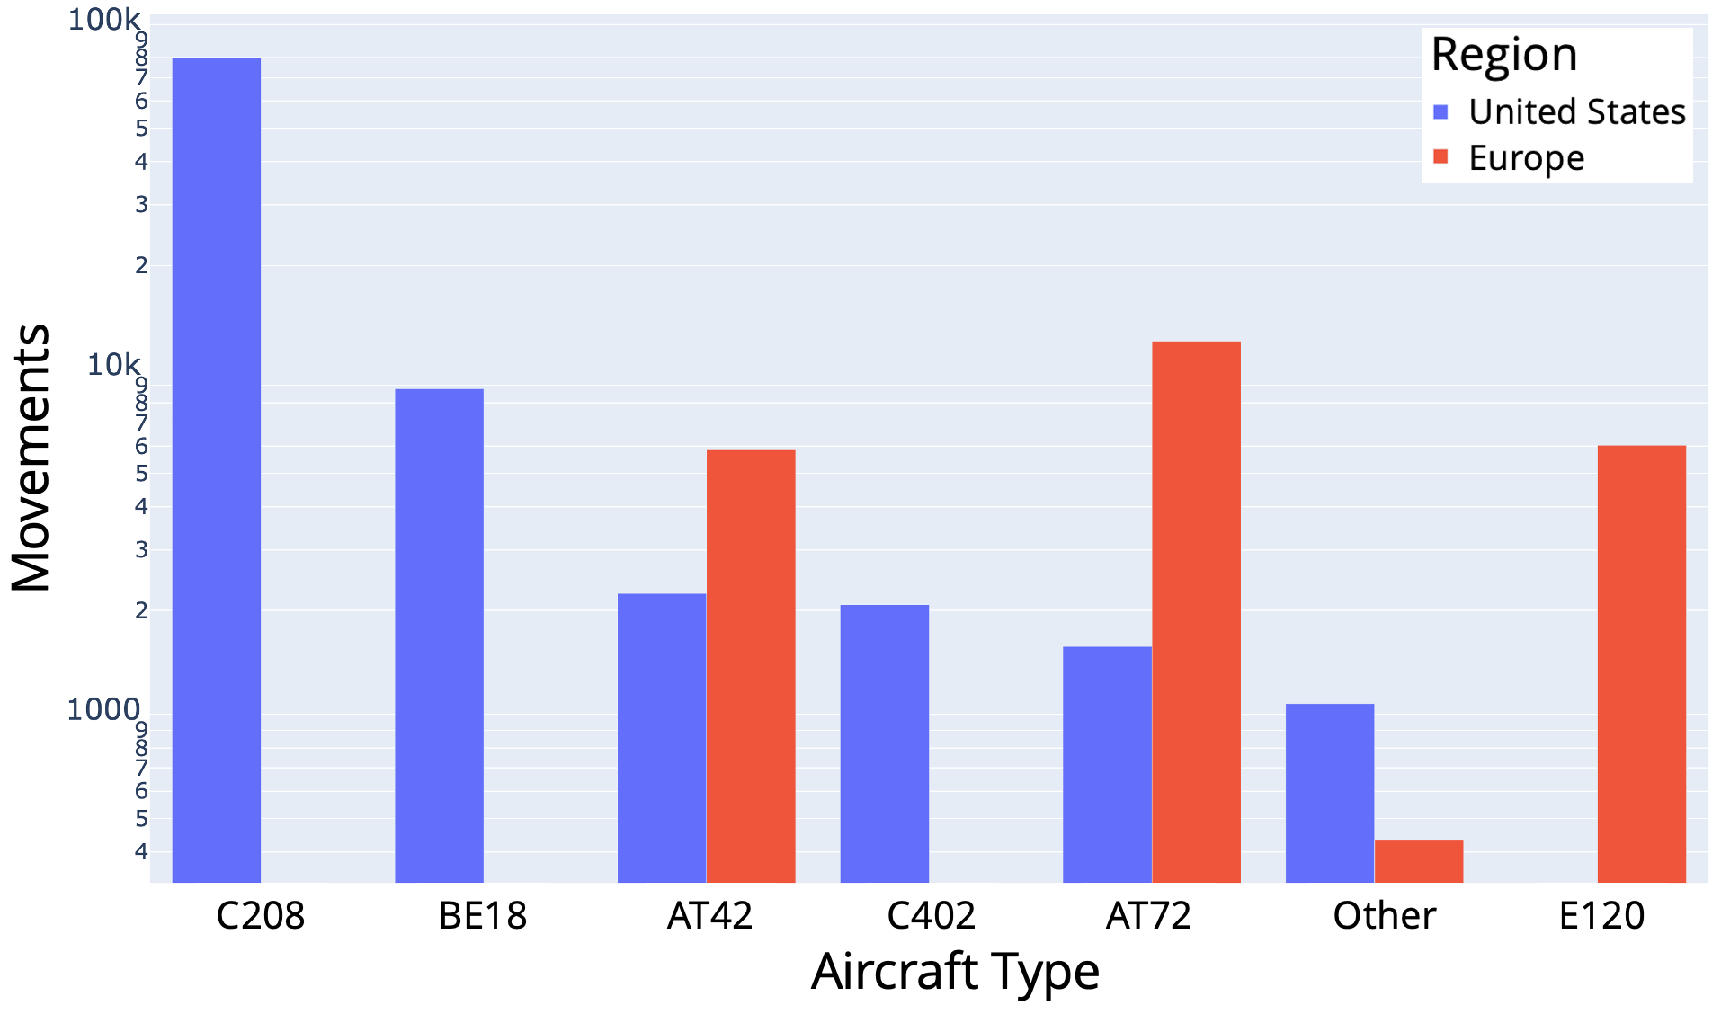
Characteristics of Regional Air Cargo Operations
What type of aircraft are flying?
Cessna 208 Caravan is the dominant aircraft in the US market but is not used in Europe
Cessna Caravan accounts for more than 83% of domestic US cargo flight movements by regional turboprop aircraft
ATR-72, Embraer 120 and ATR-42 aircraft account for more than 94% of domestic European cargo flight movements by regional aircraft
Sources: Eurostat, 2022; Bureau of Transportation Statistics, 2022
*Federal Express has a waiver to report all its small aircraft as Beech 18 C-185 (BE18), regardless of actual aircraft type
**This file is licensed under the Creative Commons Attribution-Share Alike 2.0 Generic license.

Slide 29
Characteristics of Regional Air Cargo Operations
What is a good flight distance cut-off for regional air cargo operations?
NASA’s definition of RAM: ≈ 100-1,000 km
LMI study on automated air cargo: ≈ 140-1,850 km
Discussions with industry experts revealed:
  Flights need to meet cargo sorting deadlines
  Regional air cargo flights in the US are typically <1.5 hours in duration
Analysis of flight distances for cargo in US and Europe showed that 1,000 km was an appropriate cut-off
Regional air cargo flights with <1,000 km distance
Notes:
Why use 1,000 km as the cut-off distance - confirm assumption
Consider putting this slide

Slide 30
Characteristics of Regional Air Cargo Operations
What percentage of operations are regional?
Comparison of cargo flight movements <1,000 km distance as percentage of flights across all distances
Cargo Flight Movements <1,000 kilometers |  | European percentage by all distances |  | United States percentage by all distances
Total by all aircraft types |  | 48% |  | 43%
Total by regional aircraft |  | Unavailable |  | 95%
Domestic by all aircraft types |  | 94% |  | 52%
Domestic by regional aircraft |  | Unavailable |  | 97%
Can use US percentages to estimate values for Europe
Notes:
Delete last column, make Europe red, US blue, separate left column with buffer, clarify title/table title
Put note on this slide that we use US percentage in European data analysis for regional aircraft distance estimates
Consider ways to simplify this table
Validate that we are getting a large number of flights here
Consider bar graph of percentages instead of the table

Slide 31
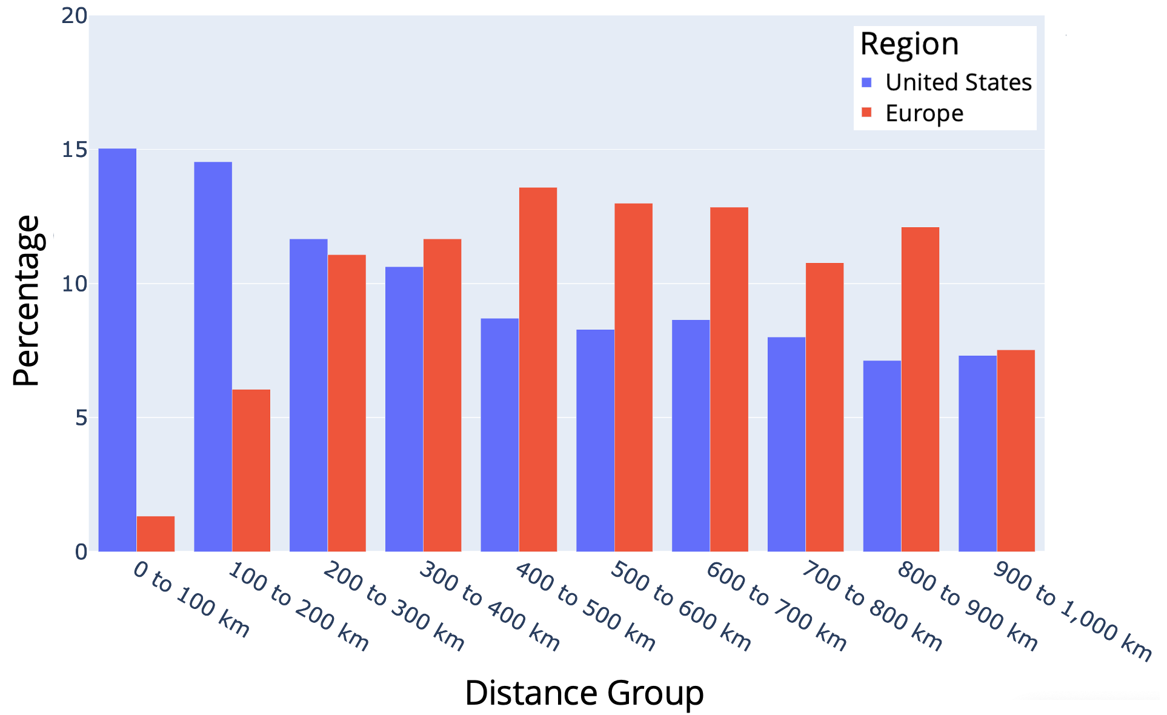
Characteristics of Regional Air Cargo Operations
Where are flights occurring?
Percentage of airport pairs with <1,000 kilometers distance:
The US has a high percentage of airport pairs within a short distance (<300 km) of each other
Airport pairs in Europe tend to be further apart (300-700 km)
Suggests that smaller aircraft may be used on shorter routes in the US
Notes:
Title: Airport Pairs With <1,000 km Distance Between Them
Note: European data for airport pairs are primarily from main commercial airports, whereas the US data includes main, other, and small commercial airports

Slide 32
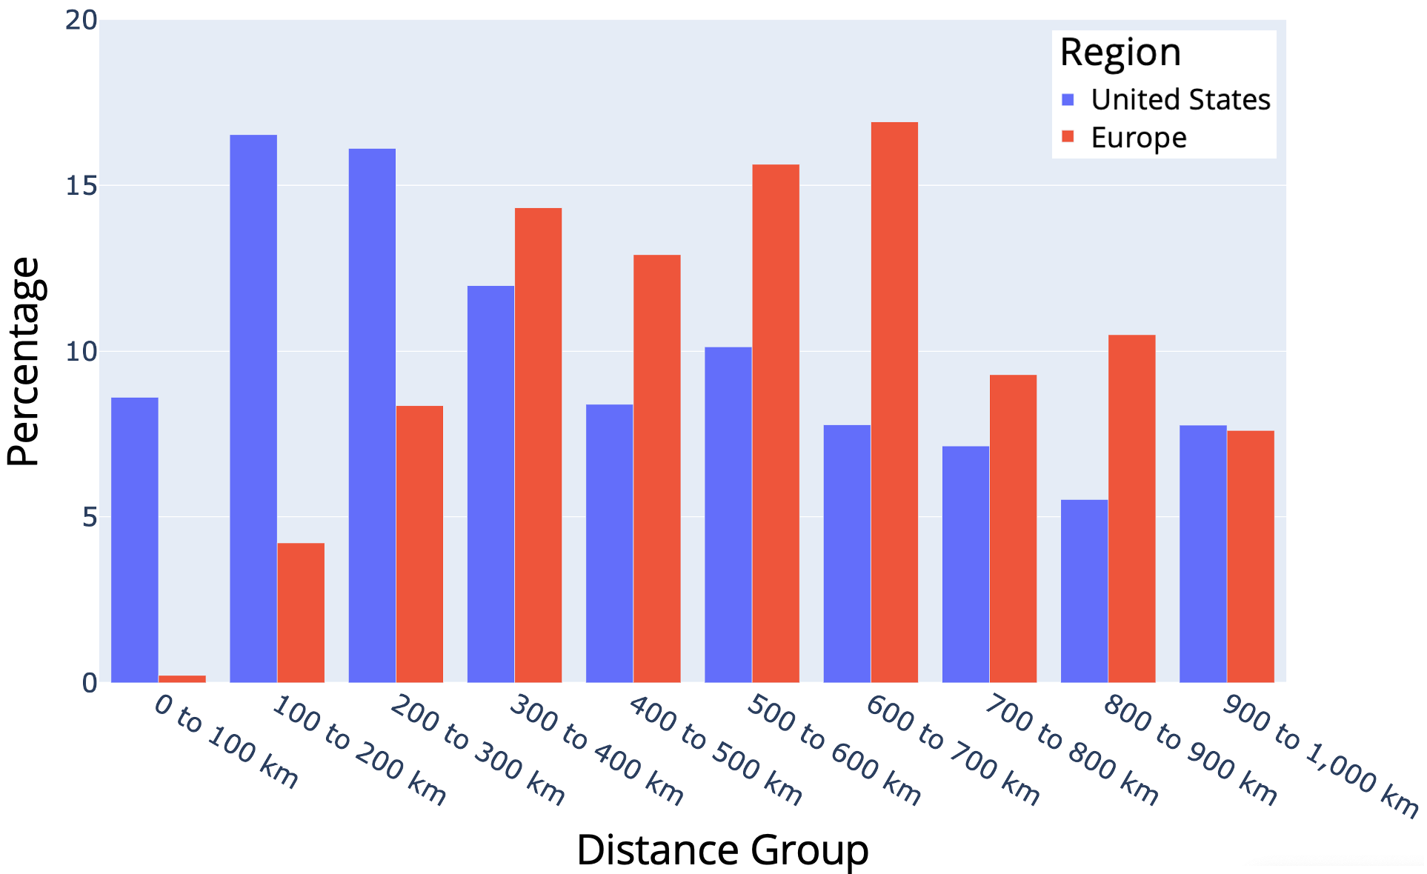
Characteristics of Regional Air Cargo Operations
Where are flights occurring?
European cargo flight movements tend to be longer in distance
  Only 12.8% occur between 0 and 300 km
  59.8% occur between 300 and 700 km
Despite fewer flights, cargo tonnage carried in Europe was approximately equal to that of the US (3.9 versus 3.7 million tonnes)
Fewer, larger aircraft are used to transport cargo in Europe
Higher numbers of smaller aircraft are used to transport cargo in the US
Percentage of cargo flight movements with <1,000 kilometers distance:
Notes:
Title: Cargo Flight Movements <1,000 km in Distance
Cargo tonnage carried in US and Europe was roughly the same despite fewer flights in Europe
Similar tonnage indicates similar market size, potentially, but way it is transported is different

Slide 33
Assessing the Potential of Cargo UAS
Overall
Caveat: Differences in data availability (e.g., domestic flights by distance in Europe)
Potential cargo UAS operations are regional flights (<1,000 km) performed by regional aircraft
Preference is given to domestic operations for initial cargo UAS operations due to differing laws between countries
Will discuss potential over the next few slides, starting with a baseline
176,303 cargo flight movements in the US
  <1,000 km and by regional aircraft
  This number accounts for 94.8% of total US cargo flight movements by regional aircraft
165,459 of the 176,303 cargo flight movements were domestic and could be converted to UAS
  This number accounts for 96.7% of total domestic US cargo flight movements by regional aircraft
In Europe, there were 60,422 total cargo flight movements by regional aircraft
  25,299 domestic cargo flight movements in Europe by regional aircraft
  Applying US percentage, we can estimate 57,249 cargo flight movements <1,000 km by regional aircraft across Europe
Notes:
Jordan

Slide 34
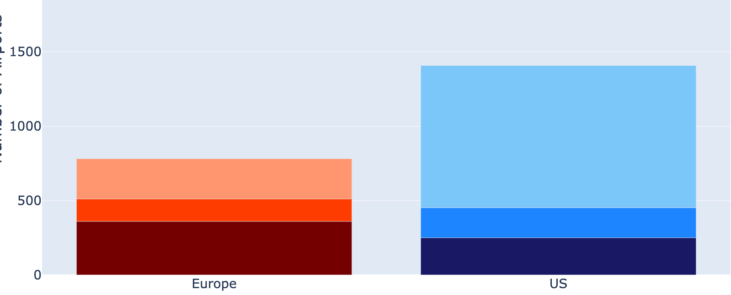
Accessibility Characteristics of Regional Cargo UAS
Europe/US Comparison
Main Airport | Medium Airport | Small Airport
≥150,000 / year | <150,000 and ≥15,000 / year | <15,000 /year
Passenger unit
=1 passenger or 100 kg of cargo
1,408
States/countries with many small commercial airports may be better candidates for initial cargo UAS operations
Number of Commercial Airports
781
956
270
Small
151
Medium
202
360
Main
250
Europe
US
Notes:
Eurostat defines airports by passenger units:
1 passenger unit = 1 passenger or 100 kg of cargo
Categories: main, other, and small

Slide 35
Accessibility Characteristics of Regional Cargo UAS
Landing Systems / Instrument Approach Procedures
  Definition of UAS Instrument Approach Procedures (UAS IAP)
    ILS CAT III
    GLS CAT I/II
  UAS IAP could include other certified landing systems in the future
UAS IAP availability at potential UAS airports | Germany | Texas | California
ILS CAT III | 9 | 1 | 1
GLS CAT I/II | 1 | 0 | 0
Total potential UAS airports with any UAS IAP | 9 | 1 | 1

Slide 36
Accessibility Potential of Regional Cargo UAS
Regional Cargo Aircraft Eligible for UAS Operations
Maximum Takeoff Weight (MTOW) is the maximum weight the pilot is allowed to attempt to takeoff
Operational Empty Weight (OEW) includes the empty weight of an aircraft plus operational items
Aircraft types MTOW (OEW) | Count of accessible potential UAS airports MTOW (OEW)
 | Germany | Texas | California
ATR 42-600 18.60 t (11.75 t) | 40 (61) total 20 (21) towered 20 (40) non-towered | 66 (73) total 36 (36) towered 30 (37) non-towered | 75 (104) total 36 (37) towered 39 (67) non-towered
ATR 72-600F 23.00 t (11.80 t) | 36 (61) 20 (21) 16 (40) | 56 (73) 35 (36) 21 (37) | 67 (100) 35 (36) 32 (64)
Bombardier CL-600 21.86 t (12.32 t) | 36 (59) 20 (21) 16 (38) | 62 (73) 36 (36) 37 (37) | 72 (100) 36 (36) 36 (64)
Embraer EMB 120 11.50 t (7.07 t) | 61 (76) 21 (22) 40 (54) | 73 (74) 36 (36) 37 (38) | 77 (118) 36 (38) 41 (80)
Cessna 208 Caravan 3.63 t (2.21 t) | 148 (158) 22 (22) 126 (136) | 267 (279) 37 (38) 230 (241) | 192 (200) 44 (44) 148 (156)

Slide 37
Summary
Established a baseline of potential UAS airports suitable for initial cargo UAS operations
  Potential UAS Airport
    Public towered airports with annual IFR flight movement percentages under 2.2%
    Public non-towered airports
  780 total potential UAS airports: 173 in Germany, 376 in Texas, and 231 in California
Investigated IAP that are most likely to be used for initial cargo UAS operations
  UAS Instrument Approach Procedures (UAS IAP)
    ILS CAT III
    GLS CAT I/II
  11 total airports with UAS IAP: 9 in Germany, 1 in Texas, and 1 in California
Determined bounds of how many potential UAS airports could service common regional cargo aircraft

