Slide 1


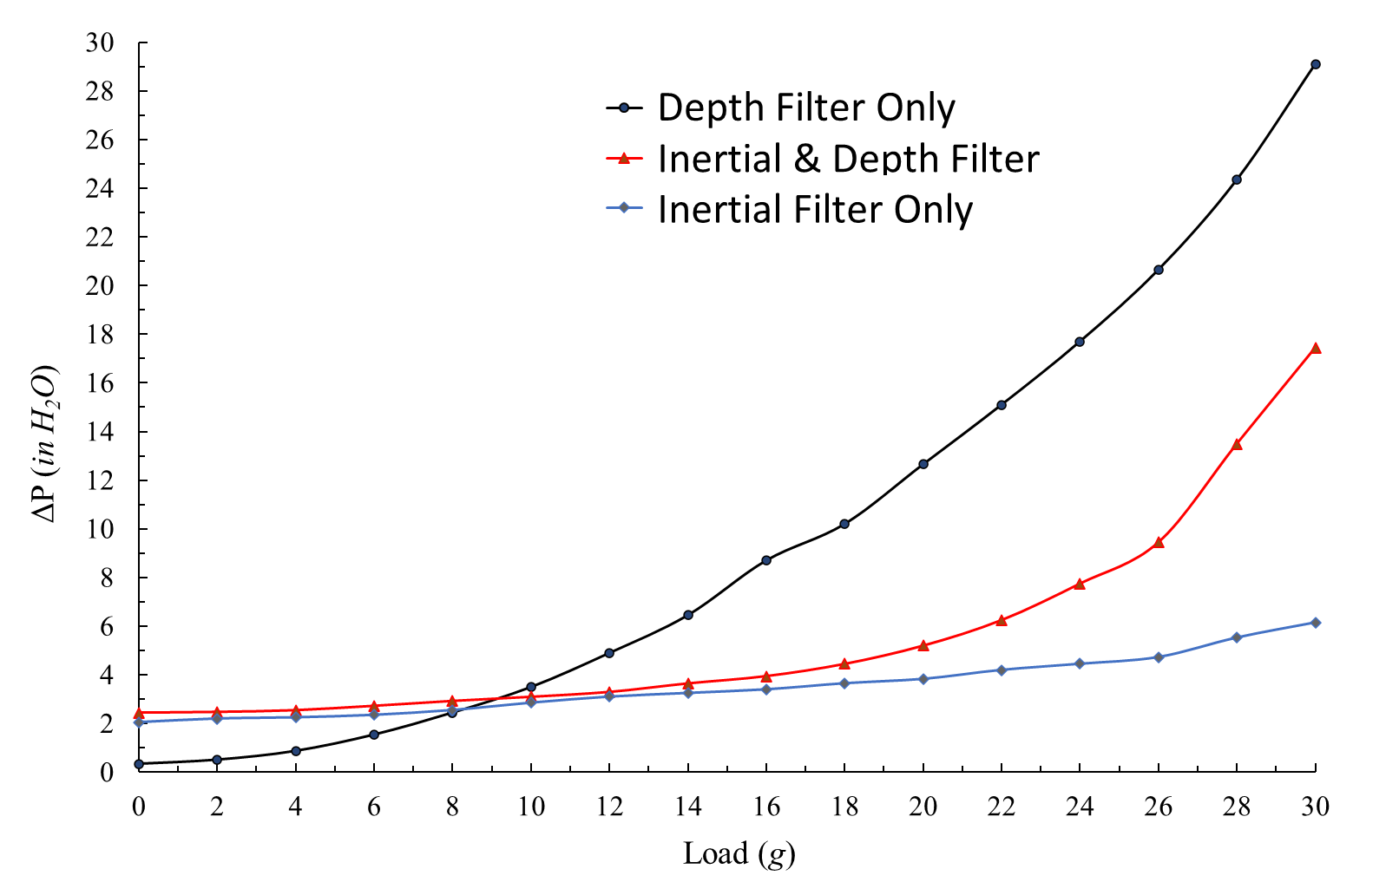
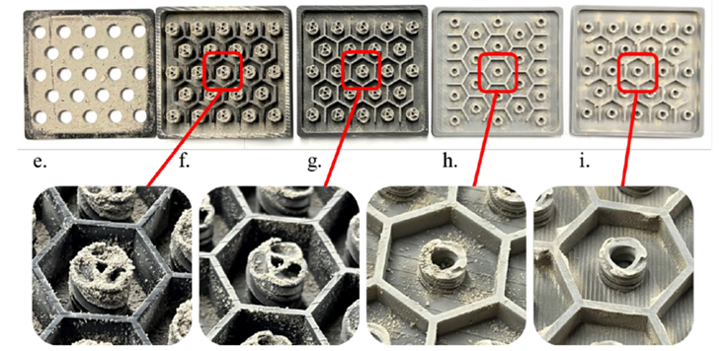
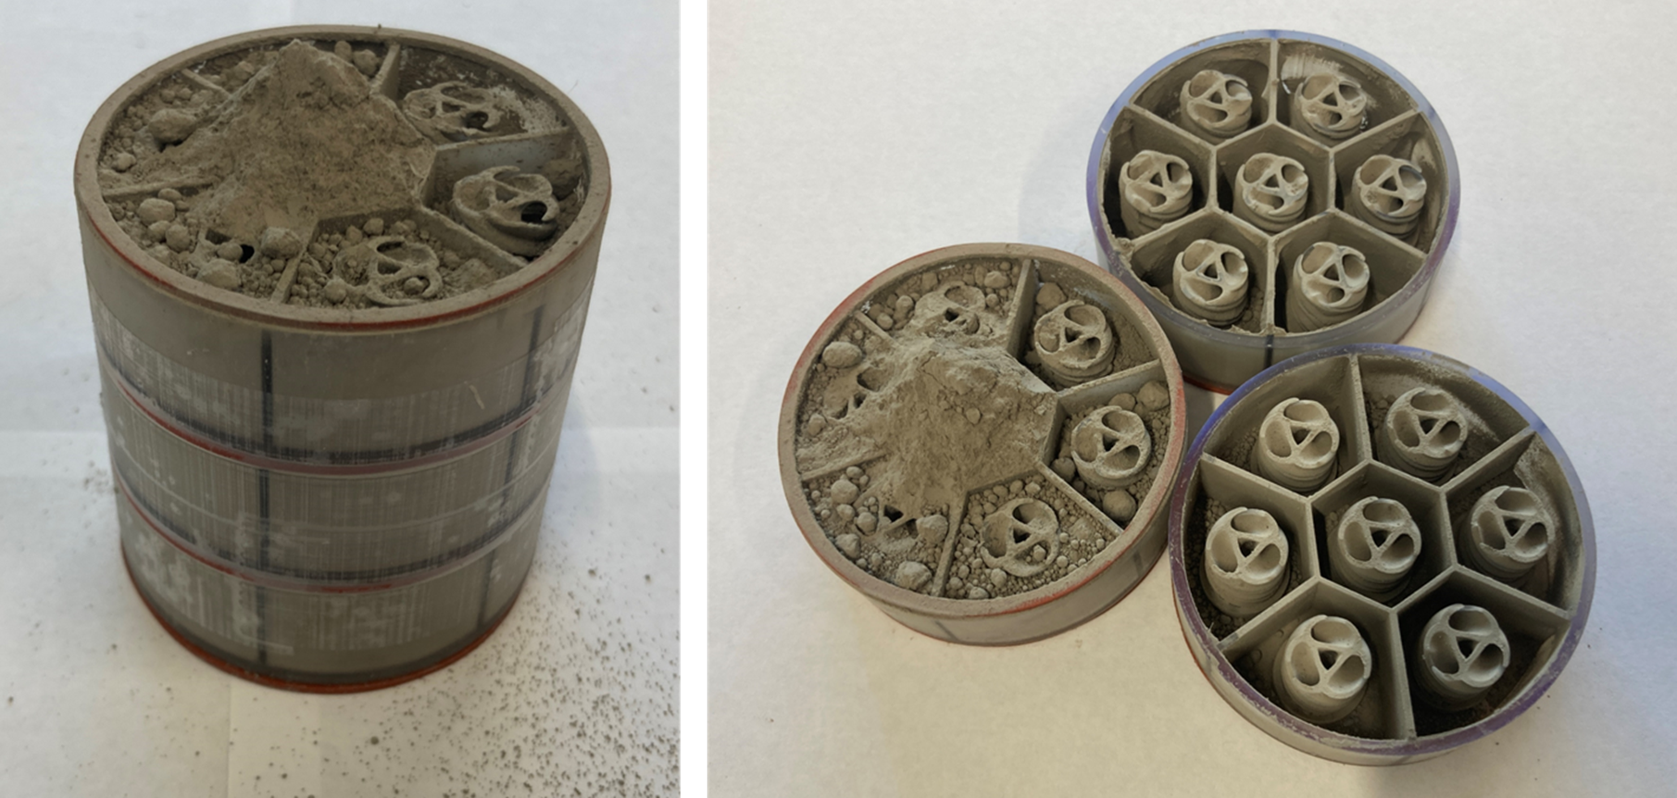
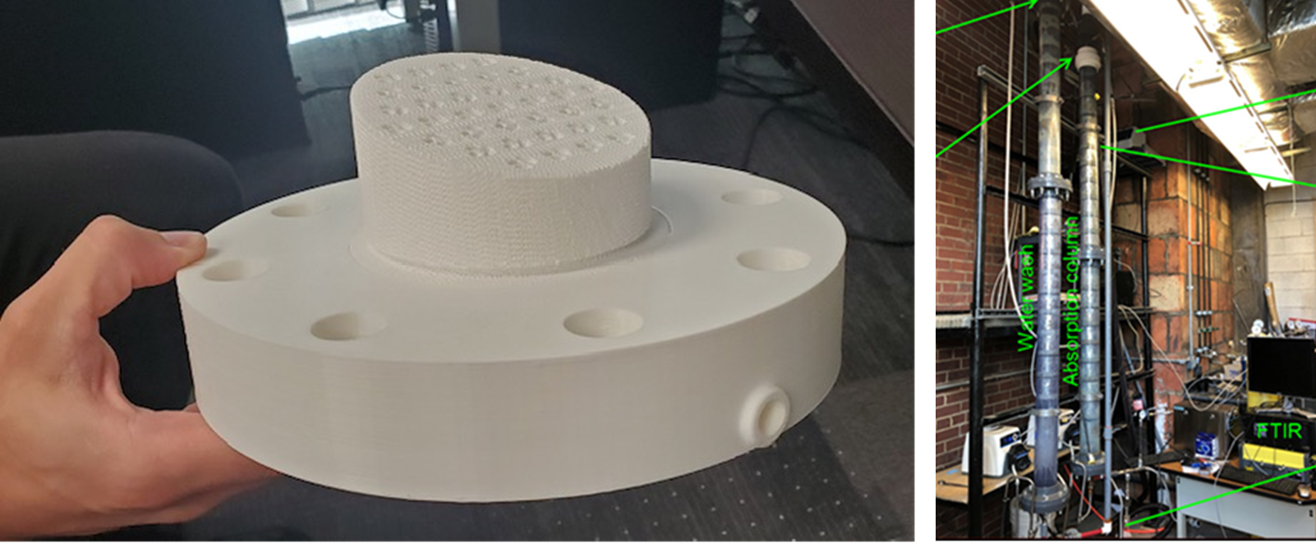
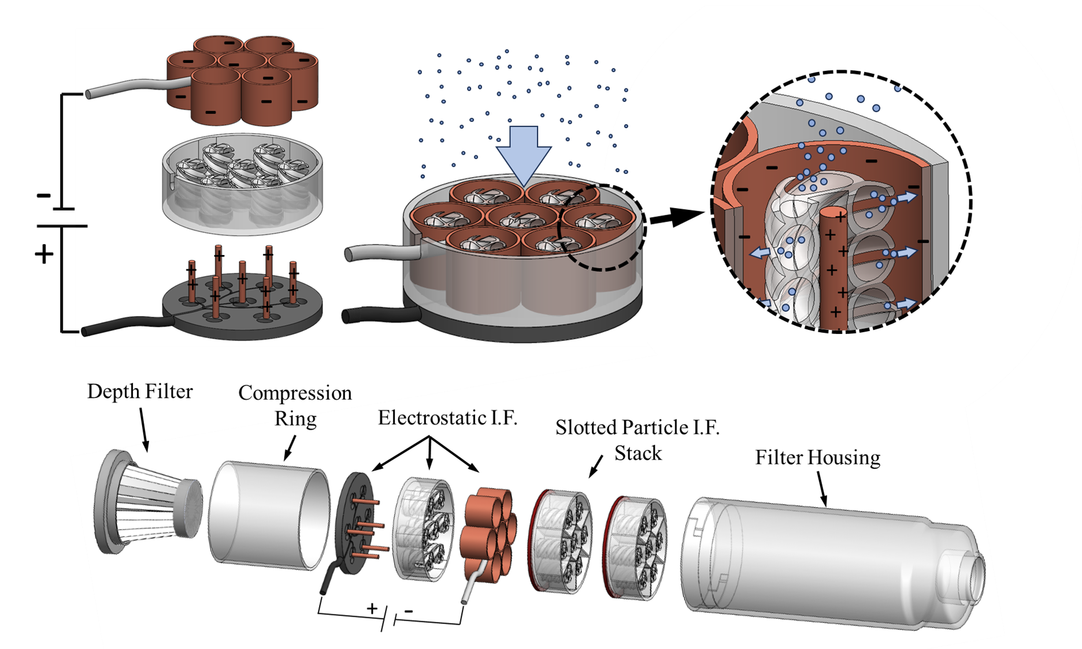
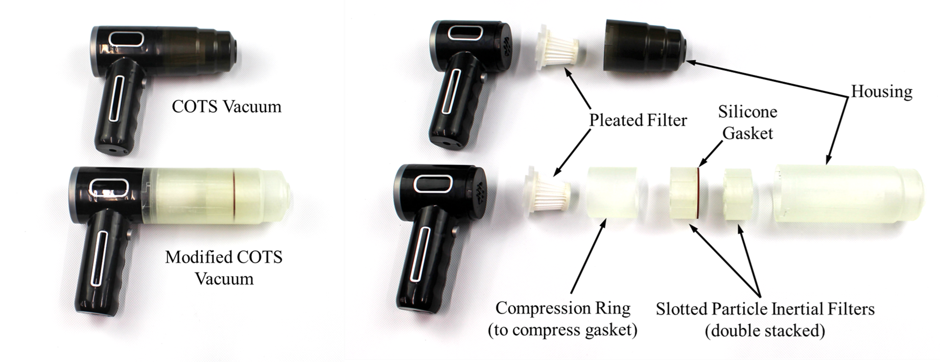
Lunar dust capture using a novel, multiplexed inertial filter
TBD
PM / PI Info John Graf | john.c.graf@nasa.gov
EXECUTIVE SUMMARY
Multiplexed inertial filtration is new. It holds promise to capture and contain lunar dust with less pressure drop. Even when the filter contains significant amounts of captured lunar dust, the pressure drop remains relatively low. State of the art vacuum cleaners use a system with 4 different filter: they can contain large amounts of lunar dust and maintain low pressure drop, but because they require 4 filters, the system size is relatively large. State of the are miniature vacuum cleaners are small, but the single in-line depth filter clogs easily. The goal of this CIF project is to develop a lunar dust vacuum cleaner <1000 cc in size, with high capacity and low dP.
Innovation
The “slotted corkscrew” version of a multiplexed inertial filter was designed, prototyped, and tested. One key innovation was the development of a hexagonal containment area to isolate the airflow around each corkscrew element. A second innovation is a multi-staged corkscrew element, with larger slots near the inlet and smaller slots near the exit.
Collaboration
Dr. Mark Weislogel, IRPI, Co-Investigator, Prototype Design & Testing
Dr. Dan Preston, Rice University, Extremely Small, Soot Sized Filtration
Dr. Mohamed Ibrahim, EPA, Inertial Filtration of Incinerator Exhaust
Pressure Drop as a function of loading (grams of lunar soil simulant captured)
Outcomes & Infusion
Outcome: demonstration of a compact filter, that maintains low pressure drop.
Infusion: development of compact prototype vacuum – presented to EHP
Future Work
Describe planned future work, pursuits and next steps
Project is selected for CIF in FY24 (focus on electrostatics)
Spacecraft Fire Safety is sponsoring R&D (fine, soot sized particles)
Pursuing Accelerated Prototype Development for EHP
Photo highlighting a four-stage filter element with hexagonal flow containment
Three stage inertial filter after >30grams of loading
Photo of EPA test facility, inertial filter prototype, and solid model of filter assembly
Prototype lunar dust vacuum cleaner, presented to EHP for infusion & collaboration
Concepts for a Lunar Dust Vacuum Cleaner with Inertial Filter Elements and Electrostatic Elements
DAA# | 20230014436
NTR#(s) | NA

