Slide 1



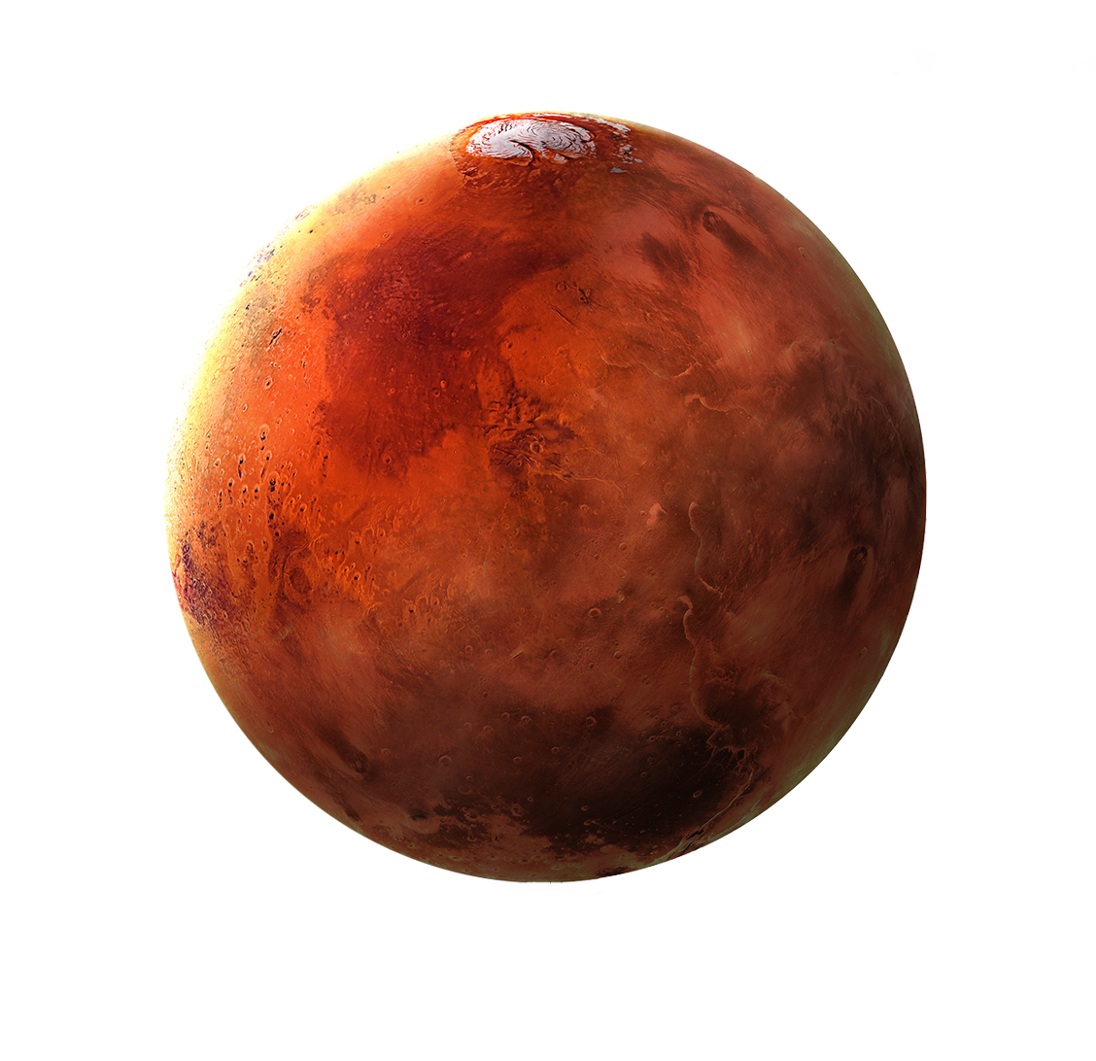

Nuclear Thermal Propulsion Fuel Development Challenges
HEAT TREAT 2023 Conference
Marvin W. Barnes
NASA MSFC
Notes:
Appreciation for this

Slide 2
Agenda
My Background
Introduction NTP
Challenges
Research

Slide 3
Background
Education
  BS in Chemical and Materials Engineering – University of Alabama in Huntsville 2008
  MS in Materials Science – North Carolina State 2018
Work Experience
  United Space Alliance 2004 -2008
    Solid Rocket Booster Materials Researcher
    Supported Columbia Return to Flight
  NASA MSFC Propulsion Department 2008 -2013
    Solid Rocket Motor Lead
  NASA MSFC Materials Laboratory 2013 to 2020
    Nuclear Thermal Propulsion Fuels Lead
    Metallic Materials and Processes Team Lead
  NASA MSFC Propulsion Department
    Advanced Propulsion Research Branch Manager
Notes:
No PhD, willing to tell you that I don’t know

Slide 4
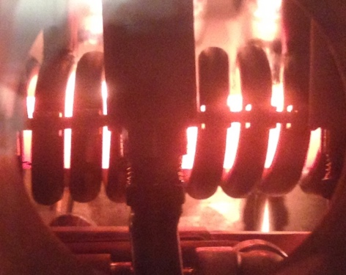
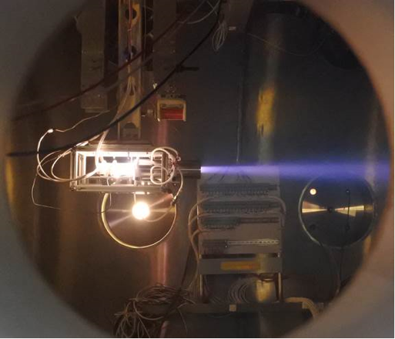
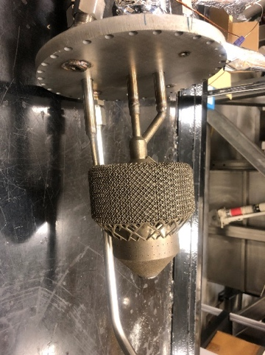
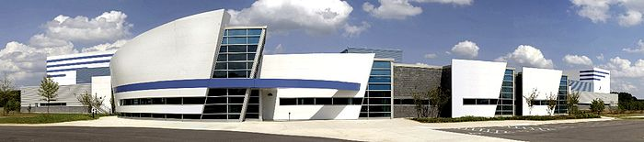
Advance Propulsion Research at Marshall
Cryogenic Fluid Management (CFM)
  Keeping stuff very cold in space without lots of boiloff
Green Propellant Technology Development and Testing
  Like Hydrazine: versatile, storable mono-propellant, but less toxic
Nuclear Thermal Propulsion
  Just like liquid propulsion, but the heat comes from radiation not combustion
  NTREES: Nuclear Thermal Rocket Element Environment Simulator
Advanced Fission / Fusion and High-Power Propulsion Technology
NTREES Copper Coil for inductive heating
4205: Propulsion Laboratory
Additively manufactured injector with integral heat exchanger
Plasma Thruster

Slide 5
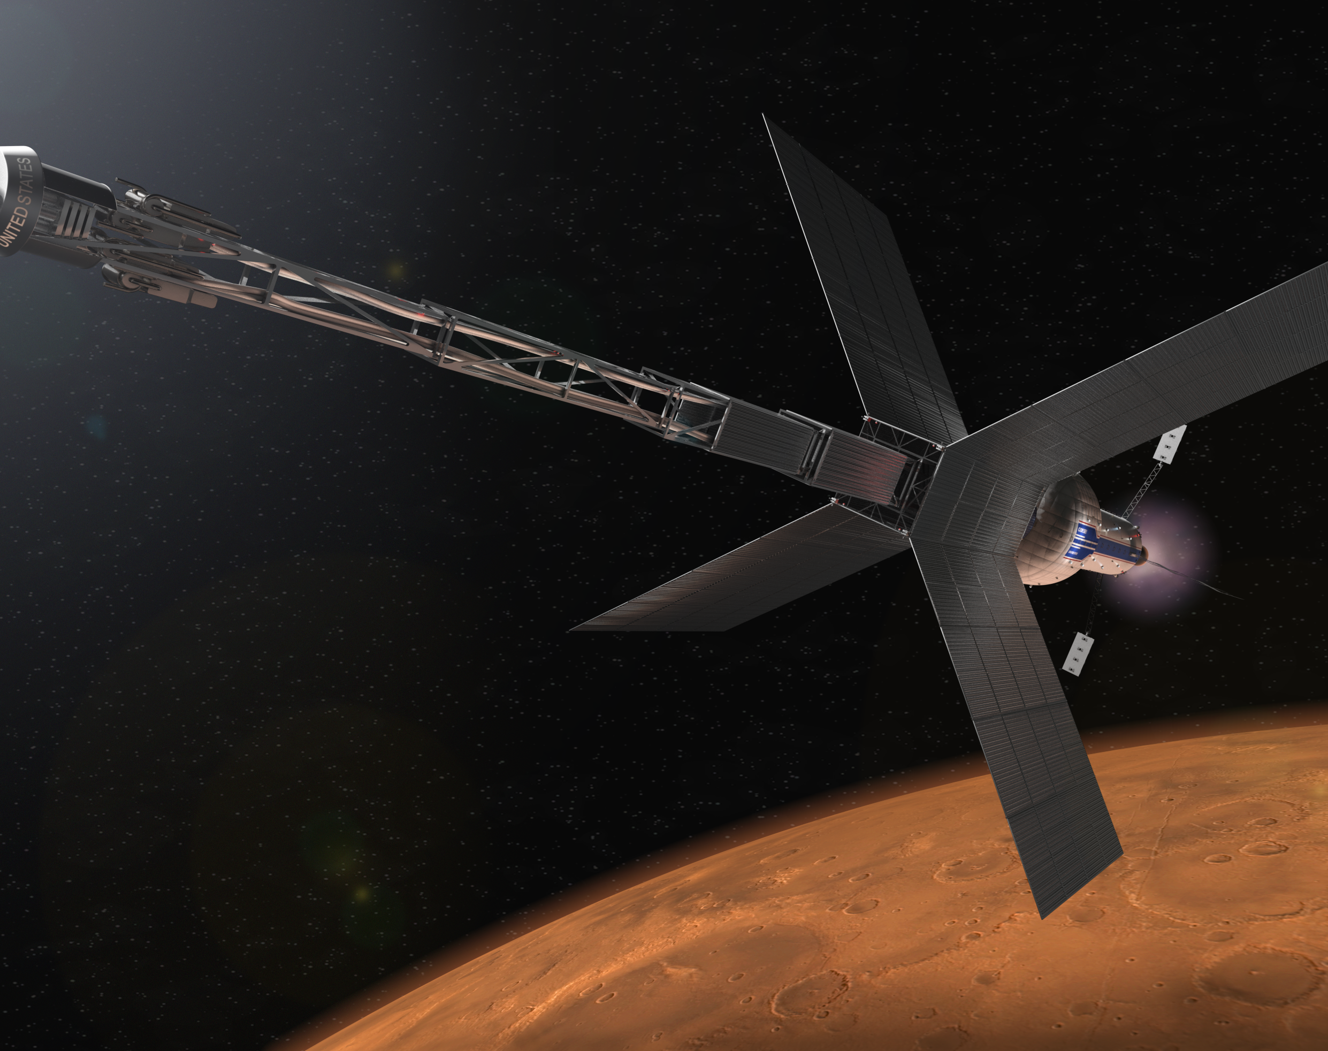
Different Forms of Nuclear Propulsion
Nuclear Thermal Propulsion
  Uses thermal energy from nuclear fission chain reactor to heat propellant
  Has heritage
Nuclear Electric Propulsion
Radioisotope Thermal Generator (RTG)
Other forms of Nuclear Propulsion
  Fusion?
Notes:
Future of space flight
Higher performing systems that will allow crewed space missions deeper into the solar system beyond the moon
Different Forms of Nuclear Propulsion but the focus of this talk is NTP

Slide 6
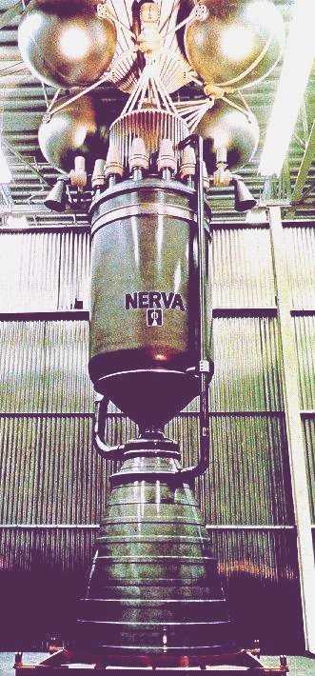
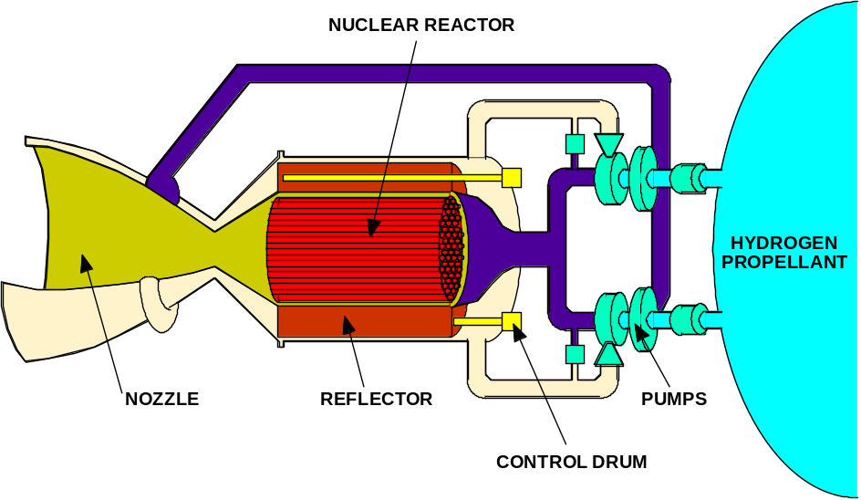
Nuclear Thermal Propulsion (NTP) Overview
Typical propellant: hydrogen
Propellant heated directly by a nuclear reactor and thermally expanded/accelerated through a nozzle
Thrust directly related to thermal power of reactor: 100,000 N ≈ 450 MW_{th} at 900 sec
Specific Impulse directly related to exhaust temperature: 830 - 1000 sec (2300 - 3100K)
HIGHER PERFORMANCE Specific Impulse improvement over chemical rockets
NERVA Nuclear Thermal Rocket Prototype
Major Elements of a Nuclear Thermal Rocket
Notes:
Low molecular weight propellant that is directly passe through nuclear core and heated to 3000K. Simple heat exchanger concept for In-space propulsion
Chemical rocket in 400 to 450 sec ISP range
ISP compare to cars gas mileage,

Slide 7
Difference between RTGs and NTP
Radioisotope
Fission
U-235
U-234
γ
Neutron
Neutrons
(
2.5)
190 MeV*
5.5 MeV
Fissile Nucleus
γ
(U-235)
Pu-238
α
(He-4)
Product Nuclei
U-235
(KE ­ 168 MeV)
Heat Energy = 0.851 MeV/nucleon
Controllable reaction rate (variable power levels)
Long history of use on Apollo and space science missions
  44 RTGs and hundreds of RHUs launched by U.S. during past 5 decades
Heat produced from natural alpha (a) particle decay of Plutonium (Pu-238)
Used for both thermal management and electricity production
Used terrestrially for over 80 years
  Fissioning 1 kg of uranium yields as much energy as burning 2,700,000 kg of coal (>20 GW-hr)
One US space reactor (SNAP-10A) flown (1965)
  Former U.S.S.R. flew 33 space reactors
Heat produced from neutron-induced splitting of a nucleus (e.g. U-235)
  At steady-state, 1 of the 2 to 3 neutrons released in the reaction causes a subsequent fission in a “chain reaction” process
Heat converted to electricity, or used directly to heat a propellant

Slide 8
Benefits of NTP
Energy density and specific impulse
Increased Safety
Mission Flexibility
Notes:
Roughly double that of the highest performing traditional chemical systems
Faster in-space mission trip times or reduce transit between planets
Higher payload capacity
Capable of restarts
Increased abort capability
Not as dependent on the position on Mars relative to the earth

Slide 9
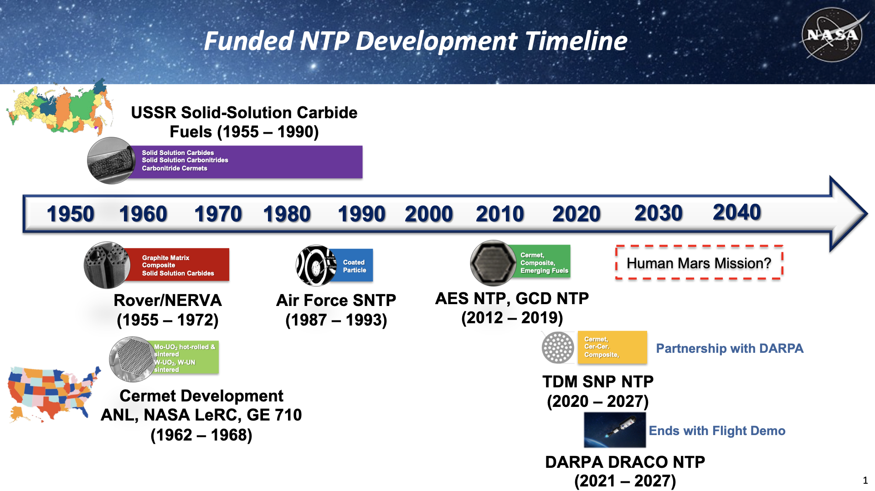

Slide 10
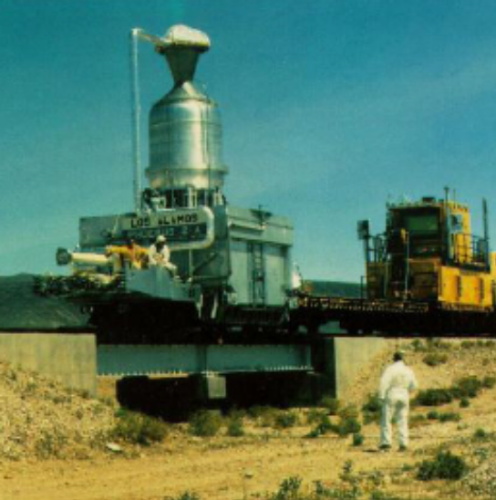
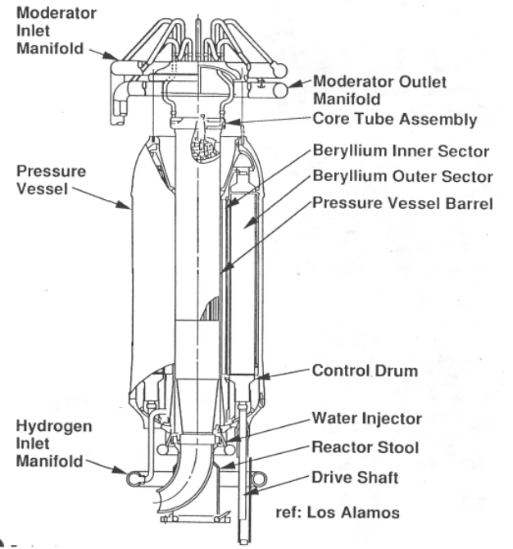
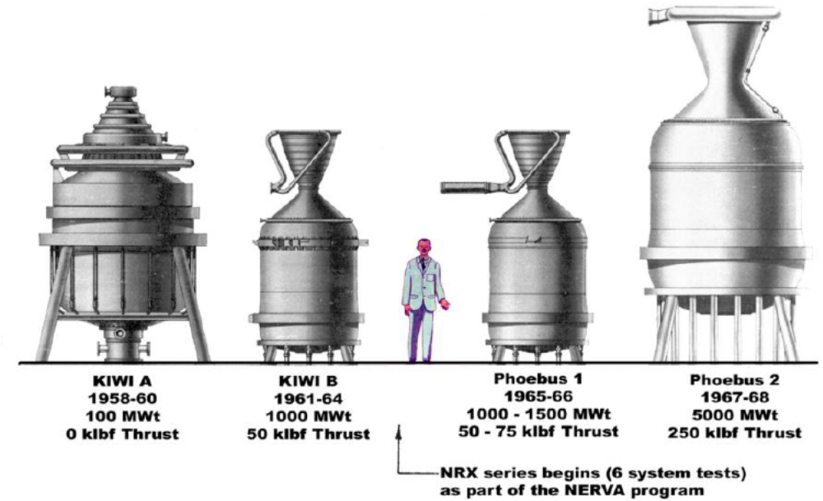
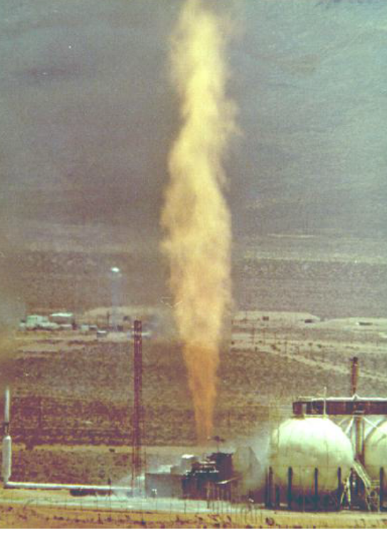
Heritage Programs and Testing
High Enriched Uranium (HEU) Fuels
Nuclear Engine for Rocket Vehicle Application (NERVA)
  Total of 23 Reactor Test
Nuclear Furnace (NF-1)
Reactor in Flight (RIF)
Nuclear Furnace NF-1
Rover/NERVA Test Reactors
Phoebus-2A
Notes:
Past fuel fabrication
-
Heritage Testing

Slide 11
Materials Challenges
Stability
Fabrication
Testing
Notes:
Fabrication
SPS
Can we use refractory AM
Machining processes
Stability
Extreme Temperatures
Hydrogen
Radiation
Testing
Non-nuclear simulated testing
Reactors
Ground Testing

Slide 12
Materials Challenges
Fabrication

Slide 13
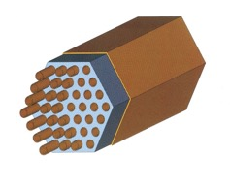
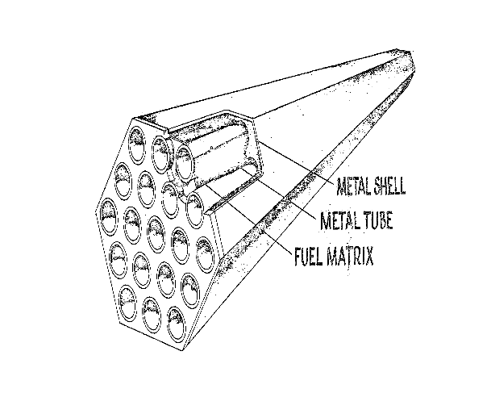
Heritage Fuel Element Design
A variety of fuel materials and designs have and are being considered
Uranium Enriched Levels
Carbides
  Bicarbides
  Tricarbides
CERMETs
  UN-Mo/W

Slide 14
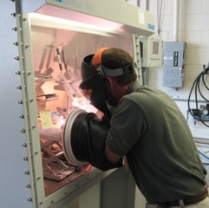
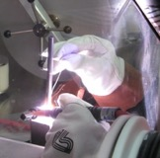
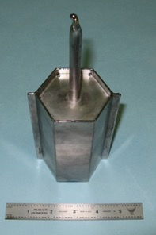
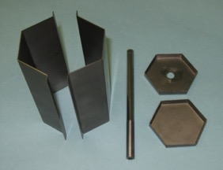
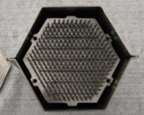
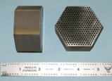
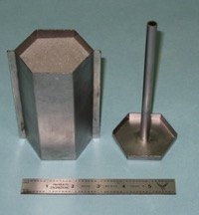
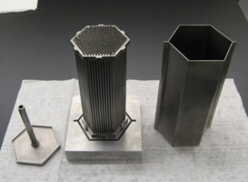
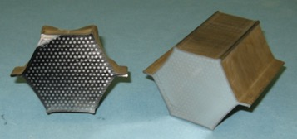
Hot Isostatic Pressing
Hexagonal HIP can components
Final closeout weld
Sealed HIP Can
Mo Mandrel assembly
HIP can after powder fill
Can assembly after HIP cycle

Slide 15
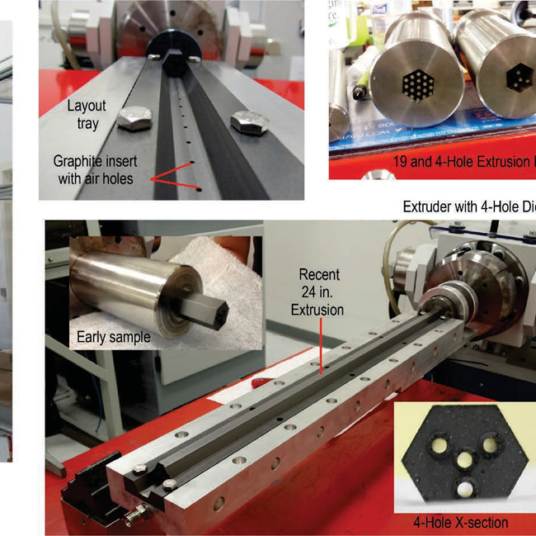
Oak Ridge Extrusion Fabrication
24” extruded composite piece made of graphite matrix materials, HfO₂, and ZrC coatings of the channels. No coating on outer surface

Slide 16
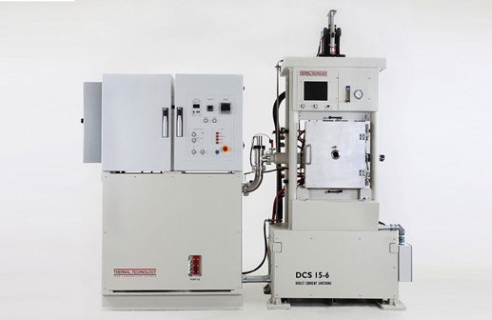
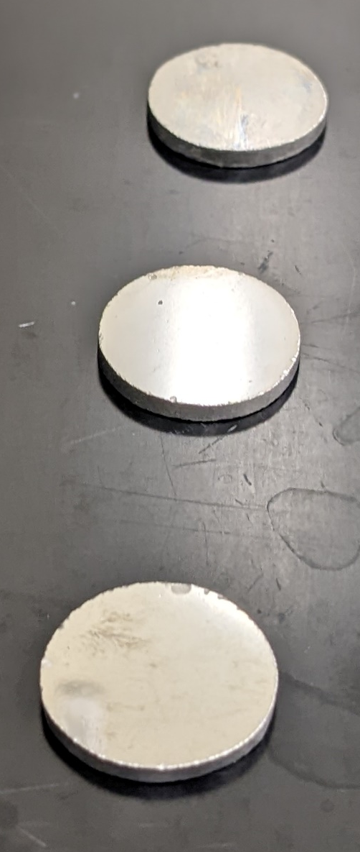
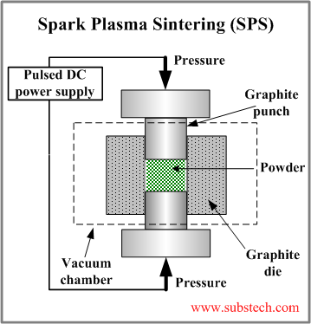
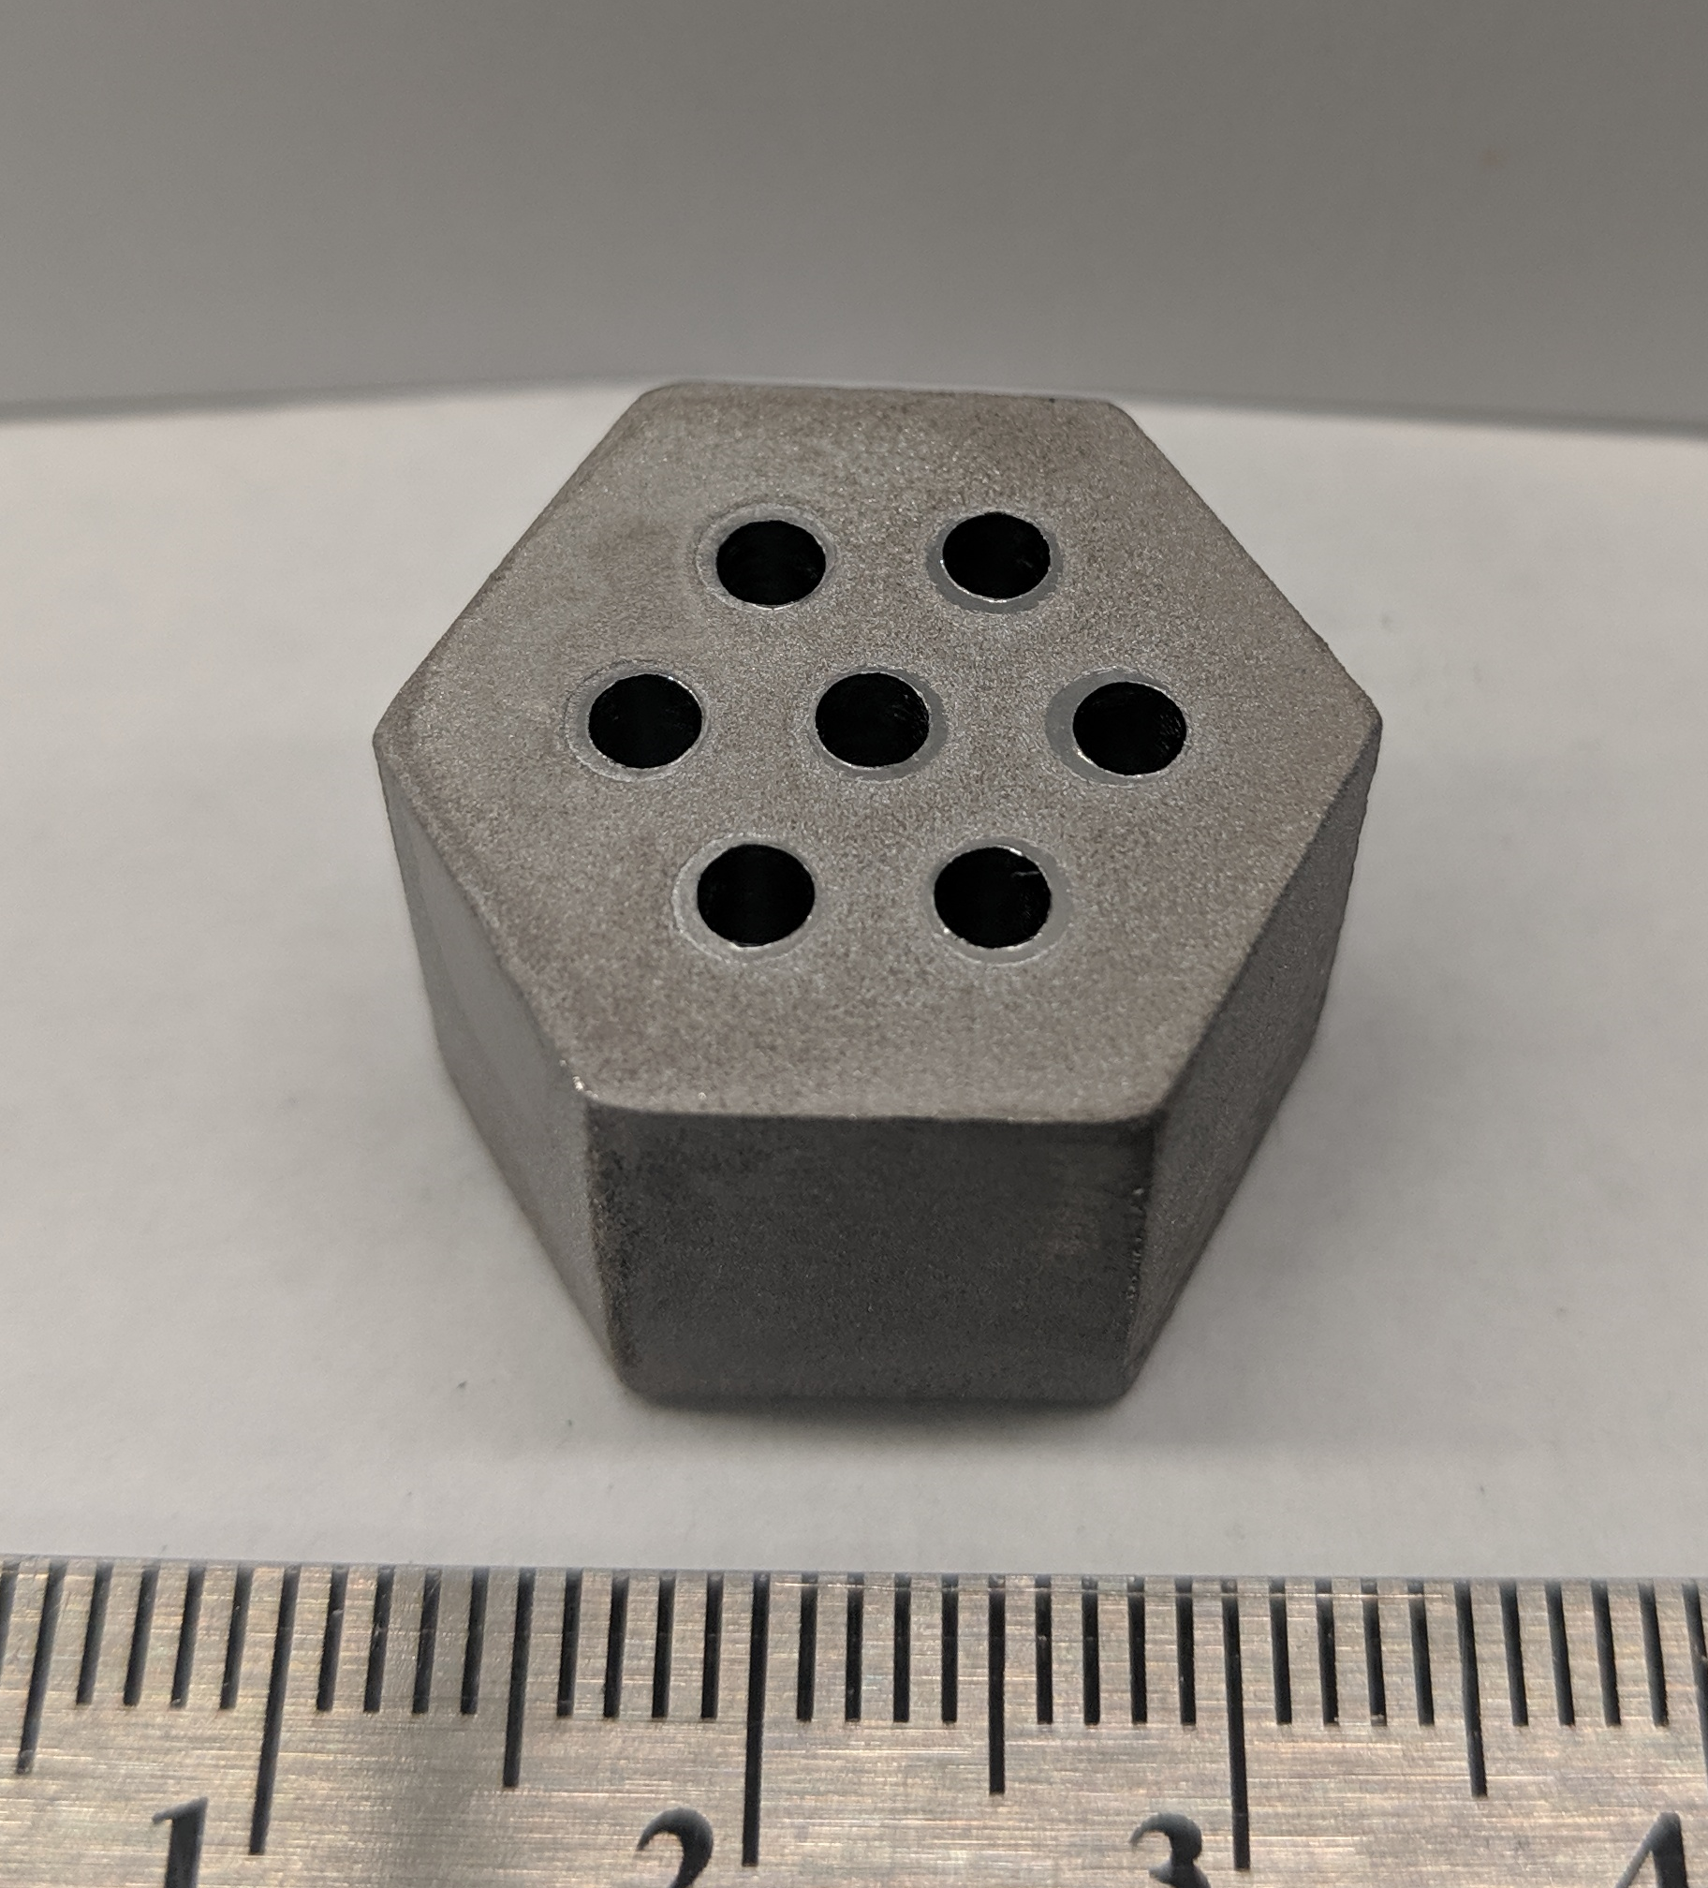
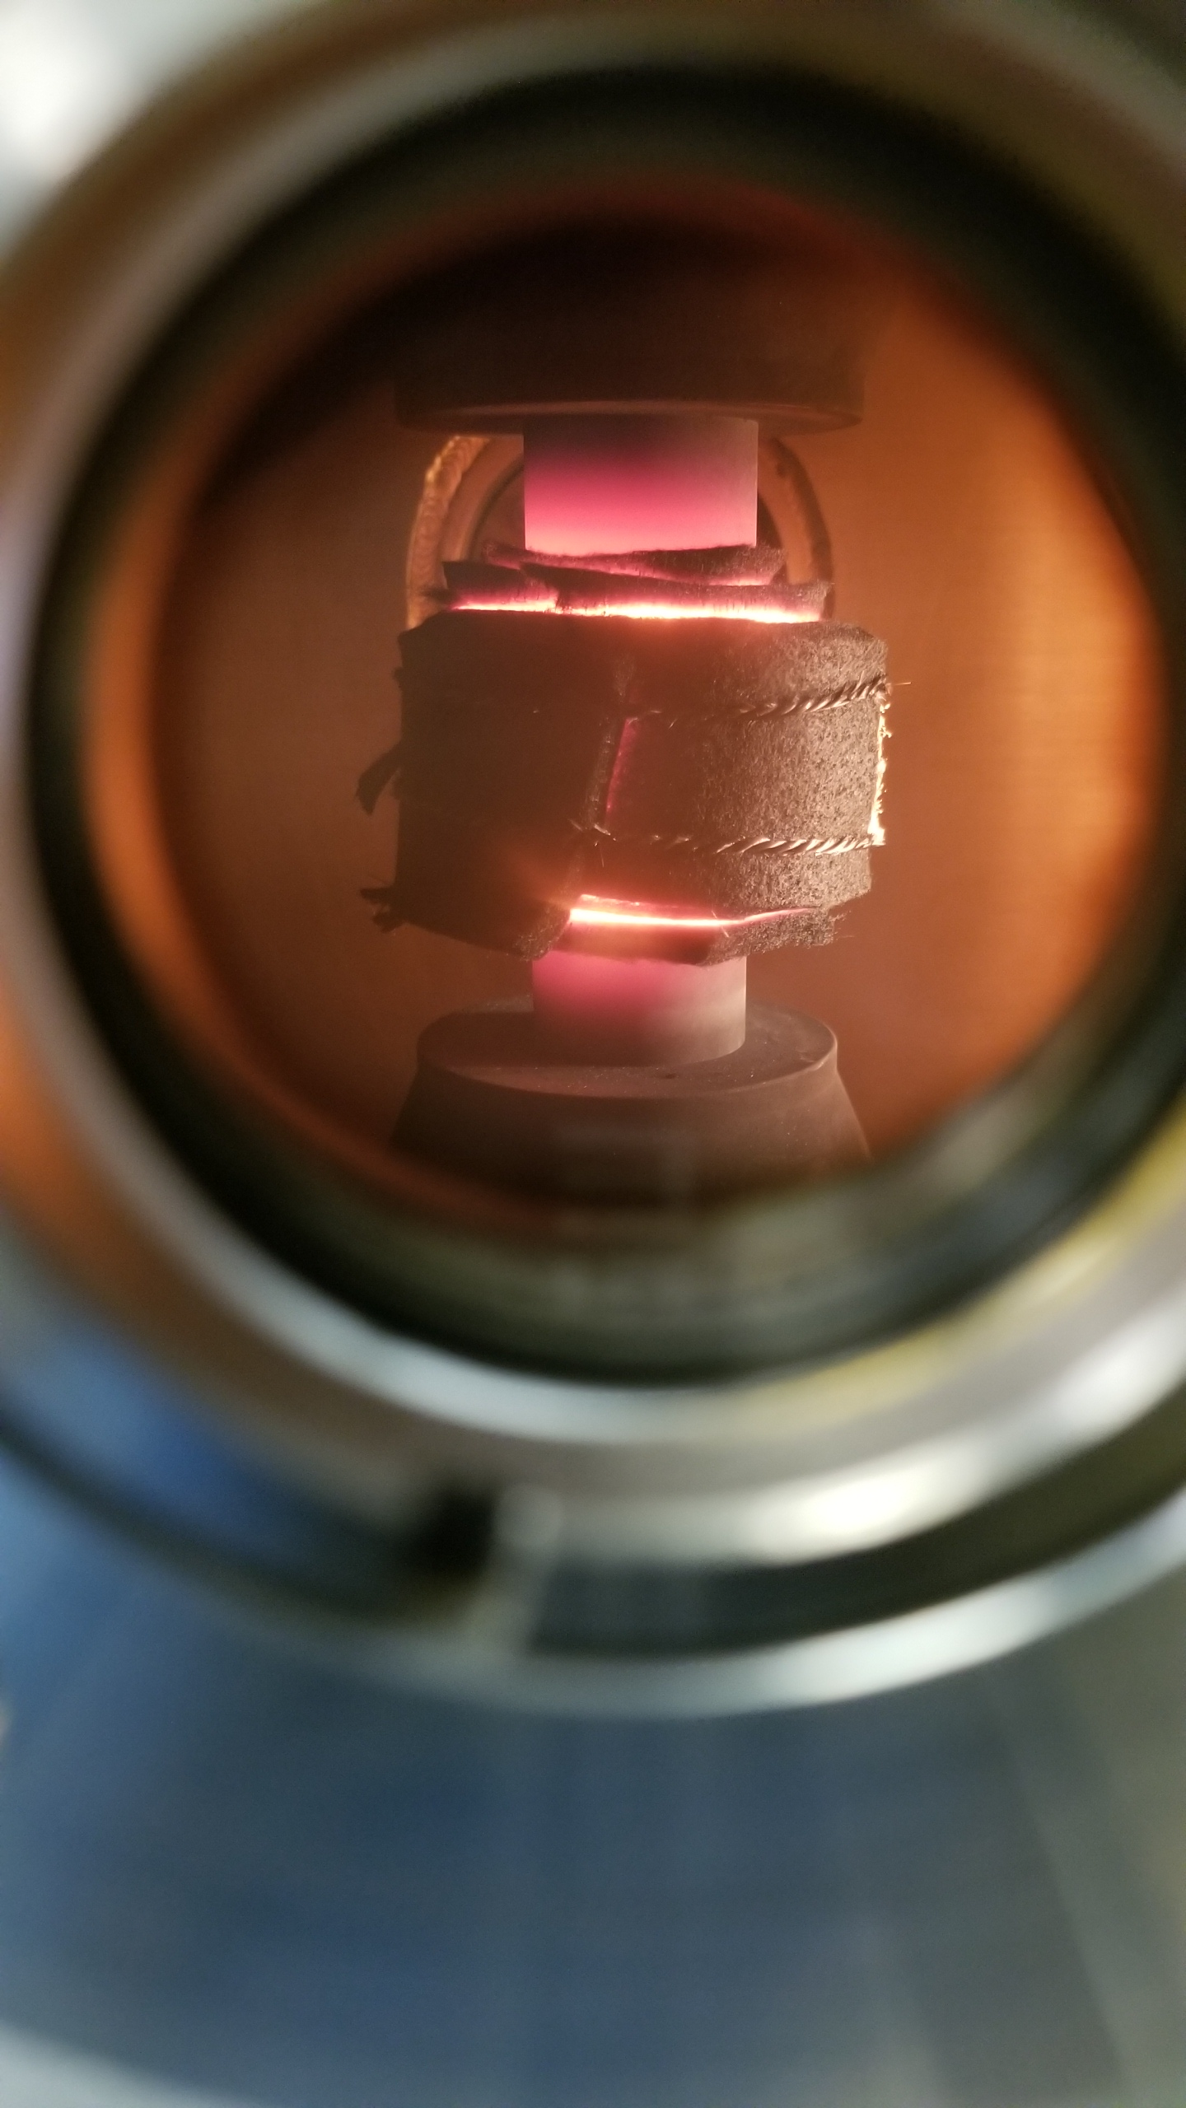
Spark Plasma Sintering (SPS)
Consolidation of constituent materials using electrical current and uniaxial pressure
Benefits
  Rapid sintering
    Low grain growth
  High density products
  Process variety of high temperature materials from powder
Notes:
High density with fewer voids

Slide 17
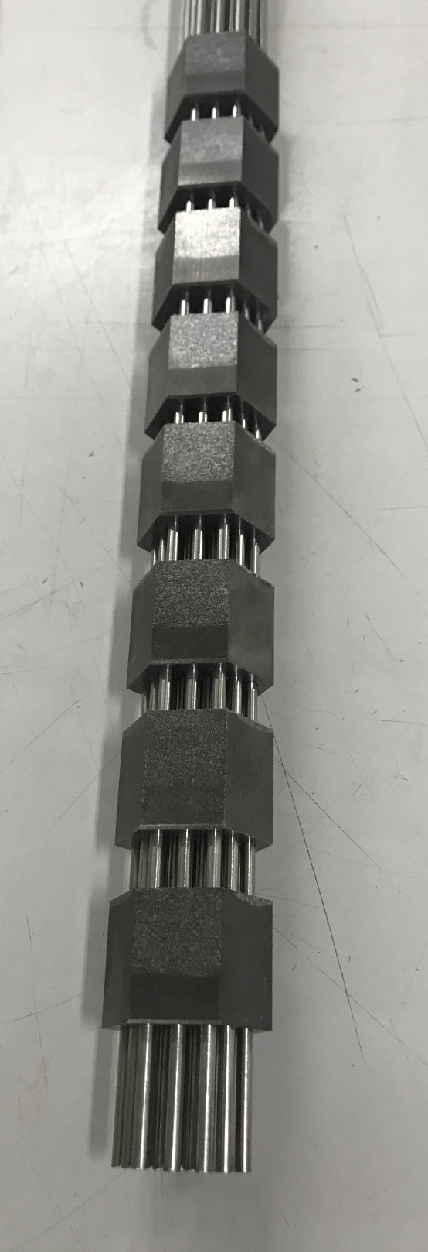
Fabrication of Surrogate Nuclear Fuel - ZrO₂-Mo Fuels
  Sintered 16 segments 1” long via SPS
  Densities reported were approximately 95% TD
  19 cooling channel pattern was formed by means of ultrasonic blaster
  Molybdenum tubes are being inserted along the cermet samples.
  Bonding to be produced at elevated temperatures/pressures via SPS.
  This will be the longest SPS fabricated cermet to be tested at NTREES.

Slide 18
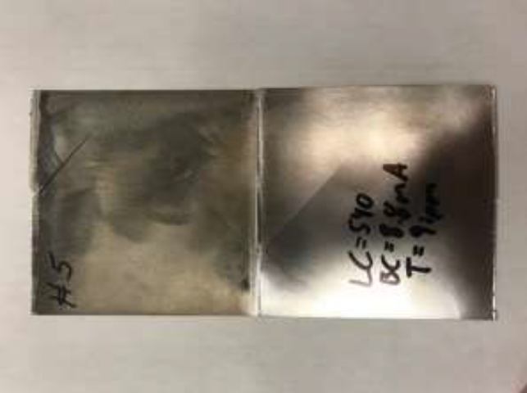
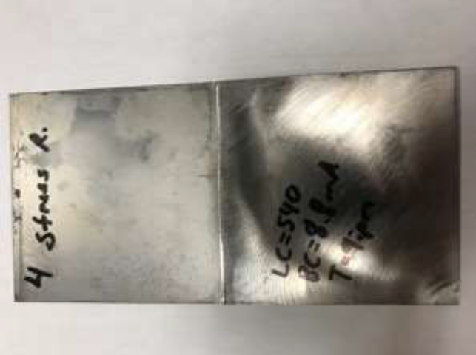
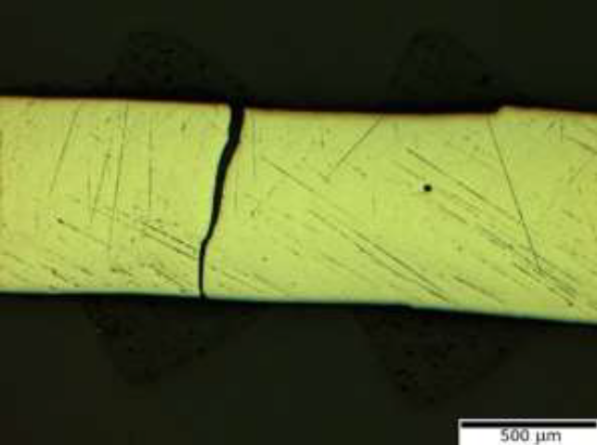
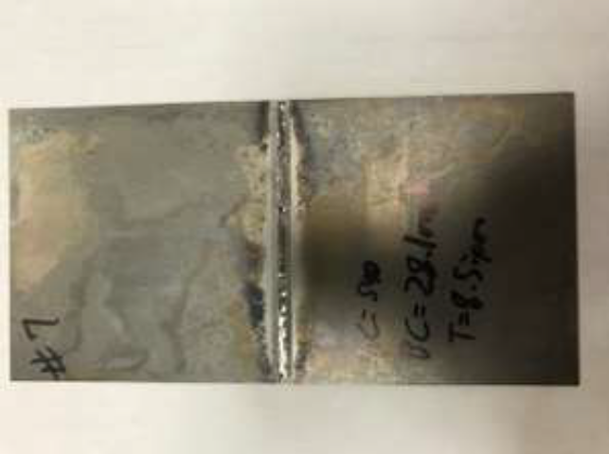
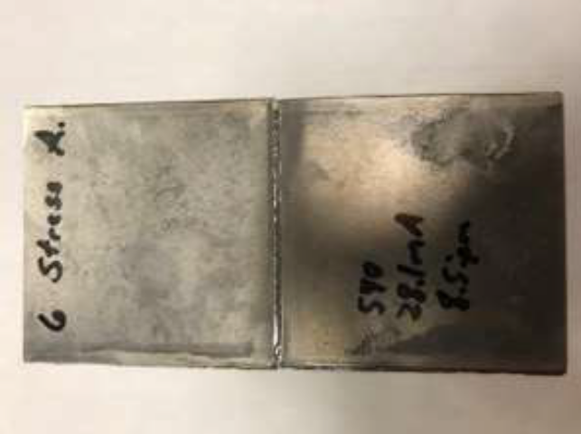
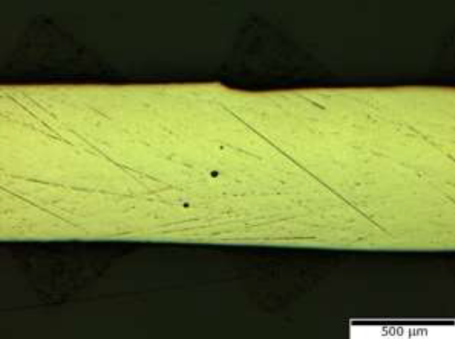
Tungsten Welding
Tungsten welding study
Cracking occurred in all weld specimens (both sheet and hexagonal tubes)
Cracking became less sever as welding study proceeded
Heat treated specimens exhibit less sever cracking (micro-cracking)
Notes:
Welding in vacuum environment
Preheat with EB beam
Used heat treatment to control cool down process which improved the process

Slide 19
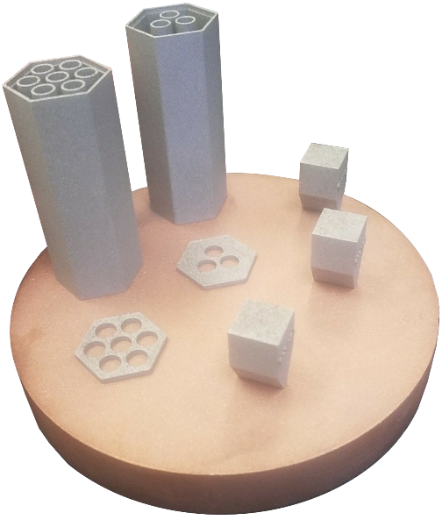
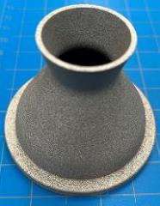
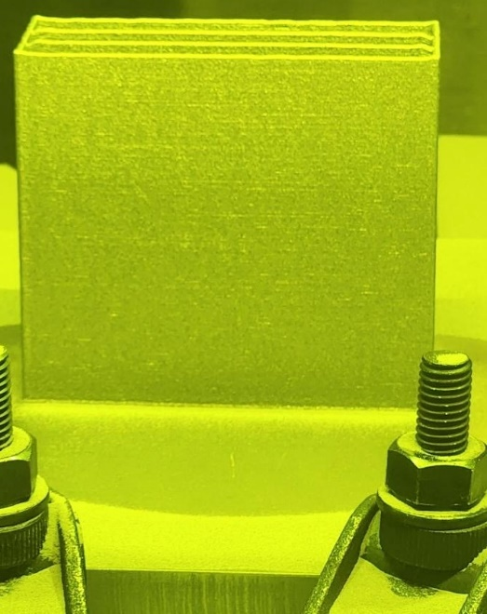
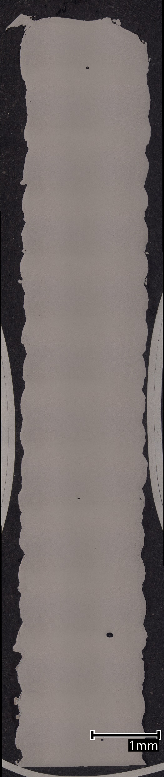
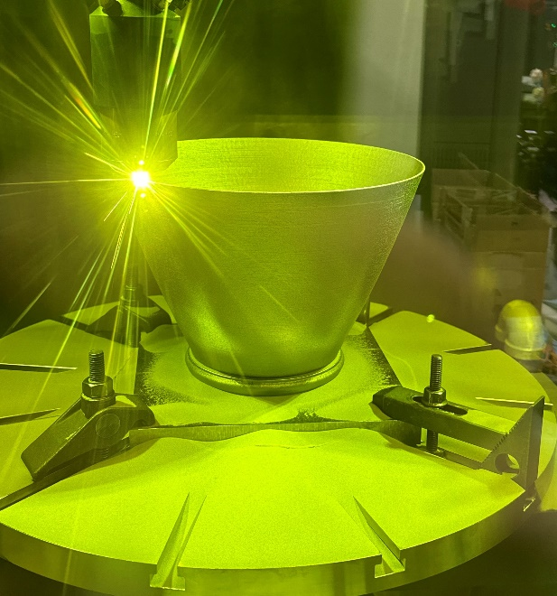
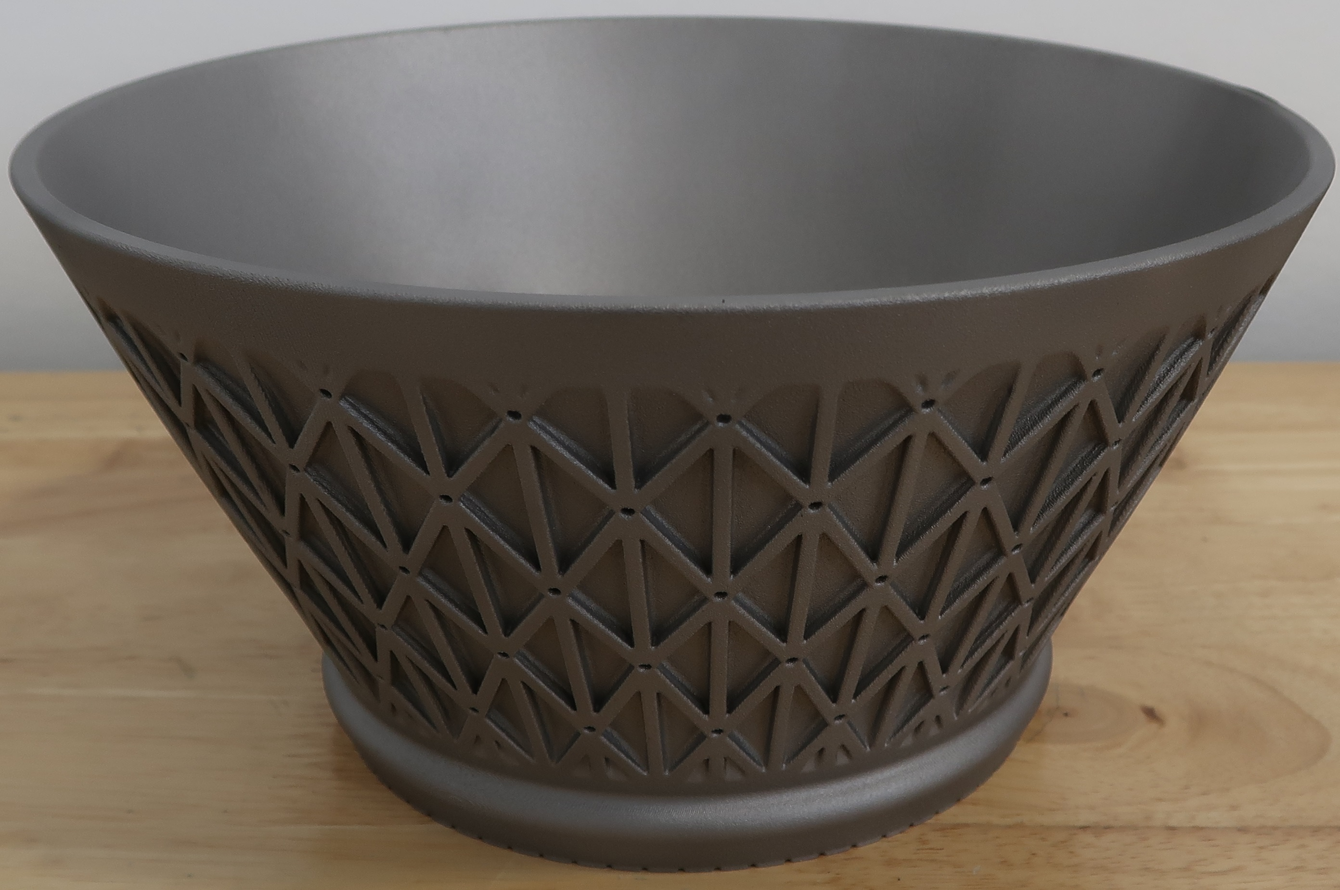
Additive Fabrication - Refractory Alloy Additive Manufacturing Build Optimization (RAAMBO)
R&D effort that seeks to generate printable refractory metals
Approach
  Utilize materials modeling and simulation to identify viable alloys and dispersoids
  Develop feedstock for laser powder-bed AM
  Develop AM parameter
  Optimize heat treatment & joining processes
  Non-Destructive Evaluation
  Surface finish
  Material property characterization & component testing
Success with niobium (C-103), molybdenum, & tungsten
First NASA W AM build: NTP fuel clad with integrated coolant channels.
L-PBF AM C103 small RCS chamber.
LP-DED AM C103 specimen build (left), SEM micrograph at 99.67-99.95 %RD (center), and 10k-lbf nozzle extension (right).
L-PBF AM C103 topology optimized nozzle extension.
Notes:
Integrated Computation Materials Engineering
No scale, these are small parts

Slide 20
Materials Challenges
Stability

Slide 21
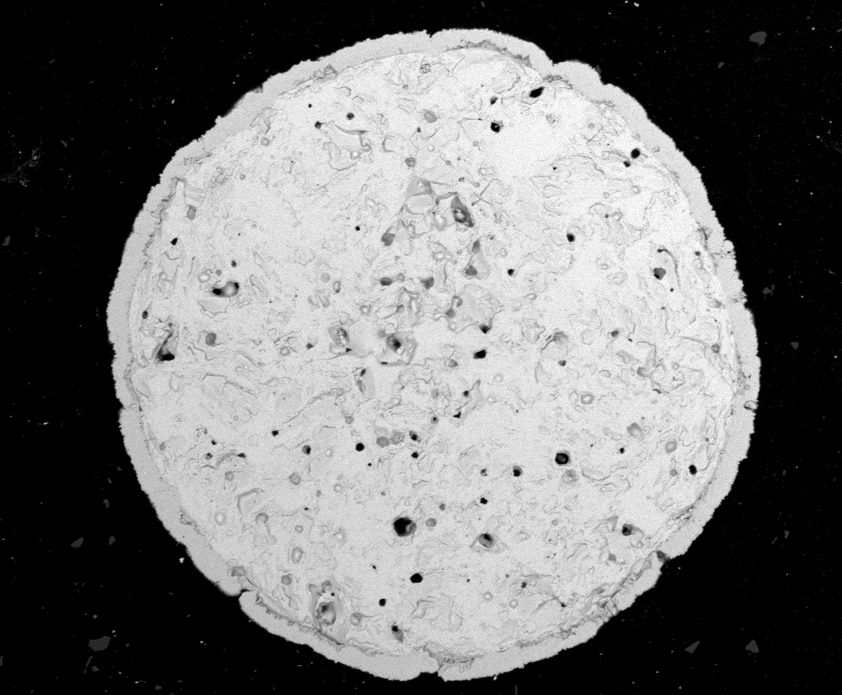
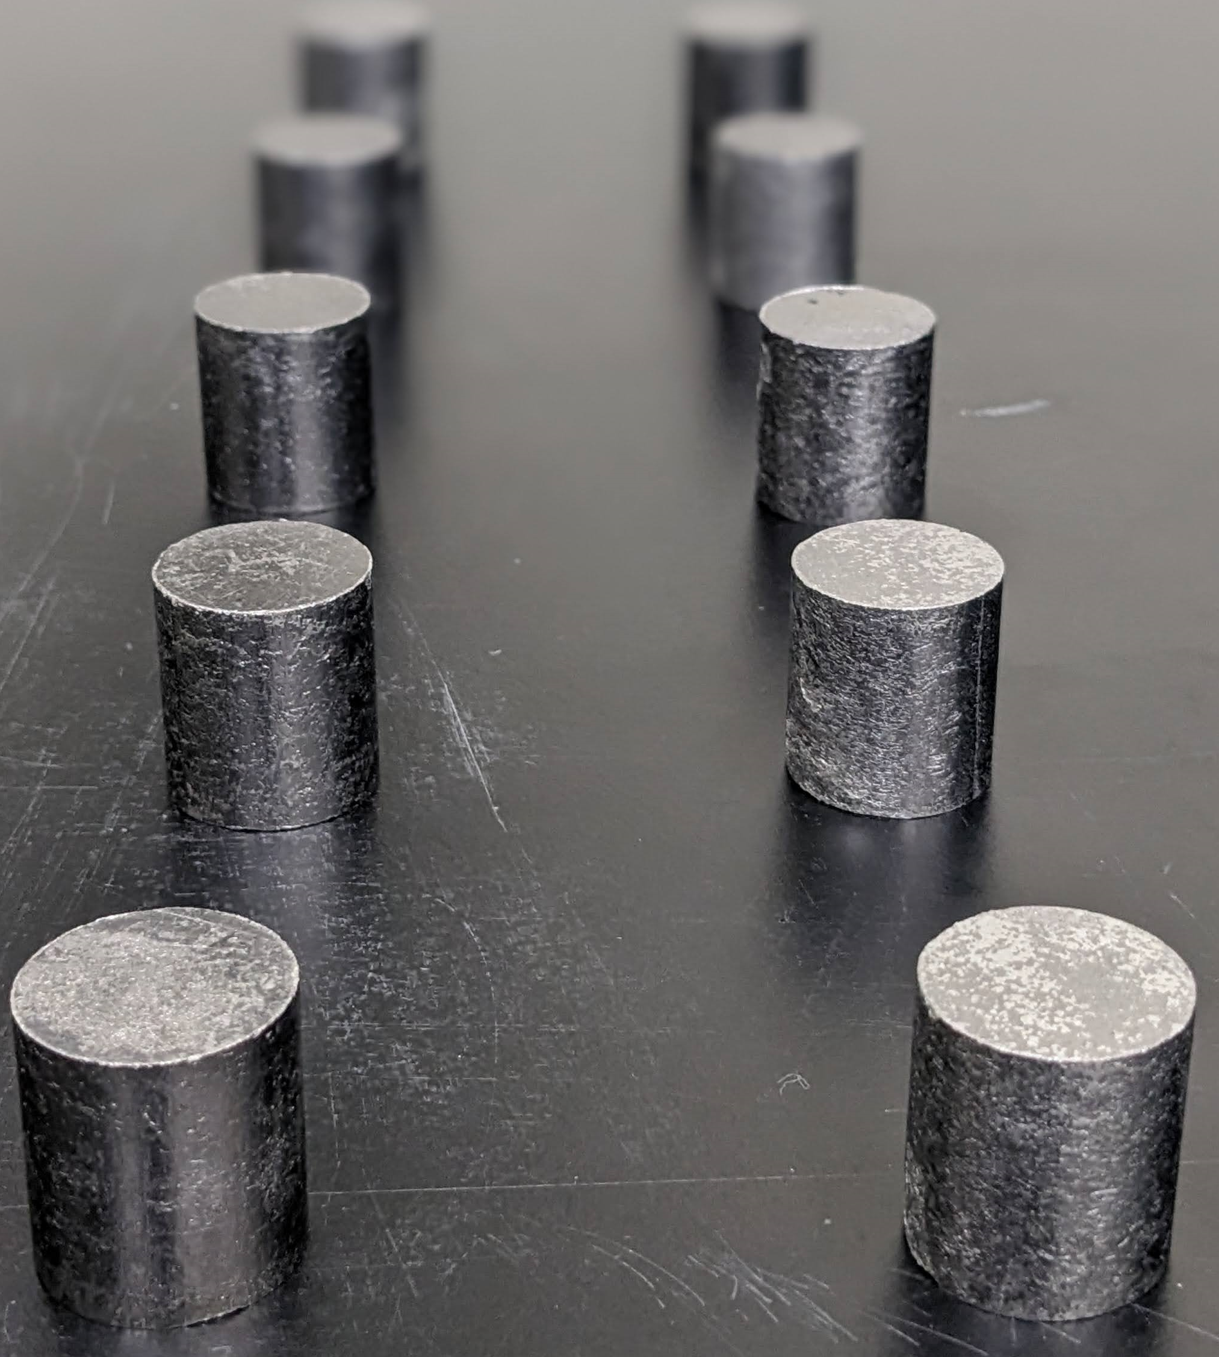
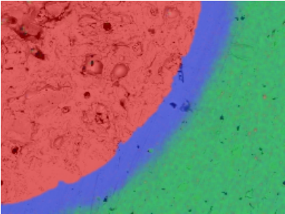
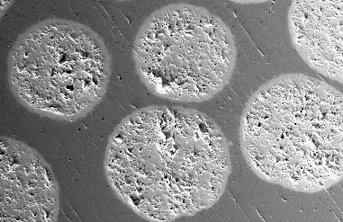

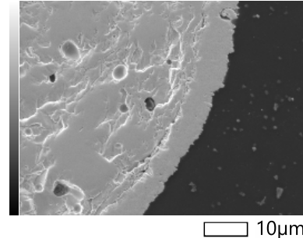
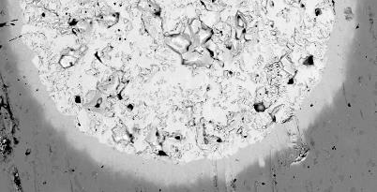

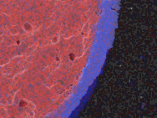


Particle Coating
Consolidated cermets. W-coated UN-Mo30W alloy matrix
50 µm
Consolidated UN kernels in Mo30W matrix
Spherical UN fuel with a W-coating.
Tungsten
coating
Tungsten
coating
Energy dispersive spectroscopy maps displaying chemical elements in UN kernel in a Mo30W matrix
100 µm
100 µm
W-coated UN kernel in Mo30W matrix
Energy dispersive spectroscopy map of UN fuel kernel.
SEM micrograph of tungsten coating around UN kernel.

Slide 22









Stability Challenges
Migration
Chemical reactions
Mass loss
Cracking
General degradation
W-RE/dUO₂
HfO2 and ZrC in Graphite Matrix
W-Mo/dUN
Tungsten Rhenium Hafnium Nitride Samples
After hot hydrogen test
As fabricated

Slide 23


Nuclear Fuel Test Article
W-Mo/dUN
Post-test

Slide 24
Materials Challenges
Testing

Slide 25

Testing
Simulated Nuclear Environment
  Induction Heating
In-pile Radiation Testing
Studying the effects of exposure to simulated nuclear
  Thermal degradation
  Chemical instability/incompatibility with propellant
  Radiation effects

Slide 26



Compact Fuel Element Environment Test (CFEET)
Built onsite at MSFC
Inductotherm 50kW power supply
Sample specifications
  Cylindrical or rectangular
  Max dimensions: 10 mm height x 20 mm diameter
Typical hydrogen flow rate: 6 SLPM
Test in Process
Susceptor
Sample
Setter
Pedestal
Base
Hot hydrogen testing at atmospheric pressure up to 2500 degC
Tungsten Internal Components
Schematic of Susceptor in Coil
Notes:
Susceptor

Slide 27

Hot Hydrogen Environment Atmosphere Test (H2EAT)
Manufactured by Thermal Technologies
  Fully automatic programable high temperature processing
Maximum temperature of 3000 C
Water-cooled induction furnace utilizing the bell-loading configuration
Hot hydrogen testing at atmospheric pressure, X sample size up to 3000 degC upgrade loading and improved functionality

Slide 28

NTREES
Nuclear Thermal Rocket Element Environmental Simulator (NTREES)
Hot hydrogen testing at elevated pressures 3000 K and higher

Slide 29
NTREES is a hot H2 furnace that can simulate temperatures, pressures, and flow rates of hydrogen coolant in nuclear rocket fuel elements which enables non-nuclear evaluation of NTP fuel forms
Test Article Temperatures up to 3000 K via inductive heating with power up to 1.2 MW.
H₂ environment – Supply pressures up to 1150 psig providing flow rates on the order of 200+ g/s.
Sufficient hydrogen for test times over an hour via onsite trailers.
Water cooled ASME code stamped pressure vessel for providing inert gas environments (Nitrogen or Argon pressures up to 1150 psig) to preclude thermochemical reactions of test articles (nitriding). Argon supply limited by bottle pressure/volume.
Fuel element lengths up to 6 foot.
Licensed by NRC to test depleted uranium (dU) and natural uranium
Instrumentation providing measurements of gas inlet/outlet temperatures, fuel element pressure drop, fuel element surface temperature (at 3 axial positions), mass spec analysis of exhaust products and exhaust temperature measurements (5 locations).
Data Acquisition and Control (DAQ) system can provide power ramp rates and specialized controls
Expected soon: Upgrades for axial temperature profile and radial temperature profiles (at exhaust).
NTREES is a one-of-a-kind facility that can provide combined effects of high pressure, high temperature, and flowing hydrogen simultaneously

Slide 30


Specialized fixture & trolley system are used to install and hold test elements in NTREES
Elements are typically hand loaded into cart through a bottom chamber flange penetration.
Chamber end cap can be opened if necessary to install/remove under special circumstances.
Hot and cold clamps are custom designed and fabricated for each test article
Test specimen axially clamped from both sides (cold end = inlet; hot end = exhaust)
Spring pressure (on cold end) used to keep test specimen in place
Specimen is supported & routed via cart on rails, simplifying loading process
Cold end utilizes silver seals, hot end is tight mechanical fit with gas in-leakage from chamber gas (provides cooling of hot end clamp)
Rails
Cart
Specialized test environment coupled with unique nature of supporting test elements has necessitated a specialized loading system which has been evolved over time.

Slide 31




Coils
Induction Coils
Notes:
An induction coil is at the heart of the system
Beautifully designed, manufactured and supplied by Fluxtrol
As the testing becomes more sophisticated the need for coils and large power supplies

Slide 32




NTREES

Slide 33

Transient Test Reactor Facility (TREAT).
Idaho National Laboratory
Nuclear Reactor temperatures and pressures.
Expose the fuel to neutron irradiation
Test nuclear fuel under severe reactor accident conditions.

Slide 34

Hydrogen Panels

Slide 35
Testing Challenges
Limitation in testing capabilities
Instrumentation
Fixturing
Coupling with the induction coil
Deviations between actual environment and simulated environment
Notes:
No nuclear furnace
Would be very costly to build

Slide 36
References
Gerrish Jr, H. P., “Nuclear Thermal Propulsion Brief History Reactor In-Flight Test Early 1960’s”, NETS Conference, 2023
https://www.substech.com/dokuwiki/doku.php?id=spark_plasma_sintering - SPS Furnace Image
Rosales, J., “The Effects of Hot Hydrogen Exposure on (U, Zr)C Fuel for Nuclear Thermal Propulsion”, NETS Conference, 2023
Mireles, O., “Refractory Alloy Additive Manufacturing Build Optimization (RAAMBO)”, NASA ER Monthly Meeting, Aug 2023

Slide 37
BackUP

Slide 38


Introduction
Solid solution carbide fuel, (U,Zr)C, is an attractive fuel candidate material for space nuclear propulsion applications given its high temperature stability, high melting point, and hot hydrogen compatibility
Solid solution carbide fuels involving UC and refractory carbides TaC, ZrC, NbC were investigated in the 1960’s under the NERVA program
Studies suggest that a low UC content is crucial for enhancing operating temperatures along with hypo stoichiometric carbon content [1]
In this work, consolidated (U_{0.2},Zr_{0.8})C_{0.93} fuel samples were tested under hot hydrogen at 2,300°C (2,573.15 K) for a cumulative time of 3 hours with intervals at 30, 90, and 180 minutes
Pseudo binary phase diagram for (U_{0.1}Zr_{0.9})C_{x} [1]
1. Lyon, Luther L. Performance of (U, Zr) C-Graphite (Composite) and of (U, Zr) C (Carbide) Fuel Elements in the Nuclear Furnace 1 Test Reactor. No. LA-5398-MS. Los Alamos Scientific Lab., N. Mex.(USA), 1973.

Slide 39

How Does NTREES Work?
NTREES primary systems include a radio frequency inductive power unit, hydrogen supply, Argon/Nitrogen inerting, water coolant, specialized instrumentation and DAQ system.
6x Optical Pyrometers
Water Coolant System
RF coil/ RF supply
Exhaust & chamber walls
RF Power Supply System
One of six power modules in Inverter identified as being involved in two of the “Trip” shutdown events.
Cost to replace module and obtain spares ~35K
DAQ System
Controls operation
Records Data
Linked to each System
NTREES is a unique and complex set of subsystems balanced to achieve combined thermal, pressure and mass flow effects for the element under test.

Slide 40



Metallic Materials Processes Team
Specializing in development of new and improved material fabrication processes for NASA applications
  Heat Treating
  Nuclear Fuel Fabrication and Testing (laboratory scale)
  3D Printed Circuits
  Energy Storage Materials/Devices
  Corrosion
Heat Treating - Post Fabrication Processing of Metallic Components
  Techniques: hot isostatic pressing (HIP), stress relieving, annealing, aging, austenitizing, tempering, cryo processing
  Example: Hot isostatic pressing (HIP) of additively manufactured GRCop-84 combustion chamber liner at 15,000 psi at 1750 degrees F for 3 hours
    HIP is used to densify and improve material properties of metallic components post manufacturing
HIP Furnace
Loading HIP Furnace
CVD, Etch and Powder Processing Lab at MSFC
  GRCop-84 Combustion Chamber Liner Ready for HIP
HIP can fill, closeout and metallography lab @ MSFC

