Slide 1


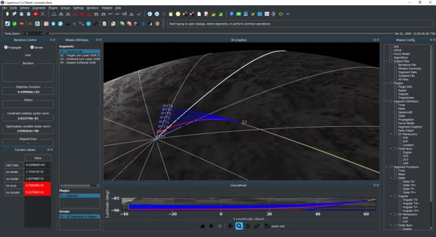



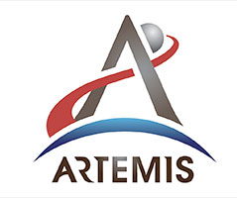
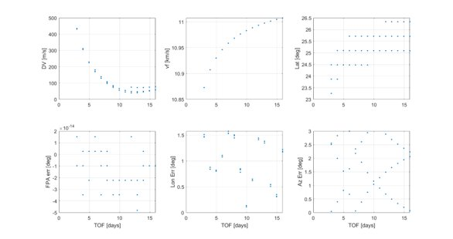
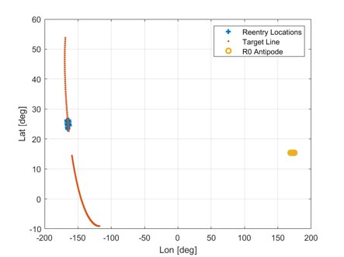
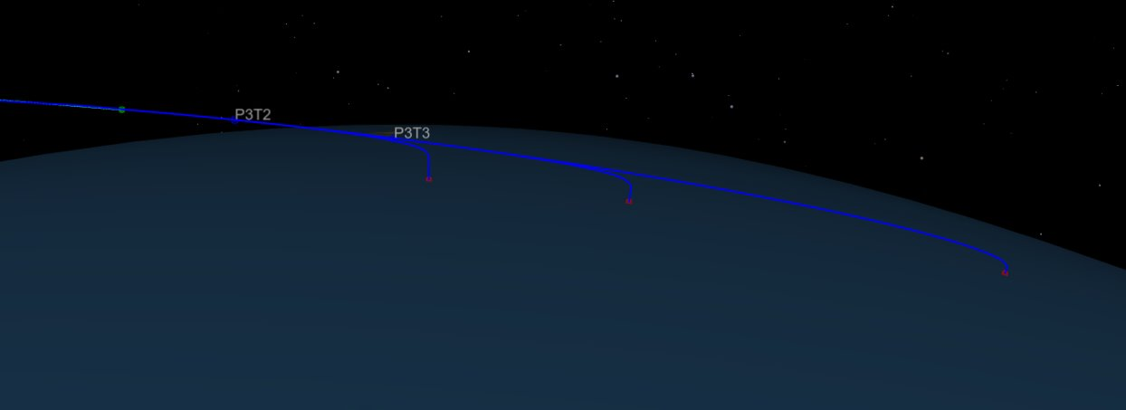
End-to-End Mission Design & Trajectory Optimization
TBD
PM / PI Info Jacob Williams | jacob.williams-1@nasa.gov
EXECUTIVE SUMMARY
The ability to compute end-to-end mission optimized trajectories is a critical component needed for the next generation of complex human spaceflight design and operations (Orion, HLS, Gateway, Mars). This project created a new interface for two of NASA’s trajectory tools: Copernicus and Genesis, enabling them to be used together for end-to-end mission design and optimization of all flight phases, including Earth ascent, lunar ascent, rendezvous, and lunar descent. This capability can also serve as a pathfinder for developing a future autonomous, onboard trajectory optimizer.
Innovation
This project is innovative because it combines two of NASA’s trajectory tools (Copernicus and Genesis), allowing them to interact in order to optimize end-to-end missions. In addition, the incorporation of an Initial Guess Generator (IGG) algorithm allows for the optimization problem to be seeded with analytical initial guesses to ensure accurate and fast convergence. Historically, this end-to-end process has been difficult, with different tools optimizing different mission phases (e.g., on-orbit vs. ascent/descent) with hand-off points from one tool to the other. This workflow is suboptimal and time consuming, since it may involve different groups, different file formats, and a person-in-the-loop. Creating a seamless integration of an on-orbit and powered ascent/descent tool has great potential to reduce cost, produce more optimization missions (e.g., most cargo to the lunar surface), and is also a critical component for potential autonomous trajectory operations for future missions.
Collaboration
This project was supported by various organizations at NASA/JSC including the Engineering Directorate (Aeroscience and Flight Mechanics Division and the Project Management and Systems Engineering Division) as well as the Flight Operations Directorate (Flight Dynamics Division).
Example of Copernicus plugin exporting multiple trajectories​
Outcomes & Infusion
In Year 2 (FY23) on the project, the project successfully completed upgrades to Copernicus and Genesis, matured the interface between Copernicus and Genesis, and improved the Initial Guess Generator algorithm. Specifics include:
  Released a new version of Copernicus (5.3). This update included many new features including a vastly improved Python API as well as improvements to the plugin architecture to enable the Genesis integration, including the ability to have Genesis export and display multiple trajectories to Copernicus.
  Released a new version of Genesis (0.3). Added a variety of state computations related to powered descent​. Expanded suite of guidance algorithms for use in plugins, with particular emphasis on powered descent guidance for HLS​. Improved performance of 6DOF cases by integrating a unit quaternion​. Improvements to the documentation, including adding a Monte Carlo tutorial​. And many other improvements​
  The Copernicus/Genesis plugin was improved, which allows a Genesis trajectory (e.g., ascent or descent) to be incorporated into a Copernicus mission, enabling an end-to-end optimization. Inputs from Copernicus are sent to Genesis, which runs and produces output sent back to Copernicus. Thus, the full power of the Genesis tool is available in Copernicus and can be used for a wide variety of applications.
A wide range of use cases exist for the end-to-end optimization capability, and there are many potential users and infusion paths:
Artemis & HLS: It can be used for the design of complex trajectories involving SLS, Orion, Gateway, and commercial landers, for example, optimization of entire trajectories between the Gateway Near Rectilinear Halo Orbit (NRHO) and the lunar surface.
Industry partners have also endorsed and expressed interest in the technology; recognizing the critical need for an end-to-end capability for future lunar landing missions (both crew and cargo).
Future Work
This activity will continue into Year 3, with specific goals of:
Scale up the Copernicus/Genesis/IGG capability from simple examples to real analyses.
Additionally, Big Data challenges exist within this work. Artemis I mission design generated millions of trajectories, which were difficult to access and distill in a meaningful and efficient way. Strategies and tools (such as Machine Learning) for data management, visualization, and interpretation will also be explored.
IGG final state error for Orion direct abort to Earth​
Demo of the Copernicus/Genesis plugin. This demo has one segment that is a replica of the segment right after CM/SM Sep for Artemis II. The plugin takes in the time, mass, and state of the SM at this segment and outputs (and graphs) the time and state of the Heel, Intact, and Toe of the footprint.
DAA# | #############
NTR#(s) | ############, ############, ############
Text Description

