Slide 1
Conjunction Assessment Special Topics
Lauri K. Newman
NASA Conjunction Assessment Program Officer
HQ Science Mission Directorate
Office of the Deputy Associate Administrator for Programs
October 11, 2023

Slide 2
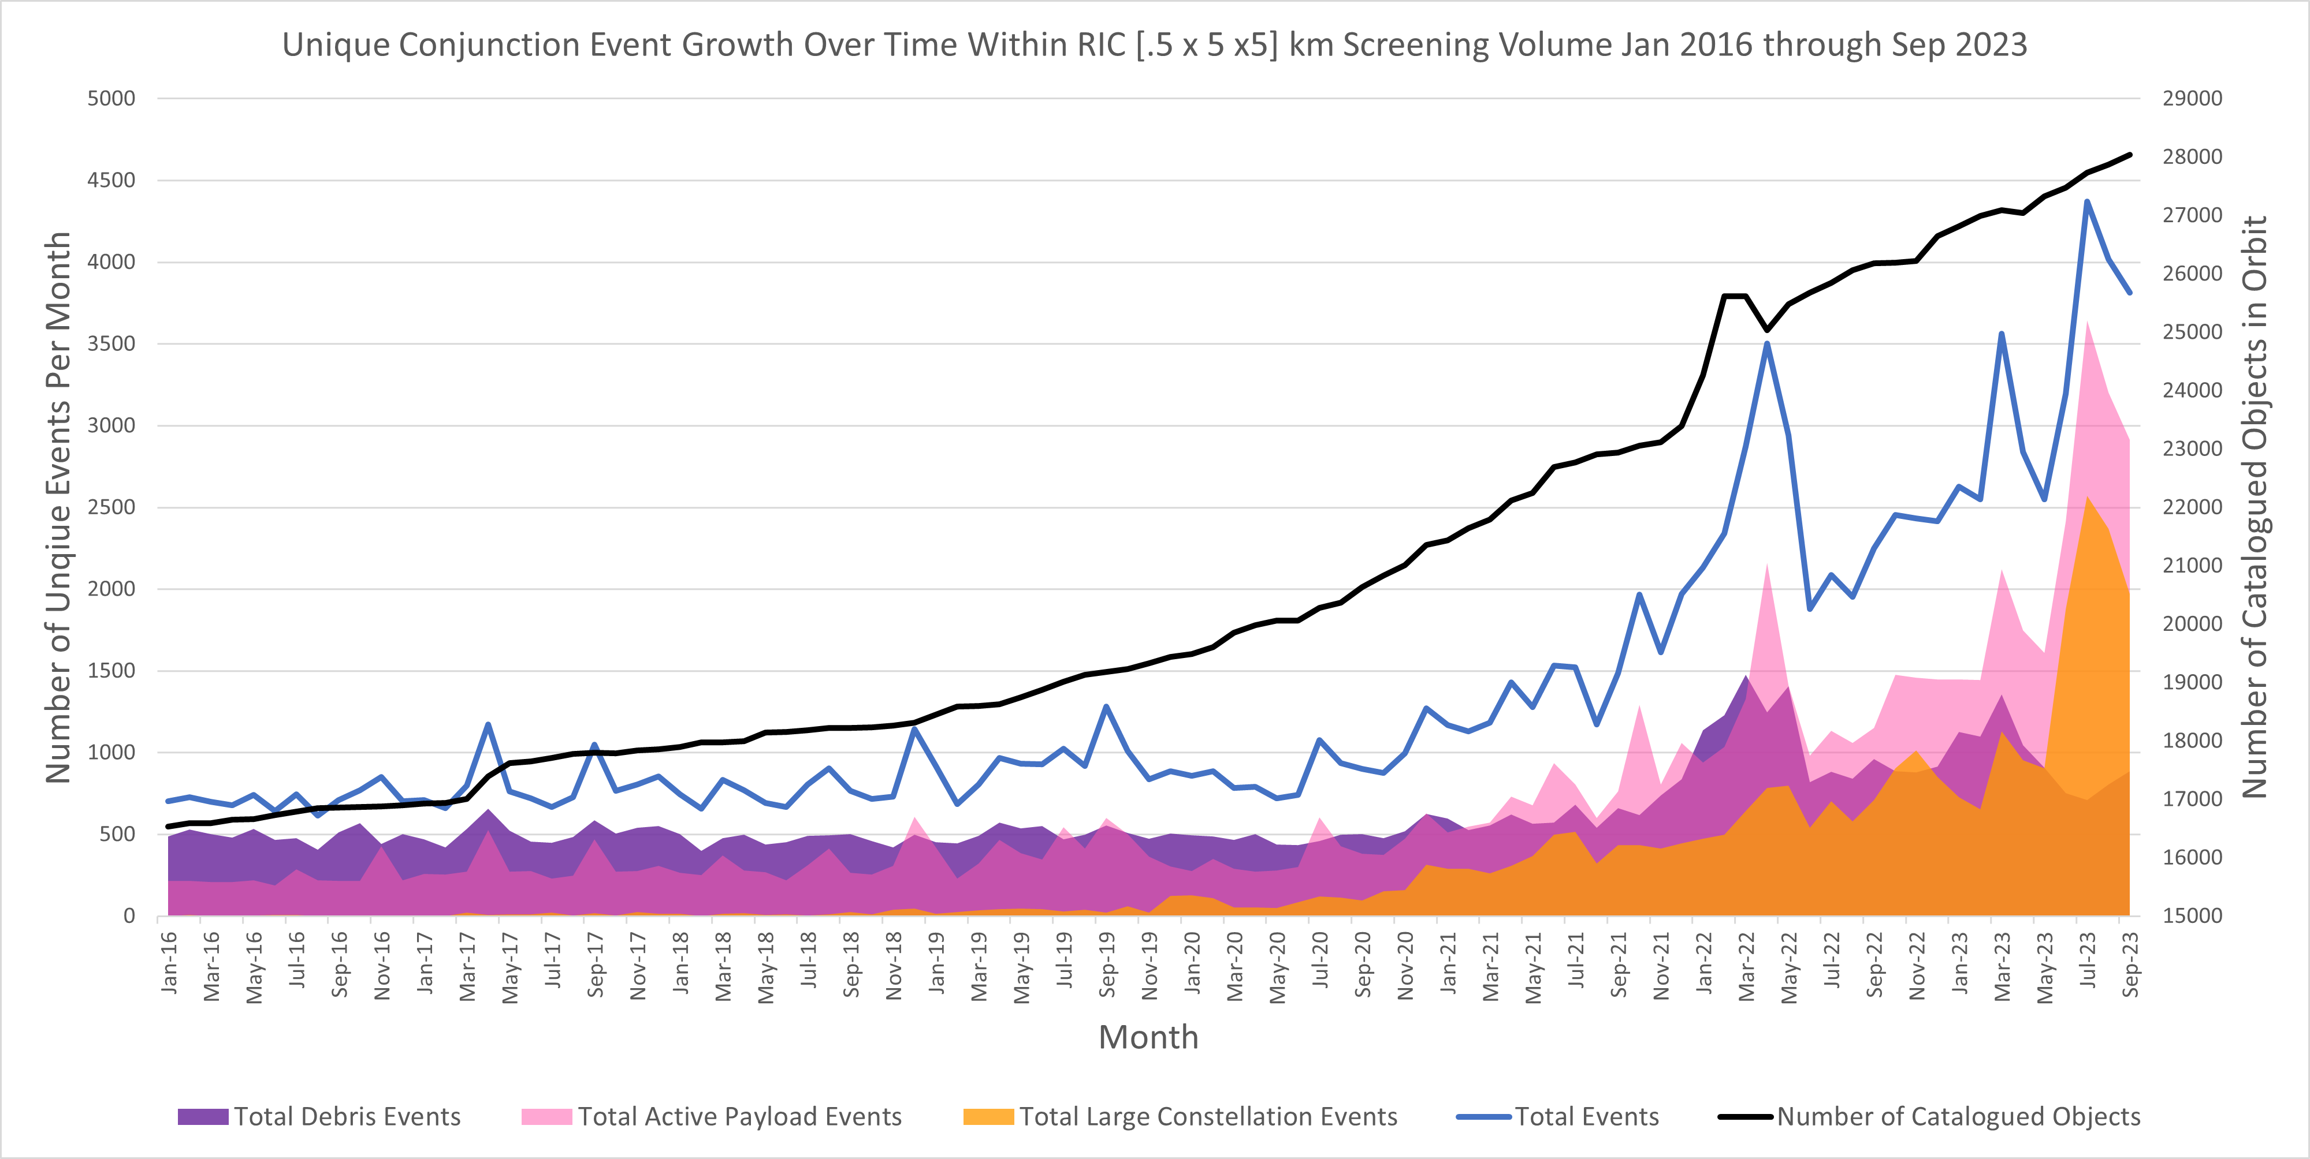
Growth in Conjunction Assessment Events
Russian ASAT test
15 NOV 2021
1st Starlink launch
23 MAY 2019
Number of conjunctions is growing, and more are with operational spacecraft than debris – requires coordination.

Slide 3
Agenda
CA organizations at NASA
Simplification of NPR
  Flow chart
  OCAP screening form
Key Best practices
Non-Earth CA
Resources for Assistance

Slide 4
NASA Conjunction Assessment Entities
Phasing loops at Earth before lunar transfer
Earth flybys
Human Spaceflight (HSF)
  ISS and visiting vehicles
  Commercial Crew
  JSC-based
CARA
  Non-HSF, Earth-orbiting missions (~100 assets)
  GSFC-based
Multimission Automated Deepspace Conjunction Assessment Process (MADCAP)
  Cis-lunar and beyond
  JPL-based
CAPO
  HQ CA integrating function
  Oversees CARA and MADCAP
CARA:
Earth-centered CA using DOD catalog
Cubesats launched from ISS
Cubesats launched with Artemis
HSF CA:
Earth-centered CA using DOD catalog
MADCAP:
Moon, Mars, Libration point ephemeris screening
Artemis support
Notes:
ODPO not included – ODARs and EOMPs are their purview in OSMA and not related to CA

Slide 5
NPR Interpretation and Simplification
We have been working to find ways to assist spacecraft with implementing the new NASA NPR 8079.1 and CA Best Practices
Planning Resources
  Flow diagram
  OCAP Screening Form
  FAQ available on website
  White Paper forthcoming
Selecting Hardware
Selecting orbit determination/ephemeris options

Slide 6
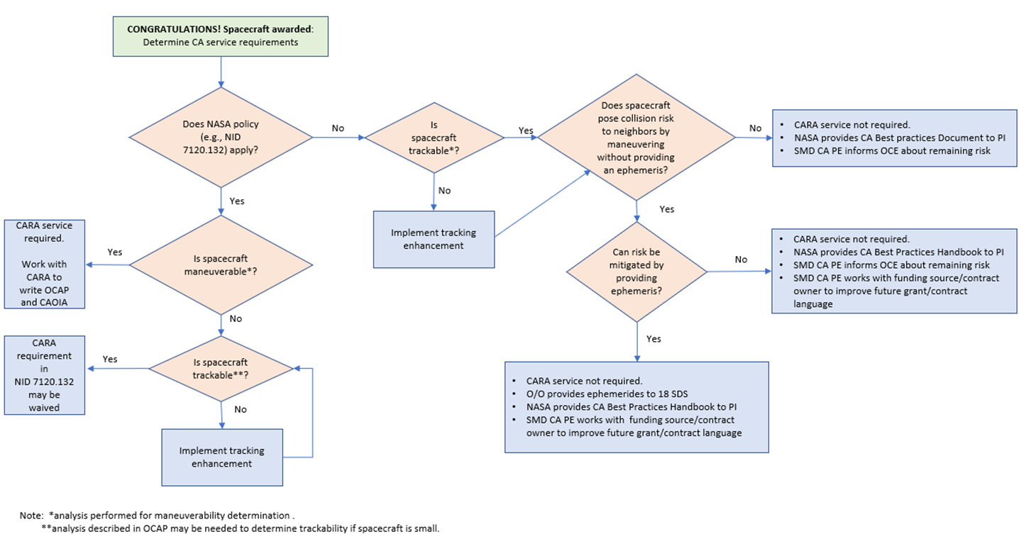
CARA Flowchart for Mission Coordination

Slide 7
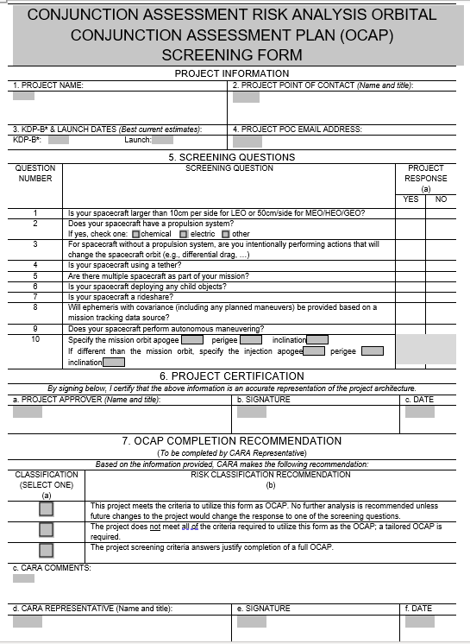
OCAP Screening Form
NPR 8079.1 requires an Orbit Collision Avoidance Plan (OCAP) document
  Set of analyses performed by CARA
  Mission makes implementation decision based on CARA recommendations
  Intended to be a conversation – not just a document
Not all missions require a full OCAP based on orbit selected, spacecraft size, maneuverability, etc.
The earlier after selection that the analyses are performed, the cheaper and easier the implementation of the necessary options is
To determine which analyses are needed for a given mission, CARA developed a screening form
  If it is determined that no analyses are needed, the screening form can be signed by mission and CARA and serve as the OCAP.
  CARA will determine which analyses are needed and only perform those that are necessary.

Slide 8
CAOIA
Other document required in NPR 8079.1 is the Conjunction Assessment Operations Implantation Agreement (CAOIA).
Template is available from CARA or MADCAP
  Different versions depending on maneuverability
  May be possible to streamline, but not tackled yet
Any agreed tailoring of NPR is documented here as part of the CA CONOPS

Slide 9
Key Best Practices

Slide 10
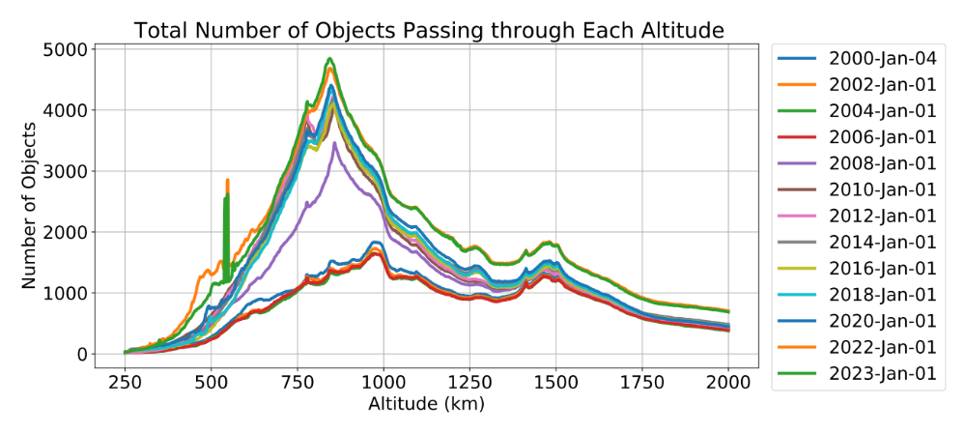
Choosing an Orbit
Choosing an orbit is one of the OCAP analyses
Understanding the ramifications of choosing a particular altitude and weighing those against the benefits is a trade study that should be mindfully undertaken.
Rideshare spacecraft can assist by raising awareness of the orbit crowding issue to their ELV provider
  Often ELVs launch to highest possible orbit without considering that a lower orbit might be safer for their customers (and allow delivering more mass to orbit!)
Starlink

Slide 11
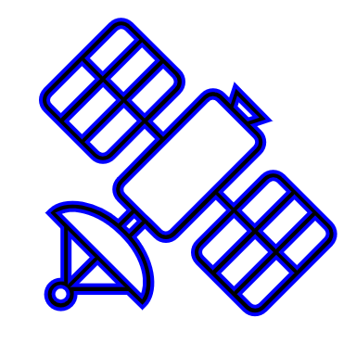
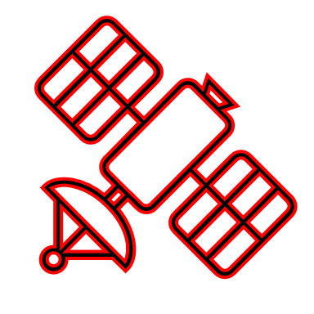
Producing a CA-Quality Ephemeris
Since close approaches are computed using predictions of future spacecraft position, an ephemeris with associated covariance (uncertainty) is required for CA.
  Other operators need to know your location to avoid you – occurs via screening of ephemeris by DOD
  Computing probability of collision requires covariance.
Position predictions must be accurate enough to enable avoidance maneuver planning.
  No current quantitative accuracy requirement exists for CA
    Due to complexity of conditions that affect prediction accuracy and conjunction remediation efficacy
    (e.g., orbit regime, maneuver response time, conjunction geometry, covariance realism, etc.)
    DOC Study underway that may provide discrete values
I
C
R
Screening Volume (RIC)
Secondary
Primary
  Close approaches identified using penetrations of large screening volume around the asset
  The ephemeris accuracy is too poor for CA to be performed if the position uncertainty of the asset is a substantial percentage of that surrounding volume.
  Analysis of ephemeris accuracy performed as part of OCAP preparation
Notes:
25% based on engineering judgement. It allows the OD to move around within the volume somewhat without bumping up against the edges

Slide 12
Ephemeris Production
Many smallsats rely on DOD data rather than produce their own ephemeris
  For non-maneuverable spacecraft in most orbits this works, but should be examined before launch (OCAP) because there are some exceptions:
    Does not work for maneuverable spacecraft as DOD doesn’t have knowledge of predicted maneuvers
    Spacecraft must be passively trackable by Space Surveillance Network (see next slide)
Maneuvers must be screened before execution to protect other on-orbit spacecraft
  No maneuver is too small to require screening
  No altitude is too low to require screening
Two Line Elements (TLEs, e.g. from SpaceTrack.org) are NOT SUFFICIENT FOR CA
  1-2 km theory error is too large for CA risk assessment and maneuver planning
  No covariance available to compute probability of collision and make risk decision
  OCAP includes determination of DOD solution sufficiency

Slide 13
Trackability
Technology advances make possible spacecraft that are too small to be tracked by the Space Surveillance Network (SSN)
  SSN is the DOD USSF resource assigned to track all on-orbit objects
  Objects must be >10 cm to be tracked reliably in LEO
  Objects must be >50 cm to be tracked reliably in GEO
  Passive tracking not currently available beyond GEO (e.g., cis-lunar)
  CA can be performed only against well tracked objects in the catalog
Un-trackable objects on orbit pose a threat to flight safety
  Objects in low inclination orbits (fewer SSN sensors with geometric visibility)
  Objects in eccentric orbits (perigee can be away from radars and satellite can be too dim at apogee for optical sensors)
  Objects too small to be regularly tracked in any orbit
  Trackability should persist for full on-orbit lifetime, not just during operations.
  Trackability should persist for full on-orbit lifetime, not just during operations.

Slide 14
Trackability Augmentation
Potential workarounds options listed in CA Handbook
One option is adding a GPS transponder
Can either fly a GPS that transmits down a point solution and do orbit determination on that to make an ephemeris or use a GPS that computes and downloads its own covariance
  Having this onboard from the receiver is likely too stringent a requirement, but it can be generated on the ground using free tools, e.g., GMAT, processing standard receiver point solution telemetry
  Can hire provider to process your GPS data (e.g., Slingshot, Kayhan, SpaceNav, CommSPOC)
Guidance for choosing:
  Want fast convergence after launch to allow CA ASAP after separation
  Must be space rated (or must test with a simulator)
  Other features, like multi-frequency, multi-GNSS, and availability of pseudoranges, are nice-to-have, but the benefit is marginal vs. just having a receiver in the first place
For Cubesats, there are GPS receiver kits on the market:
  NovAtel OEM719 is a common receiver choice
  Lockheed Martin and The Aerospace Corporation make GPS strap-ons
  JAXA Mini Mt Fuji
SSCG annual report will contain a list in future updates of OD providers and GPS transponders.

Slide 15
COLA Gap
Until the delivered spacecraft is tracked and cataloged by DOD (up to 2 weeks), CA is not possible – this is called the COLA Gap period
  Important to provide state and covariance ASAP after launch to prevent collision
  Work with ELV provider to request this data
  Provide O/O ephemerides ASAP as ELV data is only good for a short period (accuracy degrades the longer the state is propagated).
Many ELVs launch rideshares to 550 km, an orbit regime occupied by a large number of autonomously-maneuvering Starlink spacecraft.
  If the spacecraft do not need to go to this altitude for science reasons, better to choose something lower, preferably below the ISS.

Slide 16
SpaceX SAA
SpaceX has 5000 Starlink spacecraft maneuvering autonomously at 550 km
NASA has a Space Act Agreement (SAA) with SpaceX under which SpaceX agrees to take the maneuver action in the event of a close approach with a NASA spacecraft
In order to enable SpaceX to be able to take action, they require CDMs that represent close approaches based on an accurate ephemeris for the NASA asset
NASA spacecraft that plan maneuvers should not change the maneuver within 24 hours of TCA in order for SpaceX to use the CDM data from the submitted ephem that includes the planned maneuver
Spacecraft being injected near Starlink (530km – 578km) should provide ephemerides starting at injection, such as based on a separation vector, to ensure SpaceX can know the location of the spacecraft even prior to cataloging by DOD.
NASA spacecraft must fulfill this need regardless of NPR applicability due to SAA governance.

Slide 17
Satellite Autonomous Maneuvering
Becoming more common for satellites to employ autonomous maneuvering (especially large constellations)
Maneuvers automatically commanded/executed
  Often ground systems do not even know of maneuvers until after execution
Automated maneuvers don’t have to be real-time
  Allow time to screen maneuvers so other operators know where your spacecraft will be
  Consider this when designing maneuver CONOPS
Two autonomously-maneuvering satellites in conjunction may be planning mitigation actions, but neither knows what the other is planning to do
  Satellites could therefore maneuver into each other
Consortium among NASA Ames, NASA CARA, SpaceX, and Emergent Technologies have developed and are demonstrating a prototype autonomous CA approach
  Participants in Starlink/Starling formal experiment for autonomous CA
  To run JAN-SEP 2024

Slide 18
CA Beyond Earth
Catalog of non-cooperatively tracked objects used in CA only available near Earth
Activity at Moon, Mars, and Libration points increasing; risk of collision without screening
DOD developing cis-lunar catalog and screening capability
  Requirements not yet defined
  Implementation is years away
NASA Multimission Automated Deepspace Conjunction Assessment Process (MADCAP) provides ephem-on-ephem screening for missions that utilize DSN
  Relies on sharing of data; sharing of non-NASA data encouraged

Slide 19
NASA Mission Reminders
NASA missions should reach out to CARA as soon as mission is awarded to ensure least impact in implementing CA requirements
Any requests for DOD support related to SSA for NASA missions must flow through CARA
CARA is available to assist with anomaly resolution
Missions flying in Starlink regime must comply with Space Act Agreement with SpaceX – CARA assists

Slide 20

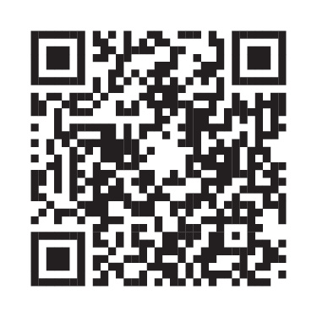
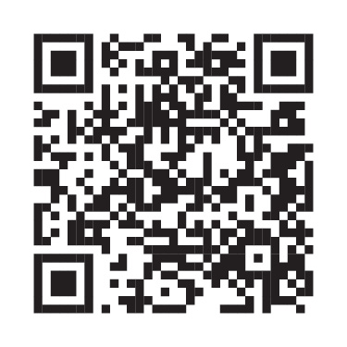
Where to go for help
General CARA questions: CARA-MissionSupport@nasa.onmicrosoft.com
CARA Operations Team: hq-cara-ops@lists.hq.nasa.gov; 301-286-9545
Submit an Orbital Data Request: CARA-ODR-Liaison@nasa.onmicrosoft.com
NASA CA Policy Questions: CAPO/lauri.k.newman@nasa.gov
CARA external website: https://www.nasa.gov/conjunction-assessment
NASA CA website: https://www.nasa.gov/conjunction-risk-analysis-and-mitigation
NASA is committed to refining and sharing appropriate best practices
NASA CA Handbook
CARA Tool Repository
NASA CA website

Slide 21

Questions?

Slide 22
Ephemeris Accuracy Assessment
Pre-launch OCAP Analysis:
  Evaluate planned orbit determination (OD) strategy to assure capability to produce accurate ephemeris
  Evaluate expected ephemeris prediction uncertainty growth over time
    If uncertainty > 25% of screening volume → recommend OD improvements
      Examples: Increased/better tracking, more frequent ephemeris deliveries, more accurate dynamic modeling, covariance tuning
In-flight Evaluation:
  Compute post facto errors in predicted ephemerides
    If errors > 25% of screening volume → recommend OD improvements
  Perform ephemeris uncertainty (covariance) realism analysis
    If uncertainty does not fairly represent errors → recommend OD improvements
    If uncertainty is not small enough to make confident remediation decisions → recommend OD improvements
Notes:
25% based on engineering judgement. It allows the OD to move around within the volume somewhat without bumping up against the edges

Slide 23
Orbital Data Request (ODR)
If a mission desires to obtain additional data or services from DOD related to CA or Space Situational Awareness, an Orbital Data Request must be submitted.
Examples:
  Launch and early orbit support
  Anomaly support
  Data redistribution (e.g. publish papers using CA results)
Process
  Obtain blank form from CARA, CARA and mission iterate contents
  DOD requires 30 days to process non-emergency requests
  Allow additional time for contents to be iterated with CARA before submission
CARA submits the request on behalf of the mission to ensure compliance with existing agreements and to prevent duplication of effort (missions may not submit directly)
  Specified in NID 7120.132 and ensures NASA complies properly with inter-agency agreements
  CARA may already have or have access to the requested data
  HSF ODRs submitted by JSC FOD

Slide 24
Anomaly Support
The CARA team can provide assistance in unexplained anomaly resolution
Examples of anomalies that CARA can assist with:
  You cannot contact your spacecraft
  Your spacecraft experiences force from an unknown source
CARA can use its resources to determine:
  Whether there were any trackable objects near your spacecraft at the time of the event
  Whether your spacecraft is in a non-nominal attitude
  Whether your spacecraft is intact
Some CARA resources are classified, so only mission personnel having the appropriate clearance are able to receive the information. It is valuable to have decision-makers at the SECRET and SCI levels for this reason
The earlier CARA is notified, the more likely that useful data can be obtained

Slide 25
CARA Operations Hours
CARA Nominal Business Hours
Monday- Friday
8:00am – 10:00pm (ET)
CARA Operations Team
  Monday-Friday 08:00 to 16:00 (ET)
    2 operators on-console [Prime and Back-up]
  Monday-Friday 16:00 to 22:00 (ET)
    2 operators on-console [Prime and Back-up]
  Monday-Friday 22:01– 08:00 (ET), Weekends and holidays
    1 prime operator is on-call (Follow up any email requests to hq-cara-ops@lists.hq.nasa.gov with a phone call to the operations phone 301-286-9545)
Orbital Safety Analysts Team (OSAs)
  7 days/week (including most holidays), from 09:00 to 05:00 (ET) (20 hours)
    1 OSA is on-console per 10 hour shift
  No OSA is on-console from 05:00-09:00 (ET) Daily
  Holiday Note: One screening (~16:00 UTC) is performed on Thanksgiving, Christmas and New Year’s Day
  In FY 24, nominal staffing will be 24 hrs/day

Slide 26
While there are different strains of on-board PNT receivers that could be used, collective experience suggests that in order to support Conjunction Assessment, one of the below choices is best: (nice to have)
Multi-frequency (or at least dual-frequency) receiver. With multiple-frequency reception, one can examine the ratios of the received frequencies and the degree that those ratios differ from those for the transmitted frequencies, and from this determine the wavefront delay and thus correct the range measurement for ionospheric interference. This approach produces more accurate position fixes.
GNSS rather than GPS receiver. A GNSS receiver can, with firmware updates, receive signals from different navigation systems (e.g., GPS, Galileo, &c.). This allows changes of system during flight should that prove advantageous.
Output of pseudo-ranges. Choosing a receiver that will output pseudo-ranges, rather than just position-velocity estimates derived from the receiver’s own Kalman filter, allows the owner-operator much more control over the filter process used to derive state estimates. To do this, one runs the receiver as a “software-defined radio.” This is a capability that typically requires licensed software, but GSFC may be able to provide this software for interested NASA users.

