Slide 1
Accelerating Additive Manufacturing Certification with Model-Based Tools
Mallory S. James¹, Somnath Ghosh², Ed Glaessgen³, Anthony Rollett⁴, John Vickers¹
¹ NASA Marshall Space Flight Center; ² Johns Hopkins University, ³ NASA Langley Research Center, ⁴ Carnegie Mellon University
October 2023

Slide 2
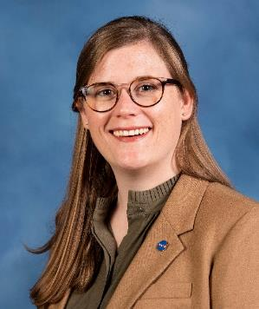
Mallory S. James
Mallory James is an Engineer at NASA Marshall Space Flight Center in Huntsville, Alabama. Currently on a developmental assignment to the Office of the Center Director, Mallory’s home role is supporting qualification and certification methodologies for AM spaceflight hardware. Her professional interests specifically include qualification considerations for multi-laser powder bed fusion systems and closed-loop adaptive AM processes, model-based tools for accelerated AM certification, and continuous process improvement in the MSFC AM Lab. Prior to joining NASA in summer 2021, she worked for the Department of Defense from 2010-2021 in various production and systems engineering roles at both Redstone Arsenal and Patuxent River Naval Air Station. She has a B.S. in Industrial and Systems Engineering from Auburn University and a M.S. in Human Factors in Aeronautics from Florida Tech.

Slide 3
Accelerating Additive Manufacturing Certification with Model-Based Tools
Institute Introduction
Motivation for the Institute
NASA Additive Manufacturing Overview
IMQCAM Overview and Research Areas
Impact of the Institute
Notes:
Everyone wants to use this technology but it is in its infancy,
As a Human Space Flight Center we were faced with the near term action of “ How can we trust and certify these parts?”

Slide 4


Institute for Model-based Qualification & Certification of Additive Manufacturing
NASA Space Technology Research Institute
IMQCAM
Co-Directors: A.D. (Tony) Rollett (CMU), PI & Somnath Ghosh (JHU)
Core Team: Sankaran Mahadevan, Caglar Oskay, Pranav M Karve (Vanderbilt); Jamie Guest, Jaafar El-Awady, Dave Elbert, Maggie Eminizer (JHU); Li Ma, Michael Presley, Steven Storck (JHU-APL), Harry Millwater (UTSA), Tao Sun (NWU), John Lewandowski (CWRU); Mohadeseh Mousavi-Taheri, Sneha Narra, Bryan Webler (CMU); David Furrer (P&W); Craig McClung (SwRI)
Other Partners: Lockheed Martin, Hexagon, NIST, NRL, ARL, Raytheon
Central goal: Innovate a model-centric workflow that closes the critical gaps between current capabilities and what is necessary for efficient qualification and certification of parts by metals additive manufacturing , meeting NASA standards.

Slide 5
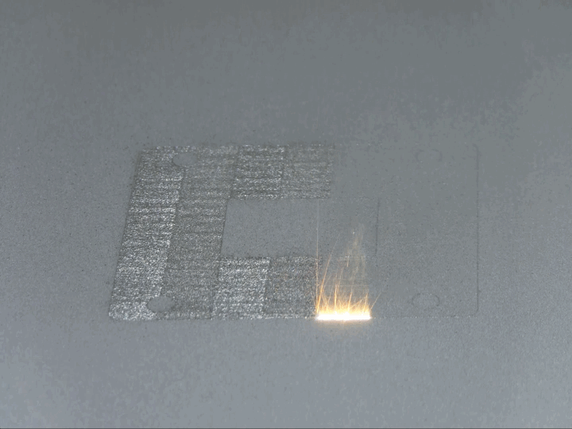
Motivation for the Institute
A new transformation of advanced AM technologies to build spaceflight hardware for NASA’s exploration missions is upon us.
This wave is enabled by dramatic changes in design and manufacturing paradigm brought about by AM.
However, many of the inherent benefits of digitally oriented AM are being negated by the cost and schedule of today’s all empirical development and certification cycles. [1]
The more we understand about the relationship between the central AM process, the material it produces and the way that the material performs, the better we can model it. In this way, ICME is a powerful tool to apply this process-structure-properties understanding to advance certification by analysis paradigms.
Credit: [2]
This effort will leverage digital twin technology to significantly decrease the resources needed in the current certification cycles further unlocking the value of AM.
[1] Vickers, J., AIAA Complex Aerospace Systems Exchange (CASE) Digital Twin Certification for Additive Manufacturing Discussion Paper
[2] NIST, https://www.nist.gov/el/lpbf-thermography

Slide 6



National Aeronautics and
Space Administration
Notes:
It’s an exciting time to be at NASA! We’re returning to the moon with Artemis II for a flyby and putting the first woman and first person of color on the lunar surface with Artemis III. These missions will help us learn as we prepare for the journey to Mars.

Slide 7

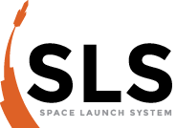
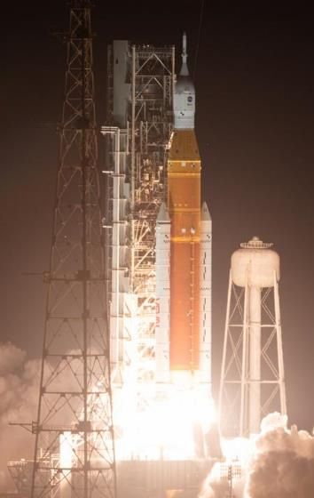
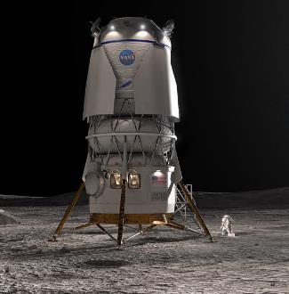

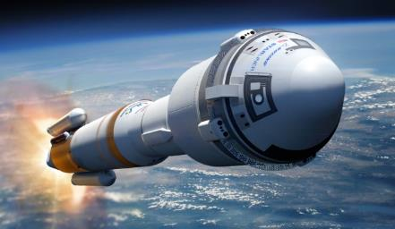
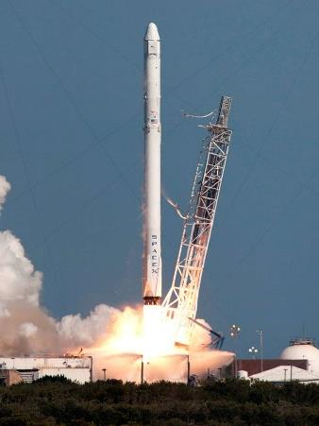
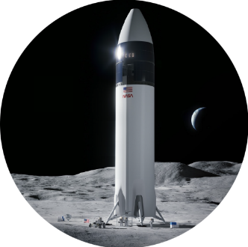
Additive Manufacturing at NASA
Additive Manufacturing is heavily leveraged on human-rated flight projects:
How do we trust and certify these parts?

Slide 8
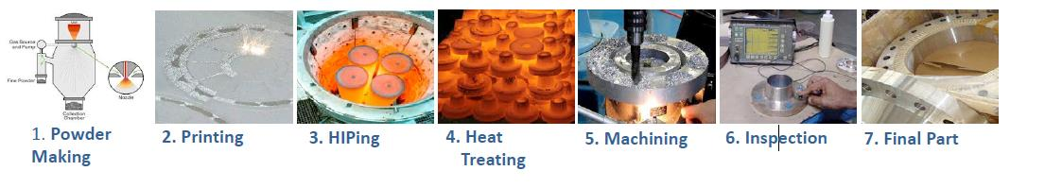
Today’s Certification Approach
Current approaches for certification rely heavily on trial-and-error where the outcomes from numerous combinations of parameters are evaluated experimentally.
Iteration may occur on a particular part build numerous times to “dial-in” the recipe.
Endless variations arise due to the sensitive nature of the metallurgical process and individual aspects of AM machines.
Once qualified, the AM process is not extensible, limiting the ability to make design or manufacturing changes.
Example Laser Powder Bed Fusion Process
Iteration required on Steps 2-6 to Mature/Qualify Part and Processes

Slide 9
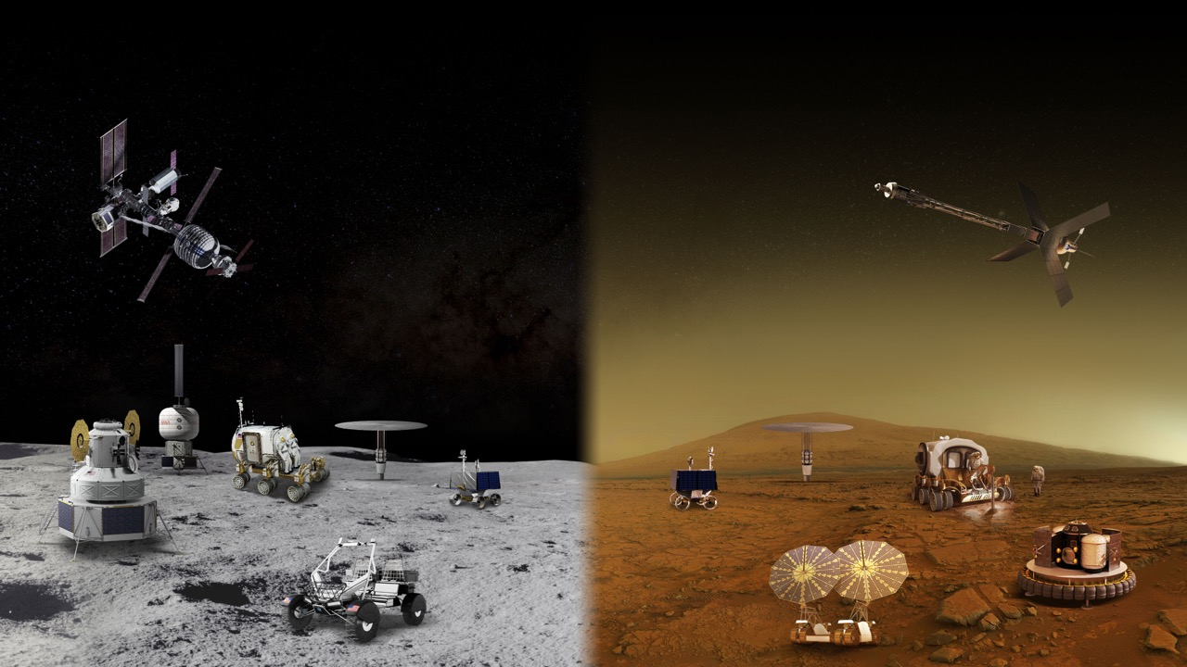

AM technology is demonstrating incredible benefits in wide-spread applications, design flexibility, affordability, schedule, performance, sustainability, and production on demand.
  Certification is the #1 challenge: complexity, unknowns, and delays are severely negating the benefits.
  Certification of remotely produced products is an unresolved technology gap.

Slide 10
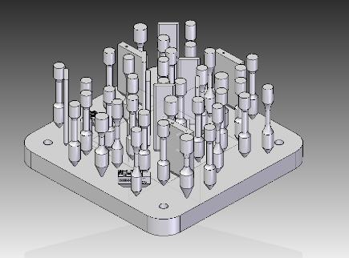
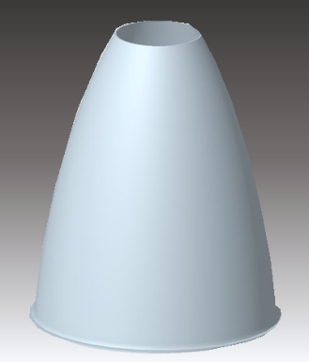
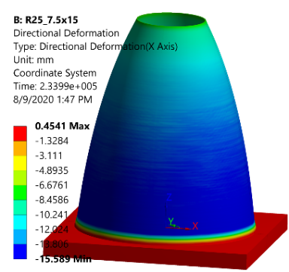
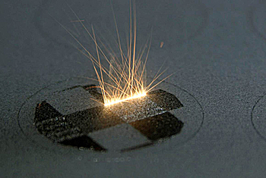
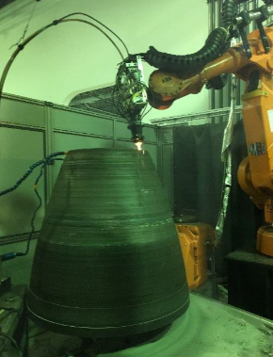
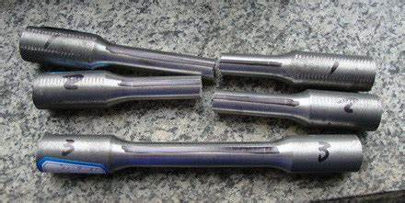
Why Modeling Matters
Design
Build
Test
Advancement of computational tools for certification enables a transition from Design-Build-Test paradigm to Design-Model-Build
Design
Model
Build
Credit: NIST
Ref: Kevin Wheeler / NASA Ames
Coupon-level material characterization work in a digital space enables component design, analysis, and certification faster and more affordably with fewer build iterations
Credit: iron-foundry.com

Slide 11
Institute Overview
What’s an STRI?
Long-term sustained investment in research and technology critical to NASA’s future. Highlights include:
Empowered university-led team
Specific research objectives with credible expected outcomes in 5 years
Talented, diverse, cross-disciplinary and fully integrated team
Low to mid TRL
Award Details
Expected duration: 5 years
Award amount up to $3M per year
Institutes expected (and empowered) to implement their own review internal processes
NASA oversight – annual reviews and brief quarterly status reports
Research Areas
A furthered understanding of materials-processes-structure-property relationships for AM through advanced computational toolsets coupled with innovative experiments, laying the foundation for accelerated product certification.
Development of uncertainty-quantified, physics-based models and simulations to understand the factors that can affect the formation, distribution, and the effects of process-induced defects and to address other principal sources of variability.
Integration and application of methodology, software tools, artificial intelligence (AI), machine learning (ML), and/or databases, etc., based on computational and experimental tools to a model-centric certification approach.

Slide 12
IMQCAM Goals
Develop a digital twin of metals additive manufacturing that comprises an integrated set of verified, experimentally-validated, uncertainty-quantified computational models and simulation & design tools that will mirror the entire materials-processes-structure-property performance and life linkage in metal AM
Demonstrated for at least two materials, Ti-6Al-4V and In718
Evaluated by multiple companies against their own data, i.e., third-party validation
Adoption of IMQCAM models by partner OEMs

Slide 13
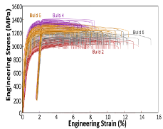
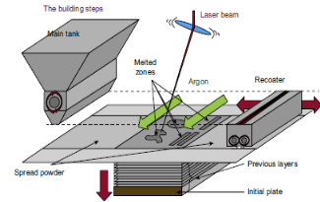
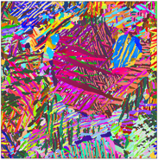
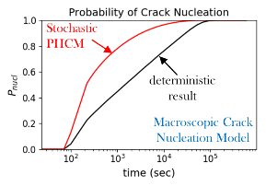
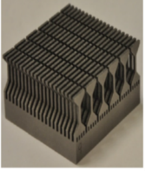
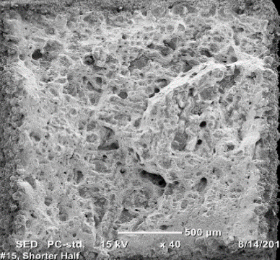
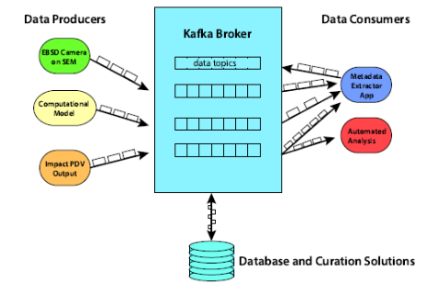
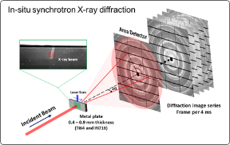
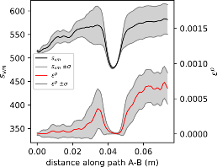
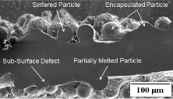
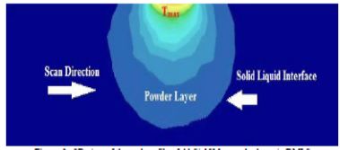
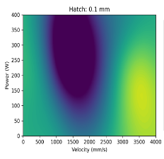
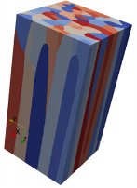
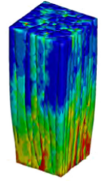
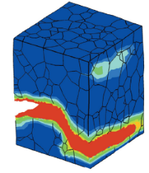
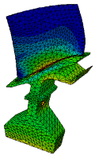
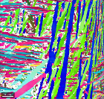
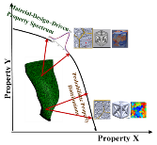
Task I: Processing, Testing, Modeling, Simulation and Design
Module IA
AM Processing, Fabrication, Design
Module IB
Microstructure & Defect Characterization
Module IC
Component Testing
Module I: Physical Asset
Uncertainty Quantification, Verification & Validation
Data Pipeline
Module IIA
Process Models (Detailed & Rough Order)
Module IIB
Micromechanical Characterization & Modeling
Module IIC
Multiscale Models Fatigue (PUCM); Component-Microstructure Design
Module II: Digital Twin
Notes:
Module IA: Process, Component/Specimens
Module IB: αλπηα laths in Ti6Al, Porosity Distribution/Surface roughness
Module IC: Fatigue testing, Strain to failure
Module IIA: Porosity profile, thermal profile
Module IIB: Synthetic β grains CPFEM simulation Crack propagation
Module IIC: Microstructure, Component, Design

Slide 14



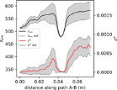
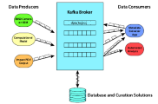



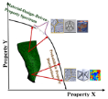
Task II: Qualification, Certification, and Translation
Task I: Processing, Testing, Modeling, Simulation and Design
Module I
Data Coordination & Dissemination
Software Coordination & Dissemination
Module II
Qualification/Certification
Using Experimental & Simulation Data
Module III
Translation
NASA Centers
Software Coordination
Industry/OEMs

Slide 15



Impact of the Institute
Traditional Experimental AM Certification
New Computational AM Certification
STRI
Cost savings from model-based tools
Material Characterization
Witness Testing Approach
Establish Process Control Factors
Post-processing Requirements
NDE Techniques
Modeled Sources of Variability
Effects of Defects and Surface Roughness
Design Materials for their Intended Usage
Dependence of Performance on Processing
Build Failure Prediction
Stress and Heat Simulation
AI/ML Tools for Process Control
Computational Materials Enables Extensibility
Notes:
Impact of the institute

Slide 16
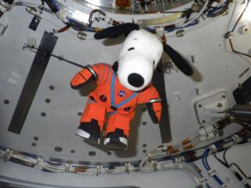
Questions?

