Slide 1

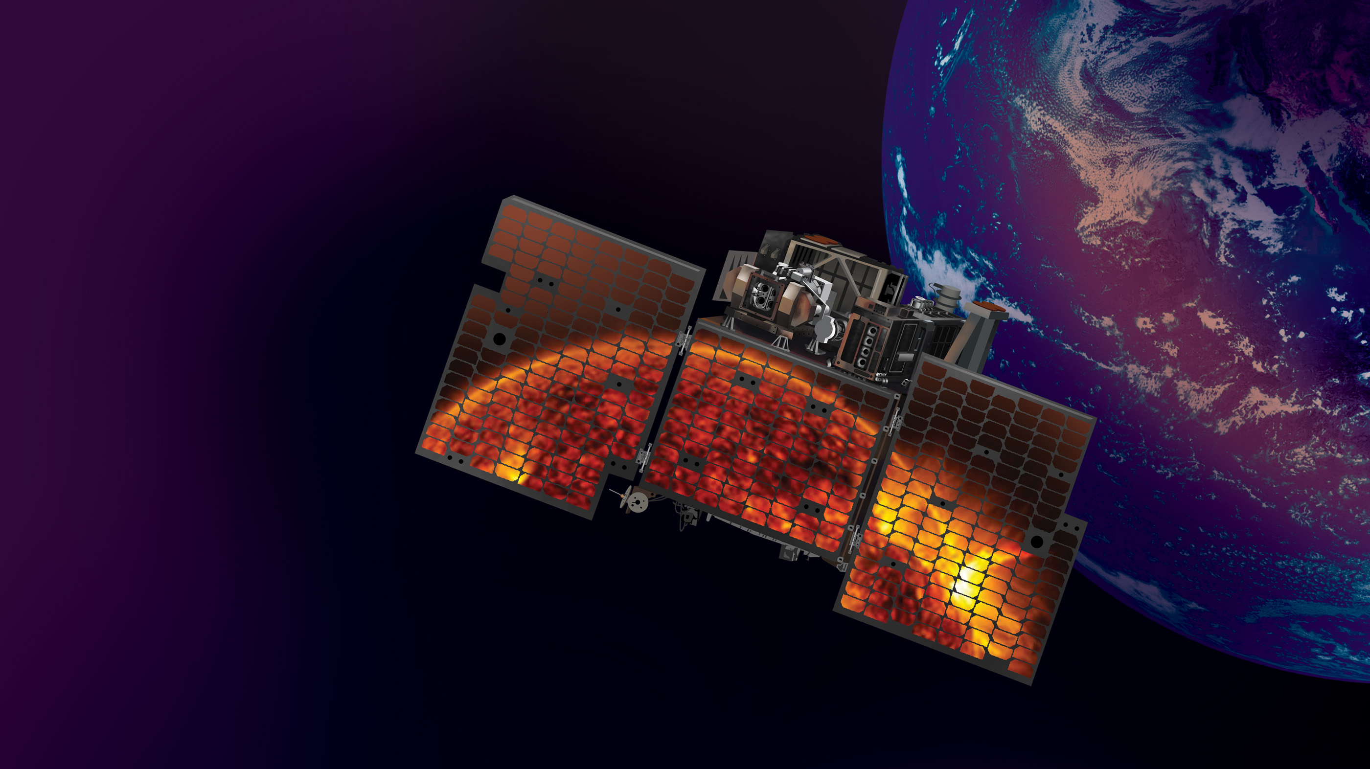


TSIS-2 Mission Status
Susan Breon¹, Ron Hooker¹, Dong Wu¹,
Doug Rabin¹, Jae Lee²
¹NASA Goddard Space Flight Center
²University of Maryland Baltimore County
SPACE FLIGHT CENTER

Slide 2
TSIS-2
The Total and Spectral Solar Irradiance sensor – 2 (TSIS-2) mission was approved to begin formulation in March 2019.
TSIS-2 was approved to continue into Phase C development in May 2022 with a launch date of February 2025
Mission Objectives
  Acquire total solar irradiance (TSI) and spectral solar irradiance (SSI) measurements to determine the direct and indirect effects of solar radiation on climate
  Extend a >44-year uninterrupted measurement record of TSI and >20-year record of SSI beyond ISS/TSIS-1
    Maintaining solar irradiance data continuity is one of the “Most Important” objectives in the 2017 Decadal Survey
    Overlapping TSIS-2 with TSIS-1 is a high priority in NASA Earth Science Division mission development
    ISS/TSIS-1 mission was recently extended to 2026 following Senior Review
  Provide accurate SSI measurements for better understanding of wavelength-dependent solar energy deposition in Earth’s atmosphere and surface

Slide 3
Level 1 Science Requirements
Science requirements were derived to reflect on-orbit performance of TSIS-1
Provide continuity of TSI measurements and maximize the chance of overlap and intercomparison with existing on-orbit climate sensors
  TSI requires 3-month minimum overlap with TSIS-1 with a goal of 6 months
  SSI requires 6-month minimum overlap with TSIS-1 with a goal of 12 months
Put all measurements that make up the record on the same calibration scale
Parameter | TSI Requirement |  | SSI Requirement
 | Baseline | Threshold | Baseline | Threshold
Spectral Range | Total Integrated Spectrum |  | 200 – 2400 nm
Accuracy | ≤200 ppm | ≤350 ppm | ≤1.0% (200 – 400 nm) ≤0.5% (>400 nm) | ≤1.0% (over full spectral range)
Stability | ≤10 ppm/yr | ≤20 ppm/yr | ≤0.05%/yr (<400 nm) ≤0.01%/yr (>400 nm) | ≤0.1%/yr (<400 nm) ≤0.02%/yr (>400 nm)
Spectral Resolution | Not Applicable |  | ≤2 nm (<280 nm) ≤5 nm (280 – 400 nm) ≤45 nm (>400 nm)
Reporting Frequency | 4 six-hourly averages per day |  | 2 spectra per day, sampled every 12 hours
NOTE: 1 ppm – 0.0001%

Slide 4
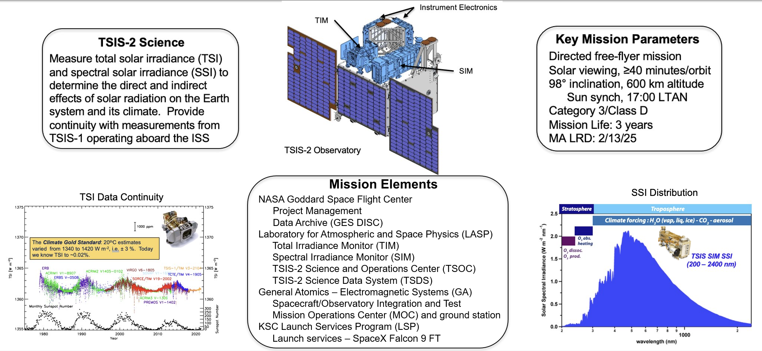
Mission Overview

Slide 5
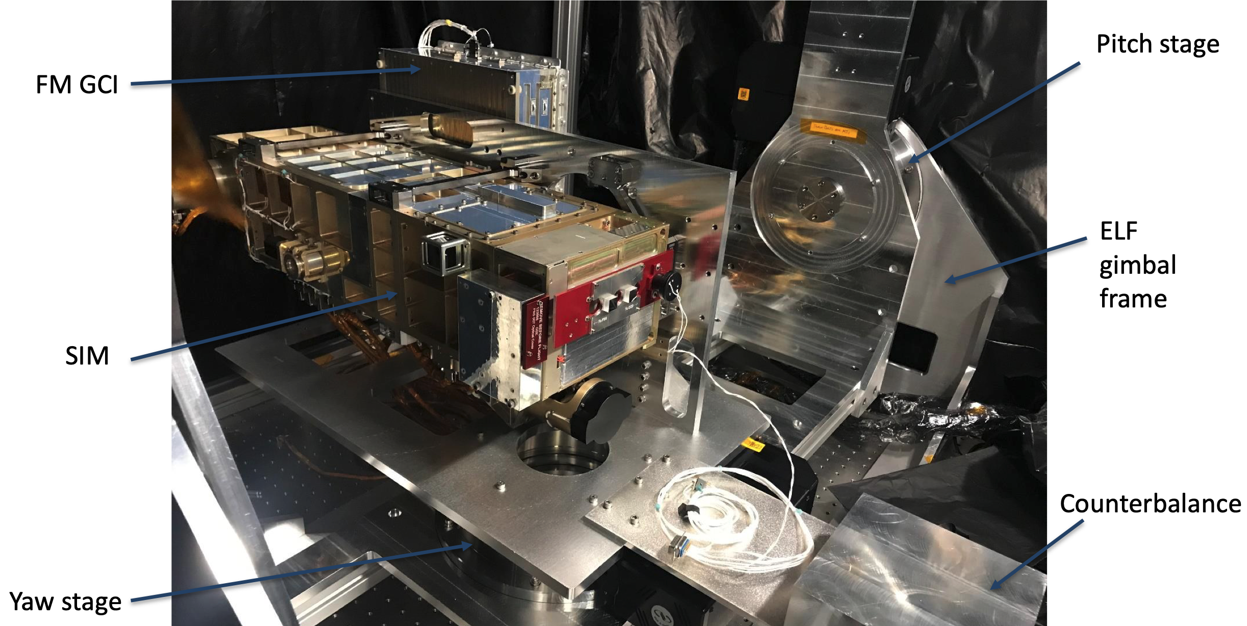
SIM Status
Spectral Irradiance Monitor (SIM)
Assembly, integration, and test is complete
Calibration data is being processed
  Performance is expected to meet requirements
In storage pending delivery to the spacecraft
  Undergoing monthly health checks

Slide 6
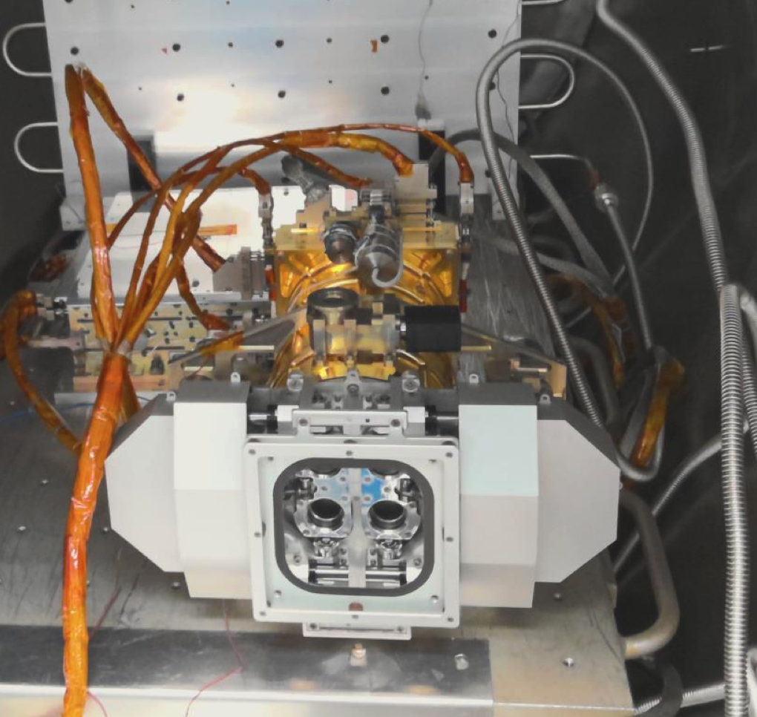
TIM Status
Total Irradiance Monitor (TIM)
Reassembly complete following replacement of cones
  Cone C heater wire shorted during TVAC testing
Regression test underway
  Vibration testing complete
  TVAC in process
Performance will be verified in the TRF prior to storage for delivery to spacecraft integration

Slide 7
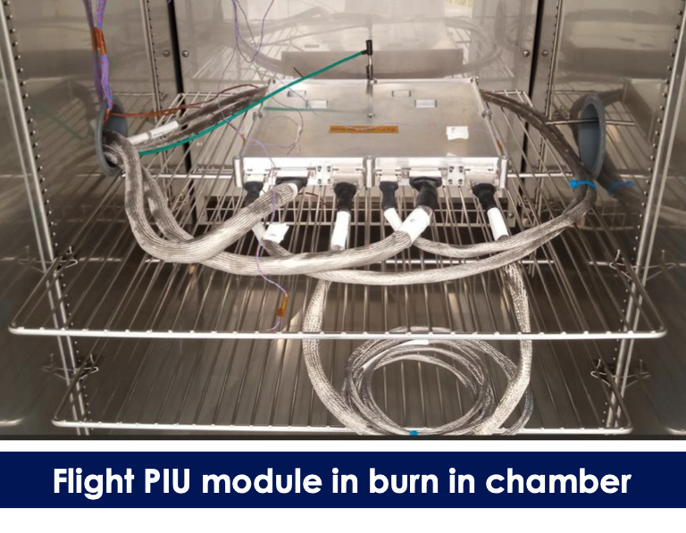
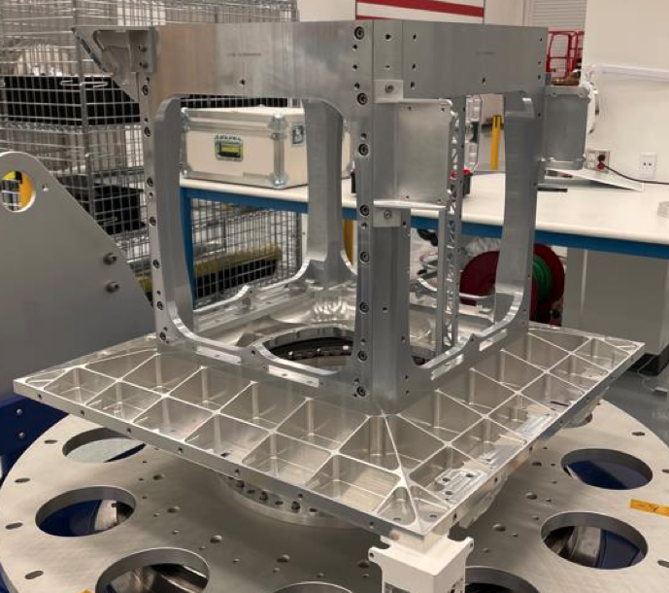
Spacecraft Status
Spacecraft
Initial structural assembly complete awaiting avionics modules
SSTL-provided modules scheduled to ship mid-October
GA-provided modules in test
  On-Board Computer – ready for integration
  Payload Interface Unit – completing environmental test
  Active Safety Module – beginning environmental test
Instrument integration expected ~ March 2024
Launch Readiness Date – February 2025

Slide 8
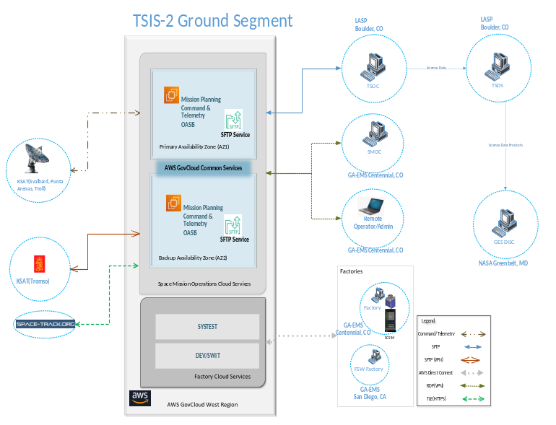
Ground System Status
Ground System
Satellite Mission Operations Center (SMOC) is managed by GA
  Hosted in AWS Cloud
  Ground station provided by KSAT
  Authorization to Operate (ATO) expected summer 2024
TSIS-2 Science Operations Center (TSOC) and TSIS-2 Science Data System (TSDS) managed and hosted at LASP

Slide 9
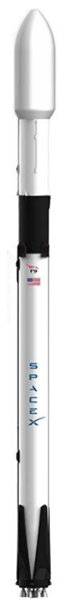
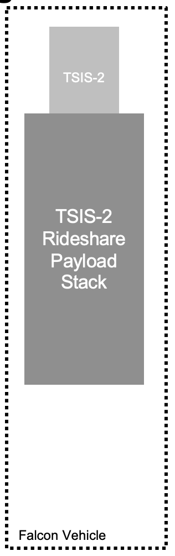
Launch Vehicle Status
Launch Vehicle
SpaceX selected under KSC’s Venture-Class Acquisition of Dedicated and Rideshare Services (VADR) contract
Developing Interface Control Document (LVICD)
  NASA controls launch date
  Cake-topper location—SpaceX can sell additional space available to Rideshare customers
  Launch location – Vandenberg (TBC)
Mission System Design Review planned for December 2023

