Slide 1
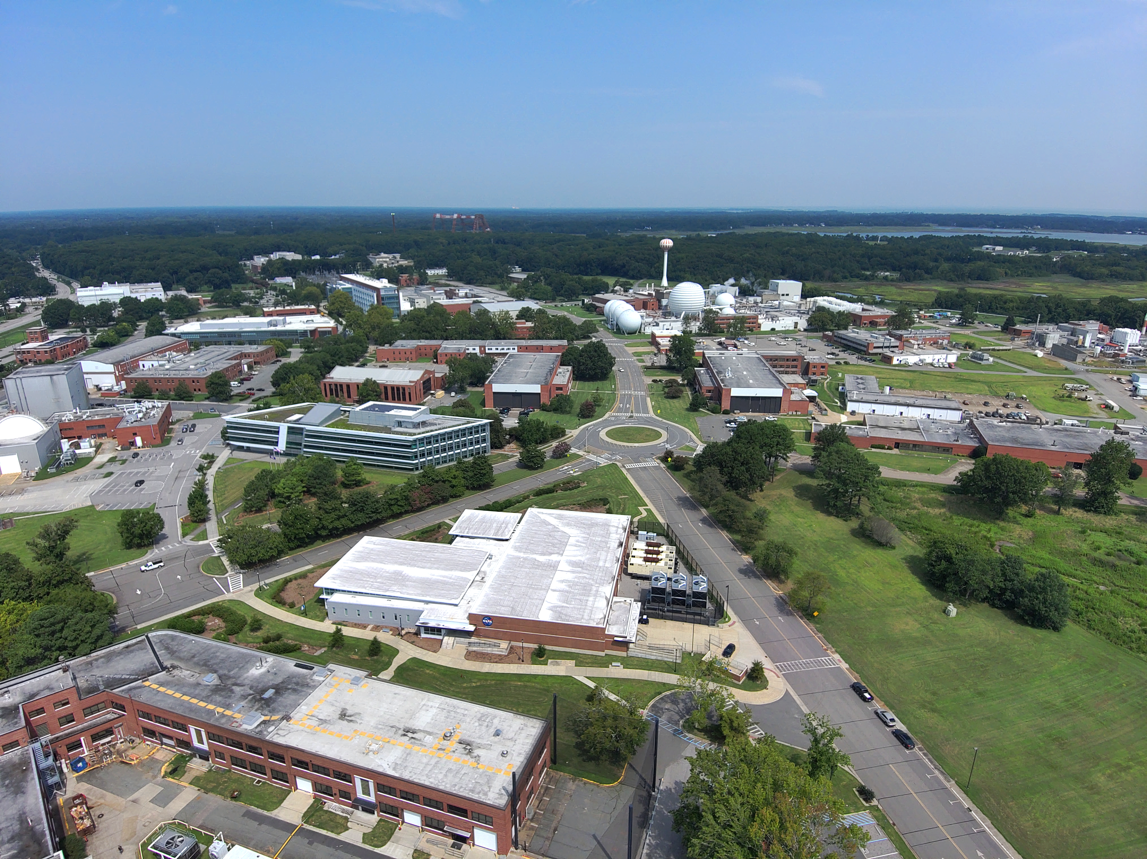

NASA Langley Research Center: Enabling Smart Cities Through Technology

Slide 2
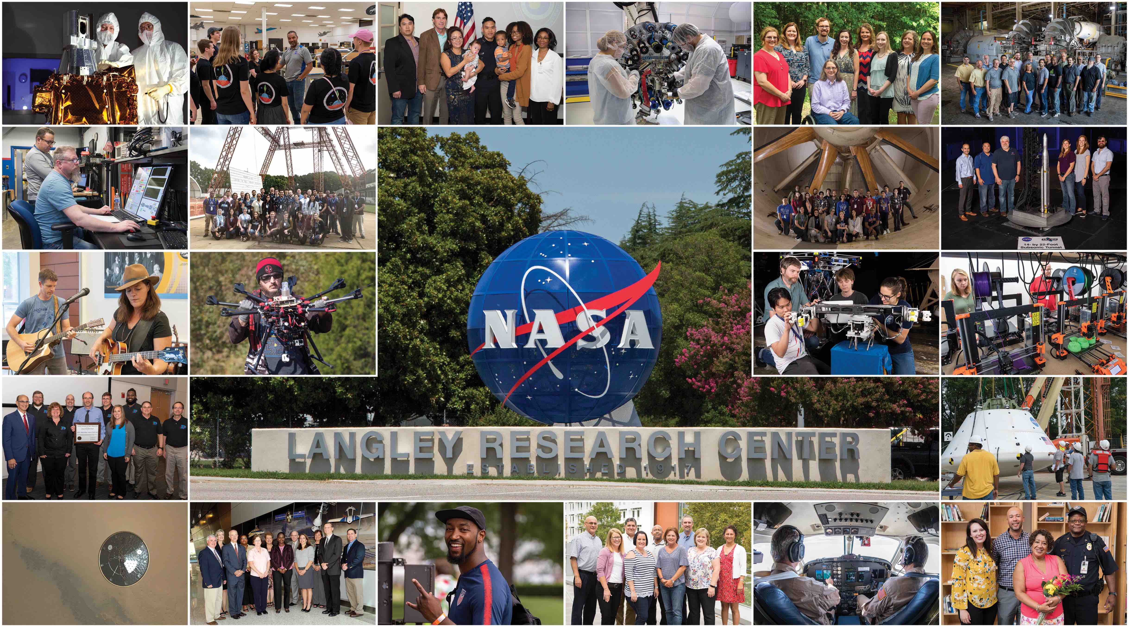

Slide 3
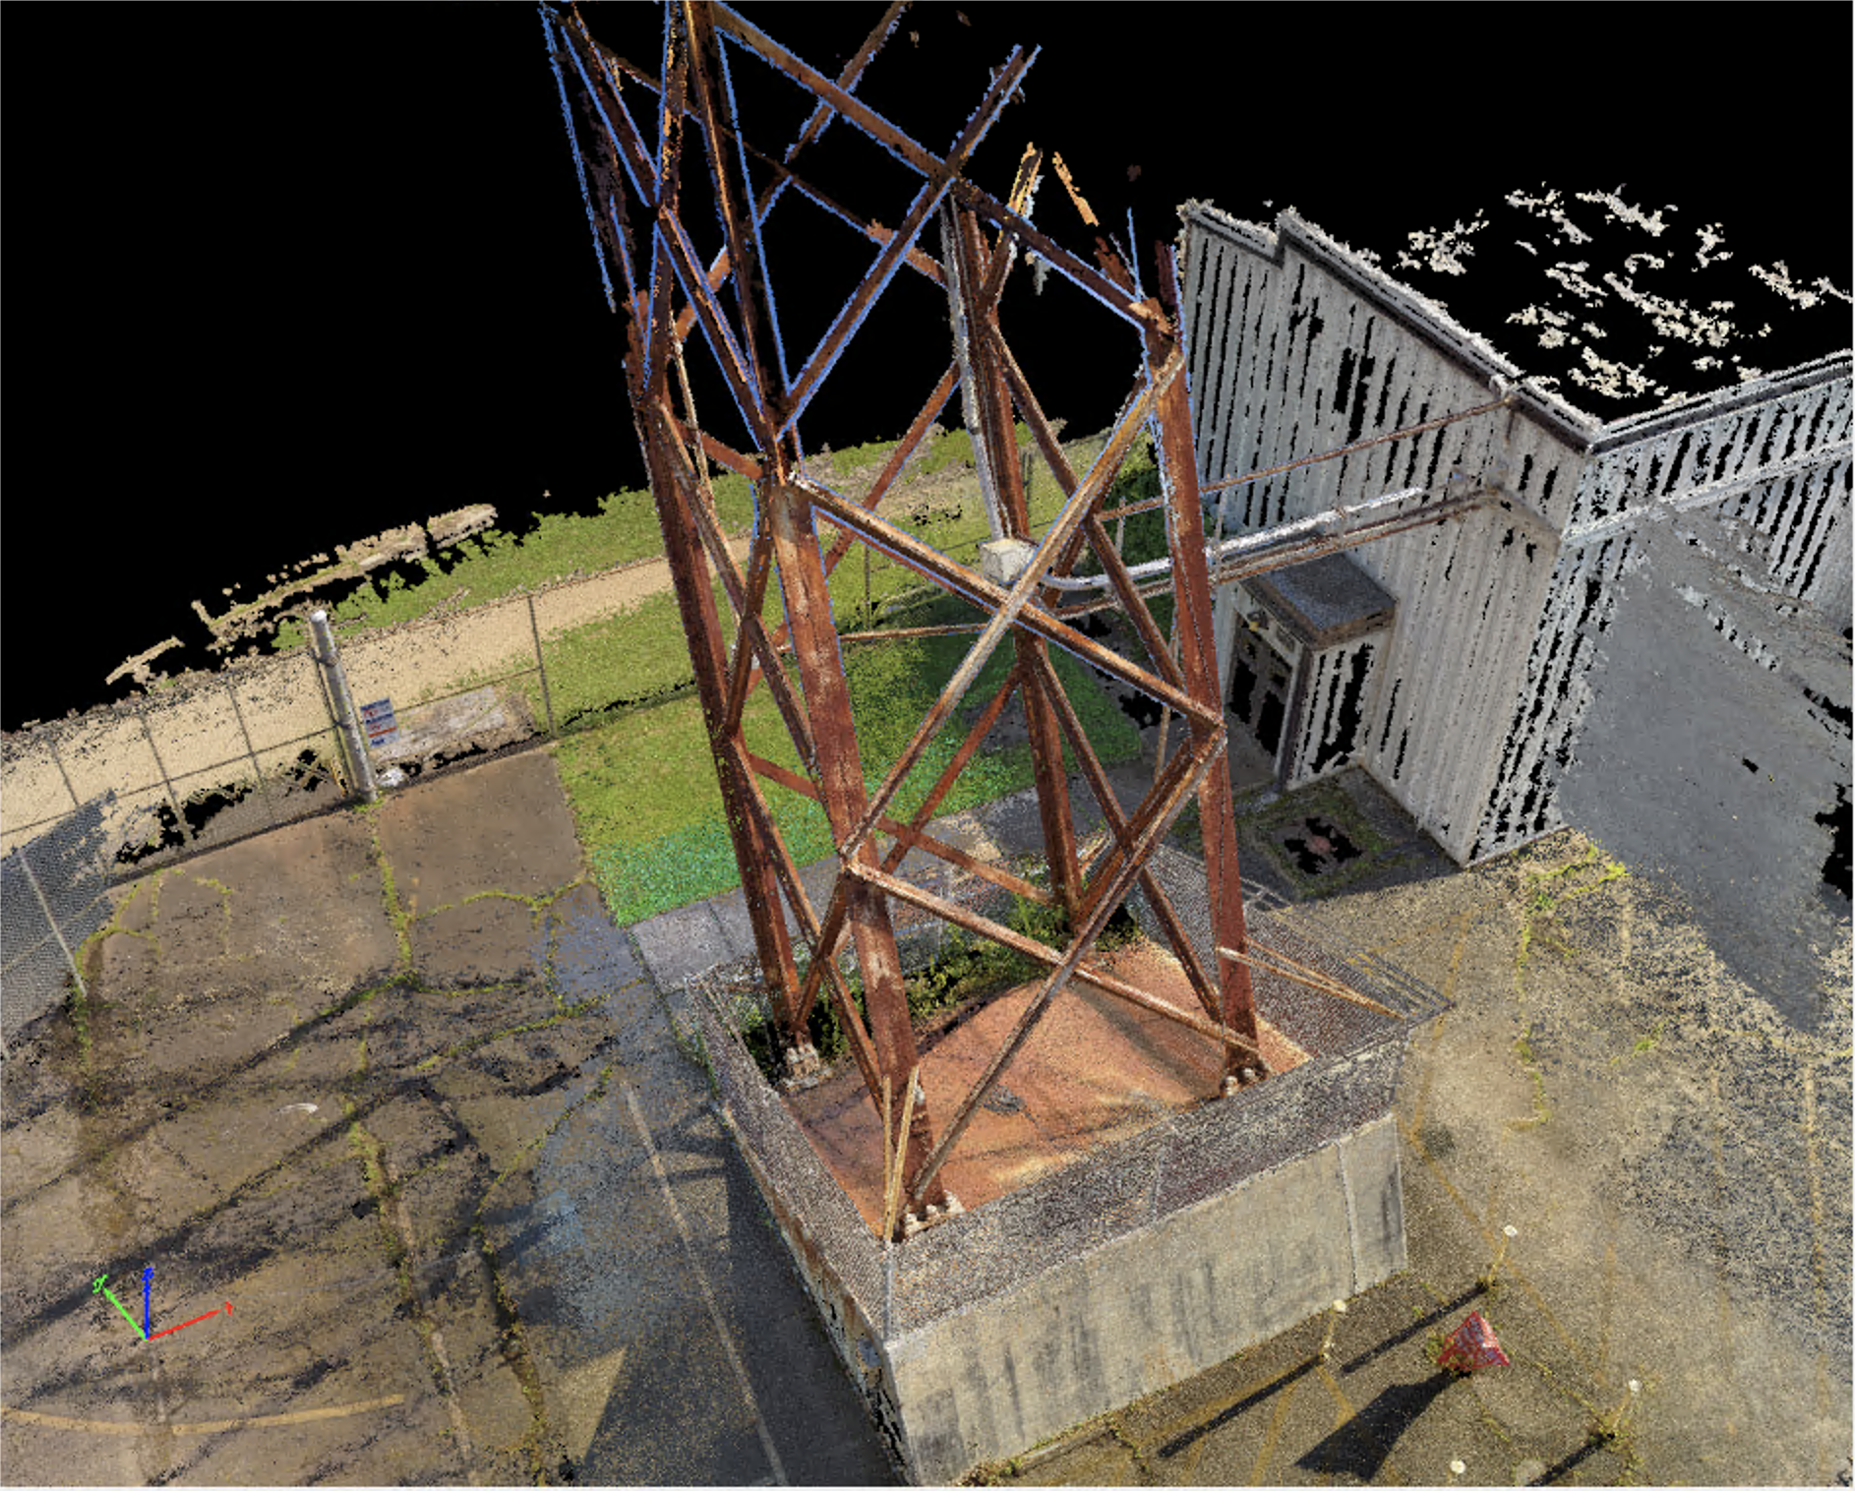
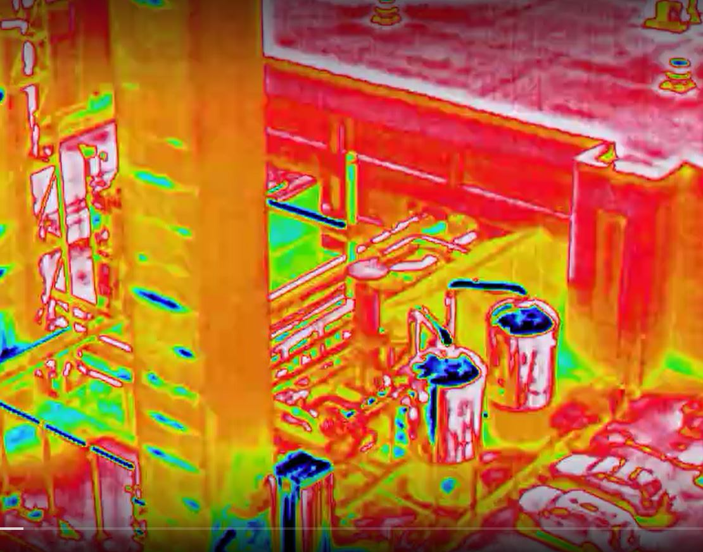
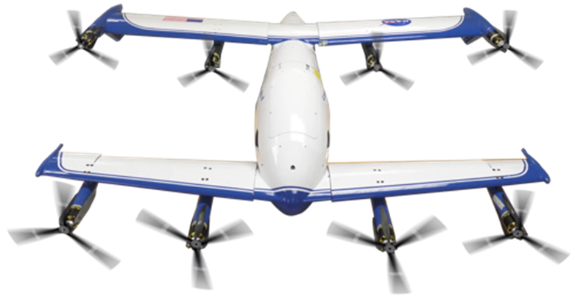
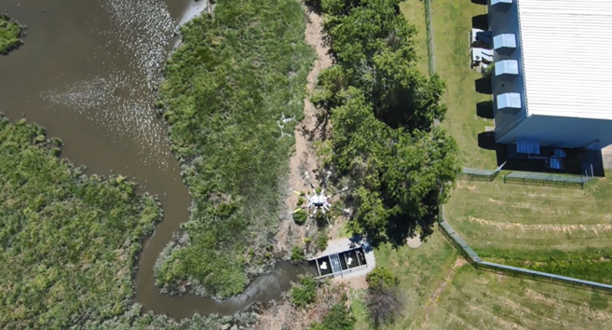
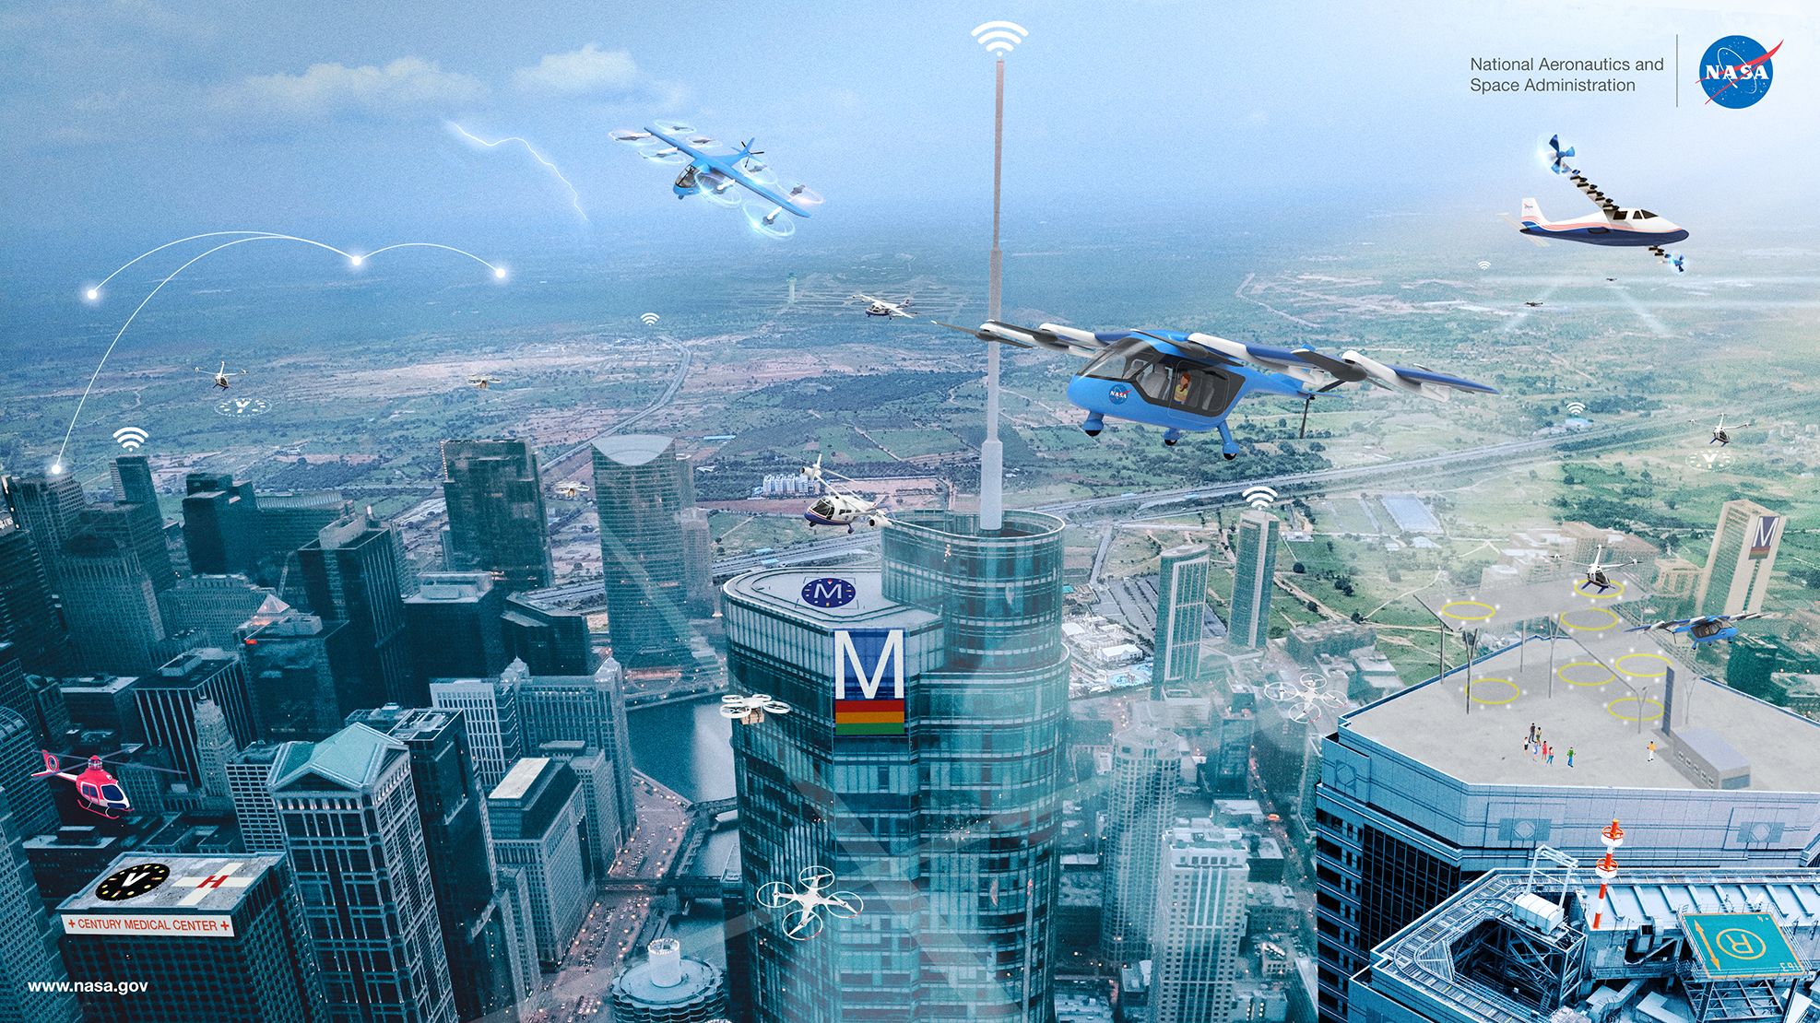
Langley Smart Center – Aero Enabled Campus
  Improving Safety
  Using autonomous sUAS to safely and efficiently gather high-resolution photogrammetry scans of large structures.
  Lowering Maintenance Costs
  Correlating visual and Infrared scans of plant equipment with real-time operational data to quickly determine anomalies
  Assessing Environmental Impacts
  Using sUAS to gather data that can leverage AI to assess and track changes in our environment
  Partnering with Industry, Academia, and Government Working within the technological ecosystem to help shape the future of Advances Air Mobility

Slide 4
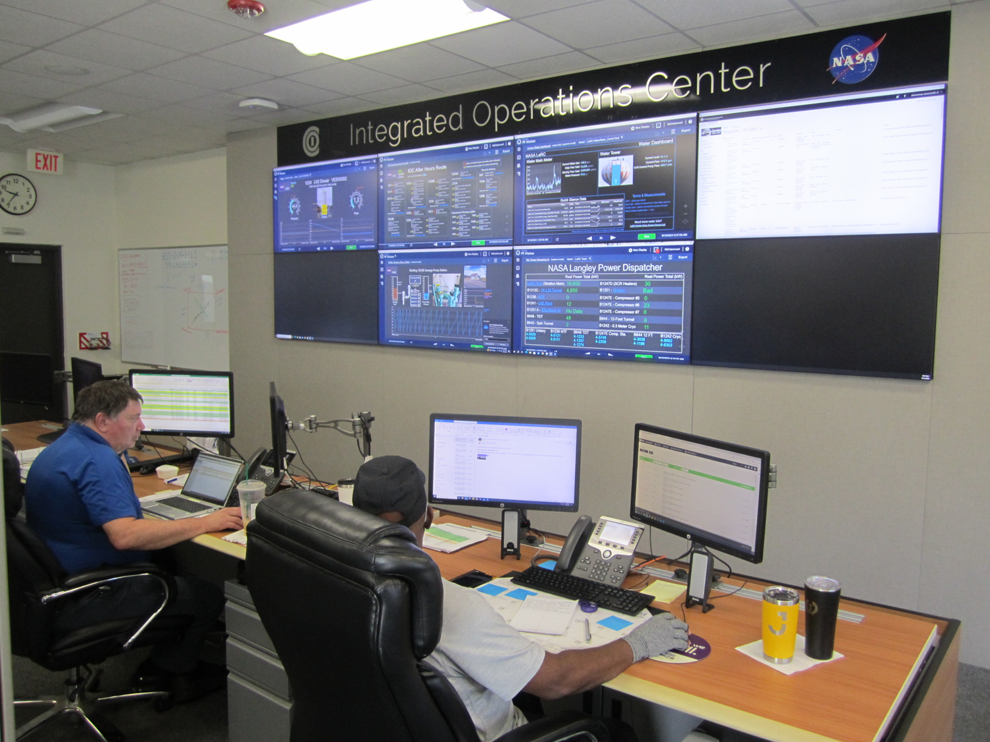
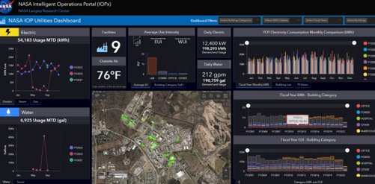
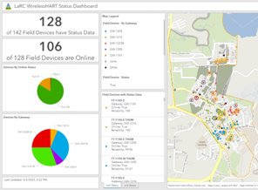
Langley Modern Operations and Maintenance with a Smart Infrastructure
LaRC Smart Infrastructure Vision and Strategy
  Transform LaRC into a Smart Center of Excellence through the development of networked, integrated information processing systems to enhance user interactions, automation, capability, and efficiency.
Integrated Operations Center (IOC)
  IT framework for managing BAS alarms and response for center infrastructure
Operational Technology / GIS Integration to support visualization and analysis
  Intelligent Operations Portal
  WirelessHART Network Status Dashboard
Integration of UAS into M&O to limit safety risk of inspecting high or hard to access equipment.

Slide 5
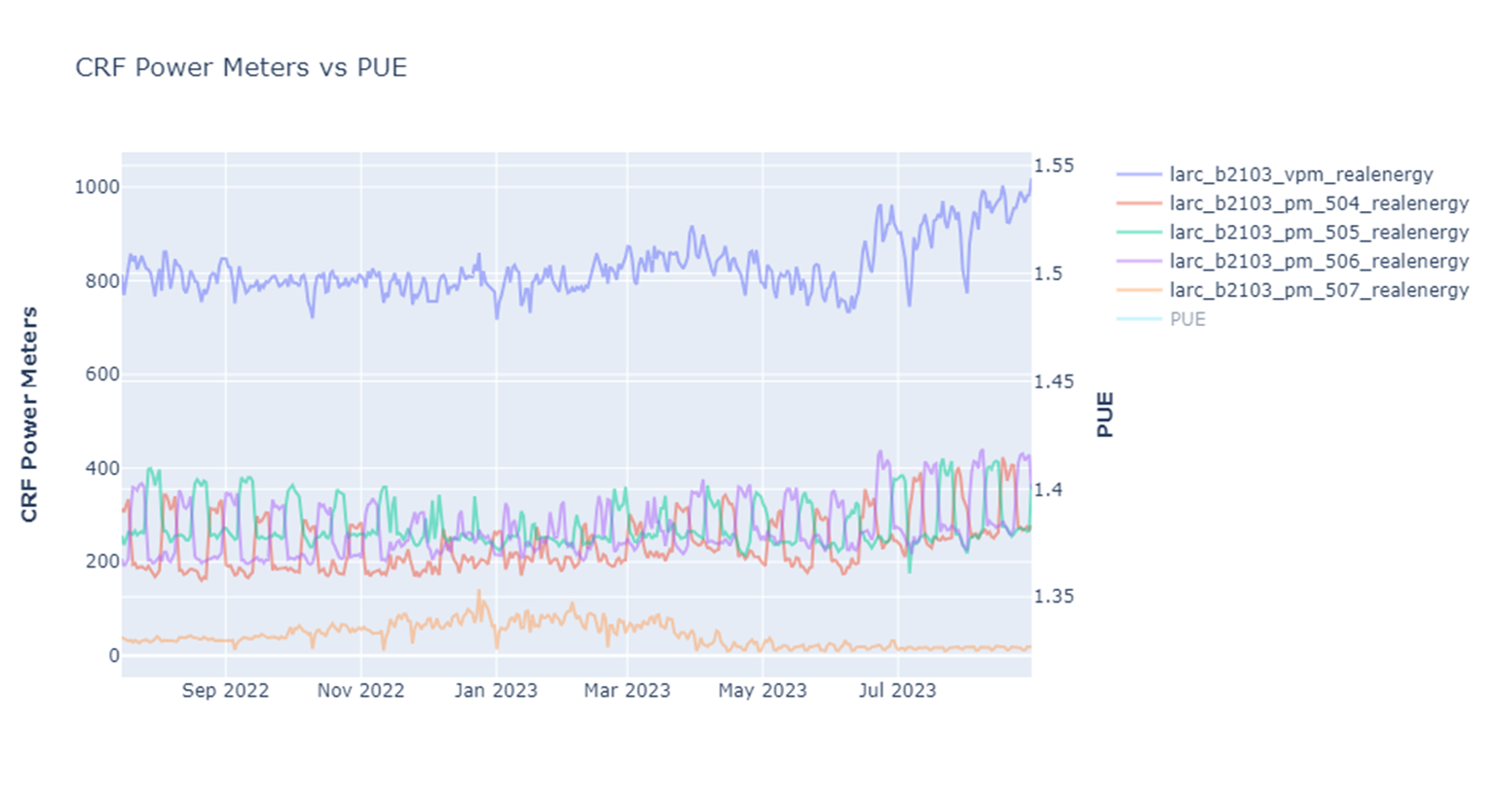
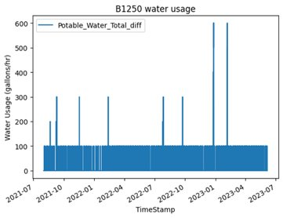
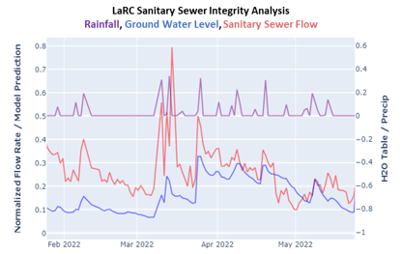
Examples of applying data science and data driven decision making to optimize our M&O:
  Computational Research Facility Power Usage Effectiveness
    Longterm, sub-metered analysis of datacenter energy usage to assess and improve efficiency
  High water usage anomaly detection to reduce high unintended usage
  Sanitary sewer inflow and infiltration correlation analysis with rainfall and water table to inform replacement strategy

Slide 6
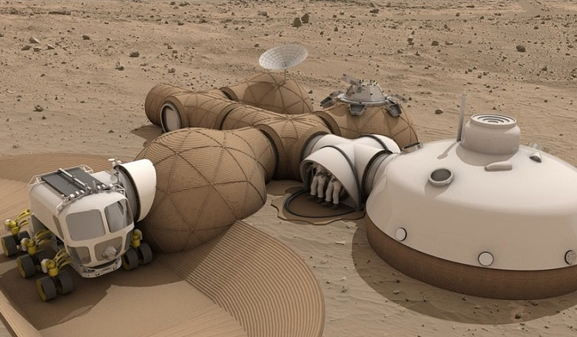
Smart Outpost Tech Enables Deep Space Exploration

Slide 7
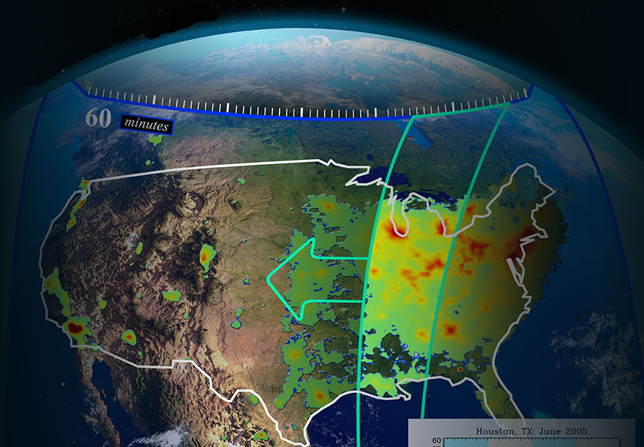

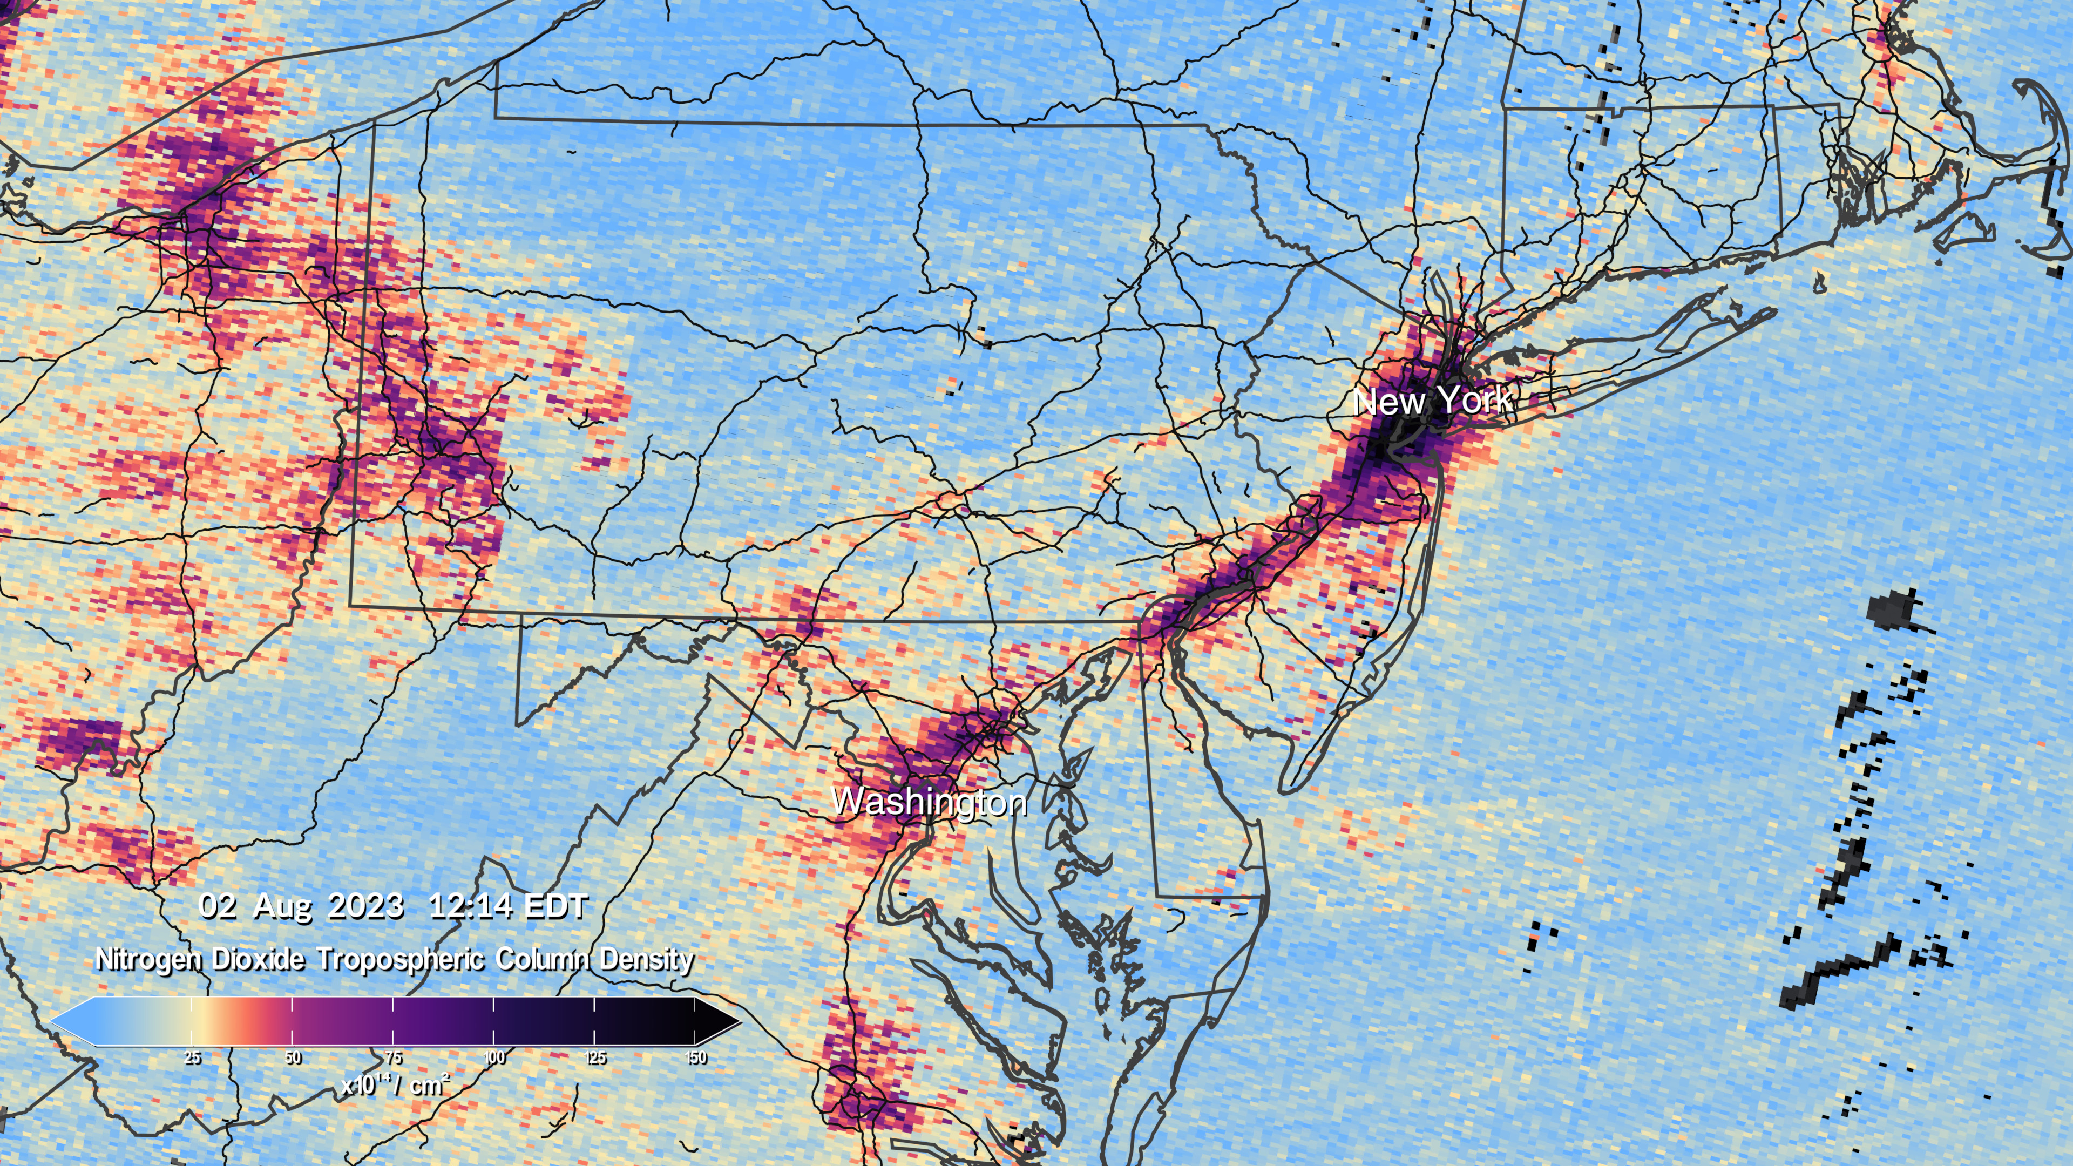
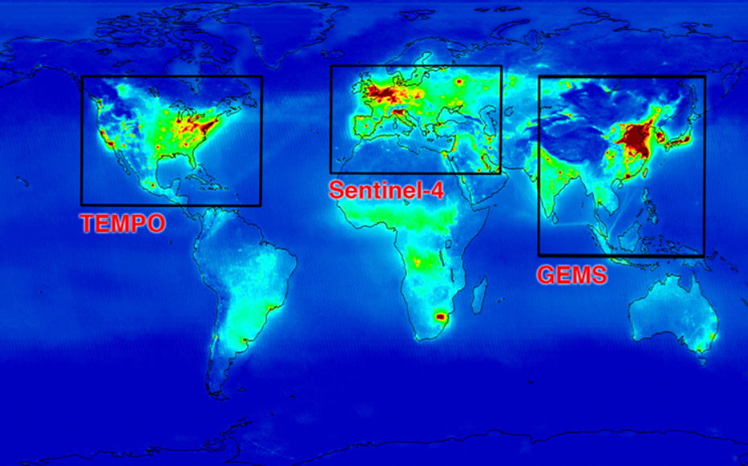
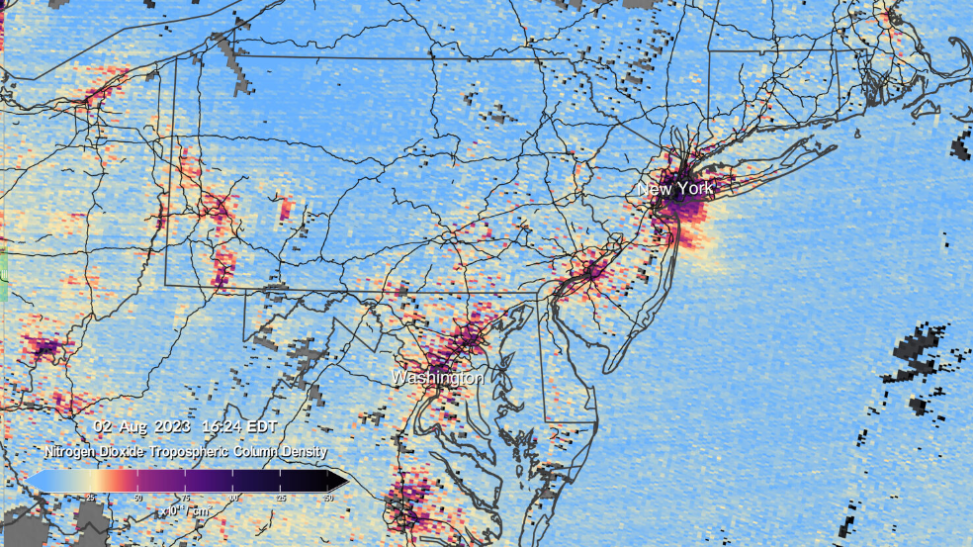
TEMPO Tropospheric Emissions Monitoring Of Pollution
Notes:
From its orbit 22,000 miles above the equator, NASA’s TEMPO, or Tropospheric Emissions: Monitoring of Pollution, is the first space-based instrument designed to continuously measure air quality above North America with the resolution of a few square miles. TEMPO is beginning to measure hourly daytime air pollution over greater North America. It measures ozone, nitrogen dioxide, formaldehyde, aerosols, water vapor, and several trace gases. Observations by TEMPO will significantly improve studies of pollution caused by rush-hour traffic, the movement of smoke and ash from forest fires and volcanoes, and the effects of fertilizer application on farmland.
TEMPO will be the North American component of a global group of satellites tracking air pollution from geosynchronous orbit.
TEMPO data will help scientists evaluate the health impacts of pollutants and aid in the creation of air pollution maps at the neighborhood scale, improving understanding of disparities in air quality within a community. Data will be shared with partner agencies that monitor and forecast air quality, such as the Environmental Protection Agency and the National Oceanic and Atmospheric Administration.
Images taken Aug 2, Top@ 1214 EST, Bottom @1624 EST

Slide 8

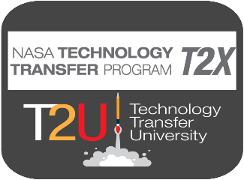


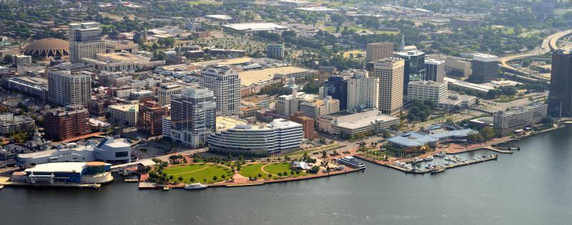

Partnering with NASA
Agreements Team
Facilitates agreement mechanisms with partners to advance NASA missions and provide access to NASA’s facilities, technical expertise, and resources.
Regional Partnerships
Connects with local industry, investor communities, academia, and state officials to increase NASA’s impact and influence in the region.
NASA Technology Transfer
Ensures that research conducted for NASA missions are made available to the public for commercialization.
T2U
Accelerates commercialization through entrepreneurship-focused partnerships and initiatives to launch and sustain startups.
SBIR / STTR Program
Provides funding for small businesses to engage in federal R&D projects with commercial potential.

Slide 9
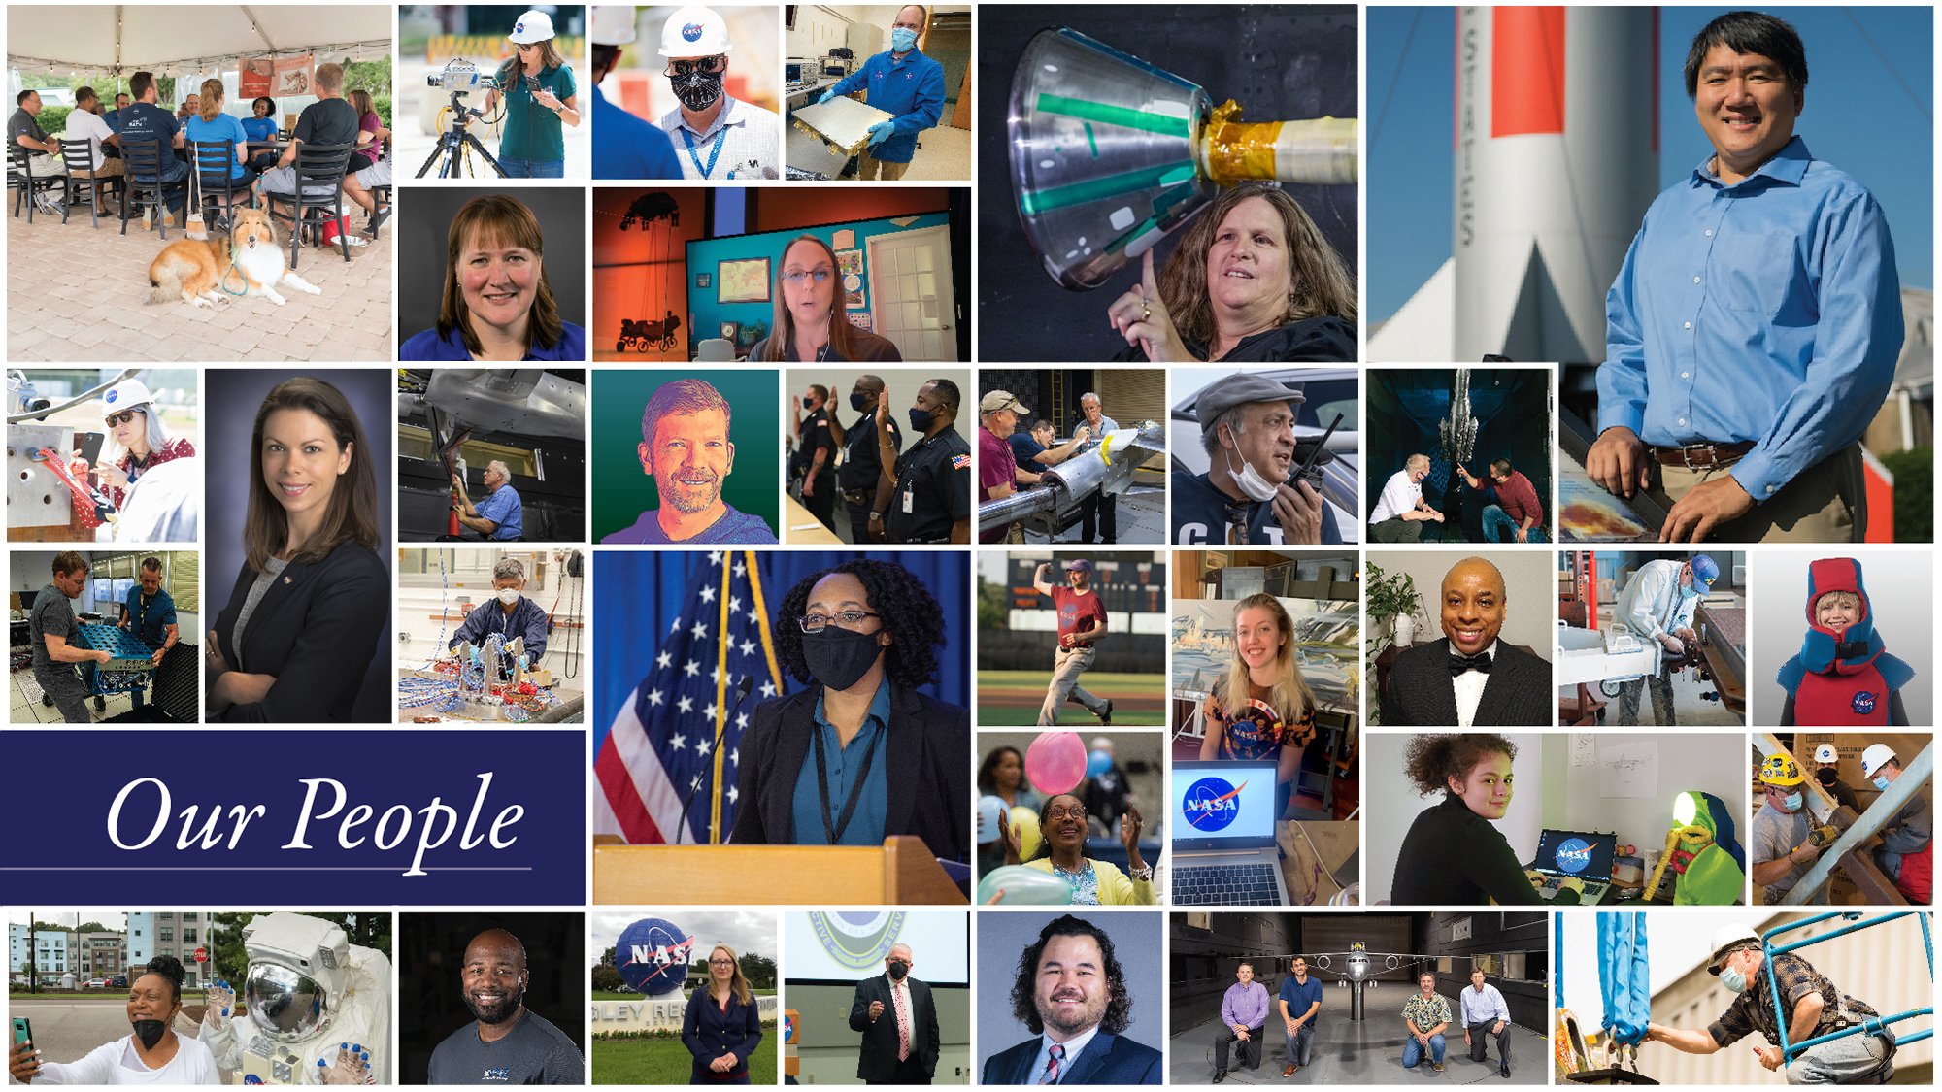
Together, We Discover

