Slide 1




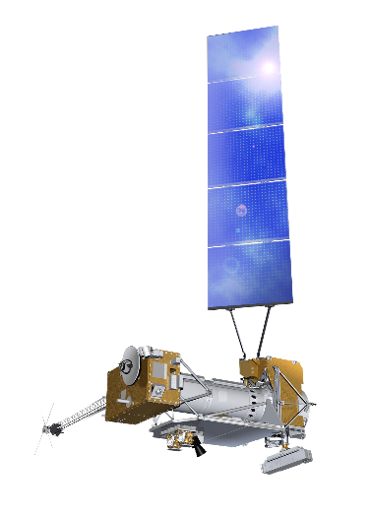
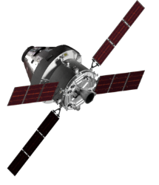
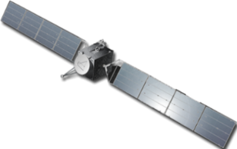

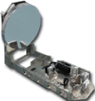

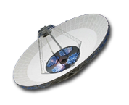
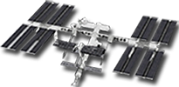
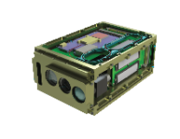
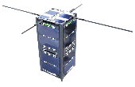

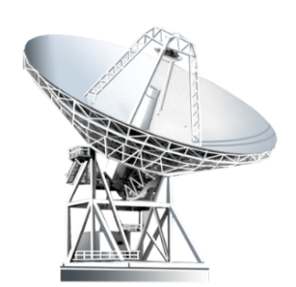




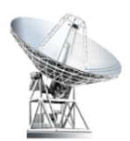
Optical Risk Reduction: Building Blocks
From Near Space
To Deep Space
LCRD
O2O
1.244 Gbps
Optical Relay
(622 Mbps RF down)
Lunar: 250/20 Mbps
(Gen2 Rates)
DSOC Gen-1 User Terminal
DSOC on Discovery Psyche Asteroid Mission
267 Mbps / 1.6 kbps maximum
1 Mbps @ 2.6 AU to Palomar
~2 Mbps @ 2.6 AU w/ RF/optical
ILLUMA-T on ISS
Lunar Relay
1.244 Gbps / 155 Mbps Relay User (ISS)
Coherent optical
5+/1 Gbps
RF/Optical Hybrid Antenna
TBIRD
Integrate 8-m optical aperture into a DSN 34m Beam Waveguide antenna
3U CubeSat Payload
2TB On-board Storage
200 Gbps LEO to Earth
LCRD
2021-12-07
TBIRD
2022-05-25
ILLUMA-T
2023-11-01
(planned)
O2O
2024 (Artemis II)
Lunar Relay
TBD
Psyche/DSOC Optical User Terminal
2023-10-12 (planned)
Advanced DSOC Optical User Terminal (2026+)
PSC73_092419 (20231010a)
Notes:
Laser Comm Relay Demonstration (LCRD) Terminal
Integrated LCRD LEO User Modem and Amplifier Terminal (ILLUMA-T)
TeraByte InfraRed Delivery (TBIRD)
Optical To Orion (O2O)
Deep-Space Optical Comm (DSOC)
Note that Lunar Relay RFP does not preclude vendor solutions involving optical, but it was not explicitly requested

