Slide 1
Ocean and Earth System Modelling
Dan Whitt, Research Scientist
2015 PhD, Stanford, Earth System Science
Earth system modeler and Interdisciplinary Oceanographer
Publications and projects: danielwhitt.github.io
Contact: daniel.b.whitt@nasa.gov

Slide 2
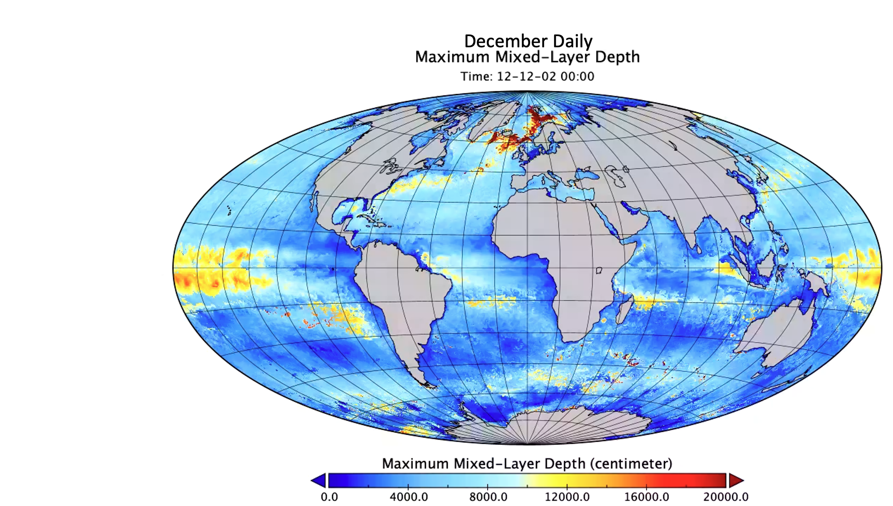
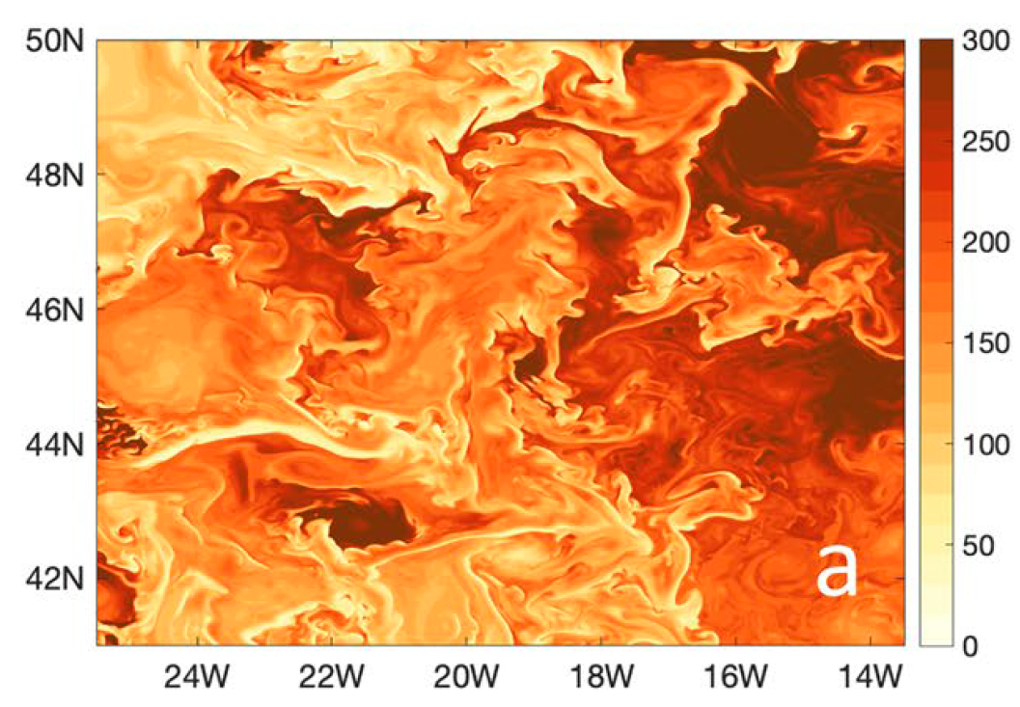
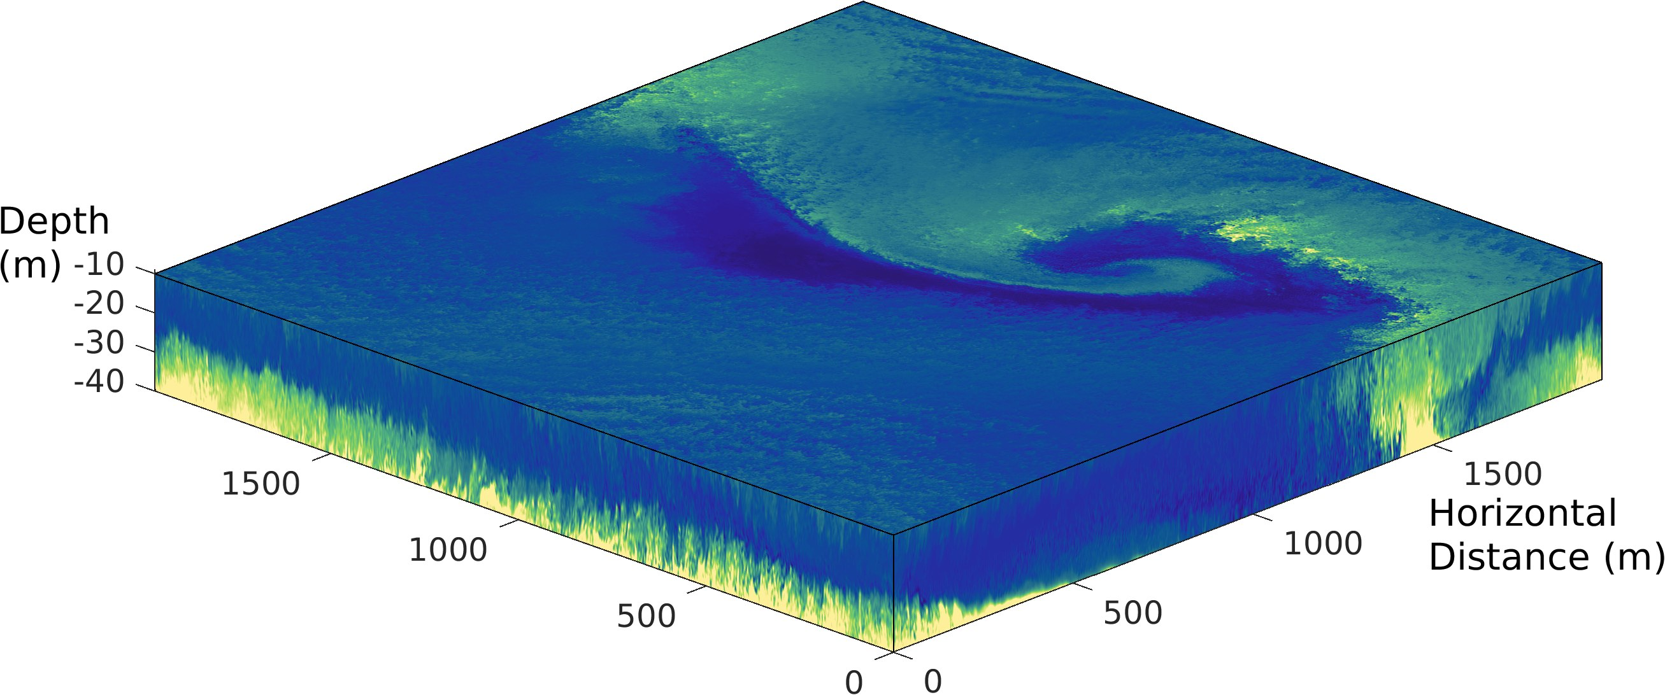
Ocean and Earth System Modelling: general capabilities
  Petascale supercomputing infrastructure + modelling and analysis capabilities + interdisciplinary upper-ocean expertise
  Multiscale ocean turbulence simulation
  Physical-biogeochemical interactions
  Analysis of large data sets from remote sensing and Earth system model ensembles
Global -> 10 km
1000 km - > 1 km
2 km - > 2 m
Whitt et al. (2019) J. Geophys. Res., 124 (12) 8798-8831
Richards, Whitt et al. (2021) J. Geophys. Res., 126 (5)
Whitt et al. (2019) J. Geophys. Res., 124 (11) 8140-8165

Slide 3
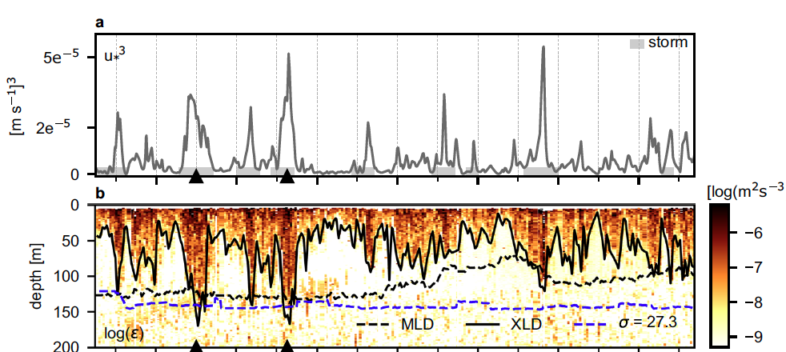
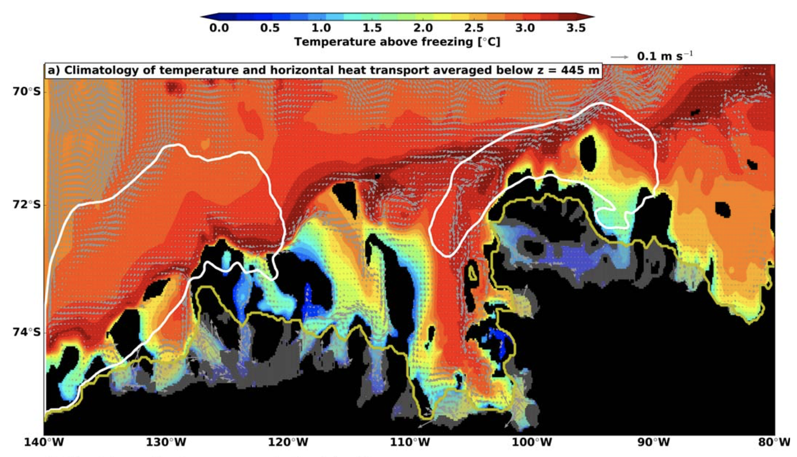
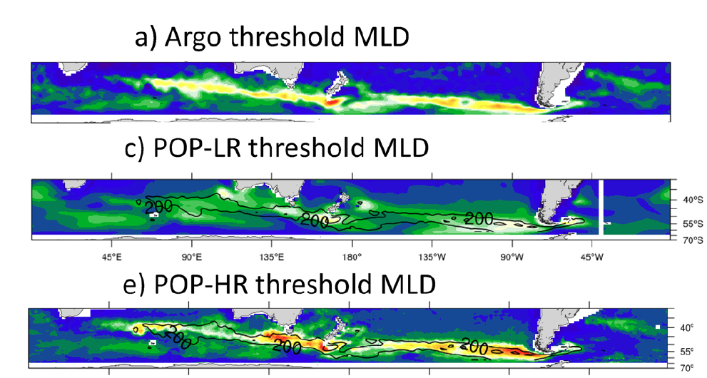
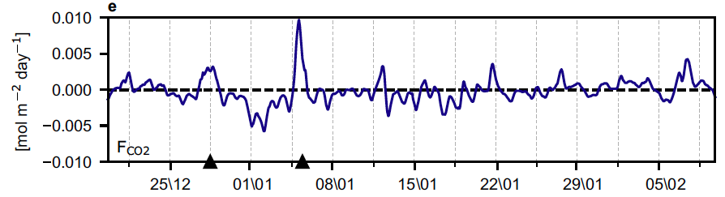
Possible Problem of Mutual Interest:
Advance Southern Ocean Process Understanding and Models
Southern Ocean dominates the global uptake of anthropogenic heat + carbon
  Accurate simulation of Southern Ocean crucial for global climate forecasting
The Southern Ocean region is biased in reanalyses and Earth system models:
air-sea fluxes of heat, water, carbon, winds and clouds, sea-surface temperature, biological productivity, ocean surface mixed layer depth, sea-ice extent and seasonality.
Processes of ocean-driven ice-shelf melting
Processes of ocean heat & carbon uptake
Understanding climate model biases
Kimura, S., Jenkins, A., Regan, H., Holland, P. R., Assmann, K. M., Whitt, D. B., ... & Dutrieux, P. (2017). Journal of Geophysical Research: Oceans, 122(12), 10131-10155
Nicholson, S. A., Whitt, D. B. et al. (2022). Nature communications, 13(1), 158
Small, R. J., DuVivier, A. K., Whitt, D. B., Long, M. C., Grooms, I., & Large, W. G. (2021). Climate Dynamics, 56, 299-327

Slide 4
Beneficial partnerships
Similar interdisciplinary scientific interests, e.g.
  Processes at the air-sea-ice interface, especially
  atmospheric storms and/or ocean (sub)mesoscale
  Physical structuring of biogeochemical cycling or ocean carbon uptake
Complementary capabilities, e.g.
  Expertise in sea-ice or ice-shelf dynamics, ocean biogeochemical processes, or atmospheric dynamics and relevant remote sensing techniques.
  Access to relevant in-situ observations
Interest in using NASA modelling capabilities and remote sensing observations, especially those from new missions: SWOT, ICESAT-2, PACE.

