Slide 1
ASDC Tools and Services
Sarah Hafer-Martin
10/20/2023

Slide 2
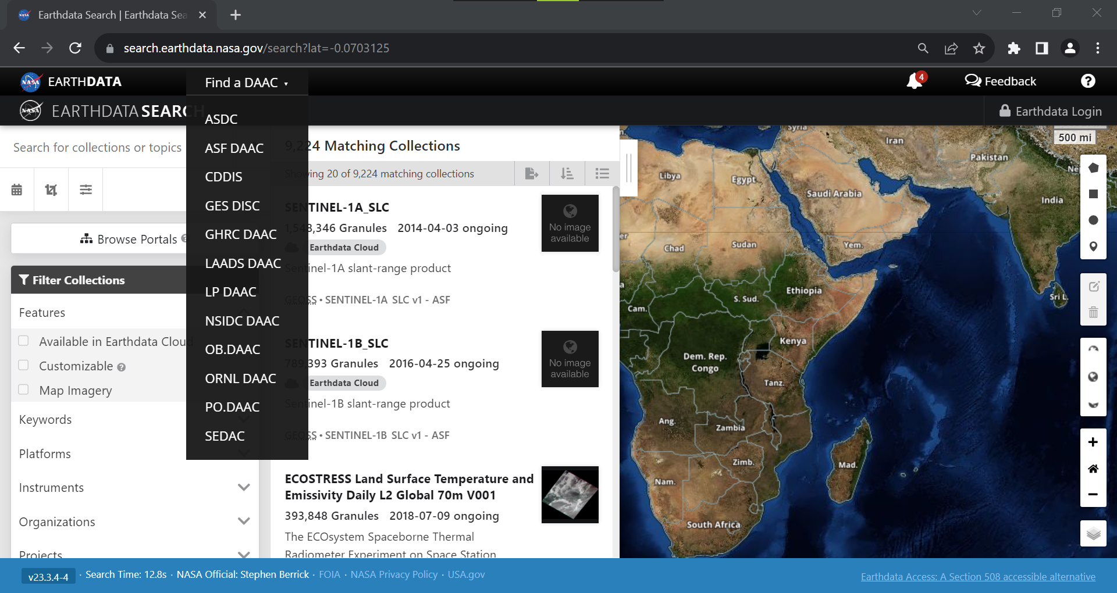
Every DAAC has a Website
Notes:
To get started I’m going to show you the ASDC website. Every DAAC has a website. Today I am only going to show you the ASDC but its pretty easy to find the other DAACs to if you are looking for them. On Earthdata search right at the top you can select find a DAAC and the link will take you right to their website. This an easy way to find them on website which you probably already visit if you are downloading NASA data

Slide 3
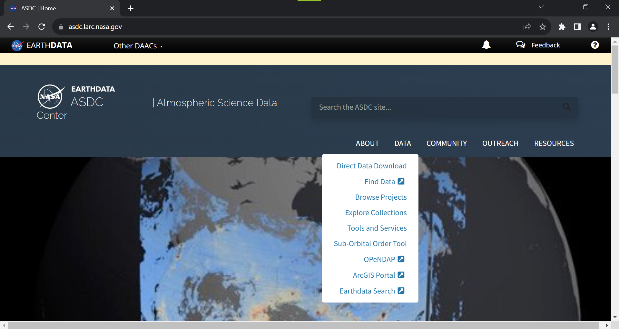
ASDC Website
Notes:
This is the ASDC website. Again, you can find other DAACs pretty easily at the top if you are looking for something different. The ASDC has Atmospheric data, but other DAACs have useful datasets for health and air quality too. I am only going to focus ASDC and on our tools and services today, but you can also find all of our data products under ‘find data’.

Slide 4
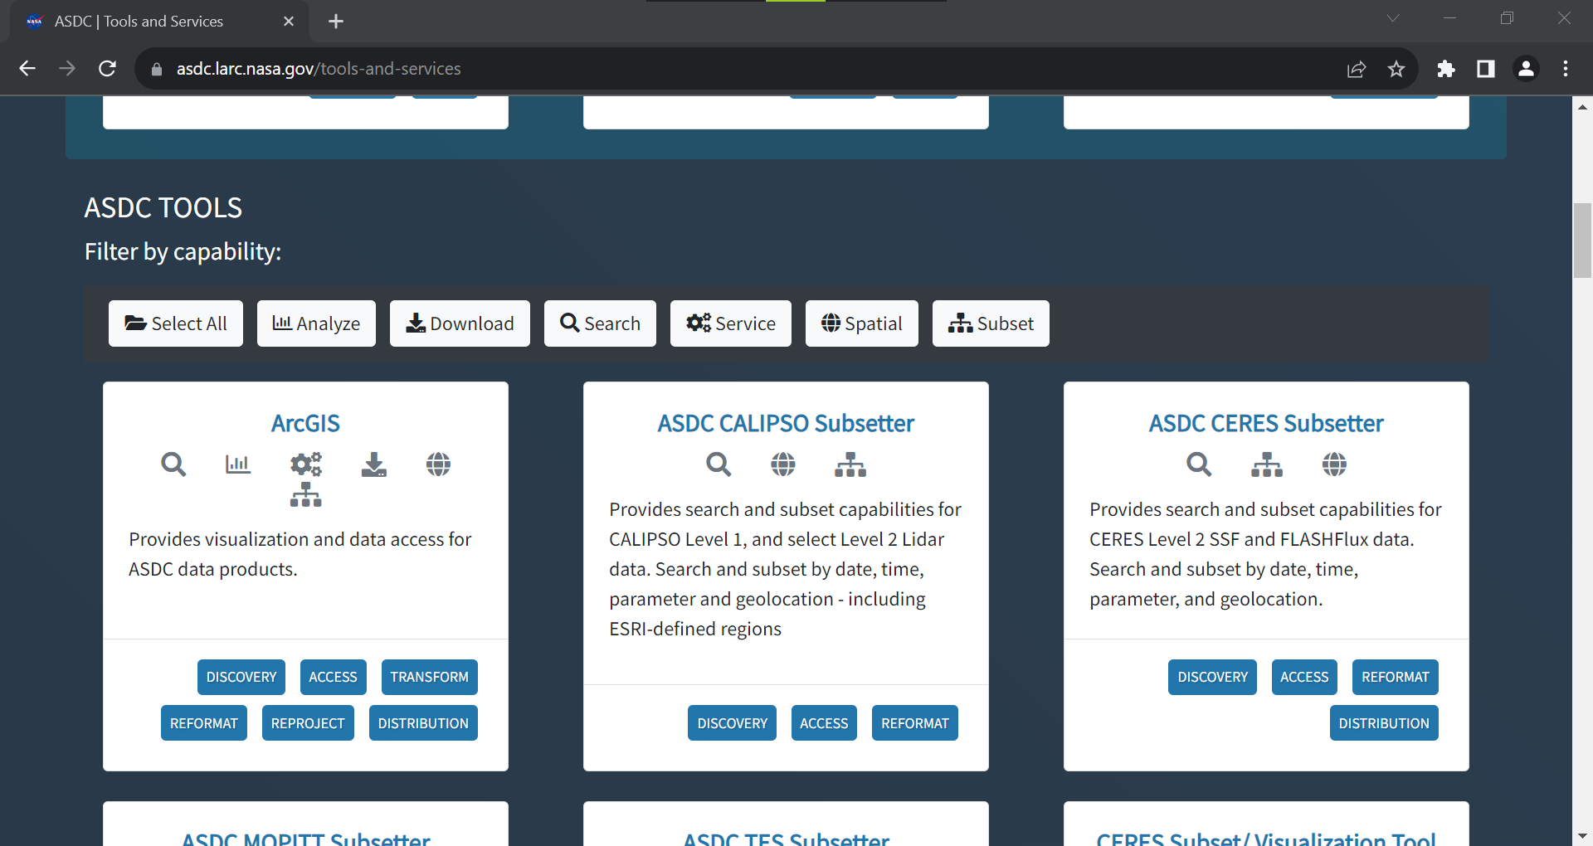
Tools and Services Page
Notes:
After you selected tool and services you’ll be brought here, and there is a long list of tools and services that the ASDC provides. There is a filter at the top so you can narrow done what you are looking for. I am going to focus on only two today, subsetters and the ED user forum. There are lots of other services including data visualization tools that encourage you to explore on your own. I am going to show you the calypso subsetter which is right in the middle, but all of the substetters are extremely similar

Slide 5
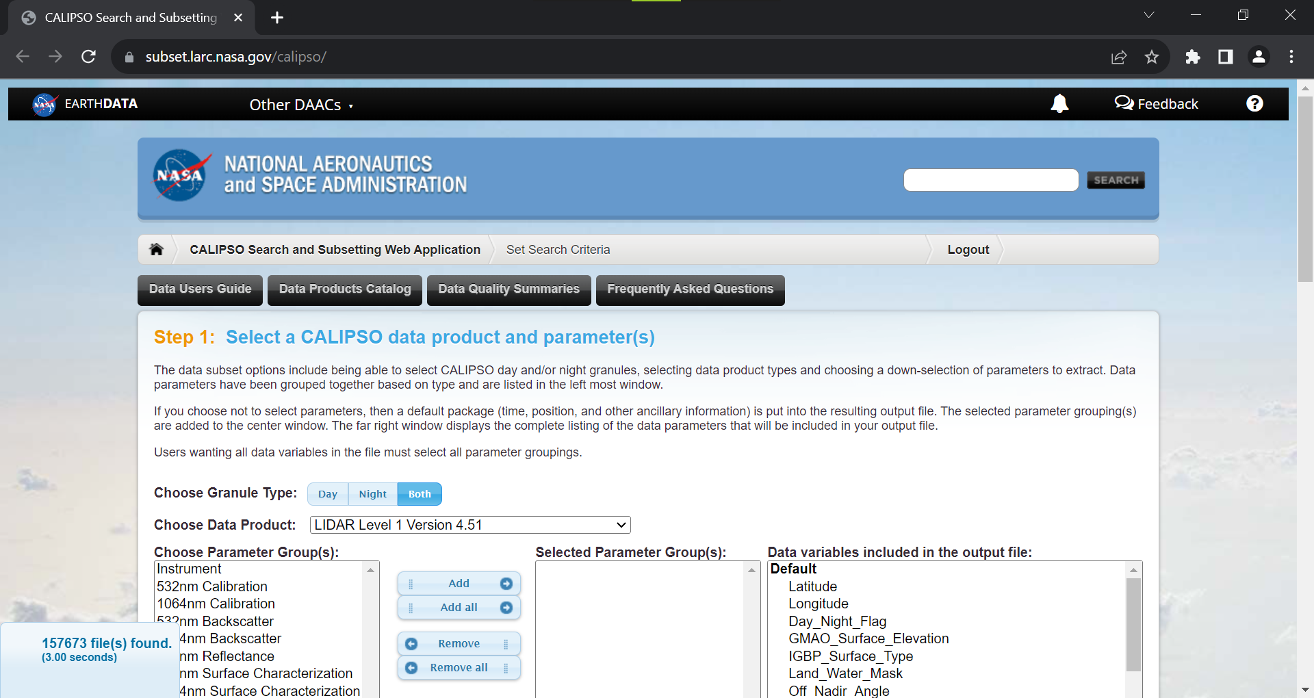
Subsetters
Notes:
You do need to log in to earthdata, it will automatically take you to the log in page when you select the subsetter. This is what the web app will look like. And this is different than just a search tool. It will search all the calypso data for the parameters you are looking for, but it will also cut down (or subset) the data to only what you need so you don’t have to download everything.

Slide 6
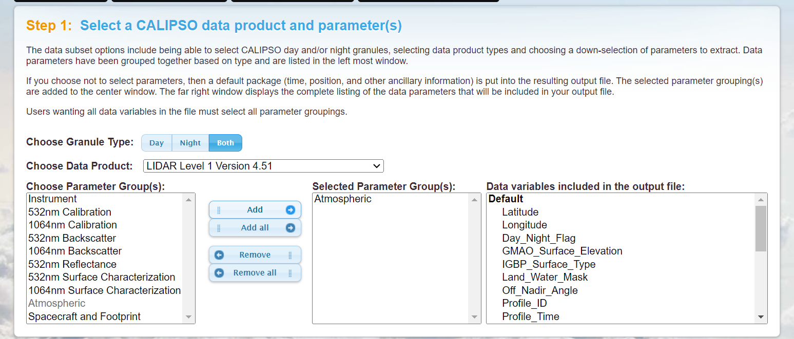
Subsetters
Notes:
First you chose which data product you want, then the variables you need. Just choose it on the left and hit the add button. Certain variable will always be included in the default because they are necessary for the data product to be readable. Again, the file you download at the end will only include what you select. If you don’t select a variable, it won’t be in the file you download.

Slide 7
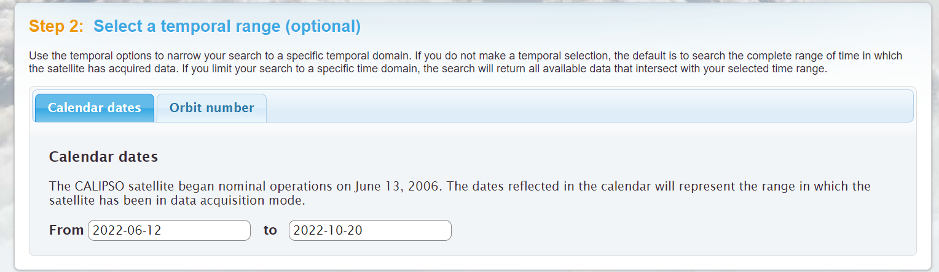
Subsetters
Notes:
Next chose the date range you want downloaded. Here I just chose a few months for the example

Slide 8
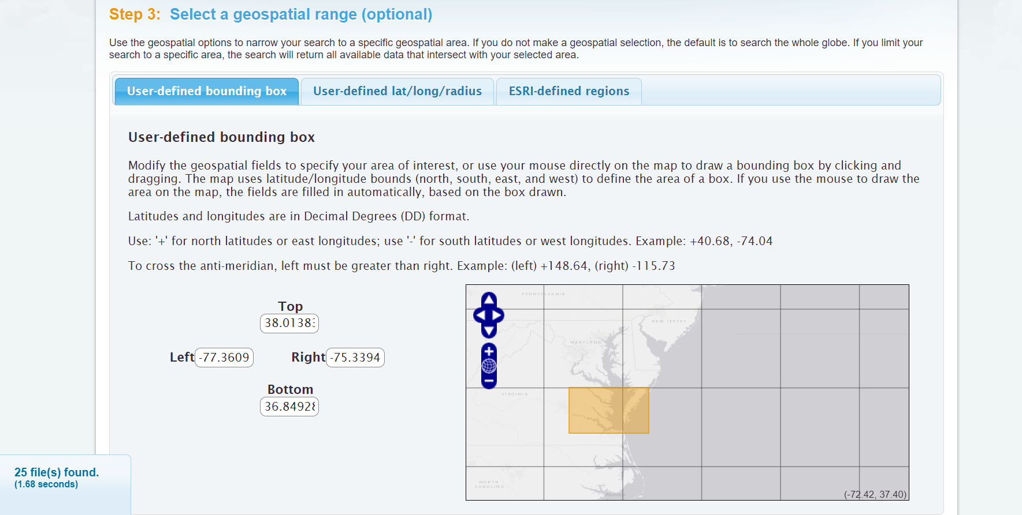
Subsetters
Notes:
Then you can subset geographically. This will cut the data to the geospatial range that you choose, so you won’t get the entire swath. You can draw a box, input lat/lon points or on some of the subsetters, you can also use ESRI-defined regions, which would allow you to select something like the state of Virginia. Not every subsetter has the ESRI feature so be aware of that. You can see at the bottom left its telling me how many files its found based on my parameters.

Slide 9
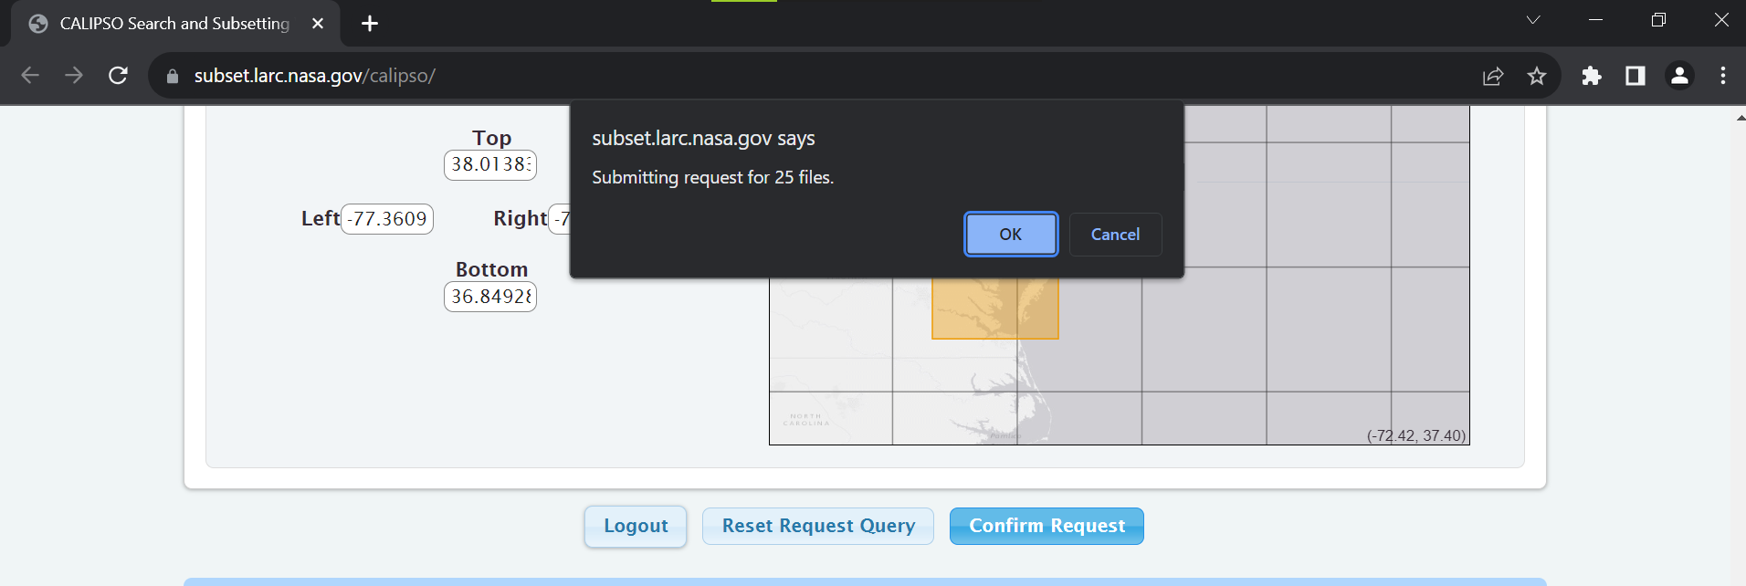
Subsetters
Notes:
Then you confirm request, hit okay

Slide 10
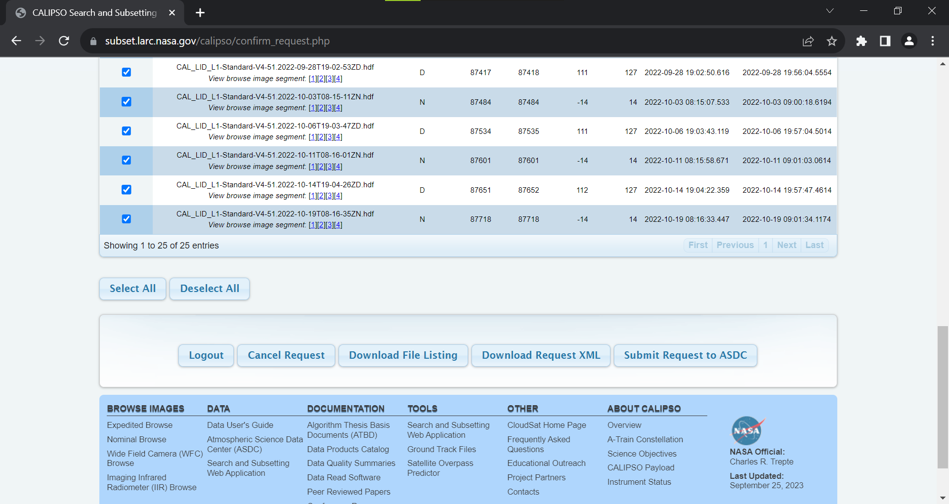
Subsetters
Notes:
And you will get a file list. When you submit your request to ASDC, the request will be for the files in the list to be subsetted to your parameters. Then you will receive your subsetted data form the ASDC based on your parameters.

Slide 11
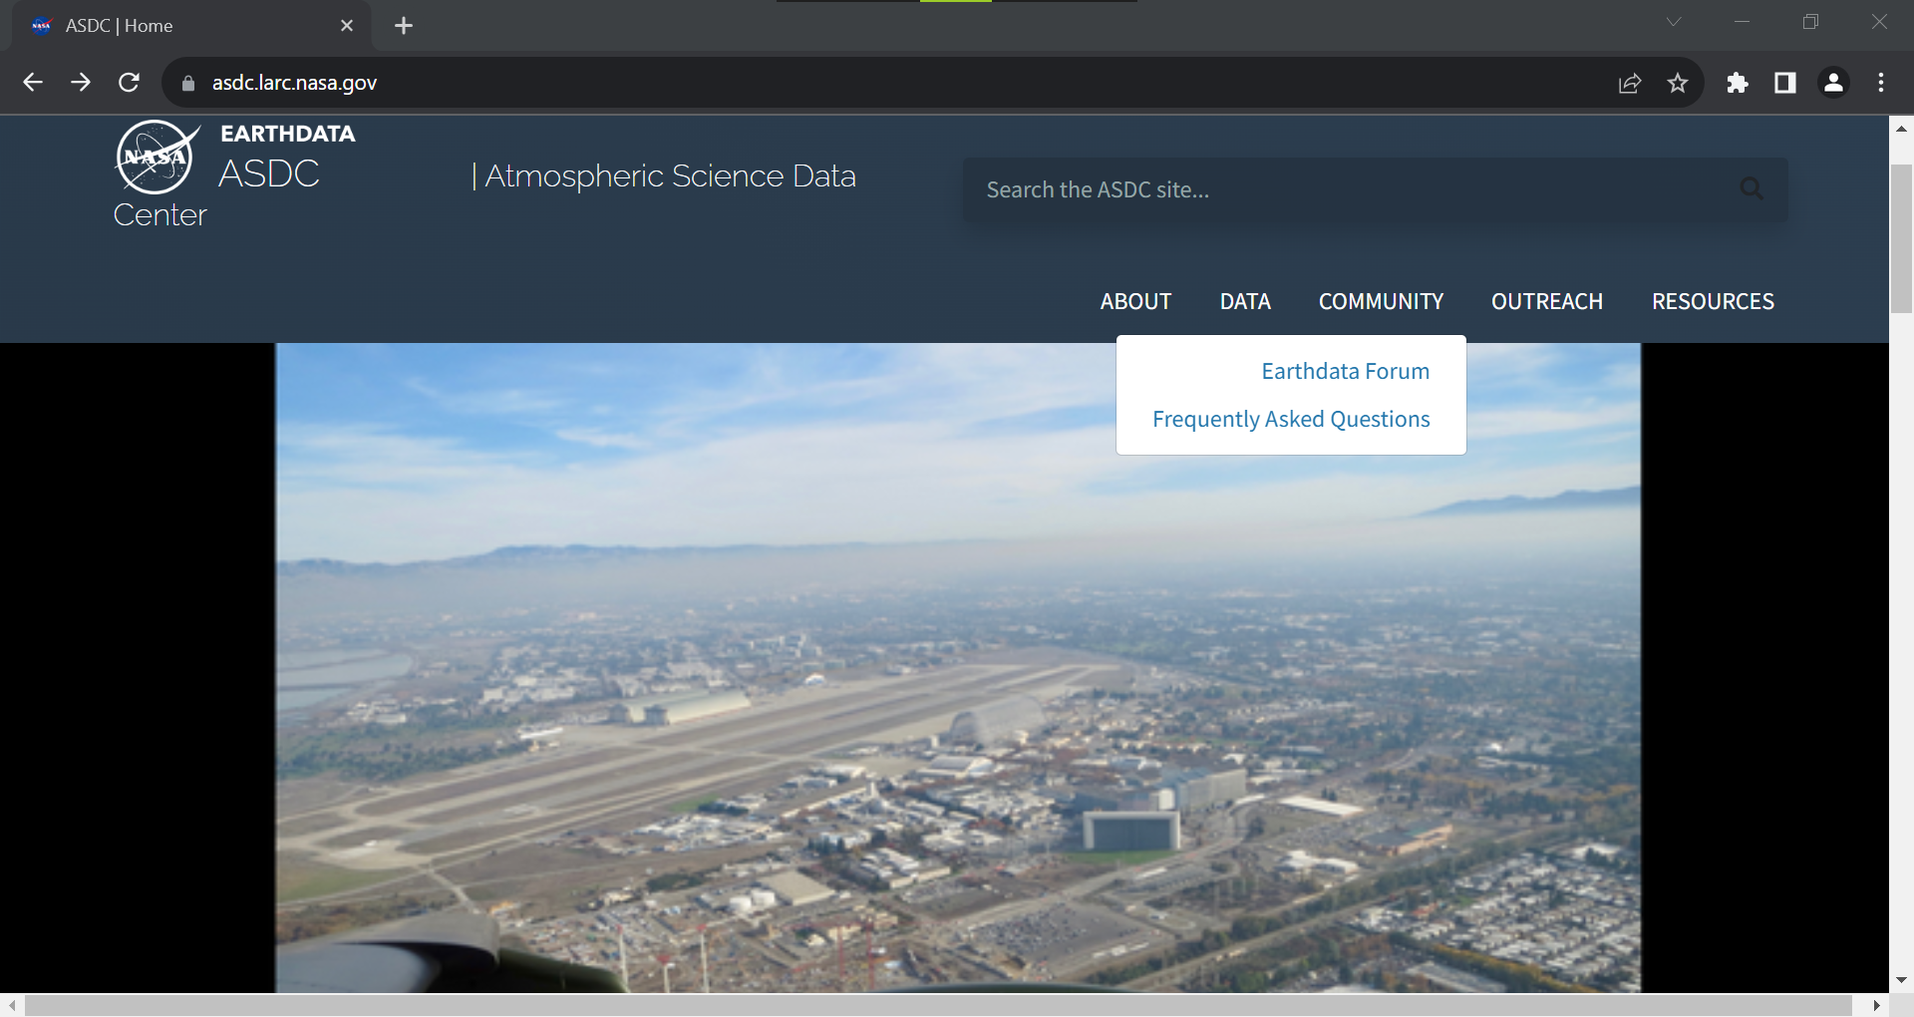
User Forum
Notes:
Next I want to show the earth data user forum. What is cool about this is you can ask questions about data from all the DAACs in one place. There is a link on the ASDC website under community to access it, this is just a quick access point

Slide 12
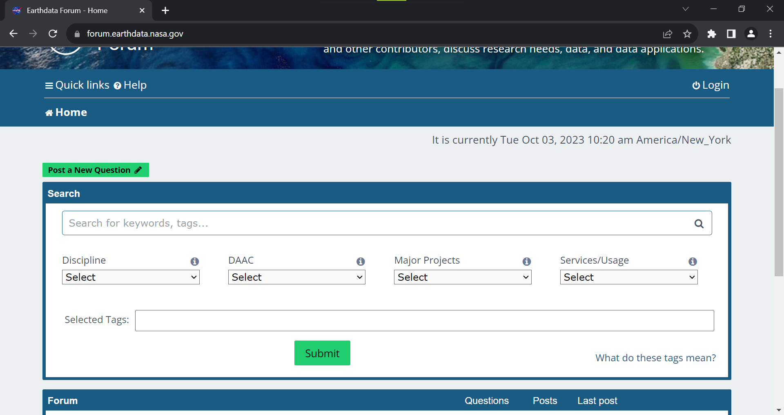
User Forum
Notes:
This will take you to Forum.earthdata.nasa.gov and there are two main options. One is to post a new question which I am not going to show because its pretty self explanatory and the other is to search what is already on the forum

Slide 13
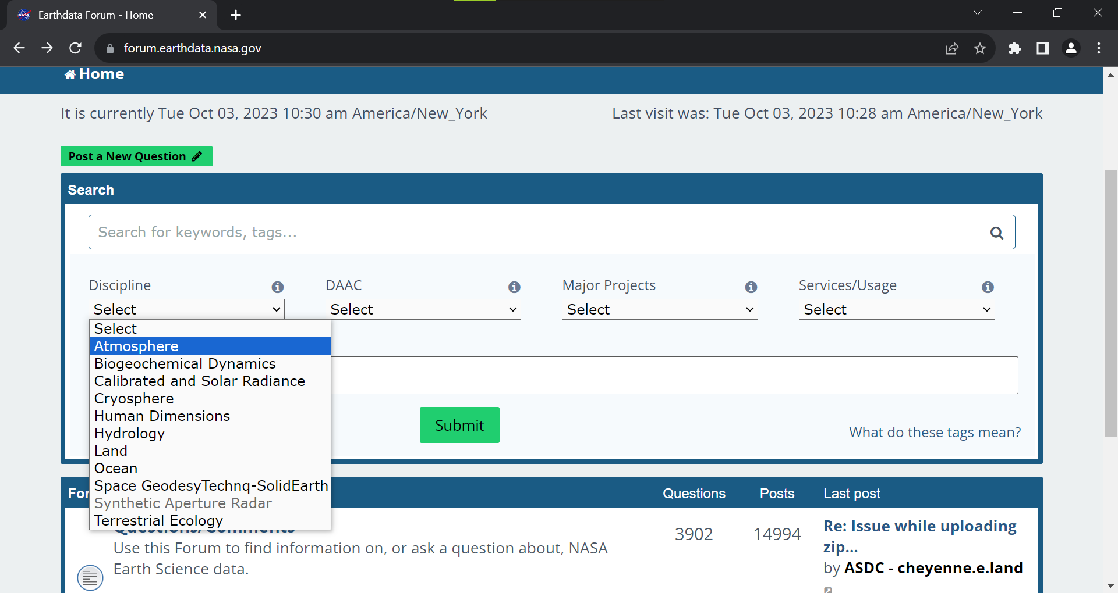
User Forum
Notes:
You can either type right in the search bar or you can use tags. There are a few categories the tags fall under and you can select what you are looking for. This especially helpful if you are looking for general info on a topic or data products.

Slide 14
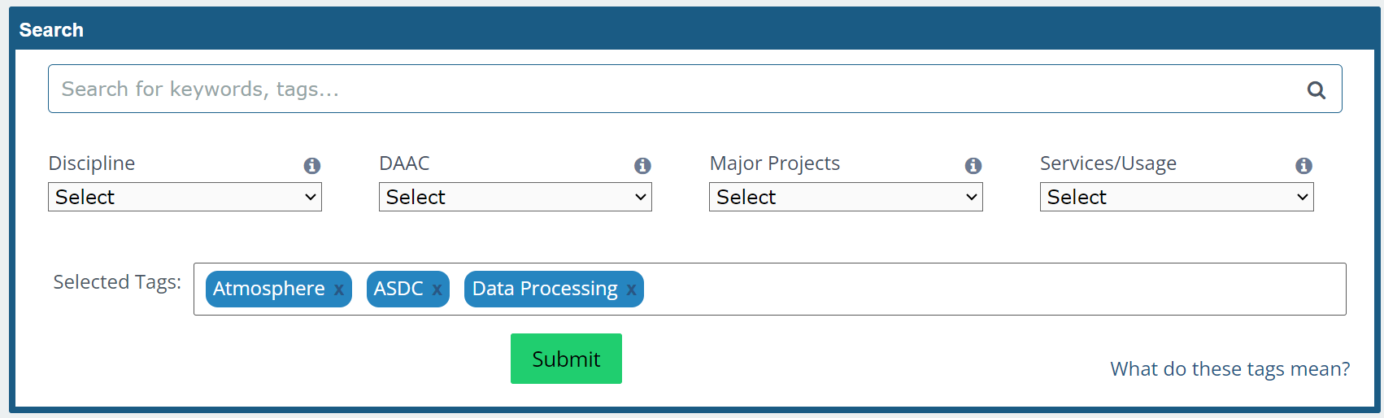
User Forum
Notes:
Here I selected three tags. In this situation maybe I’m having issues with processing my atmospheric data

Slide 15
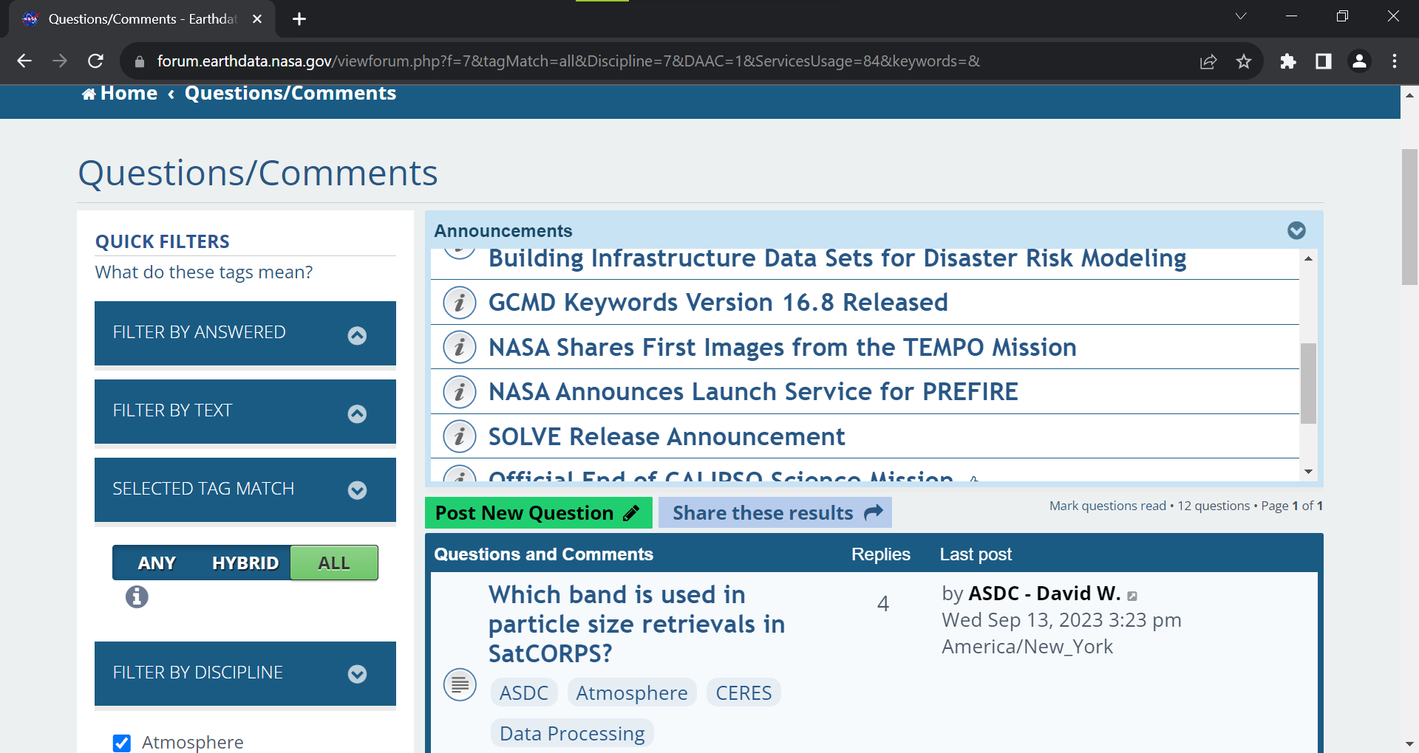
User Forum
Notes:
When I submit it will take me to a page with every post with these tags. You can get more specific than this and even refine your filters after you search too. What great about this is SMEs from the individual DAACs are responding to the questions you have on their data. What makes this different from HAQAST forum is that this is data specific and can help with the actual data retrieval process, as well as any other data questions you have.

