Slide 1
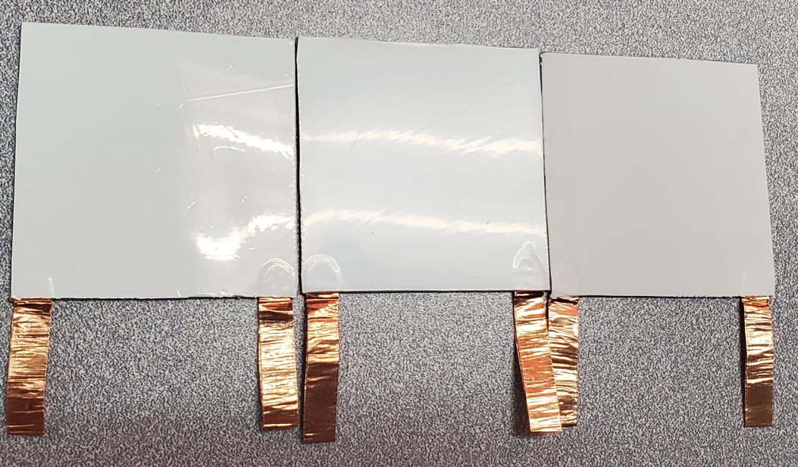
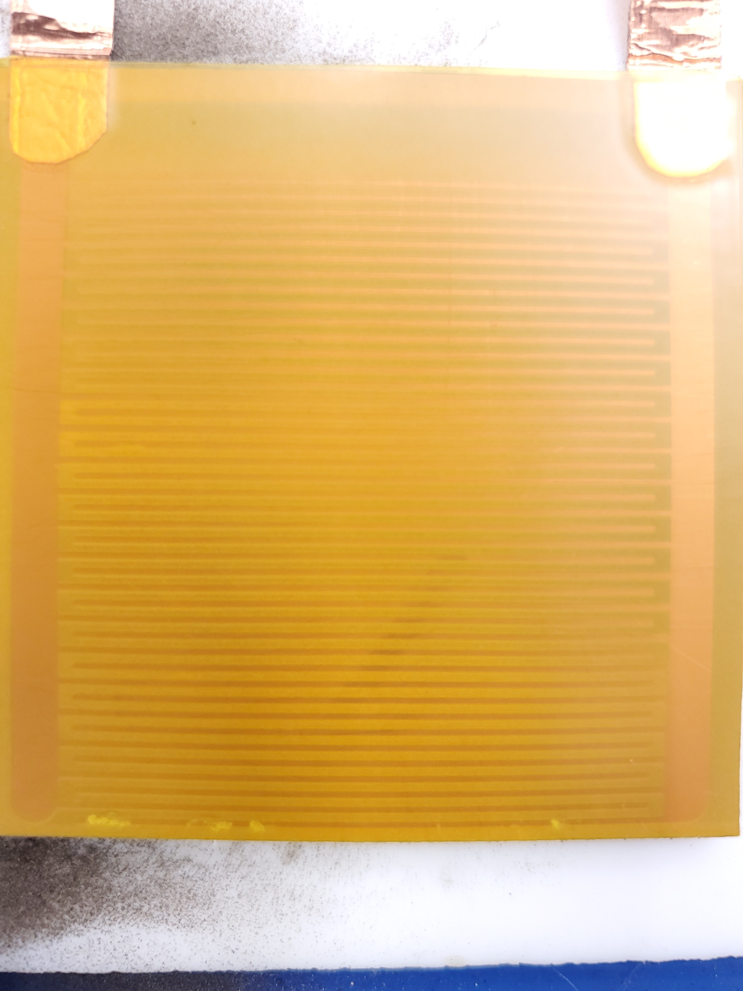
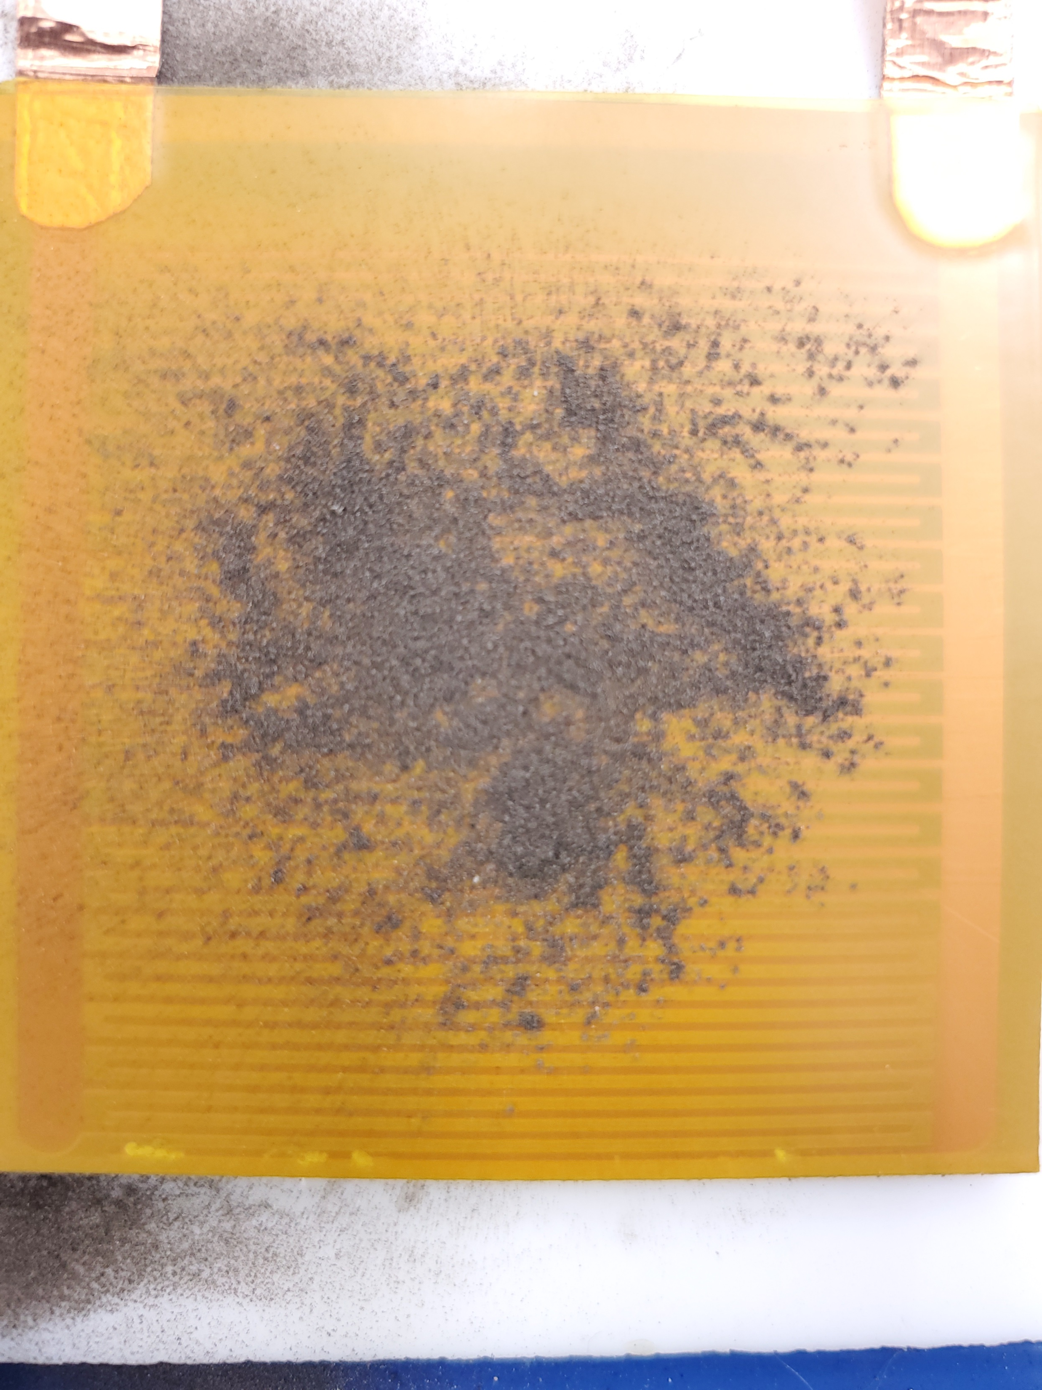
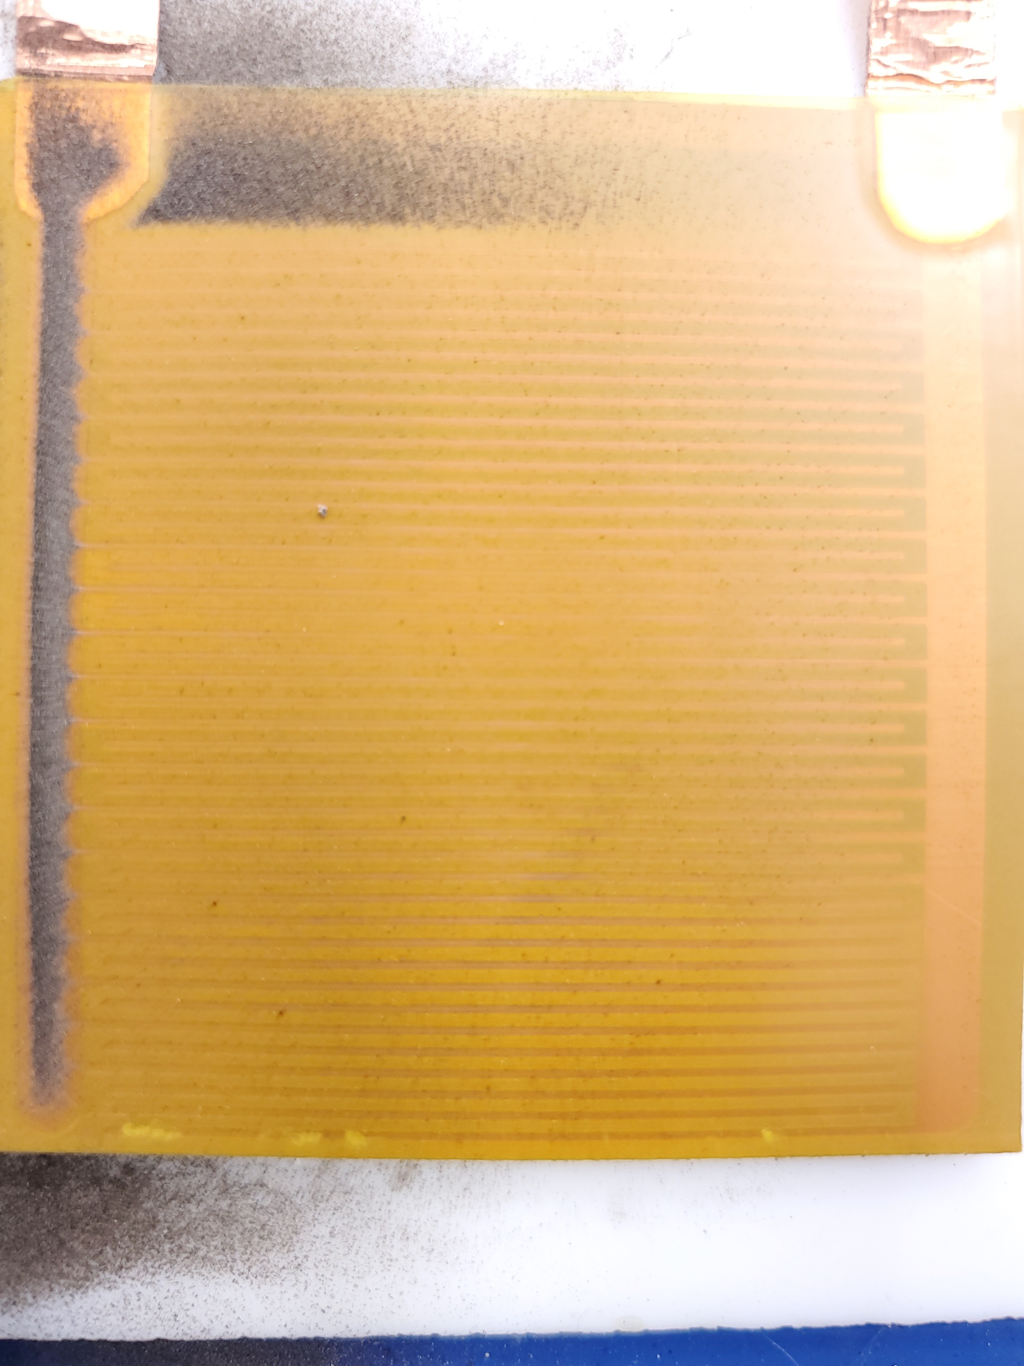
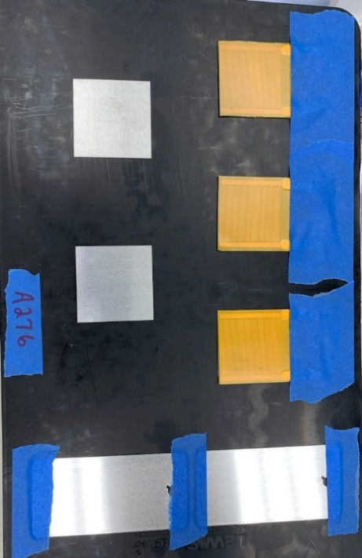
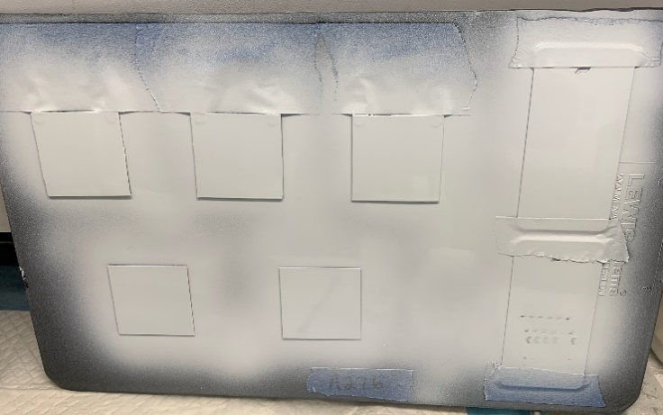
Thermal Radiator EDS Development
KSC
50 x50 mm samples were manufactured and Kapton insulating layer was tested in air at +- 1kV
White Kapton Gloss
Coating/ Thermally Conductive Kapton if necessary
Electrodes
Thermally Conductive Kapton
Adhesive
Aluminum Plate (Radiator)
Thermalbright film
White Kapton Matte
Other coatings being investigated (all paints have Kapton layer to protect copper):
Solar White (KSC APL)
Barium Sulfate
AZ-93
A276
Clean
Dirty
98.65% Cleared

Slide 2
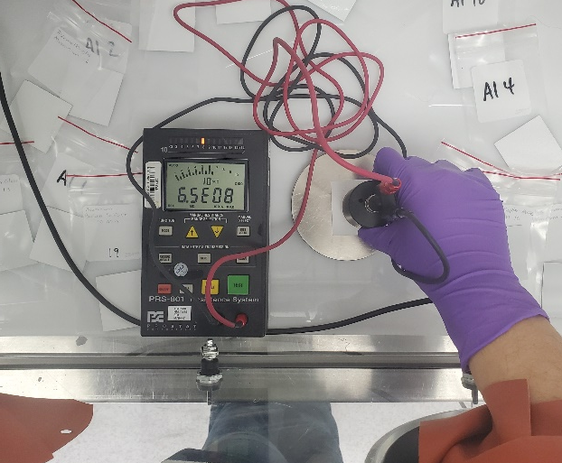
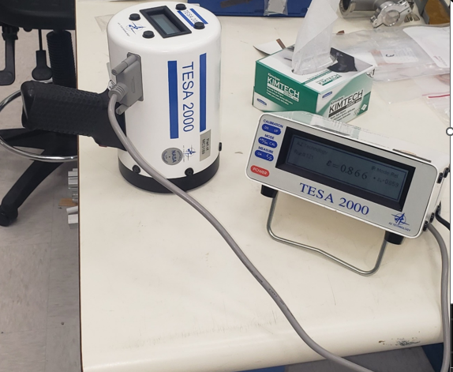
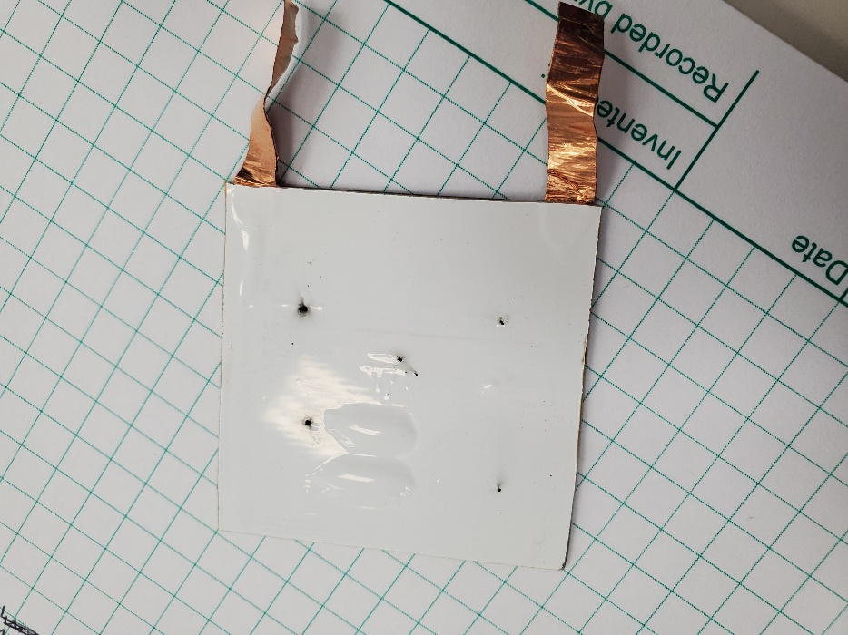
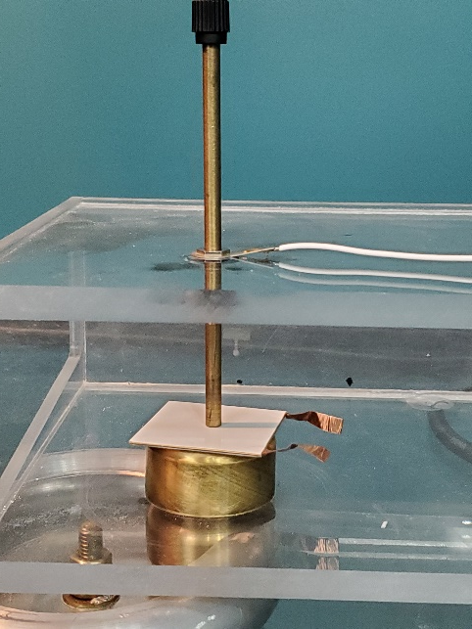
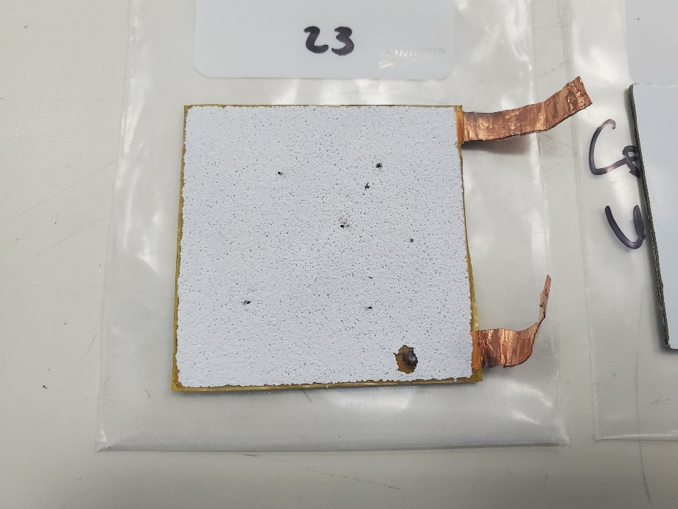
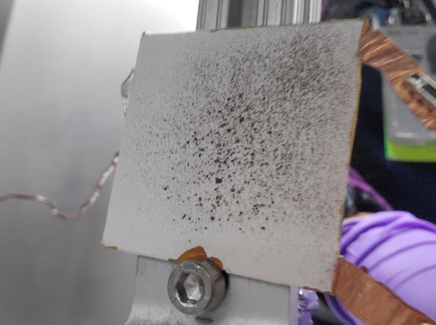
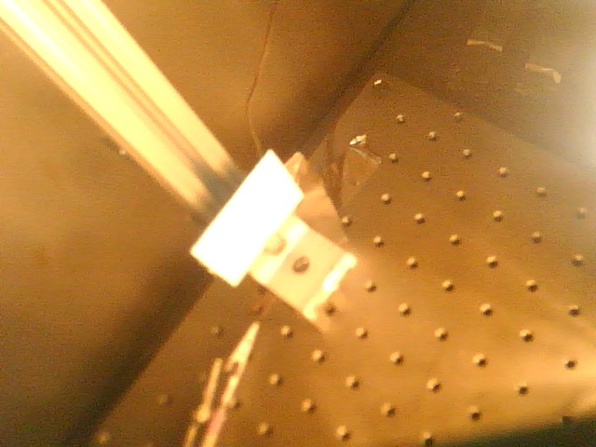
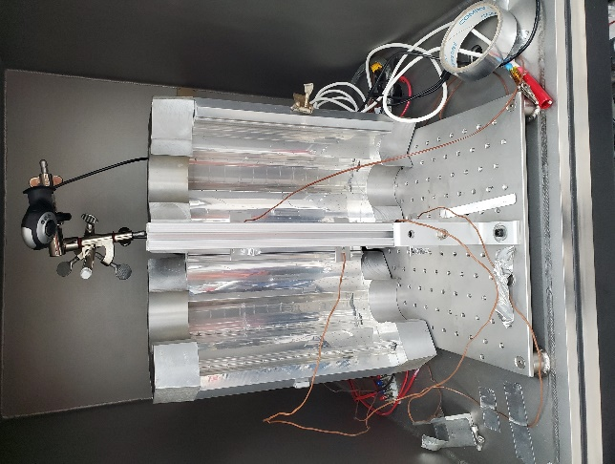
KSC Thermal Radiator EDS Testing
KSC
Several tests were conducted:
  Dust Removal in air/ vacuum
  Solar Absorptance/ Emissivity
  Surface and Volume Resistivity
  Dielectric Breakdown
  Thermal Vacuum

Slide 3
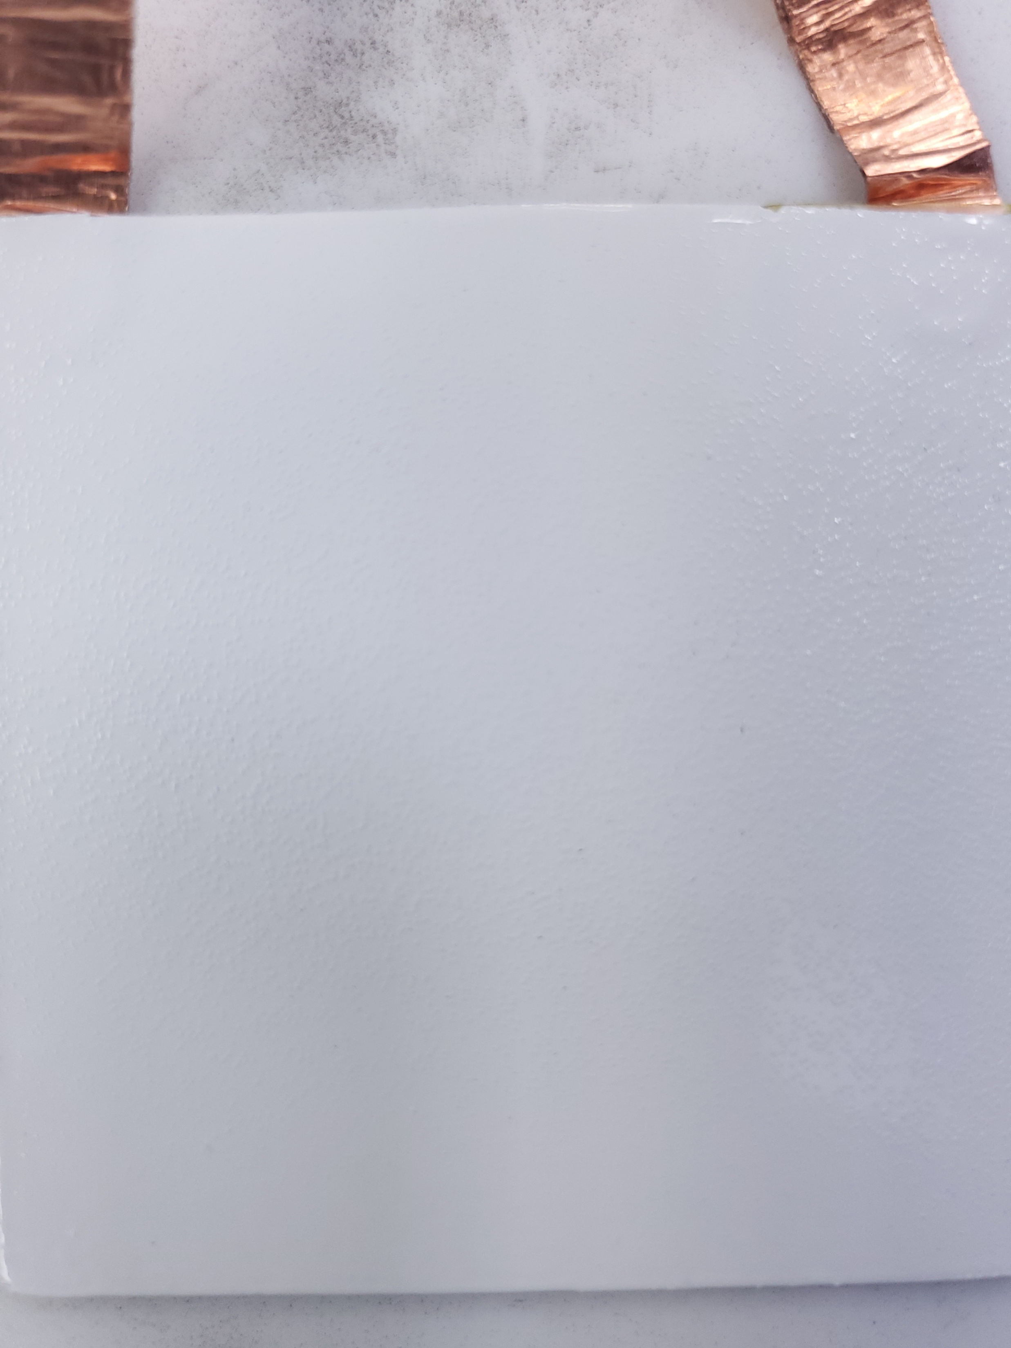
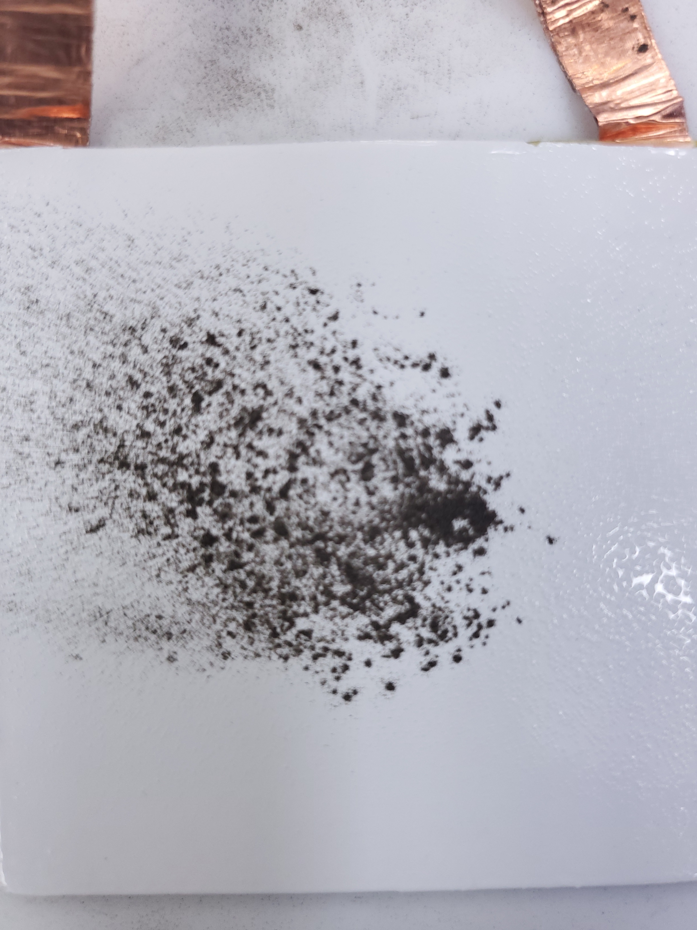
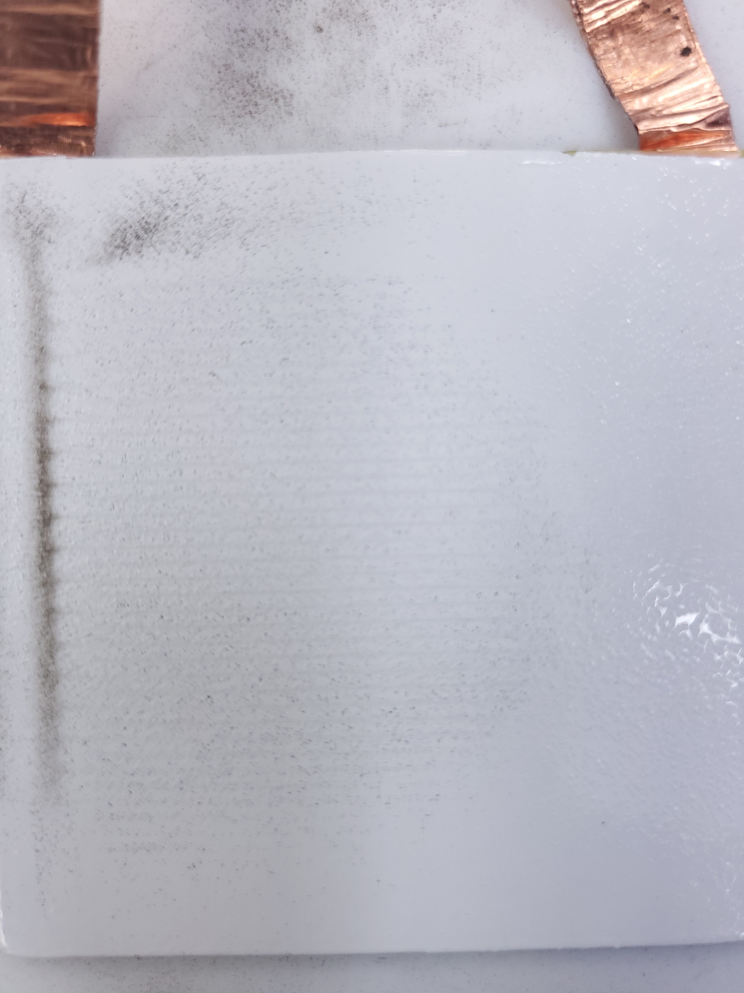
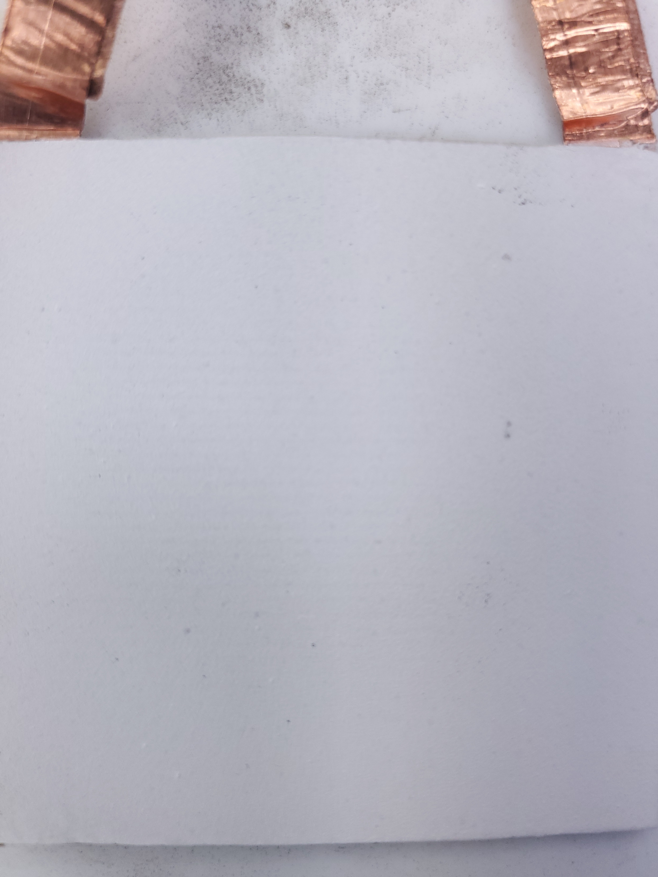
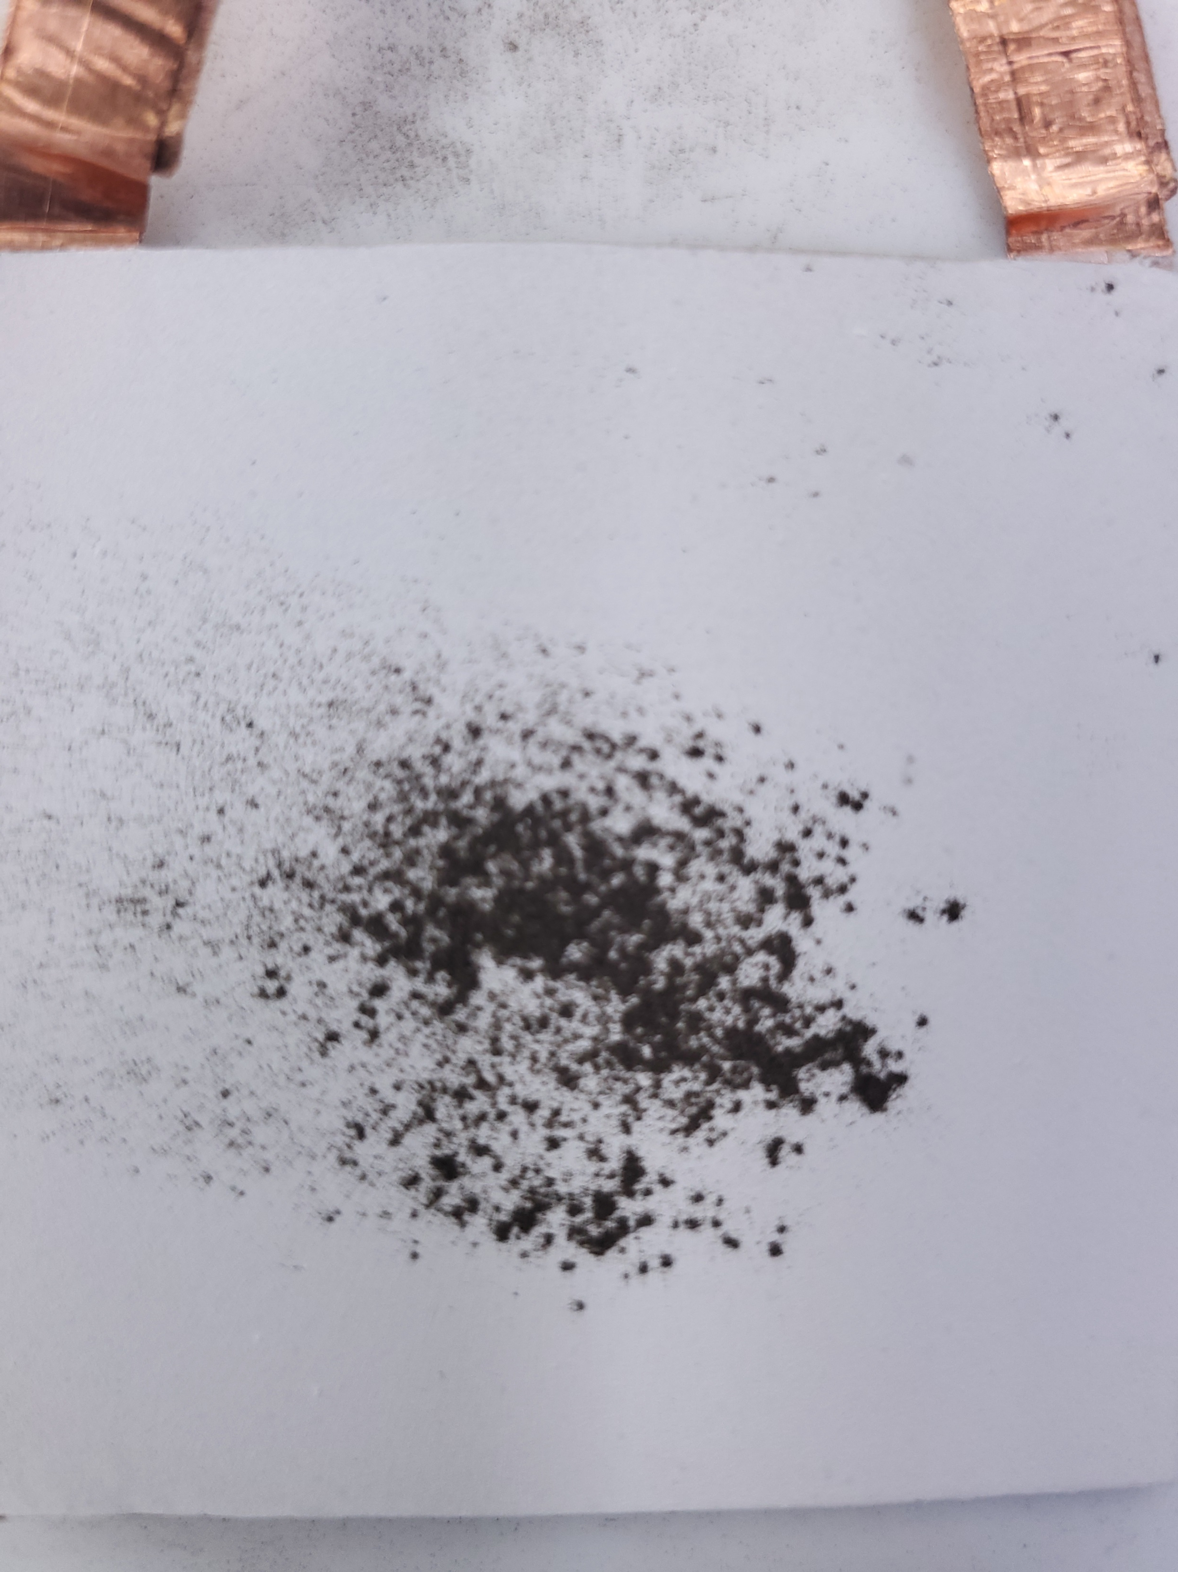
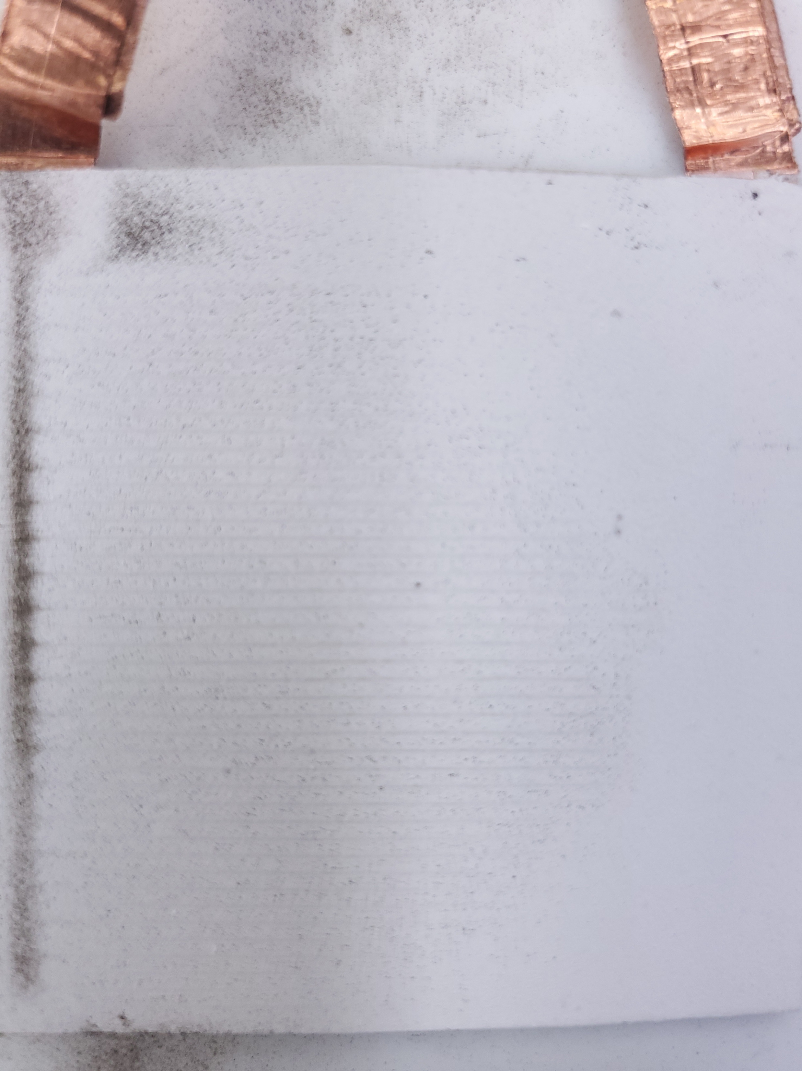
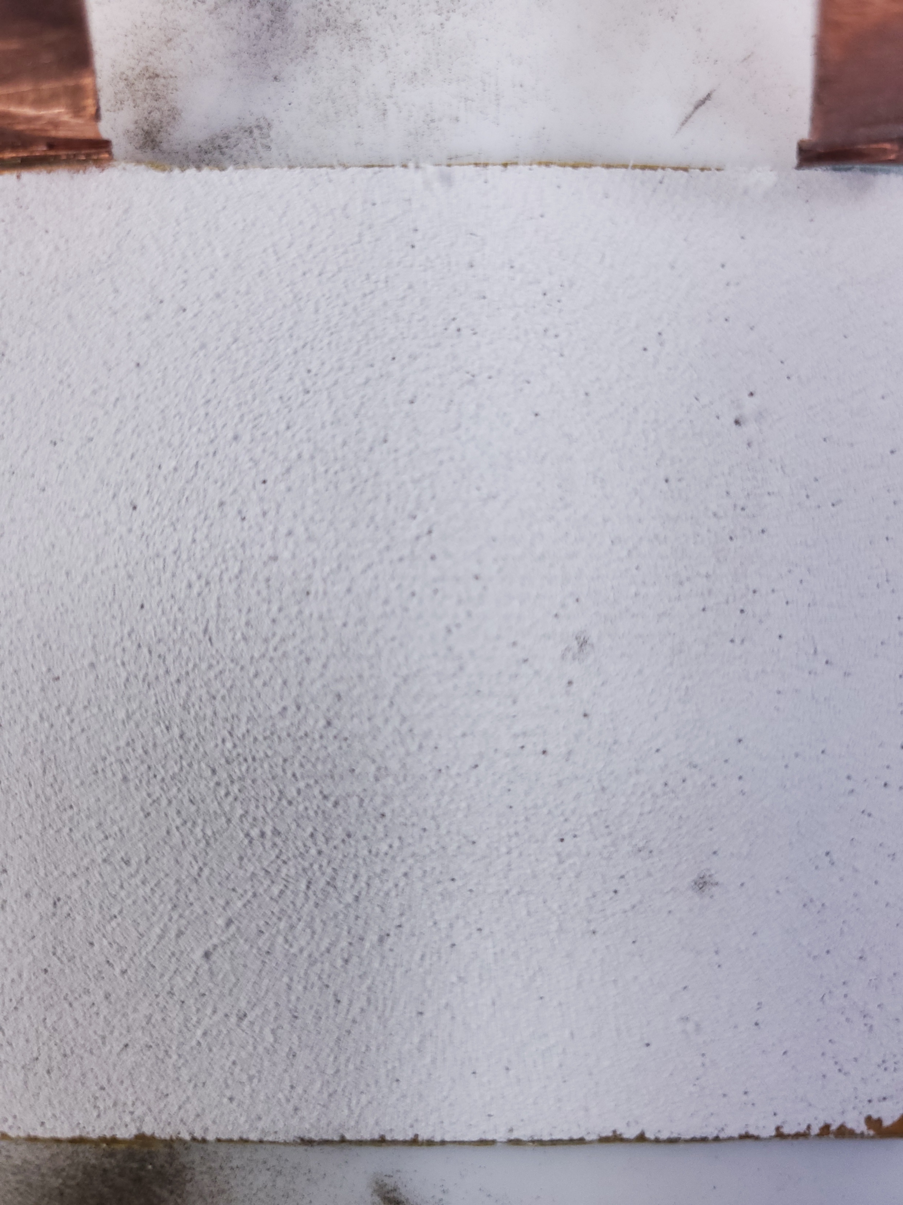
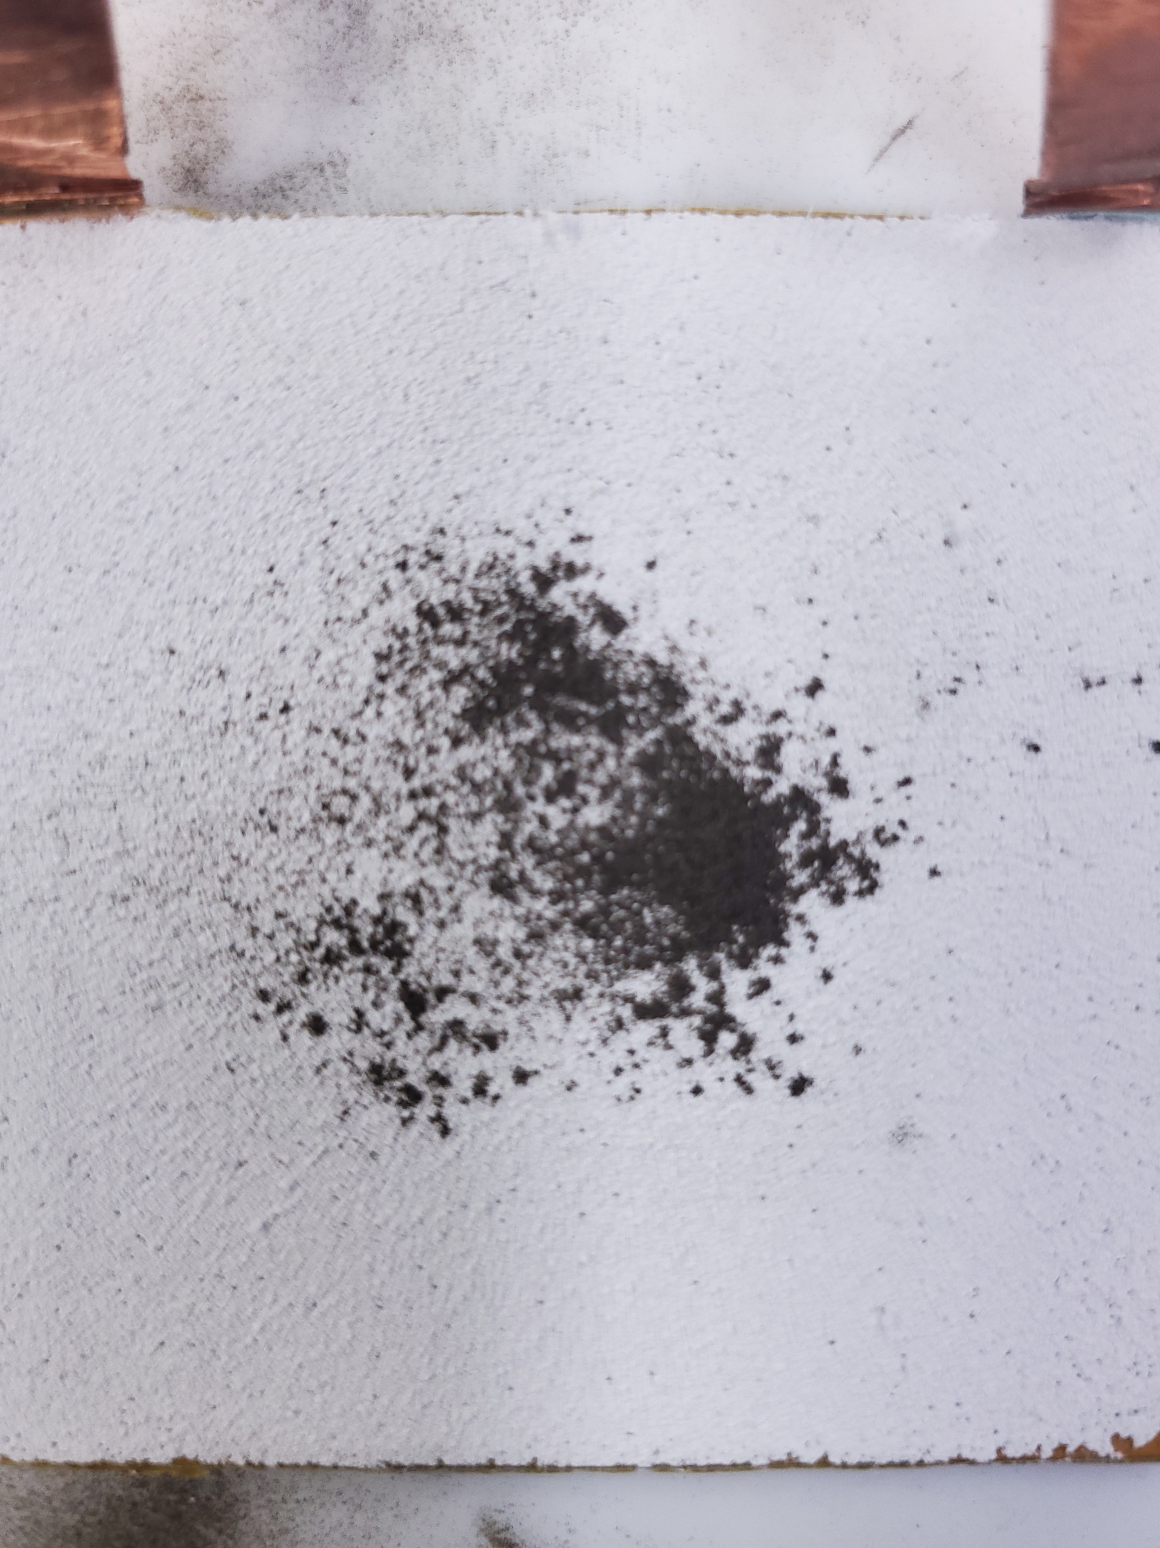
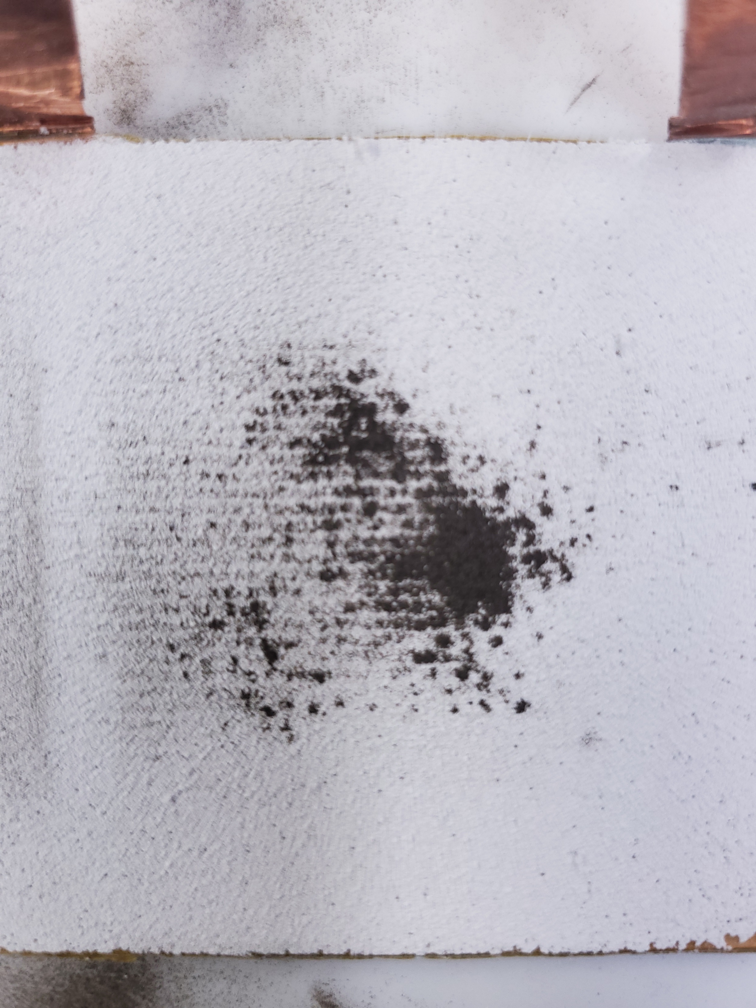
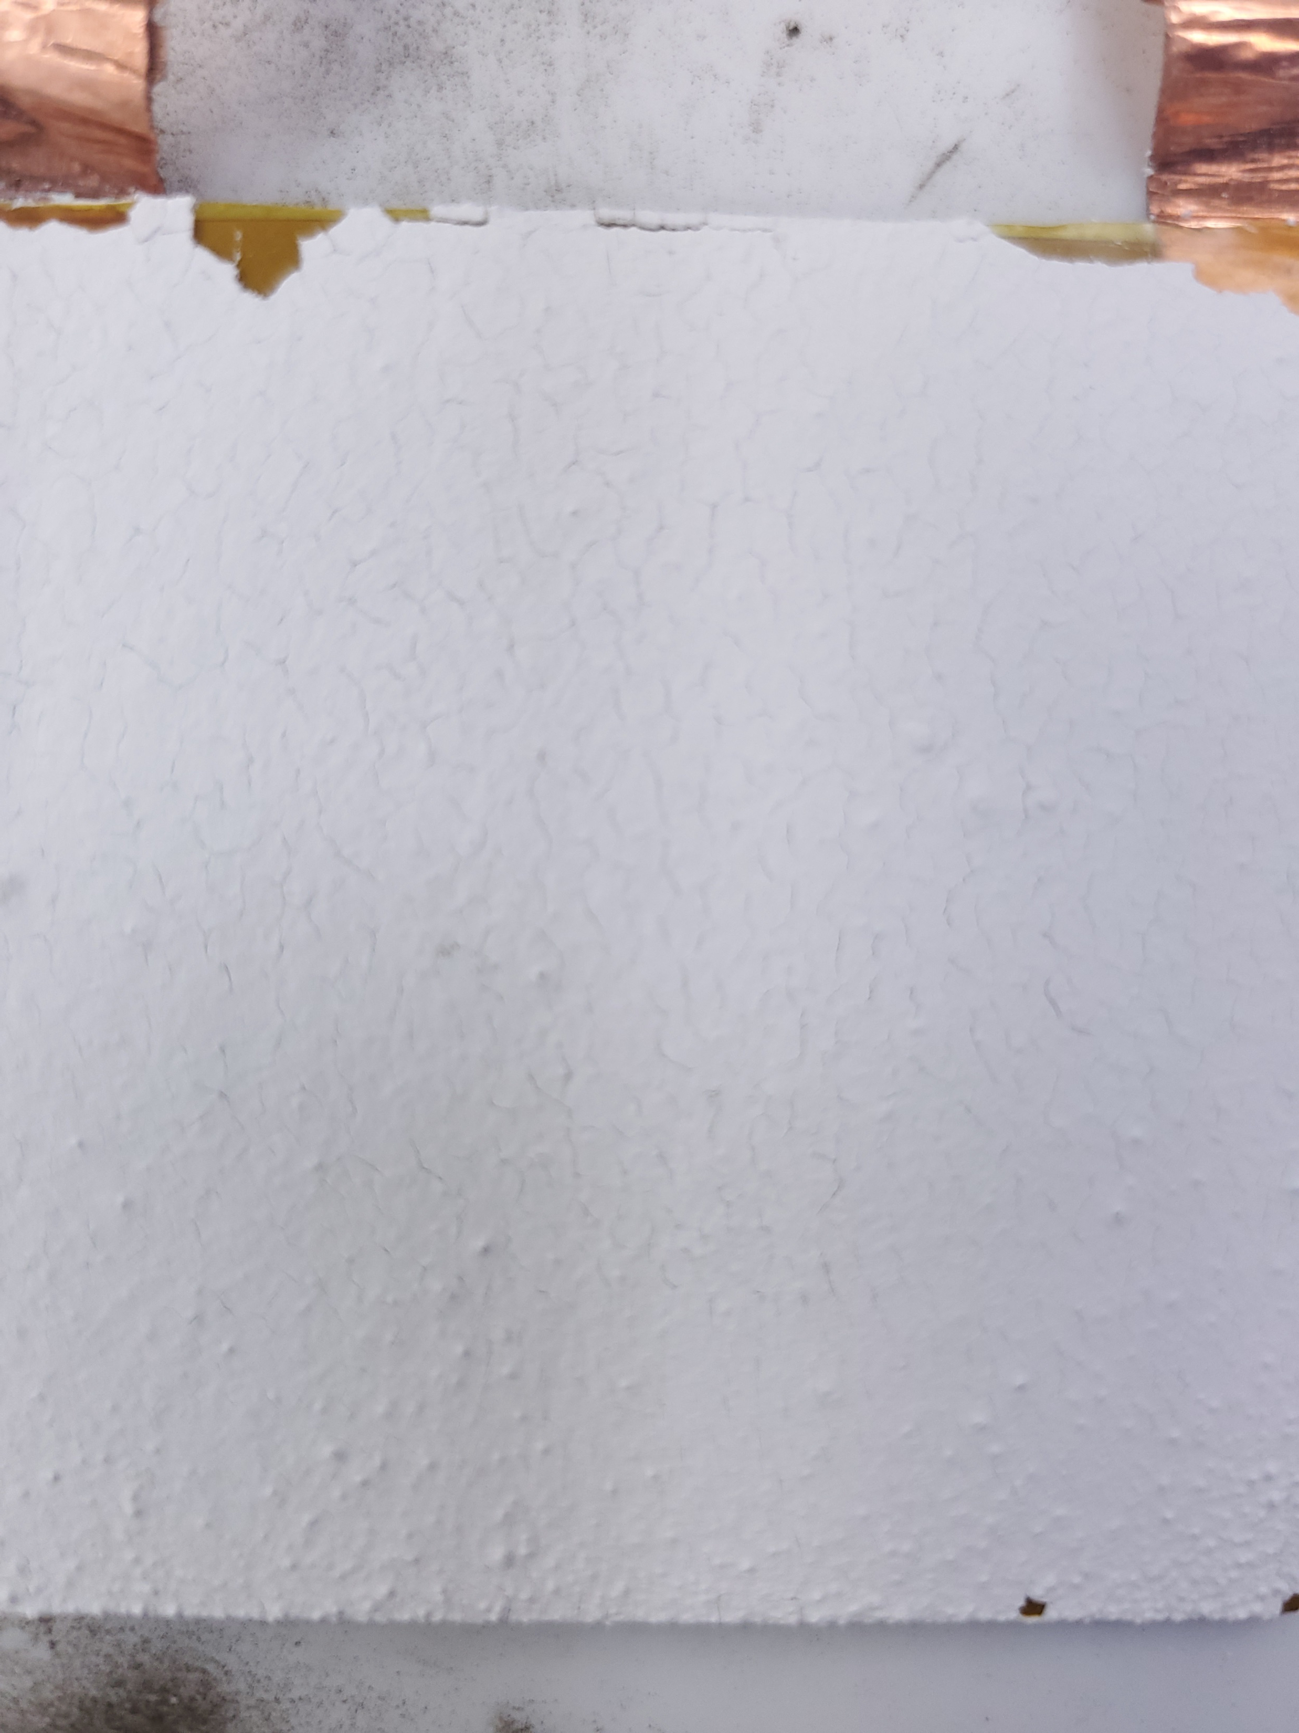
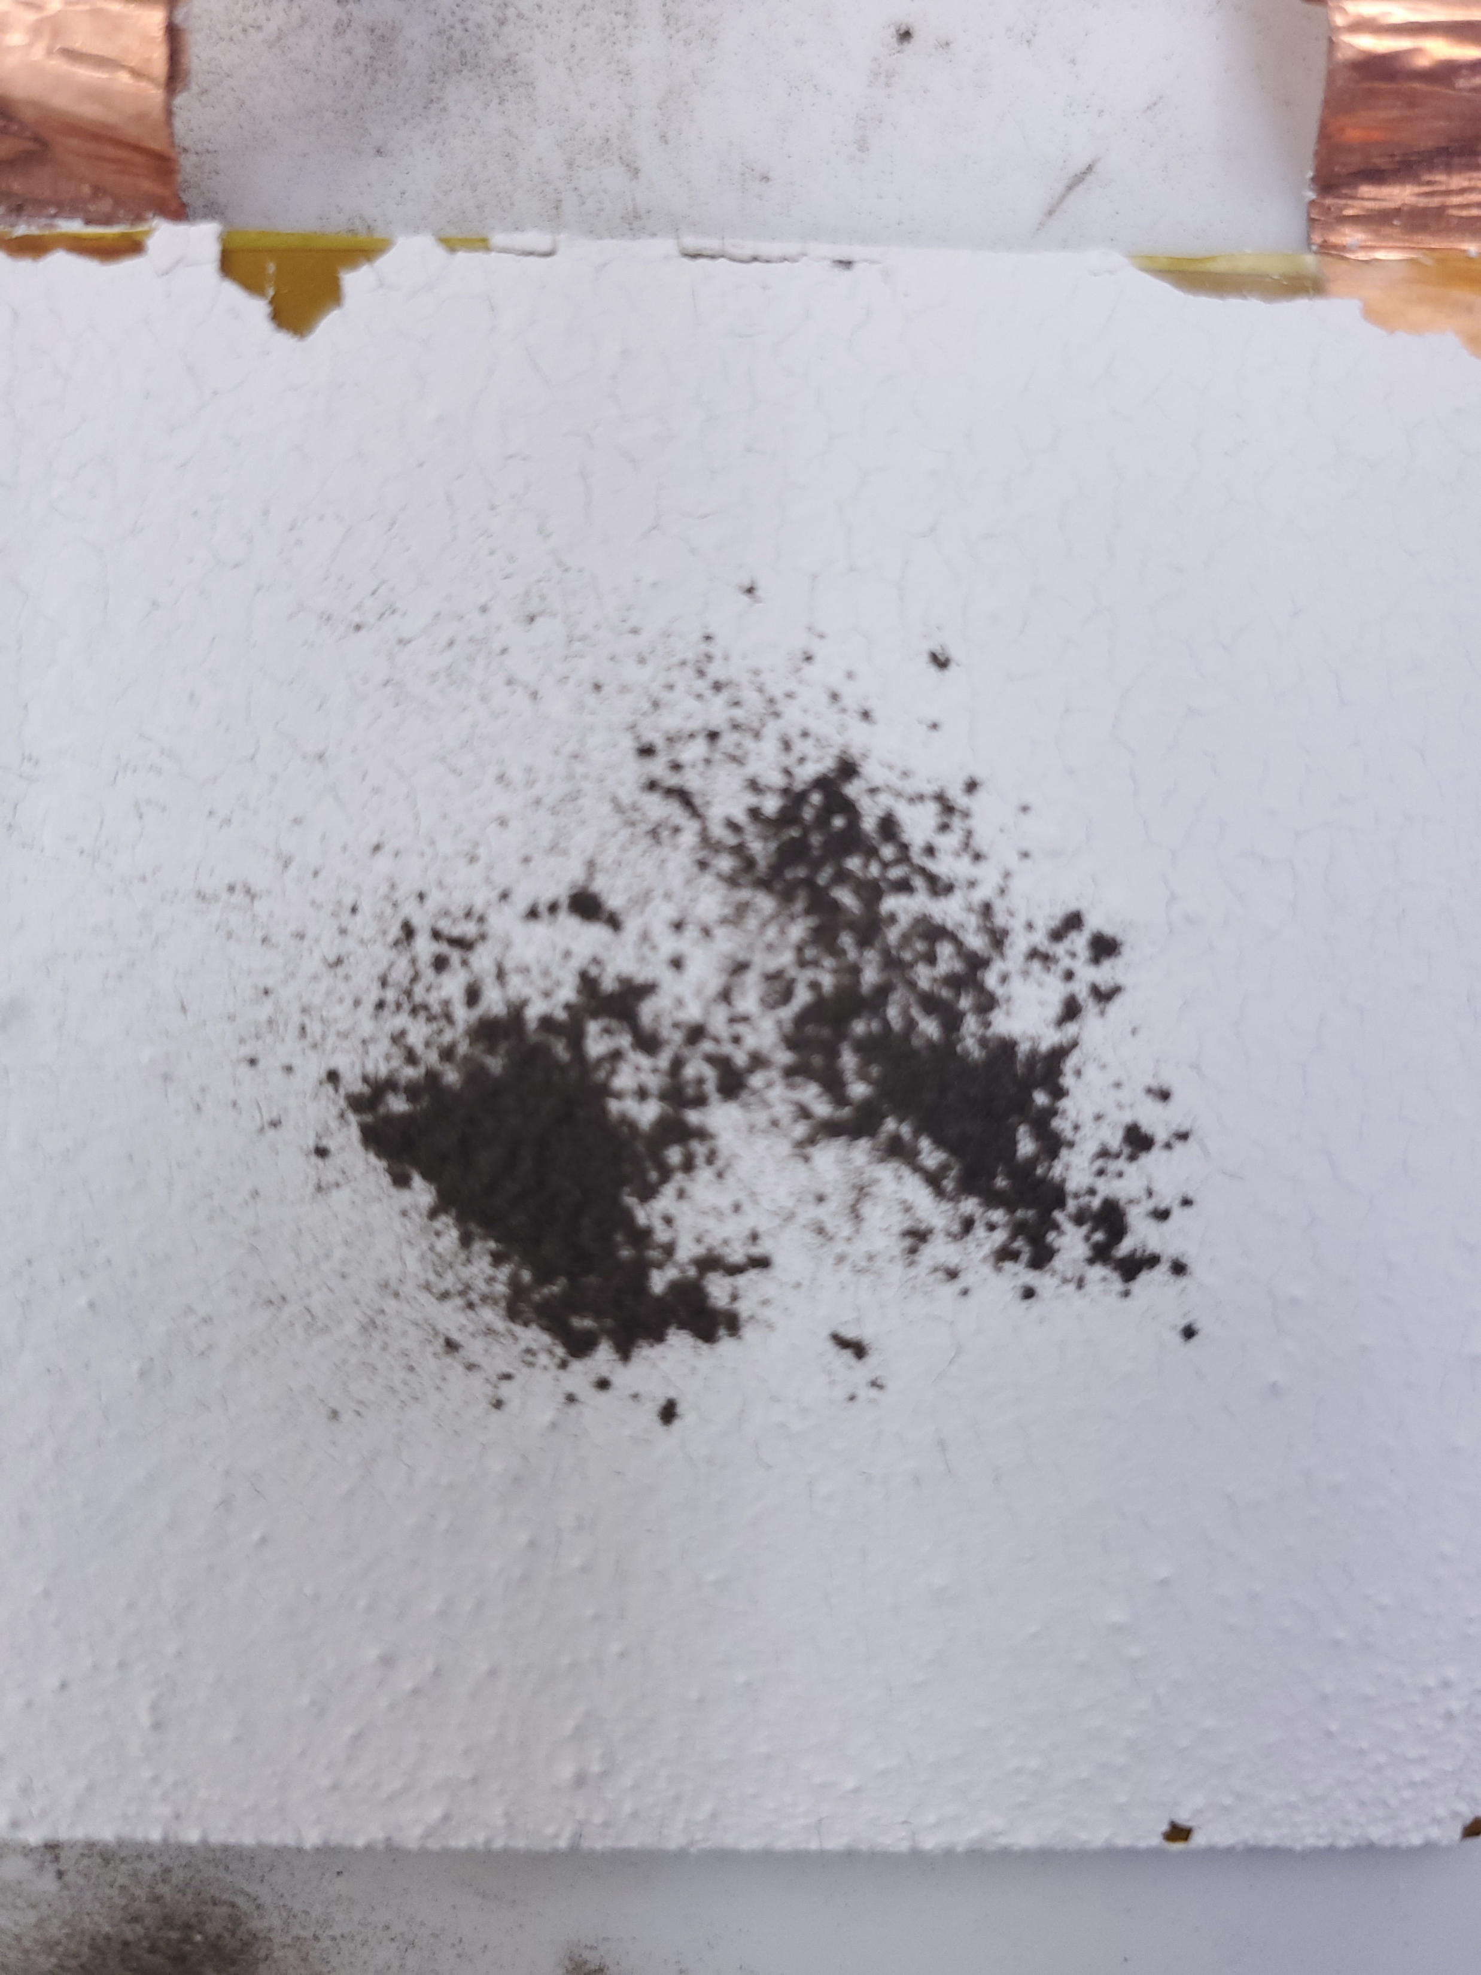
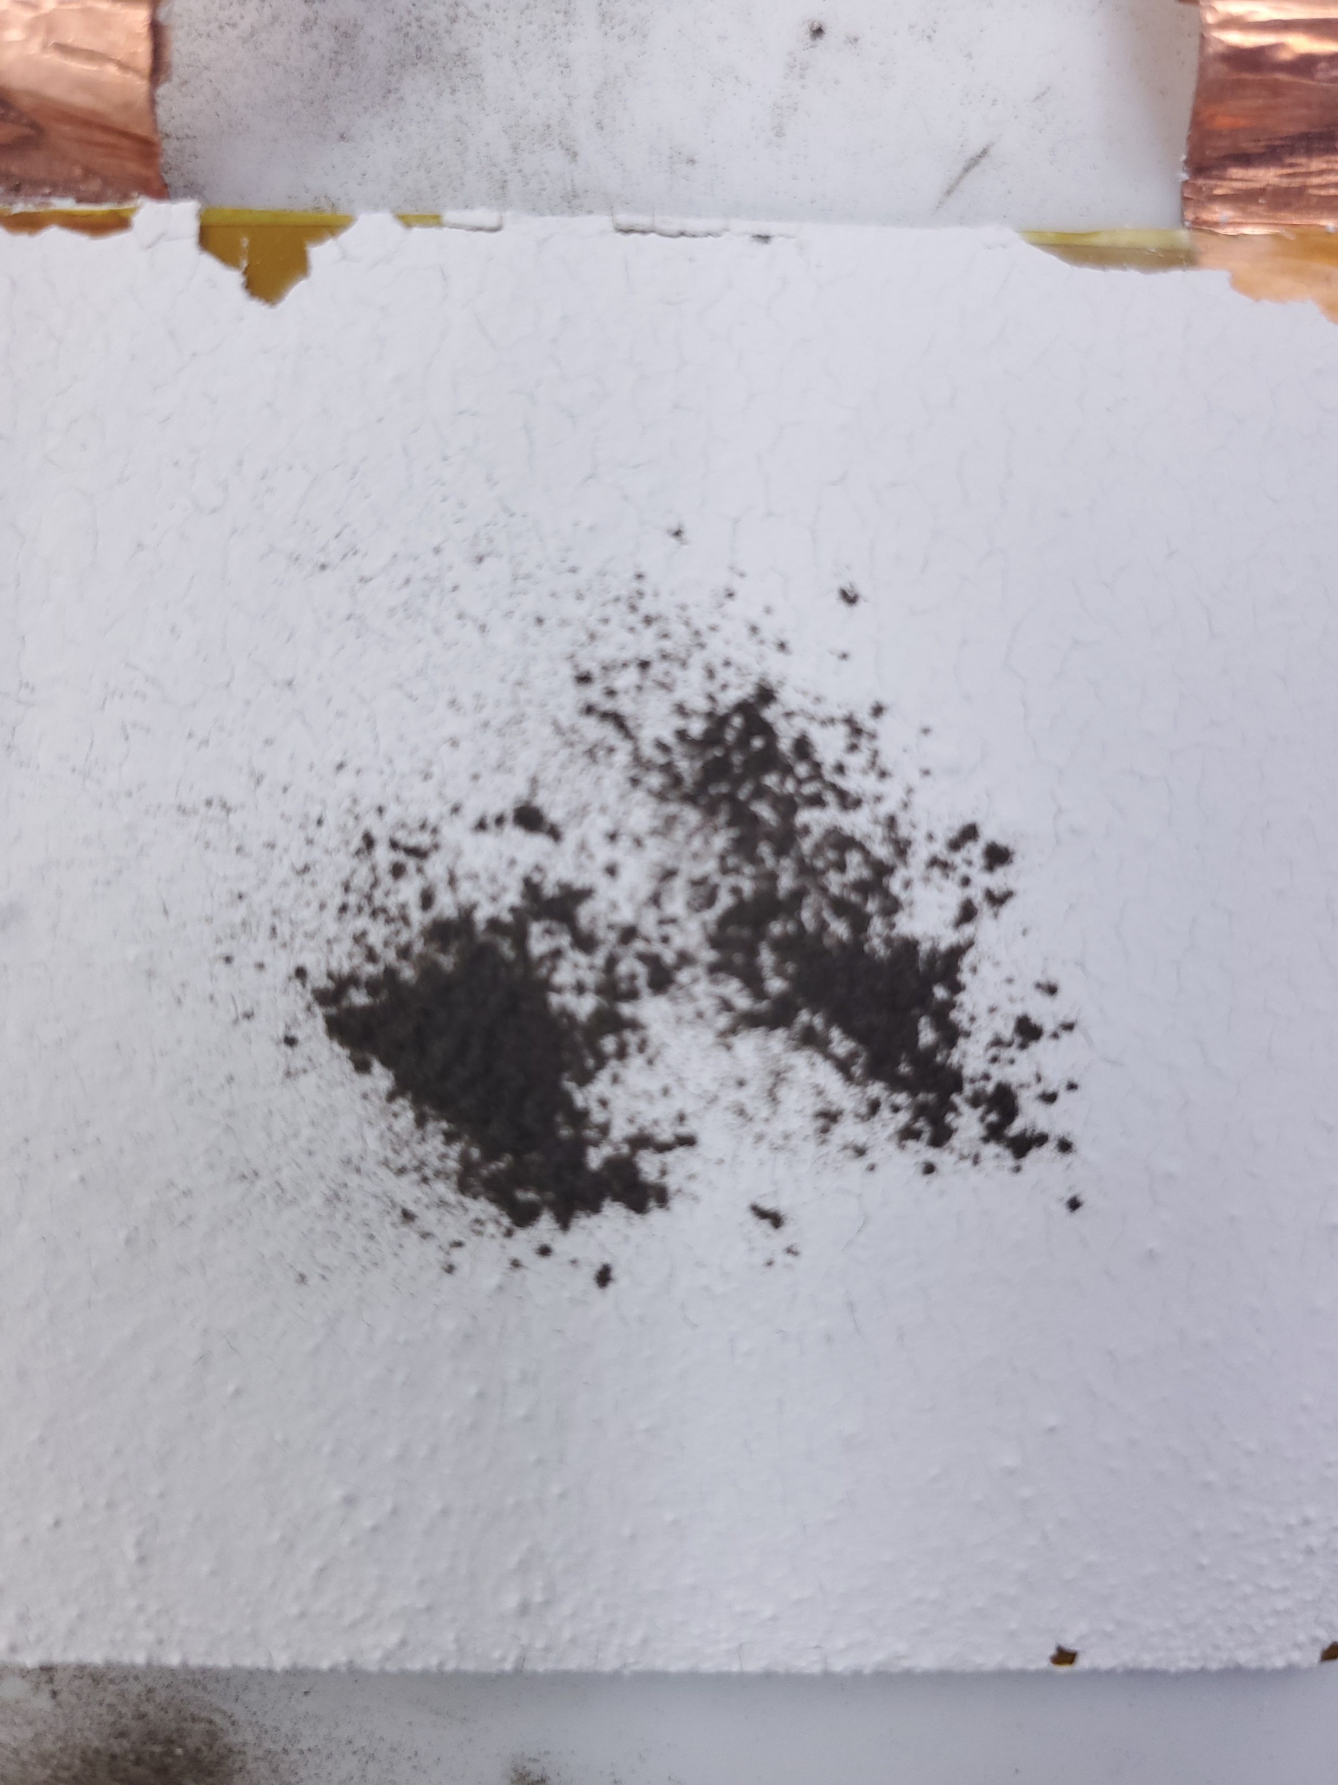
KSC Radiator Dust removal
KSC
Aeroglaze A276
Barium Sulfate
Solar Absorptance: within ~5% of original value after dust removal
Emissivity: within 2% of original value
Clean
Dirty
Clear ± 1200 V
Clean
Dirty
Clear ± 1000 V
Solar White (KSC APL)
AZ-93
Dust removal was ineffective at high humidity
Vacuum tests will lower humidity and make the EDS effective
Clean
Dirty
Clear ± 1500 V
Clean
Dirty
Clear ± 1500 V

Slide 4
Conclusion
KSC
In general, all the coatings were insulative at 0% RH/ vacuum which resulted in varying levels of dust clearing in vacuum
  Thickness between the electrodes and surface affected dust clearing
  Solar Absorptance was restored within 10% of original value when EDS worked
    Even partially it restored some solar absorptance back
Thermal vacuum revealed EDS has some thermal impact but this hasn’t been fully tested
  Different adhesive will have to be used to prevent delamination (+100 C)
More investigation is warranted before TRL 7

