Slide 1
DSCOVR Data Distribution at The Atmospheric Science Data Center
Hazem Mahmoud, Ph.D.
ASDC Scientist
10/16/2023
Notes:
STILL

Slide 2
ASDC Overview
DSCOVR Data Products and Distribution
Data Distribution Tools and Services
ASDC on the Cloud
Discussion

Slide 3
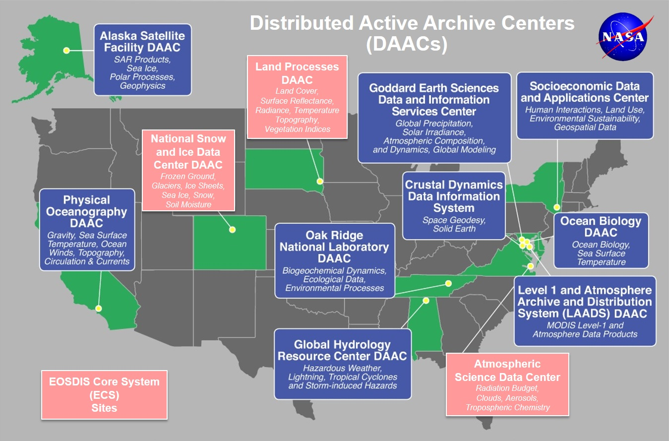
Earth Observation System Data and Information System EOSDIS
EOSDIS data centers process, archive, and distribute thousands of data products to the global user community. The primary services provided by EOSDIS are data archive & management, distribution, information management, product generation, and user support. It is comprised of multiple components including:
Distributed Active Archive Centers (DAACs)
Science Data Processing Segment (SDPS)
Science Investigator-led Processing Systems (SIPS)
Common Metadata Repository (CMR)
Earthdata
Global Imagery Browse Services (GIBS)
more

Slide 4

ASDC Vision
"To be a leading provider of atmospheric science data products and services to the science community through agility, innovation, and technical excellence“

Slide 5
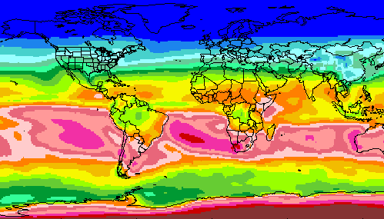
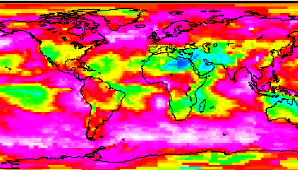
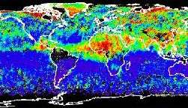
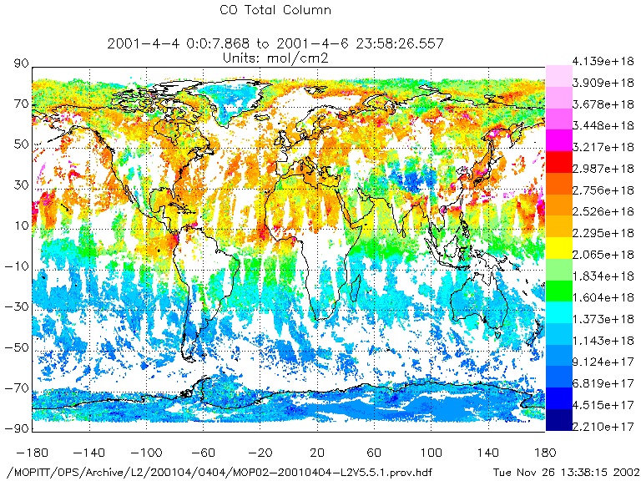
RADIATION BUDGET
CLOUDS
ASDC at a glance
100+ Science projects
  ⚬ TEMPO ⚬ MISR ⚬ MOPITT ⚬ MAIA ⚬ CERES
  ⚬ CALIPSO → RSIG (EPA)
  ⚬ Airborne field campaigns
  (KORUS AQ, DISCOVER AQ, FIREX AQ)
1300+ unique science products
Data usage
  ⚬ 4,600+ Terabytes ⚬ 160,000+ users
  ⚬ 158 countries
Data archive
  ⚬ 5.8 Petabytes ⚬ 141 million files (4,400 TB) on high-speed disks
Data in cloud (ongoing)
  ⚬ Data and services in the cloud
  ⚬ Scalable infrastructure
AEROSOLS
TROPOSPHERIC COMPOSITION
Primary Functions of ASDC
Ingest receive data from data provider
Archive preservation & provenance
Distribute tools and services
Process create higher level products
Outreach & Support research community

Slide 6
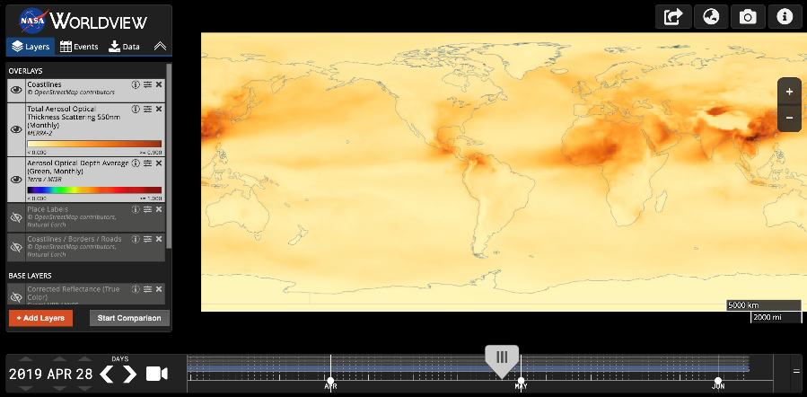





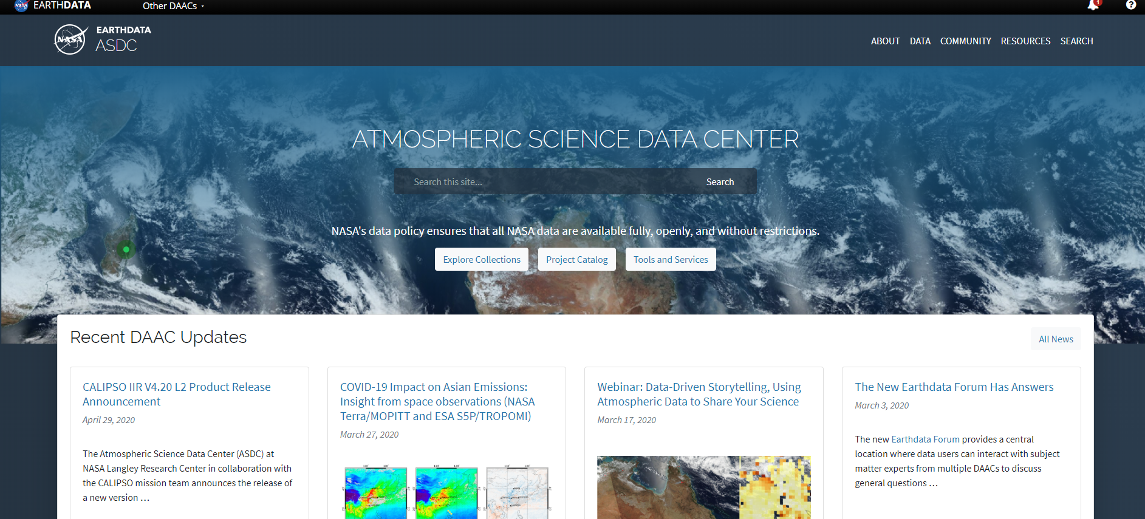
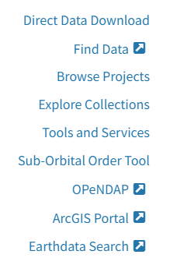




ASDC Data Distribution: Tools and Services
NASA Earthdata Search
  ⚬ metadata ⚬ browse ⚬ download
  ⚬ customize ⚬ HTTPS and AWS S3 direct data access
NASA Earthdata WorldView
  ⚬ visualize ⚬ GIBS API
NASA Earthdata Harmony
  ⚬ transform ⚬ subset ⚬ reformat
NASA Earthdata GIS
  ⚬ ArcGIS Image & Feature Service
  ⚬ OGC WMS, WFS & WCS
OPeNDAP
  ⚬ transform ⚬ subset ⚬ reformat
ASDC Subsetters
  ⚬ subset ⚬ aggregate
User Support and Other Resources
Example scripts
  ⚬ Python/Jupyter Notebook ⚬ R scripts
  ⚬ contributed tutorials/scripts
Earthdata Forum https://forum.earthdata.nasa.gov/
ASDC User Support support-asdc@earthdata.nasa.gov
https://asdc.larc.nasa.gov/
Notes:
Earthdata Login https://urs.earthdata.nasa.gov

Slide 7
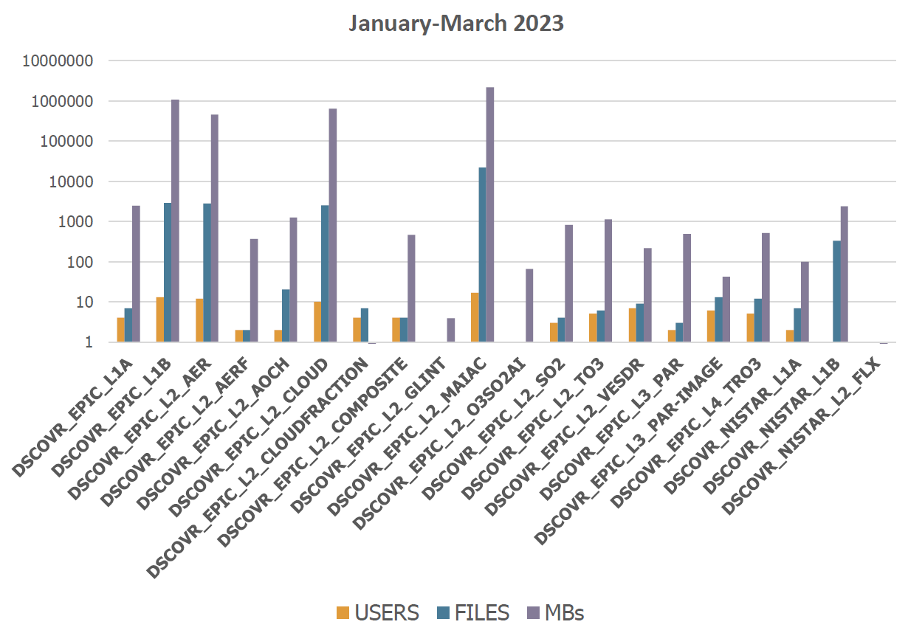
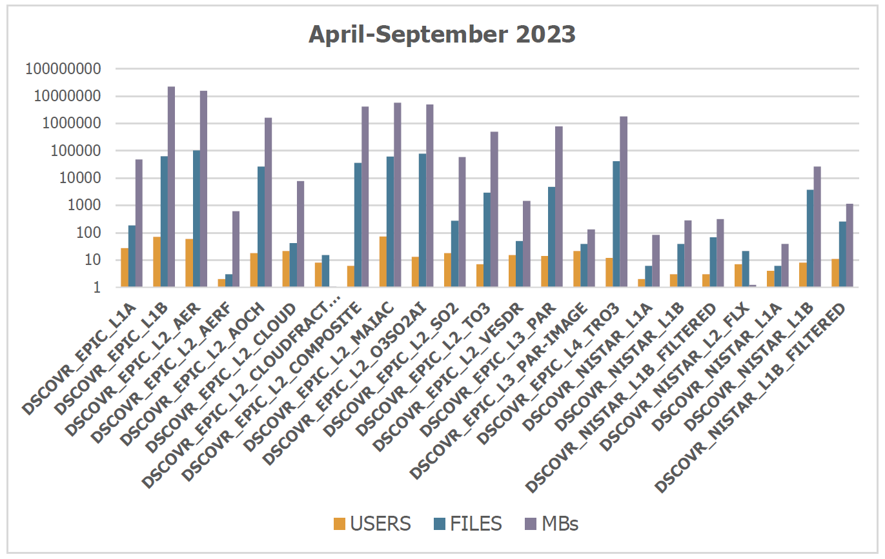
DSCOVR Data Products:
Number of Users per Product for 2020-2021
Average order size:
2020: 1143 granules, 232GB
2021: 1044 granules, 146GB
2021: 1044 granules, 146GB
2021: 1044 granules, 146GB
RECENT UPDATES:
DSCOVR_EPIC_L3_PAR
DSCOVR_EPIC_L2_GLINT
are now orderable

Slide 8
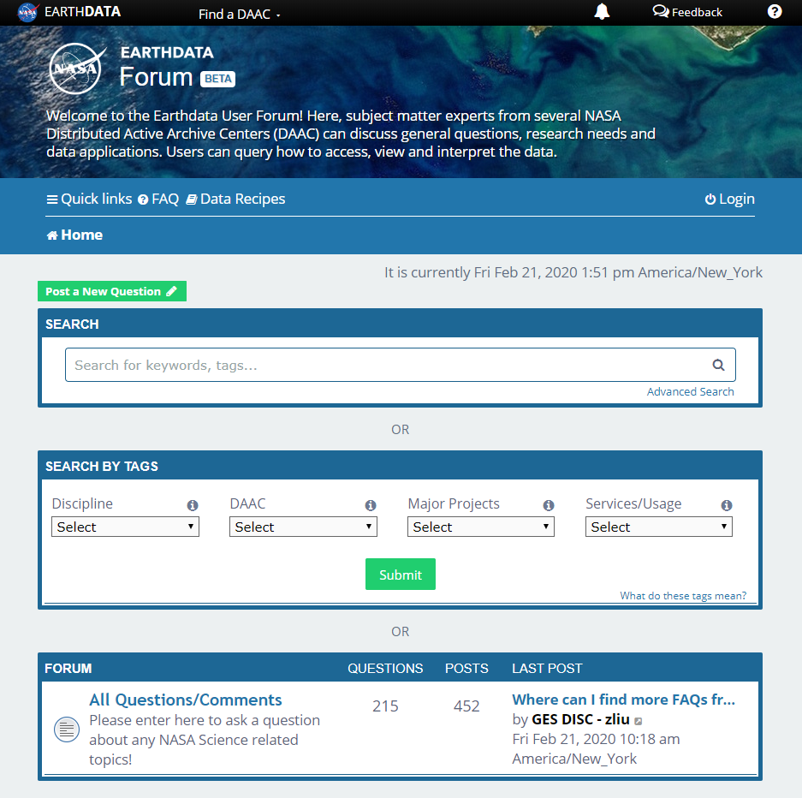
Earthdata Forum
Science Data Users can seamlessly search for information even if they do not know which DAAC the data belongs to.
Scientists & Data Providers can effectively assist their user community in more accurately using their products.
DAACs & Subject Matter Experts (SMEs) can quickly link users to existing resources.
DAAC User Services can swiftly provide inquirers with an authoritative source related to DAAC data products & services.
https://forum.earthdata.nasa.gov/
Notes:
The Earthdata Forum is our new online resource for staff members and subject matter experts from several NASA Distributed Active Archive Centers (DAACs) assist inquirers with questions about their NASA Earth science data. General questions, research needs, and data applications can all be subjects here. Members of the NASA scientific user community are encouraged also provide insights and collaborative assistance.​

Slide 9
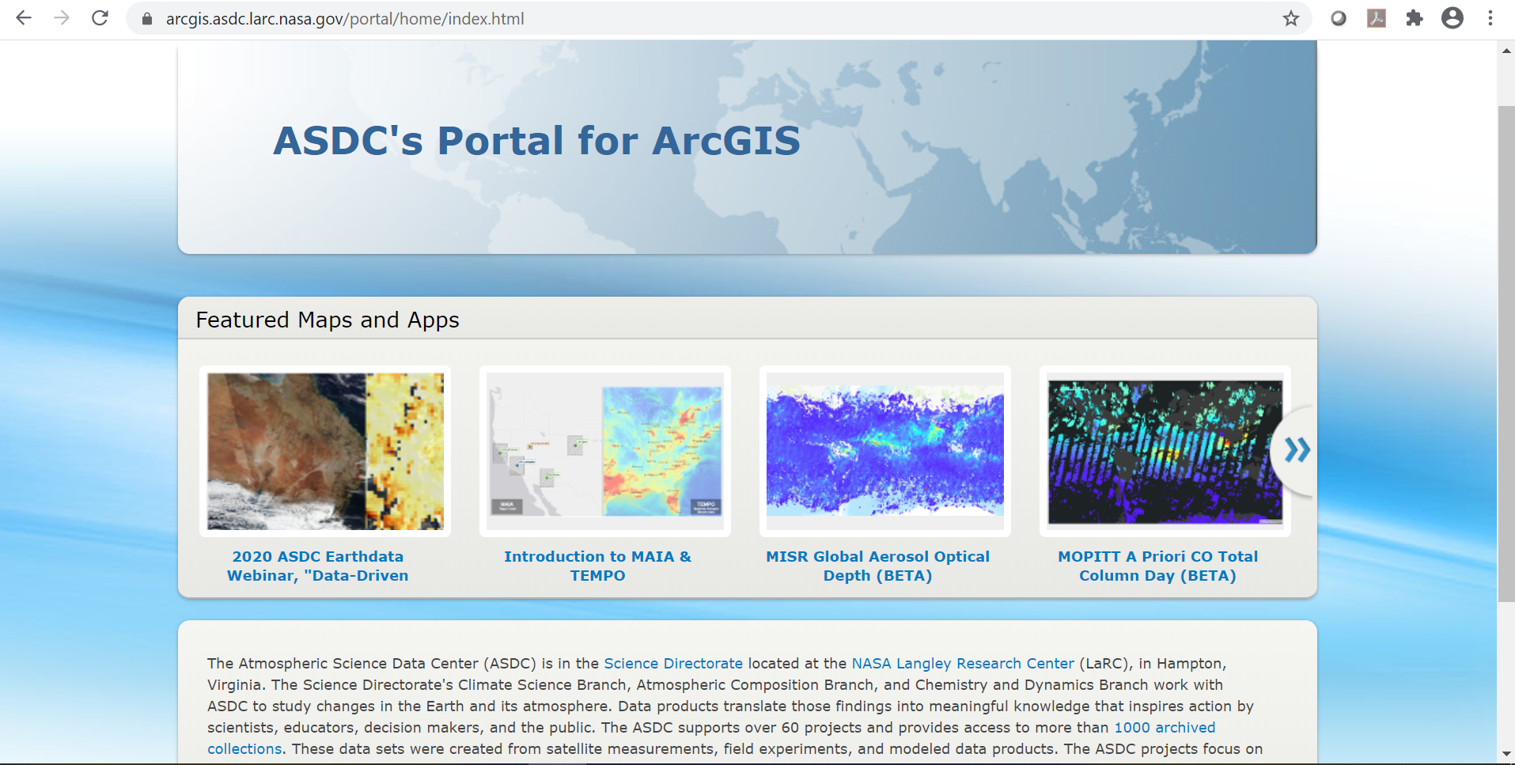

ASDC Portal for ArcGIS
Select ASDC datasets available publicly as image services and WMS
Incorporate data directly into web applications and desktop software
Develop storymaps, jupyter notebooks and outreach content
https://arcgis.asdc.larc.nasa.gov

Slide 10
Earthdata Forum
Science Data Users can seamlessly search for information even if they do not know which DAAC the data belongs to.
Scientists & Data Providers can effectively assist their user community in more accurately using their products.
DAACs & Subject Matter Experts (SMEs) can quickly link users to existing resources.
DAAC User Services can swiftly provide inquirers with an authoritative source related to DAAC data products & services.
https://forum.earthdata.nasa.gov/
Notes:
The Earthdata Forum is our new online resource for staff members and subject matter experts from several NASA Distributed Active Archive Centers (DAACs) assist inquirers with questions about their NASA Earth science data. General questions, research needs, and data applications can all be subjects here. Members of the NASA scientific user community are encouraged also provide insights and collaborative assistance.​

Slide 11
ASDC in the Cloud
ESDIS is heavily investing in commercial cloud
  Primary motivations
    To allow the science community to do unprecedented science with unconstrained processing and storage capacity across all EOSDIS data in a highly available environment (AWS)
    The size of future datasets makes on-premise archiving undesirable
      SWOT and NISAR are most often cited
  Building an AWS-native ingest and archive system called Cumulus that is intended to be used by all DAACs
  ESDIS pays for the storage. Users pay for their own compute resources.
  Data download will still be available free of charge
  TEMPO, CLARREO-PF and PREFIRE are ingested on the cloud
  User experience will not be interrupted or degraded
  Activities are being planned in a way to avoid introducing technical and schedule risks and dependencies.
  ASDC will work closely with ESDIS to identify risks, technical challenges and uncertainties, and proposing concepts and architectures for mitigating any issues that arise

Slide 12
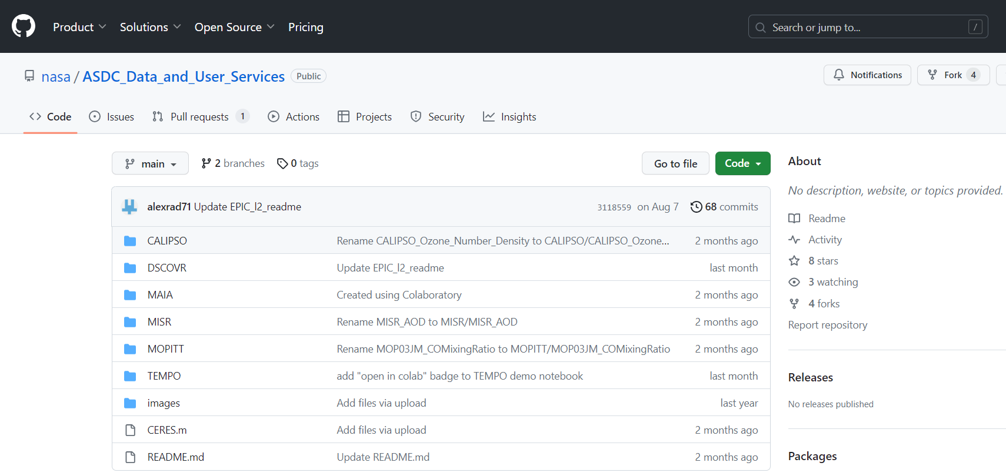

Slide 13
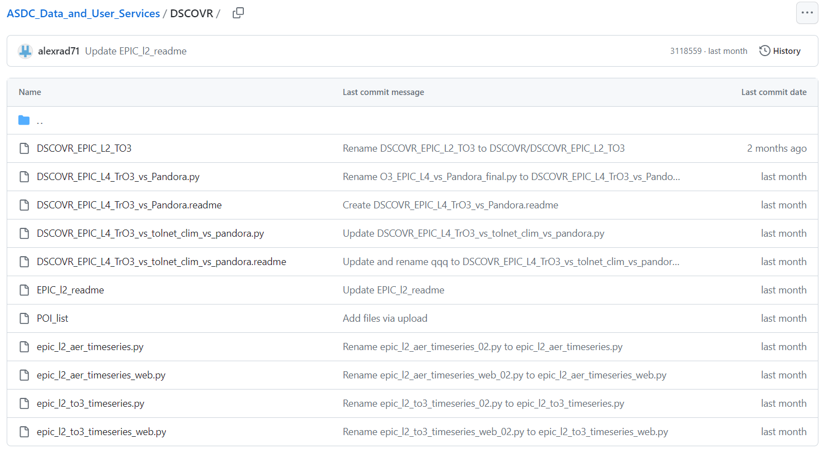

Slide 14
ASDC Overview
DSCOVR Data Products and Distribution
Data Distribution Tools and Services
Discussion

Slide 15
Atmospheric Science Data Center
NASA Langley Research Center
Hampton, Virginia (USA)
https://asdc.larc.nasa.gov/
support-asdc@earthdata.nasa.gov

Slide 16
DSCOVR Data Products:
Number of Users per Product for 2020-2021
Average order size:
2020: 1143 granules, 232GB
2021: 1044 granules, 146GB
RECENT UPDATES:
DSCOVR_EPIC_L3_PAR
DSCOVR_EPIC_L2_GLINT
are now orderable

Slide 17
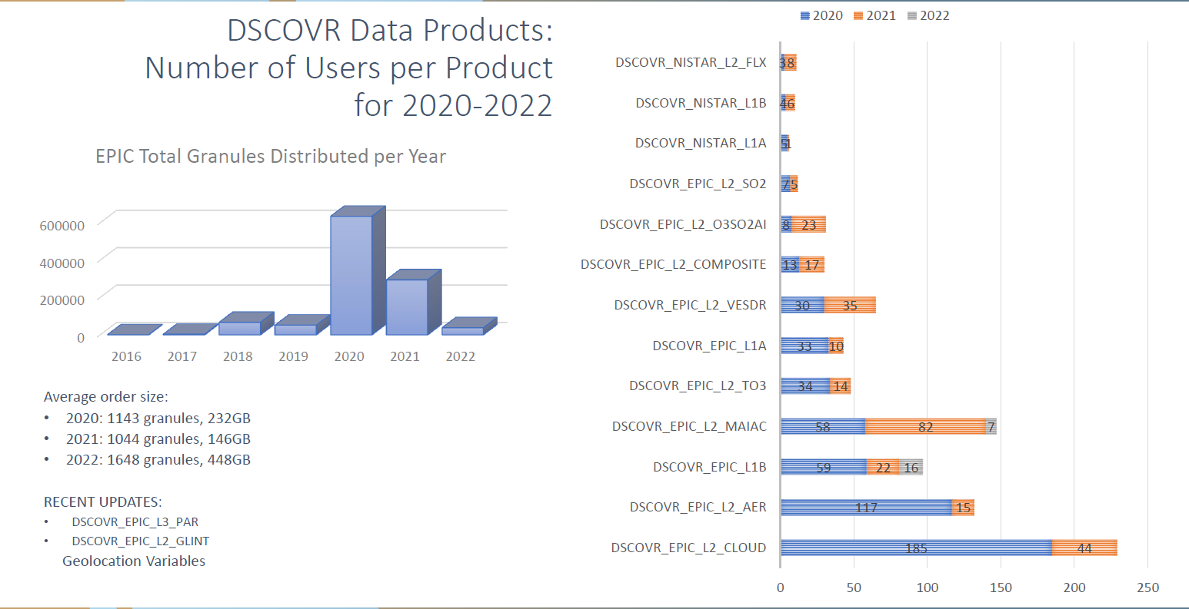

Slide 18
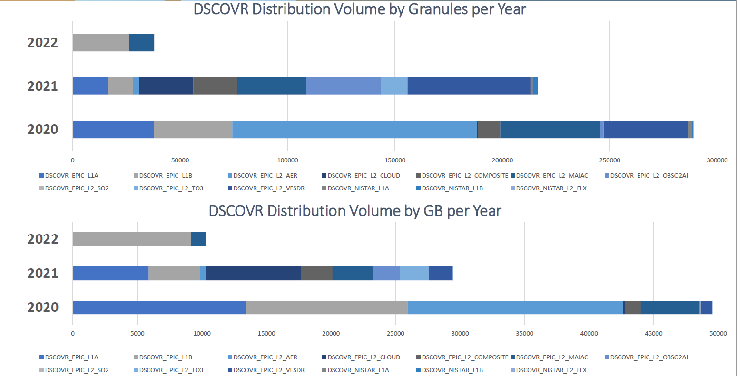

Slide 21
DSCOVR Distribution Volume by GB per Year
DSCOVR Distribution Volume by Granules per Year

Slide 22
Services at the ASDC
PRE-LAUNCH
Preparation for Ingest
  Accurate metadata for discovery
  Well formatted data for maximum interoperability
  Digital Object Identifiers for each product
Support Data Flow Testing Prior to Launch
  Interface confidence tests
  End-to-end ground system testing with instrument or synthetic data
Discuss Service Options
  Customer/Product affinities and technical capacity
  Data Delivery Cadence
ACTIVE OPERATIONS
Standard curation of archived data
  Provenance and integrity
  Up to date documentation
  Disaster Recovery
User Services staff to assist customers
  Maintain FAQs, examples of scripts
  Perform reach back to science team when necessary
  Disseminate announcements to user community
  Use customer feedback from annual third-party ACSI survey, contacts, and ASDC User Working Group to determine changes in services
Subsetting and ArcGIS capabilities
  Temporal, spatial and variable slices

Slide 23
ASDC Data Distribution: Tools and Services
NASA Earthdata Search
  CMR Search ⚬ Metadata
NASA WorldView
  GIBS API ⚬ visualization
OPeNDAP
  ⚬ transform ⚬ subsetting
  ⚬ reformatting ⚬ distribution
HTTPS data access
  ⚬ datapool
  ⚬ permanent URL/direct access
  ⚬ enables scripts/workflow
Example scripts
  ⚬ Python/Jupyter Notebook
  ⚬ R scripts
  ⚬ contributed tutorials/scripts
User Support and Other Resources
Earthdata Login https://urs.earthdata.nasa.gov
Earthdata Forum https://forum.earthdata.nasa.gov/
ASDC User Support support-asdc@earthdata.nasa.gov

Slide 24
https://asdc.larc.nasa.gov/
Notes:
Brand new website with features like filters by discipline and tools, keyword search bar, new look matching Earthdata layout
Top buttons: Explore Collections, Project Catalog, Tools and Services
News stories, outreach section coming soon
Outreach activities: Webinars, tutorials, data recipes, Jupyter Notebooks, Story Maps, more ArcGIS friendly datasets
Will be able to easily access MAIA and TEMPO data and other tools & services from this main website

Slide 25
ASDC in the Cloud
ESDIS is heavily investing in commercial cloud
  Primary motivations
    To allow the science community to do unprecedented science with unconstrained processing and storage capacity across all EOSDIS data in a highly available environment (AWS)
    The size of future datasets makes on-premise archiving undesirable
      SWOT and NISAR are most often cited
  Building an AWS-native ingest and archive system called Cumulus that is intended to be used by all DAACs
  ESDIS pays for the storage. Users pay for their own compute resources.
  Data download will still be available free of charge
  TEMPO, CLARREO-PF and PREFIRE are ingested on the cloud
  User experience will not be interrupted or degraded
  Activities are being planned in a way to avoid introducing technical and schedule risks and dependencies.
  ASDC will work closely with ESDIS to identify risks, technical challenges and uncertainties, and proposing concepts and architectures for mitigating any issues that arise

Slide 26
ASDC Portal for ArcGIS
Select ASDC datasets available publicly as image services and WMS
Incorporate data directly into web applications and desktop software
Develop storymaps, jupyter notebooks and outreach content
https://arcgis.asdc.larc.nasa.gov

Slide 27
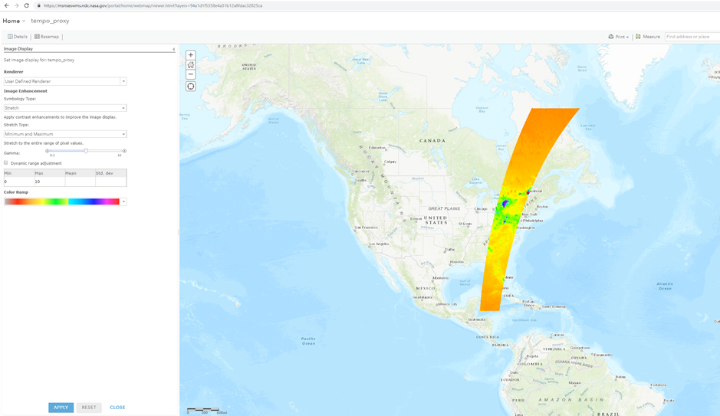
TEMPO Data Products
TEMPO file granules will be indexed by variable, date, scan, and granule correlating to the respective swath of data. Files are archived in Netcdf4 format with their respective metadata record in ODL format.
TEMPO Data Products
Level 0 | radiance, irradiance, telemetry, dark frames
Level 1b | calibrated & geolocated radiance, irradiance
Level 2 | derived products for total ozone, ozone vertical profile, formaldehyde, nitrogen dioxide, cloud pressure and fraction
Level 3 | gridded, derived products for total ozone, ozone vertical profile, formaldehyde, nitrogen dioxide, cloud pressure and fraction
Data File Naming Convention
TEMPO_NO2_L3_V01_YYYYMMDDTHHMMSSZ_ScanIDGranuleID.nc
NO2 - this is the variable or product name contained in the file L3 - this indicates the product level (L0, L1, L2, L3) V01 - this denotes the version of the data file YYYYMMDD - year, month, day HHMMSSZ - the time in UTC ScanID - this indicates the scan counter value GranuleID - this indicates the granule counter value

Slide 28
https://asdc.larc.nasa.gov/
Notes:
Brand new website with features like filters by discipline and tools, keyword search bar, new look matching Earthdata layout
Top buttons: Explore Collections, Project Catalog, Tools and Services
News stories, outreach section coming soon
Outreach activities: Webinars, tutorials, data recipes, Jupyter Notebooks, Story Maps, more ArcGIS friendly datasets
Will be able to easily access MAIA and TEMPO data and other tools & services from this main website

Slide 29
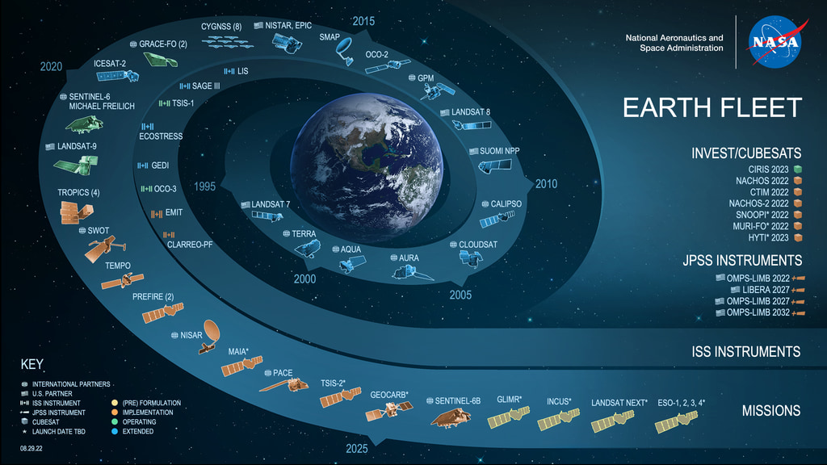

Slide 30
DSCOVR
JAN-MAR, 2023
DDD
 |  | IP ADDRESS | USER NAME
date_month | count | dc(UserIP) | dc(user_name) | Bytes | Megabytes
january | 11470 | 45 | 23 | 3.10087E+12 | 2957218.398
february | 3453 | 34 | 31 | 6.51581E+11 | 621395.7082
march | 26031 | 43 | 24 | 3.00364E+12 | 2864499.062

Slide 31
DSCOVR
JAN-MAR, 2023
DDD
MissInProd = Mission / Instrument / Product
40,970 events (1/1/23 12:00:00.000 AM to 4/1/23 12:00:00.000 AM)
MissInProd | count | dc(UserIP) | dc(user_name) | Bytes | Megabytes
DSCOVR/EPIC/L1A | 22 | 8 | 7 | 2585192736 | 2465.431915
DSCOVR/EPIC/L1B | 5524 | 17 | 13 | 1.94407E+12 | 1854008.893
DSCOVR/EPIC/L2_AERF_01 | 11 | 2 | 2 | 387078599 | 369.1469183
DSCOVR/EPIC/L2_AER_03 | 5189 | 13 | 7 | 5.1436E+11 | 490532.3366
DSCOVR/EPIC/L2_AOCH_01 | 68 | 6 | 5 | 2664079202 | 2540.663912
DSCOVR/EPIC/L2_CLOUDFRACTION_01 | 21 | 5 | 2 | 1351782 | 1.289159775
DSCOVR/EPIC/L2_CLOUD_03 | 7236 | 14 | 12 | 1.99824E+12 | 1905672.725
DSCOVR/EPIC/L2_COMPOSITE_01 | 6 | 2 | 2 | 251113442 | 239.4804401
DSCOVR/EPIC/L2_COMPOSITE_02 | 54 | 9 | 5 | 484323634 | 461.8870106
DSCOVR/EPIC/L2_GLINT_01 | 4 | 1 | 1 | 4296971 | 4.097910881
DSCOVR/EPIC/L2_MAIAC_02 | 22156 | 21 | 9 | 2.29127E+12 | 2185122.726
DSCOVR/EPIC/L2_O3SO2AI_02 | 4 | 1 | 1 | 68246121 | 65.08457279
DSCOVR/EPIC/L2_O3SO2AI_03 | 15 | 4 | 4 | 137106127 | 130.7545919
DSCOVR/EPIC/L2_SO2_02 | 22 | 5 | 5 | 1072031030 | 1022.36846
DSCOVR/EPIC/L2_TO3_03 | 15 | 5 | 2 | 1164547734 | 1110.599264
DSCOVR/EPIC/L2_VESDR_02 | 23 | 8 | 7 | 263544158 | 251.3352947
DSCOVR/EPIC/L3_PAR | 26 | 7 | 3 | 43871828 | 41.83943558
DSCOVR/EPIC/L3_PAR_01 | 7 | 3 | 3 | 509223873 | 485.633729
DSCOVR/EPIC/L4_TrO3_01 | 44 | 12 | 8 | 584138575 | 557.0779562
DSCOVR/NIST/L2 | 12 | 5 | 4 | 270849 | 0.258301735
DSCOVR/NISTAR_V3/L1A | 28 | 5 | 5 | 105052570 | 100.1859379
DSCOVR/NISTAR_V3/L1B | 358 | 2 | 2 | 2529228977 | 2412.060716
DSCOVR/NISTAR_V3/L1B_FILTERED | 12 | 4 | 3 | 236962 | 0.225984573
public/DSCOVR/EPIC | 1 | 1 | 1 | 144314 | 0.137628555

Slide 32
DSCOVR
JAN-DEC, 2022
DDD
MissInProd = Mission / Instrument / Product
392,777 events (1/1/22 12:00:00.000 AM to 1/1/23 12:00:00.000 AM)
MissInProd | count | dc(UserIP) | dc(user_name) | Bytes | Megabytes
DSCOVR/EPIC/L1A | 22295 | 68 | 50 | 8.11607E+12 | 7740086.243
DSCOVR/EPIC/L1B | 84583 | 111 | 70 | 2.98259E+13 | 28444233.45
DSCOVR/EPIC/L2_AERF_01 | 81 | 19 | 13 | 1469808971 | 1401.719066
DSCOVR/EPIC/L2_AER_03 | 68903 | 96 | 43 | 9.94341E+12 | 9482772.749
DSCOVR/EPIC/L2_AOCH_01 | 40 | 9 | 6 | 261582835 | 249.4648314
DSCOVR/EPIC/L2_CLOUDFRACTION_01 | 42 | 12 | 8 | 2420174 | 2.308057785
DSCOVR/EPIC/L2_CLOUD_03 | 89462 | 112 | 77 | 2.5309E+13 | 24136544.74
DSCOVR/EPIC/L2_COMPOSITE_01 | 296 | 19 | 20 | 15132138953 | 14431.13227
DSCOVR/EPIC/L2_COMPOSITE_02 | 391 | 17 | 13 | 34997177943 | 33375.90975
DSCOVR/EPIC/L2_GLINT_01 | 184 | 45 | 15 | 182468993 | 174.0159922
DSCOVR/EPIC/L2_MAIAC_02 | 58577 | 56 | 30 | 5.91705E+12 | 5642938.549
DSCOVR/EPIC/L2_O3SO2AI_02 | 2616 | 21 | 22 | 1.75323E+11 | 167201.5109
DSCOVR/EPIC/L2_O3SO2AI_03 | 5097 | 23 | 12 | 3.41204E+11 | 325397.4498
DSCOVR/EPIC/L2_SO2_02 | 676 | 27 | 19 | 89909285509 | 85744.1764
DSCOVR/EPIC/L2_TO3_03 | 1622 | 26 | 17 | 3.07744E+11 | 293487.8645
DSCOVR/EPIC/L2_VESDR_02 | 48445 | 39 | 29 | 1.62053E+12 | 1545453.612
DSCOVR/EPIC/L3_PAR | 105 | 28 | 17 | 110040593 | 104.9428873
DSCOVR/EPIC/L3_PAR_01 | 4081 | 38 | 21 | 6.64761E+11 | 633965.8204
DSCOVR/EPIC/L4_TrO3_01 | 450 | 46 | 24 | 62022519791 | 59149.28416
DSCOVR/NIST/L2 | 122 | 28 | 19 | 3487477 | 3.325917244
DSCOVR/NISTAR_V3/L1A | 3118 | 21 | 21 | 50255965999 | 47927.82402
DSCOVR/NISTAR_V3/L1B | 624 | 23 | 16 | 3935459875 | 3753.147006
DSCOVR/NISTAR_V3/L1B_FILTERED | 150 | 18 | 16 | 338521567 | 322.839324

Slide 33
ASDC in the Cloud
ESDIS is heavily investing in commercial cloud
  Primary motivations
    To allow the science community to do unprecedented science with unconstrained processing and storage capacity across all EOSDIS data in a highly available environment (AWS)
    The size of future datasets makes on-premise archiving undesirable
      SWOT and NISAR are most often cited
  Building an AWS-native ingest and archive system called Cumulus that is intended to be used by all DAACs
  ESDIS pays for the storage. Users pay for their own compute resources.
  Data download will still be available free of charge

Slide 34
ASDC in the Cloud
ASDC engaged in a “Phase I” onboarding activity with ESDIS support
  Period of performance is July 2020 to December 2021
  Selected a small number of data sets from MISR, MOPITT, and CERES to ingest as part of this first phase
    Data will still be ingested and stored at ASDC with a copy sent to AWS
  Phase I does not include any services such as subsetting, etc.
  Data will continue to be archived on site at ASDC for the forseeable future
Guiding Principles
  User experience will not be interrupted or degraded
  Activities are being planned in a way to avoid introducing technical and schedule risks and dependencies
  ASDC will work closely with ESDIS to identify risks, technical challenges and uncertainties, and proposing concepts and architectures for mitigating any issues that arise

Slide 36
DSCOVR
JAN-MAR, 2023
OPeNDAP |  | IP ADDRESS
date_month | count | dc(clientip) | Bytes | Megabytes
january | 0 | 0 | 0 | 0
february | 0 | 0 | 0 | 0
march | 61 | 4 | 538636 | 0.513683319

Slide 37
OPeNDAP
MissInProd = Mission / Instrument / Product
Complete 3,205 events (1/1/23 12:00:00.000 AM to 4/1/23 12:00:00.000 AM)
MissInProd | count | dc(clientip) | Bytes | Megabytes
DSCOVR/EPIC/L2_AERF_01 | 3 | 2 | 28182 | 0.02687645
DSCOVR/EPIC/L2_AER_03 | 8 | 2 | 3530814 | 3.367246628
DSCOVR/EPIC/L2_AOCH_01 | 13 | 4 | 94889720 | 90.49388885
DSCOVR/EPIC/L2_COMPOSITE_01 | 4 | 2 | 41728 | 0.039794922
DSCOVR/EPIC/L2_COMPOSITE_02 | 5 | 2 | 59320 | 0.05657196
DSCOVR/EPIC/L2_GLINT_01 | 5 | 2 | 64110 | 0.06114006
DSCOVR/EPIC/L2_MAIAC_02 | 14 | 3 | 7797299 | 7.436083794
DSCOVR/EPIC/L2_O3SO2AI_02 | 1 | 1 | 12669 | 0.0120821
DSCOVR/EPIC/L2_O3SO2AI_03 | 5 | 3 | 67420 | 0.064296722
DSCOVR/EPIC/L2_SO2_02 | 11 | 3 | 528550 | 0.50406456
DSCOVR/EPIC/L2_TO3_03 | 2 | 2 | 26928 | 0.025680542
DSCOVR/EPIC/L2_VESDR_02 | 1 | 1 | 11844 | 0.011295319
DSCOVR/EPIC/L3_PAR_01 | 2 | 2 | 26113 | 0.024903297
DSCOVR/EPIC/L4_TrO3_01 | 18 | 5 | 5637401 | 5.376244545

Slide 39
ASDC Data Distribution: Tools and Services
NASA Earthdata Search
  ⚬ metadata ⚬ browse ⚬ download
  ⚬ customize ⚬ HTTPS and AWS S3 direct data access
NASA Earthdata WorldView
  ⚬ visualize ⚬ GIBS API
NASA Earthdata Harmony
  ⚬ transform ⚬ subset ⚬ reformat
NASA Earthdata GIS
  ⚬ ArcGIS Image & Feature Service
  ⚬ OGC WMS, WFS & WCS
OPeNDAP
  ⚬ transform ⚬ subset ⚬ reformat
ASDC Subsetters
  ⚬ subset ⚬ aggregate
User Support and Other Resources
Example scripts
  ⚬ Python/Jupyter Notebook ⚬ R scripts
  ⚬ contributed tutorials/scripts
Earthdata Forum https://forum.earthdata.nasa.gov/
ASDC User Support support-asdc@earthdata.nasa.gov
https://asdc.larc.nasa.gov/
Notes:
Earthdata Login https://urs.earthdata.nasa.gov

