Slide 1
Atmospheric Science Questions to be addressed by Uranus Orbiter and Probe, NASA’s Next Flagship Mission
Kunio M. Sayanagi
Science Directorate
NASA Langley Research Center
2023-10-11
UC Berkeley CIPS Planetary Seminar
Background: Voyager 2 Image of Uranus (NASA Image Release PIA00143)

Slide 2
2022 Planetary Decadal Survey Recommendation
From Decadal Survey Public Release:
https://www.nationalacademies.org/event/04-19-2022/planetary-science-and-astrobiology-decadal-survey-2023-2032-public-release-of-the-survey-report

Slide 3
Outline
A bit about myself
Uranus Orbiter and Probe (UOP) Overview
Atmospheric Science Questions
Preparing for the mission
  Advance Science
  Advocate for Measurements

Slide 4
A bit about myself… (1)
2007 PhD in physics with minor in atmos. sci. (U. Arizona)
2007-2012 postdoc (U. Louisville, Caltech and UCLA)
2012-2022 Assistant → Associate Professor (Hampton U.)
2022 Moved to NASA Langley Research Center in September 2022!

Slide 5
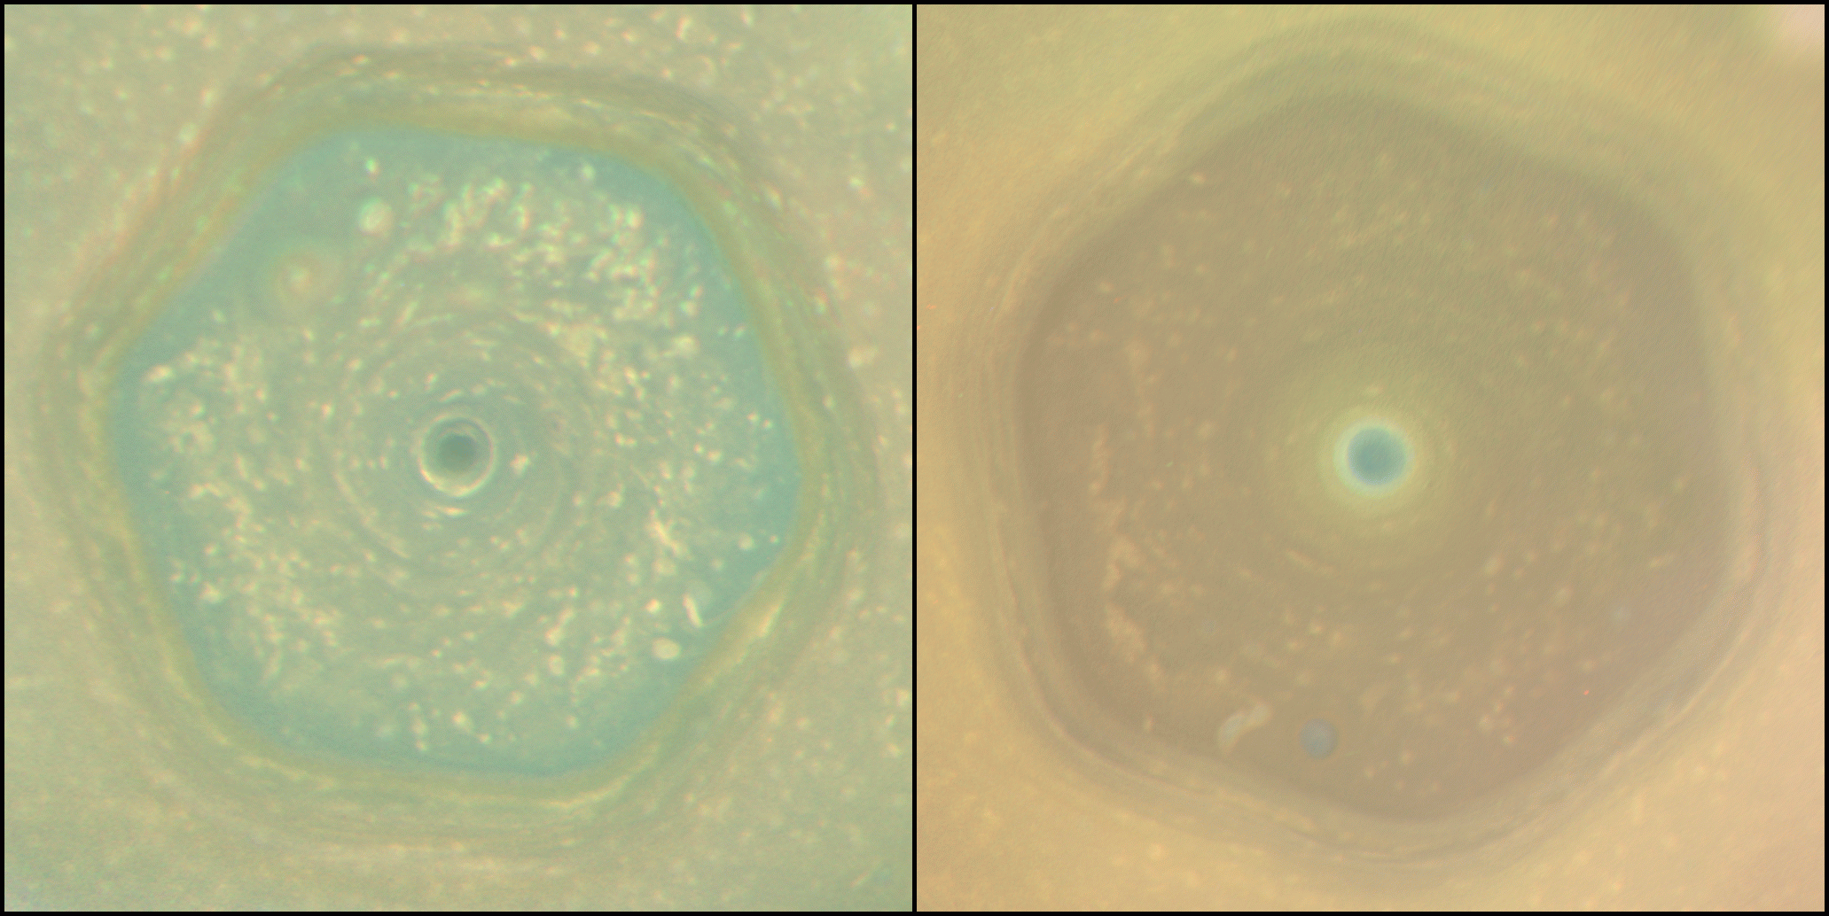
A bit about myself (2)
Core Expertise:
Atmospheric Dynamics (Venus, Jupiter, Saturn, Titan, Uranus and Neptune)
Atmospheric Remote Sensing (e.g. Cassini Imaging Team Member)
Mission Concept Development
Left: Saturn’s North Polar Hexagon in 2012 and 2016
https://photojournal.jpl.nasa.gov/catalog/PIA21611

Slide 6
A bit about myself (3)
Decadal Survey Involvement
2013 Decadal Survey: Giant Planets Panelist
  Represented GP Panel on Saturn Probe New Frontiers Mission Study
2023 Decadal Survey:
  Led CHARISMA space telescope study proposal at LaRC and whitepaper
  Neptune Odyssey Flagship Concept
    Co-I on Study Team / Atmospheric Science WG Co-lead
    Led Atmospheric Probe concept formulation at LaRC
Steering Committee of NASA Outer Planets Assessment Group (OPAG)
PI of SNAP Uranus Probe Concept Study
  Leveraged engineering capabilities at LaRC
  Designed a small probe as an option for future Uranus Flagship

Slide 7
Background: Planetary Decadal Surveys
Decadal Survey
A NASA-commissioned study conducted by a National Academies Committee.
Committee members are scientists and engineers working on planetary projects.
Committee recommends a 10-year strategy for NASA based on priority science
Mission Recommendations:
  Large Missions (“Flagship Class” > $1B): Recommend 1-2 directed missions
  Medium Missions (“New-Frontiers Class” <$1B): Recommend mission themes allowed to be proposed to NF
  Small Missions (“Discovery Class” ~$500M, “SIMPLEx Class” ~$100M):
  Decadal evaluates program value, but does not evaluate individual mission concepts
Planetary Decadal Survey History
First Decadal: 2003 “New Frontiers in the Solar System: An Integrated Exploration Strategy” (https://doi.org/10.17226/10432 )
Second Decadal: 2011 “Vision and Voyages for Planetary Science in the Decade 2013-2022” (https://doi.org/10.17226/13117)
Third Decadal: 2022 “Origins, Worlds, and Life: A Decadal Strategy for Planetary Science and Astrobiology 2023-2032” (https://doi.org/10.17226/26522)

Slide 8
2003 Decadal Medium + Large Mission Recommendations
Extended to 2017
New Horizons (Launch 2006)
Juno (Launch 2011)
Clipper (Launch 2024!!)
Phoenix (Launch 2007)
MAVEN (Launch 2013)
Curiosity (Launch 2011)
InSight (Launch 2018)
Perseverance (2020), and more
From 2003 Decadal Survey p.194 Table 8.1

Slide 9
2011 Decadal Large Mission Recommendations
→ Perseverance
→ Clipper (2024 Launch)
→ UOP?

Slide 10
2022 Decadal:
Large New* Mission Recommendations
“The highest priority new Flagship mission for the decade 2023-2032 is the Uranus Orbiter and Probe mission.”
“The second highest priority new Flagship mission for the decade 2023-2032 is the Enceladus Orbilander.”
* New missions come after following recommendations:
“NASA should continue the development of the Europa Clipper mission and closely monitor the mission’s cost.”
“The highest scientific priority of NASA’s robotic exploration efforts this decade should be completion of Mars Sample Return as soon as is practicably possible with no increase or decrease in its current scope.”
Stewardship of UOP decadal recommendation and advocacy are critical
to make UOP a reality this decade.

Slide 11

Uranus Orbiter and Probe:
Mission Architecture
UOP Mission Study materials are from Study Report
Available at National Academies Space Studies Board Google Drive:
https://tinyurl.com/2p88fx4f

Slide 13
UOP Mission Baseline Architecture Summary
2031: Earth Launch
2035: Jupiter Flyby
2044: Uranus Orbit Insertion
2045: Atmospheric Probe Entry
2045: Uranus System Tour Start
Tour Targets:
- Uranus (Atmosphere, Interior, Magnetosphere)
- Rings
- Satellites

Slide 14
Notional Mission Design
Example Trajectory (Baseline assumed for SNAP study)
From UOP Report Appendix C

Slide 15
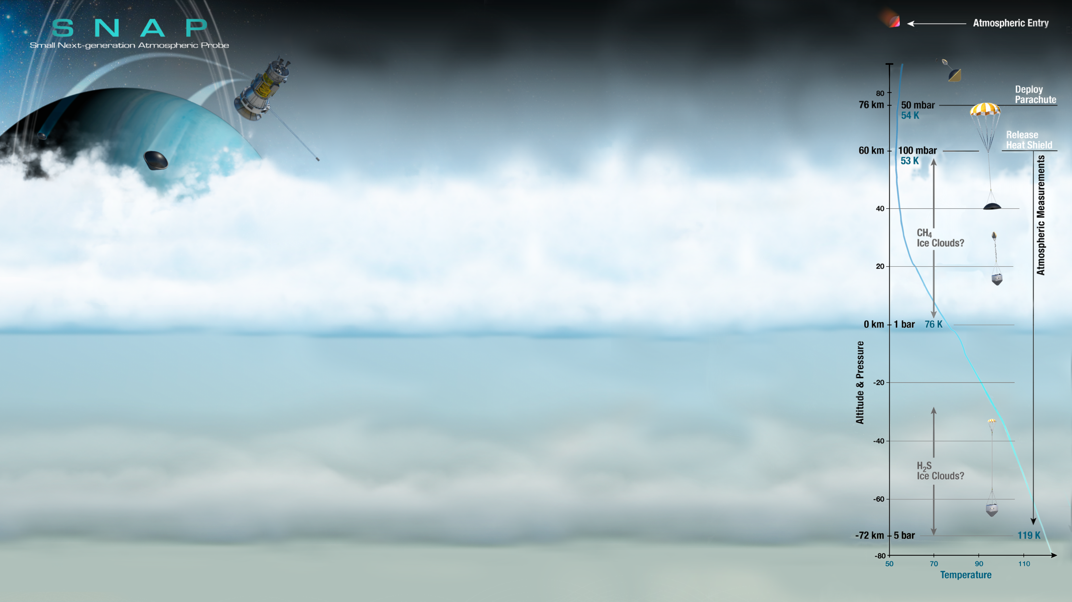
Atmospheric Probe(s)
(BG from SNAP Study)
From Pensado et al. (2022) IPPW Presentation

Slide 16
Satellite Tour
From UOP Report Appendix C

Slide 17
UOP: Orbiter Instruments
From UOP Report

Slide 18
Science Goals

Slide 19
“Thematic Questions” are identified and prioritized by the Decadal Survey

Slide 20
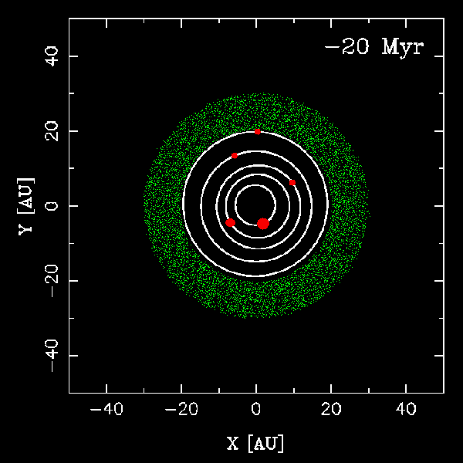
“Nice Model” of Solar System Evolution
Jupiter and Saturn pushed out Uranus and Neptune, and scattered many icy left-over materials.
Did Uranus and Neptune form closer to the sun that they are today?

Slide 21
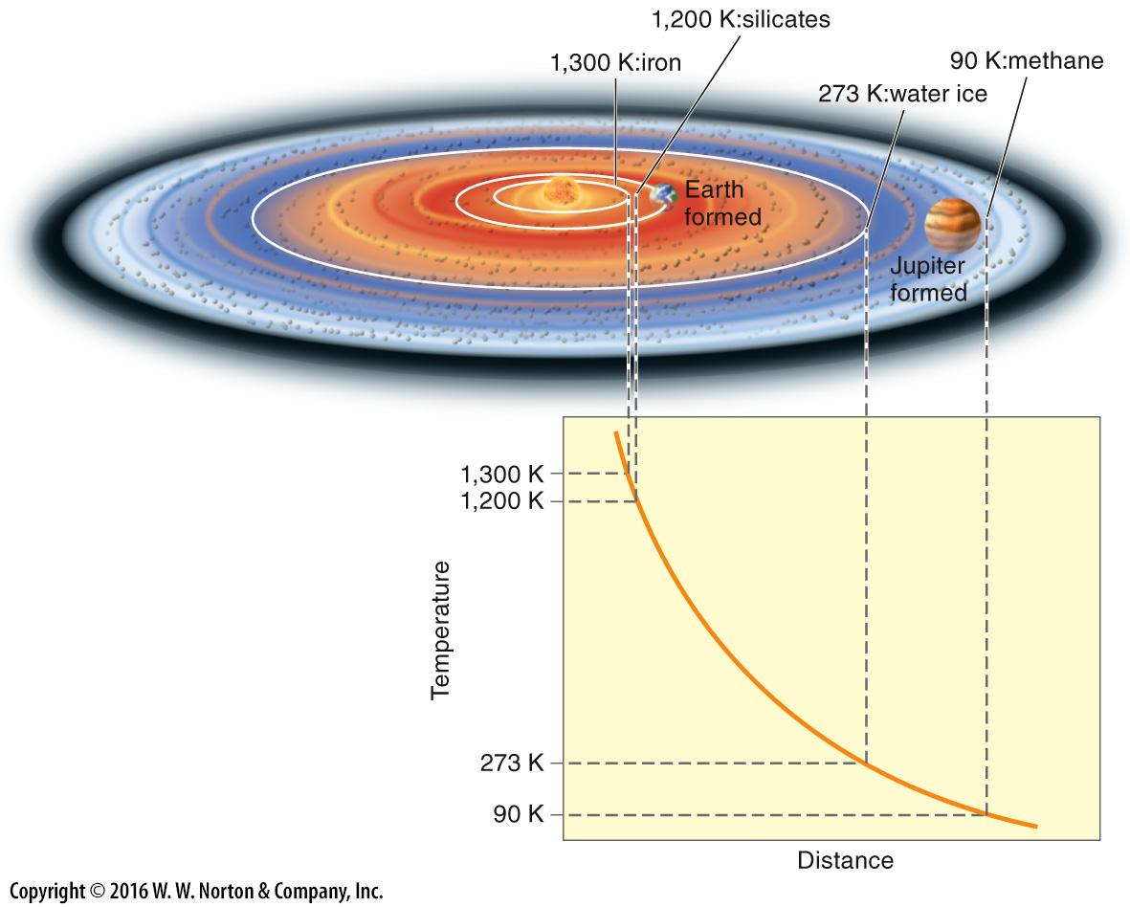
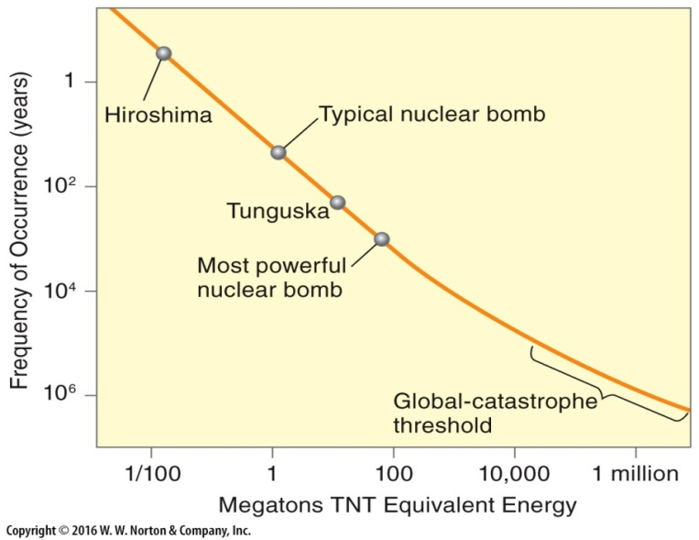
Planetary Formation and Atmospheric Composition
Planet that formed further from the sun collected:
- More volatile molecules
- More lighter elements
→ Isotopic Ratios
→ Noble Gas Abundance
From Mousis et al. (2018, Planetary and Space Science)

Slide 22
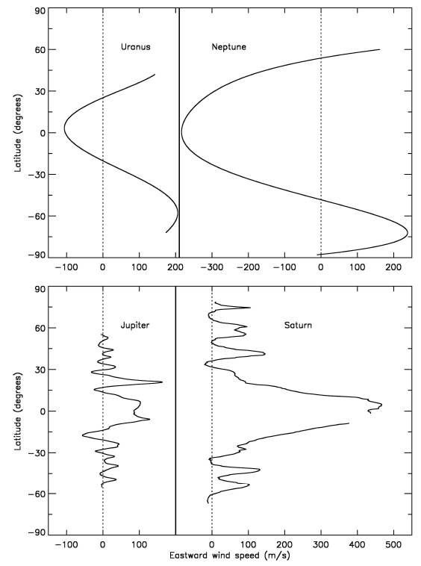
What processes shape the Cloud-top Zona Wind Structures?
Beebe. (2005) Fig. 1

Slide 23
Hypothesized Giant Planet Meridional Circulation

Slide 24

How is heat transported in Uranus’ Atmosphere?
Hypothesized stacked “Hadley”-like Circulation
How does the circulation evolve with season?
Energy Balance
Voyager detected no heat released by Uranus
Does Uranus release internal heat?

Slide 25
How is heat transported in Uranus’ Atmosphere?
Uranus has 5 condensable species:
CH₄, SH₂, NH₃, NH₄SH, H₂O
Condensible molecules are heavier than the dry H₂ gas, and inhibit convection (e.g. Li et al 2015).
From Mousis et al. (2018, Planetary and Space Science)

Slide 26
How are the zonal wind, meridional circulation, and clouds coupled?
Keck II images of Uranus in 2012.
From Sromovsky et al. (2015)

Slide 27
Uranus Atmospheric Science “Big Questions”
Origin & Formation
What does the atmospheric composition tell us about planetary formation?
Atmospheric Dynamics:
What drives the zonal wind?
What is the meridional circulation structure on Uranus?
What is the effect of moist convection on atmospheric circulation?
How are the zonal wind, meridional circulation and cloud bands coupled?
What processes tune Uranus’ thermal emission and control the planetary thermal evolution?

Slide 28
Science: How are zonal and meridional circulation coupled?
Coupling of Zonal and Meridional Circulation
The meridional circulation pattern must be a solution of the Eulerian Mean Equations:
(e.g. From Holton Chapter 10 – classic solution to the right)

Slide 29
Science Traceability Matrix (Atmospheric Science)

Slide 30
Notional Instrument Overview
We should advocate for high-priority measurements we benefit from

Slide 31
Ref. Narrow-Angle Camera: New Horizons LORRI
Lack of optical band-pass filters limits atmospheric remote-sensing potential

Slide 32
Ref. Vis/NIR Spec & Wide-Angle Camera: Lucy L’Ralph (based on NH Ralph and OSIRIS-Rex OVIRS)
Est. Mass for UOP: 29.7 kg
Lack of narrow-band filters
Spectral resolution:
Δλ=4-10 nm between 400 nm – 5 micron
Reuters et al (2018)
Reuters et al (2008)

Slide 33
Ref. Thermal IR Camera: LRO Diviner
Est. Mass for UOP: 12.1 kg
Paige et al (2010)

Slide 34
Thermal IR Considerations
Stratospheric Aerosol and Gas Composition Measurements:
  Need MIR-FIR spectral instrument
Energy Balance Measurements
  Broad-band instrument is better
Band-pass instrument like Diviner limits atmospheric science potential

Slide 35
Ref. Instrument: Probe Mass Spectrometer
Probe Mass Spectrometer is a 10-20 kg instrument
  Drives Probe Design
  UOP Probe MS’s 20.9 kg mass does not seem to include vacuum plumbing
    Baseline Instrument (Rosetta DFMS) is designed to operate in vacuum
Measurements: Atmospheric Composition
  Noble Gas Abundances and Isotopic Ratios
  CH₄, H₂S, NH₃ and H₂O abundances
  Isotopic ratios of C, S, N and O
Can we find alternative instruments?
  Chip-scale Gas Sensors?
  Tunable Laser Spectrometer?

Slide 36
Missions | Atmos. Entry Mass | Entry Sys. | Descent Module
 | CBE +Conting. +Margin | Aeroshell + Chutes | Instruments | Inst. Mass | Mass Spec Mass | Non-MS Inst. Mass | Battery
Galileo Probe | 335 kg | 219 kg (65%) | MS, ASI, USO, HAD, Neph, NFR, Lightning, Energetic Particles | 35 kg (10 %) | 13.2 kg | 21.8 kg | 7.5 kg (Li-SO₂, 2.2%)
Huygens | 318 kg | 118 kg (37%) | GCMS, ASI, USO, DISR, Surface Sci. | 48 kg (15%) | 17.2 kg (+6 kg pyrolizer) | 24.2 kg | 13 kg ? (Li-SO₂, 4%)
2010 Uranus Study | 127.1 kg | 40.8 kg (46%) | MS, ASI, Neph, USO | 17.1 kg (13%) | 9.2 kg | 7.9 kg | 11.3 kg (Li-SOCl₂, 9%)
2017 IG SDT | 320.7 kg | 147.0 kg (46%) | GCMS, ASI, Neph, Ortho-Para | 32.5 kg (10%) | 17.4 kg | 15.1 kg | 17.1 kg (Li-Ion, 5.3%)
2019 SNAP | 30 kg | 14.8 kg (49%) | NanoChem, ASI, USO | 6.6 kg (22%) | (No Mass Spec) | 6.6 kg | 0.34 kg (Li-CFx, 1.1 %)
2021 UOP | 238 kg | 121 kg (45%) | MS, ASI, USO, Ortho-Para | 22 kg (8%) | 17.8 kg | 4.1 kg | 11 kg (Li-SOCl₂, 4%)

Slide 37
Science Traceability Matrix (Atmospheric Science)

Slide 38
Where does giant-planet atmospheric science fit in the
Decadal Survey Themes and Priority Questions?

Slide 39
Final Thoughts
UOP will be great for Giant Planet Atmospheric Science Research
  Even though it is a decadal priority, it will require consistent advocacy
Advocacy needed for instrument capability for atmospheric science
Strategic thinking is needed to increase priority for Giant Planet Atmospheric in future decadal surveys
Lots of room to advance theory/modeling to prepare for UOP results

