Slide 1


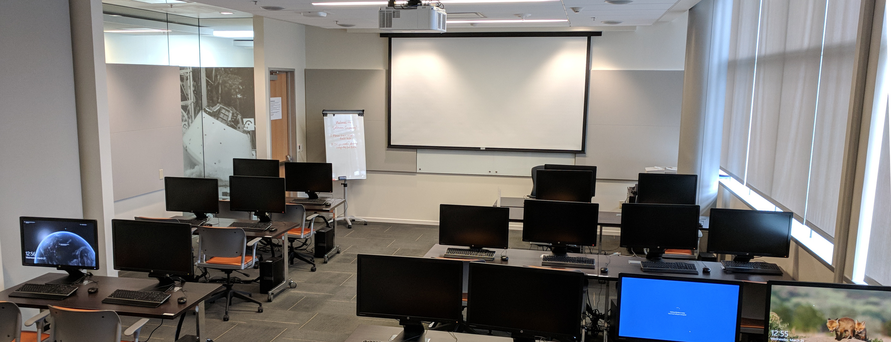
CERES Data Management
Working Group Report
CERES Science Team Meeting
Katie Dejwakh
Walter Miller
CERES DMT
Oct. 17, 2023

Slide 2

Agenda
Background
Team Highlights
Improvements:
Edition 5
Code Re-architecture
Systems
Conclusion

Slide 3
Background

Slide 4
Team
Instrument
Denise Cooper
Thomas Grepiotis
Dianne Snyder
Hunter Winecoff
ERBE-like
Dale Walikainen
Jeremie Lande

Slide 5
Team
Clouds
Sunny Sun-Mack
Walter Miller
Ricky Brown
Rita Smith
Elizabeth Heckert
Yan Chen
Steven Kohler

Slide 6
Team
Inversion
Victor Sothcott
Igor Antropov
Surface and Atmospheric Radiation Budget (SARB)
Surface and Atmospheric Radiation Budget (SARB)
Thomas Caldwell

Slide 7
Team
Temporal Interpolation and Spatial Averaging (TISA)
Beau Branch
Edward Kizer
Cathy Nguyen
Joshua Wilkins
FLASHFlux
Jay Garg
PC Sawaengphokhai
Hunter Winecoff

Slide 8
Team
Configuration Management (CM) & Infrastructure
Tammy Ayers
Willinda Evans
Nelson Hillyer
Dennis Keyes
Production Request (PR) Tool
Carla Grune
Elizabeth Heckert

Slide 9
Team
Visualization and Ordering Tool
Churngwei Chu
Pamela Mlynczak
Babak Samani
Atmospheric Science Data Center (ASDC) Support
Karen Brown
Sharon Dukes-Allen
Christopher Harris

Slide 10
Background
CERES/RBSP – not a true Science-Investigator Processing System, or “SIPS”
​
Science Team
(algorithms)
Data Management Team (DMT)
(software)
Atmospheric Science Data Center (ASDC)
Funded by Earth Radiation Budget Measurements WBS
  Funded by ESDIS

Slide 11
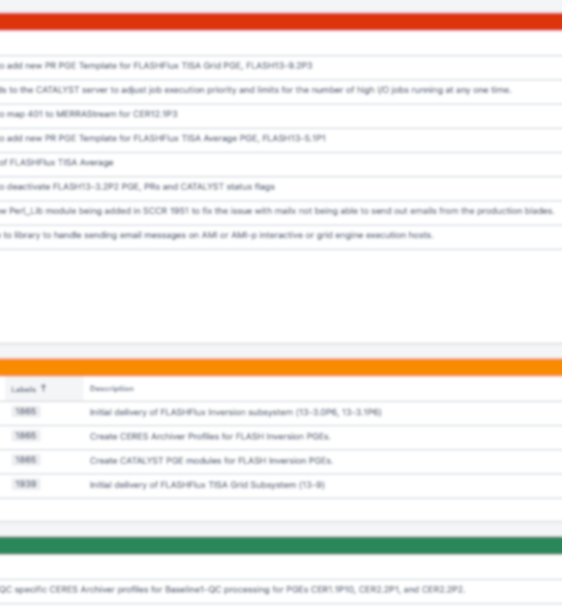
Team Highlights

Slide 12
Software Deliveries (61)
Meteorological Ozone and Aerosol (MOA):
First Edition 5 product generation executive (PGE) code delivery
Supporting software deliveries for production and archiving
SARB:
New PGE to support new “ice age” value input source (Land Information System)
TISA Gridding: Incorporating NOAA-20 VIIRS data into CldTypHist & FluxByCldTyp

Slide 13
Software Deliveries (61)
FLASHFlux:
Bug-fix to prevent unnecessary filtering of good NOAA-20 values
New PGE to produce MOA with GMAO GEOS-IT instead of FP-IT
CATALYST support for TISA NOAA-20-only runs
Instrument and ERBE-like:
Several rounds of gains and spectral response function updates for instruments
TISA Averaging: Interpolation adjustment to support surface flux processing

Slide 14
Software Deliveries (61)
CATALYST, PR Tool, and CERESlib:
Many deliveries increasing production resilience to missing or additional data
Edition 5 support
Various SORCE TSI, MATCH aerosol, and gridded GEO ancillary product updates

Slide 15
Product Availability
 | Platform
Product | Terra | Aqua | S-NPP | NOAA-20 | Availability Thru
BDS | x | x | x | x | July 2023
SSF | x | x | x | x | July 2023
CRS | x | x |  |  | 2018-2022
SSF1deg-Hour | x | x | x | x | July 2023
SSF1deg-Day/-Month | x | x | x | x | July 2023
SYN1deg-1Hour/-MHour | Terra+Aqua |  |  | Terra+NOAA-20 | June 2023
SYN1deg-Day/-Month | Terra+Aqua |  |  | Terra+NOAA-20 | June 2023
CldTypHist | Terra+Aqua |  |  | Terra+NOAA-20 | July 2023
FluxByCldTyp-Day/-Month | Terra+Aqua |  |  | x | July 2023
EBAF | Terra+Aqua |  |  | x | June 2023
EBAF ToA | Terra+Aqua |  |  | x | July 2023
Notes:
Terra+N20 transitioned March 2023 for SYN1deg and CTH
N20 only for FBCT, whole record.

Slide 16
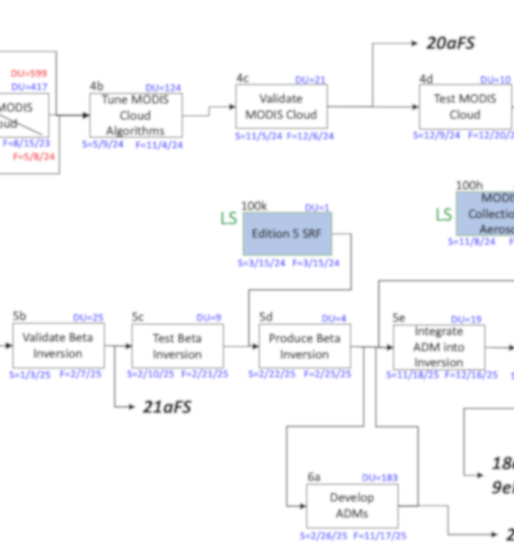
Improvements

Slide 17
Edition 5 Progress
MOA
2023
Jan
Feb
Mar
Apr
May
Jun
Jul
Aug
Sep
Oct
Nov
Dec
ESNOW
& EICE
MODIS Clouds
BDS
2024
Jan
Feb
Mar
Apr
May
Jun
Jul
Aug
Sep
Oct
Nov
Dec

Slide 18
Edition 5 Progress
First delivery:
MOA
GMAO
GEOS-IT
0.5° x 0.5° lat/lon
Edition 5 Progress
Edition 5 MOA delivered
”AlphaN” tests commencing (Alpha1, first)
  Internal-only
  Cloud properties and fluxes through gridding
Updating schedule as contingencies learned
Next delivery: BDS or ESNOW & EICE

Slide 19
TISA Code Re-Architecture
Gridded geostationary
data (GGEO)
xGLB coefficients
Normalized
GGEO fluxes
CERES data
Matching criteria
SW, LW and WN
Modular code, JSON configuration files
Ample, generalized subroutine usage
Sharing of/cross-training on code
Fall 2023 CERES Science Team Meeting
Notes:
JSON → ancillary netCDF files → genericized API code
Code clarity → parameters
Better error-handling

Slide 20
TISA Code Re-Architecture
Generic netCDF data product reader
  “Packing list” JSON file defines expected contents
  Increases modularity of codebase
  Easier to debug
Surface type look-up table finalized
  Reading 10-min. IGBP static and updated snow/sea-ice maps and resampling (SW & LW)
  Logic
  Data structure
SW narrowband to broadband module updated
Fall 2023 CERES Science Team Meeting
Notes:
10 min. can go sub-pixel (0.5 degree, etc.) → starts at 1/6th degree.
20 IGBP types converted to SW (6) and LW (7).
Weighted, mixed IGBP type partitioning (i.e. 90% ocean, 10% land. Static would say land for the whole grid box. But this is now corrected due to weighting scheme.)

Slide 21
TISA Code Re-Architecture
Gridding:
  C++ Re-architecture:
    JSON configured metadata support
    Implemented cosine SZA weighting, non-binned multidimensional variable support, offset capability
  Prototype CRS1deg product in development
    Piggybacks on resurrected CRS product
    First exercise of new, C++ codebase
Interpolation: new scheme refactoring in development
Fall 2023 CERES Science Team Meeting

Slide 22
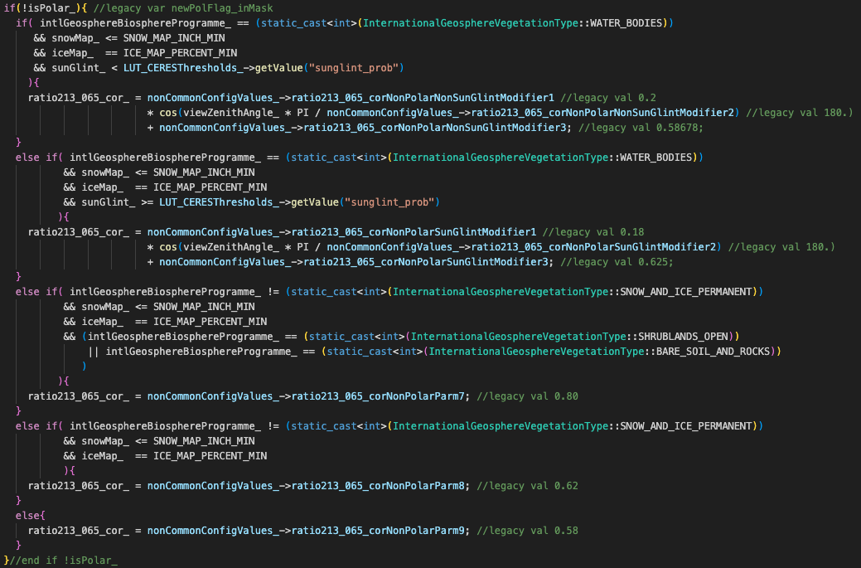
Clouds Code Re-Architecture – Cloud Mask Magic Number Removal

Slide 23
Clouds Code Re-Architecture
Concluded cloud mask “magic number” removal
Commencing in-depth testing

Slide 24
Clouds Code Re-Architecture
Concluded cloud mask “magic number” removal
Commencing in-depth testing

Slide 25
Clouds Code Re-Architecture
Concluded cloud mask “magic number” removal
Commencing in-depth testing

Slide 26
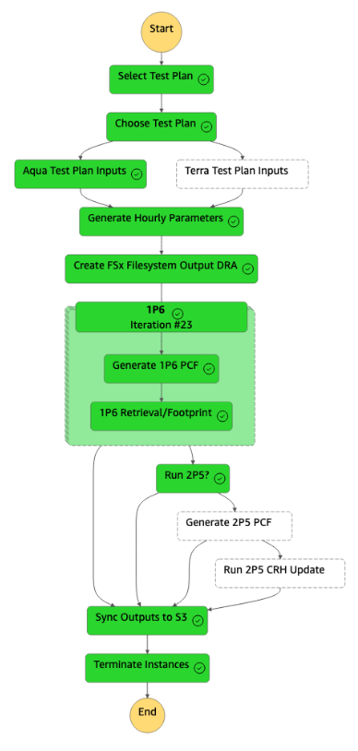
Clouds Code Re-Architecture
AWS run prototyping:
  ECS container orchestration
  Tested Fargate and EC2 for scaling
    EC2 more flexible
    Enables FSX (filesystem) usage
  Largely as performant as on premises runtime
  Most significant gains potentially algorithm, software design
Continuing to improve AWS process
Fall 2023 CERES Science Team Meeting
26

Slide 27

Systems
Summer 2023:
Replaced production storage hardware
Currently auditing ASDC data product holdings for:
  clean-out
  migration to new hardware

Slide 28
ASDC & SCF Support
Continued support for processing and storage infrastructure
Collection-level metadata issue still resolving
  Core CERES and FLASHFlux products ~100% complete
  GEO Clouds
    5 active GEOs complete
    Recently used and two-channel GEOs: ~65%
OpenShift4 transition complete

Slide 29

Conclusion
Continuing to develop Edition 5 algorithms and code
Spring 2024 transition to Edition 4B for SYN1deg products
Code re-architecture ongoing
Working with ASDC to upkeep infrastructure & metadata

