Slide 1
Engineering Directorate
Test Laboratory
Capabilities
Partnership Office Team Presentation
October 2023
Philip Swofford, Deputy Director, Test Laboratory
Victor Pritchett, Deputy Branch Chief, ET20
Richard Cooper, Team Lead, ET20

Slide 2
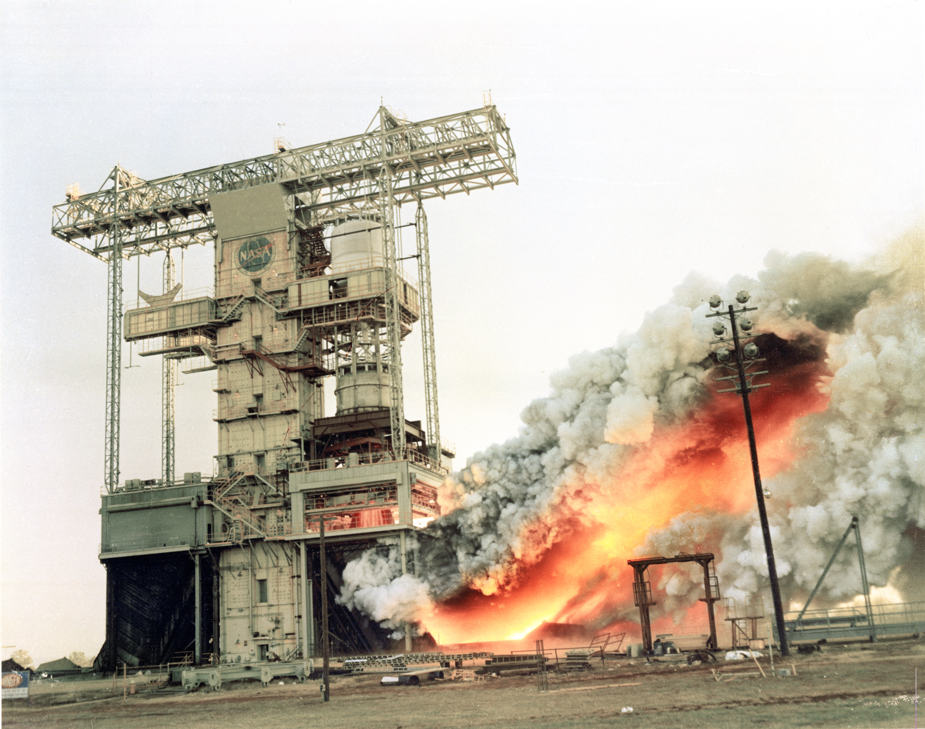
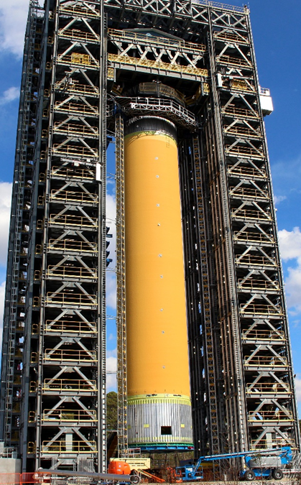

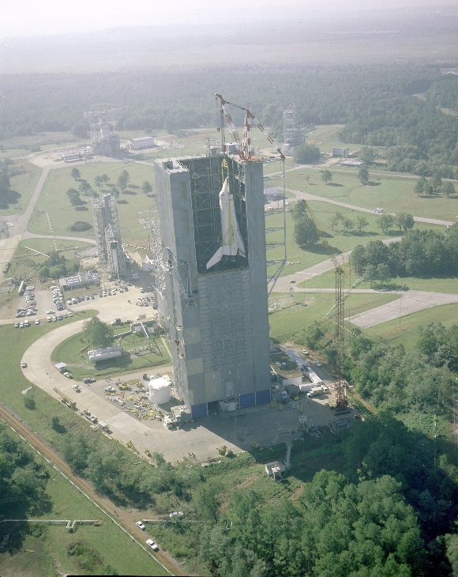
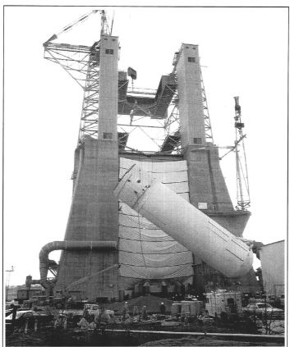
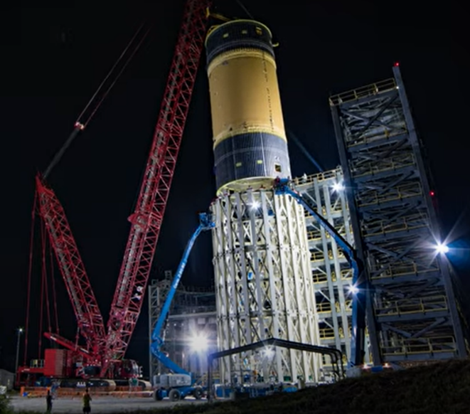
History of Successful Test Programs

Slide 3
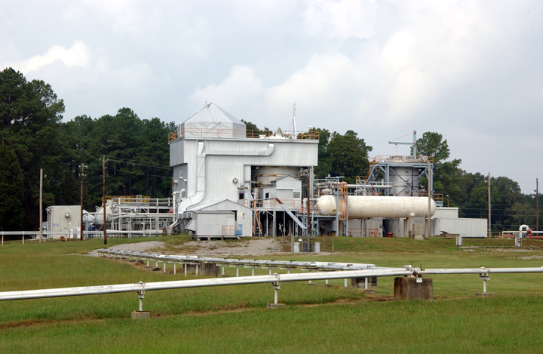
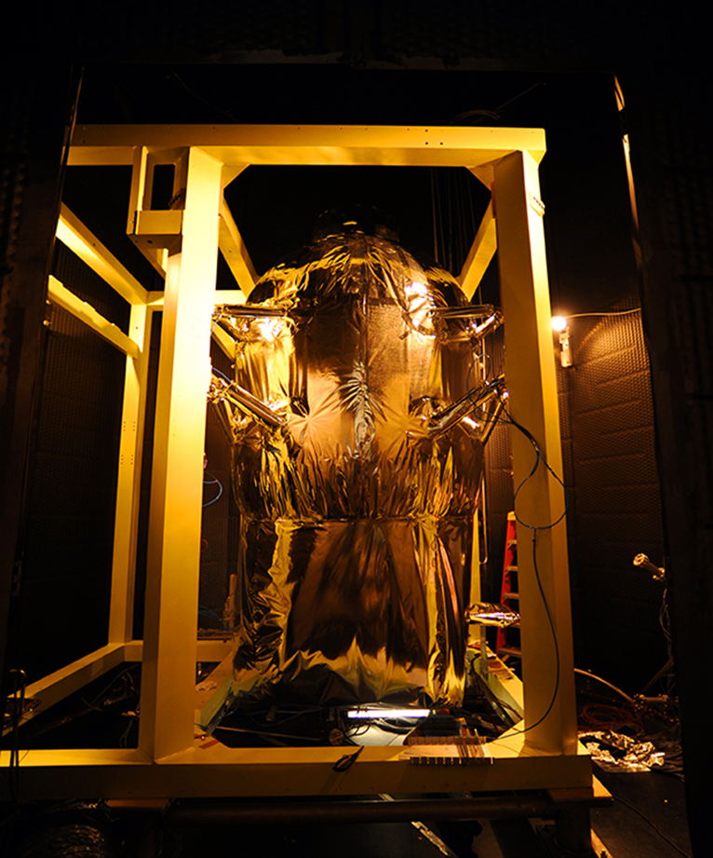
Cryogenic Fluid Management Testing
Cryogenic Propellant Storage and Transfer
– Engineering Development Unit in the 20 ft Vacuum Chamber
Test Stand 300
Simulates ascent launch profiles and deep space vacuum

Slide 4
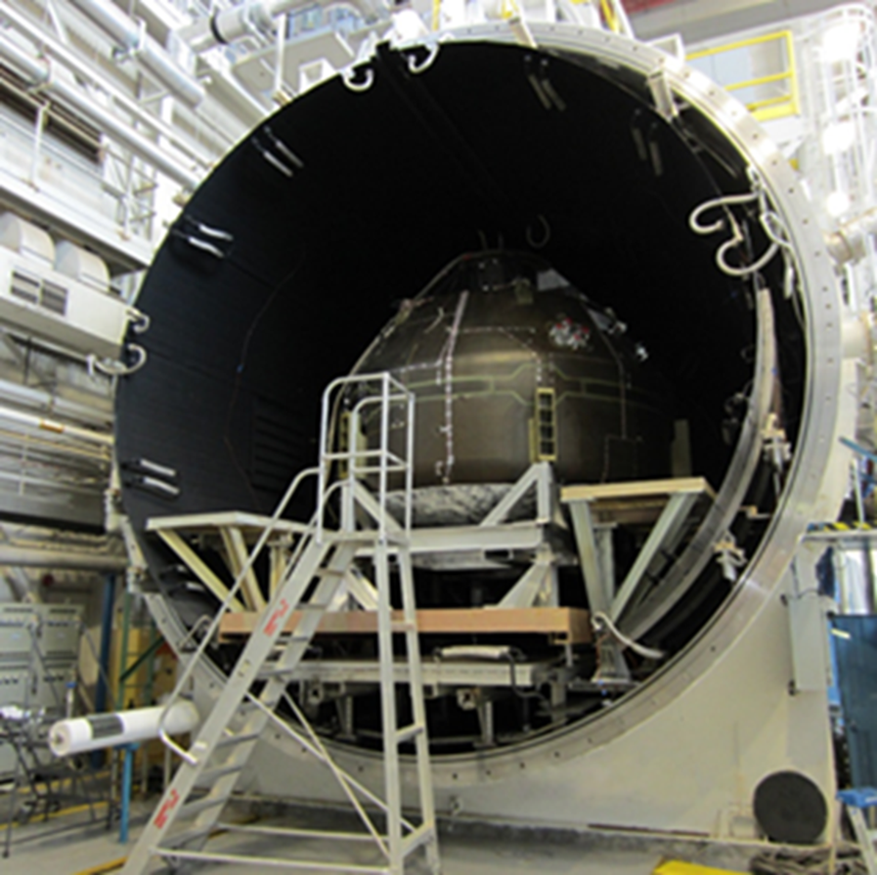
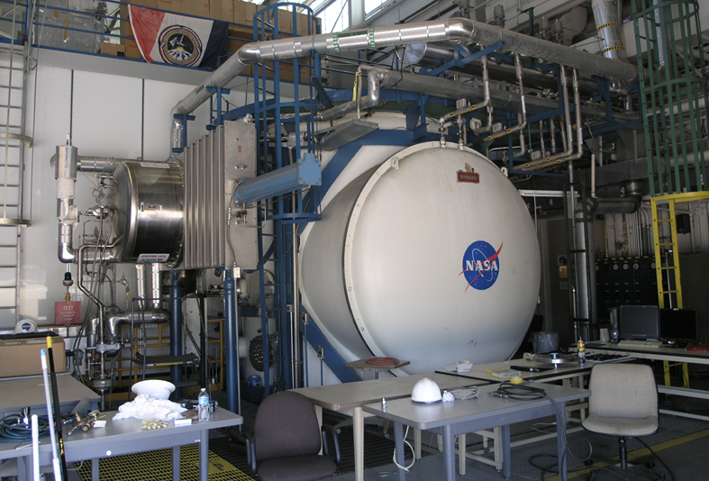
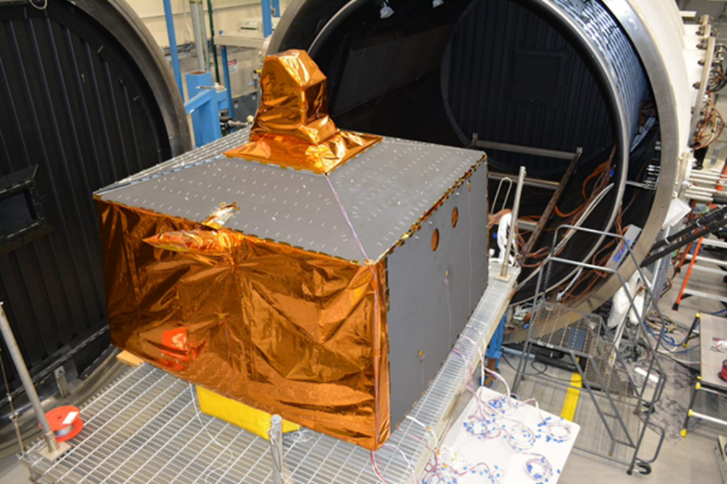
Thermal Vacuum Testing
V20
12 Chambers of varying size
Sunspot
Launch Simulation Testing
Life Cycle Testing
V15
Optical Cleanliness Thermal Vacuum Bakeout
V20 Regolith Chamber-Coming Soon!
Thermal-Humidity-Altitude Testing

Slide 5
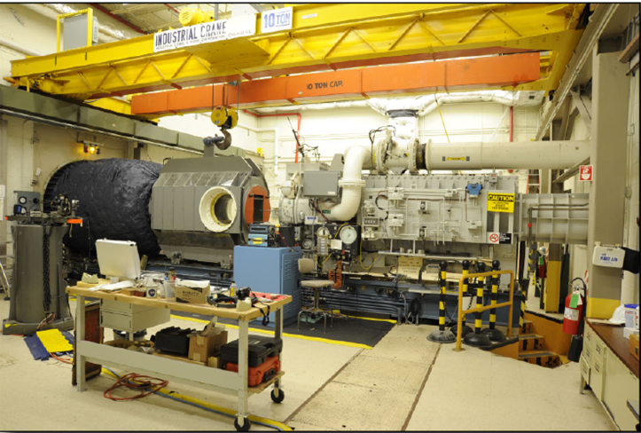
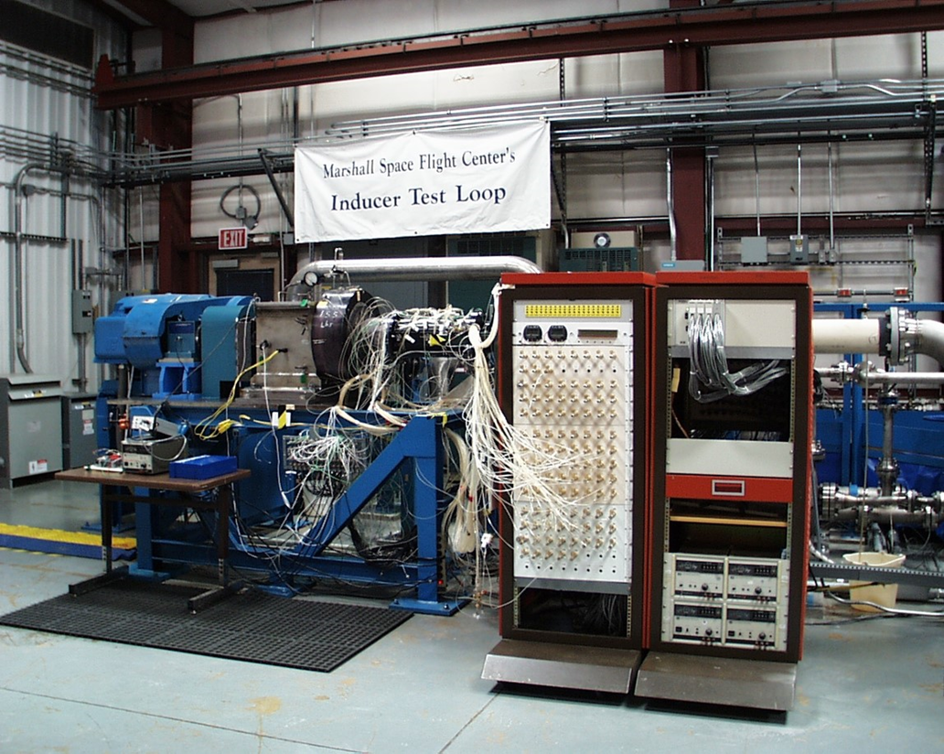
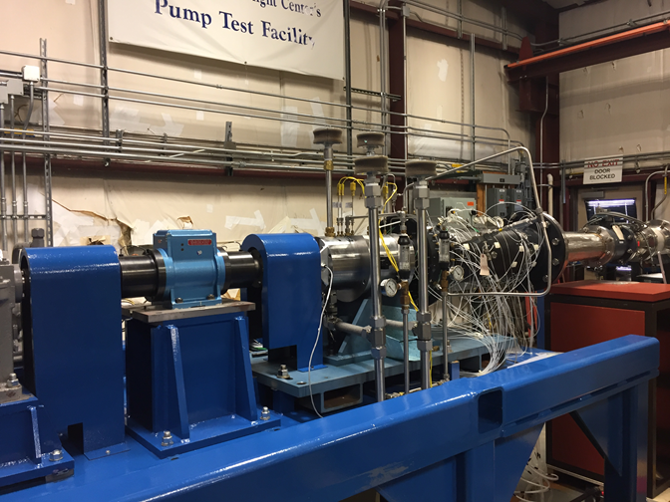
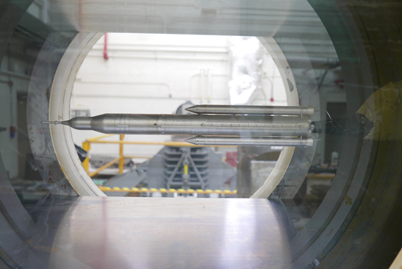
Wind Tunnel and Water Flow Testing
Liquid Engine Component Performance
Inducer Test Loop
Pump Test Facility
Wind Tunnel
Low-cost test alternative for early development of aerospace systems.
Subsonic/transonic/supersonic -speeds to Mach 5
Fluid Dynamics Testing
Turbine efficiency and flow capacity
Nozzle Test Facility
Turbine Test Equipment
Pump suction performance and flow induced anomalies
SLS Model In Wind Tunnel

Slide 6
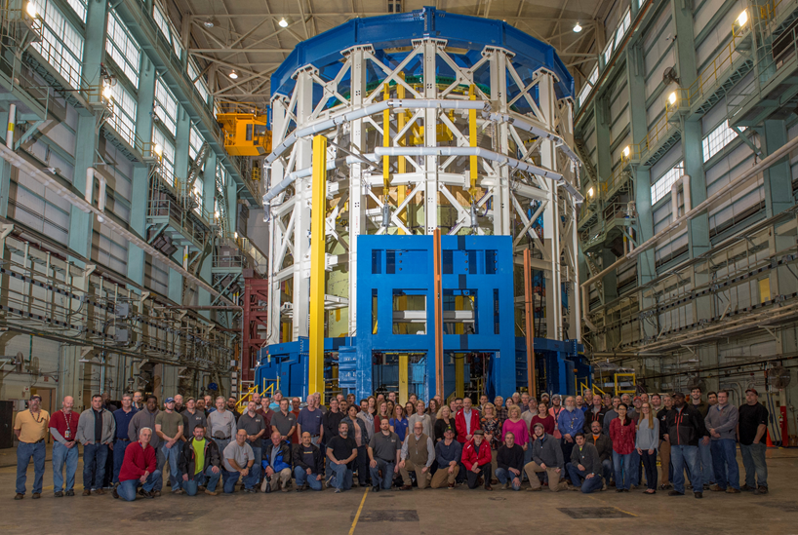
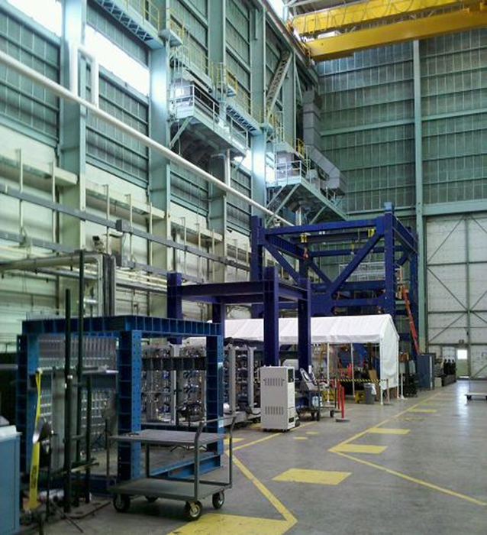
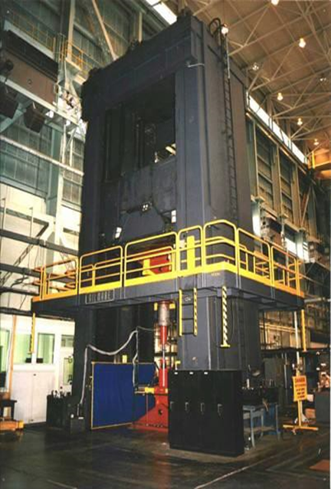
Structural Strength Testing
Test of Large and Small Structures
Gilmore
SLS Engine Section Stand
Self-Reacting Cube
Compression
Heat and Cryo Conditioning
Traditional and non-contacting measurement options
Large channel count data acquisition system
Tension
Torsion
Shear

Slide 7
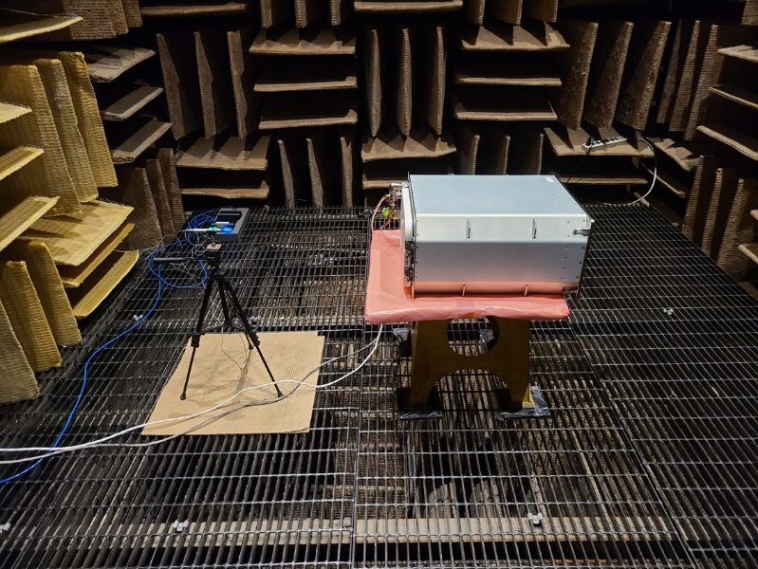
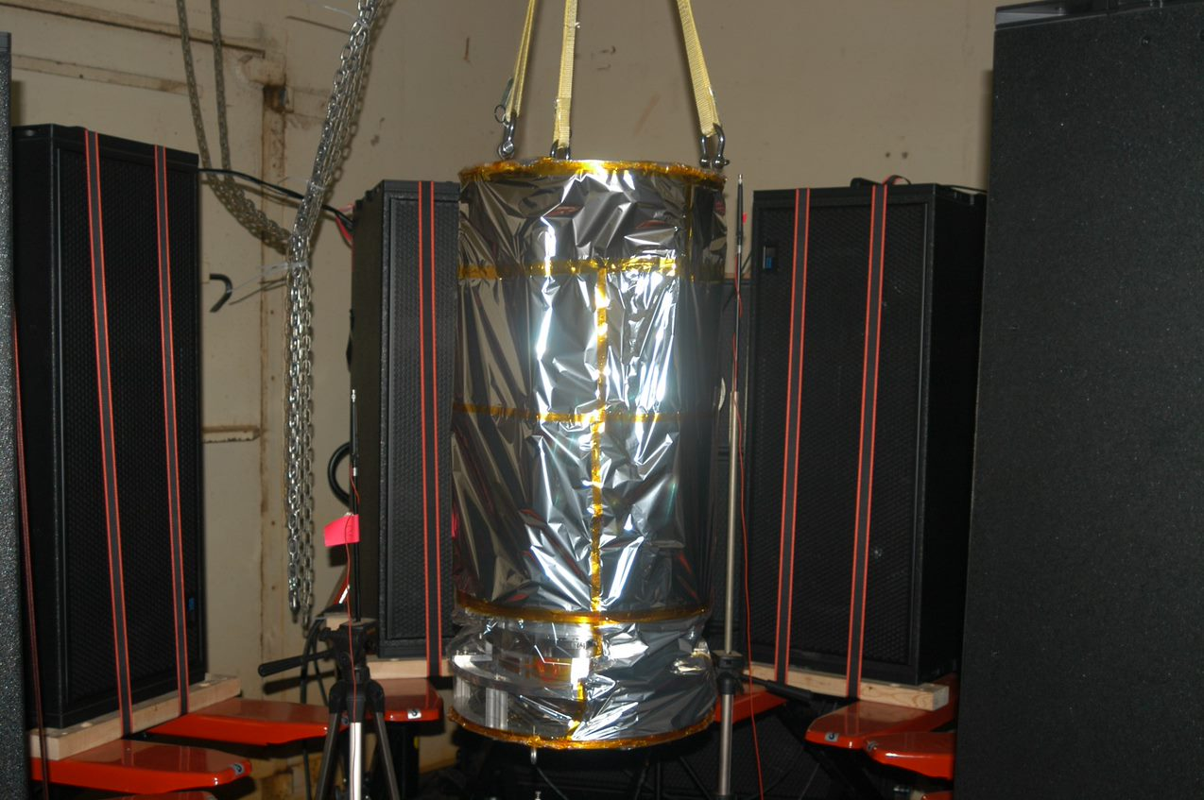
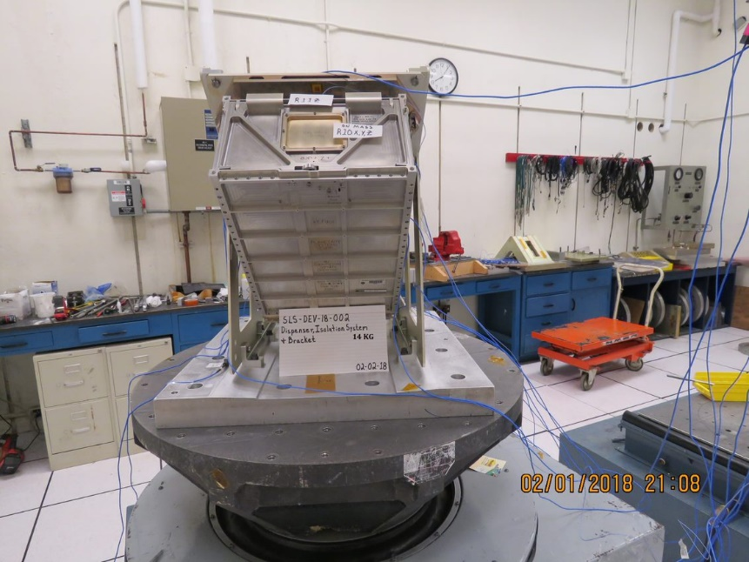
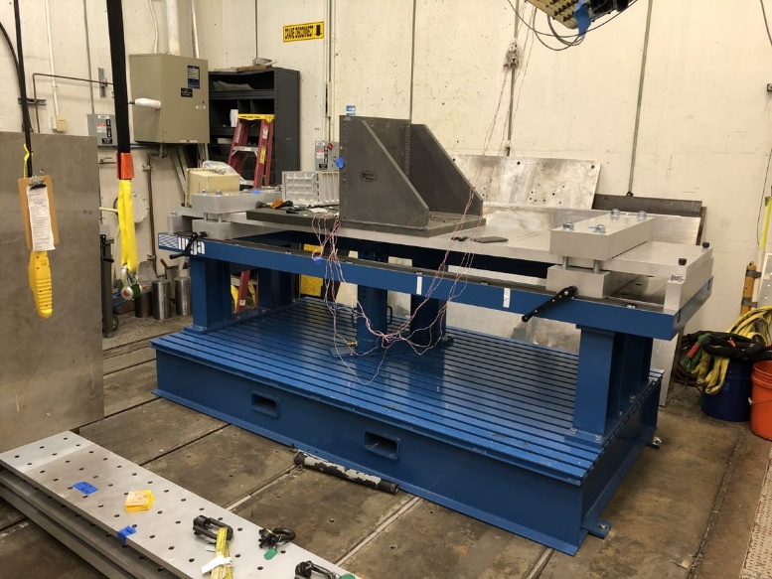
Acoustic, Shock and Vibration Testing
Acoustic testing using air-driven acoustic horn or speakers
Reverberant Chamber
Vibroacoustic Transmissibility
Vibroacoustic Transmissibility testing
Development, Qualification, & Acceptance Vibration Testing
Separation System Testing
Anechoic Chamber
Shaker, Mechanical, Pneumatic, & Pyrotechnic Shock Testing
Pneumatic Shock Machine
Vibration Lab
Pneumatic Shock Machine
Vibration Lab

Slide 8
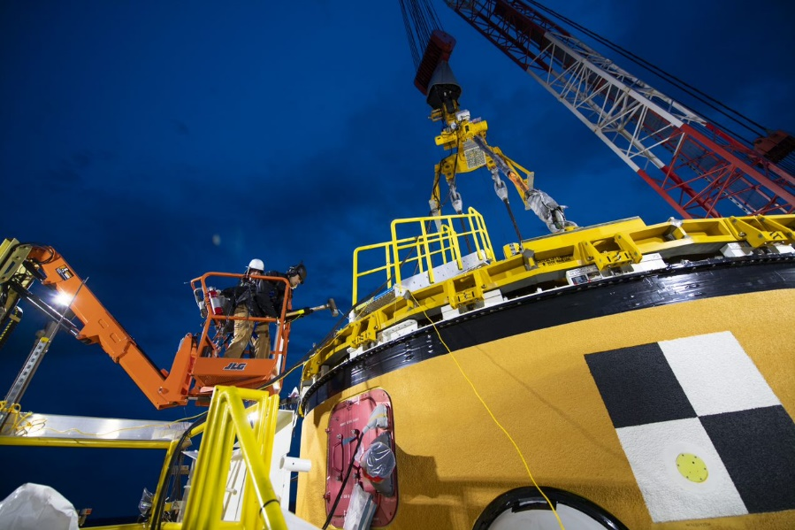
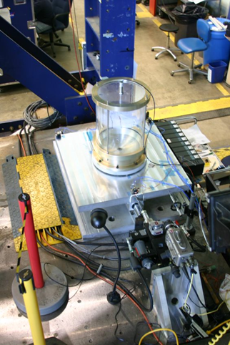
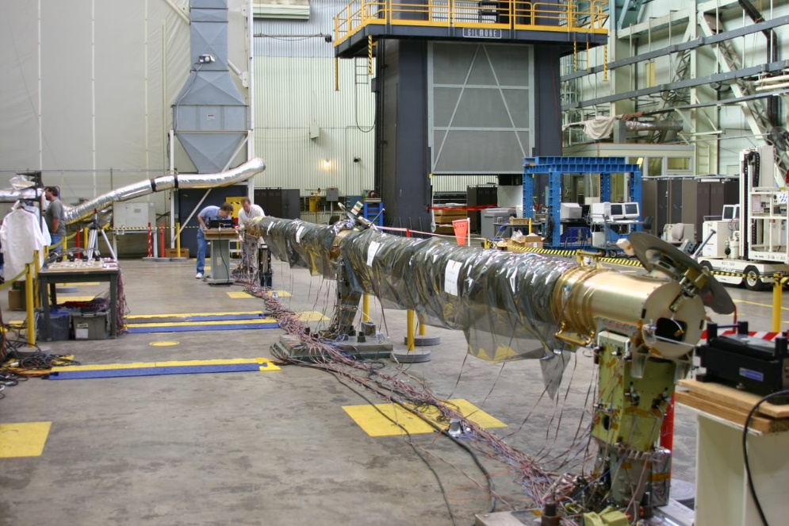
Modal and Slosh Testing
SLS Core Stage Modal Testing at Stennis Space Center
Modal testing at MSFC or customer site
Dynamic troubleshooting
Fluid slosh testing
Numerous input excitation options
Traditional and non-contacting measurement options
Large channel count data acquisition system
Space Shuttle Orbiter Boom Sensor System Modal Test at MSFC
Slosh Test Bed

Slide 9
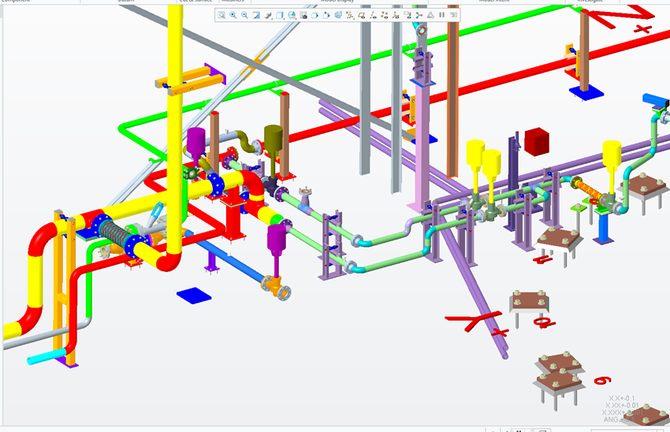
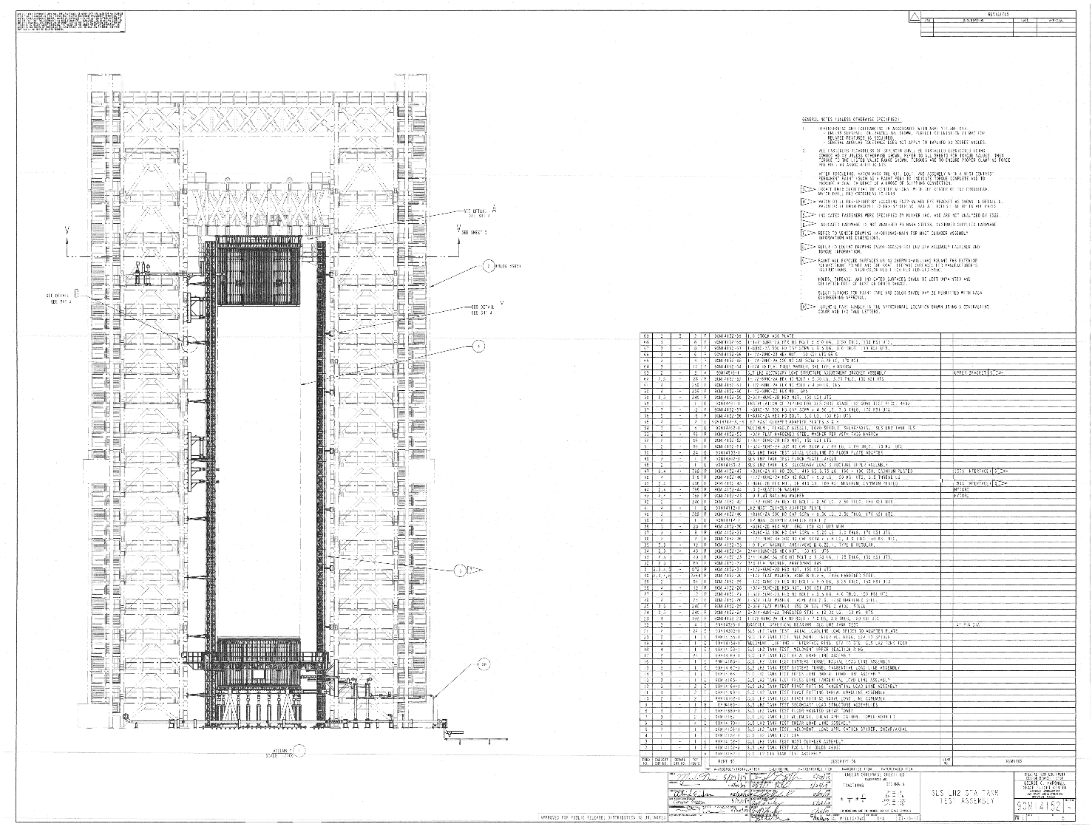
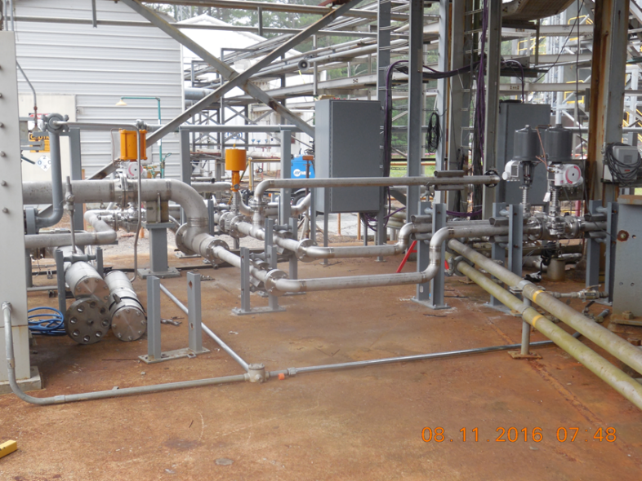
Special Test Equipment Design
Transportation Systems
Piping Design
Cryogenic Fluid Systems
High Temp/Press Vessels
R&D Prototypes
Vacuum Systems
Structural Design
Test Stands

Slide 10
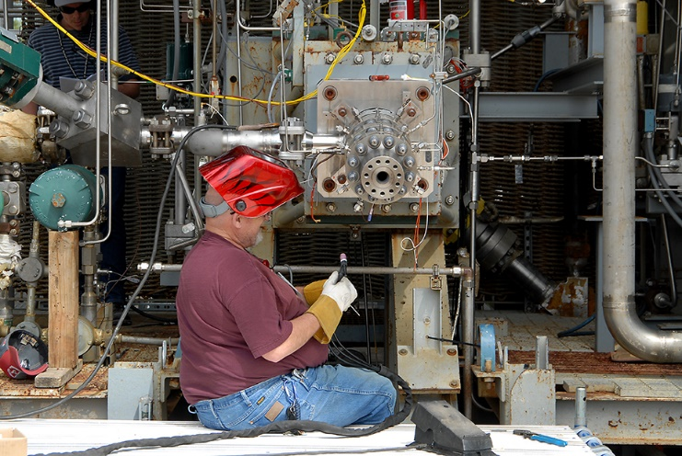
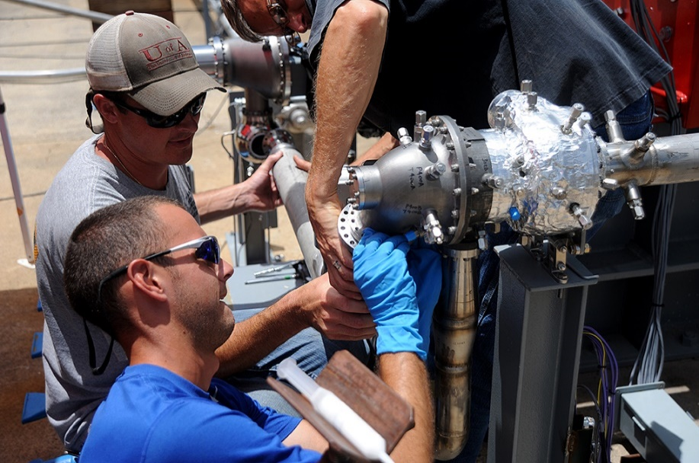
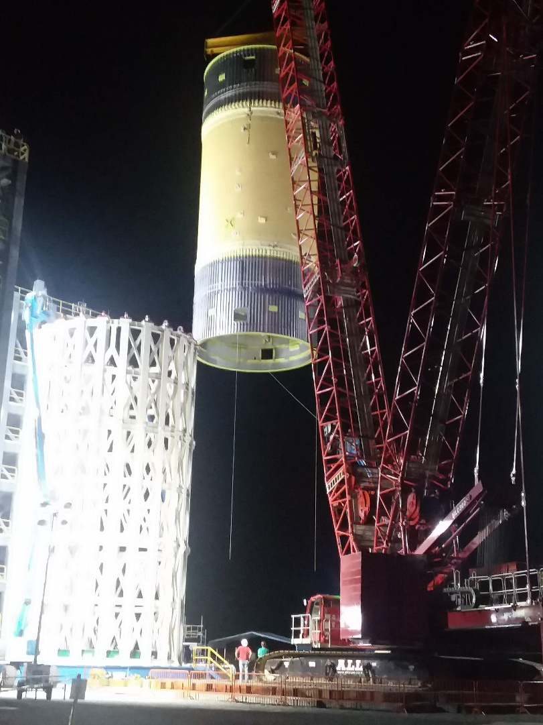
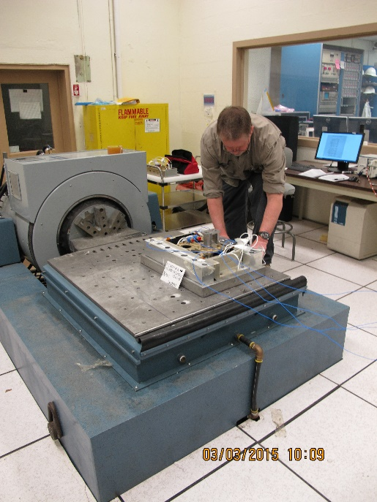
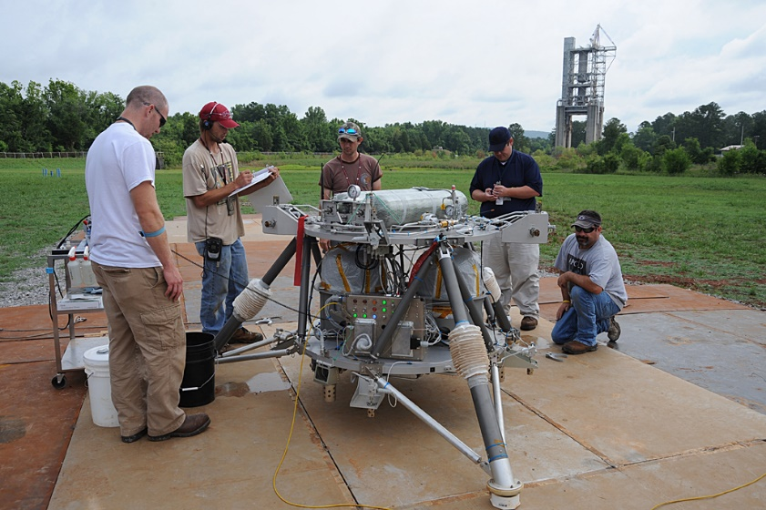
Fabrication, Machining, Lifting and Handling

Slide 11
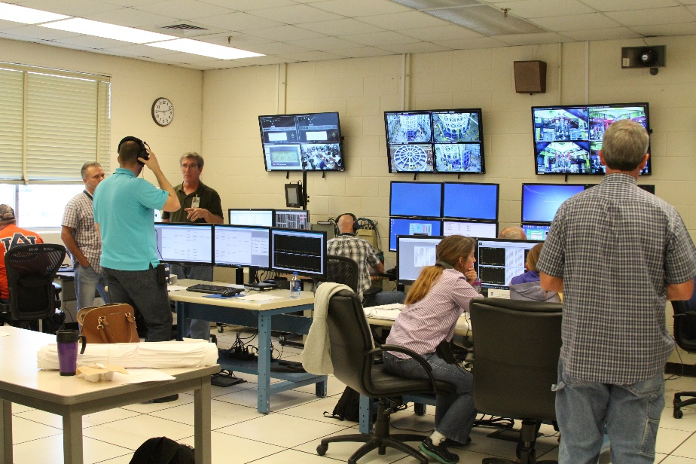
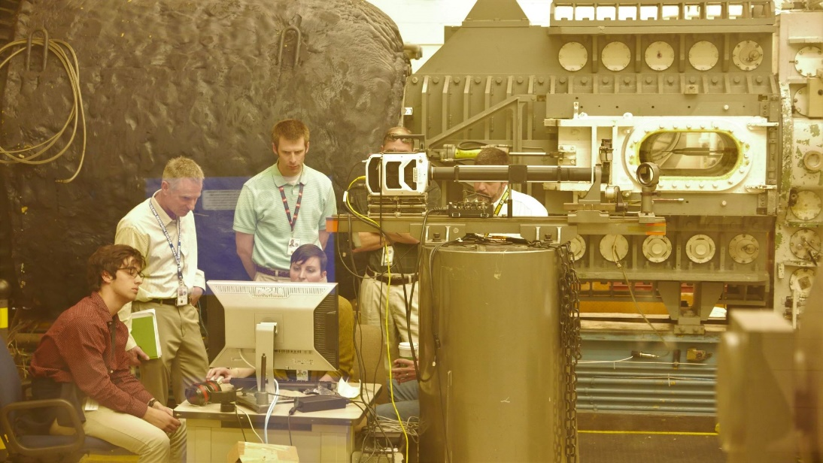
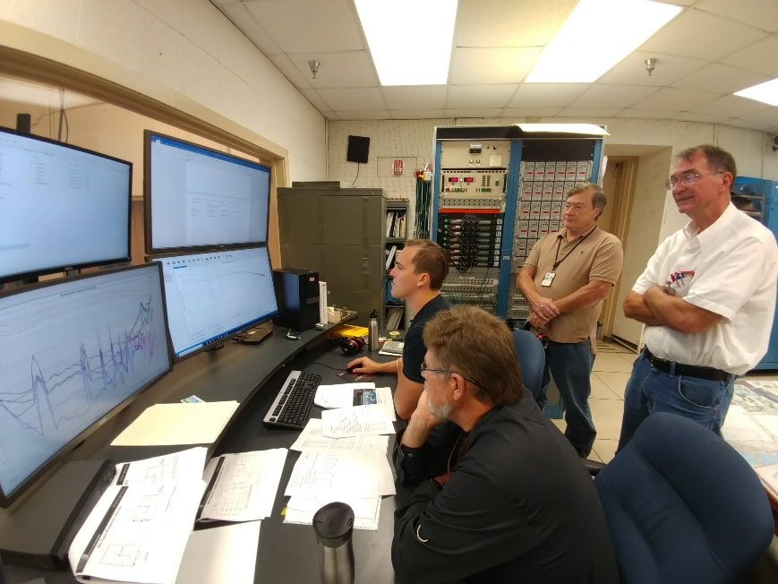
Experienced Test Personnel

Slide 12

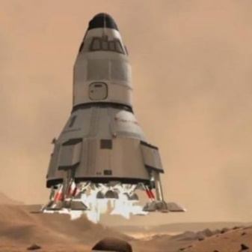

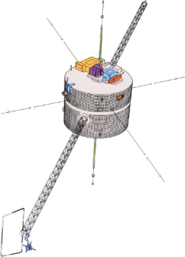
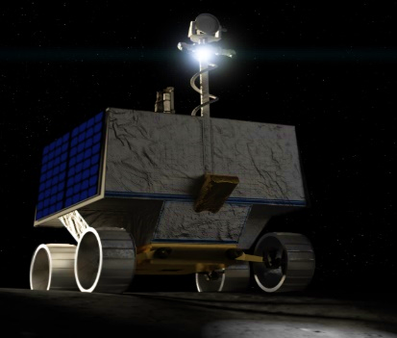





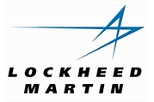













Extensive Customer Base
Mars
Ascent
Vehicle
VIPER
POLAR
POLAR

Slide 13
Test Lab Industry, Academia and DoD Project Process
Identify the test opportunity: Can NASA help?
Scope, requirements, schedule and cost defined.
Dedicated Test Lab Agreement Specialist
Expedites proposal and agreement through review process.
Does NASA have the necessary capability to perform the test?
Does it meet NASA opportunity guidelines?
Test Lab Technical Lead works directly with customer: Jointly create agreement
Keeps customer informed on progress
Agreement Executed
Technical Lead schedules work and coordinates with customer to exceed expectations

Slide 14
Test Lab Project Process-Key Personnel
NASA Test Lab Technical Point of Contact (TPOC)
Meets with the potential customer and initiates Agreement discussion.
Gathers all necessary information through discussions with potential customer.
Evaluates testing and justification of uniqueness to verify not in competition with private industry
Coordinates all planned technical activities, risk assessments, resource estimations, facility or Special Test Equipment modification requirements (if required), and technical performance reporting.
Meets with the NASA Agreement Specialist to determine appropriate Agreement type.
Works with Test Lab Resource Analyst to develop an estimated price report
Once Agreement is signed, responsible for planning and implementing the work.
NASA Test Lab Agreement Specialist​
Works with NASA TPOC & Partner to develop the draft Space Act Agreement (SAA)/Military Interdepartmental Purchase Request (MIPR)/Etc
Obtains all supporting documentation, updates the draft as required and manages the Center concurrence process to facilitate a quick and streamlined review.
Continuous focus ​
Once internal concurrence is complete, Specialist sends a copy to the to the Partner for signature.

Slide 15
Why Test at the MSFC Test Lab?
We are Customer focused
Unparalleled experience testing aerospace systems
MSFC Test Lab has unique facilities
Government Inspectors on site
35% of Test Lab work currently comes from outside NASA
Expansive Customer base
Secure location and data handling
Dedicated POCs and Schedulers-Minimizes delays to enable quick turn testing

Slide 16
Contacts
Test Laboratory Management:
Director - Lisa Bates (lisa.b.bates@nasa.gov, 256-544-0605 (Work), 256-975-9227 (Cell)
Deputy Director - Philip Swofford (philip.s.swofford@nasa.gov, 256-544-4446 (Work), 256-682-5116 (Cell))
Assistant Manager - Ray Shaughnessy (ray.w.shaughnessy@nasa.gov, 256-544-3622 (Work), 256-683-4758 (Cell))
Environmental Testing (TVAC & LSS)
Branch Chief - Kevin Burks (kevin.h.burks@nasa.gov, 256-544-6554 (Work), 256-653-9531 (Cell))
Assistant Branch Manager - Victor Pritchett (victor.e.Pritchett@nasa.gov, 256-544-5771 (Work), 256-270-3621 (Cell))
Environmental Test Facility Team Lead – Richard Cooper (richard.a.cooper@nasa.gov, 256-544-3544 (Work))
Materials Lab (Regolith Operations)
?? – Patrick Lynn (patrick.lynn@nasa.gov, 256-xxx-xxxx (Work), 302-270-1667 (Cell))
Anyone Else ??

Slide 17
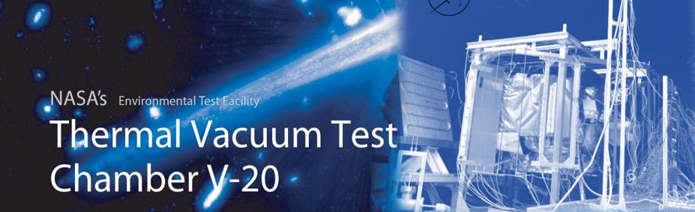
Chamber V-20 is a 20-foot Thermal Vacuum Facility located at NASA Marshall Space Flight Center’s Environmental Test Facility in Huntsville, Alabama.
The chamber was converted in 2022 to simulate planetary environments in support of NASA’s goal of returning to the Moon.
V20 operates using two newly added 32-inch diffusion pumps to aid with pumping capacity during lunar regolith operations such as sintering or additive
manufacturing. For flight tests or additional non-regolith pumping capacity, a 36” cryogenic pump along with three maglev turbomolecular pumps are used.
The chamber is capable of reaching 5e-7 Torr.
V20 has a thermal shroud installed, capable of filing with liquid Nitrogen (LN2), or heated gaseous Nitrogen (GN2). The chamber is equipped with 40-amp
0-240Vac power inputs with automatic control, with 12Vdc, 24Vdc, 208Vac, 240Vac, and 480Vac available. The chamber is also equipped with a number of
blank flanges that penetrate the shroud to allow for test article feedthroughs… which can be found in the chamber CAD file.
To aid with contamination concerns, two large 20 ft2 cold plates have been added to the chamber, bolstering its ability to handle large gas loads. The
chamber can be equipped with a residual gas analyzer (RGA), Temperature Controlled Quartz Crystal Microbalance (TQCM), IR and color camera/video
cameras, and gas purges.
The chamber is equipped with a 60,000lbs rated cart, which allows for highly customizable regolith simulant beds or test articles; The cart is rolled into the
chamber using a large winch located outside the chamber. Highly customizable fixturing, flanges, special test equipment, and feedthroughs are available
per request. Please contact us with any questions.

Slide 18
