Slide 1
Surface Atmosphere Radiation Budget (SARB) working group update
Seiji Kato¹, Fred G. Rose², David A. Rutan³,
Seung-Hee Ham², Thomas E. Caldwell²
Antonio Viudez-Mora², Tyler J. Thorsen¹, Emily E. Monroe²,
Anthony C. DiNorscia², David Fillmore³, and Xianglei Huang⁴
¹NASA Langley Research Center
²Analytical Mechanics Associates, Inc.
3ADNET Systems, Inc
⁴NCAR
⁵University of Michigan
CERES Science Team Meeting
October 17-19, 2023

Slide 2
Edition 4 products production and validation
Edition 4.2 EBAF
Produced and released through June 2023.
Edition 4.3 EBAF release in 2024 (Seiji Kato’s presentation)
Edition 4.1 SYN
Produced through June 2022.
Evaluation of GEOS-IT with Edition 4 CRS (Seung-Hee Ham’s presentation)
Edition 4 MATCH
Consistency of aerosol optical thickness derived from MODIS and VIIRS
Working with Dark Target and Deep Blue teams to mitigate AOD differences

Slide 3
Edition 5 algorithm developments
Fu-Liou code
New k-distribution coefficients
Considering increasing number of shortwave bands
MATCH transport model
Better aerosol models using CAM6
GEOS temperature and humidity profile correction algorithm.
Use averaged spectral radiances (a back-up plan for CLIMCAPS), using the algorithm developed by Smith Sr. (dual-regression retrieval algorithm).

Slide 4
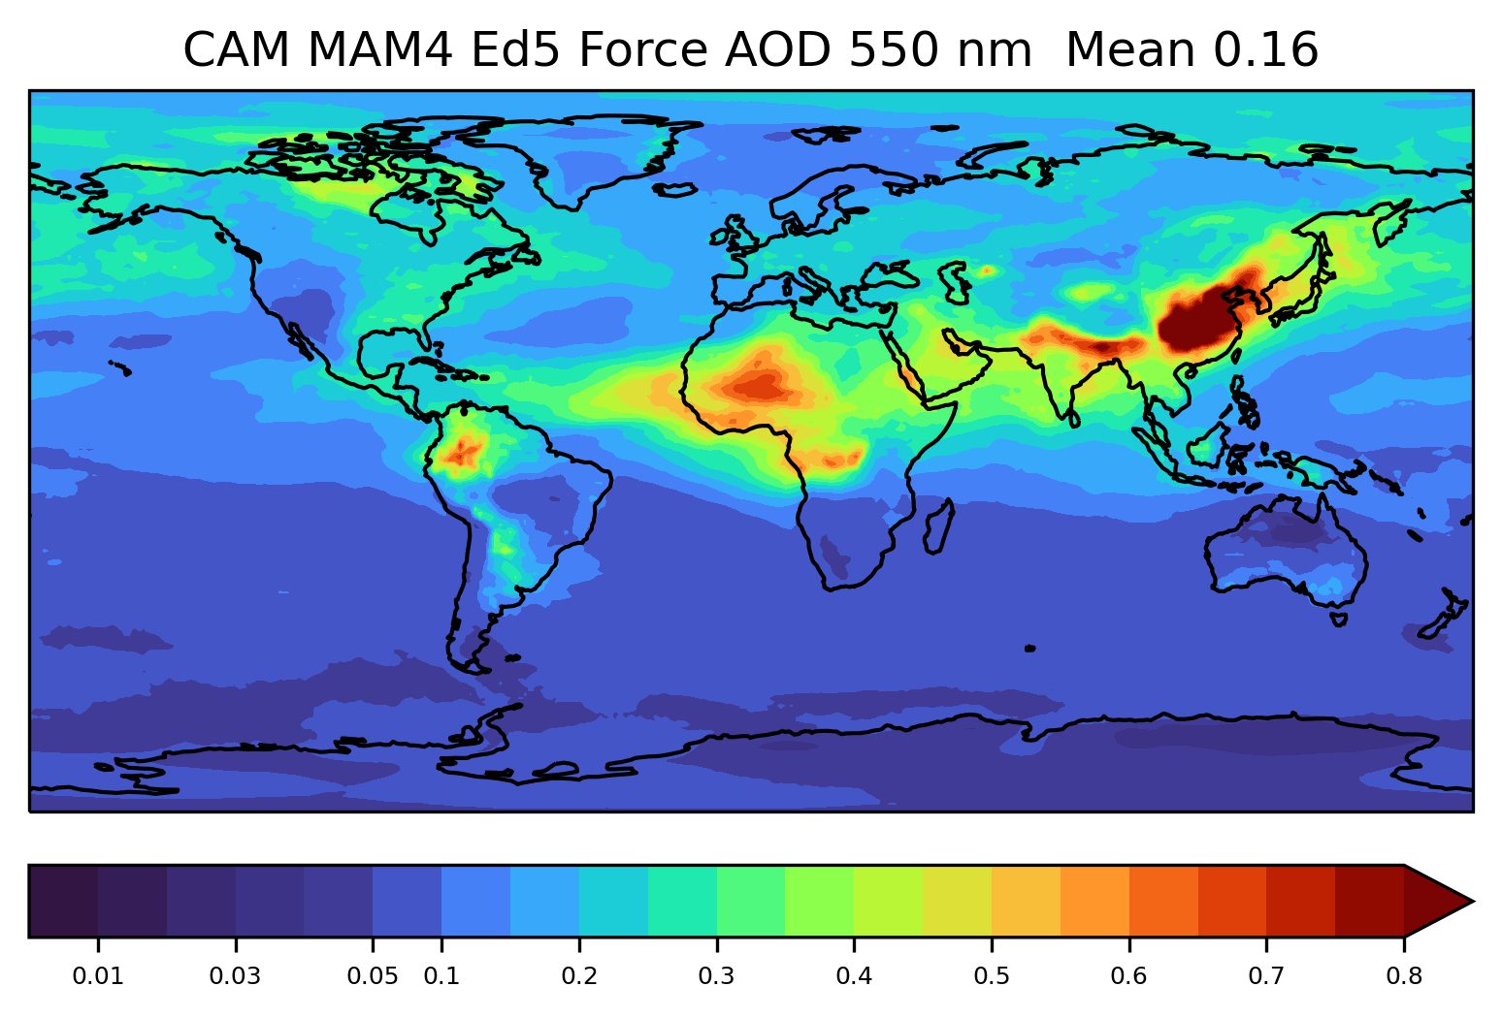
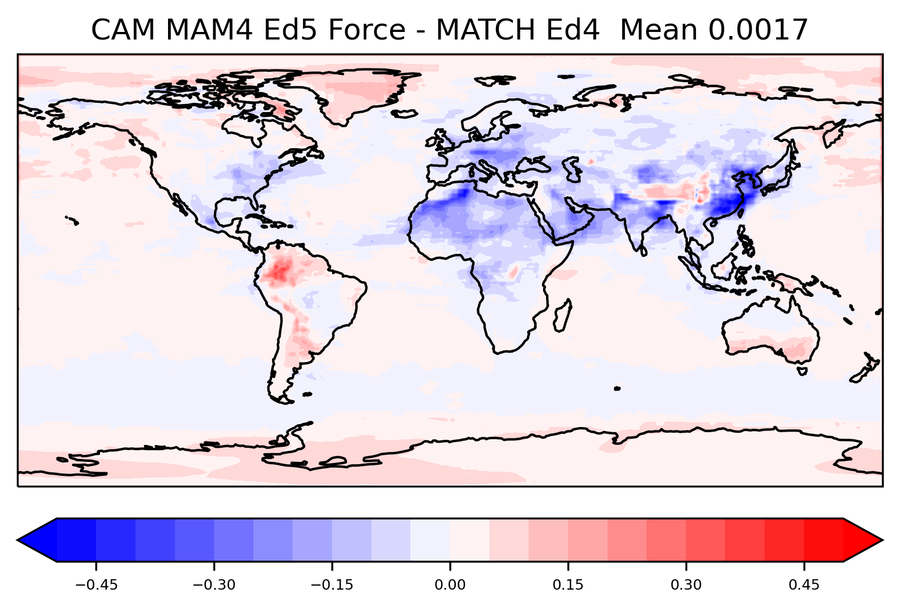
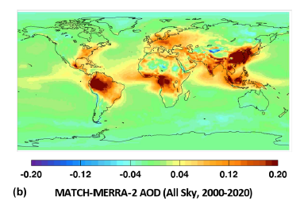
Edition 5 MATCH vs. Edition 4 MATCH (June 2010)

Slide 5
Publications
Kato, S., N. G. Loeb, F. G. Rose, S.-H. Ham, T. J. Thorsen, D. A. Rutan, W. F. Miller, T. E. Caldwell, D. R. Doelling, S. Sun-Mack, 2023: Seamless continuity in CERES Energy balanced and Filled (EBAF) surface radiation budget across multiple satellites, submitted to J. Climate.

